Slide 1
Sports
Overview

Slide 2

Fast Facts
Profile
World leader in gaming and lottery entertainment
  Casino, Lottery, Digital, Sports Betting
9,500+ employees, 1,500+ customers in 50 countries
Provider to 20 of the Top 20 lotteries worldwide
Supply 70% of U.S. instant game retail revenues
Scientific Games in Georgia
Global Lottery headquarters in Alpharetta, Georgia for 35+ years
Among the first employers to invest in Forsyth County in 1990s
1,100+ Georgia workforce & $105 million in wages to Georgians
$84+ million in goods / services purchased from Georgia firms
Proud partner to the Georgia Lottery since its inception in 1993
  Contributed $20+ billion to education since its inception
  Ranks No. 2 in the world for instant game per capita sales
Partnered with Work Source Georgia and providing internship opportunities to Georgia college students

Slide 3
Professional and Amateur Sports Protection Act (PASPA)
The U.S. Supreme Court’s decision to overturn PASPA, the 1992 federal law that prevented states from regulating sports betting, has created an unprecedented opportunity for state lotteries and gaming organizations in the U.S. PASPA was declared unconstitutional in the 6-3 decision, meaning it will be up to states, which sought sports wagering for years, to decide whether to allow residents to bet on sports – May 14, 2018
How soon could state offer Sports Wagering?
This ruling allows states to legislate immediately and for all such laws to become effective immediately.
Which states are first movers in Sports Wagering?
13 states operational including: AR, DE, IN, IA, MS, NM, NV, NJ, NY, OR, PA, RI, WV. Another 8 states authorized but not operational including: CO, CT, DC, IL, MT, NC, NH, TN
Could another federal law be on the horizon?
The NCAA (National Collegiate Athletic Association) is supportive of federal regulation focused on minimum standards and integrity. Congress may also move forward to ensure consumer protections are in place.

Slide 4
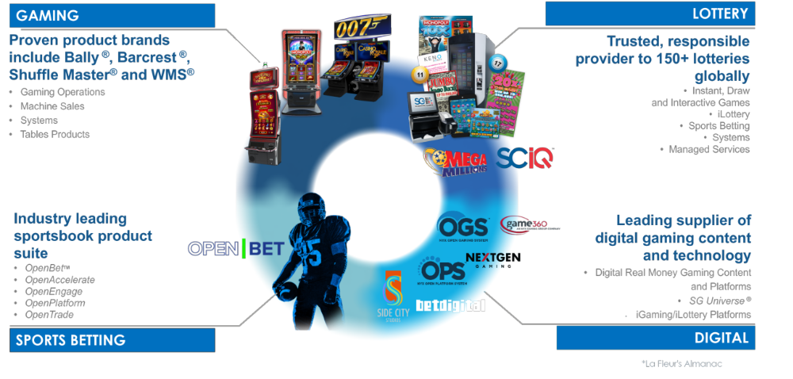
One Global Gaming Entertainment Company

Slide 5




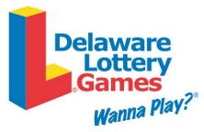






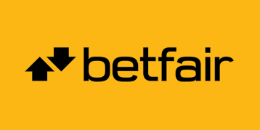




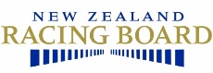





SG – Market Leading Global Sports Supplier
Private Operators
Lottery Partners
Supply 4 of the top 5 Private Operators in the UK - Process 66,000 Bets/Minute
20+
100%
1,300+
20+
100%
Strong Experience
20+ years with a history of successful sports solutions and
customer growth
Regulated
We have only ever done business with lotteries and operators
working in regulated markets
Sports Staff Globally
Local sports solutions teams across the globe on 4 continents
Years Experience
20+ years of successful sports solutions and customer growth
Regulated
We have only ever worked with lotteries and operators in regulated markets

Slide 6

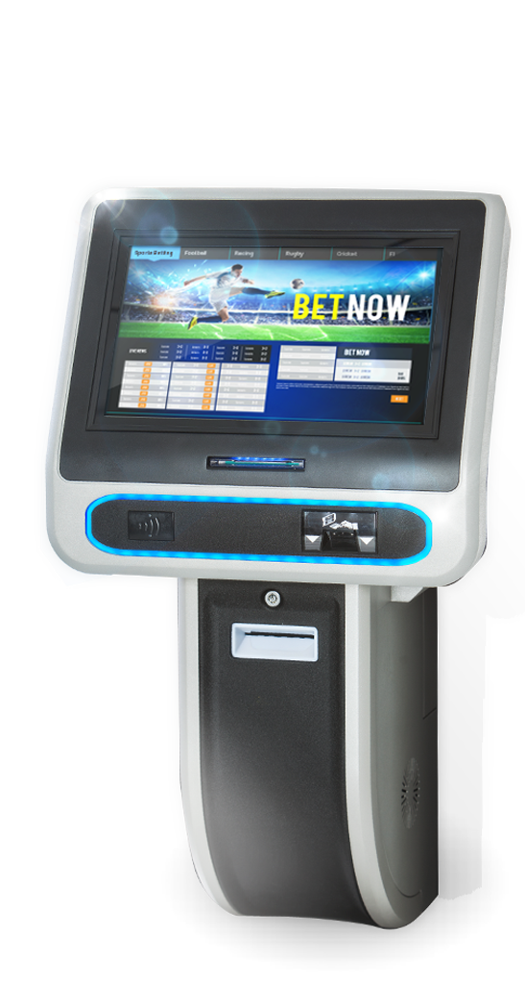
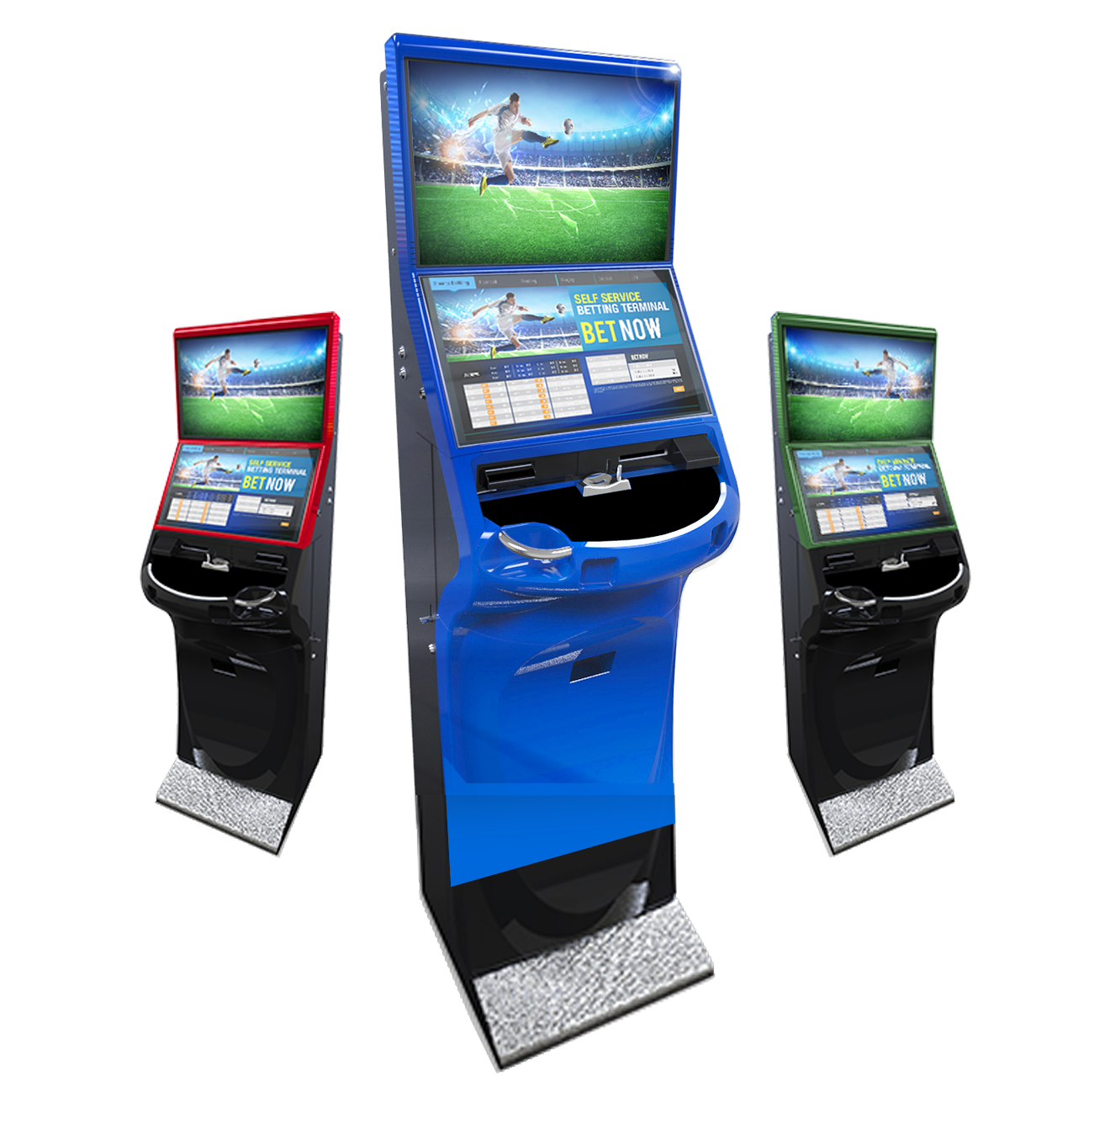
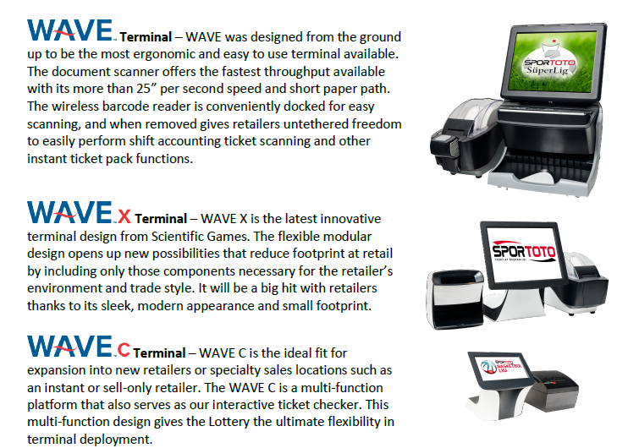

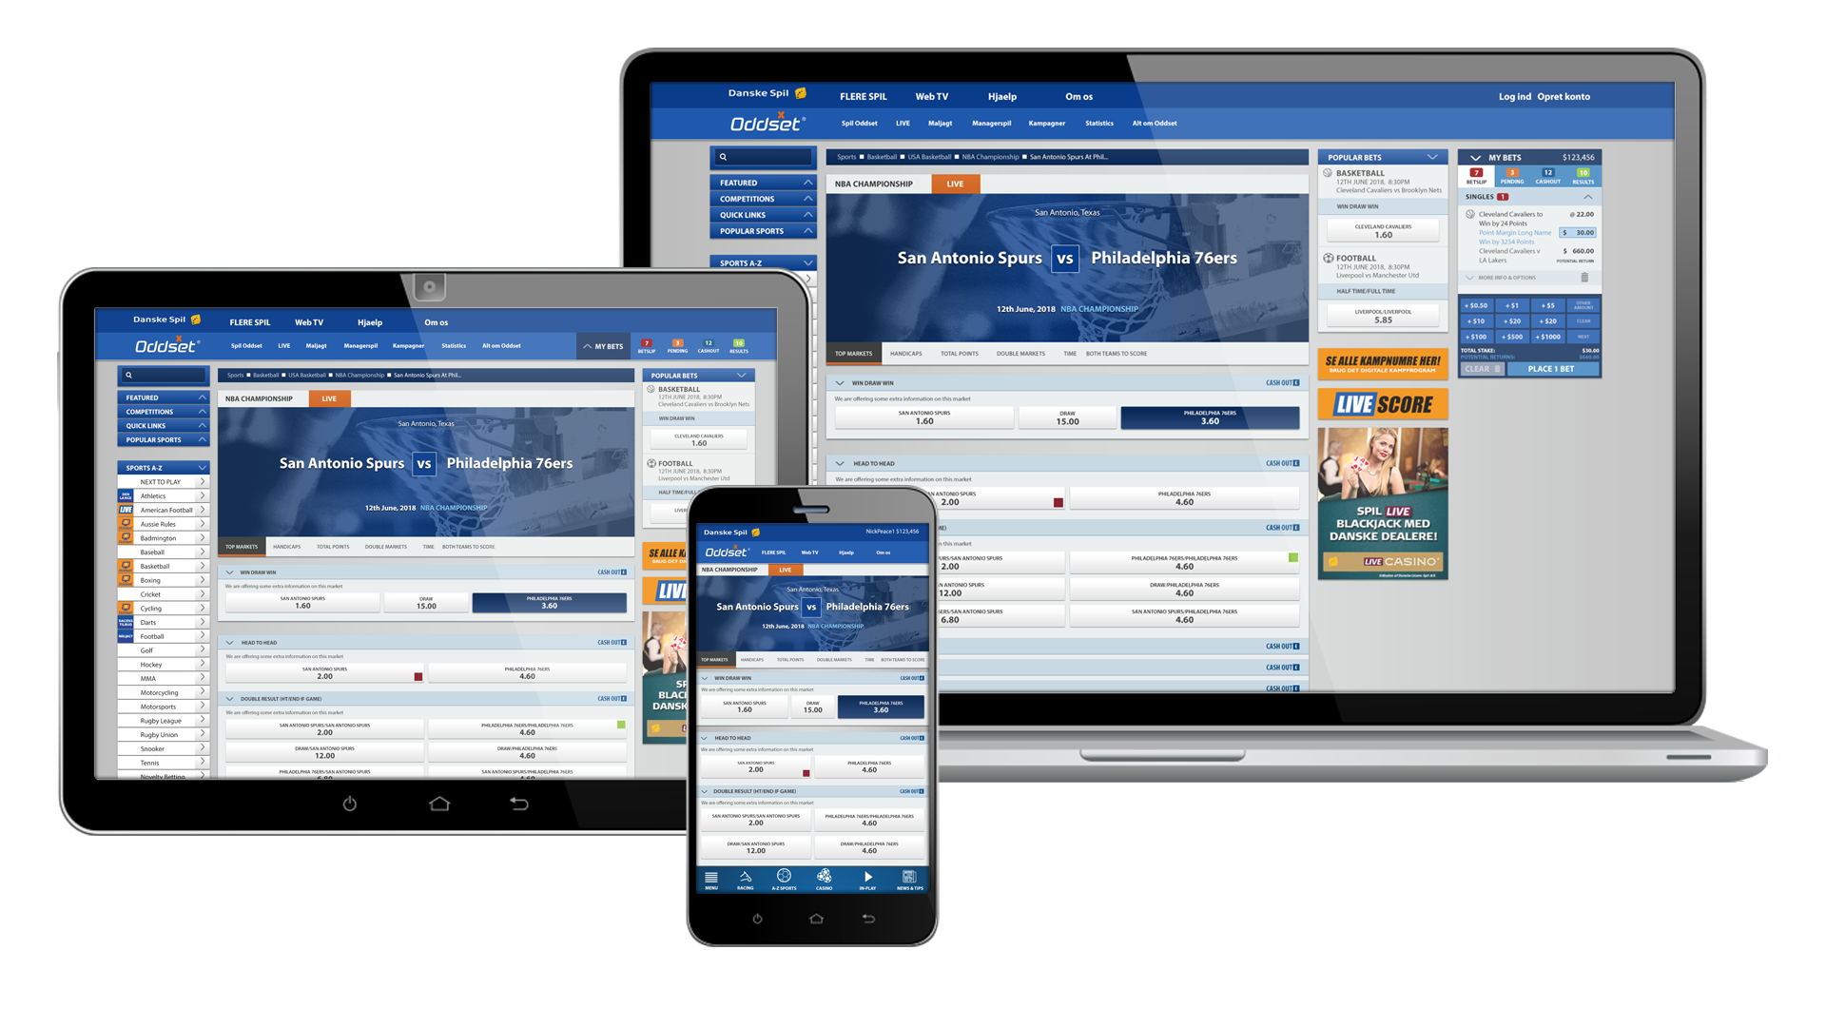





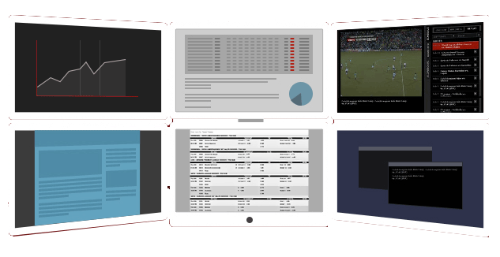



RETAIL SOLUTIONS
DIGITAL SOLUTIONS
LIVE NOW
Sports & Casino Portal
(Desktop, Mobile)
SSBT
Bar Top
ePOS
Wave
Wave X
ENGAGE API SUPPORTS BESPOKE USER INTERFACE DEVELOPMENT
SPORTS BOOK PLATFORM
PATRON ACCOUNT MGMT (PAM) PLATFORM
PLAYER ACCOUNTS & WALLETS
Managed Trading Services
EXPAND STAFF QUICKLY BY OUTSOURCING VIA SG ONLINE MARKETING, OPERATIONS & CUSTOMER SERVICE

Slide 7
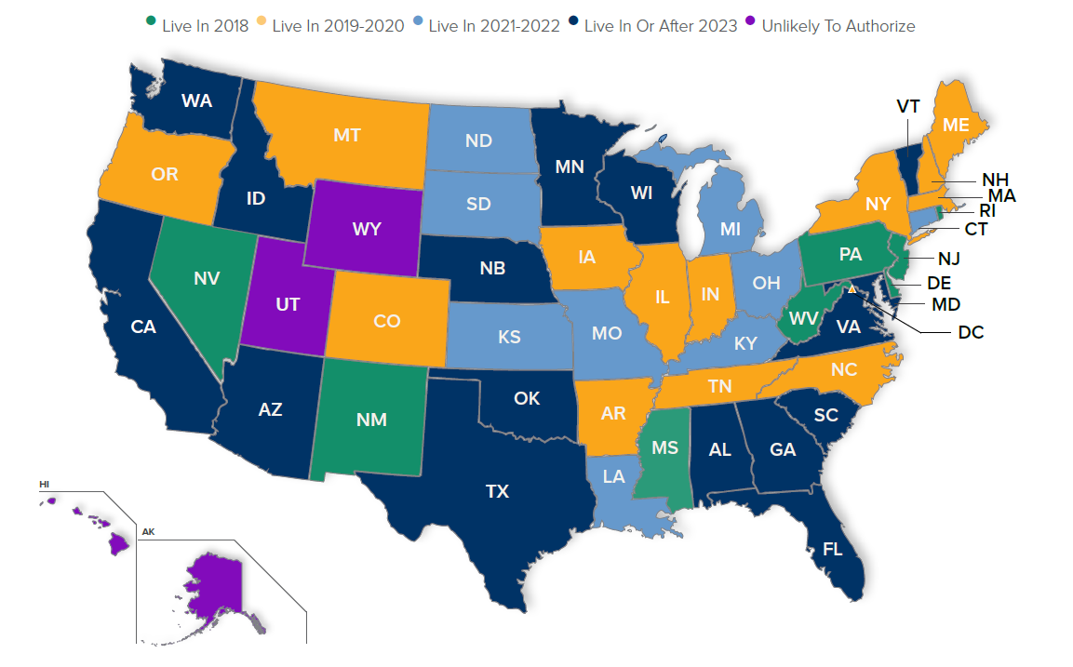
U.S. Regulated Sports: Waves of Adoption
Source: Eilers & Krejcik Gaming LLC, U.S. Sports Betting Policy Monitor, August 2019

Slide 8



What Do Americans Want?
‘LIVE’ is the
FUTURE
U.S. Betting Trends
Three Sports Drive 93%
of Legal Sports Wagering in U.S.
  In-Play sports wagering is rapidly becoming a standard handle
  NJ online wagering accounts for >70% of handle
  Europe In-Play accounts for >80% of online handle
  Regulated sports wagering is exceeding all expectations
  Significant offshore market still handles majority of wagers

Slide 9
Key Regulatory Policy Issues
How regulators will approach integrity issues?
  Uniformly, gaming regulators require operators to monitor and report any suspicious activities.
Who will operate sportsbooks?
  Trends suggest that most states will opt to give land-based incumbents (e.g., lotteries, casinos, and racetracks) exclusivity or semi-exclusivity over regulated sports betting operations
Licensing of service providers?
  Unique requirements in each state.
Whether mobile or online wagering will be offered and if so, accounts will be allowed to be set up online or require in-person registration?
  11 states allow mobile, 3 require in-person registration either temporarily or permanently.
Whether cash reserve requirements will be put in place?
  Wide variety of requirements by state; $25-500k or amounts to cover outstanding pools/bets.
Whether collegiate sports wagers will be permitted, and if so, whether local colleges will be excluded?
  Mixed approach across states; some states prohibit wagers on “hometown” college teams

Slide 10
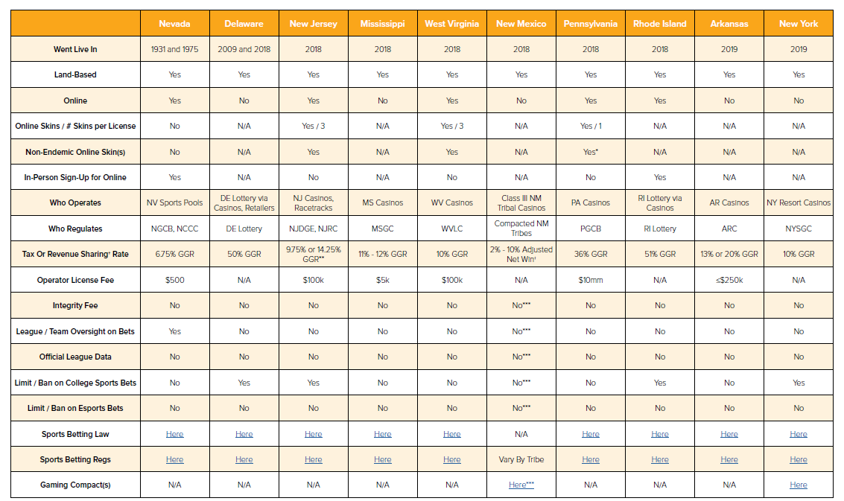
Operational States: Key Policy Provisions Matrix
Source: Eilers & Krejcik Gaming LLC, U.S. Sports Betting Policy Monitor, August 2019

Slide 11
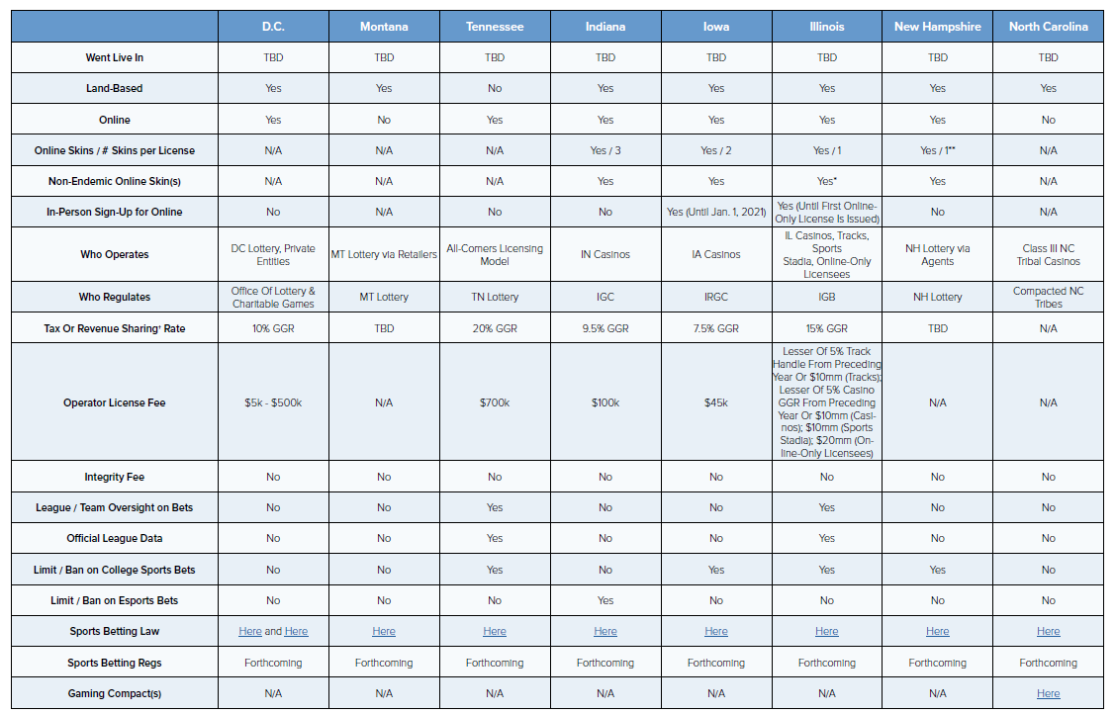
Soon-to-Be Operational States: Provisions Matrix
Source: Eilers & Krejcik Gaming LLC, U.S. Sports Betting Policy Monitor, August 2019

Slide 12


Beneficiary Funding Improved with All Sales Channels Open
Casinos & Tracks
Mobile
Lottery Retail
Full On-Venue Sportsbooks
Wide Range of Sports
Wide Range of Wagers
Dedicated Player Spaces
Broadest Wager Options
Accounts Remotely Funded
Players Geo-fenced
Widely Distributed Channel
Existing Infrastructure
Simple Wager Offers
Responsible Gaming Controls
State funding maximized thru Lottery
Lotteries regulate 70% of global sports betting

Slide 13
Best Practices for a Sports Wagering Bill
Authorize Sales Distribution Channels under their current regulatory agencies
Establish a fair Tax Rate without League Fees or Data Requirements for this low margin offer
Allow wagering on Professional, Collegiate, and In-state events without League veto power
Authorize intrastate Mobile and Online Wagering to maximize State Revenues
Permit 3rd Party vendors to facilitate Sports Wagering Operations
Provide Responsible Gaming Controls for Players
Prohibit wagering on the results of authorized Lottery games / events
Contract with Responsible Vendors supporting sports wagering in Regulated Markets

Slide 14
Thank You

