Slide 1
Constitutional
Amendments
101

Slide 2


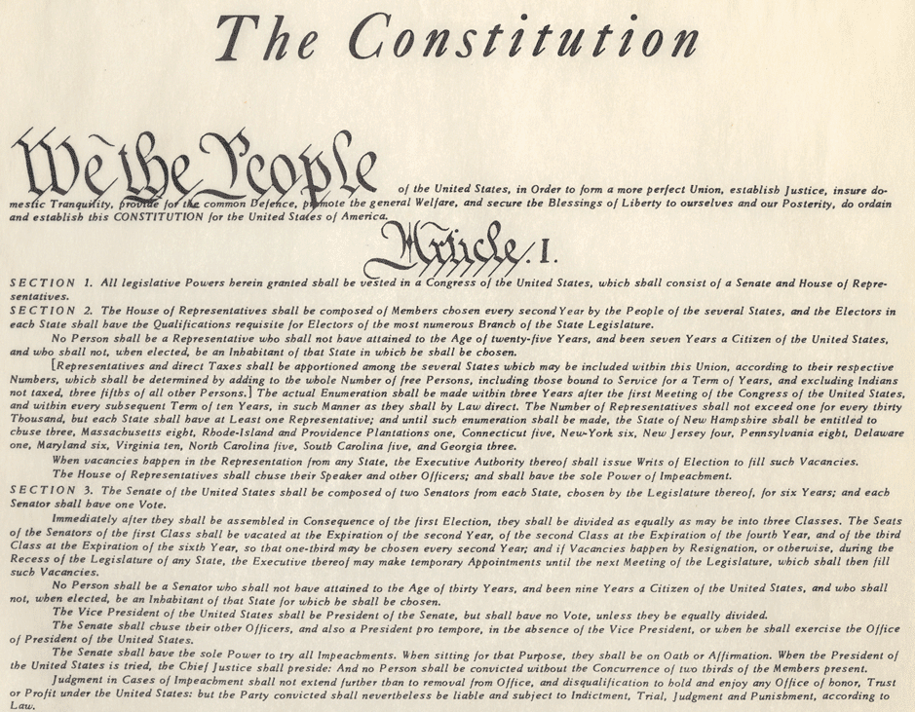
THE BASICS
All legislation must conform to
the State and Federal Constitution.
If an idea you have for legislation would likely be held to violate either the State or Federal Constitution…
You should be given a warning from our office, usually in the form of an Opinion Letter.

Slide 3
Article X, Section 1, Paragraph 1 of the Georgia Constitution
Proposals by the General Assembly; submission to the people. A proposal by the General Assembly to amend this Constitution or to provide for a new Constitution shall originate as a resolution in either the Senate or the House of Representatives and, if approved by two-thirds of the members to which each house is entitled in a roll-call vote entered on their respective journals, shall be submitted to the electors of the entire state at the next general election, which is held in the even-numbered years. A summary of such proposal shall be prepared by the Attorney General, the Legislative Counsel, and the Secretary of State and shall be published in the official organ of each county and, if deemed advisable by the 'Constitutional Amendments Publication Board,' in not more than 20 other newspapers in the state designated by such board which meet the qualifications for being selected as the official organ of a county. Said board shall be composed of the Governor, the Lieutenant Governor, and the Speaker of the House of Representatives. Such summary shall be published once each week for three consecutive weeks immediately preceding the day of the general election at which such proposal is to be submitted. The language to be used in submitting a proposed amendment or a new Constitution shall be in such words as the General Assembly may provide in the resolution or, in the absence thereof, in such language as the Governor may prescribe. A copy of the entire proposed amendment or of a new Constitution shall be filed in the office of the judge of the probate court of each county and shall be available for public inspection; and the summary of the proposal shall so indicate. The General Assembly is hereby authorized to provide by law for additional matters relative to the publication and distribution of proposed amendments and summaries not in conflict with the provisions of this Paragraph.
If such proposal is ratified by a majority of the electors qualified to vote for members of the General Assembly voting thereon in such general election, such proposal shall become a part of this Constitution or shall become a new Constitution, as the case may be. Any proposal so approved shall take effect as provided in Paragraph VI of this article. When more than one amendment is submitted at the same time, they shall be so submitted as to enable the electors to vote on each amendment separately, provided that one or more new articles or related changes in one or more articles may be submitted as a single amendment.
A resolution in either the Senate or the House of Representatives.
2/3 vote in both chambers required for approval.
State wide vote on the amendment in the next general election.
Summary of amendment must be published before hand. (See also O.C..G.A. 21-2-4)
Will take effect on the first day in January following ratification unless a different date is specified.
Each amendment must be voted on separately.

Slide 4
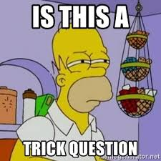

The Ballot Question
Courts have held that a ballot question:
  Must not be affirmatively misleading.
  Must adequately identify to the voter which of the several amendments it relates to.
The question is not expected to substitute for education by a voter on the issue prior to walking into the voting booth.

Slide 5
Self Executing vs. enabling amendments
Self Executing:
Fully effective upon a majority vote by electors.
Example:
Appellate and Superior Court judges shall have been admitted to practice law for seven years.
Enabling:
Further action by the legislature is needed for implementation after a majority vote by electors.
Example:
Probate and magistrate judges shall have such qualifications as provided by law.
The action by the legislature authorized by an enabling amendment can be done contemporaneously with the bill proposing the amendment or at a later date.

Slide 6

Does Sports betting require a Constitutional Amendment?

Slide 7
Article 1, Section II, Paragraph VIII
  “…all lotteries, and the sale of lottery tickets, and all forms of pari-mutuel betting and casino gambling are hereby prohibited;”
  “…a nonprofit bingo game shall not be a lottery and shall be legal in this state.”
  “…raffles by nonprofit organizations shall be lawful…”
  “The General Assembly may by law provide for the operation and regulation of a lottery or lotteries by or on behalf of the state … for educational programs…”
  **Lottery, pari-mutuel betting, and casino gambling are not defined in the Georgia Constitution**

Slide 8

Is Sports Betting a Lottery?
'Lottery,'…means any game of chance…including, but not limited to, instant tickets, on-line games, and games using mechanical or electronic devices but excluding pari-mutuel betting and casino gambling as defined in this Code section.
-O.C.G.A. 50-27-3(13)
If sports betting qualifies as a lottery, the Georgia Lottery Corporation could allow sports betting as an official lottery game, and serve as the bookmaker; however, proceeds must go to educational purposes.

Slide 9


Is Sports Betting Casino Gambling?
'Casino gambling' means a location or business for the purpose of conducting illegal gambling activities, but excluding the sale and purchase of lottery tickets or shares as authorized by this chapter.
O.C.G.A. 50-27-3(7)
'Gambling device' means any contrivance which for a consideration affords the player an opportunity to obtain money or other thing of value, the award of which is determined by chance even though accompanied by some skill…
O.C.G.A 16-12-20(2)

Slide 10
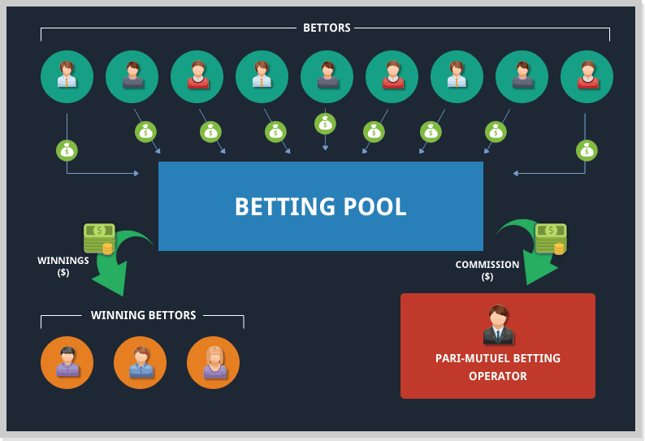

is Sports betting pari-mutuel betting?
'Pari-mutuel betting' means a method or system of wagering on actual races involving horses or dogs at tracks which involves the distribution of winnings by pools. Such term shall not mean lottery games which may be predicated on a horse racing or dog racing scheme that does not involve actual track events. Such term shall not mean traditional lottery games which may involve the distribution of winnings by pools.
-O.C.G.A. 50-27-3(20)
“A mutual stake or wage; a betting pool.”
-Black’s Law Dictionary

Slide 11

Conclusion
Although the O.C.G.A. definition of pari-mutuel betting limits application to dogs and horses, it seems the concept of these types of bets in the sport betting industry could qualify as the traditional definition of pari-mutuel betting.
Since there is no definition of the applicable terms in the Georgia Constitution…
It’s a gamble; our advice would be take the safe bet and draft a Constitutional Amendment.

