Slide 1

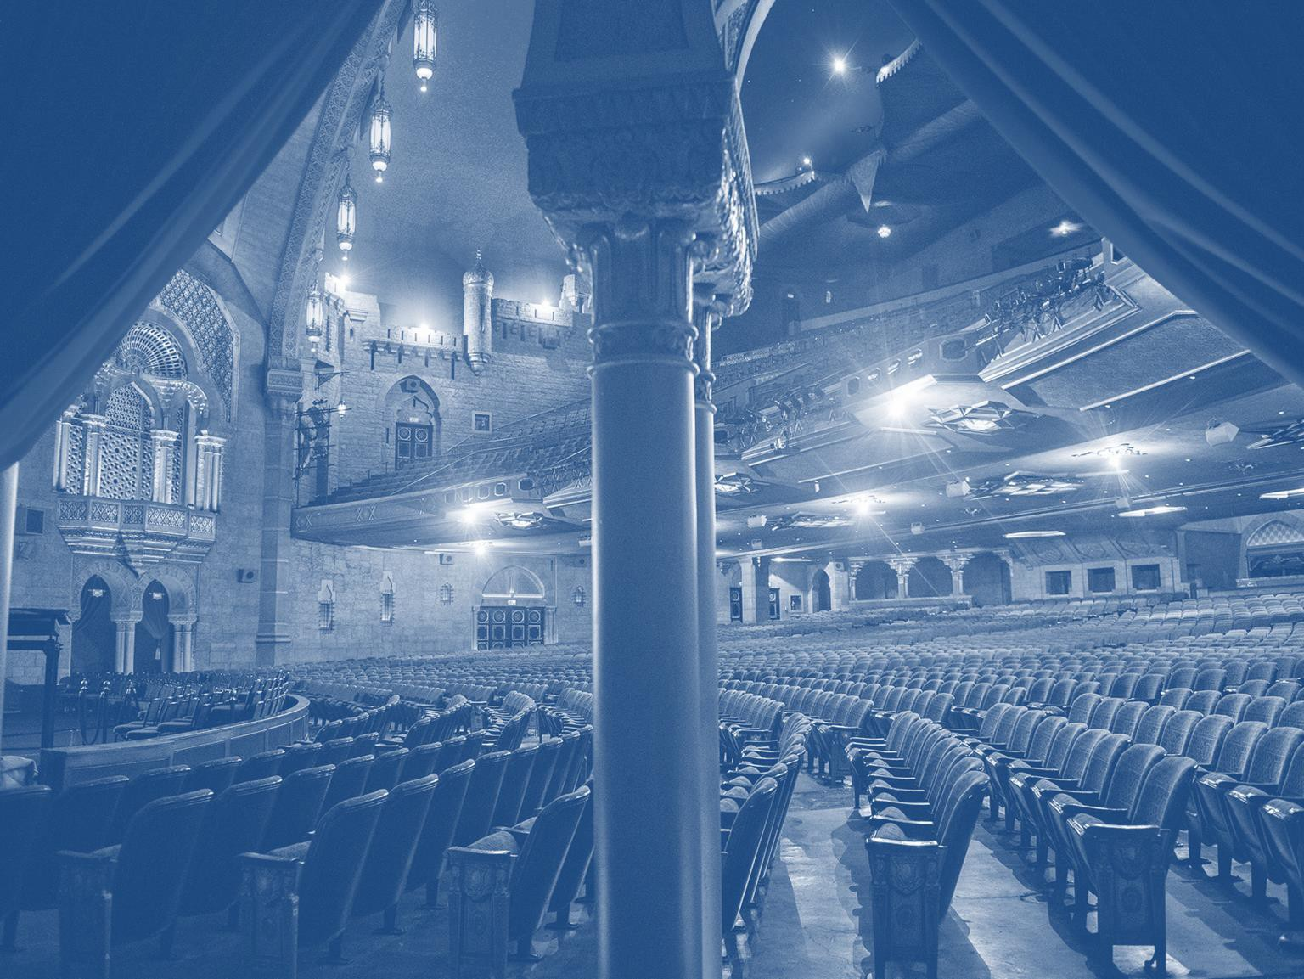

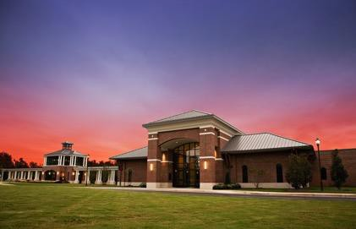
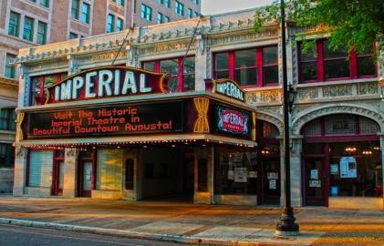
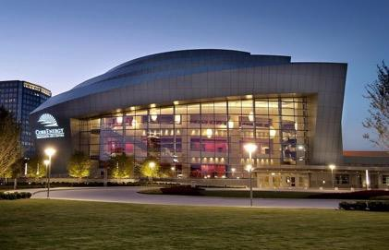
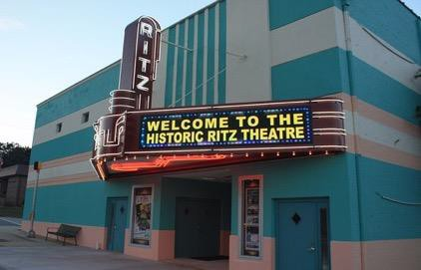
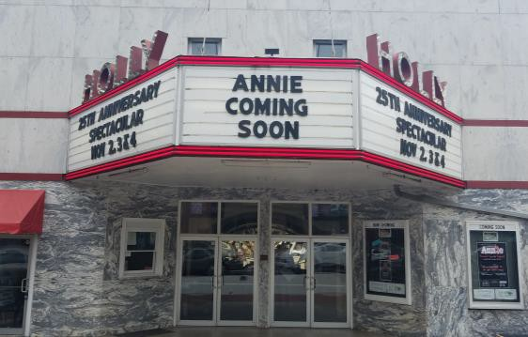
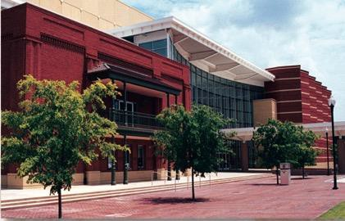
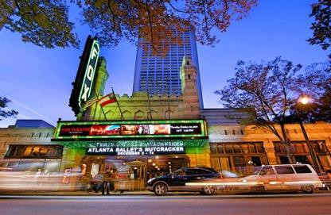
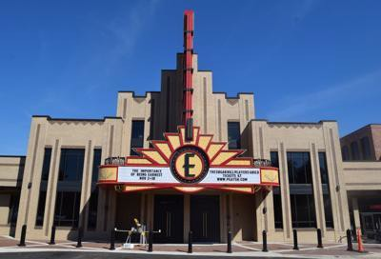
Newnan Centre, Imperial Theatre, Cobb Energy Centre, Historic Ritz Theatre Holly Theatre, RiverCenter, Fox Theatre, Eagle Theatre

Slide 2

















Americus
Rylander Theatre
Athens
Classic Center
Morton Theatre Corporation
Atlanta
7 Stages
Atlanta Botanical Gardens Cobb Energy Centre
Fox Theatre
Fulton County Arts Council Metropolitan Atlanta Arts Fund South Arts
Variety Playhouse Woodruff Arts Center
Augusta
Augusta Amusements
Augusta Entertainment Complex Greater Augusta Arts Council Imperial Theatre
Miller Theater / Augusta Symphony
Brunswick
Ritz Theatre
Buford
Buford Community Center Eagle Theatre
Carrollton
Carrollton Center for the Arts
Columbus
Columbus Civic Center Columbus CVB RiverCenter
Conyers
Conyers Rockdale Council for the Arts
Dahlonega
Holly Theatre Community Center
Dublin
Theatre Dublin
Duluth
Infinite Energy Center
Eatonton
The Plaza Arts Center
Ellijay
Gilmer Arts
Gainesville
The Arts Council Pearce Auditorium Gainesville Garden
Hawkinsville
Hawkinsville Opera House
Lithia Springs
Arts Georgia
Mableton
Mable House Barnes Amphitheatre
Macon
Historic Douglass Theatre
Marietta
Earl and Rachel Smith Strand Theatre
Milledgeville
Allied Arts
Newnan
The Newnan Centre
Peachtree City
The Fred
Rome
Historic Desoto Theatre
Springfield
Mars Theatre
Statesboro
Averitt Center for the Arts Performing Arts Center at Georgia Southern University
Thomasville
Thomasville Entertainment Foundation
Toccoa
Schaefer Center
The Historic Ritz Theatre
Vidalia
PAL Theater
Waleska
Falany Performing Arts Center
Waynesboro
Waynesboro-Burke Concert Series
Winterville
Winterville Auditorium
Georgia Presenters Member Townsend Center for the Performing Arts, Carrollton
Ellijay
Toccoa
Waleska
Gainesville
Rome
Duluth
Mableton
Buford
Winterville
Carrollton
Atlanta
Athens
Lithia
Springs
Conyers
Augusta
Peachtree City
Newnan
Eatonton
Waynesboro
Milledgeville
Dublin
Statesboro
Columbus
Hawkinsville
Springfield
Americus
Vidalia
Brunswick
2

Slide 3
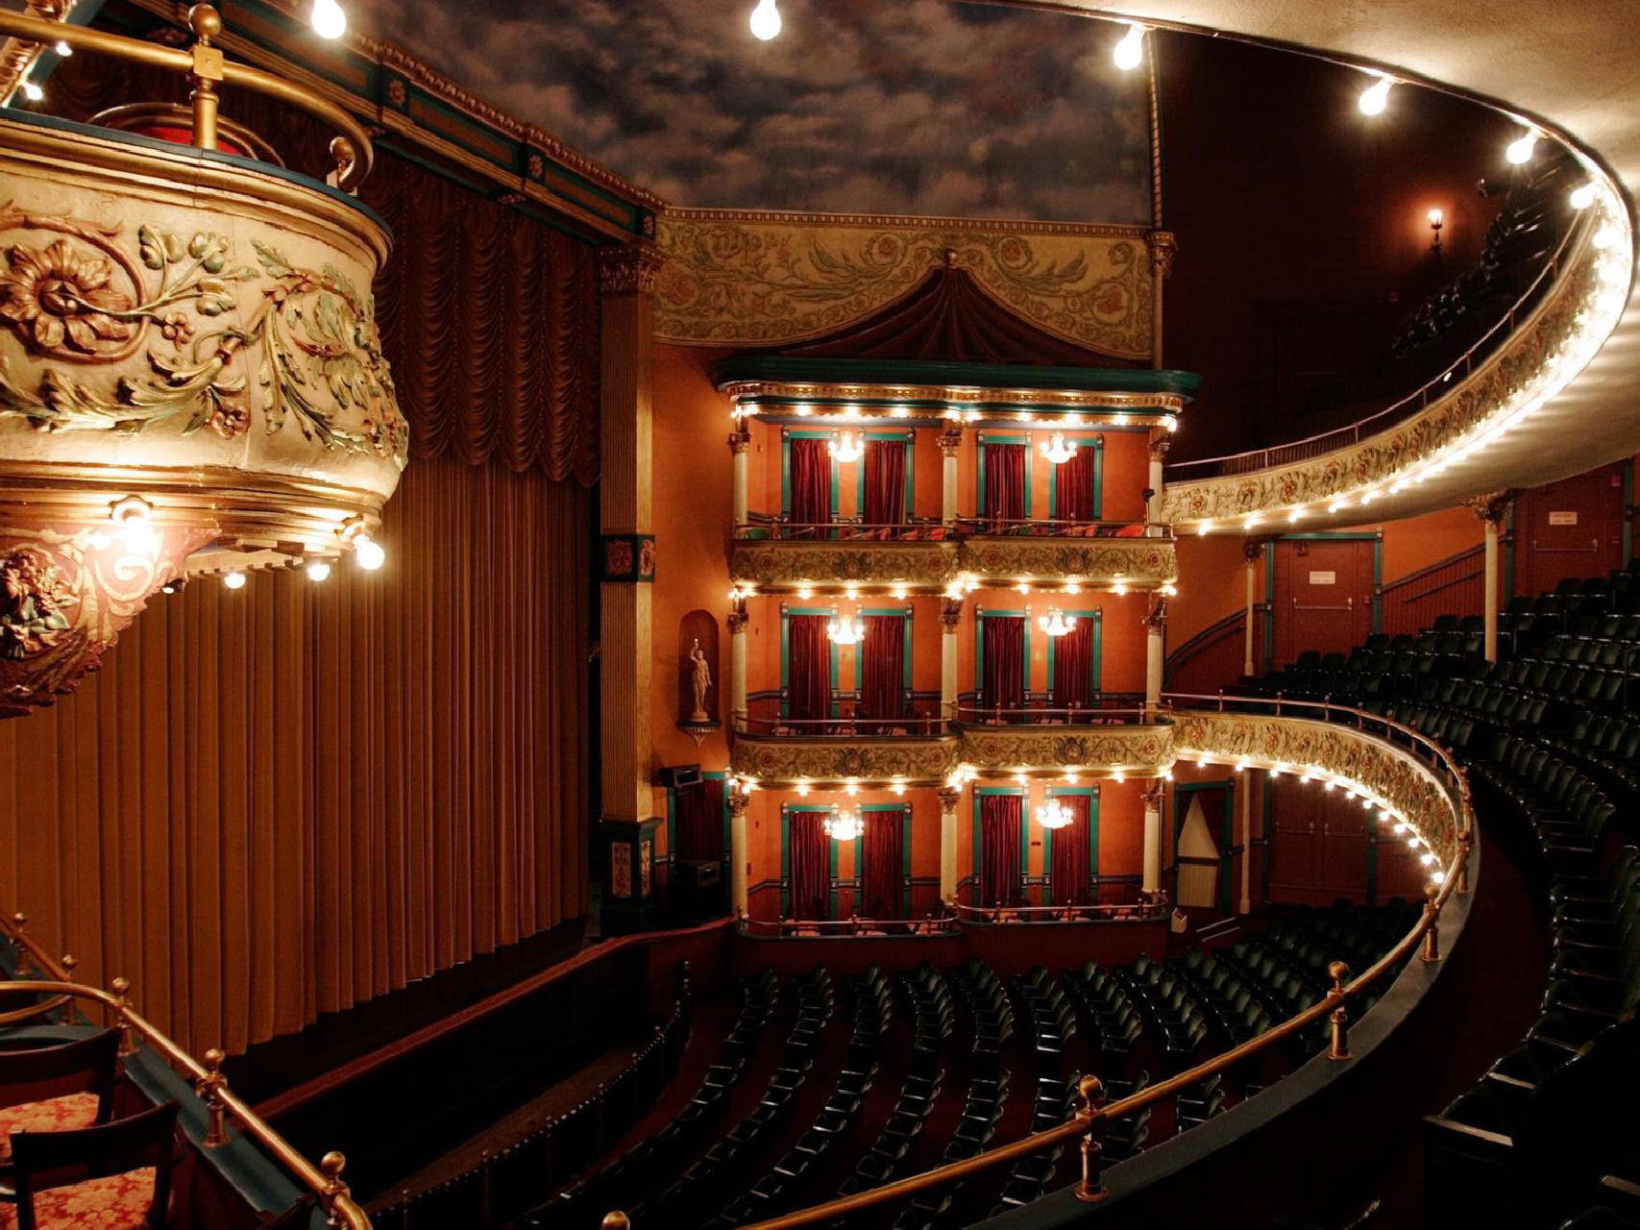


The Issue
Casinos use live
entertainment simply as a
loss leader
to draw people to the gaming floor and generate gaming receipts
This impacts a local
venue’s ability to
book talent
and drives up the price
consumers pay
3

Slide 4

Entertainment Business Model
The artist receives
85-90%
of net ticket sales
Only 10-15%
stays with the local venues 4

Slide 5
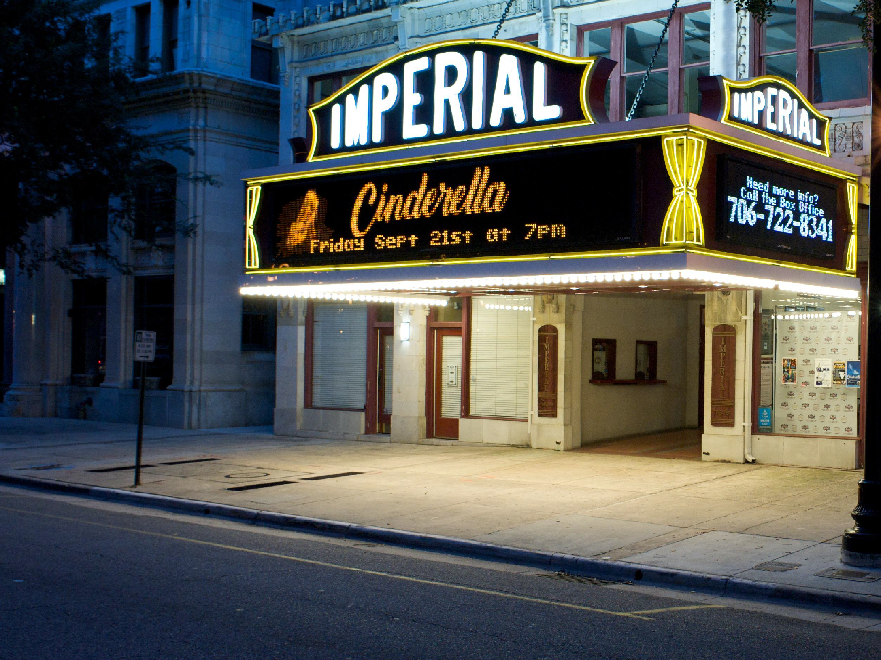

Georgia Venues Model: Survive on Small Margins
Entertainment
is our life blood –
it drives ancillary income
Income sources include
modest ticket proceeds
food & beverage sales
merchandise sales
Currently, all Georgia venues operate within the same free market system and we compete for talent and customers on a level playing field.
5

Slide 6

We are in the popcorn
business!
6

Slide 7



What the current Georgia competitive market give us?
Civic assets that support tourism and economic development
Downtown anchors, whose patrons keep local restaurants and businesses thriving
Highly revered sources of community pride
Investment in taxpayer-owned and operated venues
Venues that offer classical music and opera
Educational and cultural programming for children and seniors
Nonprofit institutions
with historical significance

Slide 8



The Casino Model
Casinos use entertainment as a
loss leader
to draw people to the gaming floor and generate gaming receipts
Offer free or deeply discounted tickets to entertainment shows
Include vouchers for “free” game play, knowing most people will keep playing even after they’ve used the voucher
8

Slide 9




The Casino Model
Casinos routinely pay artists
well above market rates
as their entertainment expenses are subsidized by other revenue streams, like gaming
CASINOS IMPOSE
Exclusivity Clauses talent can only perform at facilities owned by a certain casino
Radius Clauses talent cannot perform within a certain mile radius of the casino
Duration Clauses talent cannot return to the market for a certain length of time
9

Slide 10
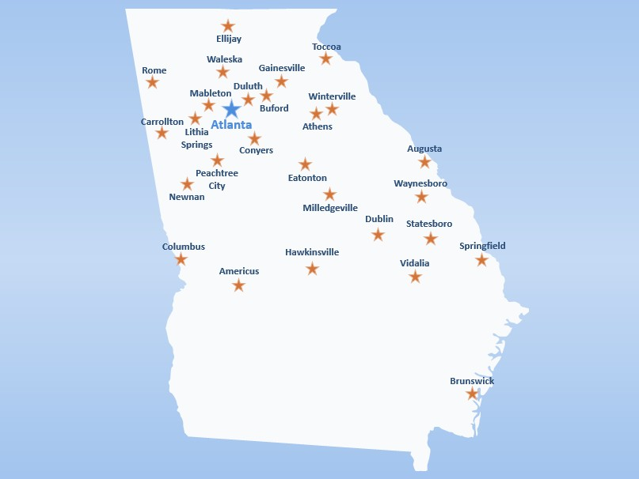

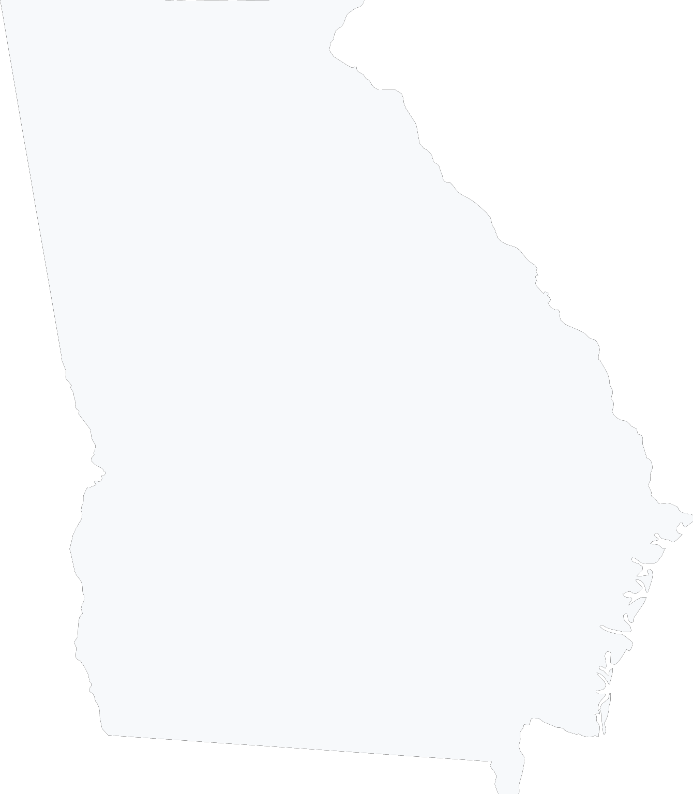
How a commonly imposed
150-mile radius clause
Ellijay Sautee
Nachoochee
_{Calhoun Canton} Clarkesville _{Toccoa}
_{Woodstock} Waleska Dahlonega Gainesville
^{Rome} Marietta ^{Roswell} Duluth
Cedartown Buford
^{Mableton} Winterville
^{Bremen} Atlanta _{Athens}
Lithia
Carrollton ^{Springs} Greensboro
Conyers Madison
Peachtree Warrenton Augusta
City
_{Newnan} Eatonton
Milledgeville Waynesboro
Macon
Swainsboro Statesboro
Springfield
Columbus _{Dublin}
Hawkinsville
Vidalia
_{Americus} McRae-Helena
Tybee Island
Douglas
Tifton
_{Moultrie} Brunswick
Thomasville
Valdosta
would impact Georgia
150-mile radius
10
CASINO

Slide 11
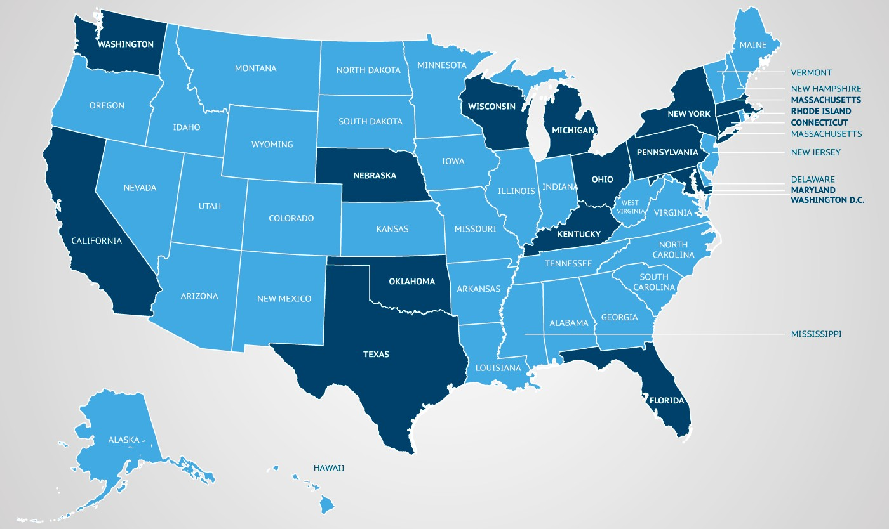

States shaded dark blue responded to survey(s) on the impact of casino gaming that will be discussed in this presentation.
These issues would not be unique to Georgia
11

Slide 12



Conventions, Sports & Leisure International
KEY FINDINGS FROM
₂₀Performing Arts Centers
₇ Markets
Providence, RI; Detroit, MI; Oklahoma City, OK; New London, CT; Easton, PA; Boston, MA; Omaha, NE
Small market theaters experienced significant
competition, oftentimes resulting in a
forced exit
from segments of the market
Theaters in large markets saw an
erosion of business
leading some to alter their business models to remain open
Venues reported
being
forced out
of market segments
being
outbid
consistently by casinos
business losses representing 25% or more of programming
12

Slide 13
“
Rising Talent Costs
“
Costs have gone way up--just today I
submitted an offer for an artist who would
For acts that play casinos, talent costs
have normally been $25K. I was told he was
have increased by 25-35% because these
now $35K, because "the casinos love him and will pay that.
acts are accustomed to receiving higher talent fees from casinos. And, for acts considering a casino play, we are forced to offer higher talent fees to keep the acts from going to the casinos.
”
– Wausau, WI
“
”
Typically we can't afford an act once one of the casinos starts to bid on it.
Once or twice we’ve been able to increase an offer by 10k-20k to confirm a show; but often that's the difference between making and losing money.
– Worcester, MA
– New Orleans, LA
“
We are now considered a casino market so prices for talent are quoted at casino rates.
– Biloxi, MS
”
”
“
In many cases we just can't compete with the fees that the Casinos pay artists. But when
we do, we generally have to pay 30%+ more than other markets that do not have Casinos.
1”3
– Providence, RI

Slide 14
“
Shrinking Revenue
Pre-casino activity was 35-40 concerts per year. Post-casino activity is 15 a year. That equates to about $400,000 a year in lost net revenue. – Providence, RI
”
“
“
Overall, concert revenue has decreased approximately 25% with the opening of the casinos.
– New Orleans, LA
Depending on the year, it
would fluctuate downwards at times to 25% less.
”
”
– Seattle, WA
“
“
If we get blocked by radius clauses our revenue is down for that fiscal year.
We have had to rely more on concessions and ancillaries - which are also impacted when attendance is down.
”
”
– Toledo, OH
– Albany, NY
14

Slide 15
12
AMS Planning and Research
KEY FINDINGS FROM
20
Nebraska, Kentucky, Alberta, Florida, Ohio, DC, Connecticut, Pennsylvania, Quebec, Massachusetts, Texas, and Wisconsin
Performing Arts Centers
Markets
80% | 70% | 15%
reported competing with casino facilities in-state or in a neighboring state | reported losing popular entertainers or concert acts to casinos | reported that legislation was enacted to offset the impact of casinos on arts & culture facilities
15

Slide 16



Central Atlanta Progress
KEY FINDINGS FROM
It is unclear of what
portion of casino revenue is
“new money”
a diversion
of other non-casino
discretionary spending
vs.
The greatest effect will be on leisure and entertainment discretionary spending
Any casino resort should leverage, not recreate,
the surrounding hospitality and leisure assets
Atlanta and other jurisdictions must carefully consider the potential impact
of a casino’s entertainment and retail component on surrounding businesses
16

Slide 17

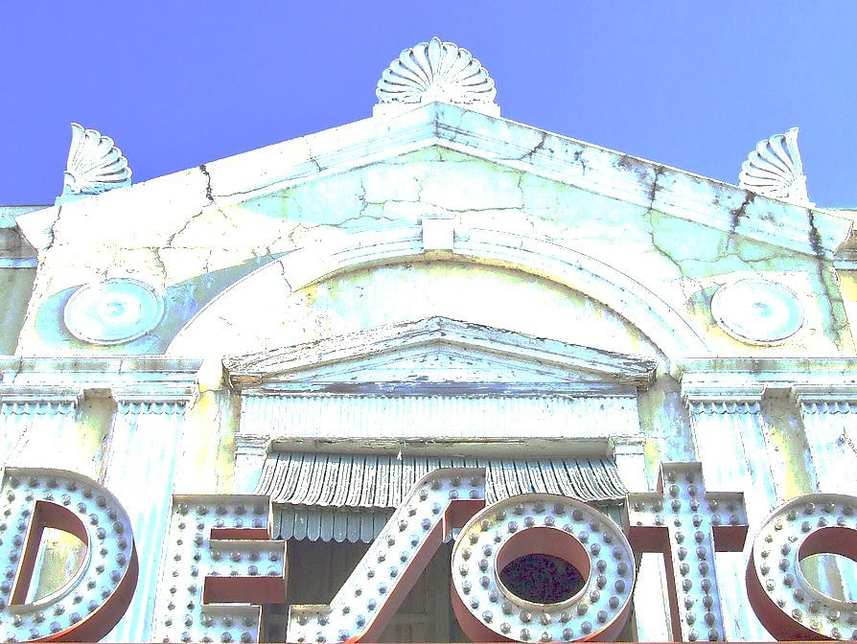



What do Georgians stand to lose?
Civic assets that support tourism and economic development
Downtown anchors, whose patrons keep local restaurants and businesses thriving
Highly revered sources of community pride
Investment in taxpayer-owned and operated venues
Venues that offer classical music and opera
Educational and cultural programming for children and seniors
Nonprofit institutions
with historical significance

Slide 18


The Solution for Georgia
The only provision that is sure to protect and preserve our valued community assets is to
Prohibit casinos from owning or operating entertainment facilities
18

Slide 19









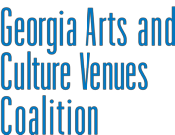
Thank You
Newnan Centre Cobb Energy Centre Imperial Theatre Historic Ritz Theatre RiverCenter
Fox Theatre 19

