Slide 1


Slide 2

“When I asked one I.G.T. artist if he ever plays, he acted as if I had insulted him. ‘Slots are for losers,’ he spat, and then, coming to his senses, begged me to consider that an off-the-record comment.”
− “The Tug of the Newfangled Slot Machines,” by Gary Rivlin
New York Times Magazine, May 9, 2004

Slide 3

Why Commercialized Gambling is Different Than Any Other Business
There is a faulty assump­tion surrounding commercialized gambling and it has led to very bad outcomes for the American people. It’s the false perception that gambling is just like any other business. The truth is, it’s not.
What separates regional casinos and state lotteries from every other business, including other vices like alcohol and tobacco, is gambling is a big con game. Citizens are conned into thinking they can collect money in a scheme designed to ultimately get them fleeced.
If you pay for a pizza, a ticket to an Atlanta Falcons game, or a glass of wine, that’s what you receive in return. When you put down your money in commercialized gambling what you receive in return is the lure you are going to win cash. It’s a financial exchange. But this exchange is mathematically rigged against you. Inevitably, you lose your money, especially if you keep doing it. Meanwhile, the gambling operators do everything they can to make you feel good as you lose. Success only comes at someone else's expense.
Commercialized gambling is a form of financial fraud, similar to loan-sharking, price-gouging, and false advertising, resulting in life-changing financial losses for millions of Americans and thousands right here in Georgia.

Slide 4
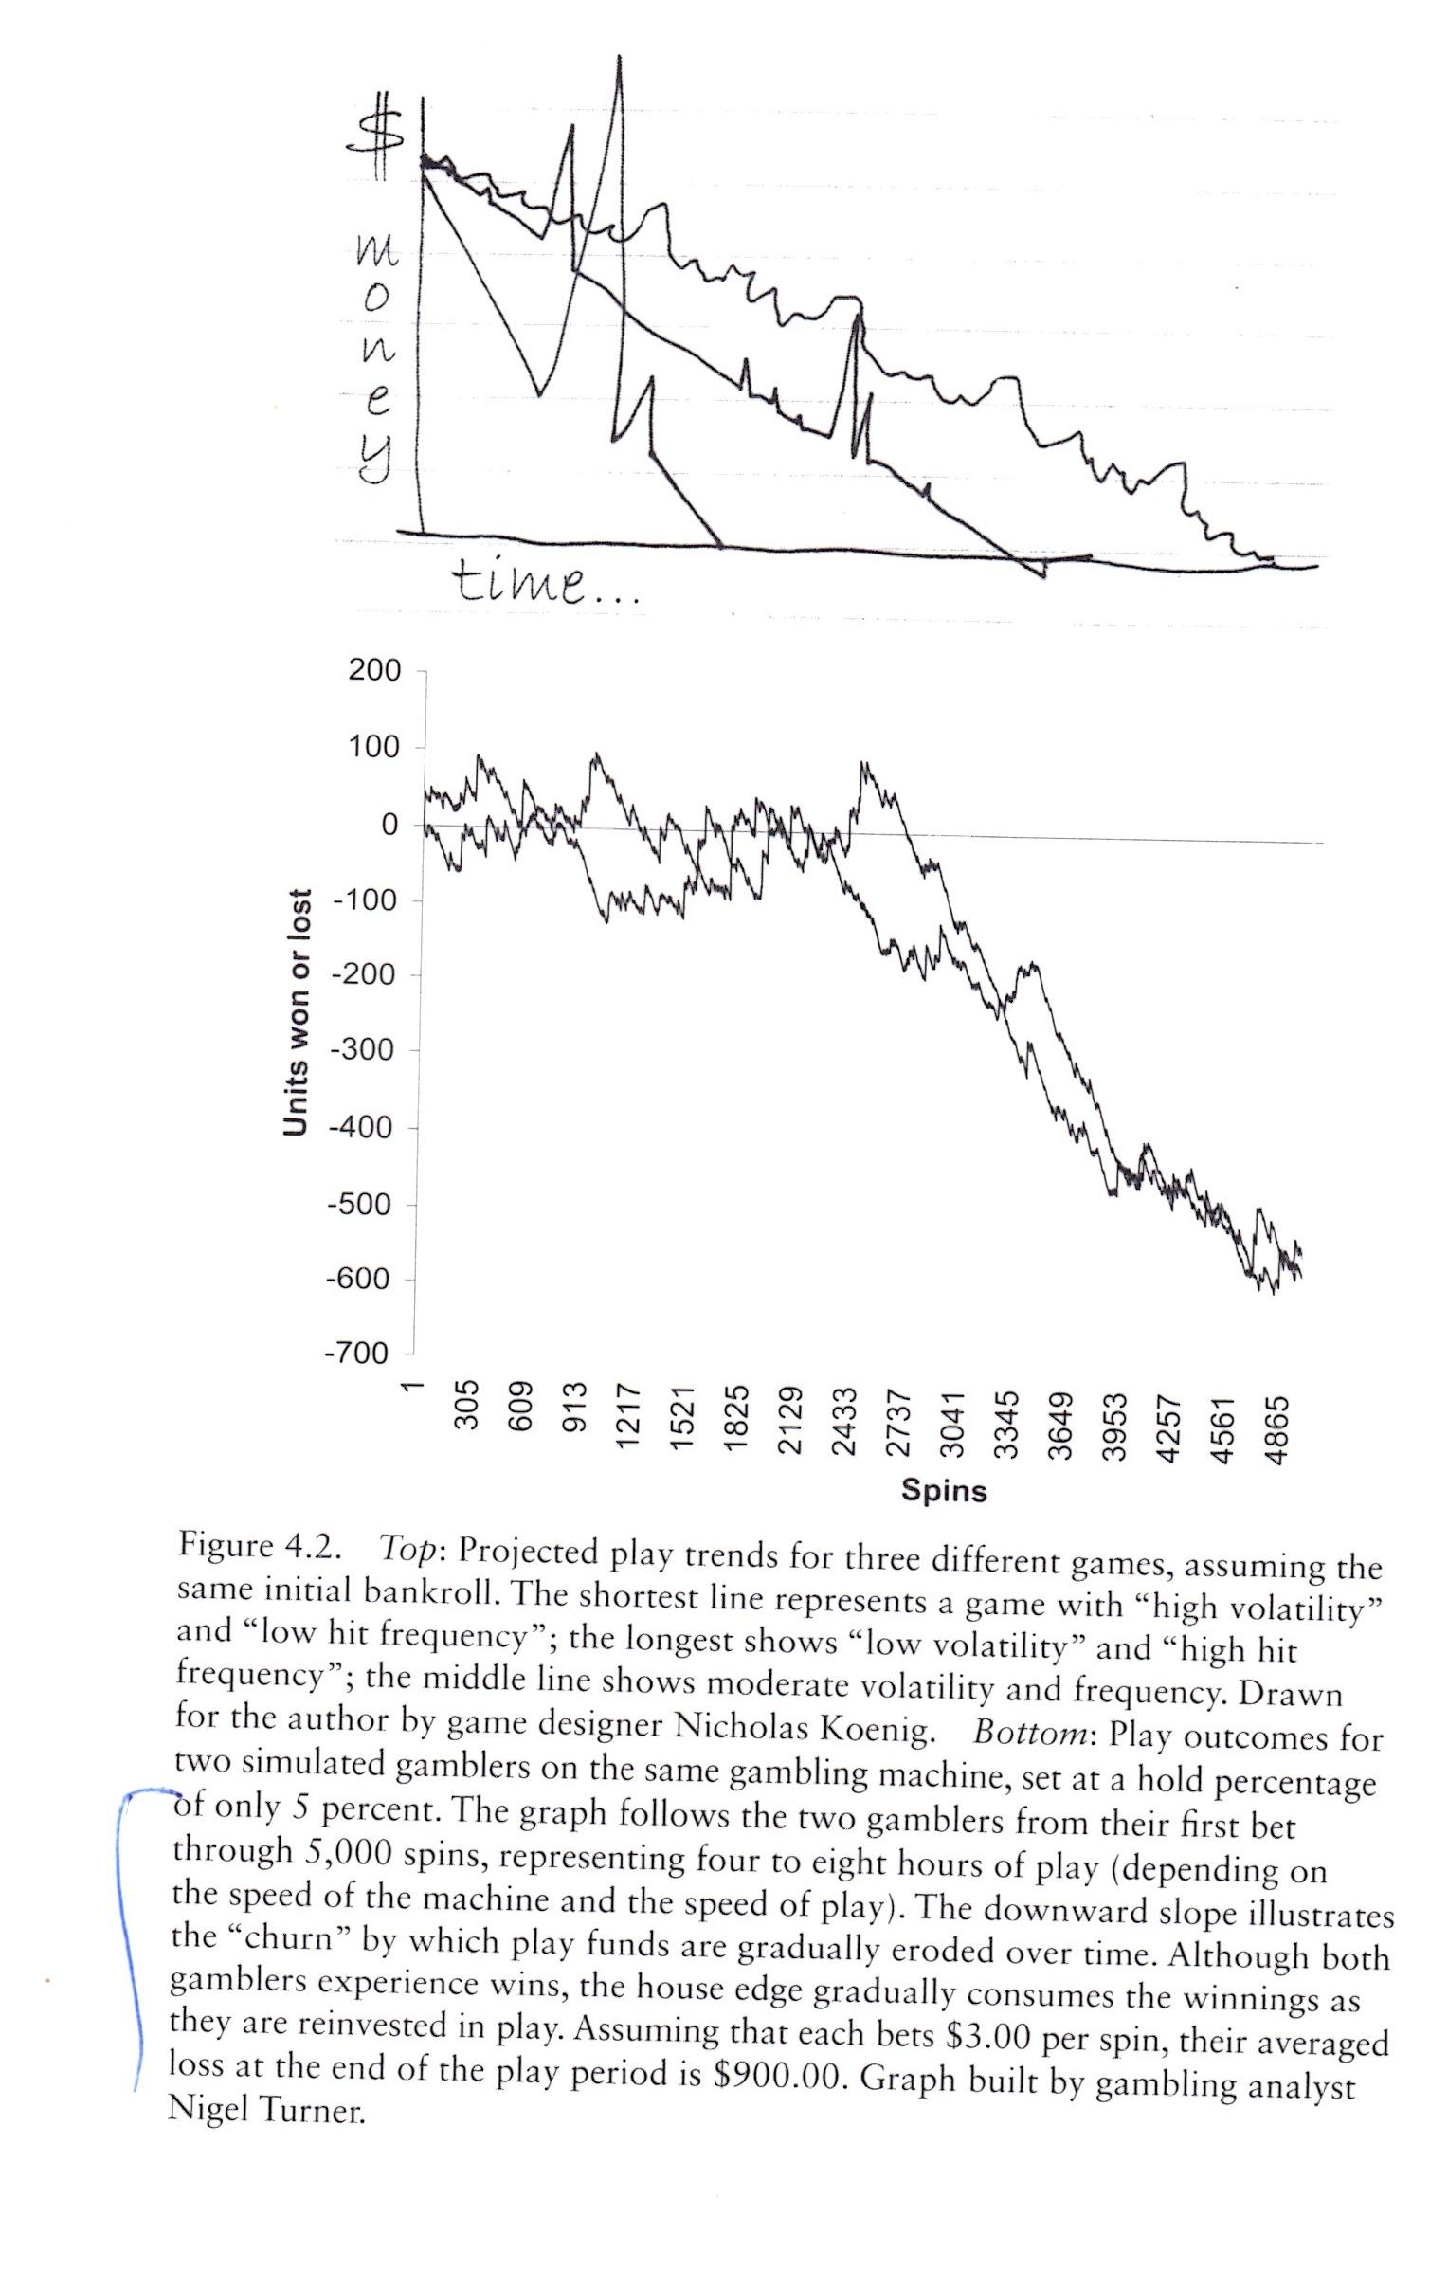
A Form of Financial Fraud That Results in Life-Changing Financial Losses for Millions of Citizens
Source: Addiction By Design, Pg. 112
By MIT Professor Dr. Natasha Schull

Slide 5
What is the most urgent problem you are looking to solve?

Slide 6
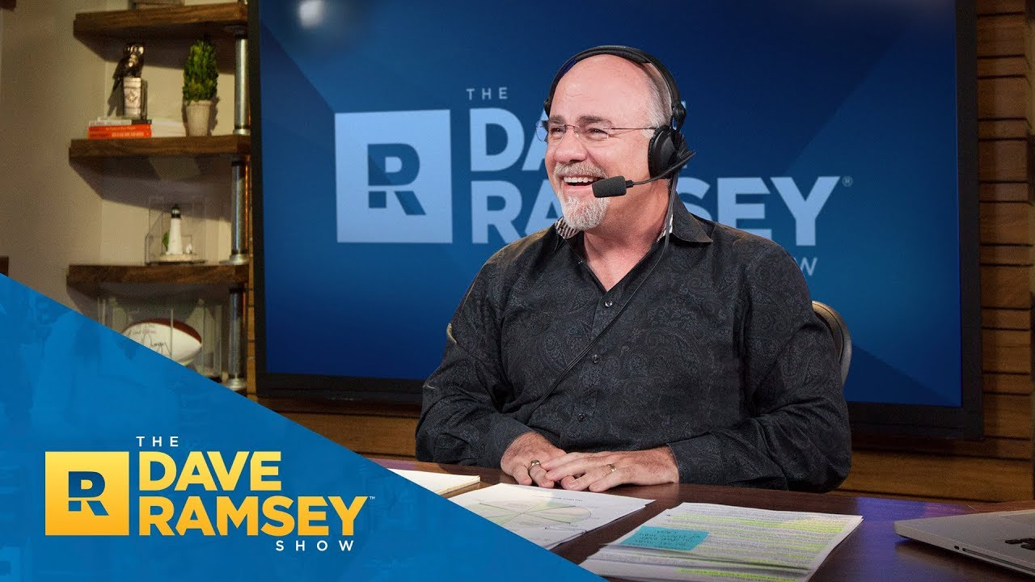
The Dave Ramsey Show, hosted by personal finance expert Dave Ramsey, is the 5th most downloaded podcast in the US. Why?

Slide 7
Because tens of millions of citizens are broke!!!
Savings is the road to wealth creation. Savings. Yet this concept of savings is almost foreign to more than half the country’s citizens.
50% of the U.S. population has zero or negative net wealth.
More than 60% of citizens don’t have enough savings to cover a $1000 emergency expense.
In Georgia, almost 1 out of 6 citizens live below the poverty line…about 15% of the state’s population.
A couple million more are one job layoff, one medical problem, or a death in the family from being broke themselves.
Sources: The Quarterly Journal of Economics, Emmanuel Saez and Gabriel Zucman, Vol. 1, May 2016, Issue 2, Wealth Inequality in the United States Since 1913: Evidence from Capitalized Income Tax Data, Pg. 554. http://gabriel-zucman.eu/files/SaezZucman2016QJE.pdf ; Bankrate’s Financial Security Index, 2018, https://www.bankrate.com/banking/savings/financial-security-0118/; Talk Poverty Report issued by The Center for American Progress. https://talkpoverty.org/state-year-report/georgia-2018-report/

Slide 8
Partial Policy Solutions That Have Been Put Forward From
Either Political Party to Help Solve the Problem
Tax Cuts
Tax Credits
Raising the Minimum Wage
Increasing Taxes on the Rich
….none of which represent a consequential fix.

Slide 9
Life-Changing Losses of Personal Wealth
to Commercialized Gambling
The sheer size and scope of these financial losses lacks any comparison:
The American people are expected to lose $1 trillion of their personal wealth to government-sanctioned gambling over the next eight years.
In 2018 alone, they were expected to lose $118 billion.
That means Americans are losing $224,505 per minute.
Source: H2 Gambling Capital, 2018 https://h2gc.com/ and “This is how much Americans lost on state-sanctioned gambling last year,” Quentin Fottrell of MarketWatch, published by Dow Jones Media, May 15, 2018. https://www.marketwatch.com/story/this-is-how-much-americans-lost-on-state-sanctioned-gambling-last-year-2018-05-15

Slide 10
In the last fiscal year results posted (FY 2018,) Georgia citizens lost more than $1.8 billion of their personal wealth to the Georgia Lottery. That's $3480 every minute.
Over the last 20 years (since FY 1999,) the citizens of Georgia have lost $30.4 billion of personal wealth to the Georgia Lottery.
If this rate of gambling losses by Georgia citizens continues at its current pace without marketing any new forms of commercialized gambling by state government, your constituents statewide are on course to lose more than $9.2 billion of their personal wealth over the next five years.
Source: Georgia Lottery Annual Reports Fiscal Years 1999-2018

Slide 11
For the Majority of Citizens Who Don’t Gamble, You Pay Even If You Don’t Play
Gambling lobbyists and some public officials continue to tout government-sanctioned gambling as a way to raise tax revenue. But history has shown repeatedly that this argument is either overstated or wrong. A 2016 national report by SUNY-Albany found that while states creating new revenue streams from gambling may see momentary bumps in tax income, “the revenue returns deteriorate—and often quickly.”
Beyond its obvious status as a budgetary shell game, government-sanctioned gambling incurs major social costs that end up being footed by all taxpayers. In addition to targeting and exploiting the financially desperate and cultivating addiction, government-sanctioned gambling leads to increases in rates of personal bankruptcy and provides new avenues for crime and money laundering. Gambling operators don’t pay for the harms they cause families, businesses, and communities. Taxpayers do.
All the citizens who don’t gamble also pay another way. Government-sanctioned gambling lowers a region’s standard of living because it’s a sterile transfer of money from millions of ordinary people’s pockets into a small number of other people’s pockets, producing nothing new and nothing of lasting value. It’s a naked money grab disguised as economic development. The economic impact is similar to throwing your money on the street so someone else can pick it up – it redistributes wealth without creating it. Because this nonproductive activity nevertheless uses up time and resources, we experience a reduced standard of living, a consequence that impacts all of us.
Sources: Cornell Univ. Professor David Just, “The big swindle: In lotteries, the poor are the biggest losers,” CNN, Dec. 18, 2013https://www.cnn.com/2013/12/18/opinion/lottery-poor-just-opinion/index.html
John Rosengren, “How Casinos Enable Gambling Addicts,” The Atlantic (Dec. 2016) https://www.theatlantic.com/magazine/archive/2016/12/losing-it-all/505814/
Social Costs of Problem Gambling, Problem Gambling Research and Intervention Project, Georgia State University, https://goo.gl/kcgQv2
Dr. Earl Grinols and Dr. David Mustard, MIT Press, Review of Economics and Statistics, Feb. 2006, https://www.mitpressjournals.org/doi/abs/10.1162/rest.2006.88.1.28?journalCode=rest
Lucy Dadayan, State Revenues from Gambling: Short-Term Relief, Long-Term Disappointment, The Nelson A. Rockefeller Institute of Government (2016), http://www.rockinst.org/pdf/government_finance/2016-04-12-Blinken_Report_Three.pdf

Slide 12
The misleading call by the gambling lobby to “Let the People Vote.” History shows what they are really saying is “Let Us Buy the Vote.”
It’s not accurate for any gambling lobbyist or public official to say a fair debate leading to an informed, educated public will happen during a casino referendum campaign because it won’t. If every legislator in a state was outspent 3 to 1 during his or her campaign, most would lose reelection regardless of their merit. Yet some legislators allow casino operators to hijack the ballot process by outspending predatory gambling opponents by a margin of at least 250 to 1. How many sitting elected officials would win a campaign if they were outspent by at least 250 to 1?
Here are just a few examples of the massive spending that has occurred in other states:
In Colorado, gambling interests outspent opponents 1,734 to 1.
In Massachusetts, citizens collected signatures to place a casino repeal referendum on the 2014 ballot. Gambling interests spent more than $15 million to defeat it. In the last 30 days, gambling interests including MGM ran more than 4000 TV ads. Repeal advocates ran zero because it was too costly to go on TV. Almost none of the TV ads run by gambling interests even mentioned the word casino.
In Maryland, another MGM-led casino campaign spent more than $40 million to pass a statewide ballot question.
In Ohio, gambling companies spent almost $50 million to pass a ballot question allowing them to open casinos in the state.
“Never a Sure Bet,” a 2009 report from the National Institute on Money in State Politics, http://stoppredatorygambling.org/wp-content/uploads/2012/12/Never-A-Sure-Bet-Report-from-National-Institute-on-Money-in-State-Politics.pdf
https://ballotpedia.org/Massachusetts_Casino_Repeal_Initiative,_Question_3_(2014)
To view the casino advertising aired to block casino repeal in MA 2014, visit Stop Predatory Gambling’s YouTube channel SPGAmerica: https://www.youtube.com/playlist?list=PLA6B145FA31CCA40A
“MGM gets the deal for Maryland’s sixth casino,” The Washington Post, December 20, 2013 https://www.washingtonpost.com/local/mgm-gets-the-nod-to-build-marylands-sixth-casino-at-national-harbor-in-prince-georges/2013/12/20/059e7276-693e-11e3-a0b9-249bbb34602c_story.html?utm_term=.87301d4b47cb
“Ohio Casino Approval referendum, Question 3, 2009 https://ballotpedia.org/Ohio_Casino_Approval_and_Tax_Distribution,_Amendment_3_(2009)

Slide 13
Four Truths About Commercialized Sports Betting
Truth #1: It’s a Form of Financial Fraud, Similar to Loan-Sharking, Price-Gouging, and False Advertising, That Will Result in Life-Changing Financial Losses for Many Georgia Citizens
Truth #2: It Severely Harms Children and Will Radically Change the Way That Georgia Children Consume Sports
Truth #3: For the Majority Who Don’t Gamble, You Pay Even If You Don’t Play
Truth #4: Illegal Gambling Tends to Increase When States Legalize Gambling

Slide 14

Georgia Lottery Online Gambling Games- October 16, 2019
Notice the amount of gambling games using child imagery and themes. The gambling games start off
with a free-to-play demo and then transition to the real money game.

Slide 15

Georgia Lottery Online Gambling Games- October 16, 2019
Notice the amount of gambling games using child imagery and themes. The gambling games start off
with a free-to-play demo and then transition to the real money game.

Slide 16

Georgia Lottery Online Gambling Games- October 16, 2019
Notice the amount of gambling games using child imagery and themes. The gambling games start off
with a free-to-play demo and then transition to the real money game.

Slide 17

Georgia Lottery Online Gambling Games- October 16, 2019
Notice the amount of gambling games using child imagery and themes. The gambling games start off
with a free-to-play demo and then transition to the real money game.

Slide 18

Georgia Lottery Online Gambling Games- October 16, 2019
Notice the amount of gambling games using child imagery and themes. The gambling games start off
with a free-to-play demo and then transition to the real money game.

Slide 19
HISTORICAL RACING MACHINES ARE SLOTS
“Idaho Lawmakers Say They Were Duped on Instant Horse Racing”
By KIMBERLEE KRUESI, Associated Press, Feb. 11, 2015
https://magicvalley.com/news/local/govt-and-politics/idaho-lawmakers-say-they-were-duped-on-instant-horse-racing/article_fb9373f0-b205-11e4-9f54-9b268638ecc3.html
“Idaho lawmakers vote to repeal ‘instant racing’”
The Spokane Spokesman-Review, March 26, 2015
http://www.spokesman.com/stories/2015/mar/26/idaho-lawmakers-vote-repeal-instant-racing/

Slide 20
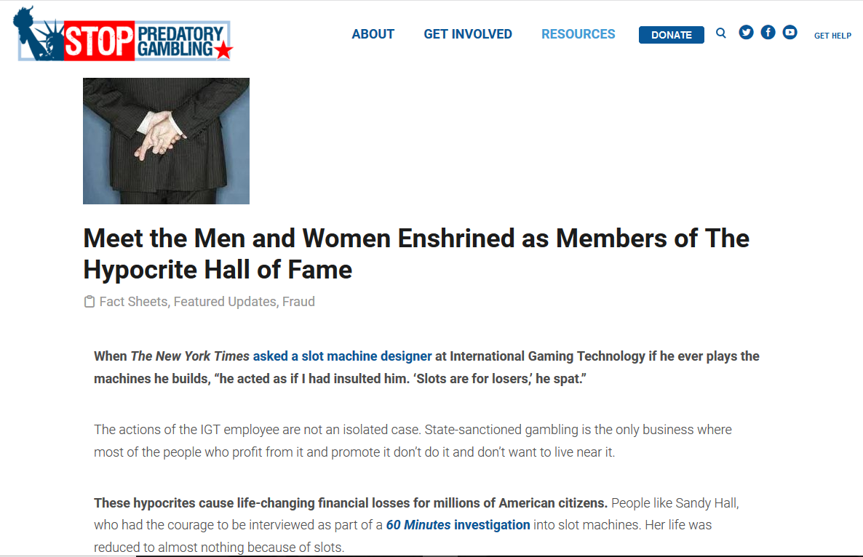
A Revealing Truth About the Big Con Behind State Government and Commercialized Gambling

Slide 21
The Way Forward
Building assets, the accumulation and investment of savings, are key for anyone looking to make a better life. A home, a college fund, retirement accounts, a stock portfolio—these assets are the hallmarks of middle and upper class America, and they are all the result of savings.
Building assets is the direct opposite of commercialized gambling. No single policy reform would create more financial peace for low-to-middle-income citizens than reversing the current scheme of turning millions of people who are small earners, who could be small savers, into habitual bettors.

Slide 22
  Goal: Reduce the amount of gambling losses suffered by the citizens of Georgia over the next eight years by 50%
No advertising or marketing to low income populations
No high dollar tickets should be marketed in low income areas (<$5)
No gambling on credit
To safeguard the health of minors, no kids under should be exposed to gambling ads and marketing on TV, radio, at point-of-sale, or on the internet. (should be sold like pornographic magazines in convenience stores)
Ban “loot boxes” and other elements of commercialized gambling that are currently being engineered into video games in games that kids under 18 are playing
Reduce the amount of lottery games being marketed to the public
Reduce the speed of the gambling (eliminate scratch tickets, electronic gambling machines, and online gambling)
Make gambling interests pay for the damage they cause

