Slide 1



Slide 2
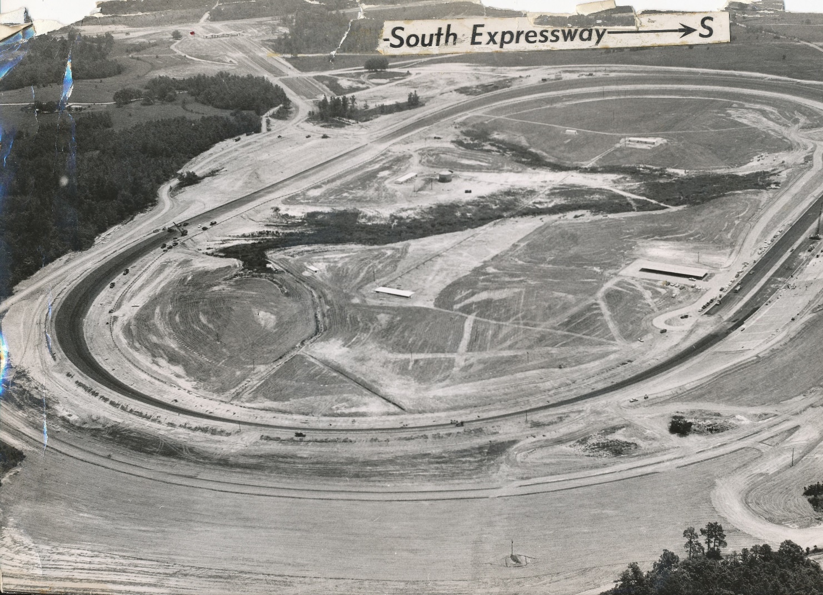
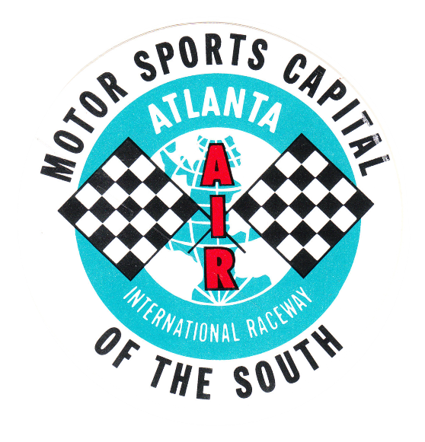
1960

Slide 3
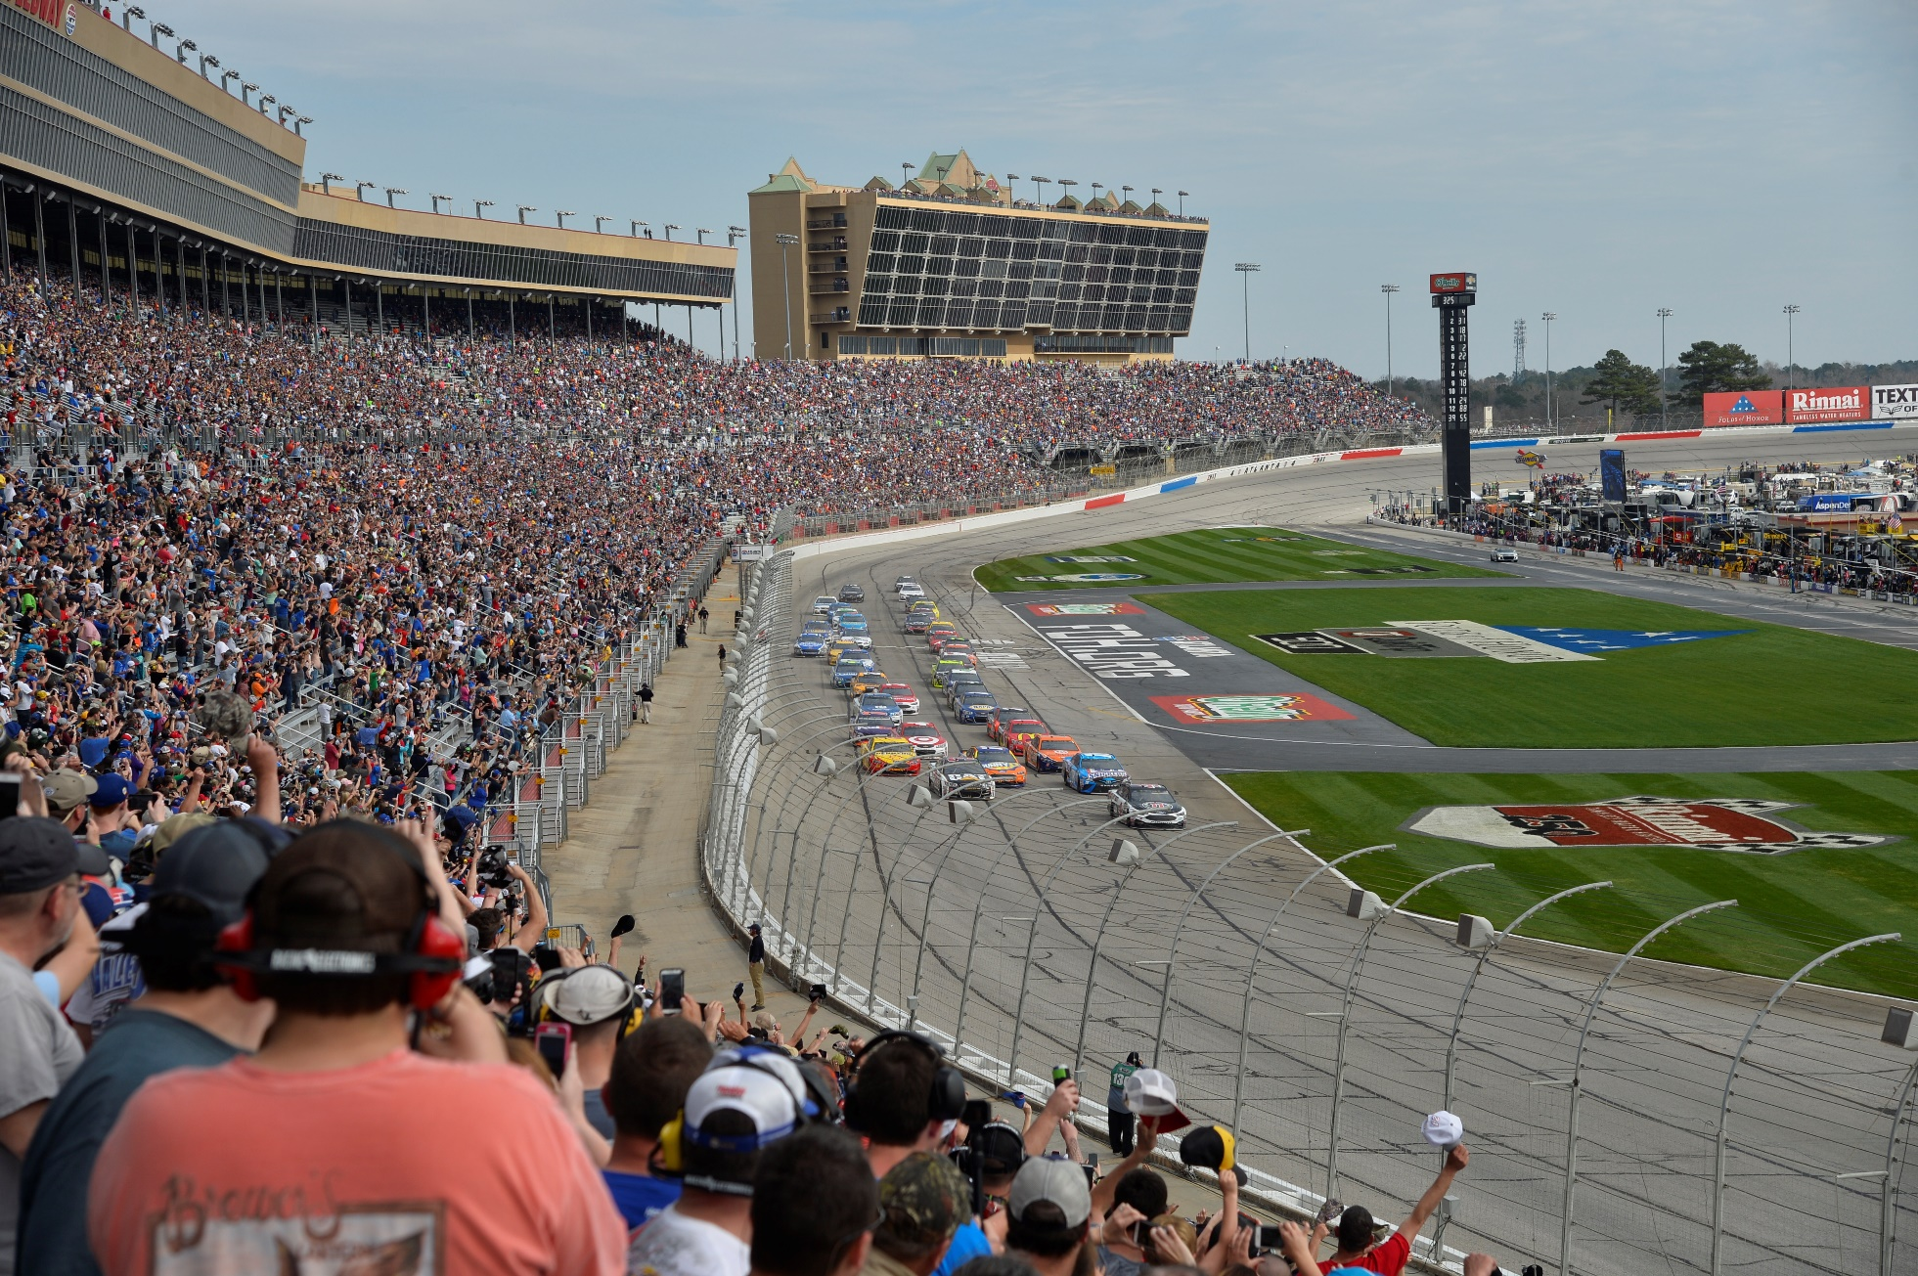

Slide 4
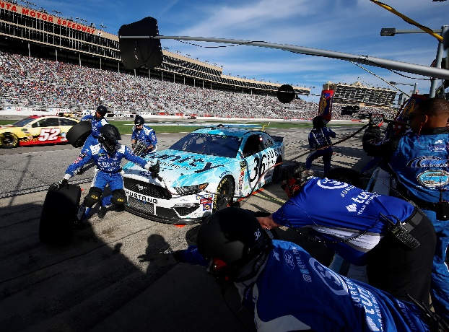
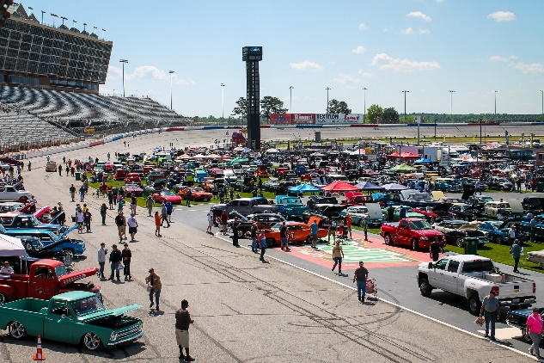
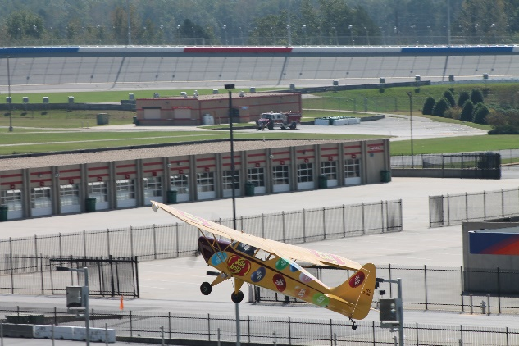
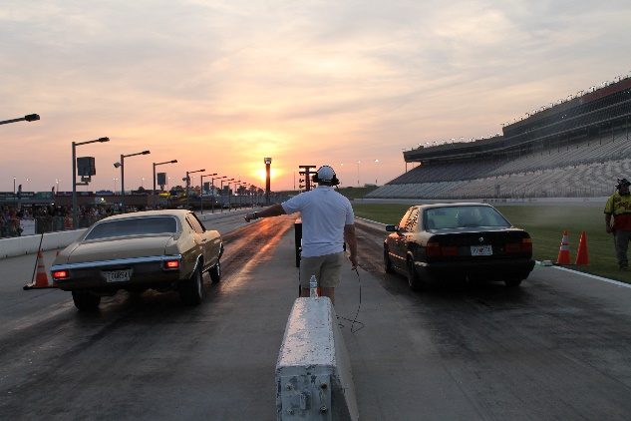

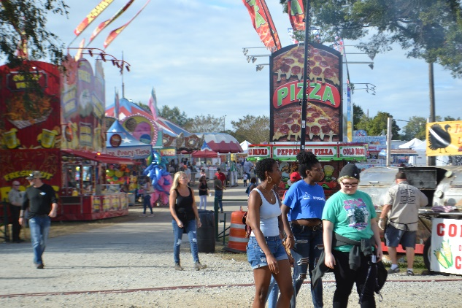
Annual Event Schedule
NASCAR Weekend – Cup, Xfinity & Gander Outdoor Truck Series
Summit Racing Equipment Atlanta Motorama
Imagine Music Festival
Georgia State Fair
Atlanta Air Show
O’Reilly Auto Parts Friday Night Drags
Papa John’s Thursday Thunder Legends Series

Slide 5
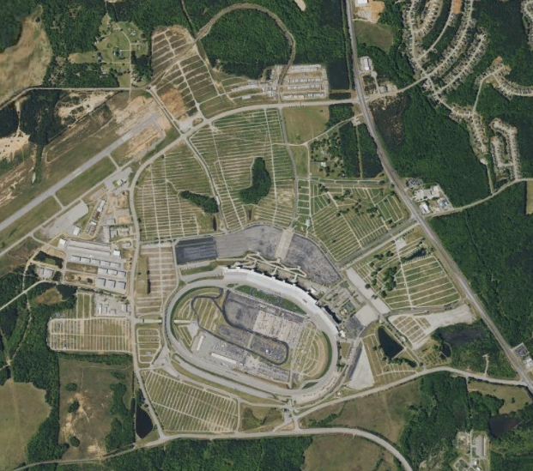
Evolution from Motorsports Facility
356 Days Usage
840 plus acres

Slide 6
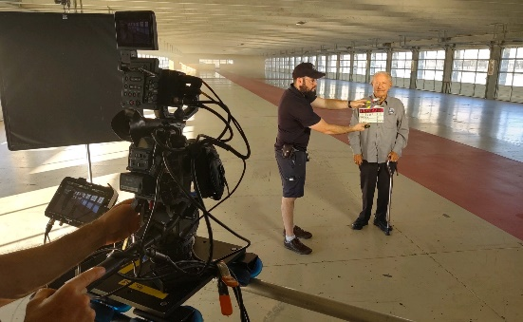
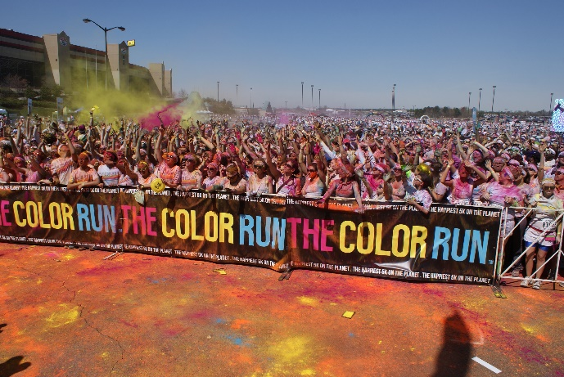
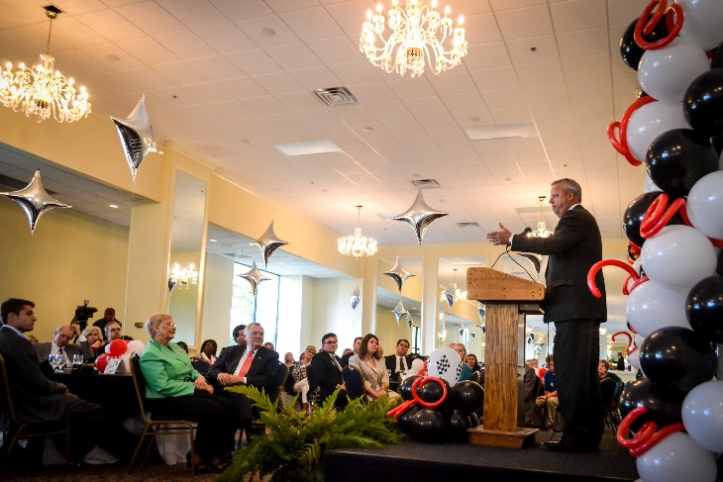
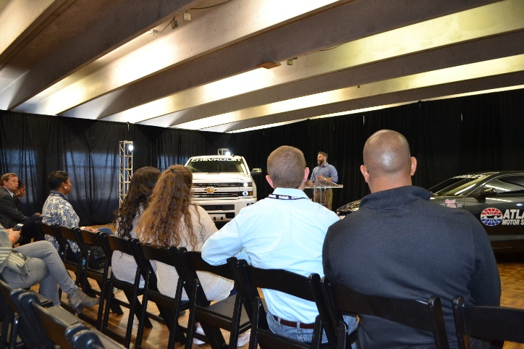
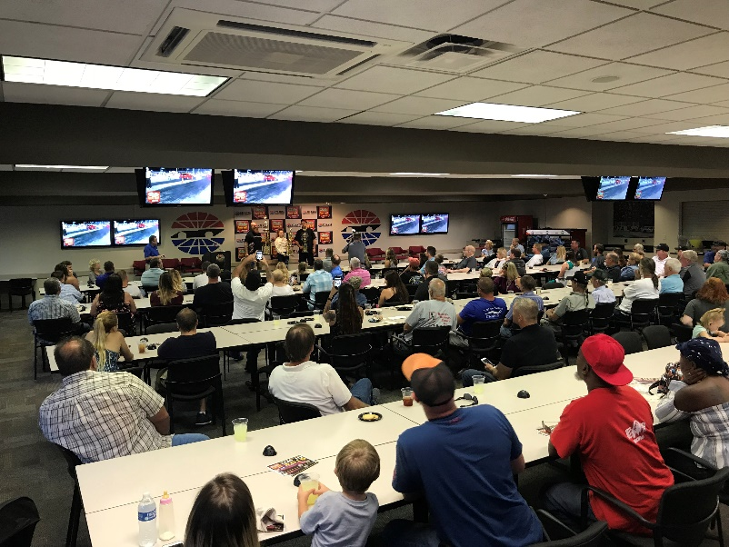
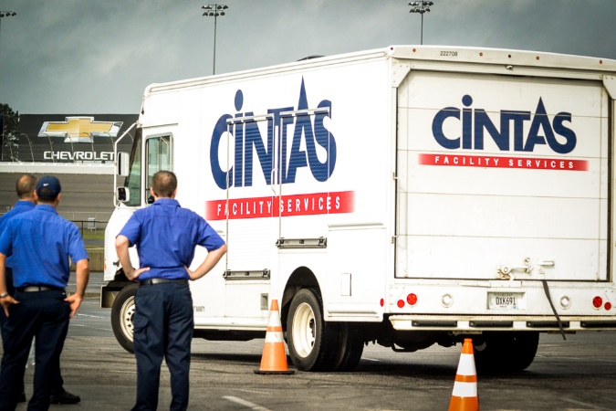
Beyond Motorsports Events
Filming
Corporate Meetings and Events
Driver Training
Motorcoach Rallys
Vehicle and Product Introductions
Athletic Events
Trade Shows
Charity and Social Events

Slide 7
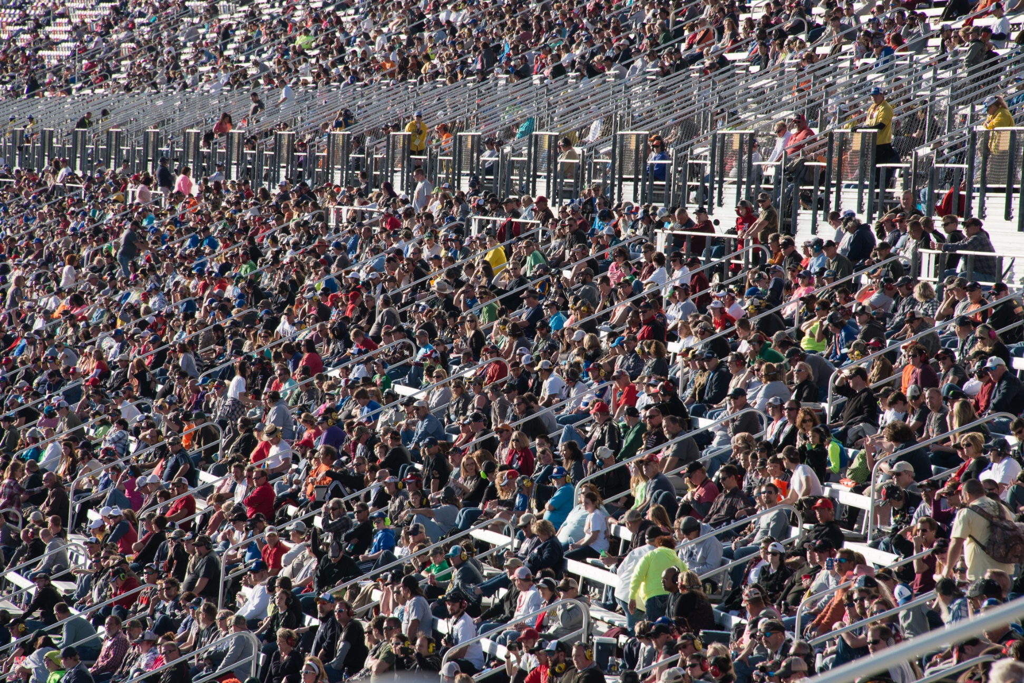

Slide 8
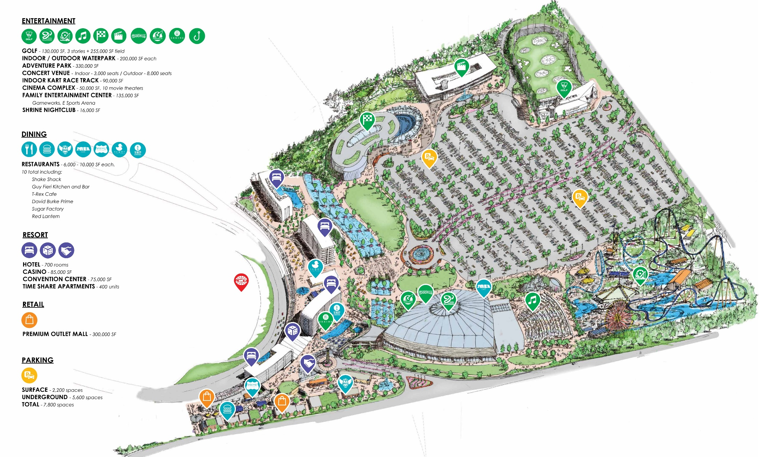

Slide 9
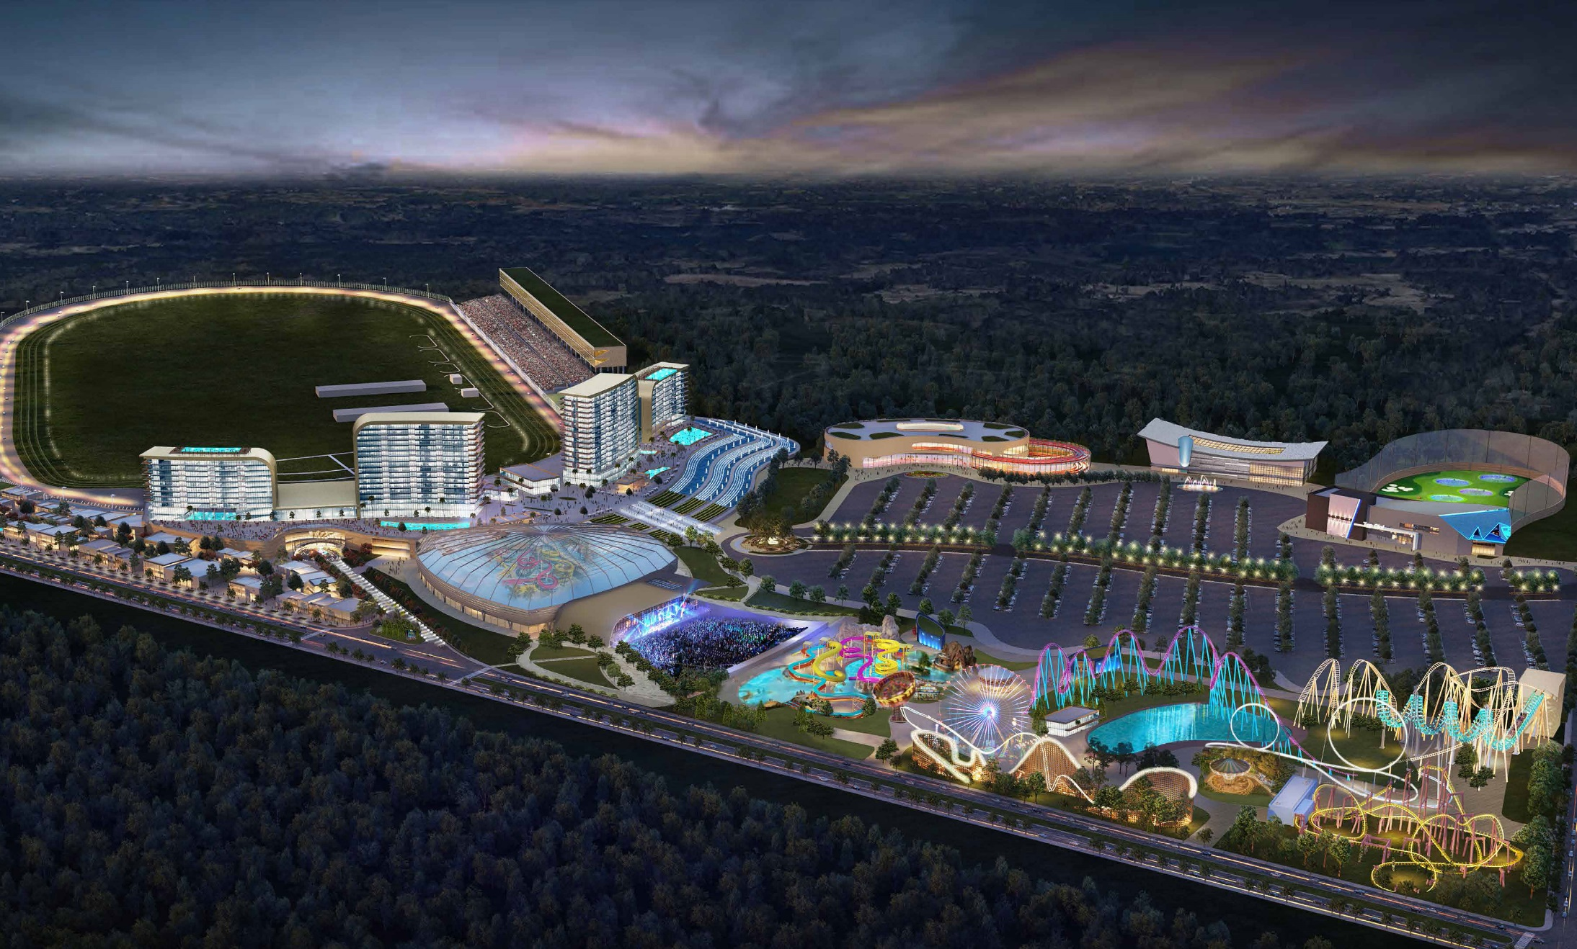

Slide 10
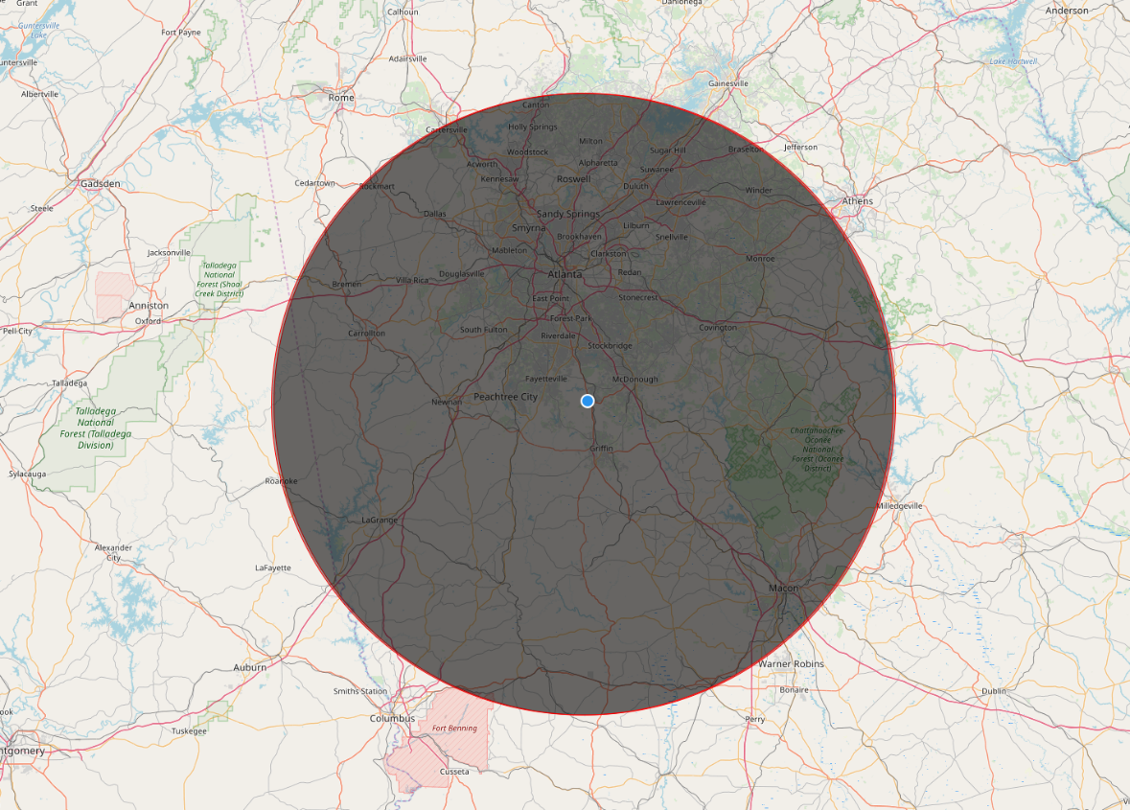
Why Atlanta Motor Speedway?
29 miles from downtown Atlanta
21 miles from Hartsfield-Jackson Airport
Convenient from I-75 via 4-lane Bruton Smith Parkway.
Adjacent to Atlanta Speedway Airport
Built in base of thousands of visitors each year
Central Population – 8.5 million people within 100 miles

Slide 11
Economic Benefits
Job Creation – over 3,000 construction workers
4,000 – 5,000 permanent jobs
Estimated $1 billion in construction revenue
Enhance current AMS events & create new opportunities
Significantly increase economic impact and bring new revenue to region
Derive major revenue from licensing, regulation and tax proceeds to support education and other statewide programs

Slide 12

ALL OF GEORGIA WINS!

Slide 13
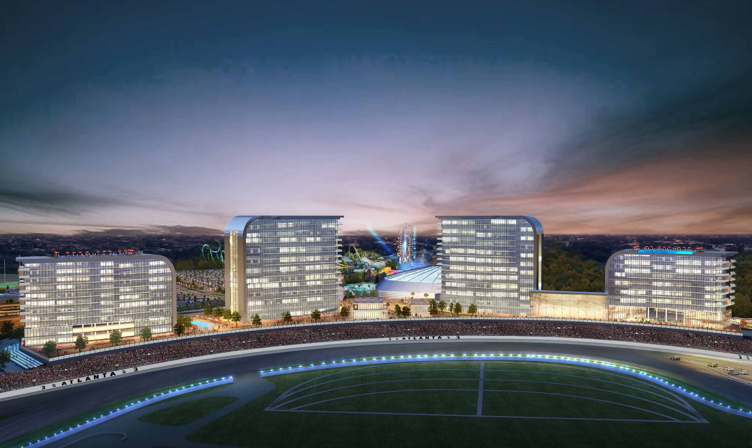
Thank You!

