Slide 1


Berneta Haynes, JD
Director of Equity and Access
Georgia Watch
www.georgiawatch.org

Slide 2


Who We Are & What We Do
Nonprofit 501(c)(3), nonpartisan consumer advocacy organization that ensures consumers have a voice in policymaking
Empower consumers through outreach and education
Serve as a trusted resource for elected officials, the public, and the media
Keep a watchful eye on legislation, court cases and proposed rules that impact consumers
Offer a toll-free consumer helpline

Slide 3


Health Access Program
Our Health Access Program seeks to expand access to safe, quality and affordable healthcare for all Georgians through consumer empowerment, policy development, and advocacy.
      Healthcare Cost & Quality
      Industry Transparency
      Patient Safety
      Medical Bills
      Insurance Coverage

Slide 4

Policy Report on APRN Practice in GA
Released January 2015
Georgia ranks 39th in the number of physicians per capita
49th in the number of primary care physicians per capita, down from 44th in 2007
129 out of 159 Georgia counties contain federally designated primary care health professional shortage areas (physician ratio of 1:3,500)
63 counties without a pediatrician
79 without an OB/GYN
78 without a psychiatrist

Slide 5
State Law Restrictions on
APRN Practice
The American Association of Nurse Practitioners lists Georgia as one of the 12 states with the most restrictive practice environments for nurse practitioners.
What makes state laws restrictive?
Medical board regulation of APRN practice
Physician supervision requirements
Restrictions on the ability of APRNs to independently perform certain medical acts, like writing prescriptions or ordering tests

Slide 6
Examples of Physician Supervision Requirements
The delegation of authority to perform certain acts and protocol agreements
Chart review requirements
Requirements that physicians also see patients periodically
Limitations on the number of APRNs that can be supervised by a single physician
Restrictions on distance between the APRN and supervising physician

Slide 7
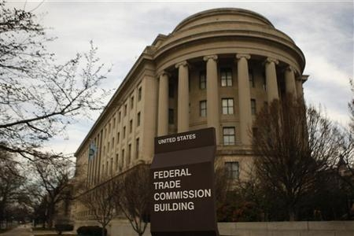
Federal Trade Commission
Institute of Medicine Future of Nursing report urged the FTC to investigate the role of NPs as PCPs and examine state regulatory practices
March 2014, FTC report urged state legislators to consider:
  Importance of consumer access to safe, effective care
  Consumer benefits that arise from increased competition among healthcare providers
    Improved innovation in healthcare delivery models
    Lower costs
  Effective collaboration does not require physician supervision of APRNs
  No legitimate health and safety concerns associated with APRN care

Slide 8

Policy Recommendations:
Grant APRNs full practice authority
  Includes Schedule II prescriptive authority
  Radiographic imaging test orders
Fair and impartial regulatory board oversight
Mandate 3rd party coverage of APRN care
  Improves access & enables patient choice in providers
Enable more graduate-level education and clinical training opportunities for nurses
  Supports the healthcare workforce pipeline

Slide 9

Questions
Berneta Haynes, JD
Director of Equity and Access
Georgia Watch
bhaynes@georgiawatch.org
Phone: 404-525-1085
www.georgiawatch.org

