Slide 1
Teaching
The “What” and “How” of your teaching is determined by “Who” you perceive as the recipients.

Slide 2
What is Your Mind Set When You Walk into a Classroom?
How Was It Determined?

Slide 3
Culture and Learning
Student’s indigenous culture anchors them to reality.
Therefore, Culture is the starting point during their matriculation.
Nothing happens independent of culture.

Slide 4
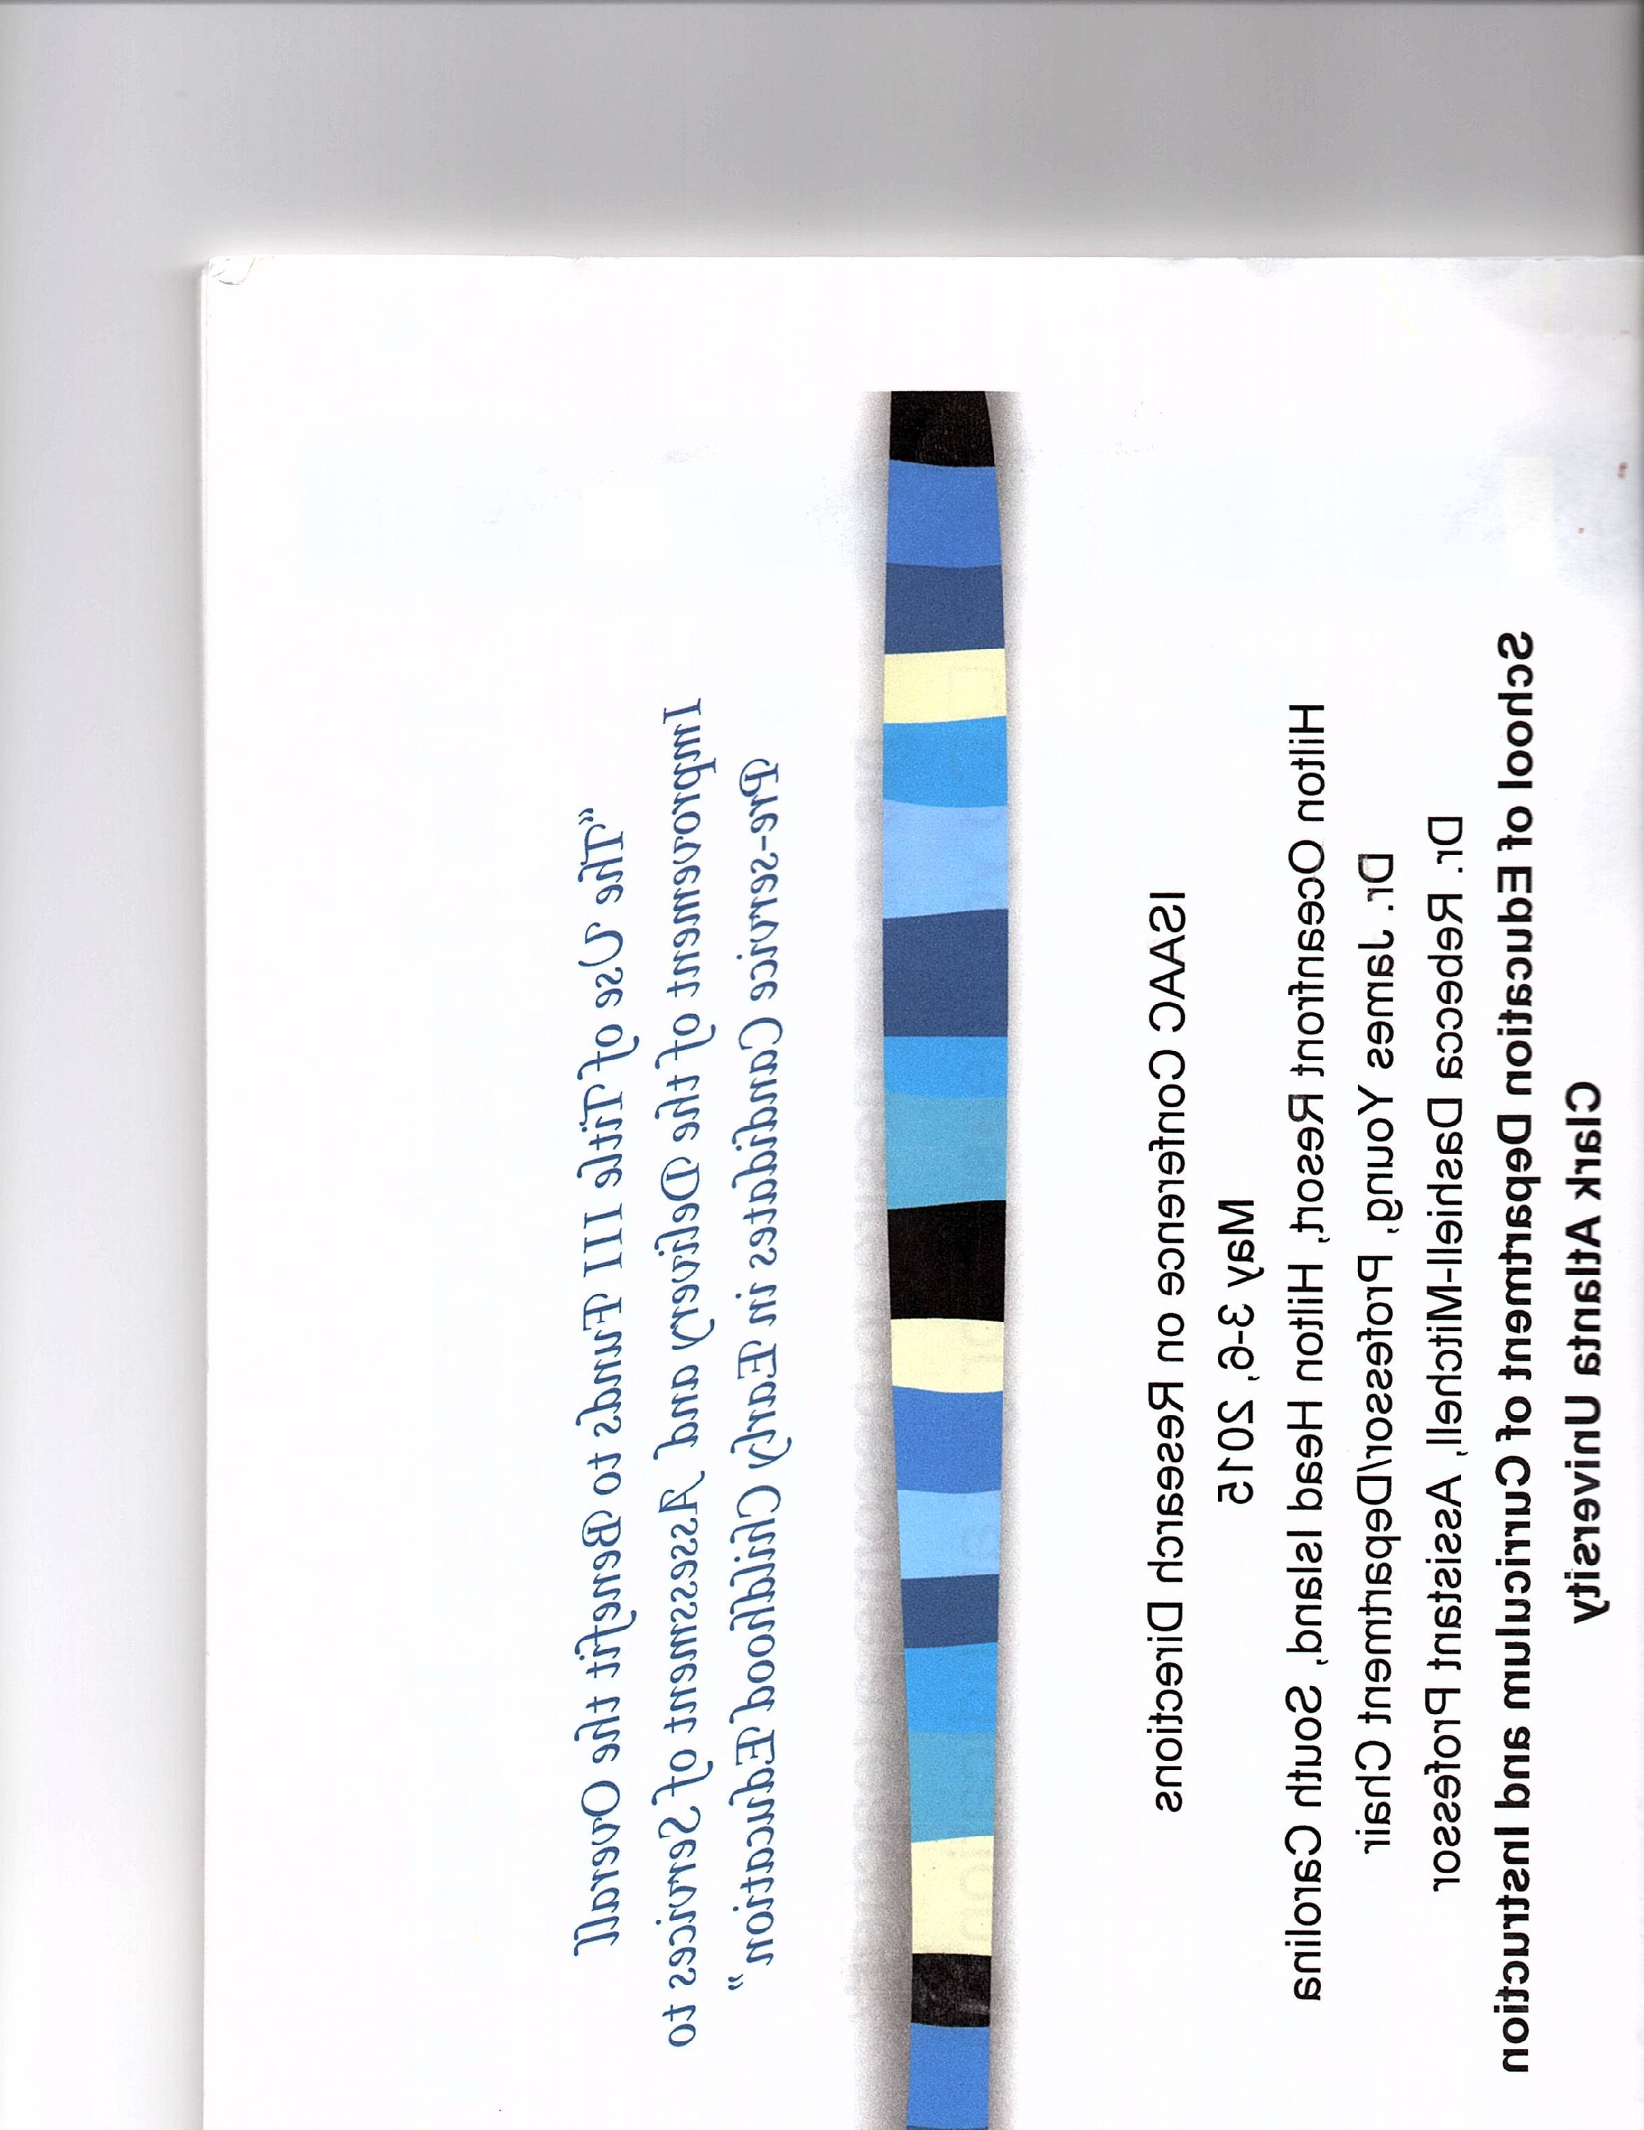
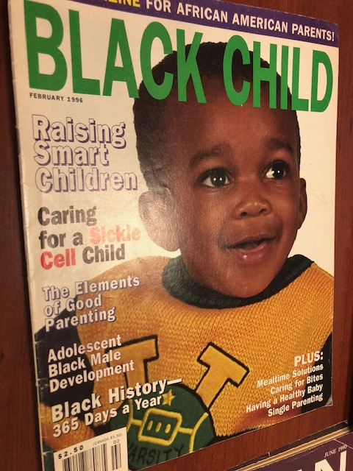
Black Child Magazine – February 1996 Issue

Slide 5
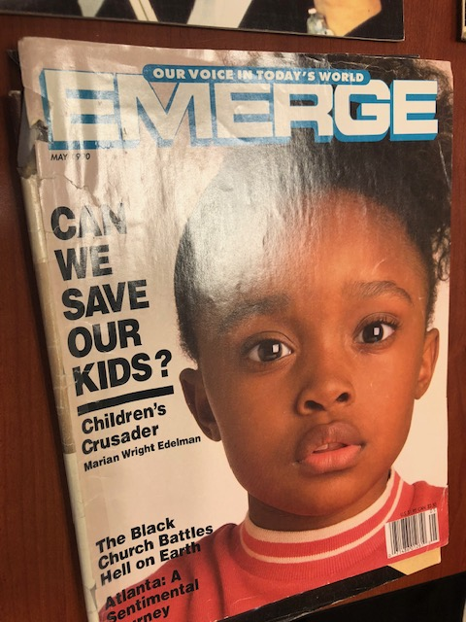
Emerge Magazine– May 1990 Issue

Slide 6
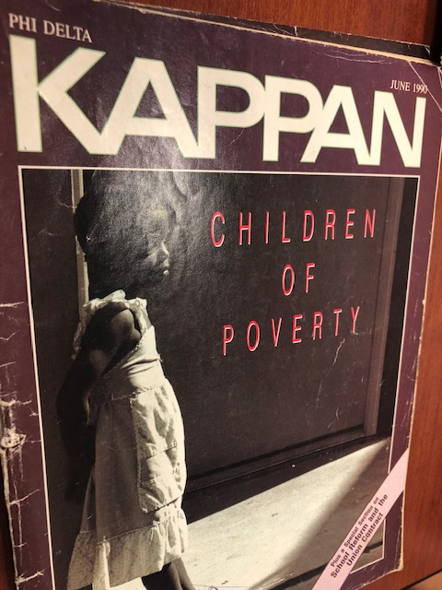
Phi Delta Kappan Magazine – June 1990 Issue

Slide 7
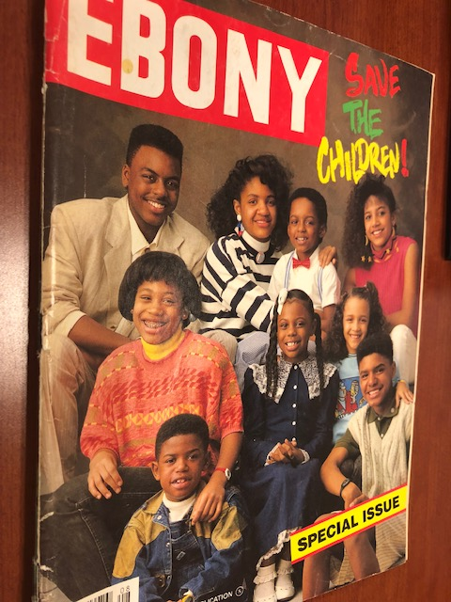
EBONY Magazine – August 1988 Issue

Slide 8
Closing the Achievement Gap
Dr. Hilliard’s Position
Four Important concerns:
1. Set high standards
2. Be problem solvers and collaborate to figure out strategies
3. Use feedback daily to plan instruction
4. Acquire deep content knowledge

Slide 9
Asa G. Hilliard
The keys to academic and cultural success for African American children is to go beyond the minimal standards of GAPSC, InTASC, NAEYC, CAEP, Common Core and others that will evolve. Excellence must be the focus. What are you willing to do?

Slide 10
Life and Lessons
An Excerpt: Intelligence, Education, Universal Knowledge How to Get It
1. Never stop learning 2. Never stop reading 3. Buy books and make notes 4. Read poetry for inspiration
5. Read history about the world 6. Master the language of your country (African and European)
7. Never speak or write on subjects you know nothing about 8. Read at least four hours daily
9. Never keep constant company with anyone who doesn’t know as much as you and from whom you cannot learn
10. Decide on a goal and keep it before you at all times 11. Try never to repeat yourself in discourse
12. Knowledge is power 13. Never attempt anything without being able to protect yourself on it
14. You are not compelled to agree with every-thing you need 15. Carry a dictionary and read newspapers
16. Carry reading and study materials while traveling 17. Read at least one book a week
18. Study a second language 19. Study two subjects at once 20. Never allow anyone to get to your bookshelf in your absence 21. Read your Bible/Koran or book of inspiration everyday

Slide 11
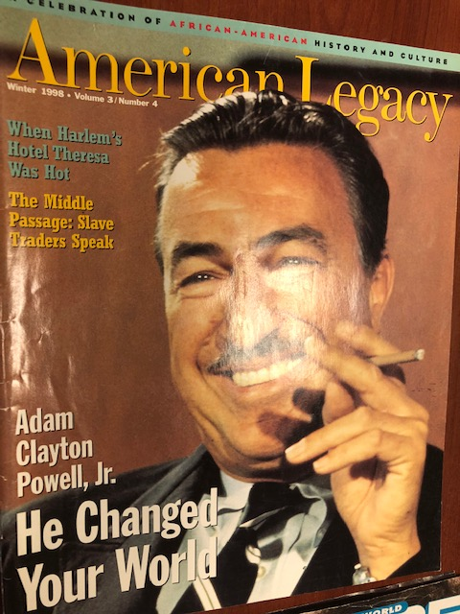
American Legacy Magazine– Winter 1998 Volume 3/ Number 4 Issue

Slide 12
Teacher Education and Culture
The role and purpose of education is to allow each generation to rationally guide and systematically guarantee that it reproduces and refines the best of itself and pass on to the next generation wisdom, knowledge, and skills necessary to develop, maintain and participate in society of the future.

Slide 13
A Mind is a Terrible Thing to Waste
Clark University: Career Options
1868 – Teaching and Preaching
Teacher Preparation 1868 – 2018 = 150 Years of Successful History

Slide 14
Culture and Tradition
“It hurts to lose certain traditions; these are practical principles of life. The loss can lead to self-destruction of the individual, society, the world, and its civilization.” Fu-Kiau, 1991

Slide 15
Sustainability of Teacher Education at an HBCU
Continuity of culture during the matriculation of their education must be consciously guided by an awareness, understanding and utilization of historical conditions and cultural experiences which give shape and meaning during the process of preparation.

Slide 16
Excellence Without Excuses
Supplementary Information from National Organizations
NABSE – Saving the African American Child
NBCDI – Being Black is Not a Risk Factor
CIBC – Council for Independent Black Institutions
CDF – Children’s Defense Fund

Slide 17
Excellence Without Excuses
Complementary Information from Black Scholars
Na’im Akbar, Clinical Psychologist Jacqueline Irvine, Educator
Charlyn Harper Browne, ECE/Psychologist Russell W. Irvine, Sociologist
James Comer, Psychiatrist Marge Spencer, Developmental Psyche
John Dill, Psychologist Hakim Rashid, Educational Psyche
V. P. Franklin, Historian Geneva Gay, Sociologist
Janice Hale, Early Childhood Diane Slaughter, Psychologist
Asa G. Hilliard, Psychologist Wade Nobles, Psychologist
G

Slide 18
Culture and Learning
      Annotate Bibliography of 100 Black Scholars Research/Writing
  Video Clips, YouTube, Films, Invited Lecturers. Contributions to the idea of
  Standing on the Shoulders of Giants

