Slide 1
Sports Betting 101: A Model for Policymakers and Regulators in Lottery States without Casinos
October 2019

Slide 2
Presentation Contents
Issue Overview – Opportunities for Lotteries
Sports Betting’s Current Environment
    A Practical Model for Lottery Implementation
    Background on Sports Betting and Federal Laws
    The Existing Illegal Market and Sports Betting’s Popularity
Sports Betting Regulatory Issues
    Benefits of Regulation
    How the Registration Process Works
    Overview of Sports Book Economics
    Specific Considerations for State Policymakers
Summary and Bottom Line

Slide 3
Issue Overview – Opportunities for Lotteries

Slide 4
Presentation Contents
Issue Overview – Opportunities for Lotteries
Sports Betting’s Current Environment
    A Practical Model for Lottery Implementation
    Background on Sports Betting and Federal Laws
    The Existing Illegal Market and Sports Betting’s Popularity
Sports Betting Regulatory Issues
    Benefits of Regulation
    How the Registration Process Works
    Overview of Sports Book Economics
    Specific Considerations for State Policymakers
Summary and Bottom Line

Slide 5
Lottery Implementation – Issues Related to Direct Involvement
The Model Lottery Framework – Several models are available to state lotteries, but a state’s choice must reflect the nature of the business and risk exposure.
Riskiness of Sports Betting - In short, state lotteries may not be the best fit to directly engage in sports betting due to:
    The low margins involved with sports betting, and potential “in the red” periods;
    The riskiness of and exposure to bets, especially with local customers’ bets likely being skewed in favor of local teams;
    Requirements of guaranteed returns to lottery beneficiaries; and
    The downside of putting taxpayers monies at risk.
A Risk Free Model – State lotteries can still participate by issuing a prescribed number of licenses that are risk free, with lotteries partnering with 3rd party providers like Caesars and providing regulatory oversight.
    Licensees would pay a percentage of the revenue (10/15% inclusive of tax) to the state lotteries for the privilege.
    Licensees would be responsible for the risks inherent with the business, leaving the state only with upside and no downside exposure.

Slide 6
Background on Sports Betting and Federal Laws
The Wire Act - Since the 1960’s, the Wire Act has been applied to prohibit sports betting and other gaming occurring across state lines via telephone and later the Internet. The Wire Act prohibitions remain in place preventing interstate wagering.
PASPA and Sports Betting - In 1992, Congress enacted PASPA, which barred state governments from licensing, sponsoring, promoting, or engaging in sports gambling. PASPA grandfathered states that had “intrastate” sports betting at the time of enactment, limited to formats that existed in 1992 (Nevada, Delaware, Oregon and Montana are the only grandfathered states).
Consumer protections are nonexistent in the illegal market. The illegal market offers:
    no protections against underage play
    no responsible gaming precautions, and
    no protections against fraud and corruption.
  Who controls the illegal market? - Illegal betting markets typically consist of (i) front businesses, private clubs, and underground operations often associated with organized crime; and (ii) unregulated offshore online betting, mostly operated in the Caribbean, creating convenient, 24-hour-a-day experience for bettors and offering clients a wider range of services.

Slide 7
The Existing Illegal Market and Sports Betting’s Popularity
Attempts to prohibit sports betting have failed. The size of the illegal sports betting handle is significant.
  Under the PASPA regime, single-game betting has been illegal in every state but NV. Merely because it has been illegal doesn’t mean that it doesn’t exist. Far from it. Millions of Americans, unable to place bets legally, do so in illegal markets.
  Handle in the illegal market is significant – about $150 billion in wagers annually (translating to about $8 billion in revenue).
    Eilers Research estimate (2014): $160 billion
    American Gaming Association estimate (2016): $150 billion
    Longitude LLC estimate (2105): $149 billion
  Illegal wagering dwarfs regulated wagering -- $4.9 billion in NV wagers in 2017.
Note: Net revenue from sports betting is about 5% of the amount of wagers

Slide 8
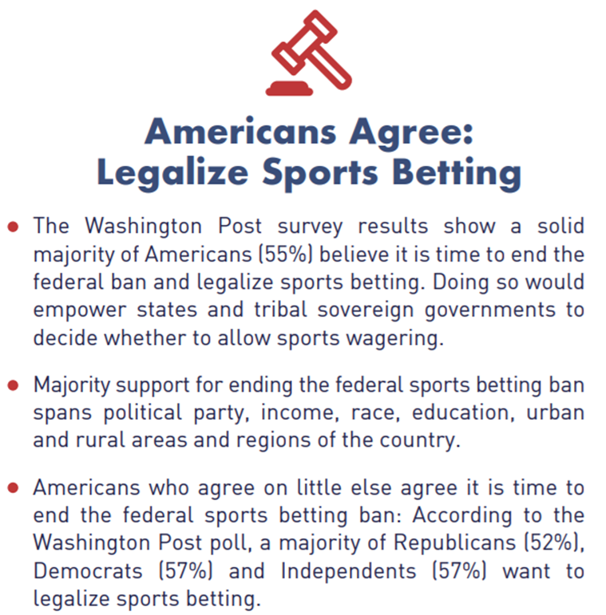
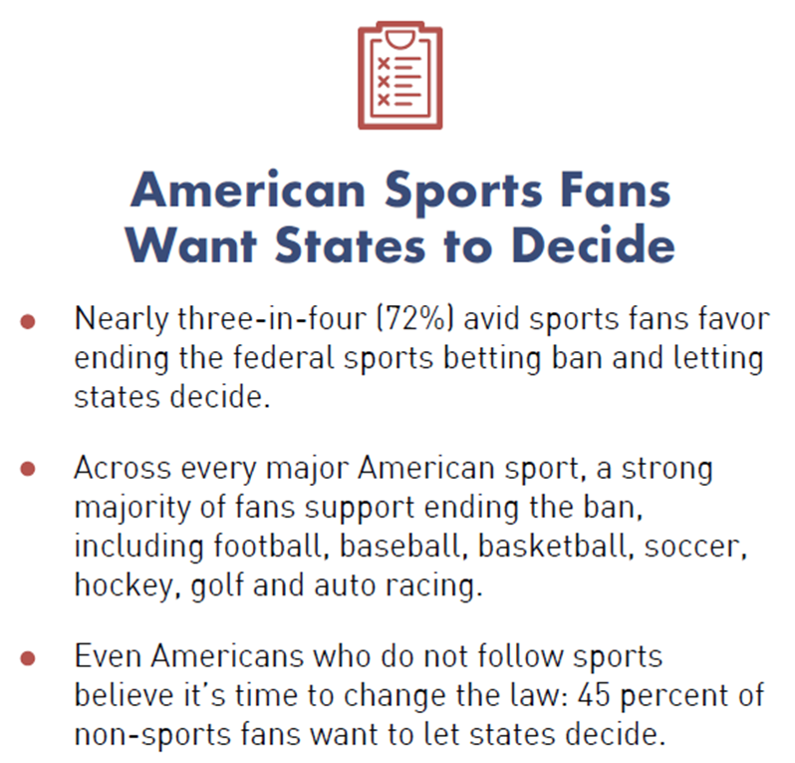
The Existing Illegal Market and Sports Betting’s Popularity
The American public favors legalizing and regulating sports betting – not prohibition

Slide 9
The Existing Illegal Market and Sports Betting’s Popularity
Support for legal, regulated sports betting has evolved within the professional sports leagues, just as it has evolved among the American public. For example:
  NBA Commissioner Adam Silver in a November 2015 New York Times op-ed:
    “…[T]he laws on sports betting should be changed. Congress should adopt a federal framework that allows states to authorize betting on professional sports, subject to strict regulatory requirements and technological safeguards…sports betting should be brought out of the underground and into the sunlight where it can be appropriately monitored and regulated.”
Law enforcement, consumer protection, and other experts on both sides of the aisle agree that the correct approach is regulation and transparency, not quixotic attempts at prohibition. For example:
  “Our nation’s prosecutors address issues of crime every day. Illegal gambling like sports betting is not in a vacuum. It’s tied to large criminal enterprises, money laundering, racketeering, extortion, drug trafficking. Regulating sports betting is a practical way to thwart this illegal activity.”
      Michael Ramos, President, National District Attorneys Association

Slide 10
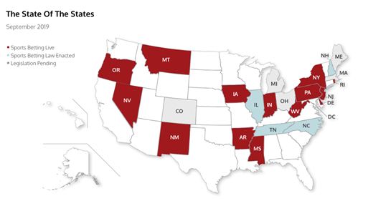
State of Play Under Current Law
Source: GamblingCompliance, September 2019

Slide 11
Presentation Contents
Issue Overview – Opportunities for Lotteries
Sports Betting’s Current Environment
    A Practical Model for Lottery Implementation
    Background on Sports Betting and Federal Laws
    The Existing Illegal Market and Sports Betting’s Popularity
Sports Betting Regulatory Issues
    Benefits of Regulation
    How the Registration Process Works
    Overview of Sports Book Economics
    Specific Considerations for State Policymakers
Summary and Bottom Line

Slide 12
A Regulated Approach Drives Out Illegal Market, Creates Revenue for States and Enhances Sports Integrity
Legal, regulated sports betting brings a number of consumer protection benefits:
  Effectively enforced age limits and self-exclusion and customer education requirements
  Employee responsible gaming training
  Protections against fraudulent, “hit and run” operators
      Maintenance of cash reserves and protection of customer assets
      Official, legal dispute resolution
  Protections against organized crime through licensing and regular auditing of operators that insures integrity and probity
A legal, regulated market brings a suite of economic benefits to host states:
  Taxes on operator gross sports betting revenue
  Income taxes on sports betting customer winnings
  Employee income taxes and other spinoff tax revenues
  In-state capture of sports betting spending
Legal, regulated sports betting enhances sports integrity through:
  Improved transparency and oversight
  Cutting funds into illegal market and removing incentives for manipulation

Slide 13
A Regulated Approach Enhances Sports Integrity, Drives Out Illegal Market, and Brings Economic Benefits
The regulatory mechanics of improved sports integrity
  Keeping fixers’ money and manipulation out of sports is a collaborative effort that brings together the expertise of regulators, betting operators, police authorities and the governing bodies of sports.
  This is the central function of sports betting regulation, which has been accomplished across Europe, in Australia and New Zealand, and in Nevada, New Jersey, and other locations in the US. The US has been an outlier in its prohibitionist approach to sports betting.
Effective monitoring of bets is designed to detect instances of possible match fixing.
      Regulators require such monitoring by operators as a condition of doing business.
      In a typical, modern regulated system, information on bets placed, whether at retail outlets or online, is recorded digitally, and algorithms applied in real time will alert a dedicated team to betting anomalies.
      We and much of the industry advocate an integrity monitoring association focused on suspicious activity notices being widely disseminated across borders, and related MOUs with regulators who will interface as needed with state and federal law enforcement authorities. The Sports Wagering Integrity Monitoring Association (SWIMA) is just such a body, and is now operational in the United States.

Slide 14
Registration and Verification Process – How Does it Work?
IP Geo
Location
Unwanted List scrub and validation
Internal neural network rules validation
SSN validation
Responsible Gaming validation
Geolocation Biometric fingerprinting
AGE & ID
New Technology
Notes:
10/7/2019
14

Slide 15
Registration and Verification Process – How Does it Work?
  Geo-location is defined as the identification of the real-world geographic location of a party
    Used to determine State and Country
    Connection Type (e.g., broadband or dial up connection)
    whether a proxy server or anonymizer is being used and more
  Both Cellular triangulation and WIFI triangulation are the core mechanisms for location control and player location
Geo Location
Sanctions check
  PEP: Worldwide Politically Exposed Persons
  DPL: Denied Persons List –US Dept. of Commerce.
  OFAC watch list – Office of Foreign Assets Control, US Treasury Dept.
  Mortality check and more
Responsible Gaming
  Validation against “Self excluded list”
    Proprietary Operator List
    Operator brick and mortar self excluded list
  By using leading third party providers we are able to determine the age and ID of a player in real time
  Player matching is done on SSN, full name, address, zip code and DOB to validate age and residency
Age & ID
Anti spoofing technology
  We leverage state-of-the-art anti spoofing technology to assure the player cannot mask their location by using or leveraging 3rd party software

Slide 16
Registration and Verification Process -- Why is the marriage of technology and regulation so effective?
Regulation and technology make possible a series of rigorous player identification processes before establishing a new account, and verifying identity at time of play (log-in).
  The identities of adults can be validated through real-time automated crosschecks of existing databases that are not utilized in brick and mortar gambling establishments.
These crosschecks are components of a comprehensive, step-wise Know Your Customer process (KYC) that builds a profile of the prospective sports betting customer. Age verification, identity verification, and cross checking against databases of unwanted persons provides, for operators and regulators alike, a comfort level that each prospective customer is
  who they say they are, and of legal age;
  located in a jurisdiction where the activity is legal; and
  not otherwise barred from participation in regulated sports betting.
Regulators control thresholds for accepting, rejecting, or requiring further KYC information.
  They can impose additional requirements that can further mitigate/eliminate the risk of play by minors or others deemed ineligible.
  In other words, regulatory requirements can “turn up the dial” with respect to unknown or suspicious entrants to a site, which has the effect of minimizing the potential harm if a customer falls into a grey area.

Slide 17
Registration and Verification Process - Evidence that Regulation Prevents Minors from Playing

Slide 18
Registration/Verification Process and Anti Money Laundering Efforts
  Every transaction is recorded, which allows the flow of money to be easily tracked.
  There are a number of reports and checks which are designed to prevent or identify possible money laundering, including:
    Reviewing unusual deposit patterns
    Reviewing unusual cash-out patterns
  Should there be any evidence to support a suspicion of money laundering, the account is immediately suspended pending a full investigation.
  Operators leverage the Know Your Customer (KYC) protocols that all banks must comply with in order to issue credit or debit cards and bank accounts to their customers.
  Any suspicious findings will be submitted to the authorities through the SAR (suspicious activity reporting) process.
  All deposits have wagering restrictions (for example, minimum wagering requirements) so depositing a large sum and trying to cash-out without meeting these restrictions will automatically suspend the cash-out and place the account under review.

Slide 19
Registration/Verification Process and Responsible Gaming Efforts
  A regulated mobile sports betting environment can be even more conducive to effective responsible gaming programs than the bricks and mortar casino environment.
  Online technology provides players with the ability to manage their sports betting in real-time:
    Setting daily, weekly, monthly deposit limits;
    Setting session limits to advise when a time threshold has been hit;
    Setting a cool-off period;
    Allowing players to self-exclude from the site for a defined period of time or forever;
    Fully auditable transaction history (deposits, withdrawals, and wins/losses); and
    Requirements for regulated sites to provide information that promotes awareness about problem gambling and services and resources for those who may have a gambling problem.

Slide 20
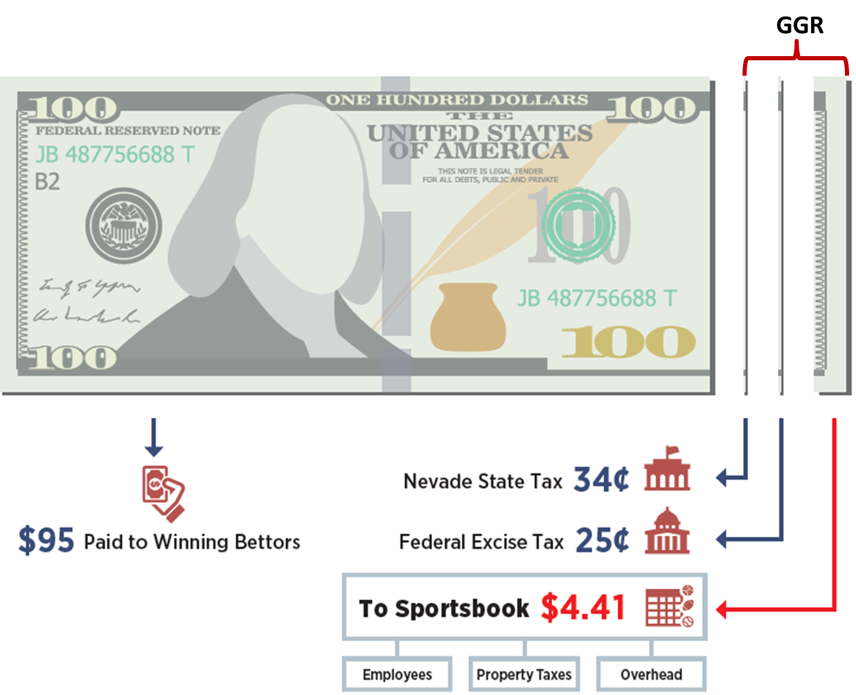
Sports Book Economics – an Overview
Sports Books Economics – Currently in Nevada
On average, a sportsbook’s revenue is only about 5% of the handle (the total amount wagered) before taxes and other expenses. Returns to operators are low, even in a low-tax state.
For every $100 customers bet:
$95 to winning bettors.
$0.34 to the state government, the result of a 6.75% NV tax on GGR
$0.25 to the federal government, as a result of the 0.25% federal excise tax on the handle, the equivalent to a 5% tax on GGR
$4.41 remainder pays licensees, overhead, advertising, payroll, technology, and other expenses. Typically sports books operate on razor thin margins as marketing and payroll normally account up to 40% of revenue.

Slide 21
Sports Book Economics – an Overview
Sports books Economics – Not a Panacea - Nevada Example
  In 2017, NV sports books had $4.9B in sports wagers placed and had $249M in revenue. A retention rate or “hold” of 5.11%
  Over the past twenty years, NV sports books held only 5.42% of sports wagers as revenue.
    Typical or “straight bets” which account for the vast majority of bets hold 4.45% of total wagers at a perfectly balanced sports book. Less frequent bets (parlay, round robins, prop bets, exotics, etc.) have higher hold percentages and help to increase the overall average hold up from 4.45%
    While hold percentages have been higher in some of the new sports betting jurisdictions, as players become more educated the hold percentages will approach those experienced in Nevada.
  Assuming a 5% hold, the black market estimates of $150B wagered annually should account for approximately $7.5B in revenue annually.
  Nevada sports wagering accounts for just 2% of state GGR

Slide 22
Sports Book Economics – an Overview
Risk Management in the Sports Book
    The liability in the sports book is managed in real time by a group of individuals constantly reviewing large amounts of data.
    The goal of a sports book is to manage risk so the game is balanced. A balanced game refers to a situation where there are equal amounts of wagers on each side. In those rare situations, the sports books has no exposure and retains only the premium charged to customers for placing the wager.
    Risk management is more difficult to manage when the market is limited to one state – the situation that would be faced by state lotteries, due to the skewing of bets by residents on local favorite teams.
    Beyond the local favorite issue, the volatility and low margins inherent in the business mean that a state lottery would not infrequently find itself under water for various periods of time with respect to customer wins/losses.

Slide 23
Specific Considerations for State Policymakers
A Reasonable Tax Rate
Goal: Shut down the illegal sports betting market and generate state revenue
Proposal: Charge a reasonable tax on Net Gaming Revenue, recognizing the business’ fundamental economics.
Rationale: Leading economists agree this rate would be necessary to allow regulated sports books to compete effectively with black market operators, allow for significant state revenue generation, keep sports betting revenue within the state, and create business conditions necessary for a low-margin product like sports betting.
A Strong Regulatory Regime
Goal: Effective regulation that protects consumers, ensures transparency, promotes sports integrity, and respects state borders and provisions on intrastate wagering
Proposal: Have Lottery Commission use NJ/NV style regulatory approach as example of successful best practice
Rationale: The regulations in sports betting states are state-of-art and easily transferable to other jurisdictions.

Slide 24
Specific Considerations for State Policymakers
Online/Mobile Betting
Goal: Shut down the illegal sports betting market and provide consumers with a competitive product.
Proposal: Allow sports betting licensees to offer intrastate betting on a mobile device or website.
Rationale: The illegal market will continue to thrive if consumers can’t access a competitive, customer-friendly product. Mobile is also essential to maximizing state revenue opportunity.

Slide 25
Presentation Contents
Issue Overview – Opportunities for Lotteries
Sports Betting’s Current Environment
    A Practical Model for Lottery Implementation
    Background on Sports Betting and Federal Laws
    The Existing Illegal Market and Sports Betting’s Popularity
Sports Betting Regulatory Issues
    Benefits of Regulation
    How the Registration Process Works
    Overview of Sports Book Economics
    Specific Considerations for State Policymakers
Summary and Bottom Line

Slide 26
Summary and Bottom Line
Prohibition doesn’t work -- Americans illegally engage in sports betting today with no consumer protections, no regulatory oversight and no state revenue
Experience in other jurisdictions demonstrates that a legal and regulated approach to sports betting drives out the illegal market, protects consumers., creates a new form of state revenues and boosts law enforcement oversight.
State lotteries may not be the best fit to directly engage in the business due to (i) the low margins involved with sports betting; (ii) the riskiness and exposure of bets, especially with local customers bets likely being skewed in favor of local teams, and (iii) the downside of putting taxpayers’ monies at risk.
A Risk Free Model - States can still participate by issuing a prescribed number of licenses that are risk free, with lotteries partnering with 3rd party providers like Caesars and providing regulatory oversight.
  Licensees would pay a percentage of the revenue (10/15% inclusive of tax) to the state lotteries for the privilege.
  The licensees would be responsible for the risks inherent with the business, leaving the state only with upside and no downside exposure.

Slide 27
Caesars Sports: The Best Choice for Race & Sports Book Management
BRAND AWARENESS, LOYALTY, & MARKETING
The Most Recognized Brand in the industry
55 million customers: CAESARS has the most robust database in the industry.
TR: The Best in the business: CAESARS loyalty program (total rewards) is the #1 loyalty program in the industry…by far!
Marketing gurus: no one markets more efficiently than caesars
Race and sports expertise
Manage 13 sportsbooks in NV for over 20+ Years
Best in class: The CAESARS PALACE SPORTSBOOK IS CONSIDERED ONE OF THE PREMIER SPORTS Books DESTINATIONS IN THE WORLD.
History of sports: CAESARS has hosted some of the most prolific sporting events and matches that have changed history. Bowe, Holyfield, Leonard, and the great Mohammed ali are just a few to call Caesars home.
governmental AND regulatory Prowess
Licensed in 19 jurisdiction and 5 countries
Influence & integrity: well respected company with the utmost integrity possessing unparalleled experience in KYC, AML, state regulatory, state legislative affairs, and federal legislative affairs.
Responsible Gaming: pioneer and innovator through EMPLOYEE training, I.T. investment, AND ENTERPRISE-WIDE SYSTEMS

