Slide 1
Communities In Schools of Georgia
The State’s leading organization in dropout prevention and wraparound services.

Slide 2
CIS – Who Are We?
Communities In Schools' (CIS) mission is to surround students with a community of support, empowering them to stay in school and achieve in life. For 40 years, CIS has been dedicated to empowering at-risk students to stay in school and on a path to a brighter future.
Working directly inside more than 161 schools and 7 community sites across Georgia, CIS connects kids to caring adults and community resources designed to help them succeed. CIS does whatever it takes to ensure that all kids – regardless of the challenges they may face – have what they need to realize their full potential.

Slide 3
CIS – Who Are We?
Based directly inside schools, Communities In Schools connects students and their families to basic and critical educational and community-based resources, tailored to each student’s specific needs.
Site Coordinators work with administrators to develop plans and build teams to give students the support and encouragement they need to unlock their potential.
By implementing the CIS Model with high fidelity, CIS provides proven, effective and adaptable services for students based on their individual needs.

Slide 4
What Differentiates Us
CIS has the evidence and research to show how schools can leverage CIS to implement Community Schools and get great results for students. Evaluations of the CIS model are often cited by the Coalition of Community Schools as evidence that the Community Schools model works.
After years of investment in perfecting and proving our model, CIS has emerged as a nationally recognized leader in evidence-based ISS. CIS has a national track record of lowering dropout rates and improving graduation rates, and we know that CIS is uniquely qualified to partner with schools to ensure the best possible outcomes for all students in a community school.
CIS has developed an evidence-based training curriculum for site coordinators and additional practitioners, having trained over 1,000 practitioners.
The Georgia Dept of Audit and Accounts Performance Audits Division cited the State's return on investment in CIS of Georgia is estimated at $18:$1 for a high school graduate over his or her lifetime.

Slide 5
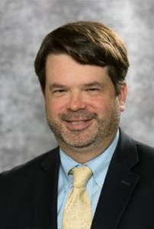
Why I Support
Robert "Trey" Ragsdale
CIS of Georgia Board Chairman, 2019-2020
Trey Ragsdale manages Local Government & Community Relations for Kaiser Permanente in Georgia. Prior to his role at Kaiser Permanente, Trey held leadership positions at MARTA, United States Senate, King & Spalding Law Firm, The Coca-Coca Company and The White House.
Trey is a Georgia native who has been involved for over two decades in improving the world around him at the local, state and national levels as a business and community servant, entrepreneur, author & speaker and mentor.

Slide 6
Communities In Schools of Georgia
2019-2020 Board of Directors
BOARD OFFICERS
Mr. Robert “Trey” Ragsdale III, Chairman
Kaiser Permanente
Mr. Edgar Moore, Jr., Vice Chair
Frazier & Deeter, LLC
Ms. Jennifer Johnson Burns, Secretary
Equifax
Ms. Paula Goodman, Immediate Past-Chair
Best Buy Stores
BOARD MEMBERS
Mr. Jason Carr
PNC Bank
Ms. Anya Chambers
Crossfit Downtown Atlanta
BOARD MEMBERS
Ms. Kathleen Edge
Southwire
Mr. Kip Farlow
Walmart
Mr. Robert Gaines, II, Ph.D.
Georgia Partnership for Excellence
in Education
Mr. Nathan Lewis
Security Capital Brokerage, Inc
Mr. Joseph Lillyblad
Southern Company/Georgia Power
Ms. Barbara Miller
Federal Home Loan Bank of Atlanta
BOARD MEMBERS
Mr. Joshua Morreale
Osborne High School
Ms. Arlethia Perry-Johnson
Retired, Higher Education Executive
Mr. Juan Sanchez
Federal Reserve Bank of Atlanta
Fredrick Bailey, CIS Alum
Milliken Policy Fellow
Britney Tigner, CIS Alum
Piedmont Hospital

Slide 7
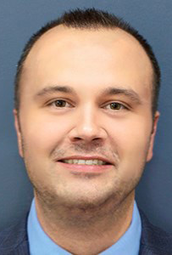
Why I Support
Jamie Jackson
CIS of Georgia in Troup County, Advisory Council Member, 2019-2020
Jamey Jackson is the Executive Vice President at Malone Workforce Solutions, based in LaGrange, Georgia. For more than 15 years Jamey has been focused in talent acquisition within the manufacturing industry, holding account management roles with Toyota Motor Engineering North America (TEMA) and Toyota Motor Manufacturing Kentucky (TMMK).

Slide 8
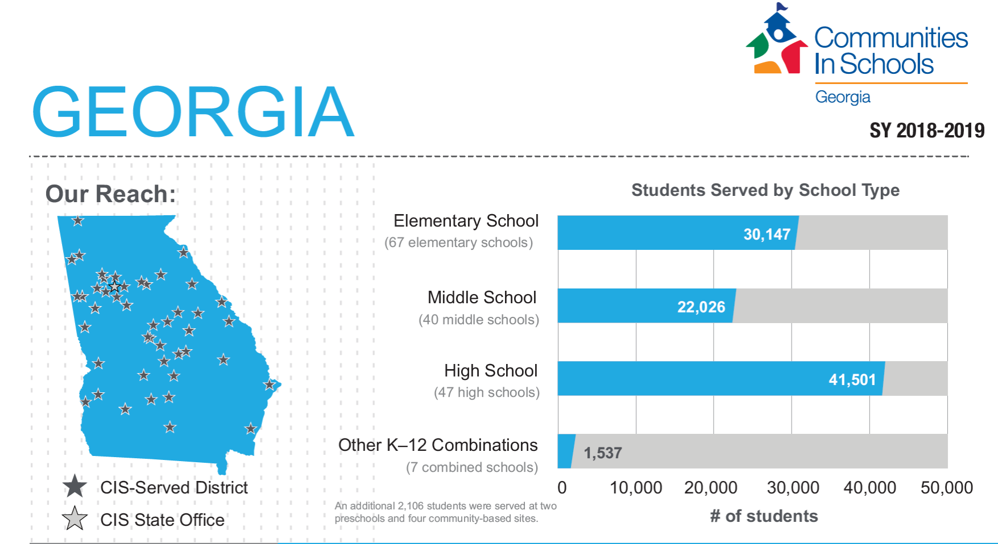
Our Impact

Slide 9
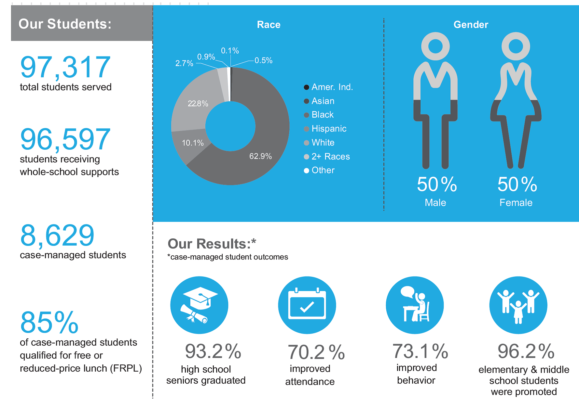
Our Impact

Slide 10
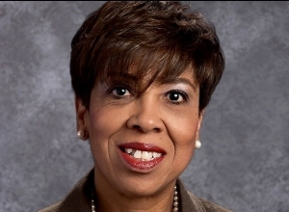
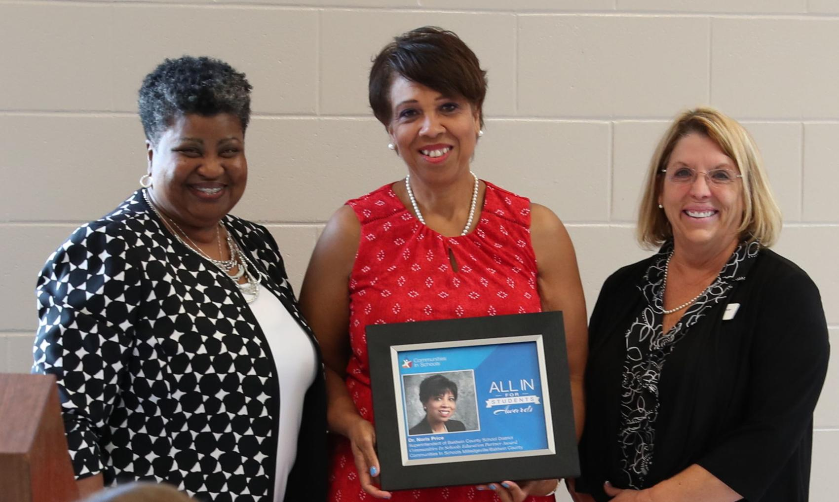
Why I Support
Dr. Noris Price
Superintendent, Baldwin County Schools
Dr. Noris Price, Baldwin County Schools superintendent, has been selected as the 2019 Communities in Schools “All In for Students Award” recipient and was acknowledged at the CIS Leadership Town Hall in Chicago, IL.
When Price came on board as Baldwin County’s school superintendent in 2014, the graduation rate stood at just 66 percent. Since then the figure has risen astronomically to 92 percent where it stood last year.
“Thank goodness for Communities in Schools and their dedicated site coordinators who support our children so they can walk across the stage and be successful in life and have options. I can't imagine Baldwin without CIS, which is why I have invested to ensure every school in Baldwin County has a site coordinator.”

Slide 11


CIS as a Community School Model
CIS can be an example of a lead agency broker and fill the Community School Model's staff role.
In this scenario, CIS delivers our model, brokers in community services and partners, and engages families and communities. Our caseloads are maintained, and CIS comprehensively fulfills the needs assessment, planning and monitoring roles.

Slide 12
CIS and Community Schools: The Connection
There are four (4) pillars that appear in most community schools and support the conditions for teaching and learning found in high-quality schools:
  Integrated student supports
  Expanded learning time and opportunities
  Family and community engagement
  Collaborative leadership and practice
These pillars were identified in a 2017 study published by the Learning Policy Institute and are recognized by the Coalition for Community Schools.
CIS is an evidence-based model for integrated student supports, which is one of the four pillars of a Community School.
Communities In Schools is a national partner of the Coalition of Community schools and sits on its national Board of Trustees.

Slide 13
CIS as a pillar of a Community School
In some communities, CIS works with district leadership to be the lead partner and offer support to the district to help implement all four pillars.
CIS is the leading example of an Integrated Student Support provider within a Community School where a district or another organization fills the Community School staff role. In this scenario, another agency (like United Way) may hire a CS Director to coordinate community level services, work on teaching and academic supports, and strategies to co-locate more community resources that help the school extend the school day.
CIS DELIVERS our model through three tiers of supports, CONTRIBUTES to monitoring and coordination conversations, ENGAGES communities and families, and BUILDS a caseload of students to support.

Slide 14
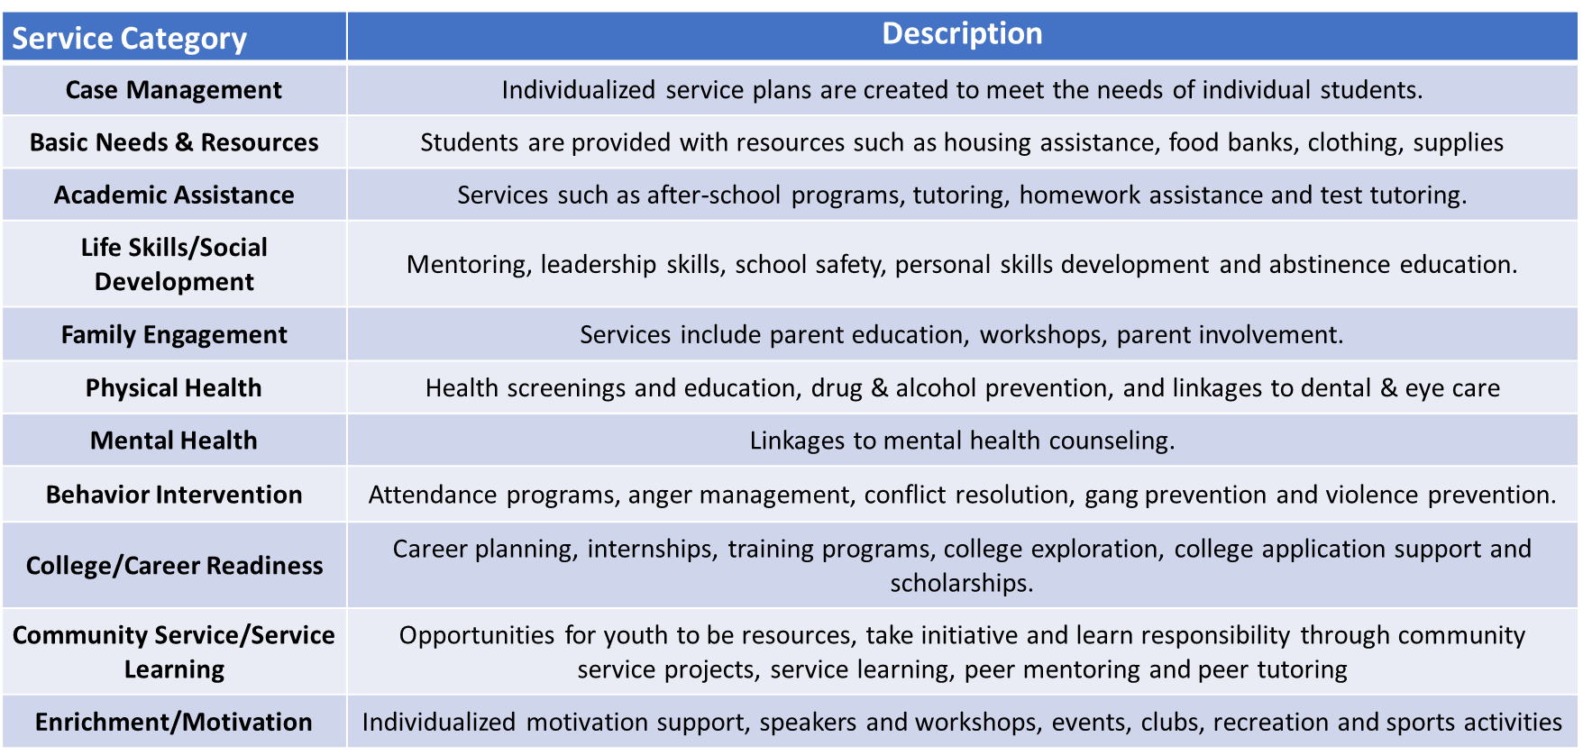
Communities In Schools Services
Notes:
Leverage strategic partnerships with social services agencies, non-profit organizations, healthcare providers to support students' non-academic needs, including their physical, emotional, social and psychological needs
Ultimately improve a school climate and student achievement by supporting students’ non-academic needs.

Slide 15

Notes:
Leverage strategic partnerships with social services agencies, non-profit organizations, healthcare providers to support students' non-academic needs, including their physical, emotional, social and psychological needs
Ultimately improve a school climate and student achievement by supporting students’ non-academic needs.

Slide 16
Questions and Answers

