Slide 1
THE RISK TO GEORGIA BUSINESSES AND LANDOWNERS POSED BY NEGLIGENT
SECURITY CASES
William V. Custer
Bryan Cave Leighton Paisner, LLC
Notes:
My name is Bill Custer.
Litigator with Bryan Cave. I represent Georgia businesses, large and small in a variety of business disputes.
I’m on the Board of Directors of the Georgia Chamber and serve on its Amicus Committee. I’m on the Board of Georgians for Lawsuit Reform.
While I frequently represent various trade groups and business groups, I am not here on behalf of any particular group or company today.
Nonetheless, in these various roles, I am very familiar with the issues of the civil justice system that give Georgia businesses concerns and I’m here to talk about one of those issues today.
I‘ve been asked to speak to the current crisis in negligent security cases which is literally changing the landscape of tort liability and insurance issues in Georgia.
The views I am going to express are solely my own. I am not being compensated by any group or company for my time today

Slide 2
Summary of the Problem
Violent crimes occur every day in Georgia.
Increasingly, the victims are suing the owner of the property where the crime occurs.
The victims claim the landowner was negligent in providing security.
Courts are awarding tens of millions of dollars against landowners for injuries from the crime – not the criminals directly responsible.
Anyone who owns a business or property is at risk including homeowners, convenience stores, apartment complexes, and grocery stores.
Notes:
What is the problem?
Violent crimes occur every day in Georgia.
People are seriously injured.
While these cases were occasionally brought against landowners in the past, the numbers of these cases being filed is increasing.
The verdicts against businesses and landowners are in the tens of millions of dollars.
The liability being imposed on businesses and landowners is completely disproportionate to their level of fault.
Indeed, as we shall see, in many of these cases, the person most responsible for the crime, the criminal bears none of the fault.
Insurers are, not surprisingly, well aware of the problem and, at least anectdotally, we see insurers are considering not providing coverage for torts arising from these crimes or are imposing strict limits on the amounts that they will insure.
Any Georgia citizen who owns property is at risk.

Slide 3



The Headlines Tell the Story….
Notes:
Some of you do not cover the legal press, but legal departments, businesses, and insurers in Georgia and all over the country are well aware of the crisis in Georgia through publications like the American Lawyer and similar publications.
And the headlines tell the story….

Slide 4
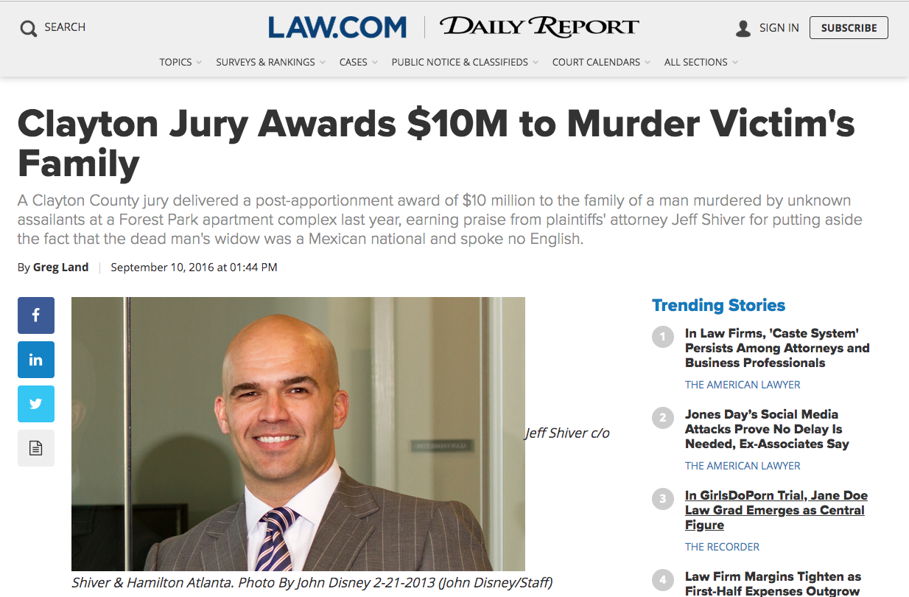
2016
Notes:
$10 million against the owner of an apartment complex for a murder committed on the property.

Slide 5
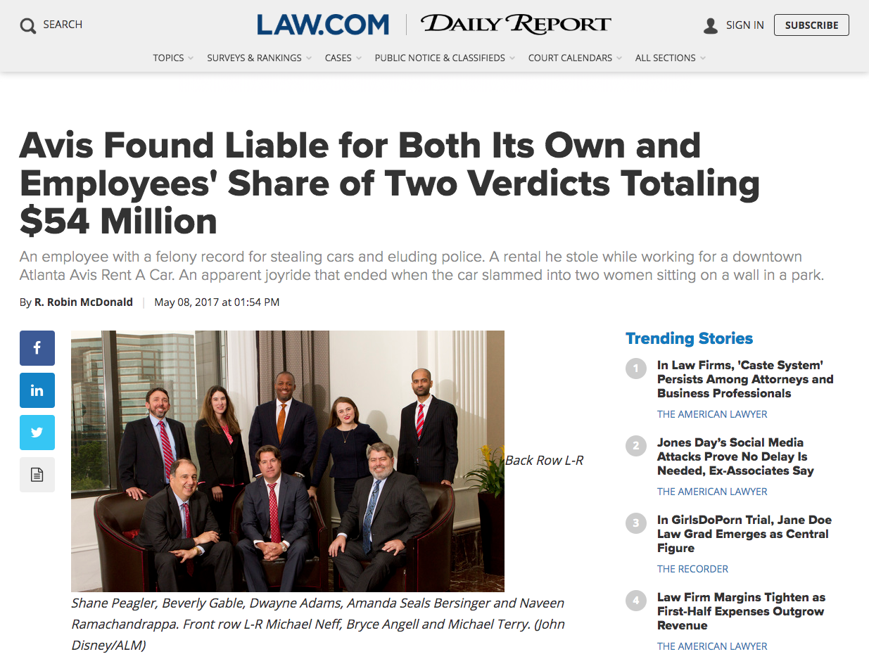
2017
Notes:
$54 million against a rental car company, where an employee stole a car from his employer, got drunk, and ran into the plaintiff hours later.

Slide 6
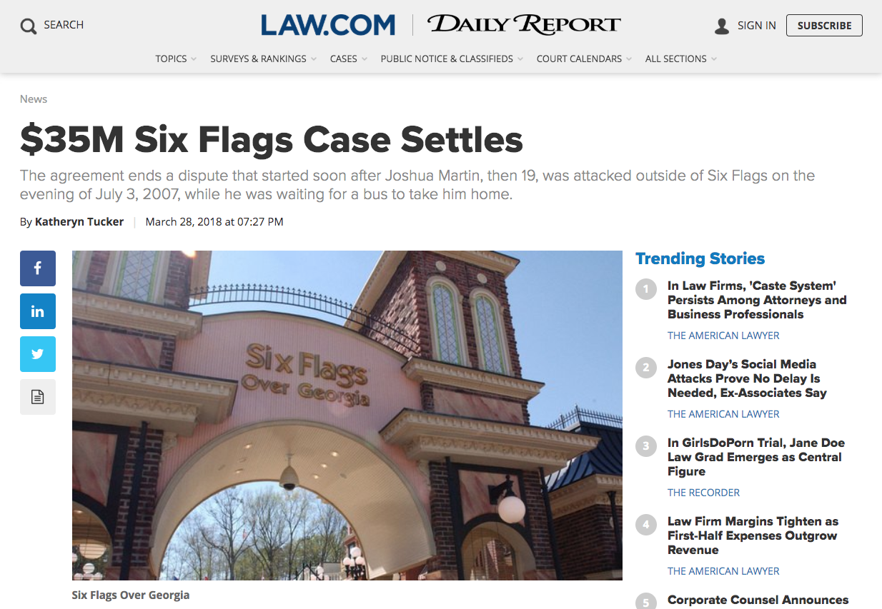
2018
Notes:
$35 million against six flags for a man who left six flags and was beaten up and hour later off property.

Slide 7
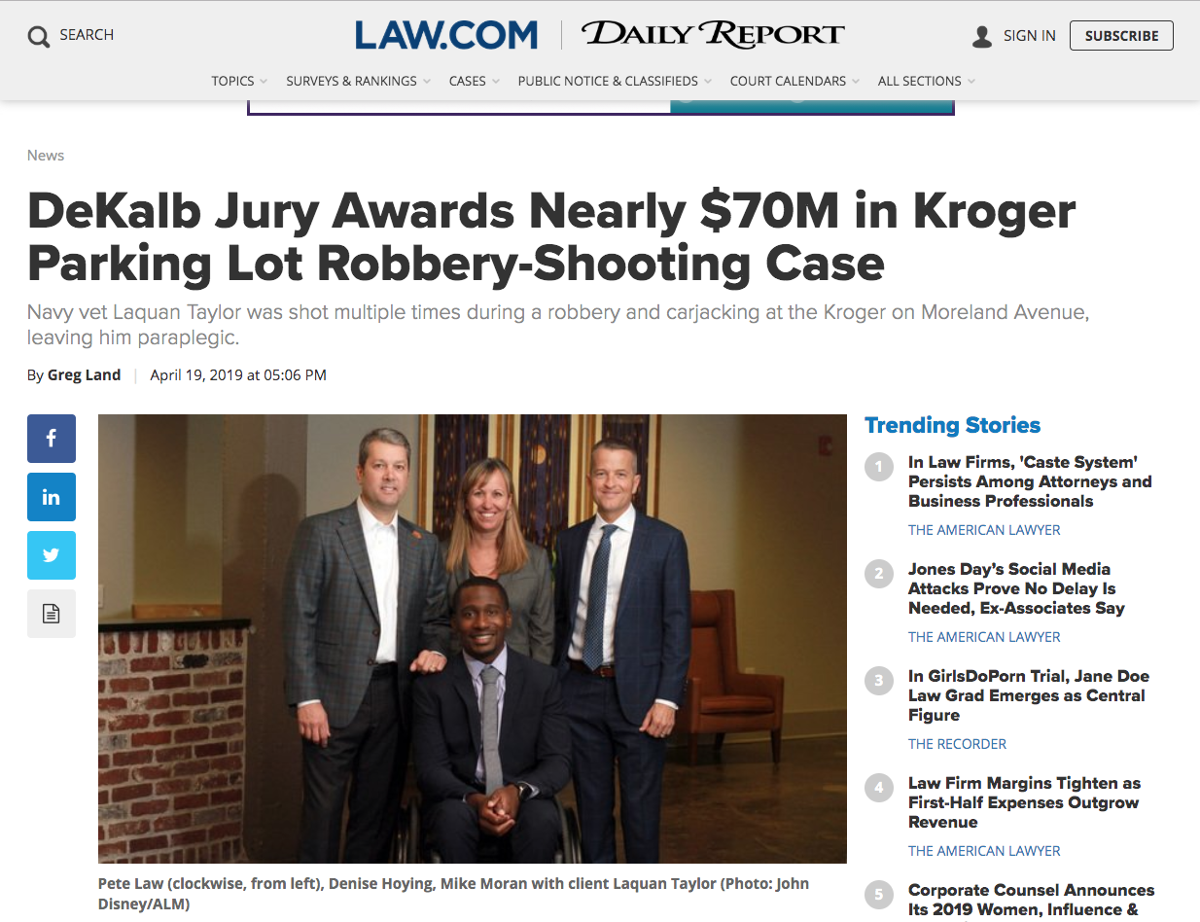
2019
Notes:
$70 million against Kroger where a man was robbed and shot in the parking lot.

Slide 8
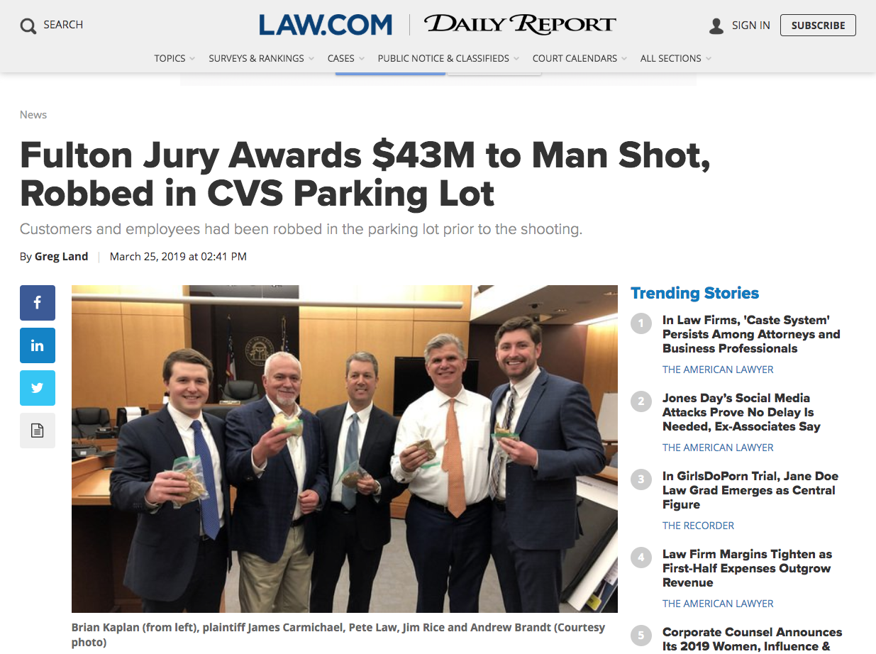
2019
Notes:
$43 million against CVS where the plaintiff was shot in the parking lot.

Slide 9
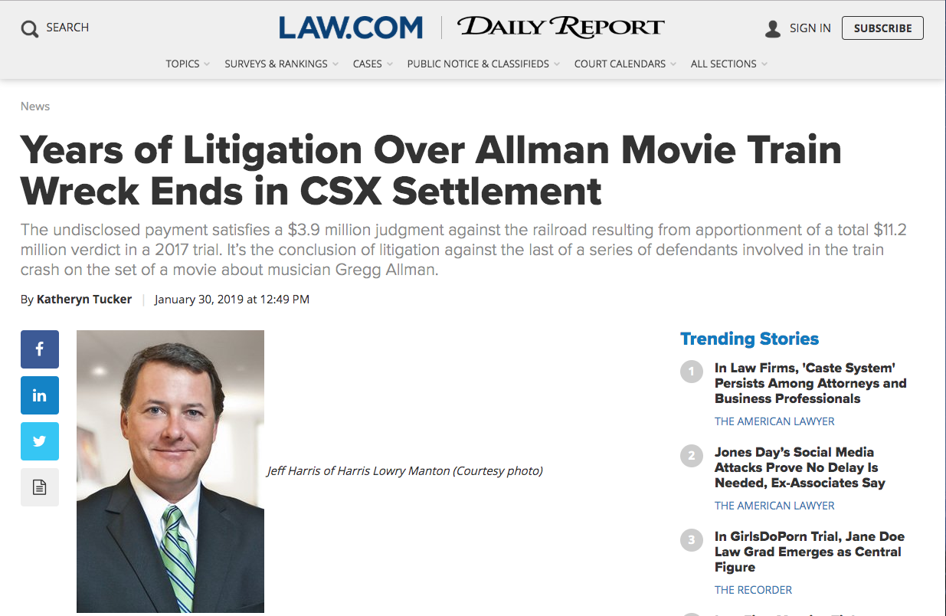
2019
Notes:
$35 million against CSX and others where a movie company trespassed onto CSX and was hit when the train came through.

Slide 10
Four Case Studies of Premises Liability
The Kroger Case – Even if you have security guards.
The CVS Case – Even if the plaintiff is not your customer and the store closed.
The CSX Case – Even if the plaintiff is trespassing on your property.
The Six Flags Case – Even if crime occurs off your property an hour after closing.
Notes:
I want to talk to you about four cases in particular to emphasize how liability for landowners is being dramatically expanded by the courts.

Slide 11
The Kroger Case
Attack on the plaintiff occurred in parking lot of Kroger located on Moreland Avenue.
Kroger had hired a security guard company to monitor security at the store.
When the plaintiff arrived at the store, he was immediately attacked by two men who took his wallet and car keys and shot him between 11 and 14 times.
The jury awarded $81 million in damages against Kroger, finding Kroger responsible for 86% of the fault, but finding the attackers responsible for only 14 percent of the fault.

Slide 12
The CVS Case
Attack on the plaintiff occurred in CVS parking lot located on Moreland Avenue.
Plaintiff traveled to Atlanta from Alabama to buy and sell refurbished electronics. He received a call from a man asking to meet at CVS to discuss sale of an iPad.
At the meeting, which took place after hours, an unknown man jumped into the plaintiffs’ car and demanded his wallet.
The two men then exchanged gunfire and the plaintiff was injured.
The Jury awarded $45 million in damages to the victim with 95 per cent of the fault allocated to CVS.

Slide 13
The CSX Case
The plaintiff was working on a movie set located on the Doctortown, Georgia railroad trestle as part of the filming of the Greg Allman biopic “Midnight Rider.”
CSX had previously refused permission to film on its tracks – the film crew went onto the tracks anyway.
A regularly scheduled train operated by CSX interrupted filming and plaintiff was killed when the engineers were unable to stop the train in time.
The movie director was convicted of manslaughter and criminal trespass.
The Jury awarded $11+ million dollars in damages but apportioned the majority of the fault, 35%, to CSX.

Slide 14
The Six Flags Case
The plaintiff attended Six Flags amusement park during the day.
After the plaintiff emerged from Six Flags, he travelled to a nearby hotel and then returned to a CCT bus stop located just off of the Six Flags property.
Some 40 to 50 minutes after Six Flags closed and plaintiff left, gang members attacked plaintiff at the CCT bus stop and he was severely injured.
The jury awarded $35 million in damages and placed 92 percent of the blame on Six Flags and 8 percent on the gang members.
Notes:
These are just the verdicts.
For every verdict , there are likely dozens of settlements.
These cases are having dramatic impacts on settlements as well.

Slide 15
Why Does This Happen?
Victims are sympathetic.
It’s currently easy to bring these claims and assert that the landowner is negligent in failing to protect victim.
The Landowner may be found liable if it is “reasonably foreseeable” the crime would occur based on prior substantially similar crime in the area.
Juries are told at trial that if they hold the criminal at fault, the victim will not be fully compensated.
Lawyers for the victims are allowed to tell juries not to assign any significant fault to the criminals.

Slide 16
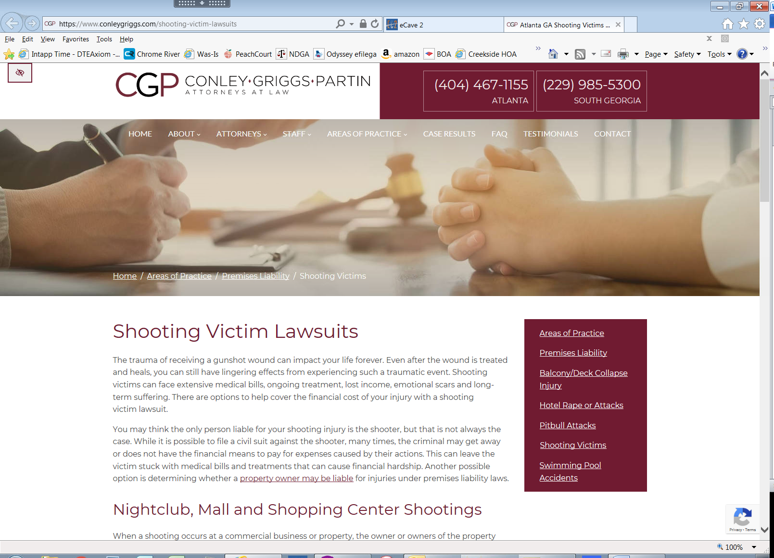
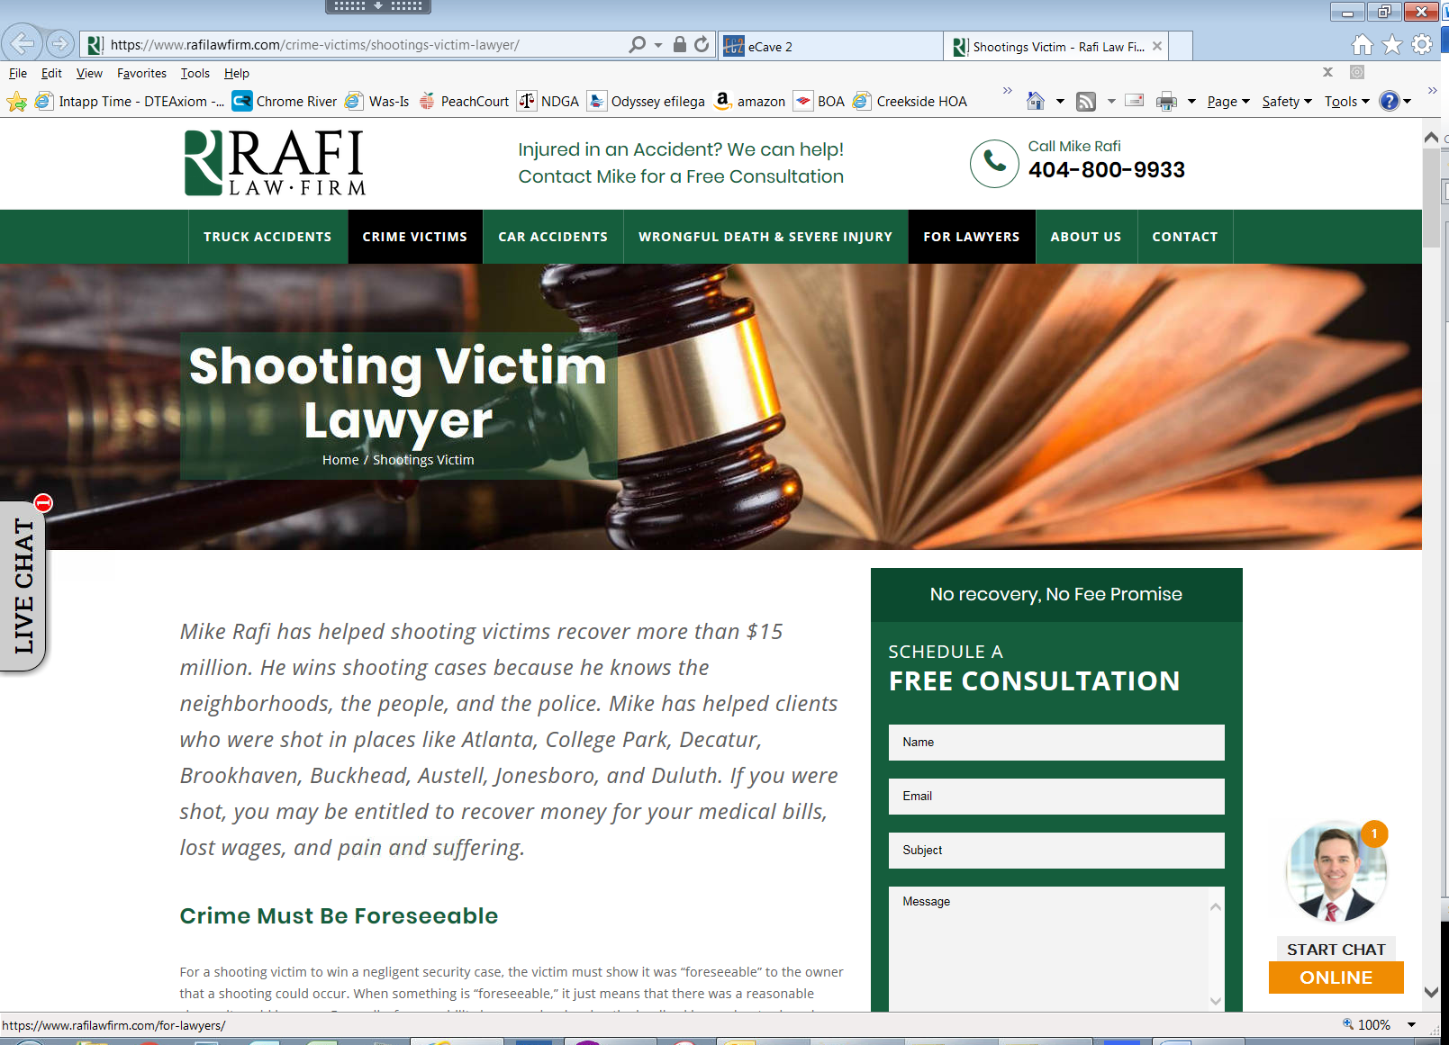
Because its Perceived to be Easy Money, A New Cottage Industry Has Emerged for Shooting Cases.

Slide 17
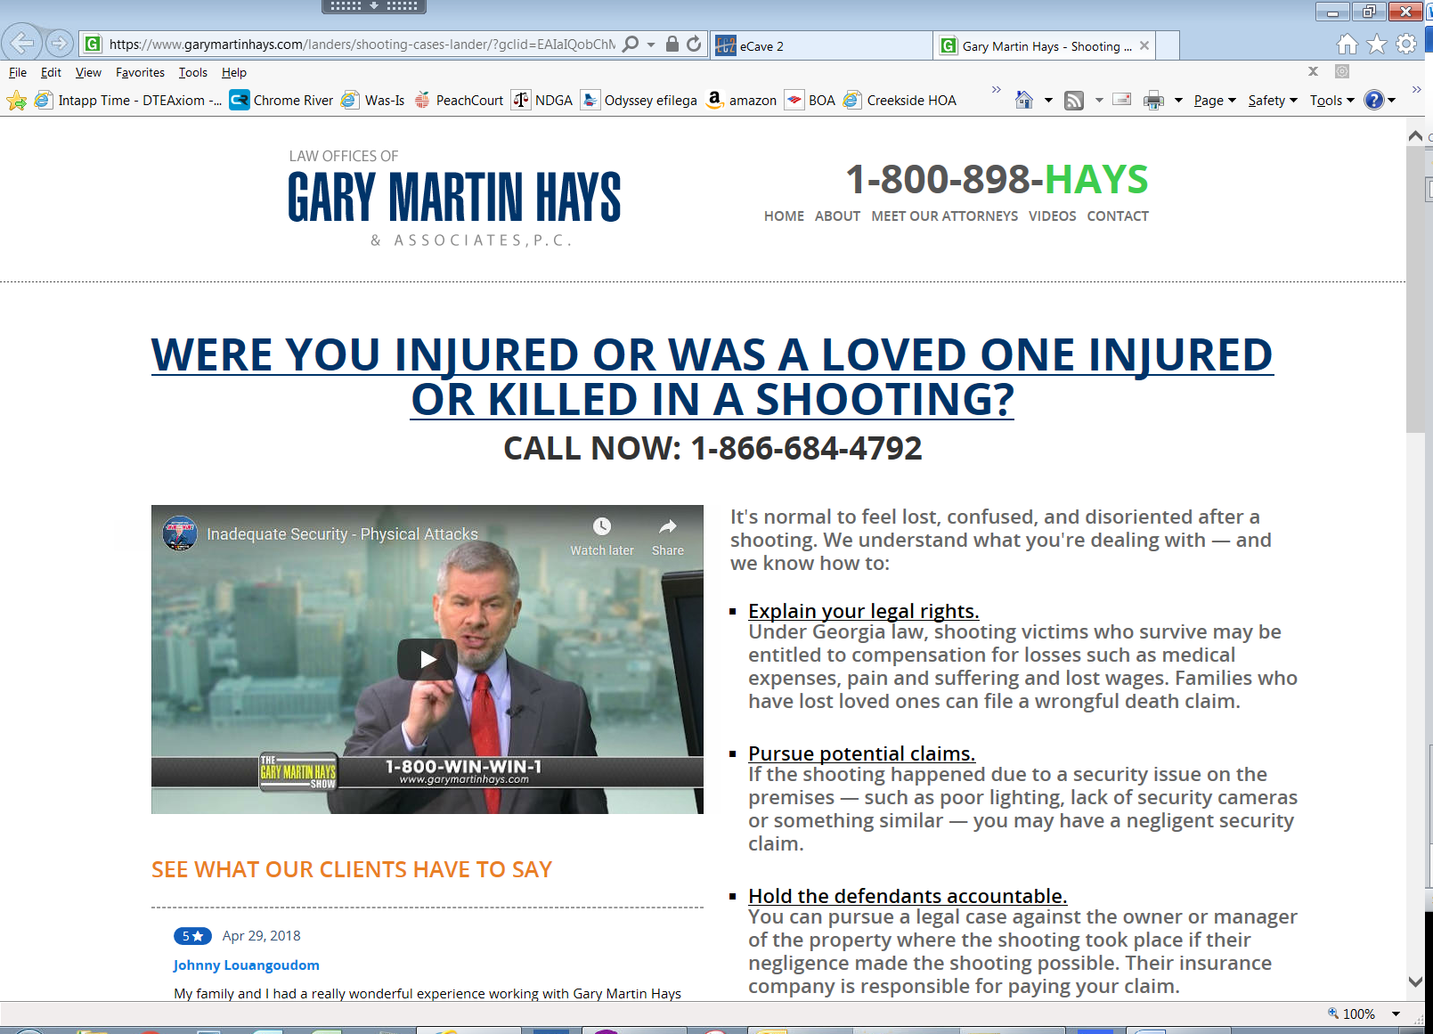
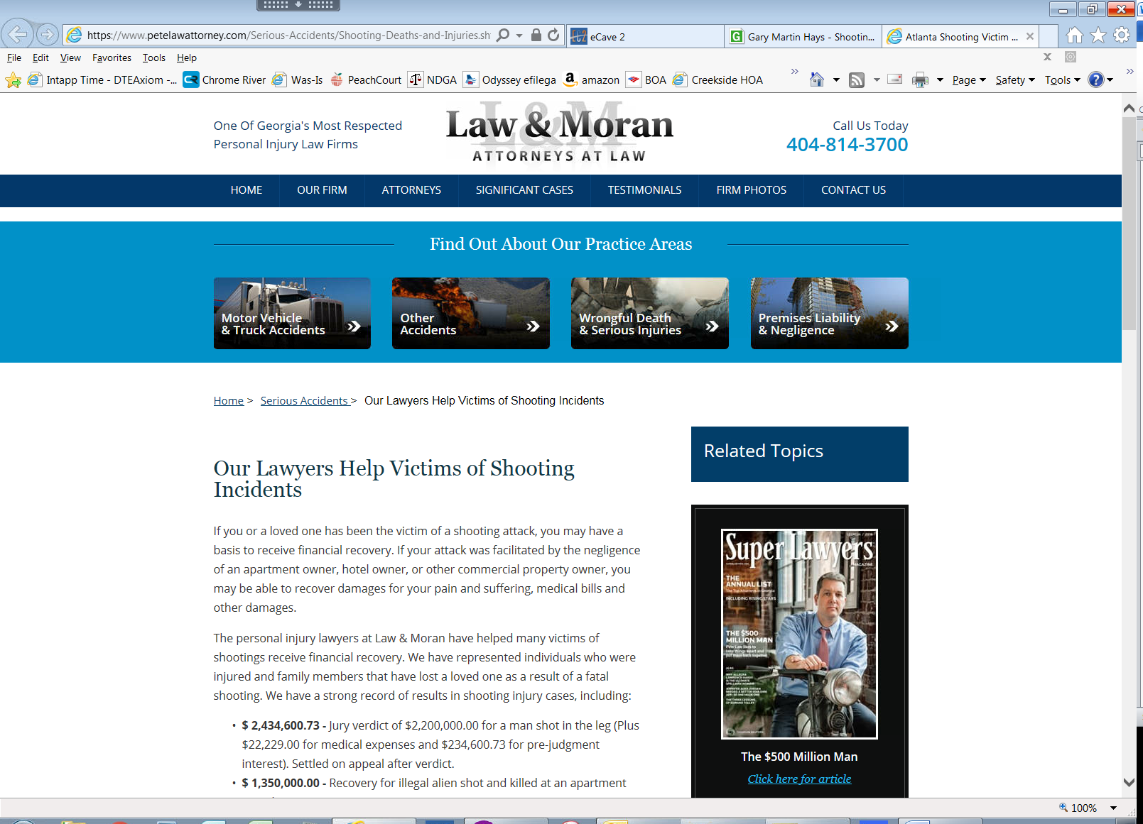
“Were You Injured in a Shooting?”

Slide 18
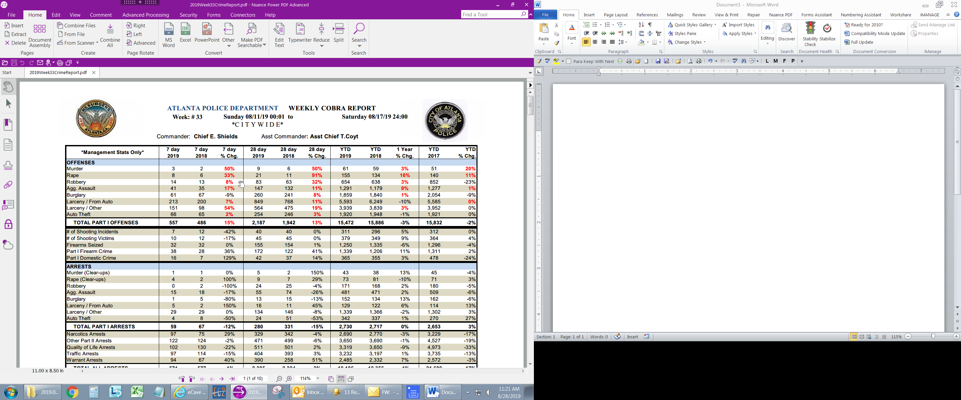
And The Industry Has Plenty of Fodder….

Slide 19
Consequences of the Crisis
Every property owner in Georgia is at risk.
Insurance is increasingly difficult to obtain for these claims, limited, or more expensive.
Small “mom and pop” businesses are particularly at serious risk.
There will continue to be a lack of investment in the high crime communities that need it most.
The reputational damage to the business environment for Atlanta and Georgia is significant.

Slide 20
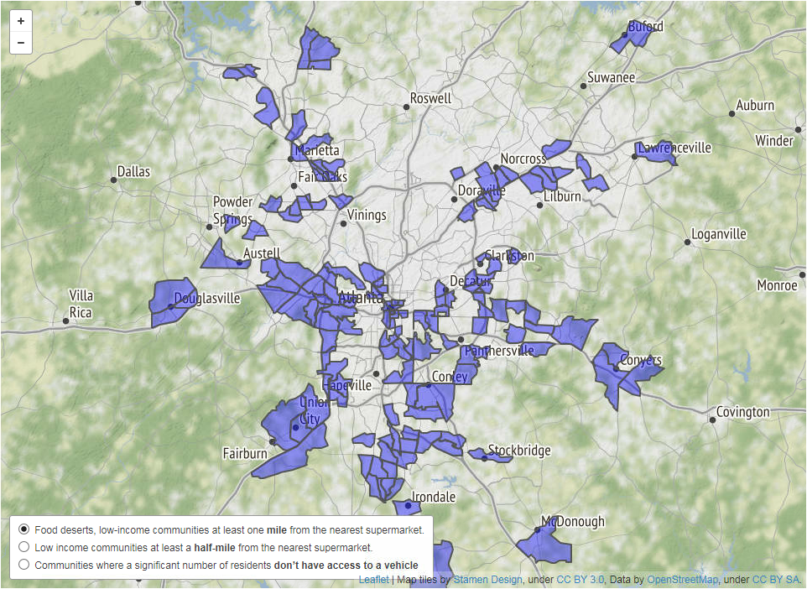
Food Deserts in Atlanta
Atlanta Journal Constitution at https://www.ajc.com/news/food-deserts-map/

Slide 21
What are the Solutions?
Adopt tougher standards for bringing these claims.
  In Alabama, a business owes its customers a duty to exercise ordinary care to protect them from third-party criminal conduct only if the business is aware of a specific imminent harm about to befall them. See Bailey v. Bruno’s, Inc. 561 So. 2d 509, 511 (Ala. 1990).
Set guidelines for security and give businesses a presumption against liability if they follow them.
  Florida has done this for convenience stores. See Fla. Stat. Ann. §768.0705.

Slide 22
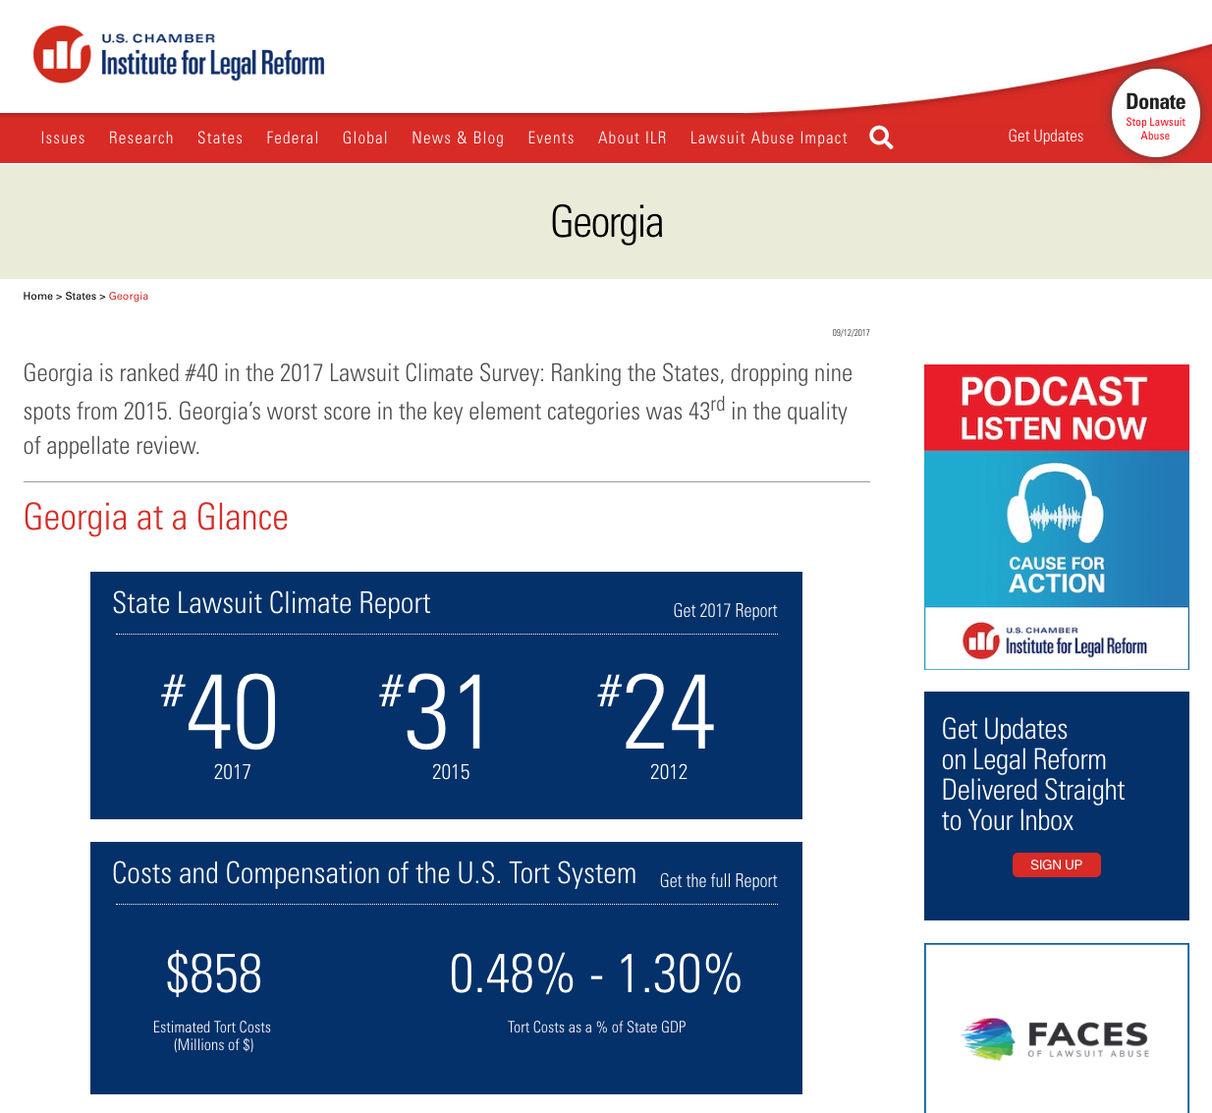
The U.S. Chamber Rates Georgia

Slide 23
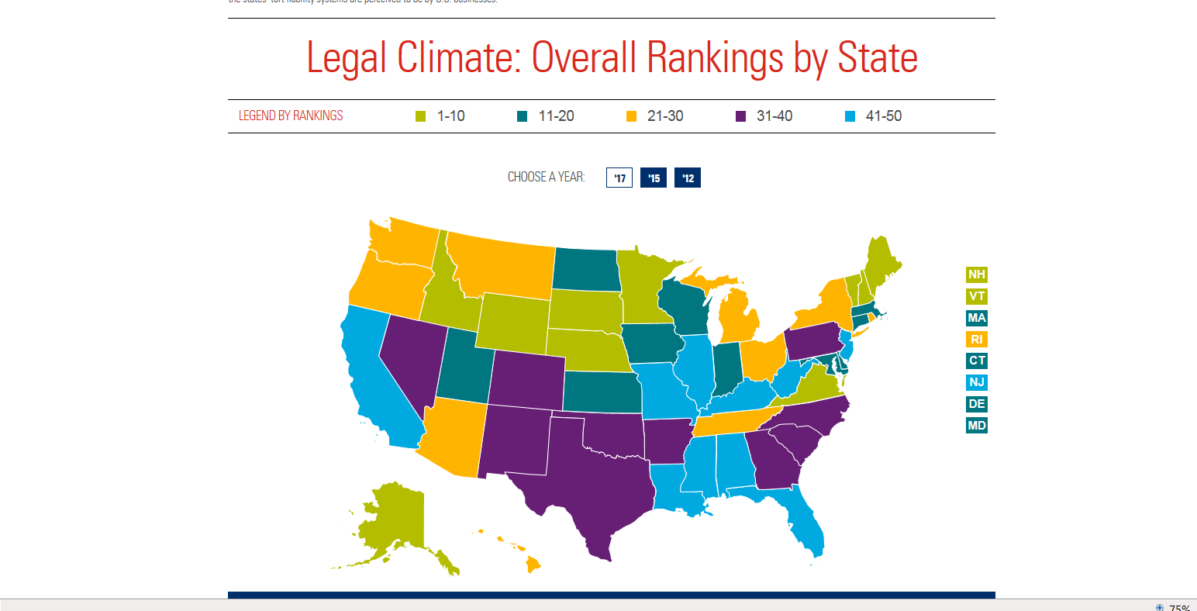
How Georgia Compares to its Sister States

Slide 24
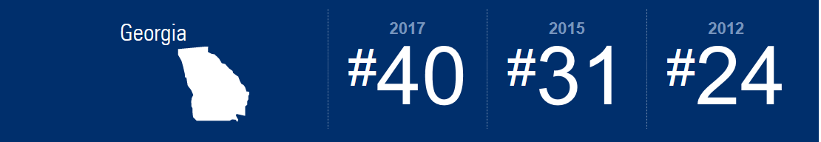
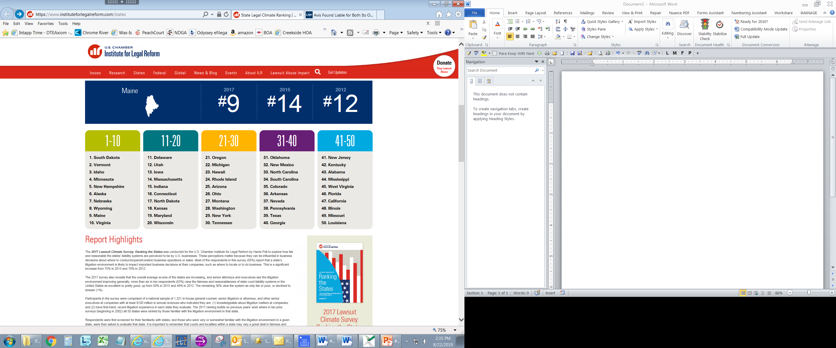
How Georgia Compares to its Sister States

Slide 25

American Tort Reform Association

Slide 26
Judicial Hellholes of 2018-19
1. California
2. Florida
3. New York City
4. St. Louis, Missouri
5. Louisiana
6. Philadelphia Court of Common Pleas
7. New Jersey Legislature
8. Madison and St. Clair Counties, Illinois
9. Twin Cities, Minnesota
10. Oklahoma

Slide 27
ATRA Puts Georgia on Watch List
ATRA also included seven (7) jurisdictions on its “watch list,” including:
Colorado,
Georgia,
Montana,
Newport News, Virginia,
Ohio,
Pennsylvania, and
West Virginia.

Slide 28
Conclusion
QUESTIONS?

