Slide 1


Department of Community Health’s Technology Project Update
Presentation to: The Joint Study Committee on Transparency and Open Access in Government
Presented by: Joe Hood, Deputy Commissioner
Date: September 8, 2017

Slide 2

Mission
The Georgia Department of Community Health
We will provide Georgians with access to
affordable, quality health care through
effective planning, purchasing and oversight.
We are dedicated to A Healthy Georgia.

Slide 3
Current Large IT Initiatives at the Department of Community Health
The Department currently has three IT Initiatives that are in various stages:
Enterprise Data Solution (EDS) Replacement of the federally required data warehouse which houses Medicaid and State Health Benefit data. | Pending Procurement Negotiations and Budget
Electronic Visit Verification (EVV) A new federally required GPS location software and/or app to provide real-time transmission of Home Health Medicaid Services. | Procurement Process under Development
Medicaid Management Information System (MMIS) Replacement Replacement of the existing Medicaid claims system platform to allow the development of a new federally required modular system. | Contract in progress to prepare a strategy

Slide 4
DCH Large IT Initiatives
Enterprise Data Solution
(EDS)

Slide 5
Enterprise Data Solution (EDS)
A Decision Support System (DSS) is a federally mandated component by the Centers for Medicare and Medicaid Services (CMS). Georgia’s proposed DSS is known as the Enterprise Data Solution and will be a component of the state’s Medicaid claims processing IT system, known as the Medicaid Management Information System (MMIS).
Combining Georgia Medicaid and State Health Benefit Plan claims data will create a significant research database to allow for the analysis of “Population Health” data. The data warehouse will provide a means to research specific health policy questions for our state.
There are more than 20 terabytes worth of data, covering over 10 years of claims.

Slide 6
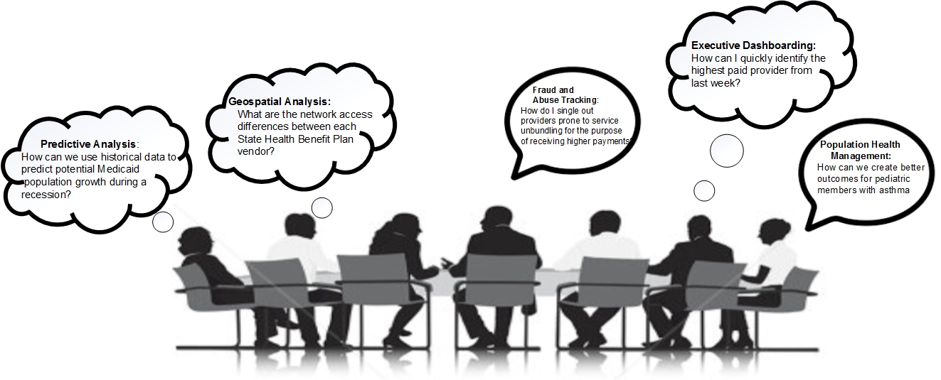
The thoughts that drive the need for an EDS

Slide 7
Current Decision Support System
Current System is a legacy system (more than 15 years old) under contract with Truven (IBM Watson Health)
Primary Challenges:
  The system does not meet federal requirements of modularity and therefore CMS will not approve a contract extension, or support the system with ongoing federal funds
  There are limited and disparate analytical tools within the existing system, which requires significant data manipulation with 3rd party software to answer and present data extracts
  Proprietary software that lacks compatibility to interface with other systems such as Georgia Health Information Network (GaHIN), which is the primary tool DCH is leveraging to move data between physicians and organizations, such as our Care Management Organizations (CMOs)
  The current data warehouse design lacks the flexibility required for complex data analysis

Slide 8
Status of the EDS Procurement
History/Status
2 year procurement process to date
The contract is under negotiation with the state partner agencies (GTA and DOAS)
Contract will be contingent upon federal and state matching funds availability
New System will provide:
A federally compliant system which is eligible for 90% federal funds for development and implementation for the Medicaid portion (excludes SHBP);
A system that is compatible with new open interfaces allowing for GaHIN, SHBP, and other data sources to be added; and
Integrated tools and platform that allow for real-time response to data queries.

Slide 9
DCH Large IT Initiatives
Electronic Visit Verification
(EVV)

Slide 10
Electronic Visit Verification (EVV)
Electronic Visit Verification (EVV) is a computer-based system that electronically verifies the occurrence of home health services by documenting the precise time the service begins and ends
Different vendors offer system approaches. Commonly utilized features:
  GPS to verify the location
  Smart phone or Tablet with a software app to log the start and end times of service
  May allow for other data to be transmitted such as service billing codes
EVV is a Centers for Medicare and Medicaid Services (CMS) requirement for state Medicaid programs
It was passed as part of the 21st Century Cares Act
The Act requires compliance by 1/1/2019
The procurement planning is underway and the overall procurement is subject to CMS federal fund approval and state funds matching approval

Slide 11
DCH Large IT Initiatives
Medicaid Management Information System
(MMIS)

Slide 12
Medicaid Management Information System
(MMIS)
  The Medicaid program supports over 1.8 million members, 100,000 providers and pays claims amounting to more than $9 billion per year
  The core Medicaid Management Information System (MMIS) consists of 19 applications and is supported by another 30 that provide the following services:
    Medicaid claims payment
    Care management
    Data management, reporting and analytics
    Fraud detection and quality management
    Provider and member management
    Prior authorization of services and appeals

Slide 13
CMS Modularity Mandate
In December, 2015, the Centers for Medicare and Medicaid Services (CMS) passed a final rule providing enhanced match funding for the modernization of state Medicaid Eligibility and Enrollment (E&E) systems with the goals of developing streamlined and interoperable systems that provide a consumer-friendly experience.

Slide 14
Why Modularity? Why Now?
  Federal mandate
  Current MMIS vendor contract with DXC expiring
  Availability of enhanced federal matching funds (90/10 match)
  Opportunities for innovation and competition
  Ability to adapt to changes in policy, programs, and technology in a timely, cost-effective manner
  Increased system integration and interoperability with Georgia agencies, other state’s systems, and federal agency partners

Slide 15
DCH Large IT Initiatives
Questions?

