Slide 1
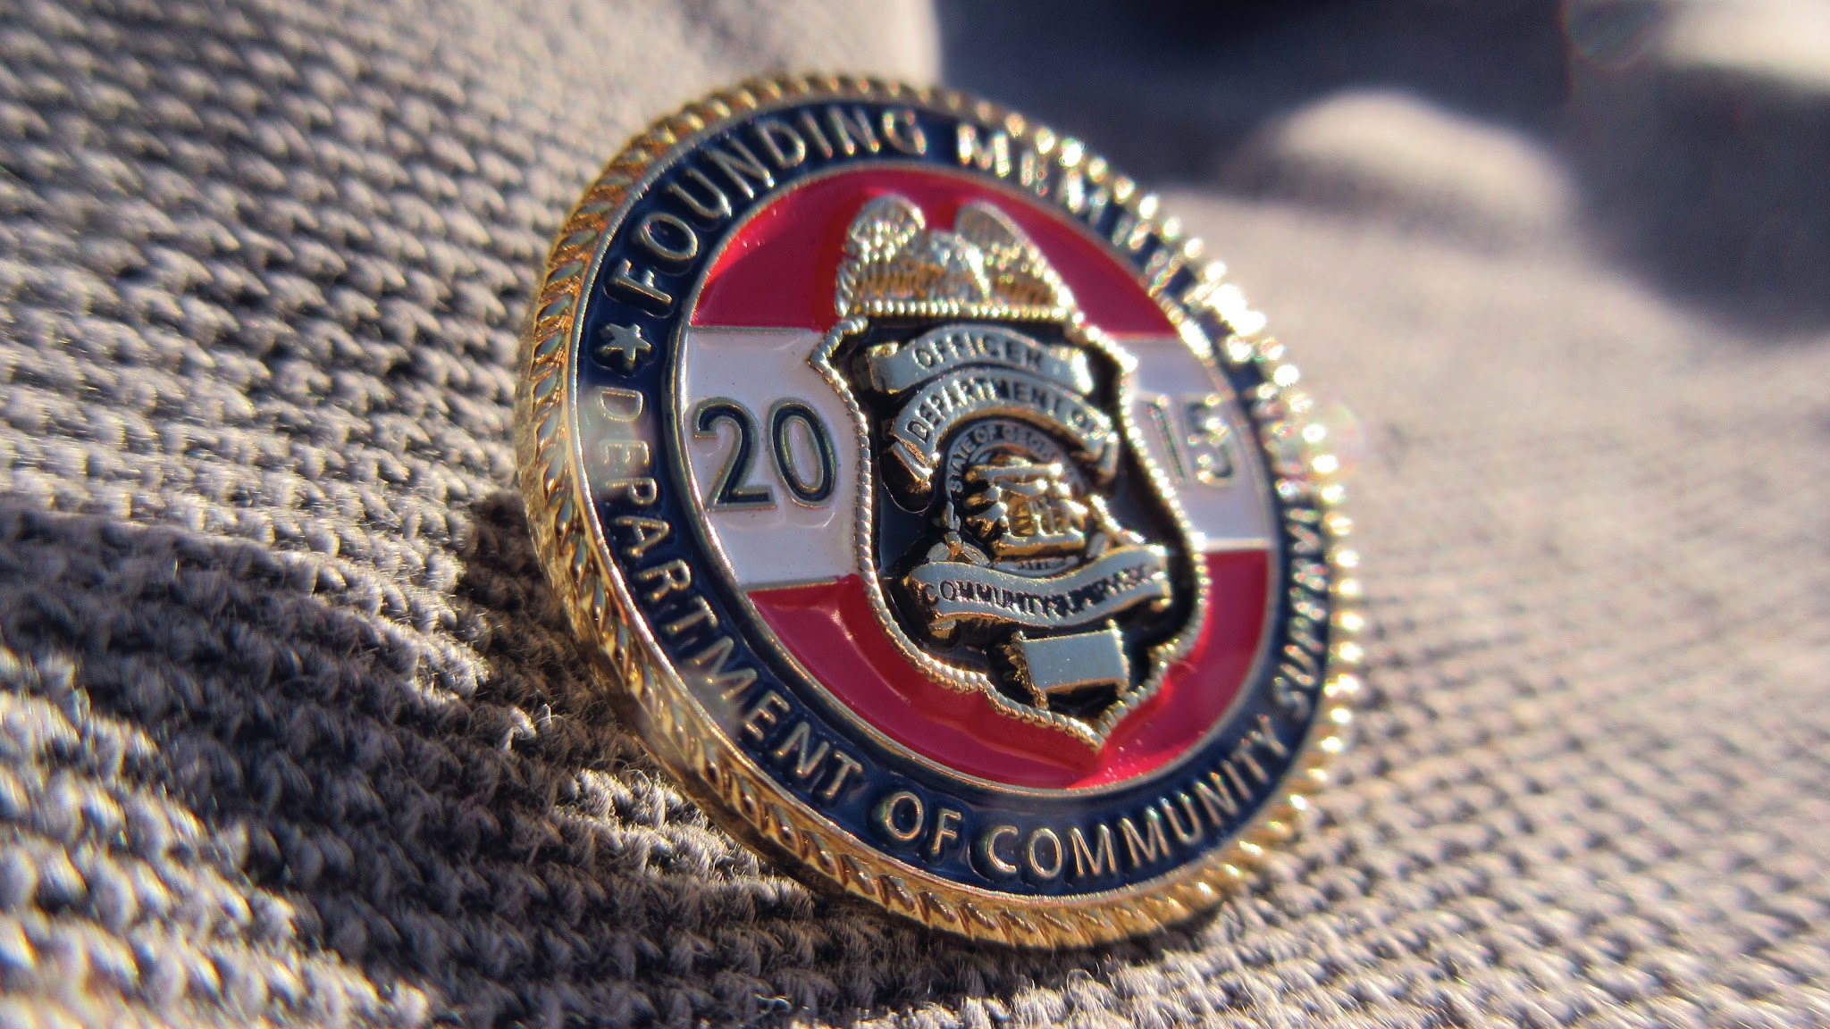

Sex Offender Supervision
Presented to SR 371 Study Committee
October 30, 2019

Slide 2

The DCS Mission
As an integral part of the criminal justice system, we protect and serve all Georgia citizens through effective and efficient offender supervision in our communities, while providing opportunities for successful outcomes.

Slide 3
Sex Offender Supervision
Offenders under DCS supervision for a sex offense or that are registered sex offenders for a previous offense are placed on a specialized caseload.
The SORRB Risk Level does not impact DCS supervision
SDP is defined in Policy as a sexually violent predator between July 1, 1996 and June 30, 2006; or a sexual offender who is determined by the Sexual Offender Registration Review Board (SORRB) to be at risk of perpetrating any future dangerous sexual offense.
  SDPs, like all offenders are supervised according to the conditions imposed by the Court or Parole Board.

Slide 4
Electronic Monitoring
Electronic Monitoring (EM) is provided by STOP (Satellite Tracking of People)
Cost Per Person Per Day: $3.09
  For SDPs, this is billed to DCS
  For FY19: DCS paid $334,156
All SDPs under DCS supervision are equipped with EM
Officers have the ability to establish inclusion or exclusion zones and are notified when an offender has exited or entered one of these zones.

Slide 5
Sex Offender Population
Data as of September 2019
Total Sex Offenders: 12,233
Male: 11,924 Female: 309
Percent Employed: 76%
Avg. Sentence Length: 14 years
Sexually Dangerous Predators (SDP): 295
Notes:
For Avg. Sentence Length, life sentences are calculated at 25 years.

Slide 6
Sex Offender Population
Data as of September 2019
Actively Supervised Sex Offenders: 7,536
Male: 7,313 Female: 223
Percent Employed: 76%
Avg. Sentence Length: 14 years
Top Circuits: Coweta (394); Atlanta (390); Stone Mountain (361); Chattahoochee (337); and Ocmulgee (281)
Sexually Dangerous Predators (SDP): 224
Notes:
For Avg. Sentence Length, life sentences are calculated at 25 years.

Slide 7
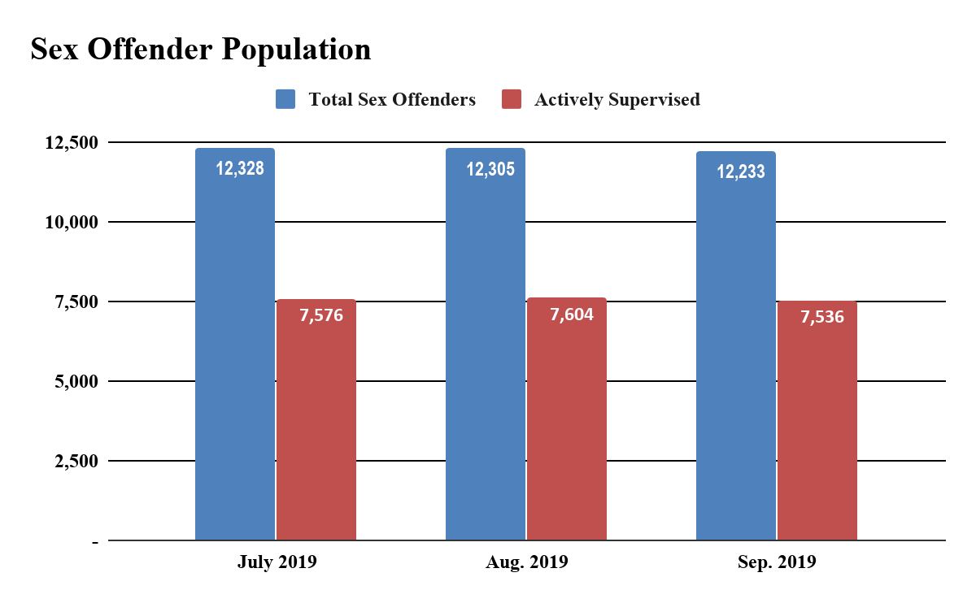

Slide 8
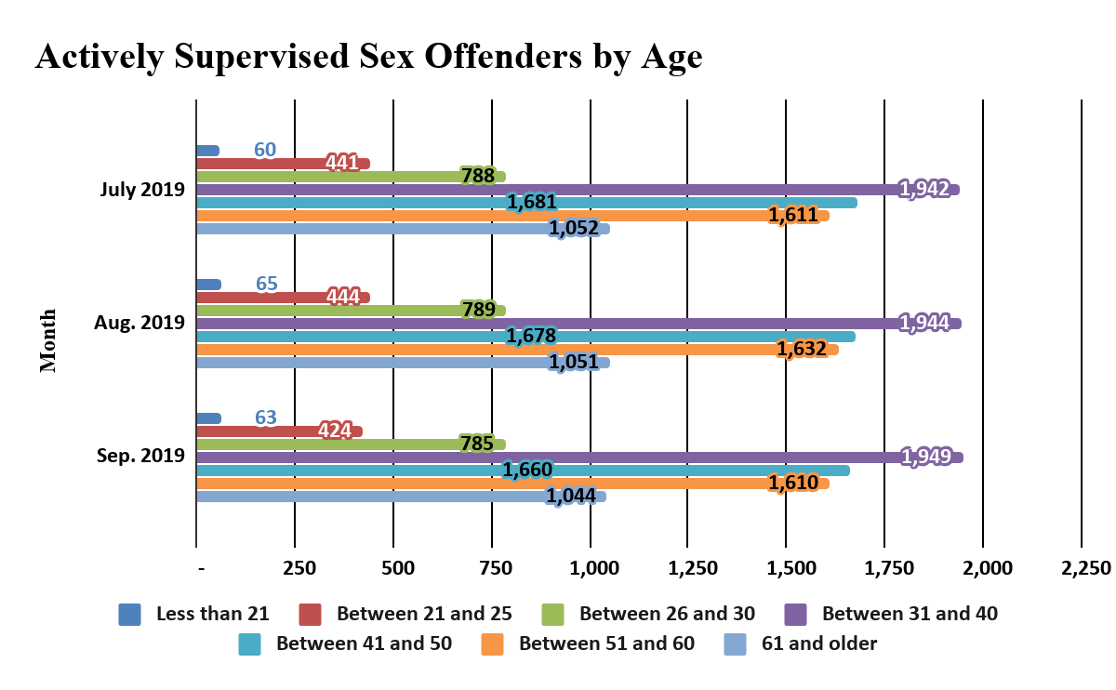
Notes:
1 age not reported for each month

Slide 9
Impact of Parks v. GA
Prior to Parks v. GA, all SDPs under DCS supervision were placed on EM. Upon completion of the sentence, DCS would coordinate with the local Sheriff’s Office to ensure continued EM.
After Parks v. GA, when a SDP has completed their sentence, they are removed from EM.
Any legislative remedy that allows for lengthier periods of supervision for sex offenders will over time lead to a larger sex offender population under DCS supervision.

Slide 10
QUESTIONS?

