Slide 1


DCS Housing Initiatives
Presented to the Senate Study Committee on Homelessness
October, 17 2017

Slide 2
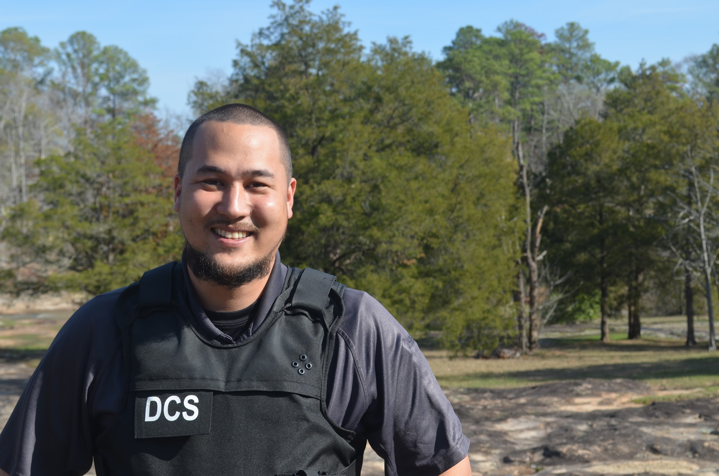
The DCS Mission
As an integral part of the criminal justice system, we protect and serve all Georgia citizens through effective and efficient offender supervision in our communities, while providing opportunities for successful outcomes.

Slide 3
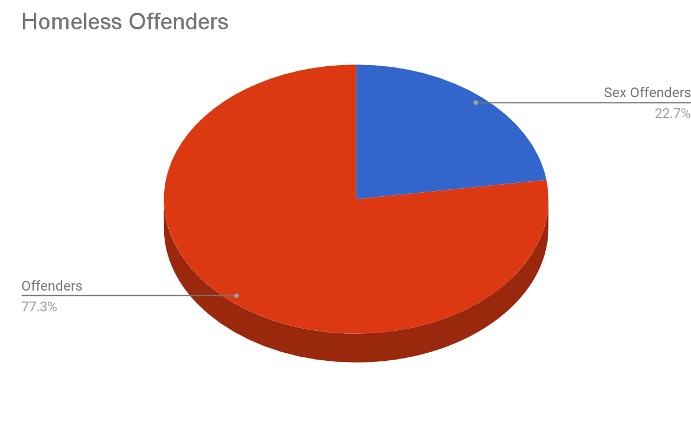
Current Data
Currently, there are 766 offenders under DCS supervision that are homeless. 174 of these offenders are sex offenders.
Approx. 50% (86) of the homeless sex offenders are homeless because of proximity restrictions.
Notes:
Currently, there are 766 offenders under DCS that are homeless
(174) of these offenders are sex offenders
Approx. 50% (86) of the homeless sex offenders are homeless because of proximity restrictions.

Slide 4
DCS Initiatives
ReEntry Partnership Housing (R.P.H.)
Transitional Housing for Offender ReEntry (T.H.O.R.)
Housing Coordinators

Slide 5
Assessments
R.P.H.
R.P.H. (ReEntry Partnership Housing) is a collaborative housing program between the Georgia Department of Community Supervision (DCS), Georgia Department of Corrections (GDC), and Georgia Department of Community Affairs (DCA) designed to cut spending and reinvest savings to further improve public safety.

Slide 6
R.P.H. Goals
Enhance reentry by establishing a progressive transition back to society under the guidance of CSOs.
Provide short-term financial assistance to help stabilize reentry process.
Save tax dollars by shortening incarceration for eligible participants.
Free up prison beds for Georgia’s most violent offenders.

Slide 7
Why R.P.H.?
A common obstacle to successful reentry is the lack of stable housing.
Research shows there is a link between homelessness and offending.
The barriers to housing for offenders -including those with mental health needs- is difficult for many to overcome on their own.
Housing is a stabilizing force that provides a consistent base to access employment, treatment for mental health, or substance abuse disorders, and other support services.

Slide 8
R.P.H.
Overview
Using State Criminal Alien Assistance Program (SCAAP) funds from GDC, DCA pays approved housing providers to provide room and board to eligible placements.
In most cases, housing providers are currently compensated monthly per placement for three months.
Housing providers can be faith-based or secular; however, faith-based activities must be optional for R.P.H. placements.
Housing providers serving participants with a mental health need are compensated at a higher rate and are equipped to provide for recommended treatment.
Under the guidance of their Community Supervision Officer (CSO), participants are able to obtain a license, find a job, participate in prescribed programming, find their own home, and address any other needs they may have.
Notes:
1) DCS receives an annual appropriation of $830,815 and then send the entirety of that to DCA for RPH - this money is used first.
2) If the $830,815 is spent in a fiscal year then Correction's has allocated $5,167,584 for RPH, this is a one-time pot of money not a continuing appropriation. For instance if we spend $1,000,000 out of it this year there will only be $4.1m left for next year.
Historically we've never spent more than the $830k - last year we spent a total of $699,940. We have spent so far during FY18 $194, 095.
Providers serving participants with mental health needs provide treatment and are recommended to:
Have a crisis intervention plan in place.
Provide direct access to local outpatient treatment centers.
Have a S.O.A.R. representative to help participants access social security benefits.
Possess or have access to a transitional housing program for the participant after the R.P.H. period of 120 days.

Slide 9
R.P.H Eligibility and Expansion
R.P.H. is intended for problem residence cases:
Granted parole, but cannot be released due to homelessness.
Set to max-out of prison with probation supervision to follow.
Recently released from custody, but became homeless post-release.
No registrable sex offenses.
No detainers or pending charges.
No medical issues that would require a nursing home or personal care home.
No delinquent reports for drug possession, assault with injury, assaulting an officer, or cell phone possession in the previous year.
Expansion of RPH eligibility to all offenders under DCS was due to Georgia’s criminal justice reforms and the GA-PRI.
Currently in the process of expanding RPH to offenders sentenced in accountability courts.
Notes:
A workgroup consisting of DCA, DCS, GDC, and CACJ began meeting January 2017 to begin working on an intergovernmental agreement for RPH expansion to include Accountability Courts. The agreement was approved in July 2017.
In September, DCS attended the Council of Accountability Court Judges Conference and provided training to Accountability Court Coordinators.
Court Coordinators will be involved in identifying prospective providers in their circuits.
The Accountability Court placements under RPH will begin in January 2018.
Beginning January 2018, new tiered levels of placements will be available to properly accommodate all offender populations.
Providing substance abuse treatment component and expanding mental health treatment services to RPH. This was done to expand the length of participation for treatment period followed by stabilization/job hunting based on needs. (from 3 months to up to 6 months now)

Slide 10
R.P.H. Provider
Numbers
Currently 29 active R.P.H. housing providers
5 R.P.H. providers are willing/able to accommodate MH level 3 cases.
  Since inception of this process, we have successfully placed 9 MH level 3 cases.
This is an increase of 7 during FY17.
R.P.H. facilities are located in 8 of the 10 Judicial Districts.
Current maximum bed space has reached our FY17 goal of 300.
Since FY 2011, 3064 inmates granted parole have been placed in the R.P.H. program.
  84% of these placements are either still on active parole or have successfully completed parole supervision.

Slide 11
T.H.O.R.
DCS has 82 active housing providers in THOR:
18 - Structured Housing
30 - Standard Recovery
34 - Intensive Recovery
Transitional Housing for Offender ReEntry (T.H.OR.) is an online directory of community-based housing options for offenders currently under community supervision.
Structured Housing: Residents need a healthy and safe environment to live but are not required to attend substance abuse services or substance abuse counseling.
Standard Recovery: Residents are required to attend 1 or more hours of substance abuse services or substance abuse counseling per week.
Intensive Recovery: Residents are required to attend 5 or more hours of substance abuse counseling per week delivered by certified substance abuse counselors or licensed professionals

Slide 12
Housing Coordinators
As a part of the Georgia Prisoner Reentry Initiative, Community Coordinators and Housing Coordinators work to build community resources for released offenders to ease their reentry and help reduce recidivism.
This is an effort only in our 17 PRI Counties.
DCS has hired six Housing Coordinators which cover 5 of our GA-PRI pilot sites. Two in Fulton County. One in Muscogee, Richmond, Bibb, and Chatham.
GA PRI Resources (17 Pilot Counties)
Number of Providers
Sex Offender Housing
Sex Offender Services
Hard to Place Housing
Supportive Housing
Transitional Housing
Permanent Housing
Emergency Housing
Temporary Housing
11
21
51
99
130
132
69
171

Slide 13
Additional
Initiatives
Housing Trainings
DCS conducts housing training for GDC counseling staff. To date, 80 of the 81 GDC institutions have received housing training for their counselors.
DCS hosts an annual RPH Provider Collaborative meeting to discuss issues and gauge feedback from providers.
Field Services unit provided an annual update to the Georgia Supportive Housing Association during their November conference.
Housing Web Page
DCS Housing web page is accessible via DCS, PAP, GDC, and DCA websites.
This contains information on RPH, THOR, application process, provider requirements, etc., and improved access to the online THOR Directory.
https://dcs.georgia.gov/housing-programs

Slide 14
Additional
Initiatives
Criminal Justice Reform
The CJRC has tasked a workgroup to develop housing recommendations.
Removal of the blanket ban on felony offenders from public housing assistance.
Interagency Coordination
DCS has a representative on the Balance of State Continuum of Care which is composed of representatives of relevant organizations within 152 of Georgia’s 159 counties with a goal of ending homelessness.
Created internal focus groups to work with other stakeholders and develop recommendations to address homeless offender populations

Slide 15
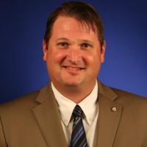

Contact
dcs.ga.gov
Scott Maurer
Assistant Commissioner
scott.maurer@dcs.ga.gov

