Slide 1

Learning Disabilities and Very Young Children
Understanding developmental concerns in children birth to five
Susan Adams
Deputy Commissioner
Georgia Department of Early Care and Learning

Slide 2

Developmental Focus
Providing developmentally appropriate environments and instruction
Understanding and monitoring developmental milestones
Making appropriate referrals
  Health
  Vision and Hearing
  Developmental delays
Differentiating instruction based on individual needs within the classroom

Slide 3
What Teachers Might Notice
“Uneven” development
Significant strengths and notable challenges
“A bright kid who just doesn’t get something”
Can’t keep up with his book bag… coat…
“He isn’t very interested in stories or activities.”

Slide 4

Red Flags
Language
  Expressive
    Late talker
    Difficulty learning new words
    Struggles with rhyming, isolation of sounds
  Receptive
    Failure to fully understand what others are saying
    Following directions
    Difficulty understanding questions

Slide 5

Red Flags
Cognitive Processing
  Not demonstrating object permanence
  Lack of symbolic play behavior
  Limited understanding of means-ends and cause/effect relationships
  Struggles with concepts of time
Motor
  Poor pencil grasp
  Difficulty with button, zipping, tying
  Hopping, skipping

Slide 6
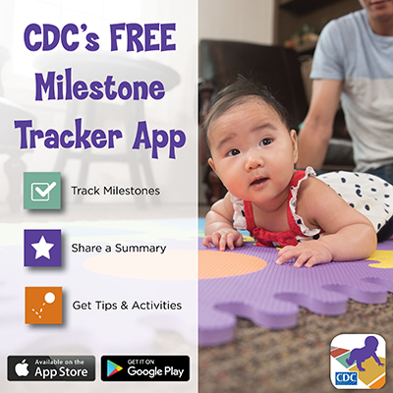
Initiatives
Learn the Signs. Act Early. Campaign
  Partnership with Centers for Disease Control (CDC)
For Teachers:
  Watch Me! training
  Developmental Monitoring Starter Kits
For Families:
  Celebrating Milestones booklet
  Milestone Tracker app

Slide 7
Referrals
Children Birth up to 3rd birthday:
  Contact Children 1st
  Services through Babies Can’t Wait (DPH)
Children Three through five years old:
  Contact local school system
  Services through Special Education Preschool

Slide 8

Questions
Susan Adams
susan.adams@decal.ga.gov
404-651-7420

