Slide 1
Senate Study Committee Preventing Youth Substance Abuse Disorders and Rate of Diagnosis for Children with ADHD and Related Diseases
Garry McGiboney, Ph.D.
Georgia Department of Education

Slide 2
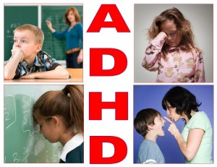
Attention Deficit Hyperactivity Disorder

Slide 3
CDC published a National Health Statistics Report, Diagnostic Experiences of Children with Attention Deficit Hyperactivity Disorder
Findings:
  About three-quarters of children with ADHD were diagnosed before age 9 and one-third of those by age 6
  Usually a pediatrician made the first diagnosis for about half of the children
  ADHD is frequently comorbid with Learning Disabilities
  Many researchers report finding comorbidity 20-50 percent of the time with reading disabilities and up to 30 percent in math disabilities

Slide 4
9 out of 10 children with ADHD were treated with medication and/or behavioral therapy, both of which are recommended ADHD treatments, depending on the needs of the child and the effectiveness of the treatment
Of these children:
  about 4 in 10 (43%) were treated with medication -- the most common single ADHD treatment
  about 1 in 10 (13%) received behavioral therapy alone
  about 3 in 10 (31%) were treated with combination therapy (medication and behavioral therapy)
About 1 in 10 children with ADHD were receiving neither medication treatment nor behavioral therapy
One study showed that medication treatment is the primary choice when behavior therapy is unavailable (Visser, et. al)

Slide 5



Practices for ADHD Treatment (American Academy of Pediatrics)
Preschooler (ages 4-5) | Behavior therapy as the first line of treatment Medication if behavior therapy is insufficient
Elementary (ages 6-11) | Medication Behavior therapy Preferably both
Middle and high school (ages 12-18) | Medication Behavior therapy Preferably both

Slide 6
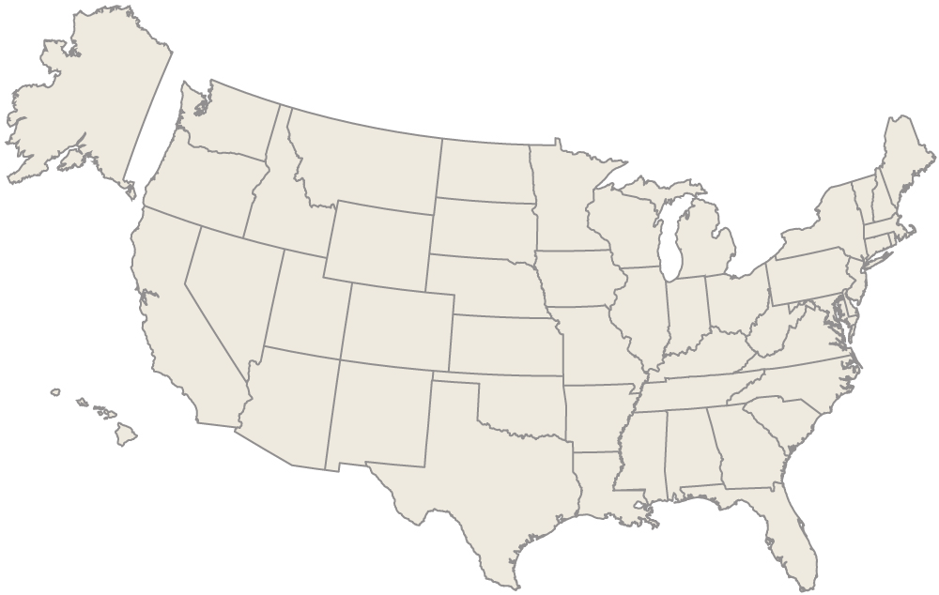
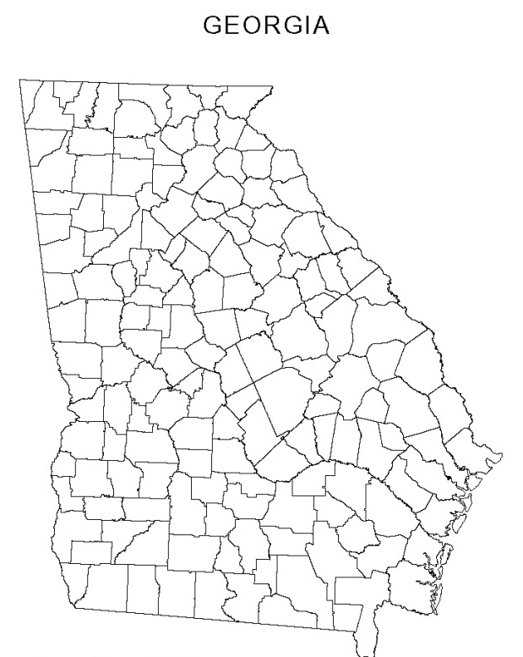
74%
78%
78% of children with ADHD in Georgia took medication for ADHD, compared to 74% nationally – Georgia ranks 17th highest in the country

Slide 7
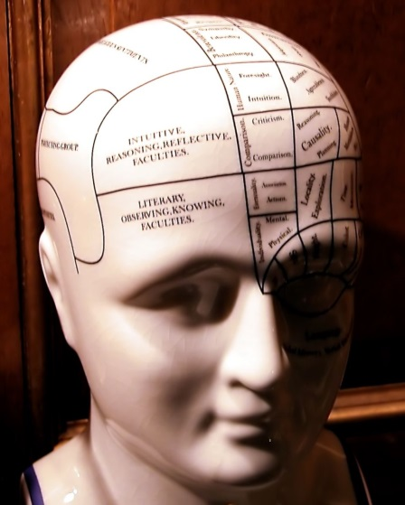
Substance Use and Abuse

Slide 8
Georgia Student Health Survey 2.0
(N=628,350)
Alcohol usage in past 30 days
2014 – 11%
2013 – 12%
2012 – 14%
Binge drinking (5 or more drinks at one setting) in past 30 days
2014 – 6%
2013 – 6%
2012 – 6%
Each percent equals approximately 6,283 students

Slide 9
Georgia Student Health Survey 2.0
Marijuana usage in past 30 days
2014 – 10.7%
2013 – 9.1%
2012 – 8.3%
Tobacco (cigarettes) usage in past 30 days
2014 – 6.2%
2013 – 6.0%
2012 – 6.1%
Each percent equals approximately 6,283 students

Slide 10
Georgia Student Health Survey 2.0
Prescription drug usage (without a prescription) in past 30 days
2014 – 5.4%
2013 – 4.2%
2012 – 3.1%
Each percent equals approximately 6,283 students
Georgia law (O.C.G.A. § 20-2-144) requires schools to provide drug and alcohol instruction for grades K-12

Slide 11

Factors Impacting ADHD and Substance Abuse

Slide 12
Substance Abuse Education Reduces Drug Use
Research indicates that schools play an important part in helping students make safe and healthy choices about both legal and illegal drug use (Midford)
Substance abuse education is effective in reducing usage among middle and high school students (Midford)

Slide 13
A positive school climate increases the likelihood that ADHD students can cope in the school setting (Long, DeRuvo, and Rosenthal)
A positive school climate can increase the exposure to and experience with positive interactions for ADHD students and other students (Todd, Horner, Sugai, and Sprague)
School climate for the student with ADHD should be based upon a solid foundation of general behavior intervention and prevention principles such as Positive Behavioral Interventions and Supports (PBIS) (National Resource Center on ADHD)
Self-regulation (ability to process and control thoughts, feelings, impulses, and behaviors) in ADHD students is enhanced in a positive school climate using PBIS (Renz)

Slide 14
A safe and supportive school climate increases protective factors and reduces the risk of drug use problems developing among students (Midford)
Students with ADHD are more likely to be suspended from school than the general student population (Achilles, Mclaughlin, and Croninger)
As an ADHD student gets older the likelihood of the student being suspended from school increases (Achilles, Mclaughlin, and Croninger)
The rate of out-of-school suspensions decreases after the implementation of PBIS – in elementary, middle, and high schools (Sugai and Horner)

Slide 15
School Climate
A safe and supportive school climate increases protective factors and reduces the risk of drug use problems developing (Sugai)
School climate refers to the quality and character of school life (National School Climate Center)
School climate is based on patterns of students', parents' and school personnel's experience of school life and reflects norms, goals, values, interpersonal relationships, teaching and learning practices, and organizational structures (Sugai)

Slide 16
School Climate
An unstable/unhealthy, non-supportive, non-responsive school climate can exacerbate the conditions of students with adjustment problems such as ADHD (Sugai)
Children need school environments that establish safety, stability and positive and supportive relationships (Ford)
Children struggle when in negative/unsafe school environments and are less likely to succeed academically and graduate from high school (Mental Health America)

Slide 17
School Climate
A positive school climate has been shown to lower levels of drug use (LaRusso)
Because School Climate…
Improves a wide range of emotional and mental health outcomes (Way, Reddy, and Rhodes)
Increases student self-concept (Cairns)
Reduces psychiatric problems among high school students (LaRusso)
Increases psychological well-being (Ruus)
…and reduces the student “need” to self-medicate

Slide 18
How to Improve School Climate
There exists a preponderance of evidence to support implementation of Positive Behavioral Interventions and Supports (PBIS) as an effective framework to improve school climate (Sugai and Horner)
PBIS is a proactive approach to establishing the supports and culture needed for all students to achieve social, emotional, and academic success. It is a framework for changing school climate to be more positive, supportive, safe and secure (Sugai)

Slide 19
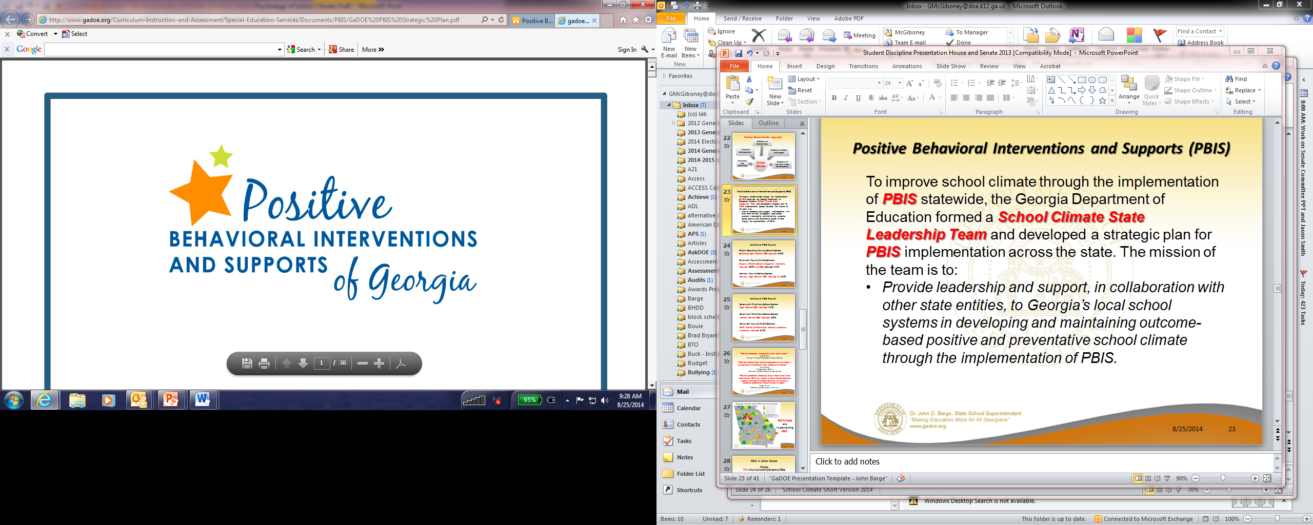
Advocacy Organizations
Georgia Appleseed
Georgia Advocacy Office
Anti‐Defamation League, Southeast Region
Foundations and Private Entities
Southern Education Foundation
United Way of Greater Atlanta
The Carter Center
The Marcus Center
Leadership Georgia
First Lady’s Children’s Cabinet
LEA Representatives
Superintendents, teachers, principals
Legislators:
Randy Nix, Georgia House of Representatives
Katie Dempsey, Georgia House of Representatives
Institutes of Higher Education:
Center for Excellence in Developmental Disabilities, Georgia State University
Georgia College and State University
Georgia Southern University
University of Georgia
National Association of State Boards of Education
Center for Safe and Healthy Schools
Statewide Partners
Georgia Department of Behavioral Health and Developmental Disabilities
Georgia Department of Early Care and Learning
Get Georgia Reading Campaign
Juvenile Court Judges
Georgia DFCS
Regional Education Service Agencies
Georgia Department of Public Health
Georgia Department of Juvenile Justice
Georgia Supreme Court’s Committee on Justice for Children
Georgia Council on Substance Abuse
Georgia PTA
Georgia Family Connection Partnership
Governor’s Office of Children and Families
Georgia State Board of Education
REACH Georgia
Professional Educator Associations
Georgia Association of Educational Leaders
Georgia Association of School Psychologists
Georgia School Counselors Association
Student Support Team Association of Georgia Educators
Georgia School Boards Association
Georgia Association of School Social Workers
Notes:
We called upon all of these partners to develop the State’s PBIS Strategic Plan.

Slide 20
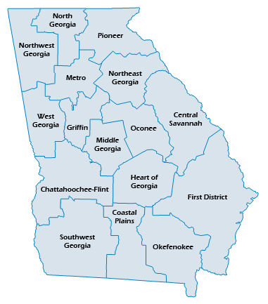
PBIS is being implemented in over 350 schools in 50 school systems
28 additional school districts have requested PBIS training
Part-time School Climate Specialist are in each RESA, through funding from the Governor’s Office and the Georgia General Assembly, to provide technical assistance to school systems implementing PBIS
Regional Education Service Agencies (RESAs)

Slide 21
Social Emotional Learning
Social and emotional learning (SEL) is the process through which children and adults acquire and effectively apply the knowledge, attitudes, and skills necessary to understand and manage emotions, set and achieve goals, feel and show empathy for others, establish and maintain positive relationships, and make responsible decisions
Students learn the language of social interaction – crucial for positive mental health factors
Through the Marcus Institute, the GaDOE is working with SEL experts in 18 school systems to establish linkages between SEL, school climate, social development and language, behavior, reading, and mental health (see the Illinois model)

Slide 22

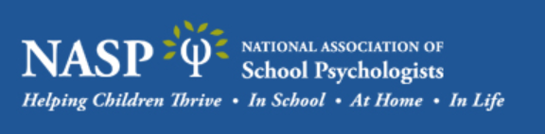



Critical and Essential Resources

Slide 23
School Counselors
School counselors respond to the need for mental health and behavioral prevention, early intervention and crisis services that promote psychosocial wellness and development, and academic support for all students (ASCA)
School counselors provide school-based prevention, universal interventions and targeted interventions for students (ASCA)
Georgia has approximately 3,400 school counselors –
ratio of 1:500 (1:450)

Slide 24
School Psychologists
School psychologists consult with school staff, parents, and service providers regarding social emotional development, mental health, and learning needs of children (NASP)
School psychologists screen, evaluate, identify and make referrals for children exhibiting problems (NASP)
School psychologists participate in planning and implementing appropriate educational and mental health supports (NASP)
Georgia has approximately 750 school psychologists -
ratio of 1:2,475 (1:1,000)

Slide 25
School Social Workers
School social workers have special expertise in understanding family and community systems and linking students and their families with community services essential to promote student academic success, social development, and physical development (SSWAA)
Georgia has approximately 620 social workers –
ratio of 1:2,742 (1:250)

Slide 26
School Nurses
School nurses serve a vital role in the school by promoting positive mental health, physical health, and academic outcomes for students (NASN)
As members of interdisciplinary teams, school nurses collaborate with school personnel, community health care professionals, students and families, in the assessment, identification, intervention, and referral of children in need of physical and mental health services (NASN)
School nurses spend 32% of their time providing mental health services (Zupp)
Georgia has approximately 1,555 licensed school nurses, 700 short of the number needed to meet the recommended ratio of 1:750

Slide 27
Linking ADHD and Substance Abuse Issues to the Larger Whole
A major shift occurs around third or fourth grade from “learning to read” to “reading to learn” (Bernstein and Waber)
At the third grade many children with ADHD start to have academic problems, even when they had done well in earlier grades (Bernstein and Waber)
Beyond third grade, students when reading are expected to incorporate cause/effect sequences, goals/plans for characters, and reach conclusions that relate to final events to those at the beginning of the story, but students with reading deficiencies are unable to accomplish these expectations (Westby and Watson)

Slide 28
Linking ADHD and Substance Abuse Issues to the Larger Whole
It has long been observed that learning disorders, especially reading difficulties, occur in combination with Attention-deficit/Hyperactivity Disorder (ADHD) (McGrath, et al)
Children and adults with limited literacy are stigmatized, which complicates their efforts to interact with others and benefit from interventions (Lincoln, et. al)
Conduct disorder children are at a greater risk of substance abuse as an adolescent (Bennett, et al)
The findings show that an eight point increase in reading scores at the third grade would result in a 23 per cent decrease in the risk of conduct problems and interest in substance use (Bennett, et al)

Slide 29

Resources
No significant and sustainable change has ever taken place without first changing the conversation
Substance Use
Reading
Climate
Mental Health
ADHD
Prevention

Slide 30

Notes:
The work of the Get Georgia Reading Campaign is guided by a cross-sector group of leaders who are committed to this effort and who serve on what we call the Campaign Cabinet. They represent the state leaders “reach the people who reach the people” and can move this work out to every county and every community across Georgia.

Slide 31
Language Nutrition
Language Nutrition
All children should receive abundant language-rich adult-child interactions, which are as essential for brain development as food is for physical growth
Positive Learning Climate
All educators, families, and policy makers should understand and address the impact of learning climate on social emotional development, attendance, engagement and ultimately student success
Teacher Preparation
All teachers should be equipped with evidence-informed skills, knowledge and resources that effectively meet the literacy needs of each child in a developmentally appropriate manner
Access
All children and their families have access to and supportive services for healthy development through the availability of quality education, healthcare , and other services that support children
FOUR PILLARS
Access
Notes:
This group of leaders from around the state in 2013 based on compelling research identified four pillar that are essential to not only literacy, but also serve as a foundation for other related needs. We know from the research that language, learning climate, teacher prep, and access all have to be addressed in order for our children to be healthy in body, mind, and spirit. I humbly suggest that we change our conversation and our method of strategies to one that embraces the four pillars to establish funding priorities.

Slide 32
Recommendations | Priorities (4 Pillars)
Expand PBIS to provide full-time School Climate Specialists at each RESA to augment efforts to improve school climate and expand to Pre-K | School climate, Access, and Teacher Prep
Create grants to expand social and emotional learning training to more school systems and include Pre-K | Language Nutrition, School Climate, and Teacher Prep
Continue efforts to increase the number of school nurses | Access and School Climate
Reduce the counselor-student ratio; social worker-student ratio; school psychologist-student ratio | Access and School Climate
Create grants for schools to expand and augment substance use and abuse education | Access, School Climate, and Teacher Prep
Notes:
These are our recommendations.

