Slide 1
Improving Disease Surveillance:
DPH SendSS System
Presented by: Cherie L. Drenzek, DVM, MS
State Epidemiologist
Date: September 8, 2017

Slide 2
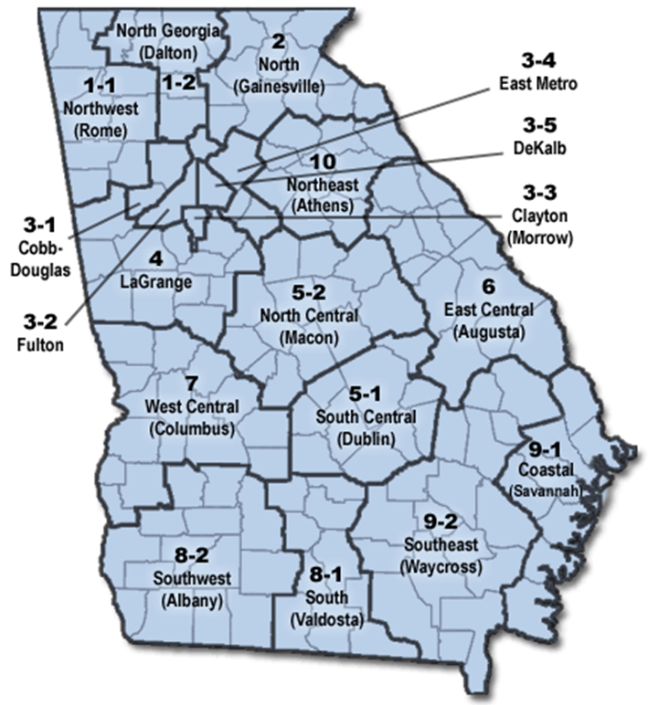
Public Health in Georgia
Monitors and protects the health of communities
Disease surveillance: identify community health problems.
Laboratory diagnosis
Investigation
Information for Action: Control/mitigation/prevention measures

Slide 3

Disease Surveillance
Passive Notifiable Disease Reporting
Molecular epidemiology
Electronic Laboratory Reporting
Active Lab Surveillance
Astute clinician calls
Syndromic Surveillance in Emergency Departments

Slide 4
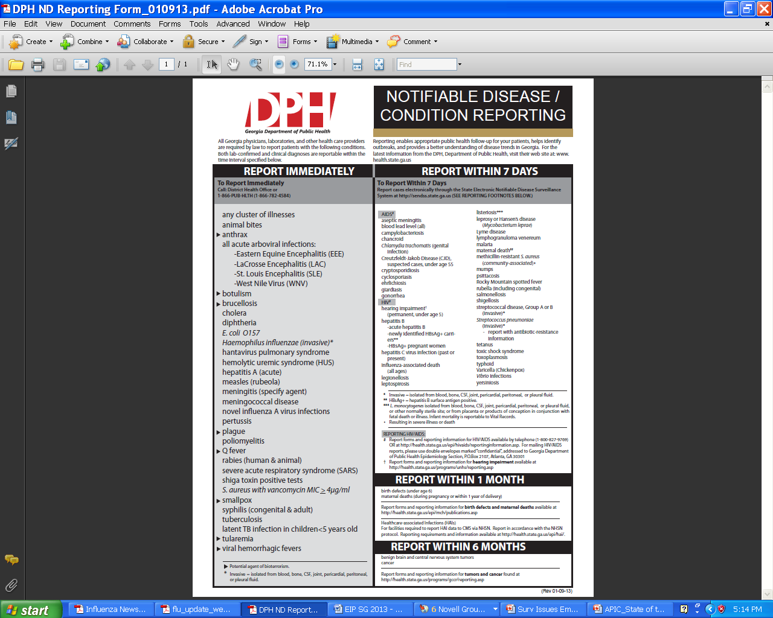
Notifiable Disease Surveillance
http://health.state.ga.us/pdfs/epi/notifiable/ND%20Reporting%20Poster.pdf

Slide 5
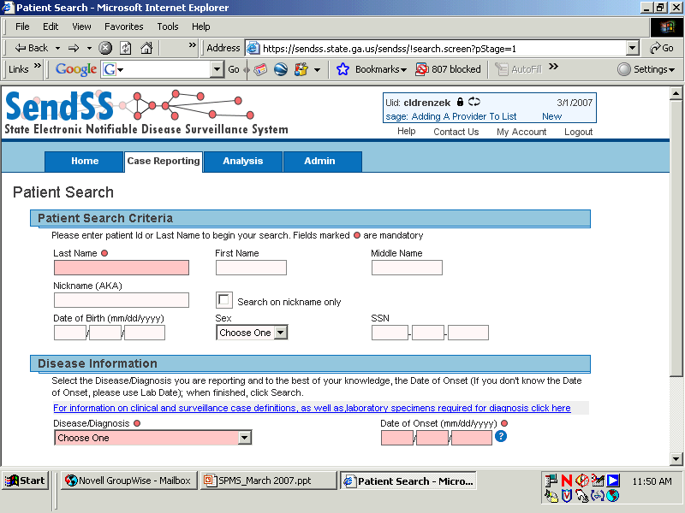
http://sendss.state.ga.us
Notes:
To improve timeliness of disease reporting and early detection of communicable diseases, the Epidemiology Branch instituted a secure, web-based notifiable disease reporting system called SendSS (State Electronic Notifiable Disease Surveillance System) on a widespread basis in 2003. Using this system,health care providers, laboratories, and county health departments can report notifiable diseases in near real-time, resulting in more rapid intervention and follow up. We have seen a marked improvement in reporting times with the advent of SendSS, as seen in the next slide.

Slide 6
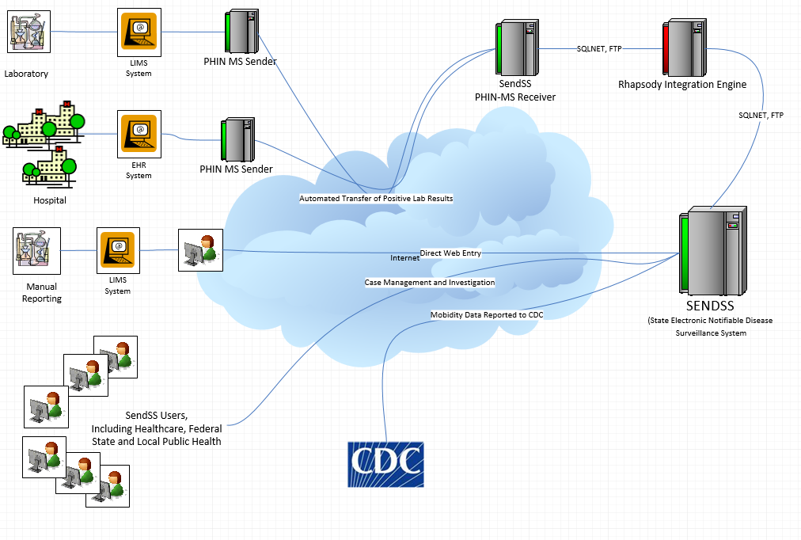

Improvement: Electronic Laboratory Reporting (ELR) in SendSS
Lab results for many notifiable diseases are now electronically transmitted into SendSS every day from commercial laboratories.
These messages are formatted in a standardized way (HL7 2.3.1 or 2.5.1)
These messages are used to create new case records in SendSS or linked with existing case records.
Goal is to increase efficiency, improve timeliness, completeness, and accuracy of notifiable disease data

Slide 7
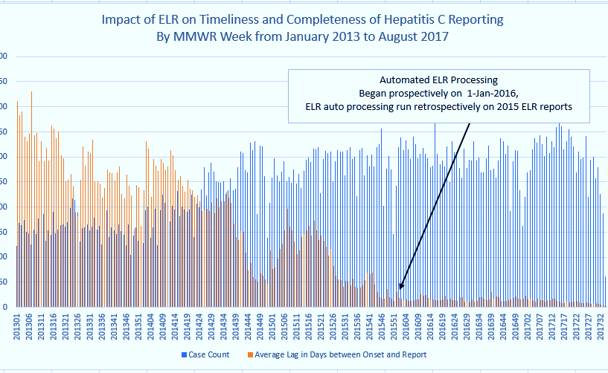
In 2016, a total of 14,026 hepatitis C cases were reported to DPH

Slide 8
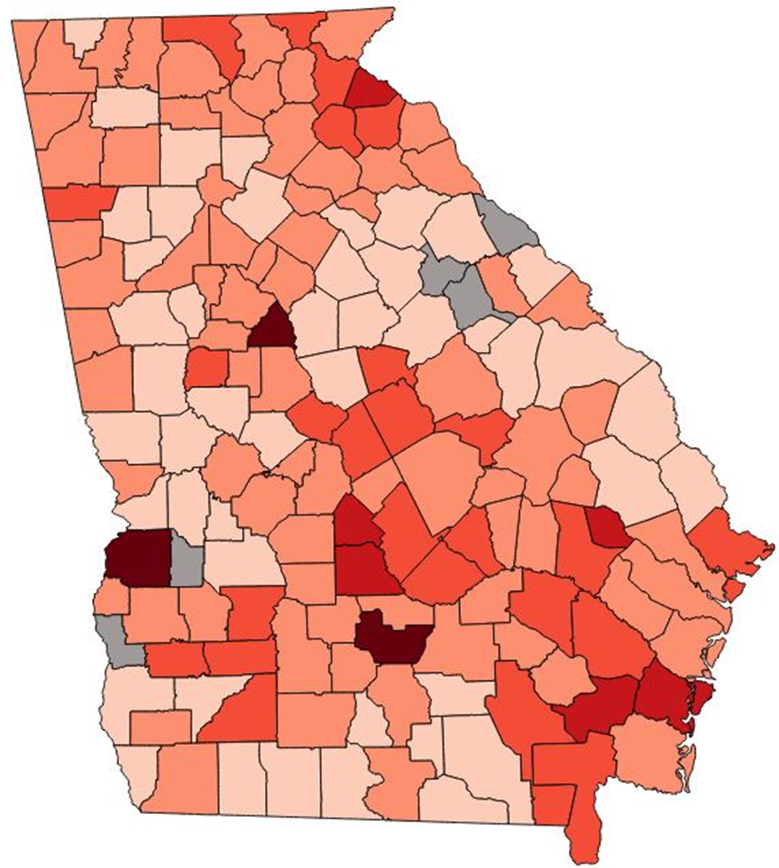

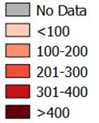
Total Reported Hepatitis C Infections by County, Georgia, 2016 (n=14,036)
Since 2010, Georgia has seen a 240% increase in the total reported hepatitis C infections among those aged 30 years and younger, particularly in rural areas, primarily due to ongoing opioid and heroin epidemics.

Slide 9
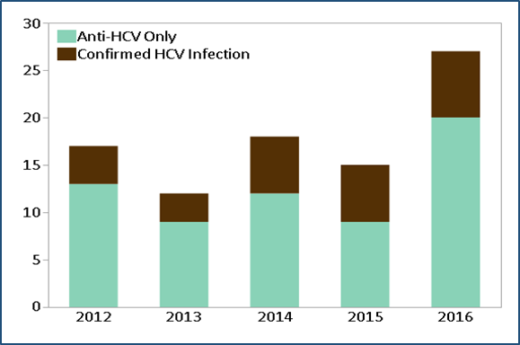
Reported Hepatitis C Infections in Babies ≤ 36 Months of Age, Georgia, 2012-2016
Additionally, about half of the young adults with Hepatitis C were females of child-bearing age.
As such, we have seen a 60% increase in hepatitis C infections among babies 36 months of age or younger from 2012 to 2016 in Georgia.

Slide 10
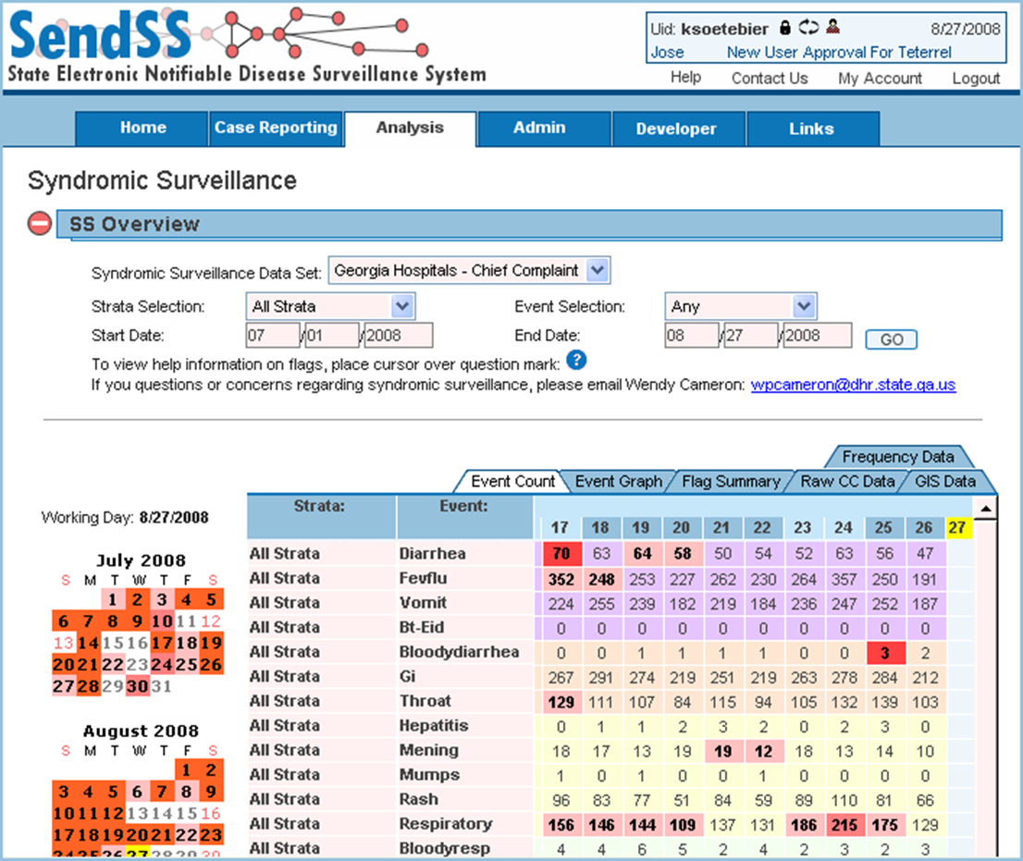
Improvement: Syndromic Surveillance in SendSS
Patient chief complaint data are electronically collected from ~125 Emergency Departments across Georgia and transmitted to SendSS daily.
The chief complaints are parsed for symptoms and automatically assigned into “syndromes” (rash/fever, gastrointestinal, ILI, overdose, asthma)
A statistical algorithm determines whether the number of certain syndromes is “more than expected” (red flags).
Epidemiologists investigate flags and view data for trends.
In 2016, 5.2 million ED visits captured in SS

Slide 11
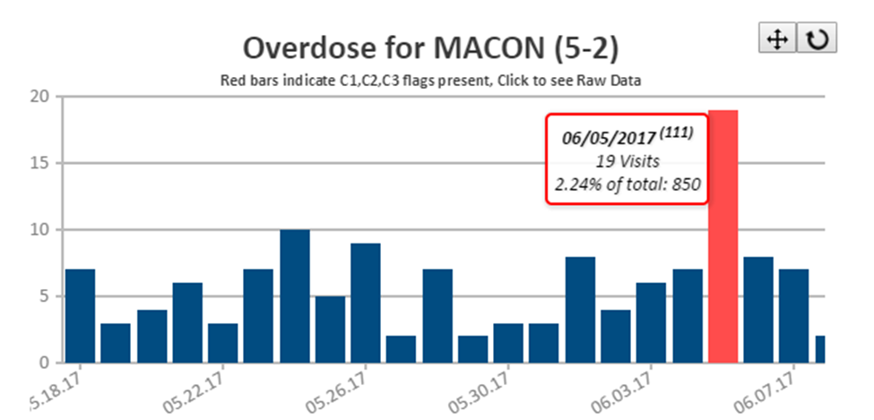
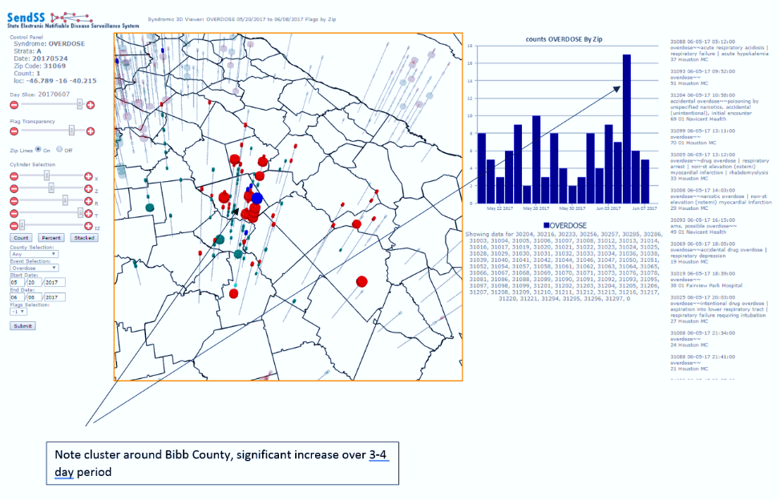
Example: Detection of a cluster of overdoses associated with counterfeit “Percocet” pills

Slide 12

Control
The success of any disease prevention or containment strategy is founded upon surveillance and epidemiology

