Slide 1

Tourism Industry in
Dahlonega & Lumpkin County
Senate Rural Georgia Study Committee Meeting
August 9, 2017
Dahlonega-Lumpkin County Chamber & Visitors Bureau

Slide 2
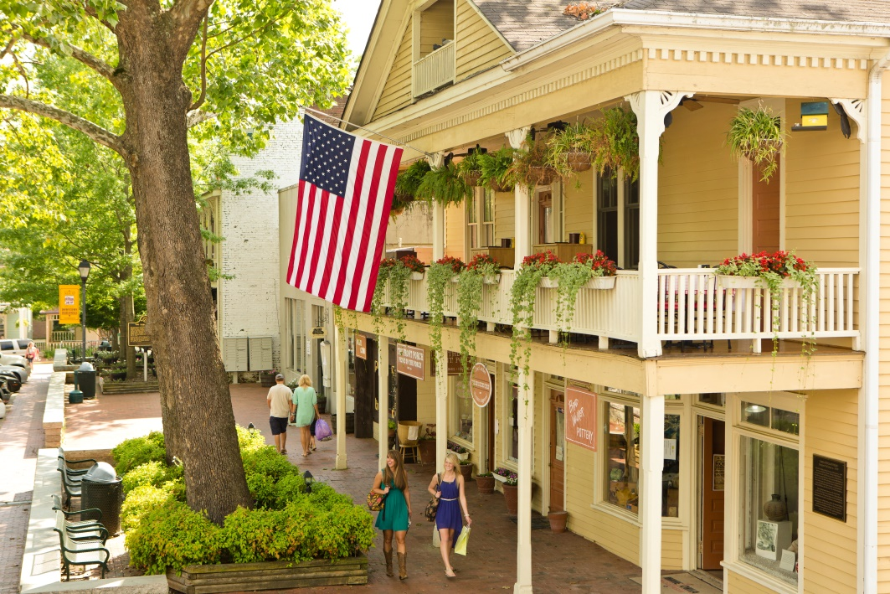
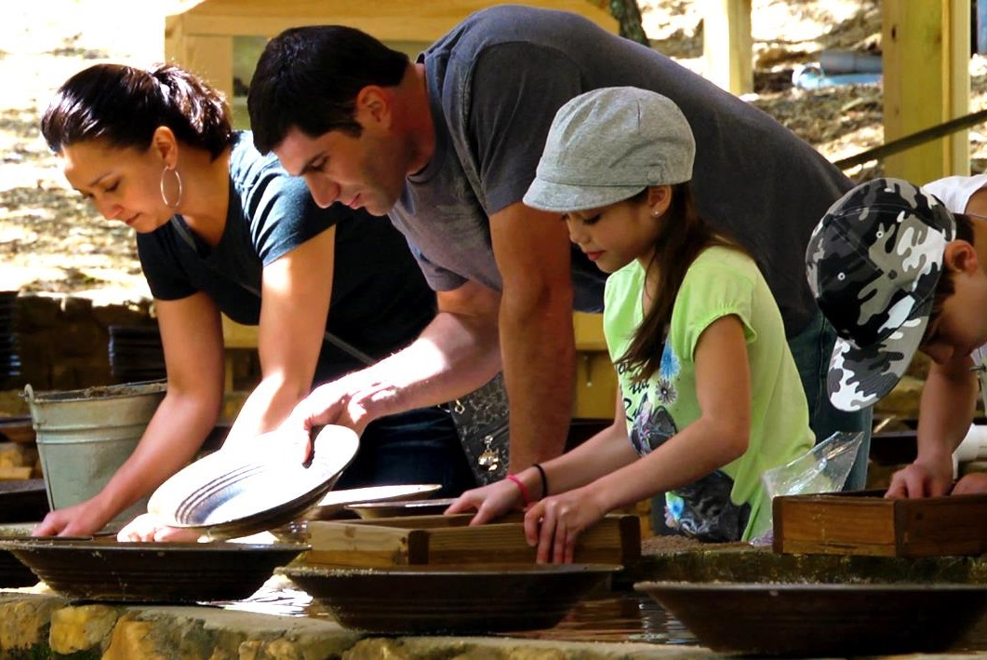
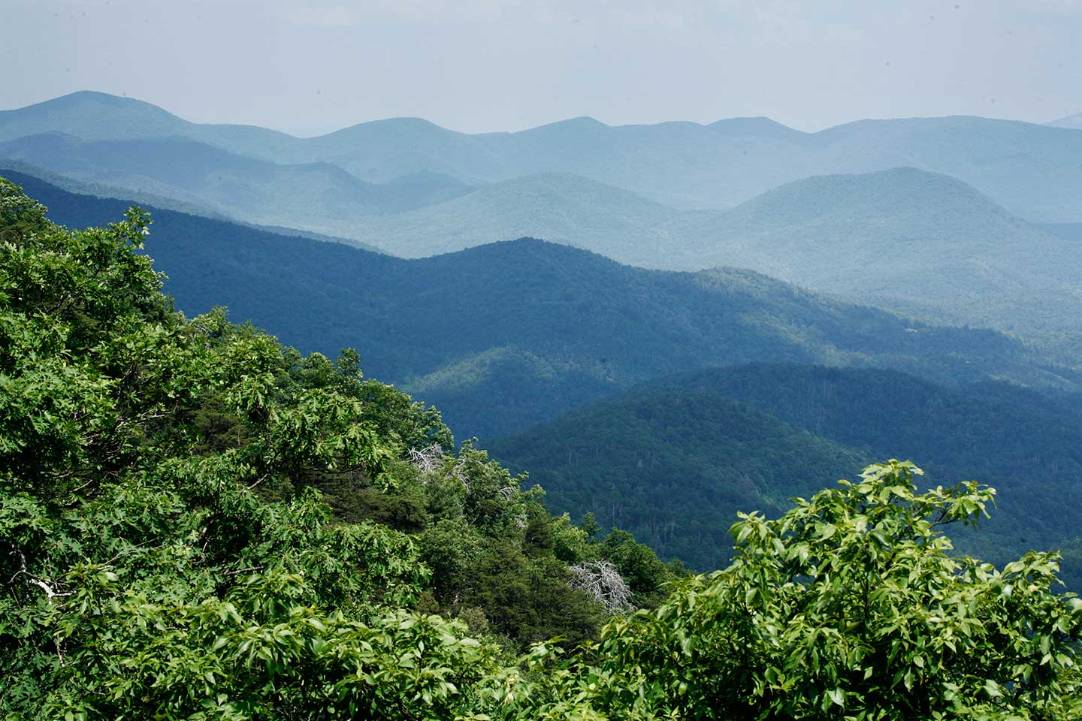
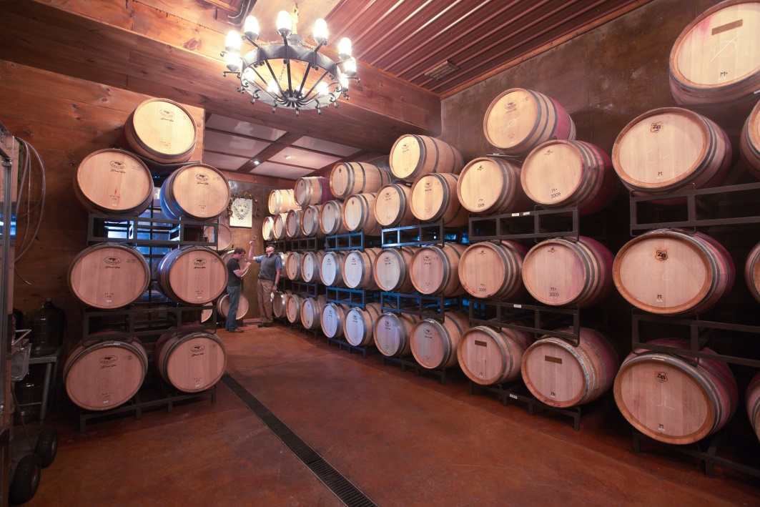
Dahlonega & Lumpkin County

Slide 3
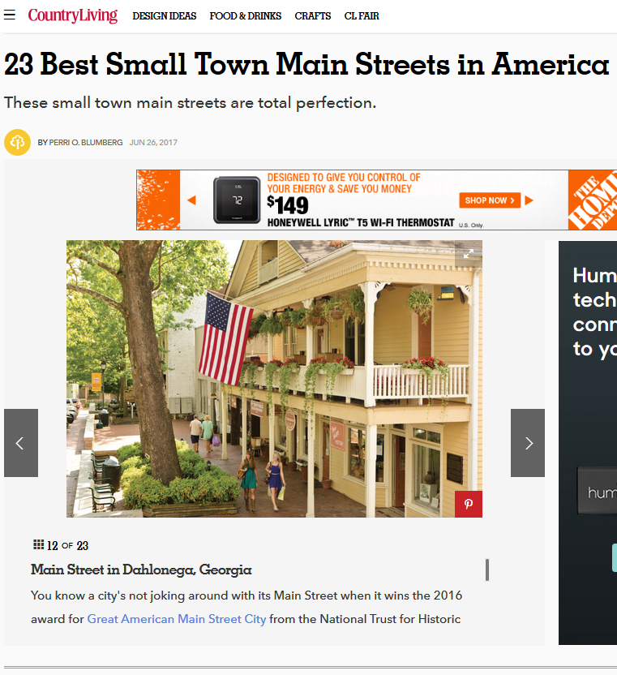
Most Recent Accolades
Southern Living, Trip Advisor, Country Living

Slide 4
Tourism Economic Impact in 2015
$40.57 million
in Tourism Spending
in Dahlonega & Lumpkin County
340
Jobs Created
$7.64 million
in Worker Paychecks
$1.6 million
in State Taxes
$1.16 million
in Lumpkin County taxes

Slide 5
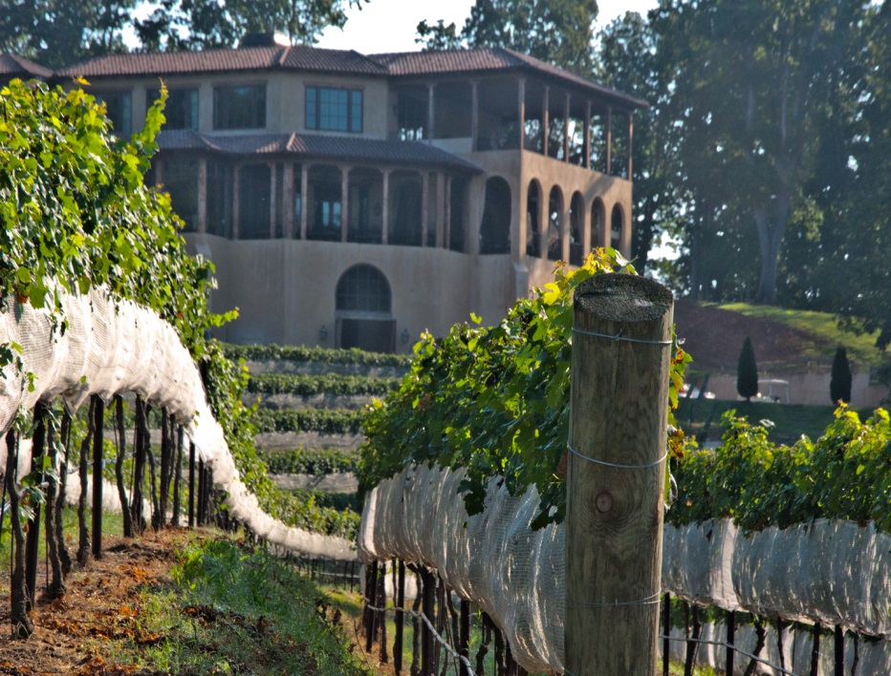
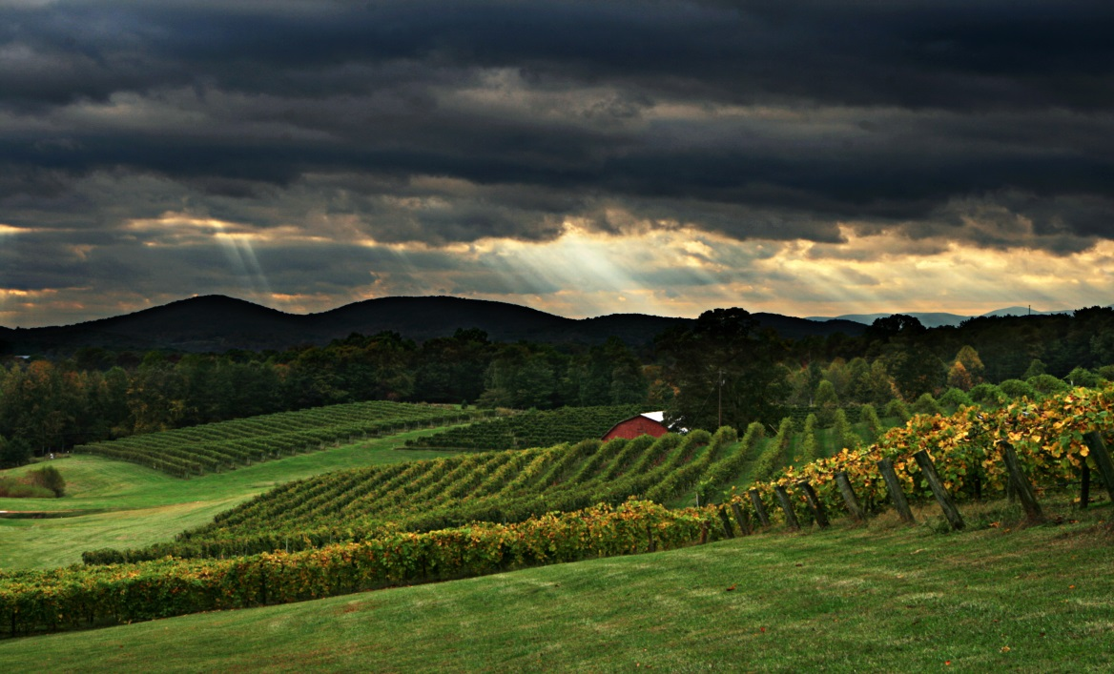
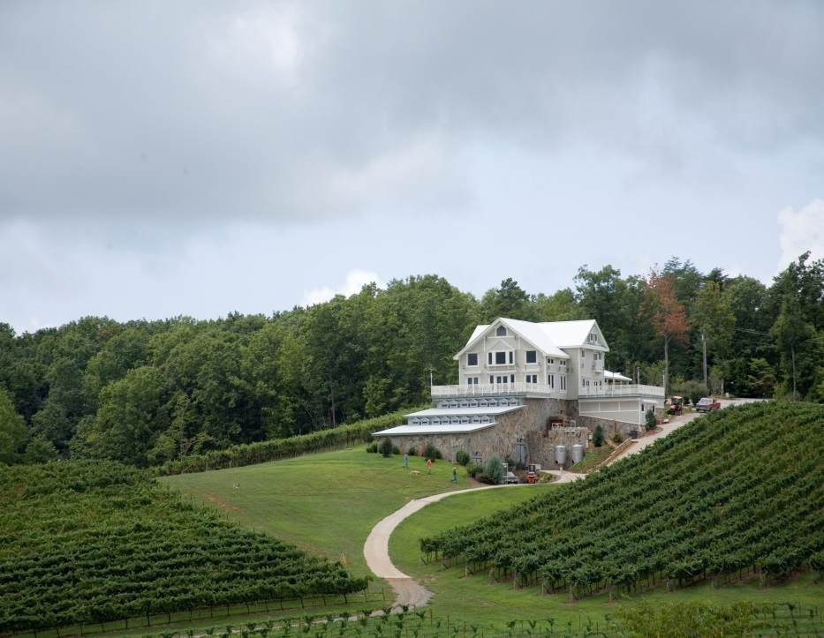
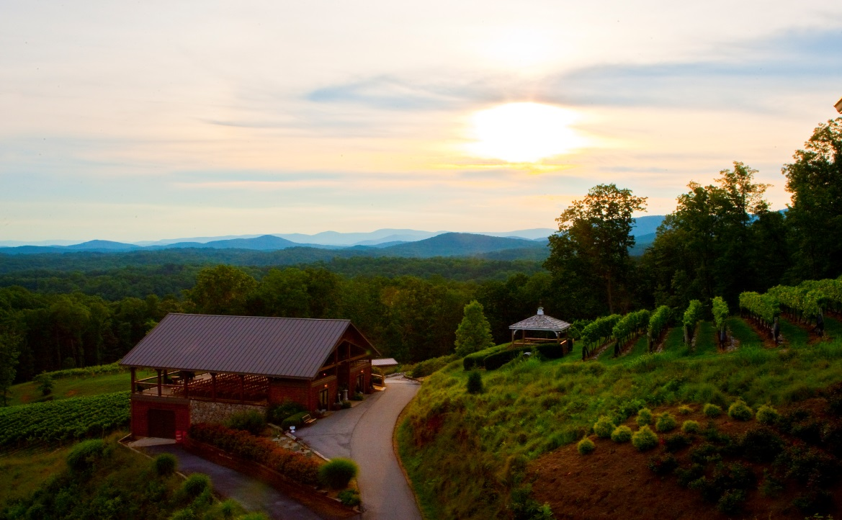
Heart of Georgia Wine Country

Slide 6
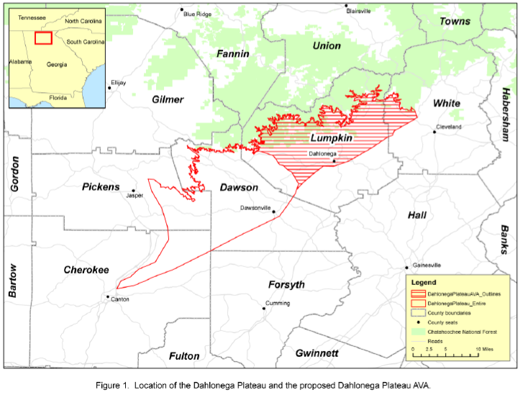
Dahlonega Plateau AVA

Slide 7

Dahlonega Plateau Promotion

Slide 8



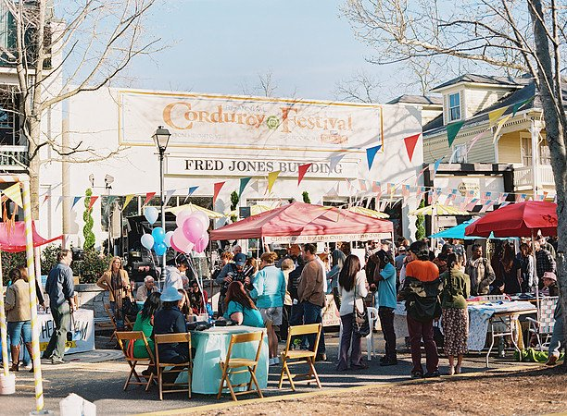



Film Production

Slide 9
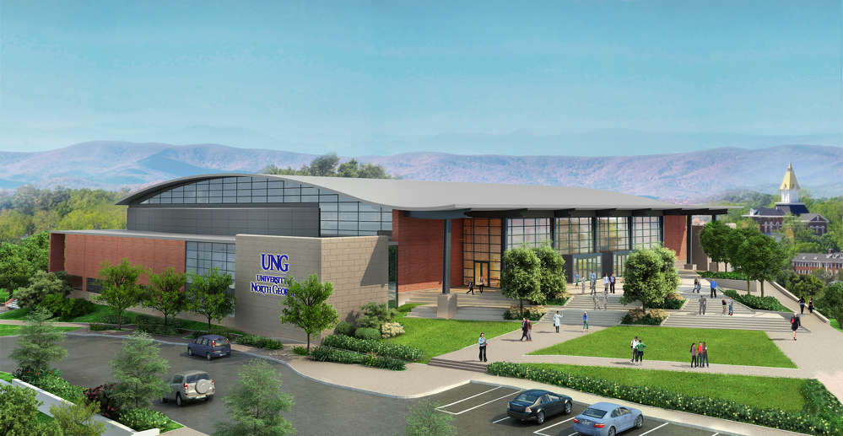


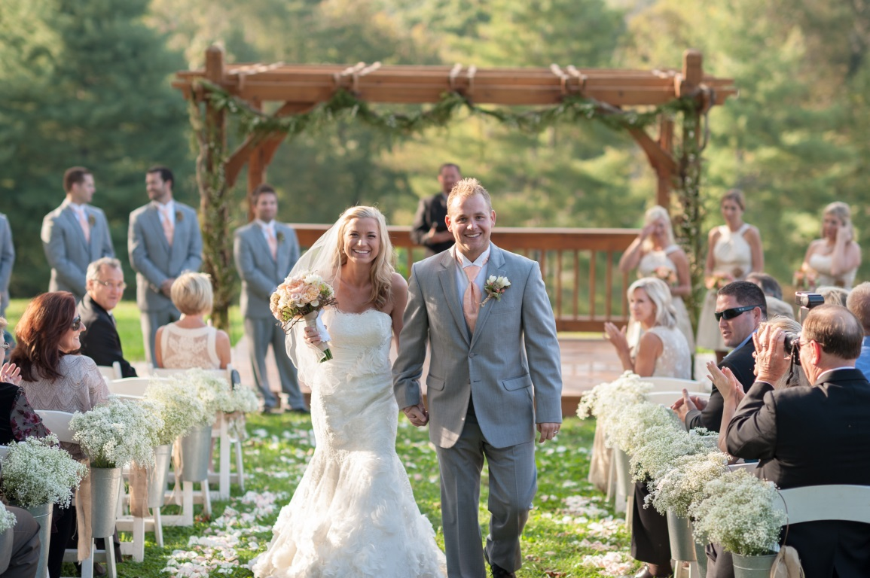
Leisure & Group Travel

Slide 10

On the Cusp of the Path of Totality

Slide 11

A Little Dive Bar in Dahlonega

