Slide 1
COAM Industry
Past, Present & Future
“Prediction is very difficult, especially if it's about the future.”
United C-Stores
David Jaffer
(770) 939-8720
djaffer@jafferlaw.com
United C-Stores

Slide 2
Future of the COAM Industry
The future is in your hands
Future of Education Funding
Future of Responsible Gaming
Future of Sensible COAM Legislation
United C-Stores

Slide 3
Future of the COAM Industry
Proposed Legislative Framework – Three Prong Test
Is the proposed legislation good for Georgia?
Can the Georgia Lottery Corporation administer the proposed legislation?
Is the proposed legislation equitable to the participants?
United C-Stores

Slide 4
Future of the COAM Industry
Independent C-Store Operators’ Recommendations:
Allow for contract incentives and remove roadblocks, like the 9-Months Rule
Minimum C-Store share to be no less then 45%
Georgia Lottery Gift Card Program
Revision of 50/50 Gross Retail Receipt rule to include gift card purchases
United C-Stores

Slide 5
Future of the COAM Industry
Allow for contract incentives and remove roadblocks, like the 9-Months Rule
Better Solution – Build on legitimacy, transparency and with clarity:
Allow market to provide for incentives like other vendors provide to control the real estate inside the convenience store
The incentive can be a form of a signup bonus or performance bonus, allow the free market to dictate
COAMs contracts will be fair, inducements will be flushed out of our system, Georgia Lottery’s job will become easier and Masters will be able to better protect their legitimate COAM contracts
United C-Stores

Slide 6
Future of the COAM Industry
Allow for contract incentives and remove roadblocks, like the 9-Months Rule
Application of the 9-month rule (2016 SB388):
1/1/2018 Location enters a three-year contract with a Master
United C-Stores

Slide 7
Future of the COAM Industry
Allow for contract incentives and remove roadblocks, like the 9-Months Rule
Application of the 9-month rule (2016 SB388):
1/1/2018 Location enters a three-year contract with a Master
12/31/2019 Location sells business
United C-Stores

Slide 8
Future of the COAM Industry
Allow for contract incentives and remove roadblocks, like the 9-Months Rule
Application of the 9-month rule (2016 SB388):
1/1/2018 Location enters a three-year contract with a Master
12/31/2019 Location sells business
The new owner cannot bring another Master to this location
United C-Stores

Slide 9
Future of the COAM Industry
Allow for contract incentives and remove roadblocks, like the 9-Months Rule
Application of the 9-month rule (2016 SB388):
1/1/2018 Location enters a three-year contract with a Master
12/31/2019 Location sells business
The new owner cannot bring another Master to this location
Either assume the existing contract or stay out of the market for 9-months – no COAM for 9-months
United C-Stores

Slide 10
Future of the COAM Industry
Allow for contract incentives and remove roadblocks, like the 9-Months Rule
Application of the 9-month rule (2016 SB388):
1/1/2018 Location enters a three-year contract with a Master
12/31/2019 Location sells business
The new owner cannot bring another Master to this location
Either assume the existing contract or stay out of the market for 9-months – no COAM for 9-months
Punishment to New Owner and Property Owner
United C-Stores

Slide 11
Future of the COAM Industry
Allow for contract incentives and remove roadblocks, like the 9-Months Rule
Application of the 9-month rule (2016 SB388):
1/1/2018 Location enters a three-year contract with a Master
12/31/2019 Location sells business
The new owner cannot bring another Master to this location
Either assume the existing contract or stay out of the market for 9-months – no COAM for 9-months
Punishment to New Owner and Property Owner
Because Master paid the inducement on 1/1/2018, they want to protect that inducement, it was not a legal transaction, they cannot sue based on a breach of contract, so they created this 9-month rule
Why does the new owner want to bring another Master? Same Reason – Inducement. Masters are now looking to expand the 9-month to 42 Month
United C-Stores

Slide 12
Future of the COAM Industry
Minimum C-Store share to be no less then 45%
Maintain minimum C-Store share to be no less then 45%
The 2013 legislation made COAM more lucrative for Masters
Locations were made to do more work for less payout
Future demands equity and fairness
Allow market driven incentives to reflect the workload between Location, Lottery and Master or change allocation amongst them
United C-Stores

Slide 13
Future of the COAM Industry
Minimum C-Store share to be no less then 45%
Maintain minimum C-Store share to be no less then 45%
The 2013 legislation made COAM more lucrative for Masters
Locations were made to do more work for less payout
Future demands equity and fairness
Allow market driven incentives to reflect the workload between Location, Lottery and Master or change allocation amongst them
Location Lottery Master
60 20 20
70 10 20
45+Incentives 20 35-Incentives
United C-Stores

Slide 14
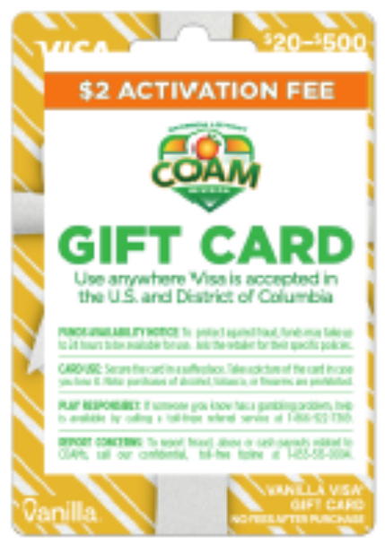
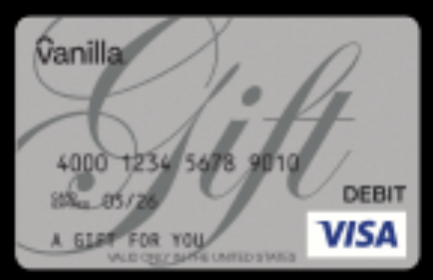
Future of the COAM Industry
Georgia Lottery Gift Card Program
Encourage Georgia Lottery to move forward with rolling out its Gift Card Program
United C-Stores

Slide 15

Future of the COAM Industry
Georgia Lottery Gift Card Program
Encourage Georgia Lottery to move forward with rolling out its Gift Card Program
Encourage Masters Licensees to reinvest in propriety card system
United C-Stores

Slide 16
Future of the COAM Industry
Revision of 50/50 Gross Retail Receipt rule to include gift card purchases
50/50 GRR
Reset GRR quarterly to allow for minor month to month fluctuation
United C-Stores

Slide 17
Future of the COAM Industry
Independent C-Store Operators’ Recommendations:
Allow for contract incentives and remove roadblocks, like the 9-Months Rule
Minimum C-Store share to be no less then 45%
United C-Store
Georgia Lottery Gift Card Program
Revision of 50/50 Gross Retail Receipt rule to include gift card purchases
United C-Stores

