Slide 1
COAM Industry
“Making Progress &
Moving Forward”
United C-Stores
David Jaffer
(770) 939-8720
djaffer@jafferlaw.com

Slide 2
COAM Industry
The size of the Convenience Stores (C-Store) industry
Economic contribution made by the C-Store to the Georgia economy
Nearly 2/3 of the C-Sores offer COAMs at their location
Independent C-Stores are the workhorse of the COAM industry
United C-Stores is a leading trade association dedicated to advancing the needs of the independent c-stores owners and operators.

Slide 3
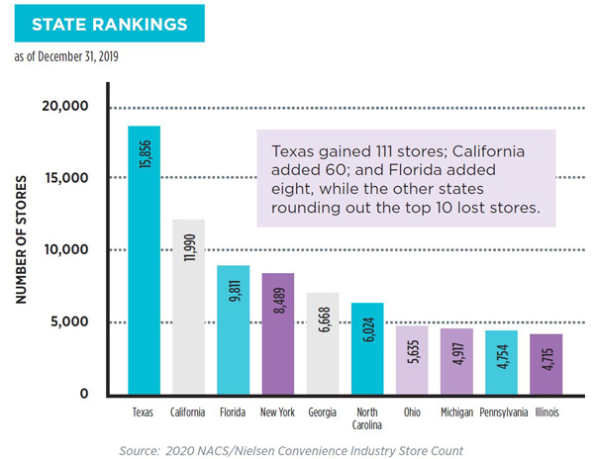
Georgia C-Store Sector
Number of C-Stores in GA

Slide 4
Georgia C-Store Sector
Total Number of C-Stores in Georgia: 6,668
Stores Selling Fuel: 5,846
Number of People Employees: 106,672
Transactions Per Day: 7,647,049
Total Sales: $35,692,357,862
Merchandise: $8,735,830,103
Foodservice: $1,712,685,630
Fuel: $22,135,218,402
Labor Expenses: $1,869,873,489
Credit Card Fees Paid: $575,835,457
Utilities Expenses: $176,275,480
Pre-Tax Profit: $880,830,706

Slide 5
Making Progress & Moving Forward
In 2013 the COAM licensing and regulatory function was transferred from the Georgia Department of Revenue (DOR) to the Georgia Lottery Corporation (GLC)
Our discussion will primarily focus on market conditions post 2013
Industry Transformation – COAM Renaissance

Slide 6
Making Progress & Moving Forward
COMPLIANCE
Innovation
TRUST
INCREASED REVENUE FOR GEORGIA
Statutory
foundation

Slide 7
Making Progress & Moving Forward
Successful Transformational Change.
Empowering the Georgia Lottery Corporation (GLC) to modernize the COAM revenue collection, accounting and distribution process through the GLC’s central accounting system.
Significantly more funding directed to our education system. From almost nothing in 2013 to over $90 million in 2020.
A solid foundation for expansion and growth supported by over 5000 retailers or Location Licensees.

Slide 8
Making Progress & Moving Forward
Impractical
Restraints
Unreasonable
Expectation
Inequity
Lack of technical innovation

Slide 9
Making Progress & Moving Forward
Bar against Incentives (Inducement)
Inequitable statutory provisions for LL v ML
50/50 Gross Retail Receipt
No transportability for COAM wining
Need better redemption system
Equitable distribution of COAM revenue
Today location are doing more with less

Slide 10
Making Progress & Moving Forward
Lack of Free Market Operation through legislation restraints
Unlawful to
Provide Inducement
9-Month
Rule

Slide 11
Making Progress & Moving Forward
Unnecessary & Frivolous Litigation
    Breach of Contract Claims
    Contract Manipulation
    Outdated Contract Provisions
    Law Cannot Solve All Problems

Slide 12
The Age of COAM Renaissance
United C-Stores provides its members a standard COAM Contract and offers a vault for contract storage
Move forward with Gift Card - Fantastic Plastic
Allow for industry incentives – It will make it equitable
Clean up existing COAM statutes to address inequities

