Slide 1

Community Health Centers- Great Community Partners now and in the Future
August 2017

Slide 2
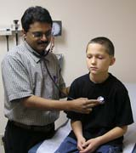
Georgia Today
In Georgia there are 34 FQHC organizations with 203 clinic sites in 111 counties and plans to expand.
For calendar year 2016 Health Centers served over 500,000 patients.
From 2004 to 2016 Georgia health centers increased patients served by 100%.
Source: UDS Georgia Rollup Report 2015

Slide 3
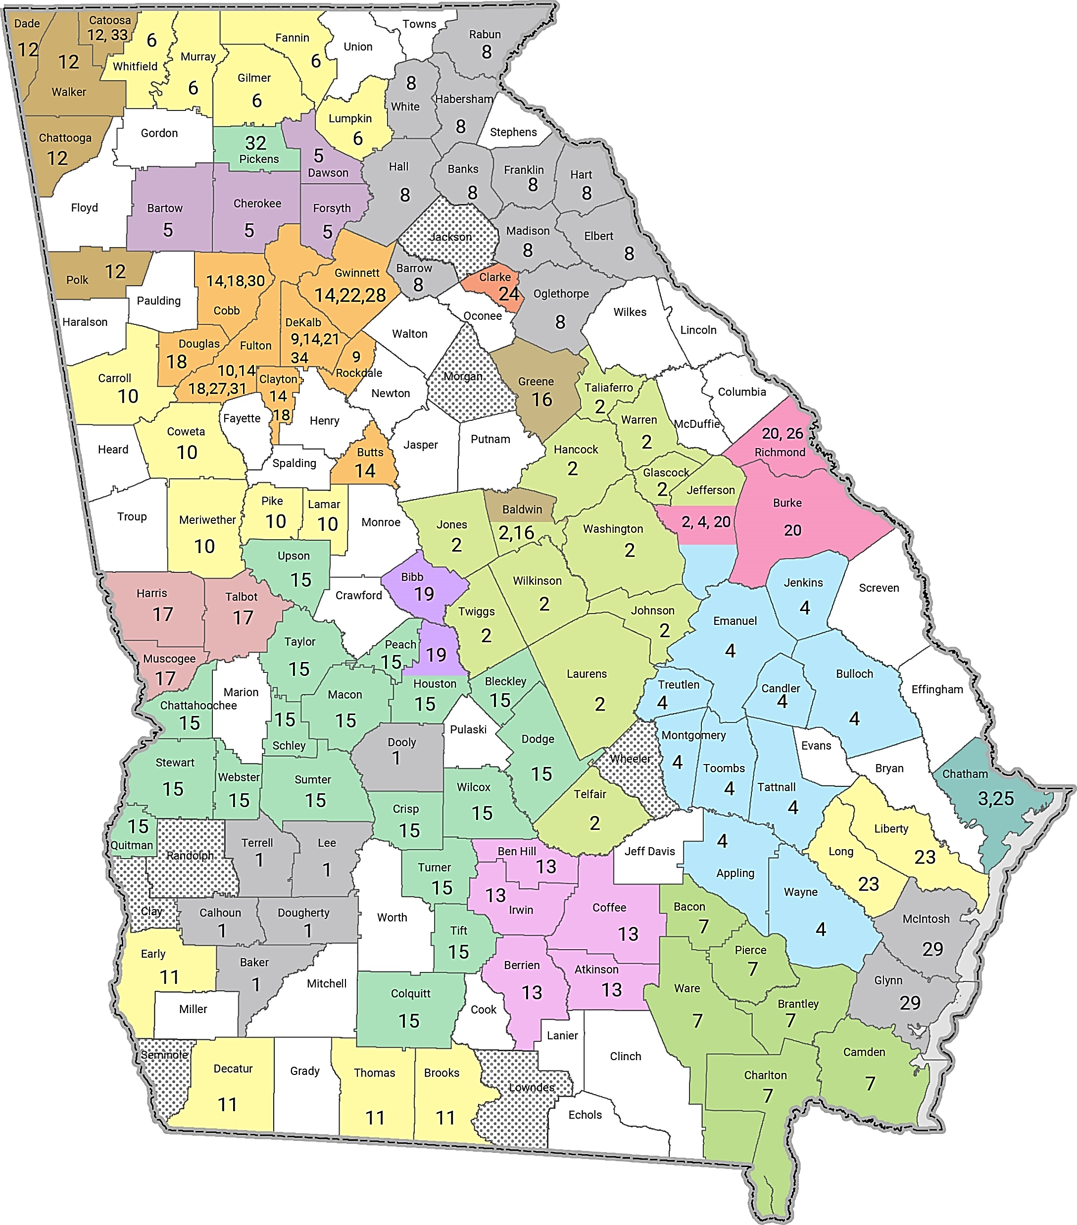
Georgia’s Community
Health Centers
1. Albany Area Primary Health Care, Inc.
2. Community Health Care Systems, Inc.
3. Curtis V. Cooper Primary Health Care, Inc.
4. East Georgia Healthcare Center, Inc.
5. Georgia Highlands Medical Services, Inc.
6. Georgia Mountains Health Services, Inc.
7. McKinney Community Health Center, Inc.
8. MedLink Georgia, Inc.
9. Oakhurst Medical Centers, Inc.
10. YourTown Health
11. Primary Care of Southwest Georgia, Inc.
12. Primary Health Care Center, Inc.
13. South Central Primary Care Center, Inc.
14. Southside Medical Center, Inc.
15. Southwest Georgia Health Care, Inc.
16. TenderCare Clinic, Inc.
17. Valley Healthcare System, Inc.
18. Family Health Centers of Georgia, Inc.
19. First Choice Primary Care, Inc.
20. Neighborhood Improvement Project, Inc.
21. Whitefoord Community Program, Inc.
22. Four Corners Primary Health Care, Inc.
23. Diversity Health Center, Inc.
24. Athens Neighborhood Health Center, Inc.
25. The J.C. Lewis Health Care Center, Inc.
26. Christ Community Health Services, Inc.
27. St. Joseph's Mercy Care Services, Inc.
28. Center for Pan Asian Community Services, Inc.
29. Coastal Community Health Services, Inc.
30. Good Samaritan Health Center of Cobb, Inc.
31. Health Education, Assessment and Leadership, Inc.
32. Good Samaritan Health & Wellness Center
33. North Georgia Healthcare Center, Inc.
34. Recovery Consultants of Atlanta, Inc.

Slide 4

Five Core Requirements for Community Health Centers
Governance by a community board with a patient majority of 51%
Location in a federally designated medically undeserved area
Have nonprofit, public or tax exempt status
Provide comprehensive preventive and primary health care services, referrals and other services needed to facilitate access to care, such as case management, translation and transportation
Provide services to all in their service area, regardless of ability to pay, and offer a sliding fee schedule that adjusts out-of-pocket charges for care according to family income.

Slide 5
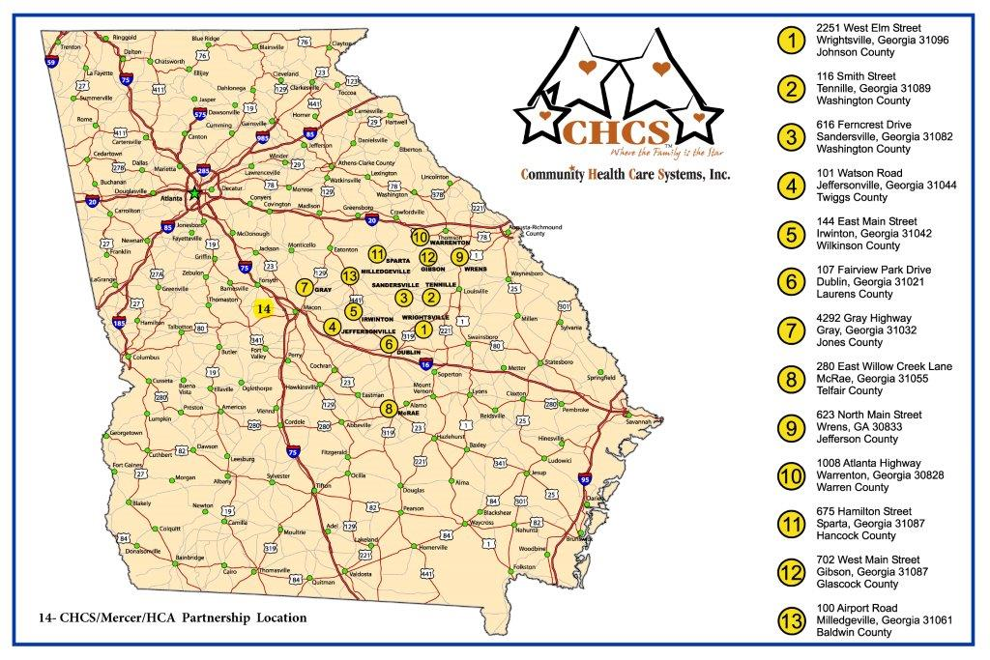

Slide 6

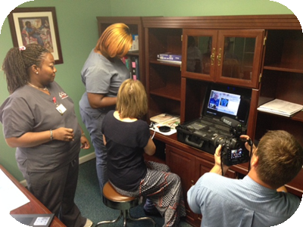

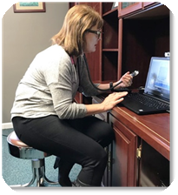
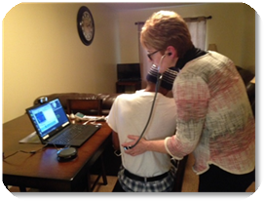

Provider Interaction at the office
At the patient’s home

