Slide 1

Behavioral Health Workforce in Rural Georgia
Barriers to Georgian’s Access to Adequate Healthcare
Study Committee Meeting
GA State Capitol
November 6, 2017
Kay Newberry Brooks, EdD, LPC
Aspire CEO

Slide 2
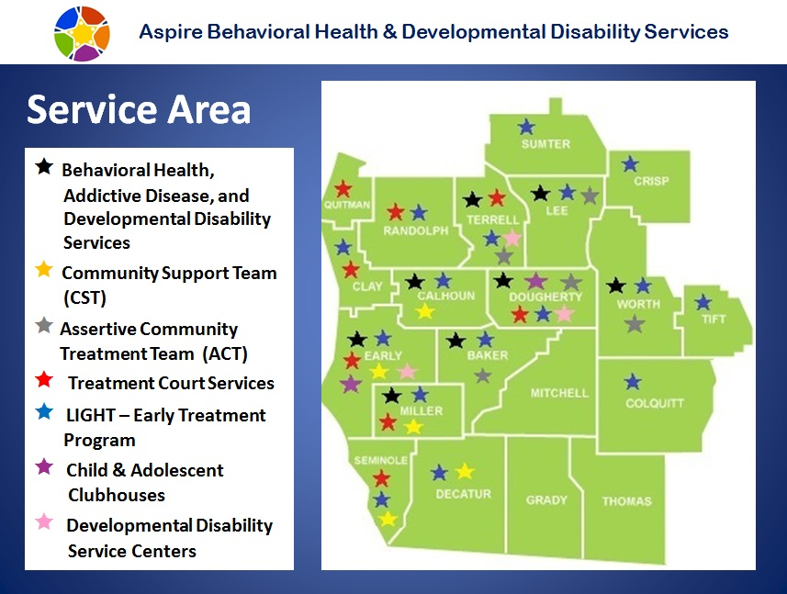
8,182 Square Mile Service Area
Poverty Rate: 24.6% SW GA | 16.5% GA | 14.7% Entire US | 17.2% Rural US

Slide 3


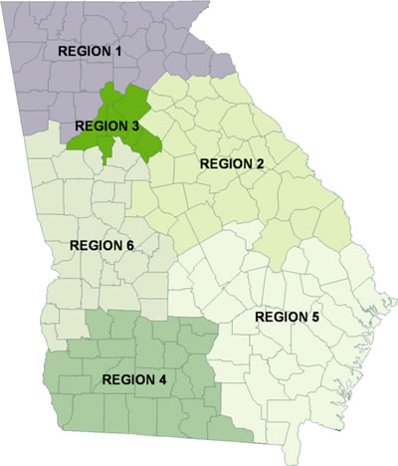

Georgia Department of Behavioral Health and
Developmental Disability
System of Care
Commissioner Judy Fitzgerald
If you or a loved one needs help dealing
with a behavioral health crisis,
the Georgia Crisis and Access Line (GCAL) offers free and confidential crisis intervention 24/7.

Slide 4
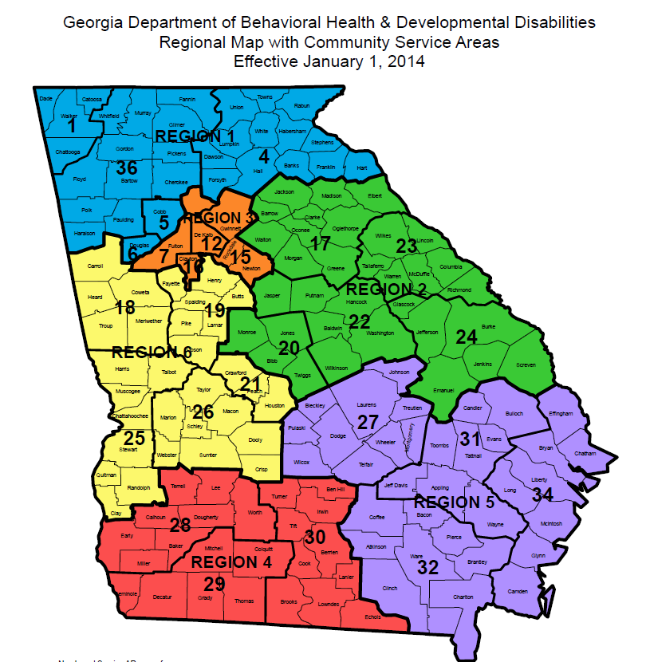

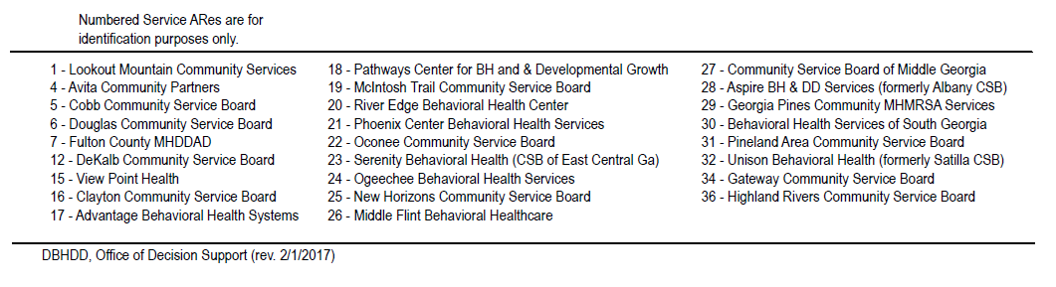

Slide 5

Behavioral Health Recovery is built on:
Appropriate Level of Care with appropriate community support services.
Health—overcoming or managing one’s disease(s) or symptoms – including abstinence if one has an addiction – and making informed, healthy choices that support physical and emotional wellbeing.
Home—a stable and safe place to live.
Purpose—meaningful daily activities, such as a job, school, volunteerism, family caretaking, or creative endeavors and the independence, income, and resources to participate in society.
Community—relationships and social networks that provide support, friendship, love, and hope.

Slide 6


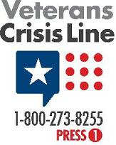

Recovery Focused Transformation Services
Recovery is possible! This belief guides the approach to mental health, addiction treatment and developmental disability services.
Services are centered on the individual and/or family and focused on their recovery journeys! Assisting individuals to achieve their goals, discover their strengths and identify what they need to make their recovery a reality.
Shift from crisis driven services to prevention focused, strength based, continuum of care that provides sustained support based on the strengths, the wellness, and hopes of the individual in recovery.
Recovery Focused Work force to include Certified Peer Specialist and Certified Addiction Recovery Empowerment Specialist

Slide 7
Trauma Informed Services
Promote trauma-informed practices in the delivery of services to people who have experienced violence and trauma and are seeking support for recovery and healing. Trauma informed practices are guided by the following fundamental beliefs.
People with lived experience of trauma can and do recover and heal;
Trauma-Informed Care is the hallmark of effective programs to promote recovery and healing through support from peers, consumers, survivors, ex-patients, and recovering persons and mentoring by providers; and
Leadership teams of peers and providers charting the course for the implementation of Trauma-Informed Care are essential. National Center for Trauma-Informed Care (NCTIC)

Slide 8

Behavioral Health is a Public Health Challenge!
In Georgia, over 2.3 million face the challenge of living with mental illness; 1 in 3 will receive treatment. 1 out of 4 adults will experience at least one behavioral health illness in their lifetime!
In U.S. death by suicide happens every 16 minutes
In Georgia, suicide is the 11th leading cause of death
In U.S. 22.1 million with substance abuse and 17.9 million with alcohol dependence or abuse
41% of Georgians with addictive diseases report needing treatment but are not receiving
One out of every 10 families are affected by intellectual disabilities
111,000 children in Georgia live with serious mental illness.
Adults with a co-occurring ICD-9 mental health disorder (in addition to substance dependence) was 48% for 50- to 64-year-olds and 61% for those aged 65 and over.
Opioid epidemic – increasing demand for addiction services – especially with elderly
Robust Accountability Court services
Strong referral to BH continuum of care for Individuals returning to community

Slide 9

Behavioral Health Needs of a Community
Early intervention- key to recovery
Easy access to services
Affordable services –
Individualized services – team approach
Evidence based treatment
Community based services (out of clinic)
Stakeholder collaboration
Positive outcomes

Slide 10
Competent Behavioral Health Workforce:
Community Support Staff
PEERS/CARES credentialed staff
Licensed Clinical Staff (LPC, LCSW, LMFT)
LPNs, RNs, NPs, APRNs, PAs
Primary Care Doctors, Psychiatrist

Slide 11

Behavioral Health Professional
Workforce Shortage
Uneven geographic distribution
Recruitment challenges across the treatment field
Fragmented system of provider silos that compete for limited workforce

Slide 12
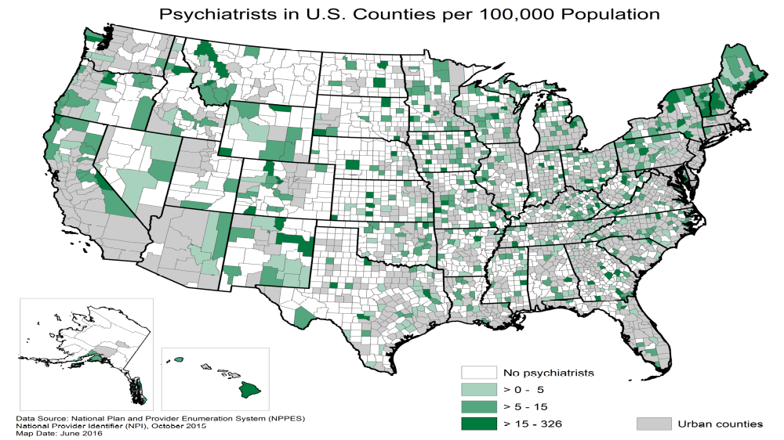

Slide 13
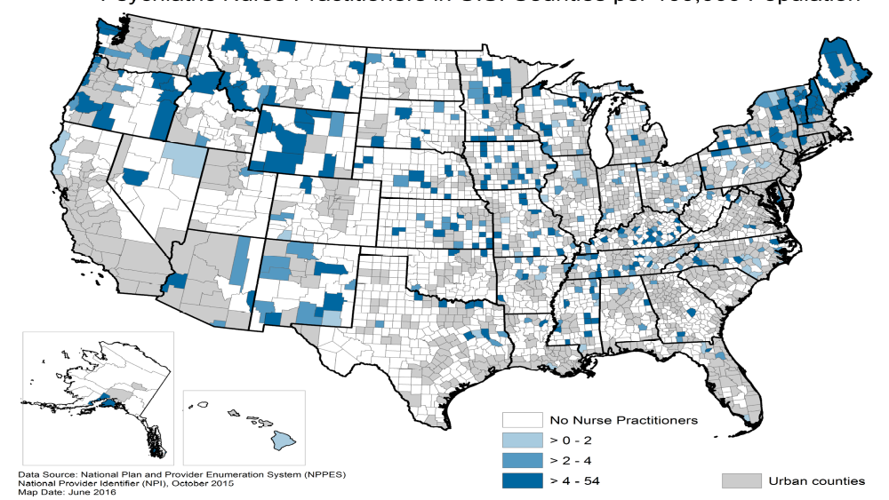
Psychiatric Nurse Practitioners in U.S. Counties per 100,000 Population.

Slide 14
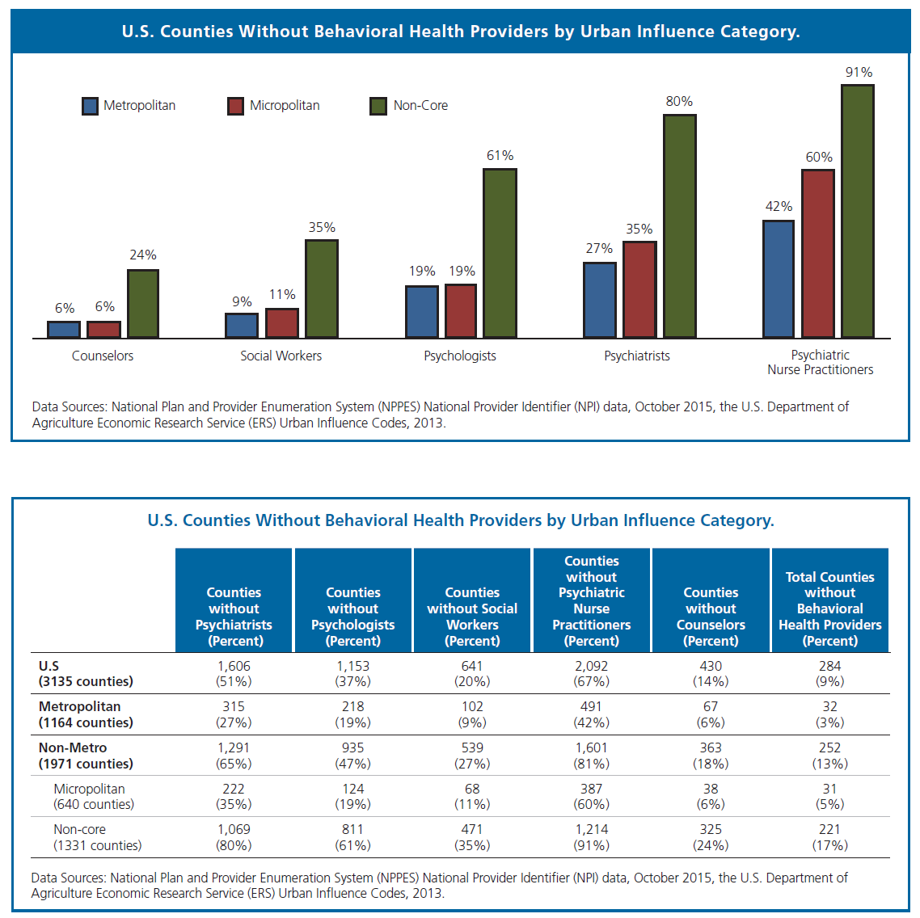

Slide 15
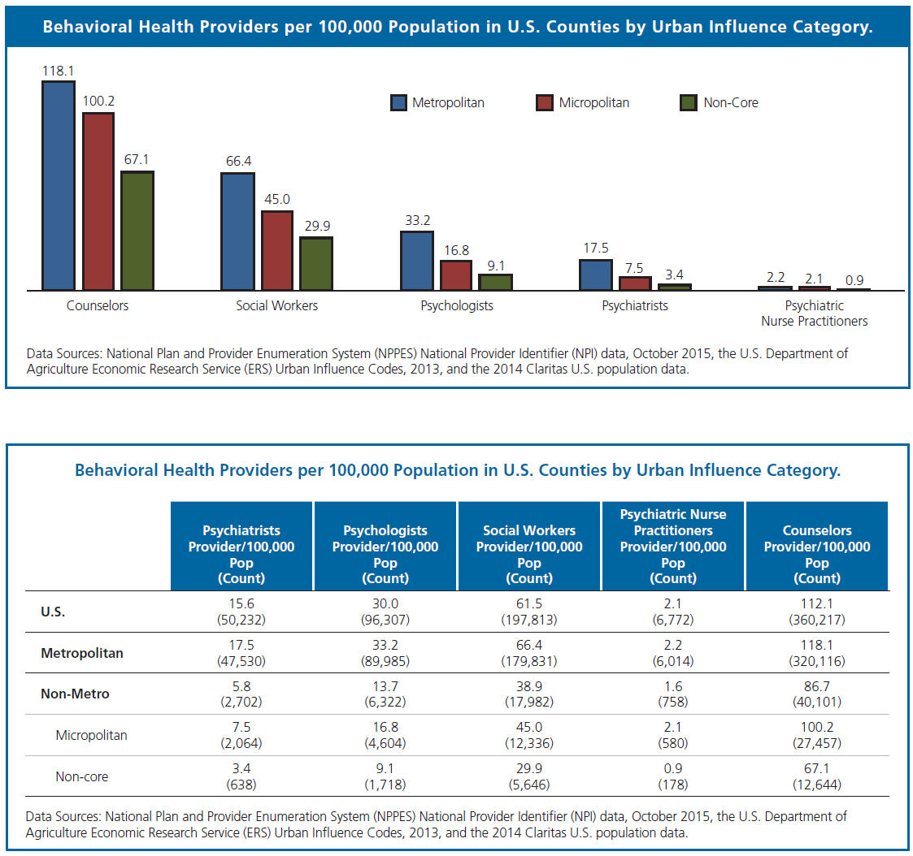

Slide 16
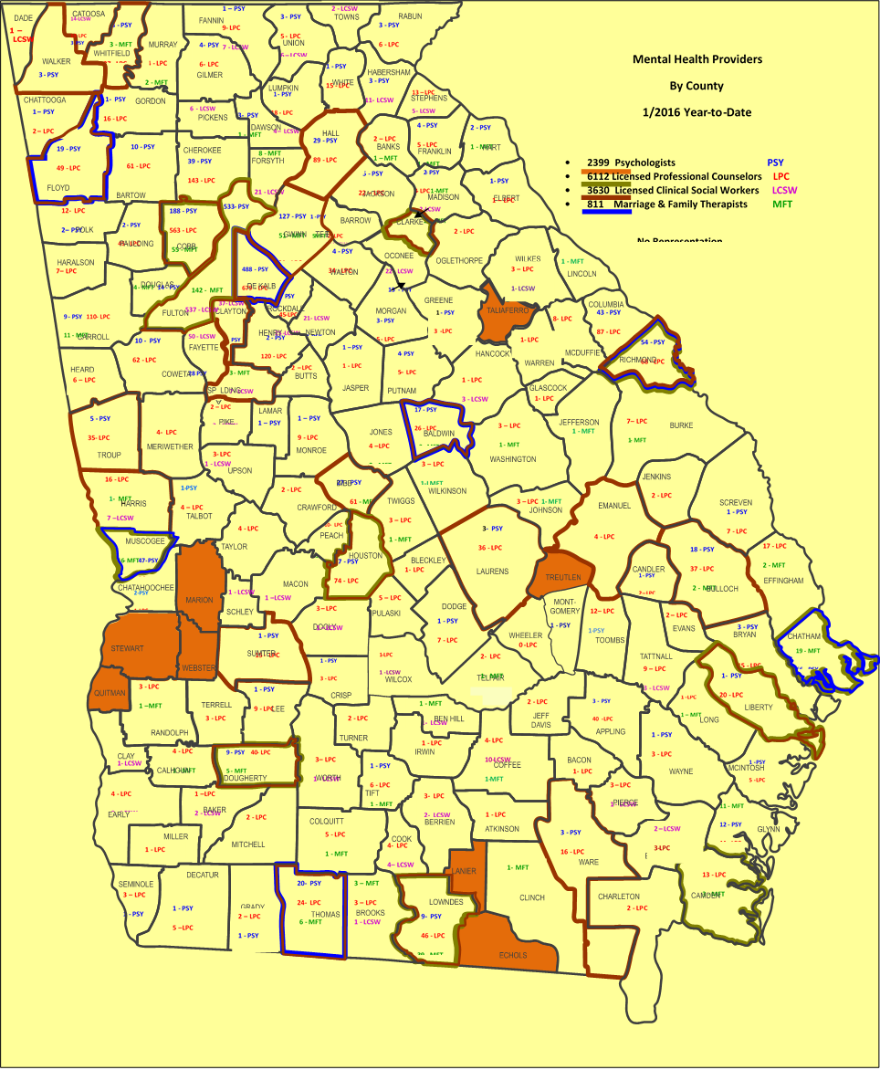


Slide 17
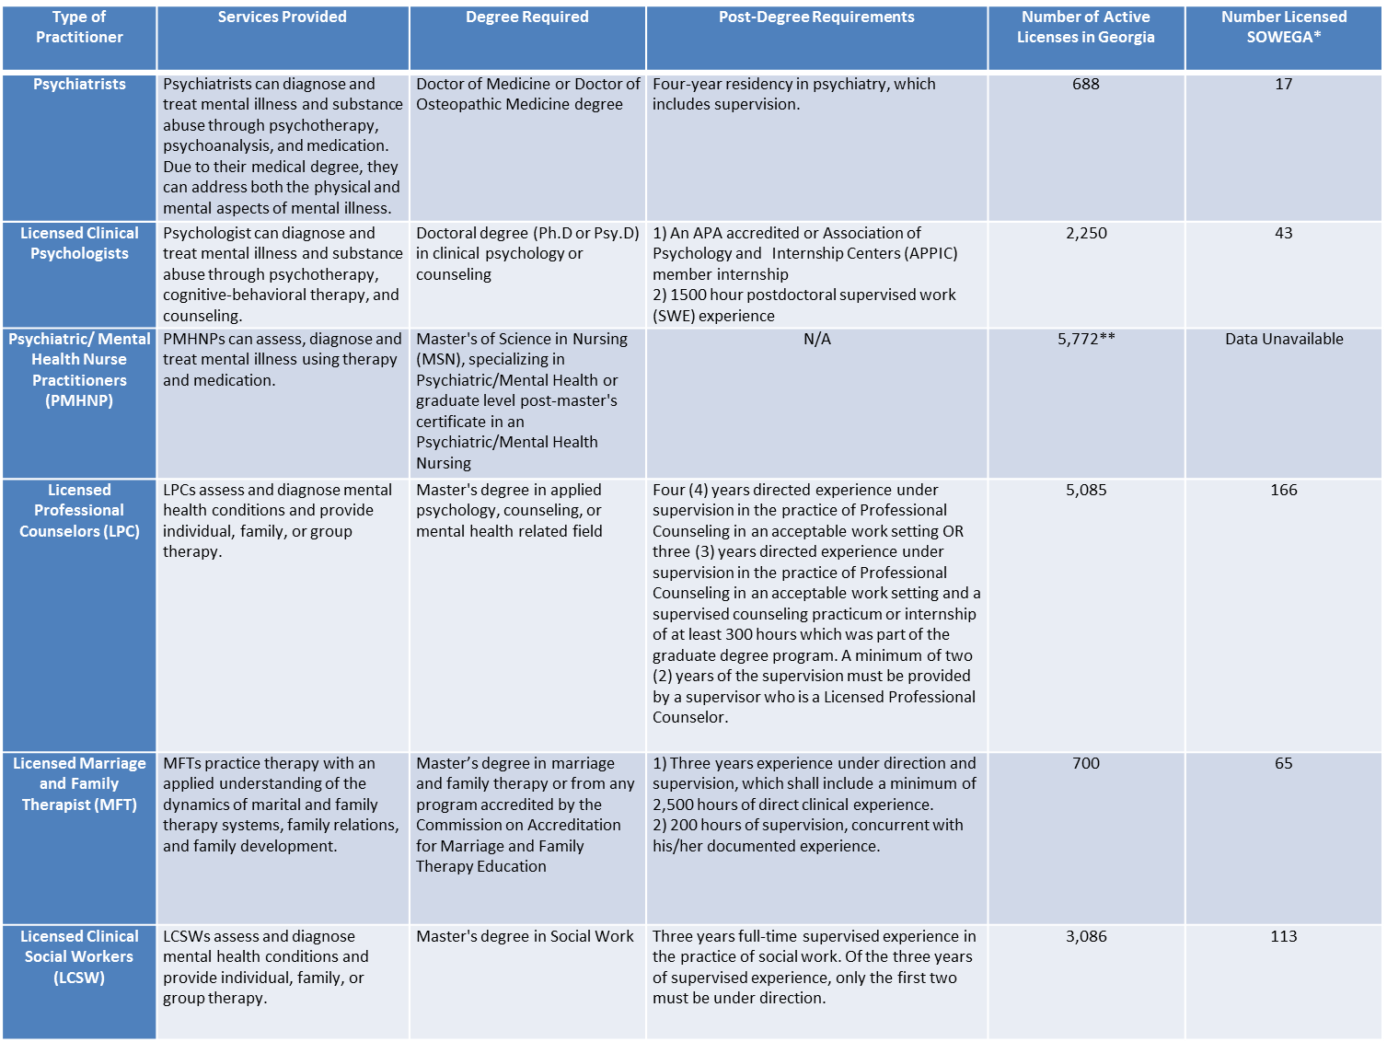

Slide 18
Challenge of an Aging Behavioral Health Workforce
46% of psychiatrists are older than 65 years old (national)
In Georgia:
  2015 survey, 58.7% of the physician workforce is age 50 and above and of that percentage, 20.1% reported they will retire in the next 5 years.
  21.2% of the physician workforce retiring in the age group of 50 and above are practicing in rural counties.

Slide 19
An integrated health and substance use disorder treatment system
requires a diverse workforce…
That includes, mental health counselors, physicians, nurses, mental health treatment providers, care managers, and recovery specialists.
However, Medicare, restricts “billable” health care professionals to physicians (including psychiatrists), nurse practitioners and clinical nurse specialists, physician’s assistants, clinical psychologists, clinical social workers, and certain other specified practitioners.
Medicare does not include as billable mental health counselors who are trained to provide services for substance use disorders.
A 2015 American Journal of Alcohol and Drug Abuse article reports that rural substance abuse treatment centers, compared to urban centers, had a lower proportion of mental health clinicians.

Slide 20


Partnership Benefits
Maximize available resources
Capitalize on Expertise
Collaborative Case Coordination to enhance recovery focused services
Healthy and Safe Families and Communities
Helping one, changing all!

Slide 21

OUTCOMES To Consider
With easy access to services, competent BH staff, appropriate treatment and community support services:
Improvement in care coordination between medical office/hospital/BH staff
Improvement in Treatment/Medication compliance
Stabilization of co-occurring medical/behavioral health concerns
Behavioral challenges decrease, school absence and suspension decrease
Emergency room visits, hospital stays, and periods of incarceration reduced.
High-risk and harmful substance use is decreased.
Employment opportunities for staff and individuals served

Slide 22
ASPIRE Behavioral Health and Developmental Disability Services –
Kay Newberry Brooks, EdD, LPC
Aspire Executive Director
229.430.4005
kbrooks@albanycsb.org

Slide 23
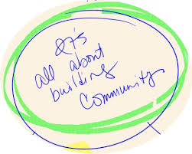

Slide 24
Resources:
Addressing Bullying http://www.stopbullying.gov
Appendix: Helpful Resources and Websites
(Note: These organizations, materials and links are offered for informational purposes only and should not be construed
as an endorsement of the referenced organization’s programs or activities.)
Children’s Mental Health Awareness Day http://www.samhsa.gov/children
Find Youth Info http://www.findyouthinfo.gov
Resources
Information About Mental Health • http://www.MentalHealth.gov
Additional information you could use to host a conversation in your community http://www.CreatingCommunitySolutions.org
sing Public Attitudes

Slide 25
Resources
National Institute of Mental Health (NIMH) http://www.nimh.nih.gov
National Registry for Evidence-Based Programs and Practices • http://www.nrepp.samhsa.gov
National Center for Trauma-Informed Care http://www.samhsa.gov/nctic
Children’s Mental Health Initiative Technical Assistance Center http://www.cmhnetwork.org
Recovery Support Services
National Consumer Technical Assistance Centers • http://ncstac.org/index.php
Homeless Resource Center http://www.homeless.samhsa.gov
Shared Decision Making in Mental Health Tools http://162.99.3.211/shared.asp
College Drinking: Changing the Culture http://www.collegedrinkingprevention.gov
Million Hearts http://millionhearts.hhs.gov/index.html
Resource Center to Promote Acceptance, Dignity, and Social Inclusion • http://promoteacceptance.samhsa.gov
Evidence-Based Practices for Treatment

Slide 26
Resources
SAMHSA-HRSA Center for Integrated Health Solutions: www.Integration.SAMHSA.gov
Substance Abuse and Mental Health Services Administration (SAMHSA) http://www.SAMHSA.gov
Suicide Prevention Resource Center • http://www.sprc.org
The Institute of Medicine’s Preventing Mental, Emotional and Behavioral Disorders Among Young People: Progress and Possibilities
http://www.iom.edu/Reports/2009/Preventing-Mental-Emotionaland-Behavioral-Disorders-Among-Young-People-Progress-andPossibilities.aspx
Voice Awards http://www.samhsa.gov/voiceawards
YouTube videos
  23 ½ Hours by Dr. Mike Evans
Monitoring tools and educational materials
  CDC: www.cdc.gov
  American Heart Association: www.heart.org
  American Diabetes Association: www.diabetes.org

