Slide 1

Attacking Dyslexia For All Of Our Children
Regardless of Zip Code, Race, and Ethnicity

Slide 2

45,000+ member teachers and others on the Campus, from 50 states and 42 countries.

Slide 3
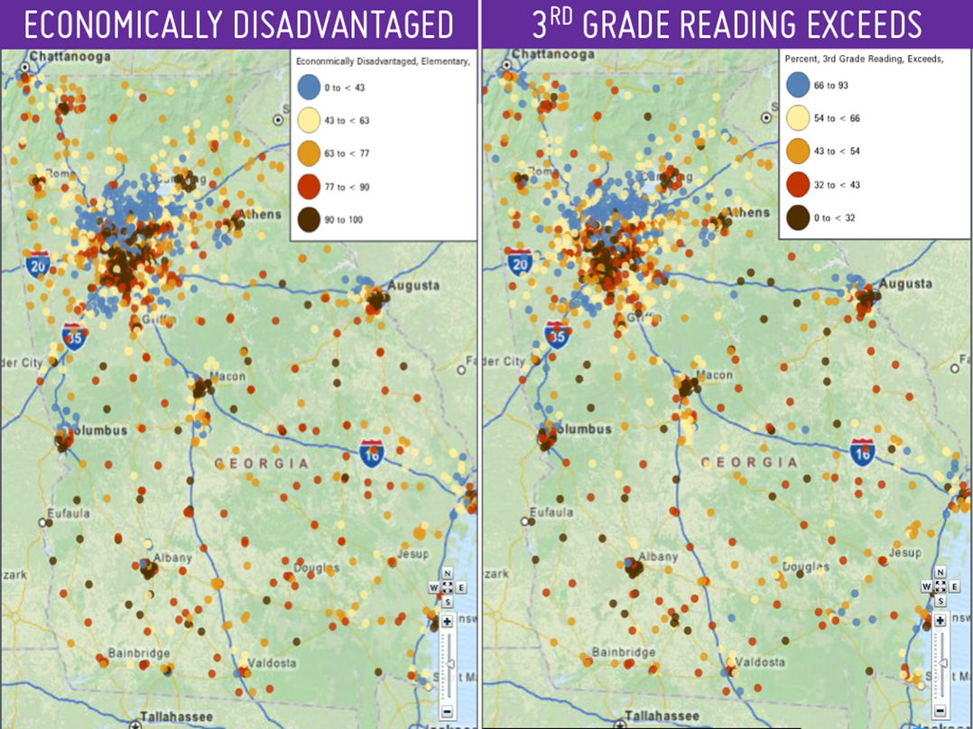

Slide 4
Construction of the Reading Brain
Silence no child
Be each child’s conversational partner
Set & teach expectations & procedures
Expand & extract language
Connect with each child
EXPAND
EXPAND
MONITOR & TEACH
MONITOR & TEACH
PREPARE
Language acquisition
Critical thinking
Executive functions
Empathy

Slide 5


Each Child’s Learning Profile is
as Unique as a Fingerprint

Slide 6
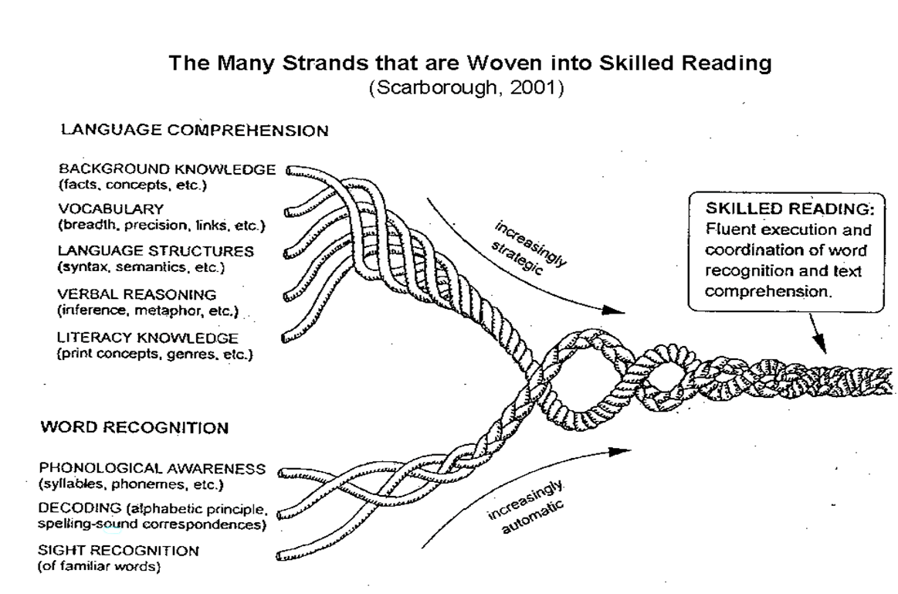









Slide 7

Dyslexic Brains Require Research-Proven Methodologies and Programming
to Learn to READ
Multi-sensory
Systematic
Intentional
Sequential
Scaffolded
Small group or individual
Wilson
Orton Gillingham
S.P.I.R.E
Fundations
Lindamood Phoneme Sequencing Program (LiPs)

Slide 8
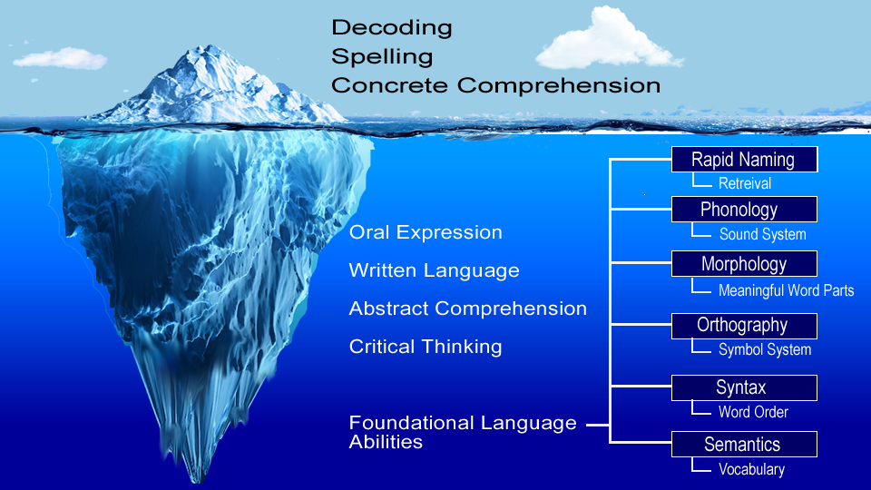

Slide 9
Instructing and Monitoring a Dyslexic Brain
Explicit, systematic multi-sensory instruction for all students, all components identified by NRP.
Concentrate on phonemic processing, phonics, decoding, and fluency until all are stable.
Strategic focus for oral and written language at each grade level.
Develop greater syntactical understanding, empathy, executive functioning, critical thinking.
Use formative and summative assessment
MONITORING AND
TEACHING THE READING BRAIN

Slide 10
IDEA 2004
EXCLUSIONARY FACTORS
34 C.F.R. § 300.534
Determination of eligibility (b) A child may not be determined to be eligible under this part if— (1) the determinant factor for that eligibility determination is (i) Lack of instruction in reading or math; or (ii) Limited English proficiency; and (2) (c) (10) (ii) The term does not include learning problems that are primarily the result of visual, hearing, or motor disabilities, of mental retardation, of emotional disturbance, or of environmental, cultural, or economic disadvantage.

Slide 11
cyates@atlantaspeechschool.org
smims@atlantaspeechschool.org
www.coxcampus.org

