Slide 1

Rural Broadband
Frankie Rigdon – VP Operations
Jason Smith – VP Business Development

Slide 2
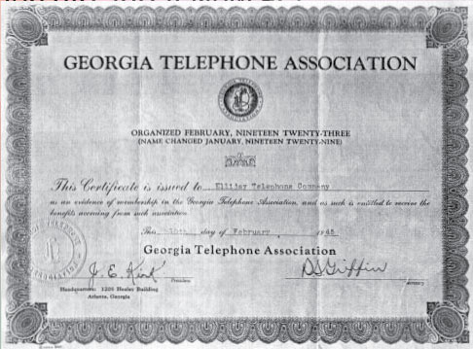

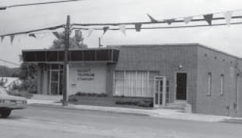
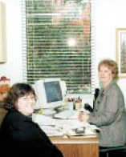
114 Years ago…
Leaders in Communication
since 1903
Internet Beginnings
Dial-up provider offering 56K in 1996
“High Speed” DSL initially offering 768K & 1.5Mb in early 2000
Cable Modem initially offering 10Mb in 2006

Slide 3


Offerings
More Internet than Telephone
Cable Modems
Hundreds of Megabits
Fiber Optics
ETC keeps Growing, Looking to Serve
ILEC
Gigabit (1000 Megabits) Speed
Gilmer County
CLEC
Pickens County 1999
Fannin County 2004
TN License 2005
NC License 2014
- Continuing to Lead, Evolve and Serve

Slide 4
Where ETC is Going
Growing Private Partnerships
Providing wholesale services to commercial partners
Community Fiber Optics Builds
Crowd-Funding Approach
  {Market > Set Goals > Get Commitments > Launch when goal is met}
Continued strategic investments
Supporting technology evolution, demand and network reliability

Slide 5
Need & Opportunity
Growing Demand
54% of Broadband customers subscribe to 40Mb/4 or More
Why?
Broadband isn’t used for just Internet
Gap = Opportunity
88% of customers are at base speeds of 20/2 up to 150/20, (new Ignite Fiber ranging from 50Mb to 1Gig Synchronous)
6% of customers are at max speeds of 6Mb
5% of customers are at max speeds of 3Mb
1% of customers are at max speeds of 1.5Mb
12% of Broadband customers can only get 1.5Mb-6Mb

Slide 6
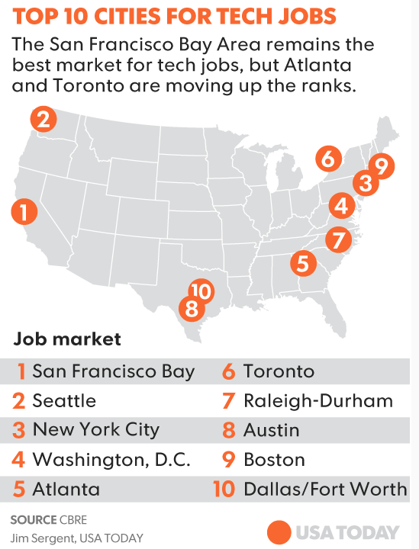
Did You Know?
Investing in Rural is Important!
Quality of Life
Education/Distance Learning
Healthcare/Telemedicine
etc…
7/2017
These examples, and more, lead to major economic impact in rural communities.
Support Tech Talent Growth
Remote Offices / Work
Source: https://www.usatoday.com/story/tech/2017/07/18/top-cities-tech-jobs-now-include-atlanta-and-toronto/484759001/

Slide 7
Desire to Serve… Need help
Bridge Gap
Incentives
Funds needed to bridge gap for ROI buildouts
Similar to how USF (Universal Service Fund) drives voice
- We are Willing and Ready to Serve -

Slide 8
Contact Information
Frankie Rigdon
706.697.5557
frankier@ellijay.com
Jason Smith
706.697.5576
jasons@ellijay.com
etcnow.com

