Slide 1

Education of Advanced Practice Registered Nurses (APRN)
Elizabeth Downes, DNP, MPH, APRN, FNP-BC, CNE, FAANP, ANEF, FAAN
Betty Tigner Turner Clinical Professor
MSN Program Director
Paul D. Coverdell Peace Corps Fellows Director
Consultant, The Carter Center
Nell Hodgson Woodruff School of Nursing at Emory University
CCNE Accreditation Visitor

Slide 2
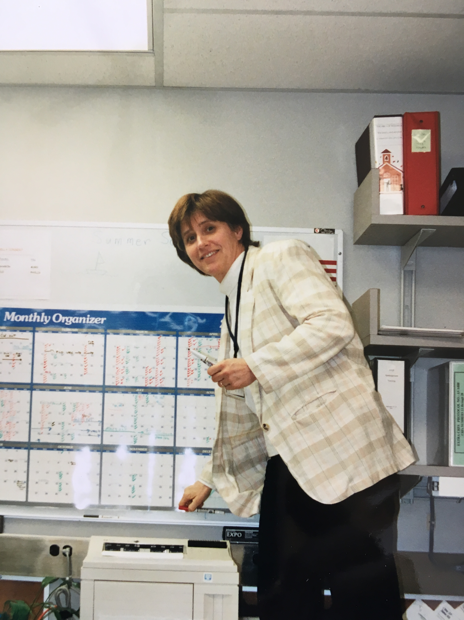
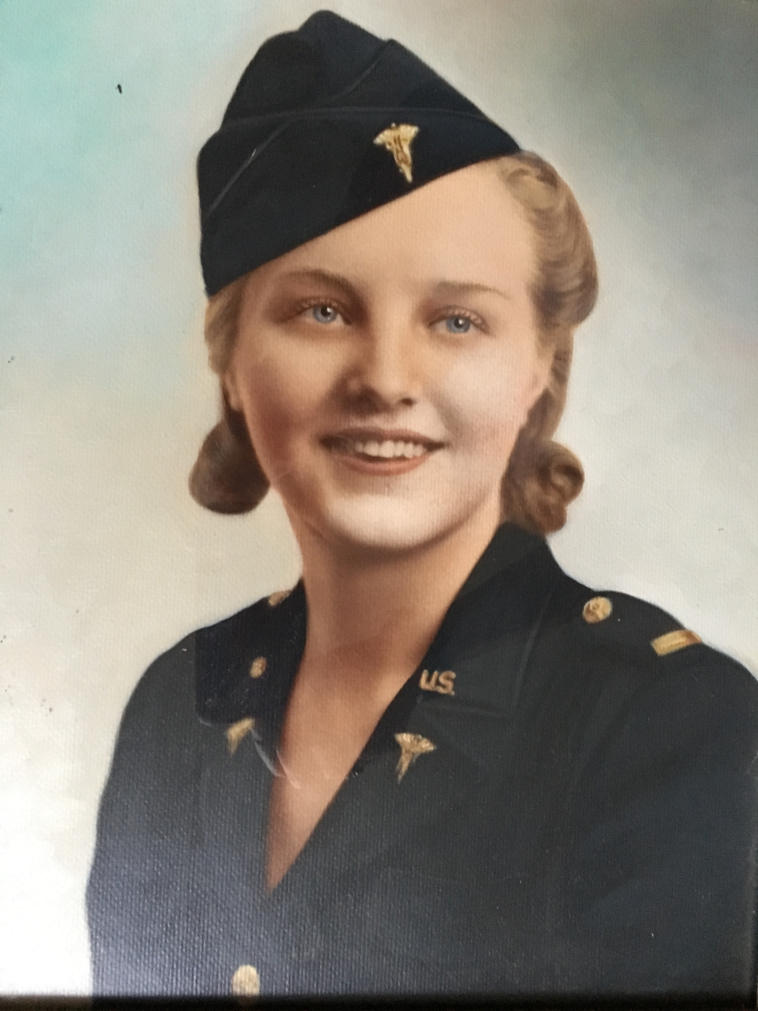
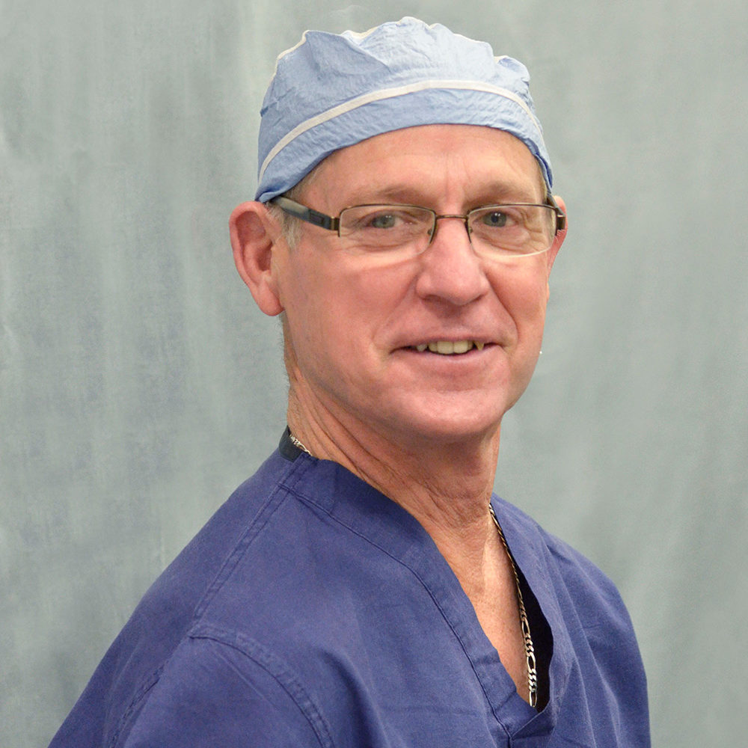
Transitions in nursing

Slide 3
Intra Professional Progression
MA
PA
MD
NA
RN
APRN
DA
DH
DDS
Notes:
MA Medical Assistant -> PA Physicians Assistant -> MD Medical Doctor
NA Nurse Assistant -> Registered Nurse -> Advance Practice Nurse
DA Dental Assistant -> Dental hygienist -> Doctor of Dentistry
Reference; Marion, L

Slide 4
Paul Abramowitz, 2009. The evolution and metamorphosis of the pharmacy practice model
“Situations in health care change because of the people who are providing the day-to-day patient care activities, coupled with visionary leaders, who ask themselves important yet simple questions. How can what we do be made more effective, more efficient, and safer?”
Notes:
http://www.harveywhitney.org/lectures/paul-w-abramowitz/

Slide 5
Evolution and metamorphosis entry to practice
Profession | Degree | Year of transition | basis
Pharmacy | PharmD | 1997 (2005) | ACPE*
Physical Therapy | DPT | 2017 | CAPTE**
Notes:
*Accreditation Standards and Guidelines for the Professional Program in Pharmacy Leading to the Doctor of Pharmacy Degree. Accreditation Council for Pharmacy Education. Chicago; 2006
** Commission Accreditation in Physical Therapy http://www.capteonline.org/uploadedFiles/CAPTEorg/About_CAPTE/Resources/Accreditation_Update/AccreditationUpdate_0110.pdf#search=%22DPT requirement%22

Slide 6
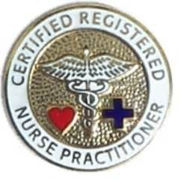
MSN prepared APRNs
Standardized curricula
Credentialed programs
Clinical practica
Full disclosure: I am the MSN program Director at Emory

Slide 7

MSN well prepared APRN AND
There is need for advanced competencies:
Increasingly complex care
Improving patient outcomes
Enhanced leadership skills
Financial management
Faculty roles

Slide 8
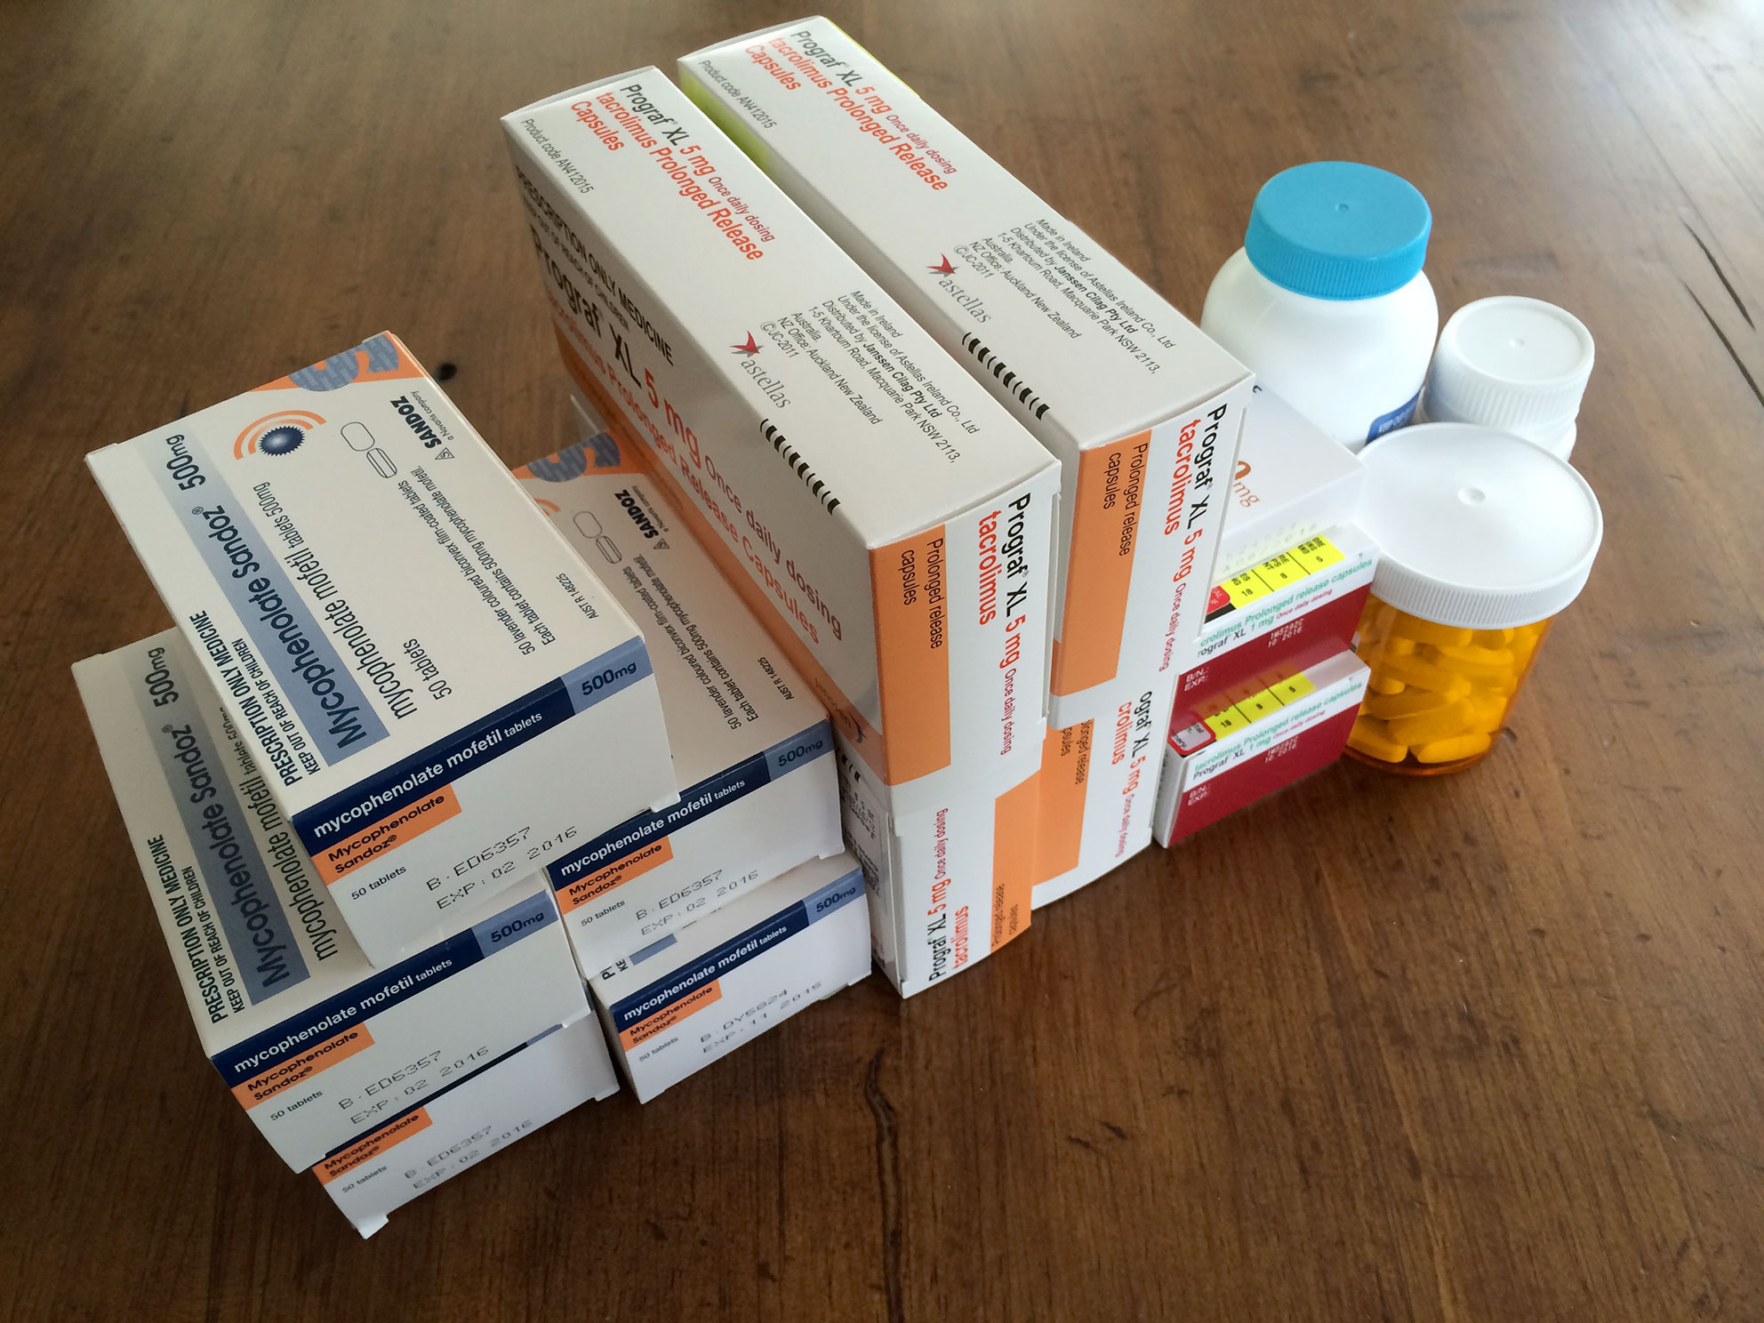
MSN well prepared APRN skilled but

Slide 9

Another Masters? MBA?

Slide 10
Nurses with practice doctorates are needed to do the following:
Evaluate the evidence base for care;
Deliver that care;
Set healthcare policy;
Lead and manage clinical care units and health systems;
Develop interdisciplinary standards;
Solve healthcare dilemmas; and
Reduce disparities in healthcare delivery.
Notes:
Marion, L., Viens, D., O’Sullivan, A., Crabtree, K., Fontana, S., Price, M., (2003). The practice doctorate In nursing: Future or Fringe? https://www.medscape.com/viewarticle/453247

Slide 11

Parity

Slide 12

Questions??
Elizabeth Downes
edownes@emory.edu
404-727-1544 (office)

