Slide 1
Financial Efficiency Star Rating
Ted Beck, CFO
Tiffany Taylor, Policy & External Affairs
Georgia Department of Education

Slide 2
Objective
Provide information on the Financial Efficiency Star Rating (FESR) and seek the elimination of the star rating requirement outlined in O.C.G.A. §20-14-33(c).

Slide 3
FESR Requirements
Adoption, annual review and publication by GOSA and GaDOE
Review and ratings for individual schools and school systems
Comparison to state standards, progress on improved student achievement, and comparable performance
Five-star rating system, with rankings from “5 = Excellent” to “1 = Unsatisfactory”

Slide 4
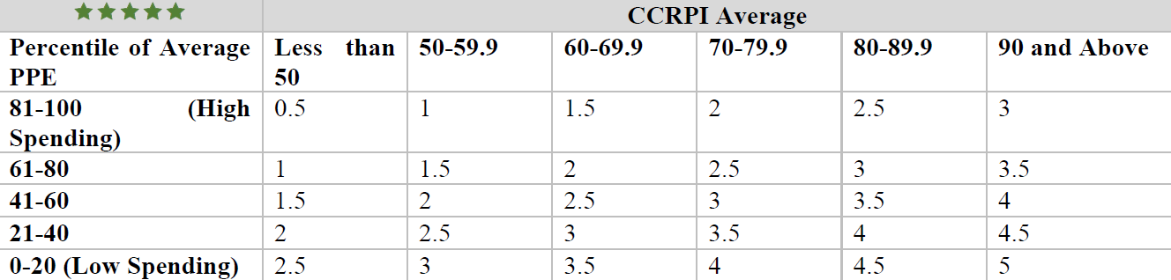
FESR System
Star rating (0.5 to 5) compares Per Pupil Expenditures (PPE - force ranked and placed on a 0-100 scale) to CCRPI scores

Slide 5
Issues with FESR
Ranking per pupil expenditures
  Process for fulfilling the “comparable performance” requirement
  Does not account for variability in districts
    Base costs to operate penalize small and rural districts
    Spending needs, in part, related to makeup of school population
  Rewards for spending less on students and punishes for spending more on students
Comparison of spending to achievement
  Array of data gives the illusion of a correlation
  Statistical evaluation/study needed to understand and make this correlation
Federal Funding is an inverse of FESR calculation
  Federal: more funding based on poverty, at-risk populations, and poor performance
  FESR: High performance vs. low per student cost
Scope
  Simple rating fails to capture the essence of complex data calculations
  Unfunded mandate requiring significant time and effort for implementation and management

Slide 6
Proposed Solutions
Eliminate FESR, which includes the requirement of a star rating
Eliminate the comparison of financial efficiency to achievement, progress, and comparable performance.
Require financial transparency and information from GaDOE and schools, without the judgment determinations
  Financial Transparency Act (2017)
    Financial data collected by GaDOE
    Published on comprehensive dashboard
    Overlaps with FESR requirements
  Dashboard could be updated to provide information such as CCRPI score (or score components) for quick review and comparison, without making judgment determinations for the consumer.

Slide 7
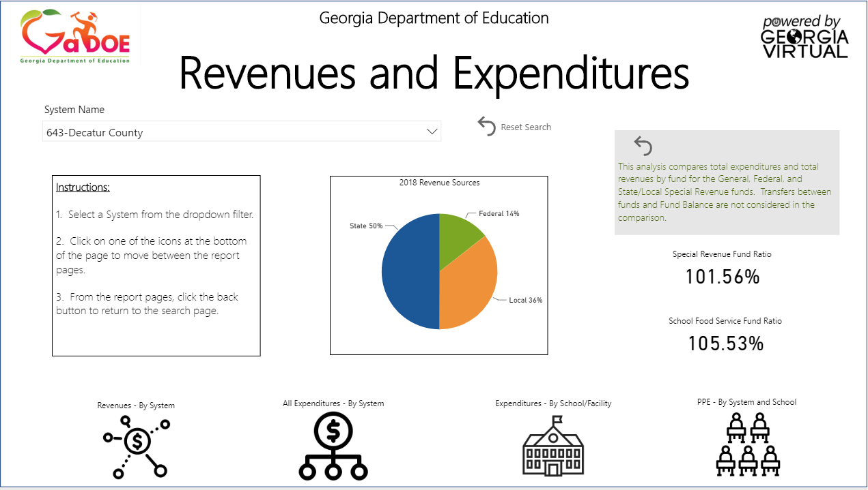
Financial Transparency Dashboard: Decatur City
Decatur City Schools
FESR: 2.5
CCRPI: 88.1 (3-yr avg)
PPE: $11,235.04 (3-yr avg)

Slide 8
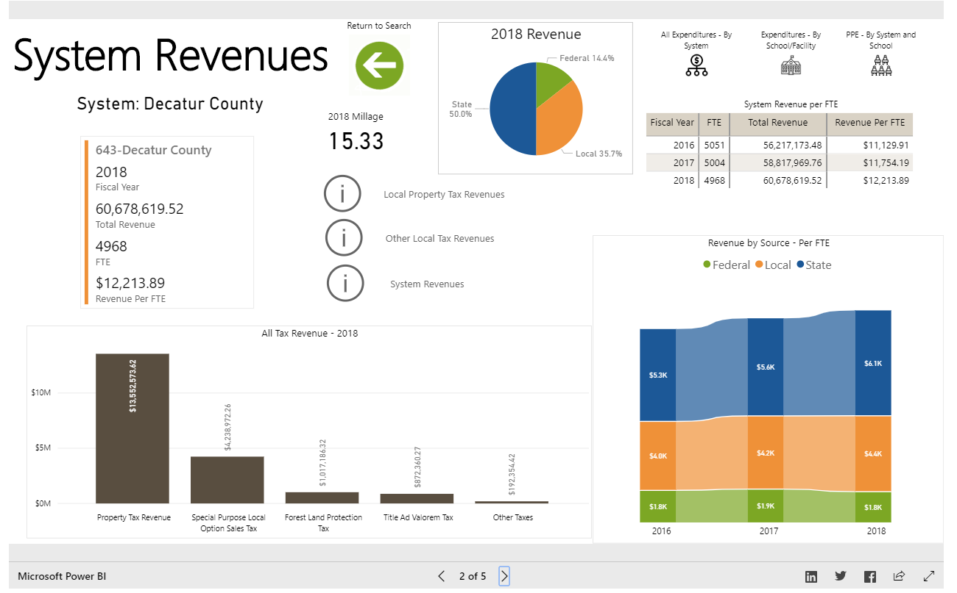
Financial Transparency Dashboard: Decatur City

Slide 9
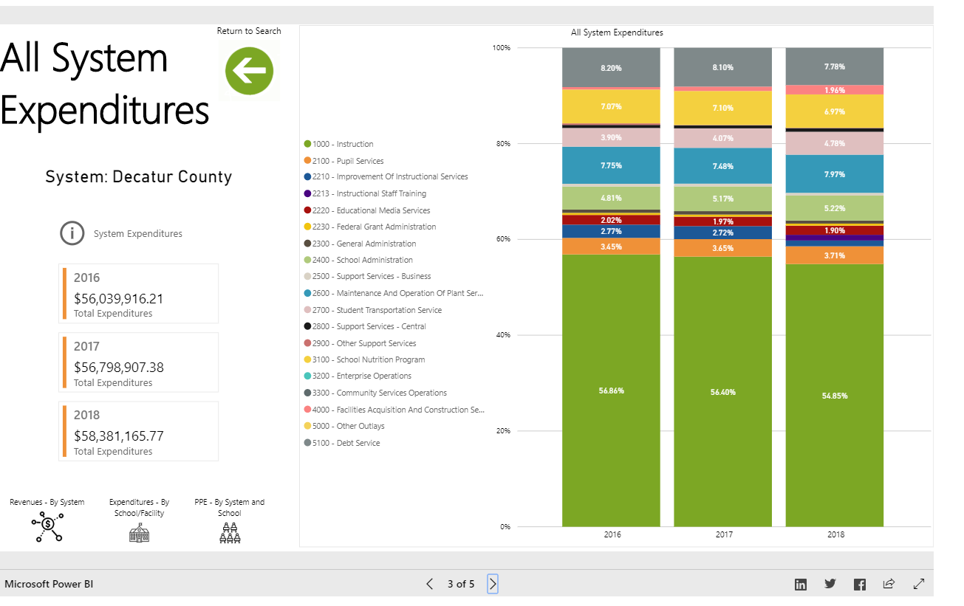
Financial Transparency Dashboard: Decatur City

Slide 10
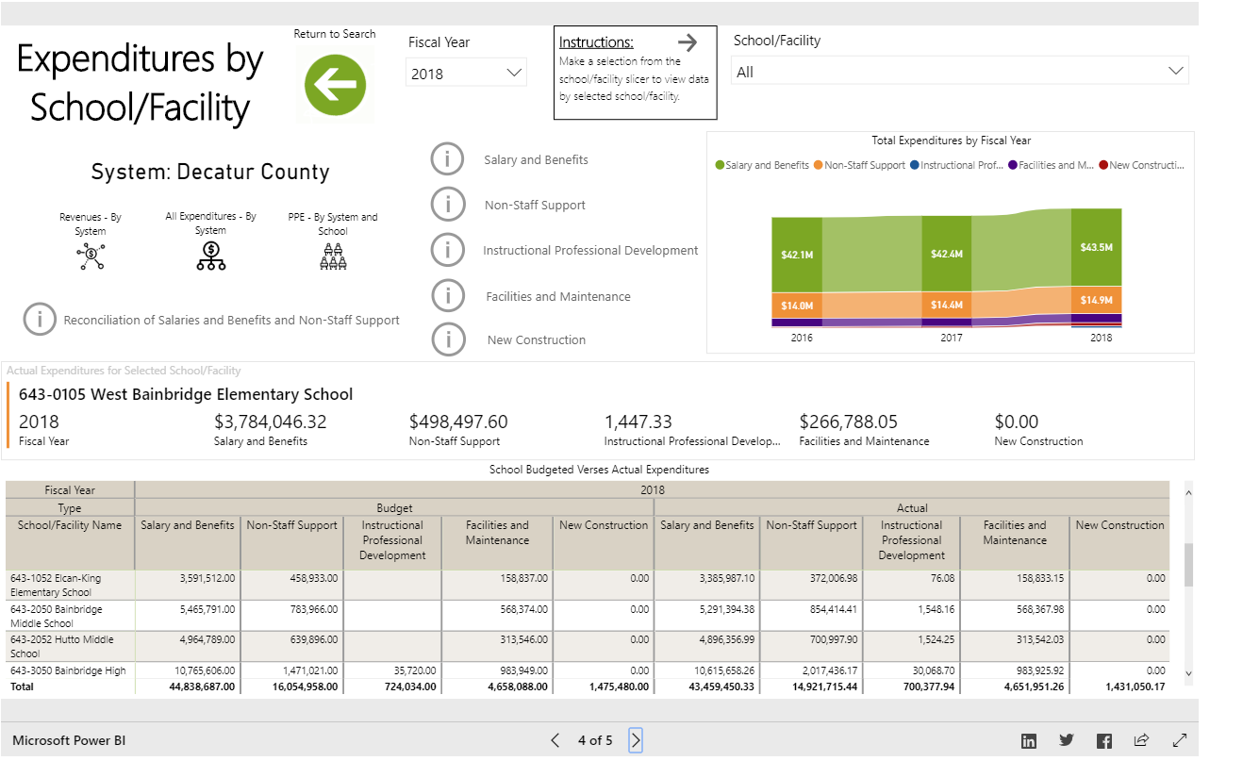
Financial Transparency Dashboard: Decatur City

Slide 11
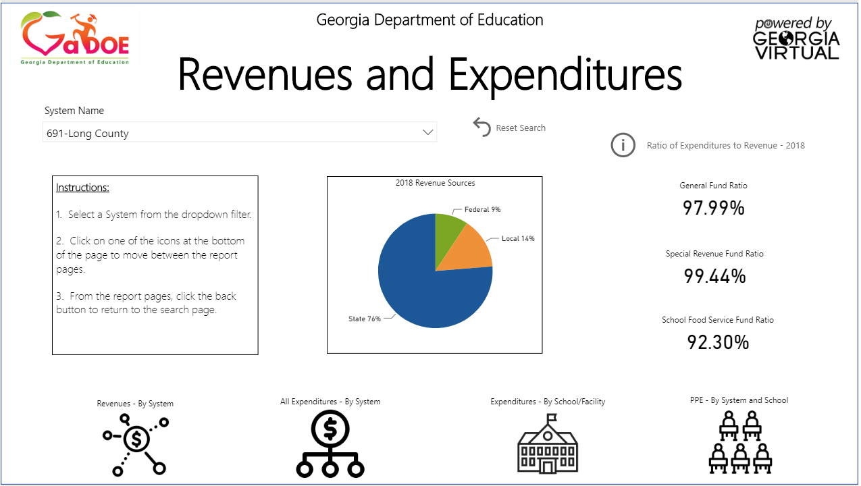
Financial Transparency Dashboard: Long County
Long County Schools
FESR: 4
CCRPI: 71.2 (3-yr avg)
PPE: $7,343.87 (3-yr avg)

Slide 12
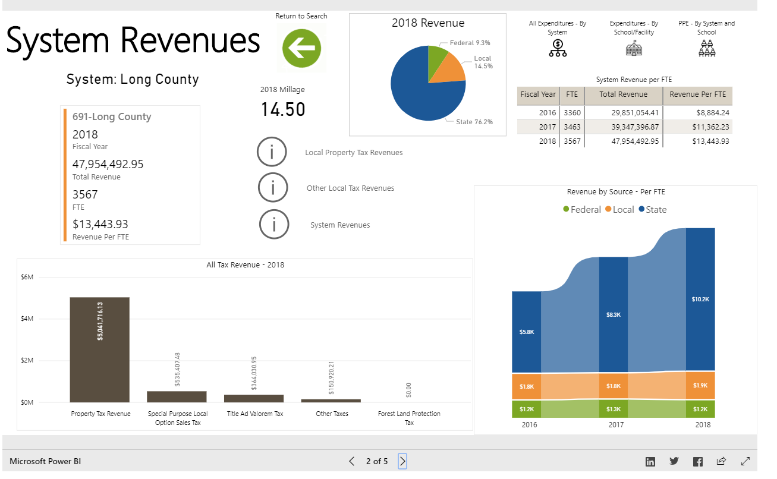
Financial Transparency Dashboard: Long County

Slide 13
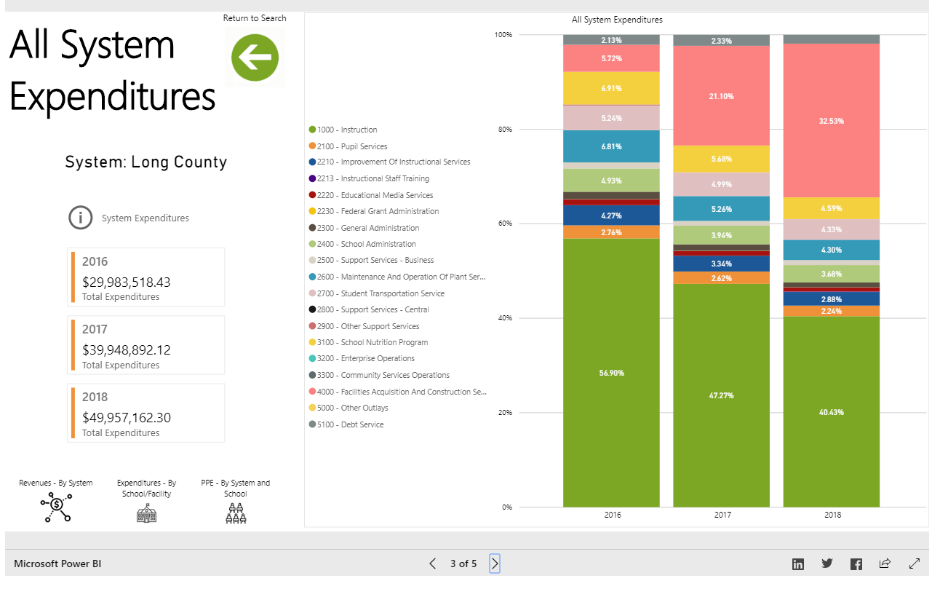
Financial Transparency Dashboard: Long County

Slide 14
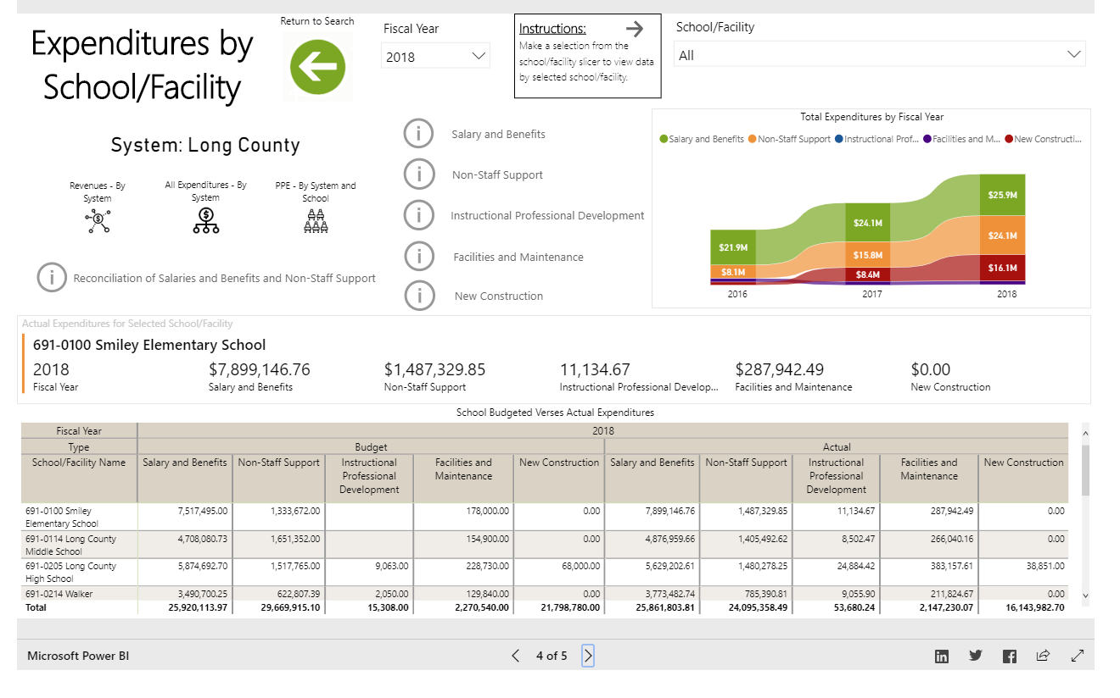
Financial Transparency Dashboard: Long County

