Slide 1

Felony Disenfranchisement in Georgia
“Felony disenfranchisement prevented 265k Georgians from voting in 2018.
85% of those disenfranchised were living in the community under correctional supervision.”

Slide 2
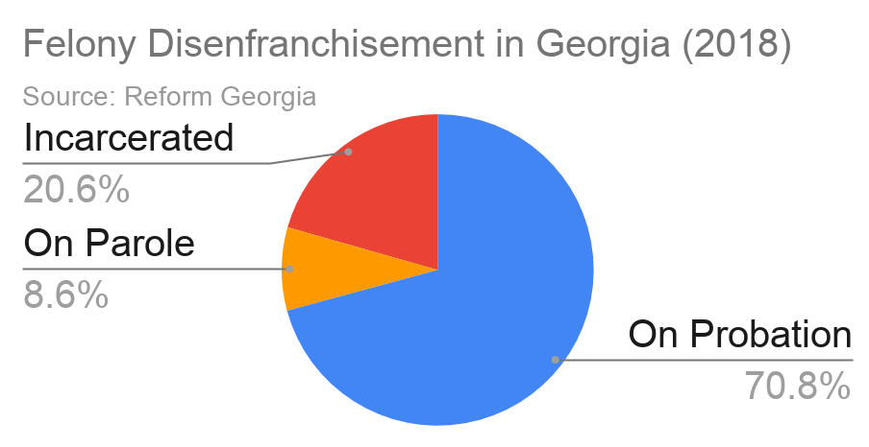

Slide 3
The Numbers
In 2018, over 266,000 Georgians could not vote due to felony disenfranchisement
211,511 were under correctional supervision (79.4%) while living in their community
  188,511 people were on felony probation and living in their community
    31.9% (64,579) for felony drug offenses (possession, sale, etc.)
      25% for drug possession (50,605)
      7% for drug sale
    35.4% (71,667) for property offenses (burglary, vehicle theft, fraud, etc)
  23,000 Georgians were on felony parole (approx.) (8.7%)
  Probation sentences in Georgia average 6.3 years, near double the US average
54,806 Georgians were disenfranchised due to felony incarceration (20.6%)
  47% of 2018 prison admissions (8,575) were non-violent crimes (property, drug)

Slide 4
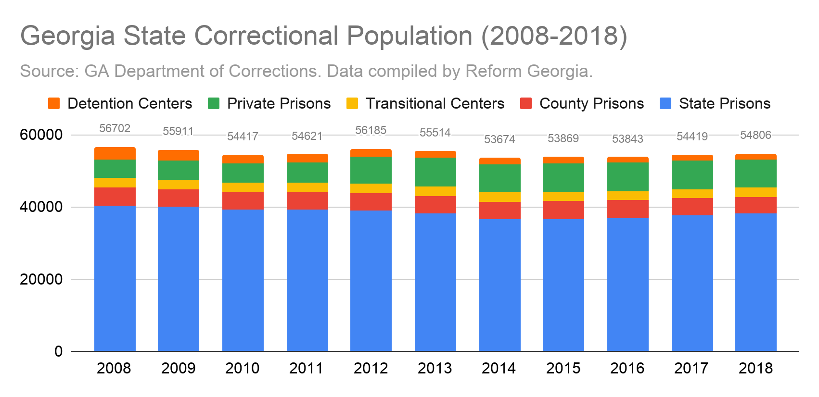

Slide 5
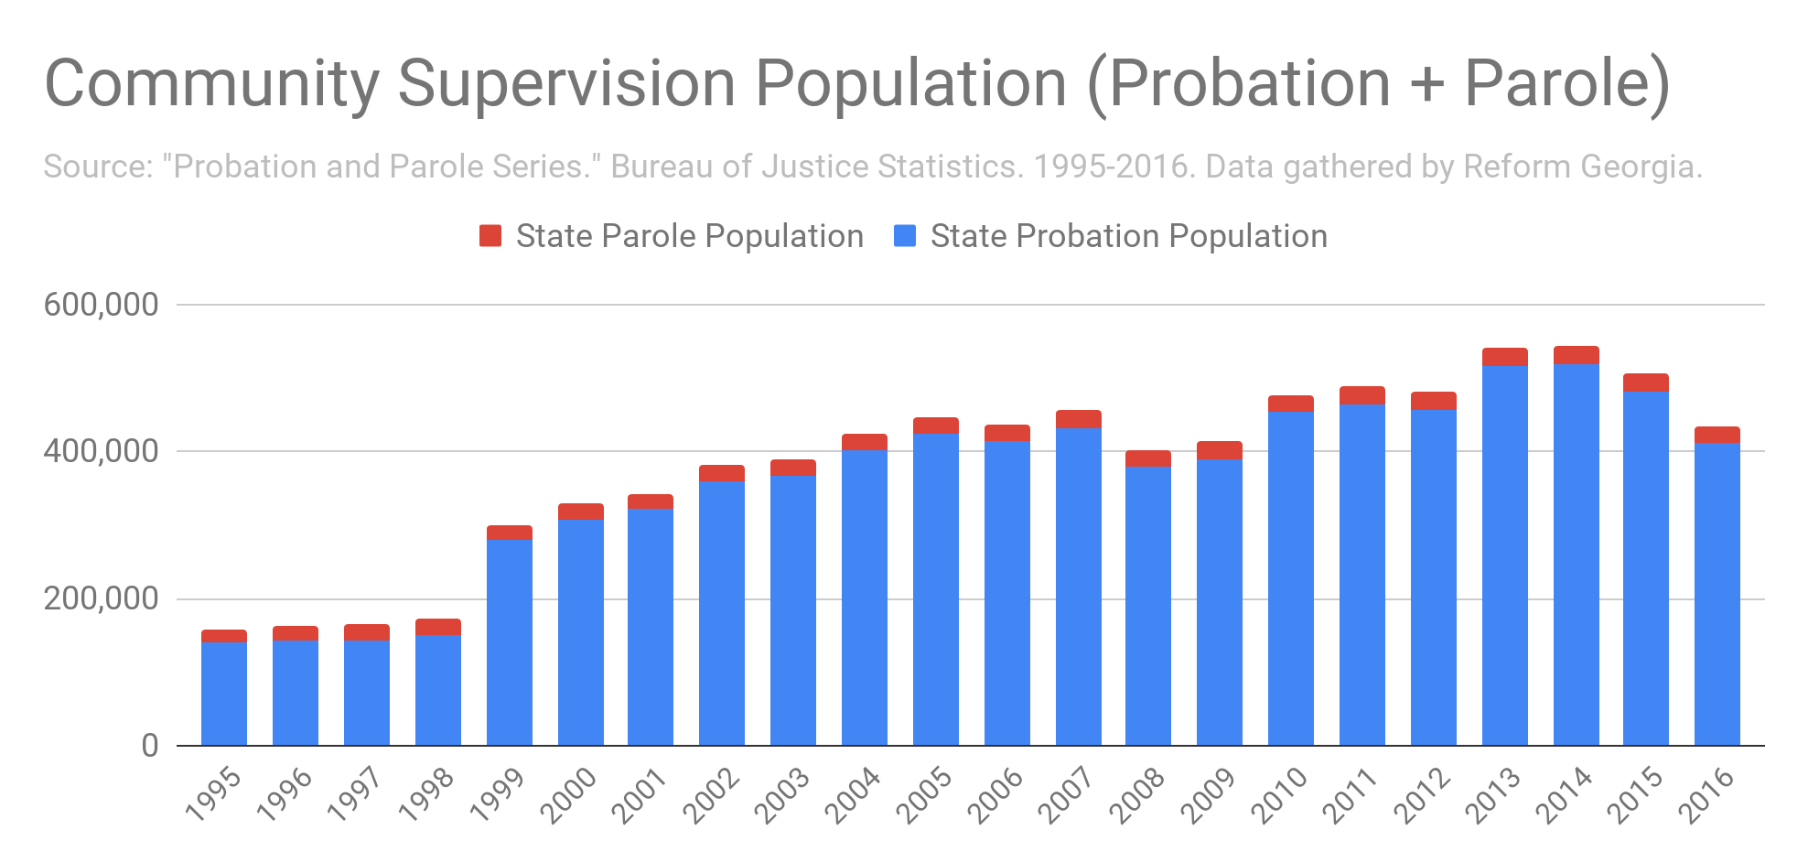

Slide 6
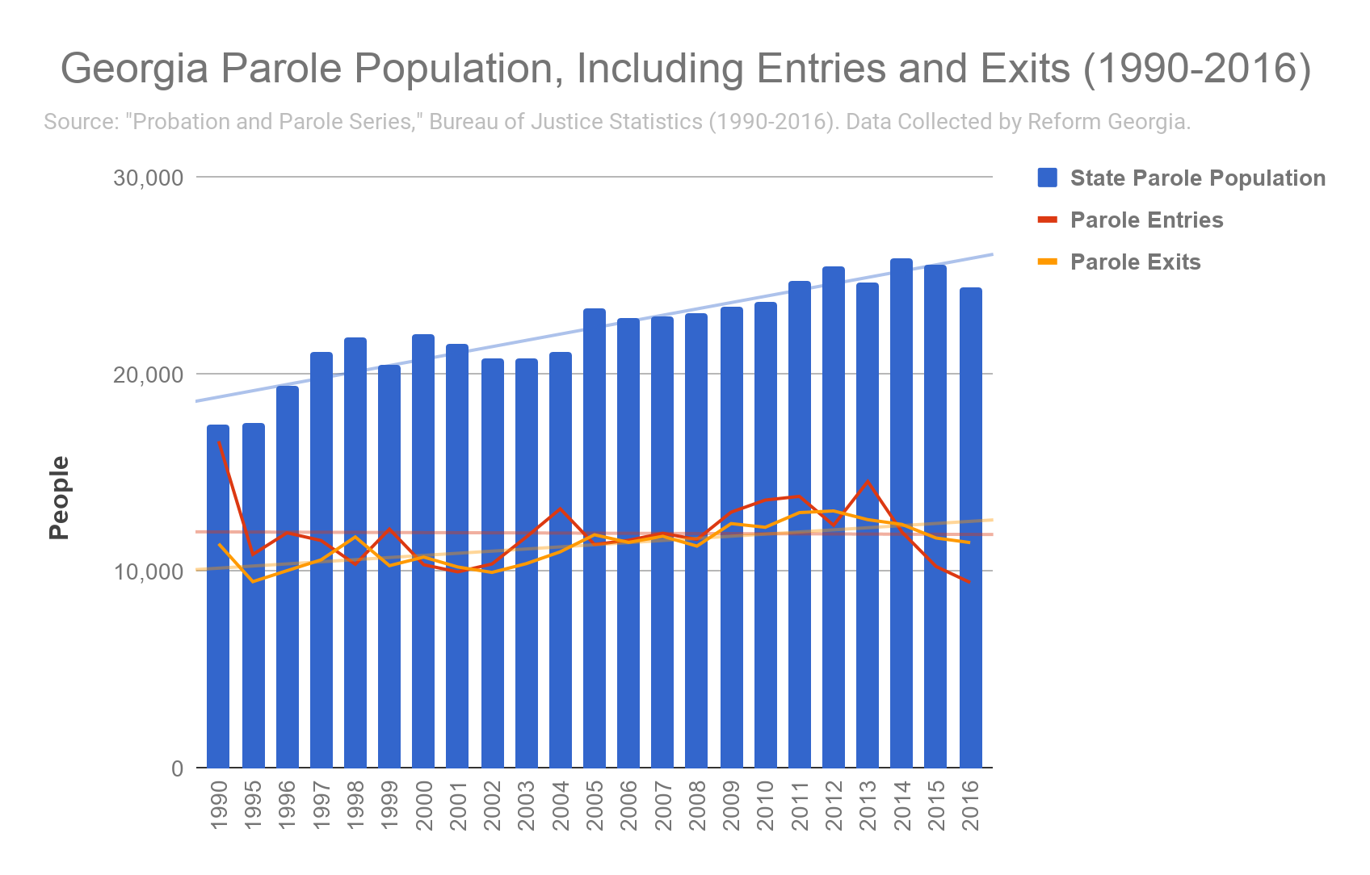

Slide 7
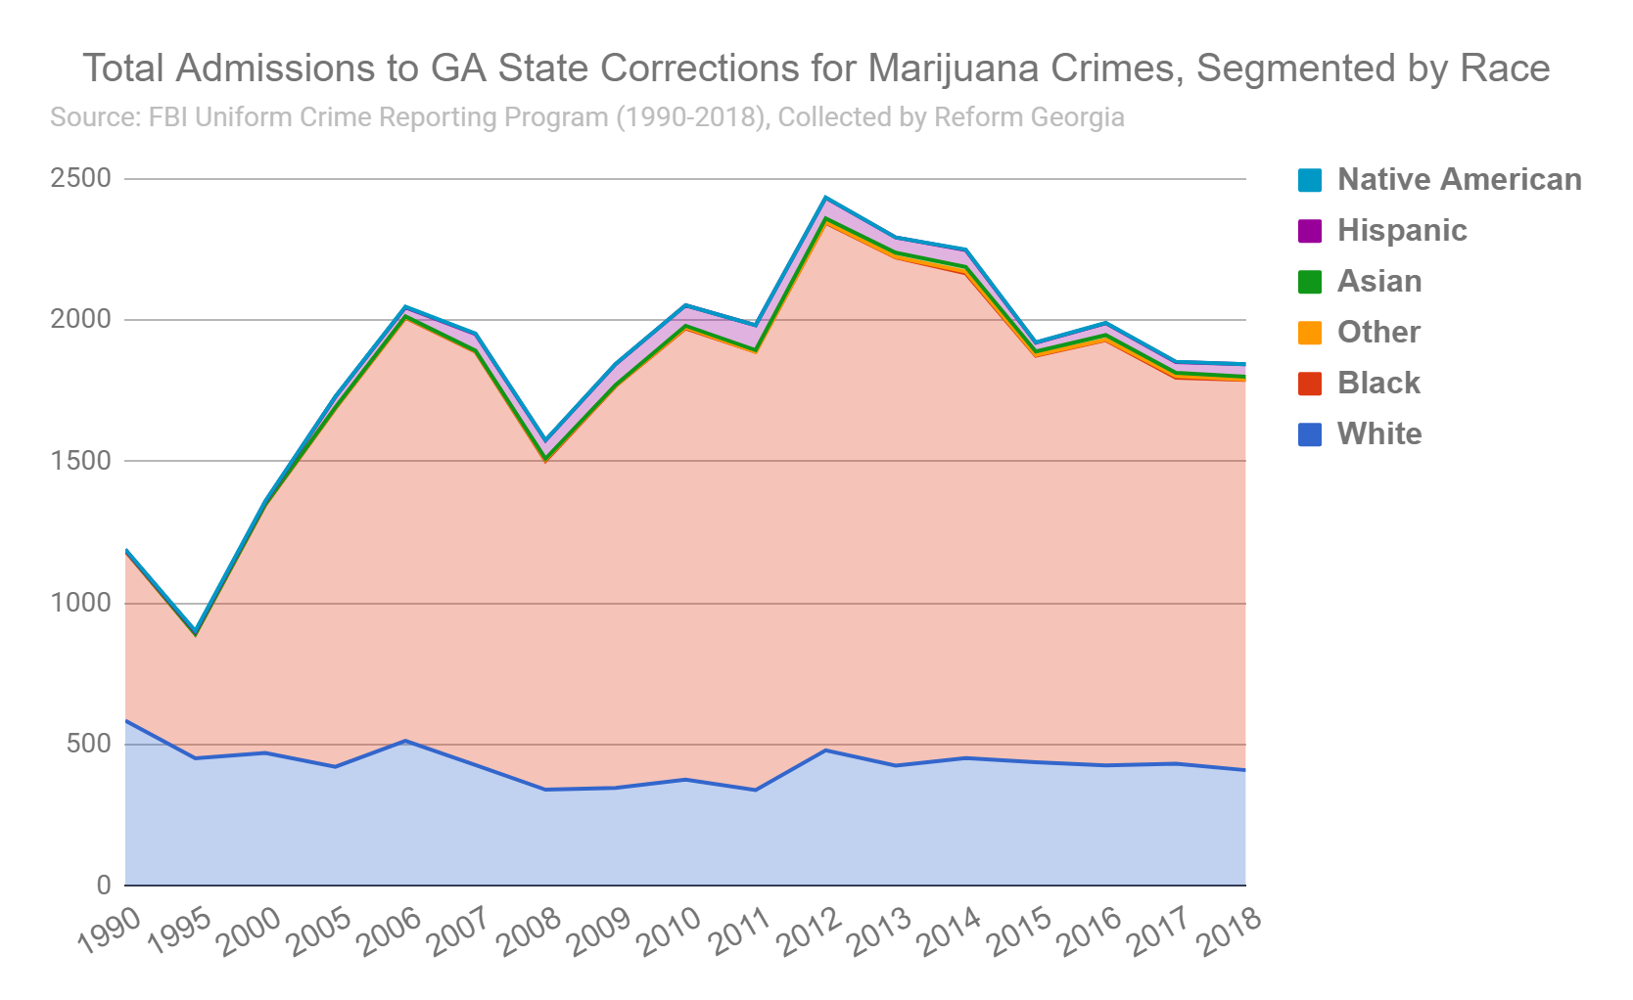

Slide 8
