Slide 1
GEORGIA trade with CUBA
August 11, 2015

Slide 2
overview of recent policy changes
Telecommunications
Consumer Communication Devices
Financial Services
“Cash in Advance” Definition
License Application Review Policies
Notes:
Amid the recent changes to U.S. policy toward Cuba, several address changes that may have an impact on the business environment in Cuba (from perspective of U.S., and specifically GA companies doing business in the market). Among the changes:
TELECOM: In order to better provide efficient and adequate telecommunications services between the United States and Cuba, a new OFAC general license will facilitate the establishment of commercial telecommunications facilities linking third countries and Cuba and in Cuba.
CCD: Commercial sales, as well as donations, of the export and reexport of consumer communications devices that enable the flow of information to from and among the Cuban people – such as personal computers, mobile phones, televisions, memory devices, recording devices, and consumer software – will be authorized under Commerce’s Consumer Communication Devices (CCD) license exception instead of requiring licenses.
FINANCIAL SERVICES: permission to open and maintain correspondent banking arrangements with Cuban financial institutions. I will discuss this in more detail later.
CASH IN ADVANCE: I will discuss this in more detail later
CHANGES IN THE APPLICATION REVIEW PROCESS: Commerce will set forth a general policy of approval for applications to export or re-export items necessary for the environmental protection or enhancement of U.S. and international air and water quality or coastlines (including items that enhance environmental quality through energy efficiency).

Slide 3
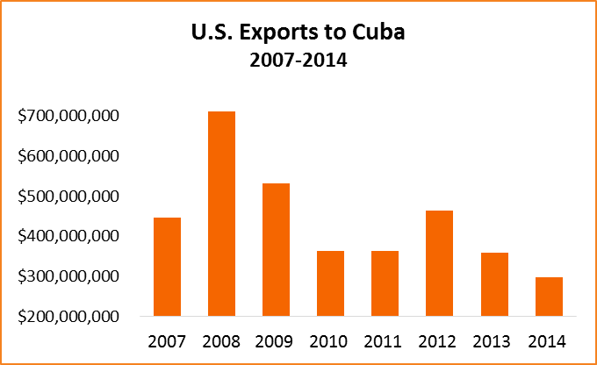
U.S. Exports to Cuba
Source: Global Trade Information Service (GTIS), Global Trade Atlas
Notes:
Before we look more closely at Georgia’s exports to Cuba through the years, it is important to understand the backdrop of U.S.-Cuba trade. The export of approved agricultural commodities became permissible under the Cuban embargo in 2000. However, in the past decade, United States exports to Cuba have experienced a marked decline. In 2014, U.S. exports to Cuba totaled just $299 million. This is the lowest level since 2003; 16.8% decrease from 2013, and a nearly 58% decrease from peak exports of $711.5 million in 2008 (please refer to graph below).
Cuba currently ranks 125th among U.S. export markets. This declining trend is also evidenced when looking at Cuba’s top import partners, where the U.S. dropped from 4th to 5th in 2014 behind Venezuela, China, Spain and Brazil.
Top products: poultry (nearly half of total exports); soybean oilcake; soybeans

Slide 4
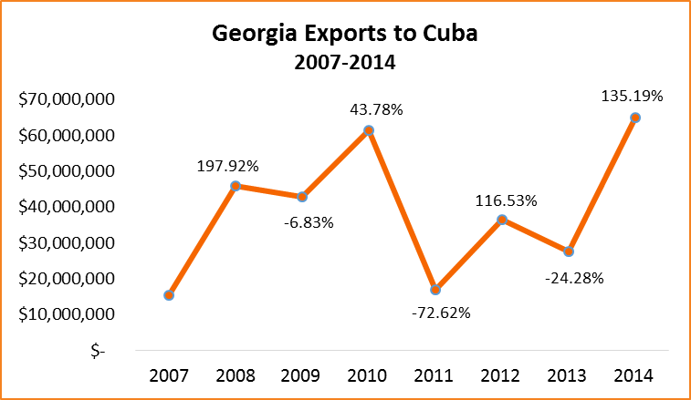
GEORGIA Exports to Cuba
Source: Global Trade Information Service (GTIS), Global Trade Atlas
Notes:
Looking at Georgia exports, the clear trend is volatility of exports.
Cuba currently ranks 72nd among Georgia’s top export markets. For 2014, Georgia exports to Cuba topped $64.8 million, the highest level since 2010. Also for the first time, the Port of Brunswick was the leading port in the U.S. for exports to Cuba
However, the seemingly strong export growth is deceiving, given that Georgia’s exports in 2013 decreased nearly 25% from the previous year. Furthermore, Georgia exported just two products to Cuba last year, soybean oilcake ($56.1 million) and poultry ($8.6 million).
2014 was the first year that Georgia exported soybean oilcake to Cuba, and looking more closely at the export data, Georgia’s vast increase was due to a similar decrease in oilcake exports from Louisiana and Virginia.

Slide 5
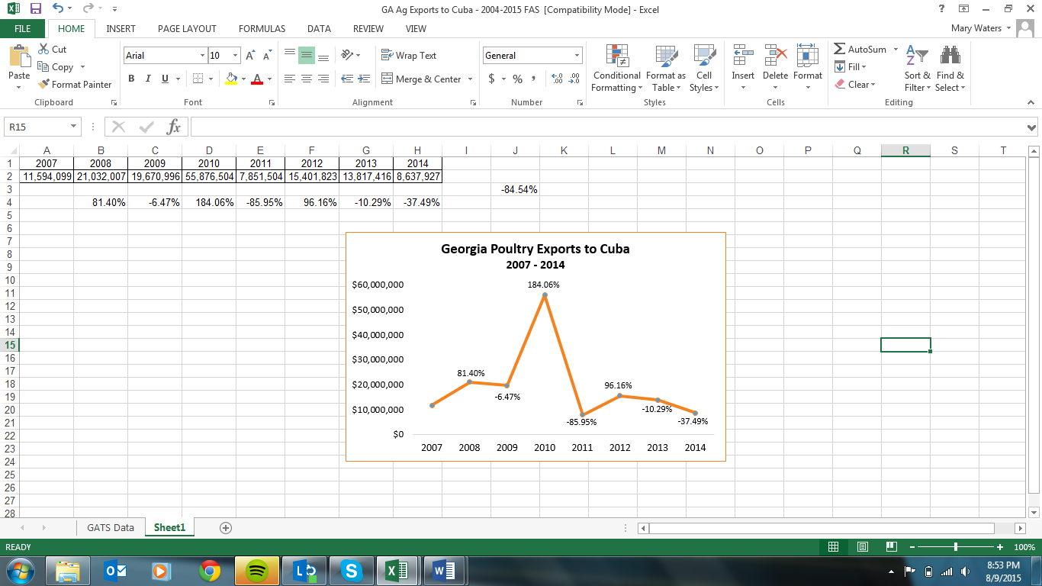
GEORGIA POULTRY Exports to Cuba
Source: FAS Agricultural Export Data
Notes:
Poultry remains the number one export product to Cuba, but Georgia’s share has declined every year since the peak in 2010.
For 2015 year to date (January to June):
Georgia exports to Cuba are $28.6 million
Decrease of 42.7 % over the same period last year
#1 among exporting states.

Slide 6
Future trade with cuba
Revisions / additions to permissible exports
  Support for the Cuban People
  Embargo remains in place, pending legislative action
Third party payment provisions remain unclear
  One correspondent banking relationship established
  U.S. banks hesitant to engage
“Cash in Advance”
  “Cash before transfer of title to, and control of” export items
Notes:
Significant barriers to trade still exist for Georgia companies wanting to do business in Cuba:
While the U.S. has eased certain restrictions for U.S. companies and individuals to engage with Cuba, the embargo remains in place until it is lifted by Congress.
Support for the Cuban People, provision does provide for greater access of export products for building materials and equipment that can be used by the private sector in Cuba for renovation/construction of privately-owned buildings.

