Slide 1

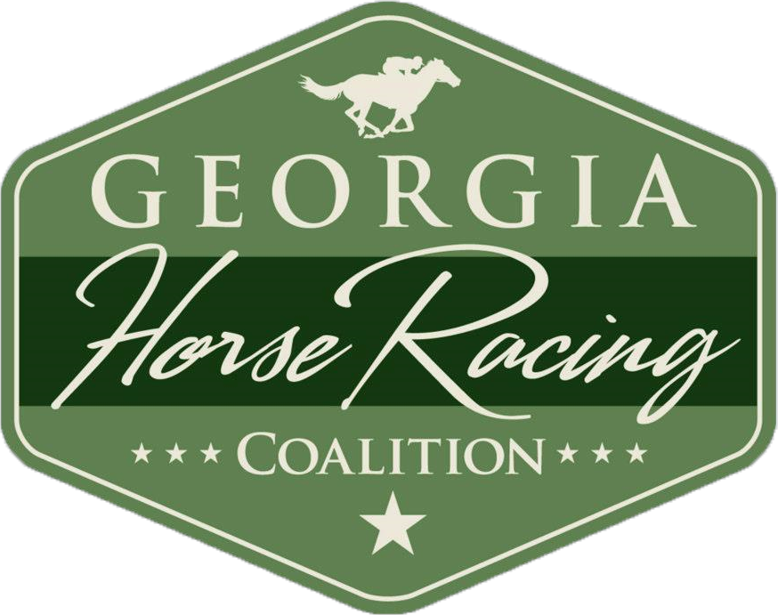
Georgia Economic Impact of Horseracing
Dr. Christine Lewis
Lewis Group
For the GA Horseracing Coalition

Slide 2
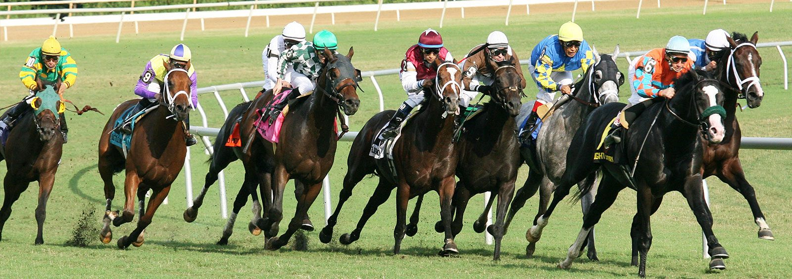
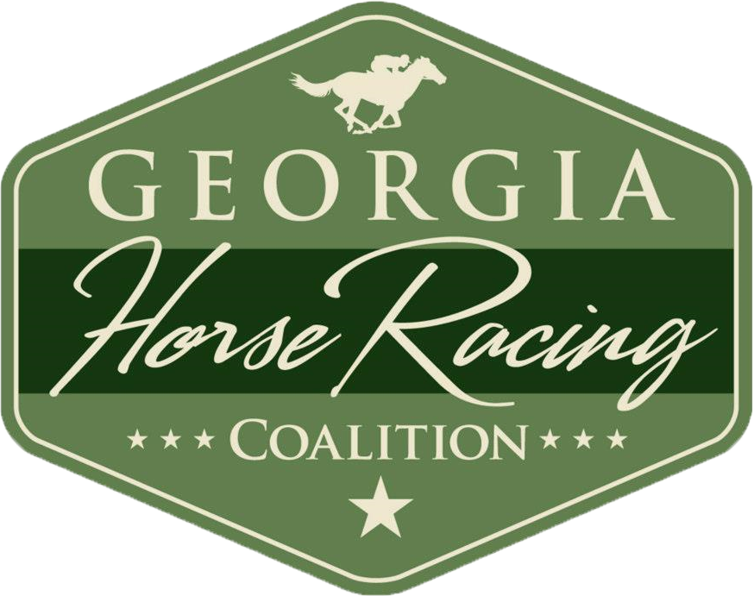
Horseracing in Numbers in Georgia
PROJECTIONS ARE BASED ON 3 NEW HORSERACING TRACKS IN GEORGIA. EACH FACILITY WILL BE A STATE OF THE ART ENTERTAINMENT CENTER.

Slide 3
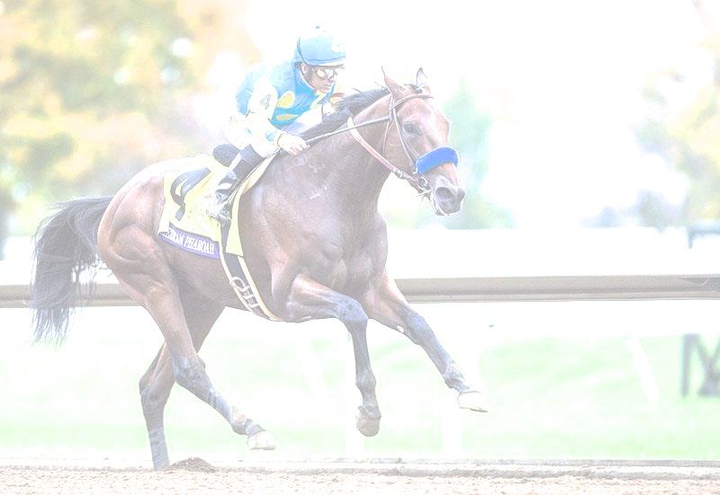
Project Investment and Construction Cost
Total Project Development: $700 Million
Direct Construction Development: 5,070
Direct Construction Labor Income: $294.3 Million
Direct Construction Taxes: $41 Million
Total Construction Employment (including direct, indirect and induced labor): 8,417
Total Construction Labor Income: $468 Million
Total Construction Contribution to State GDP: $698 Million
Total Construction Economic Output: $1.24 Billion

Slide 4
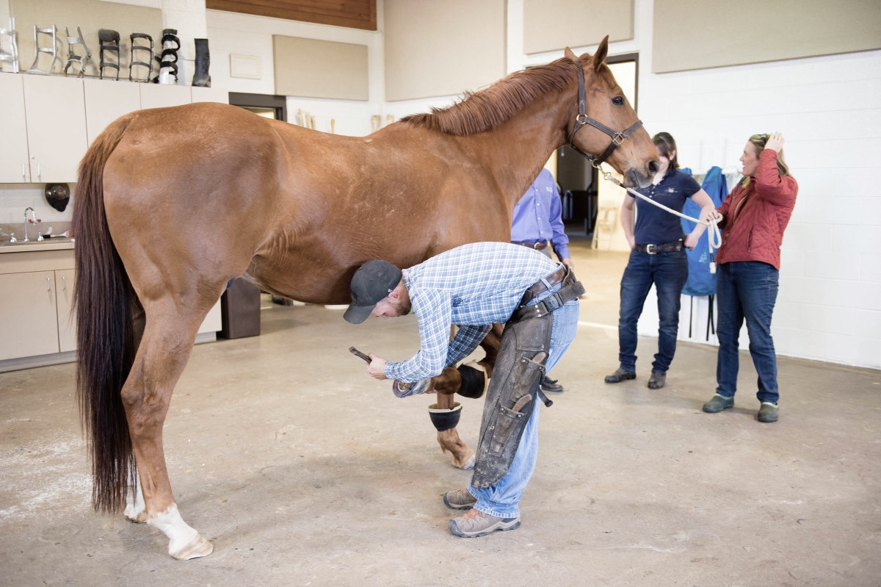
Contributions to State and Local Economy
Direct Employment: 3,775 (and growing as business grows)
Direct Labor Income: $132.3 Million year one and $665 Million over first 5 years
Total Operations Employment (direct, indirect and induced labor): 9,384
Total Operations Labor Income: $468.6 Million year one and $2.3 Billion over first 5 years
Total Operations Contribution to State GDP: $898 Million year one and $4.49 Billion over first 5 years

Slide 5
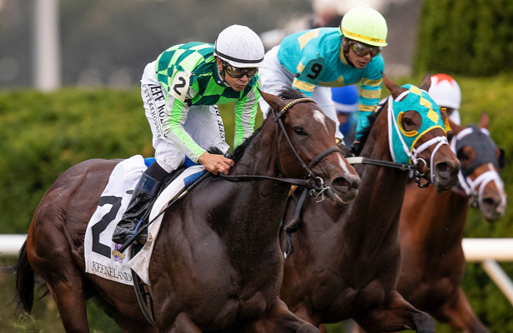
Contributions from Tax Base
Direct Gaming Taxes (@ 20%): $183 Million year one and $915 Million over first 5 years
Total Taxes from Operations: $284 Million year one and $1.4 Billion over first 5 years

Slide 6
Economic Impact to Georgia Economy
Allocation to Purses and Breed Development and Horsemen’s Contribution: $81.7 Million year one of operations and $408.5 Million over first 5 years
New Horse Industry-Related Employment (direct, indirect, induced): 1,767
Labor Income (direct, indirect, induced): $79 Million year one of operations and $395 Million over first 5 years
Contributions to State GDP: $101 Million year one of operations and $505 Million over first 5 years
Total Economic Output: $143 Million year one of operations and $715 Million over first 5 years

Slide 7
Changes to the Horse Industry Experienced in Other States
Growth across all segments of the horse industry
Consolidation of small players into larger organizations
Increased investments in land, equipment, and supplies
A shift in mindset and purpose – some existing participants shifted from a recreational to a more profit oriented purpose and subsequently adopted a more sophisticated, business like approach
Increased availability and quality of race horses with improved the attractiveness of the races and led to an increase in export handle
Increased involvement in the industry from out of state participants

Slide 8
Top Ten Counties by Value for Horses Raised
Union, 2%
Henry, 2%
Carroll, 6%
Mitchell, 3%
Forsyth, 3%
Fulton, 5%
Banks, 3%
Thomas, 4%
McDuffie, 3%
Coffee, 3%

Slide 9
Top Ten Counties by Value Boarding, Training, and Breeding of Horses
Gordon, 3%
Cherokee, 6%
Dougherty, 3%
Bulloch, 3%
Putnam, 6%
Henry, 4%
Rockdale, 4%
Jasper, 5%
Morgan, 5%
Thomas, 5%

Slide 10
