Slide 1
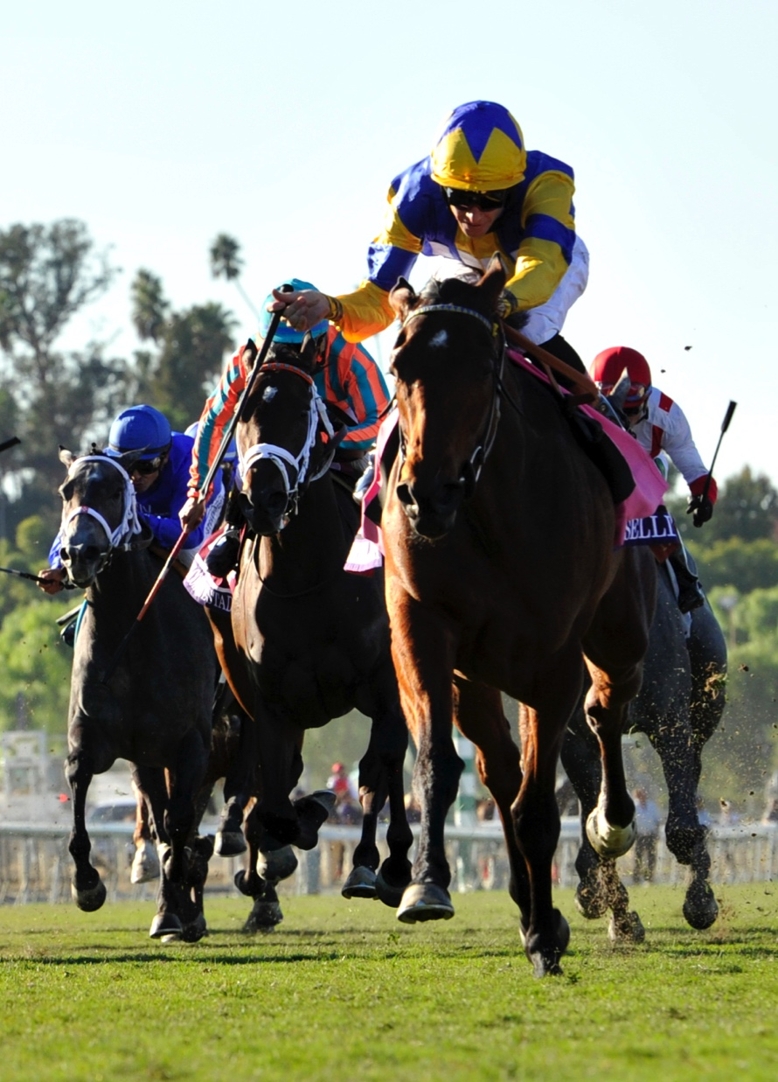
Off-Track Pari-Mutuel Facilities
Presentation to the Georgia Senate and House Preservation of the HOPE Scholarship Program Study Committee
Michele Fischer, Vice President Sales & Business Development – The Americas
September 15, 2015
© 2015 Sportech, Inc. All Rights Reserved

Slide 2
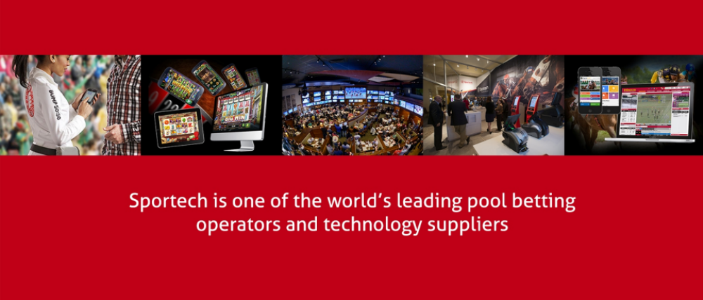
© 2015 Sportech, Inc. All Rights Reserved

Slide 3
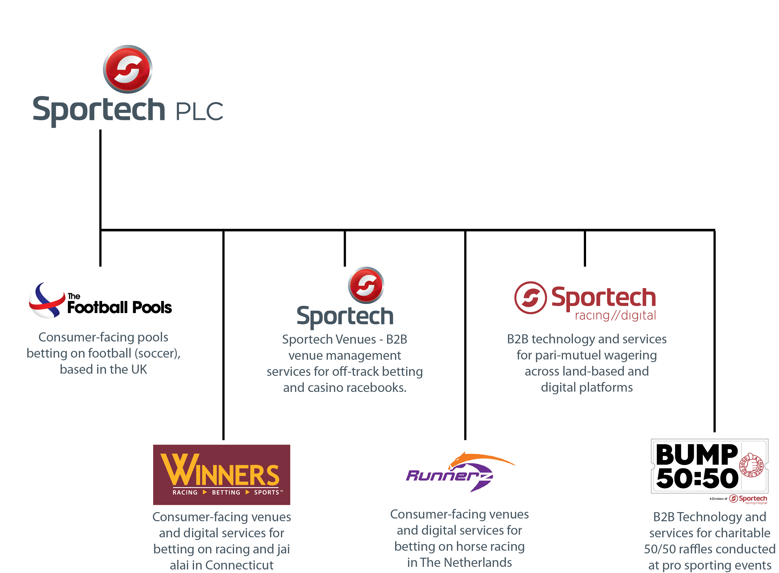
© 2015 Sportech, Inc. All Rights Reserved

Slide 4
Sportech is one of the world’s Leading pari-mutuel betting operators and technology providers
Operate in highly-regulated markets
Presence in 38 U.S. States
Customers in 34 Countries
1,000 Employees worldwide
Our systems process over $13 billion in global wagering annually
© 2015 Sportech, Inc. All Rights Reserved

Slide 5
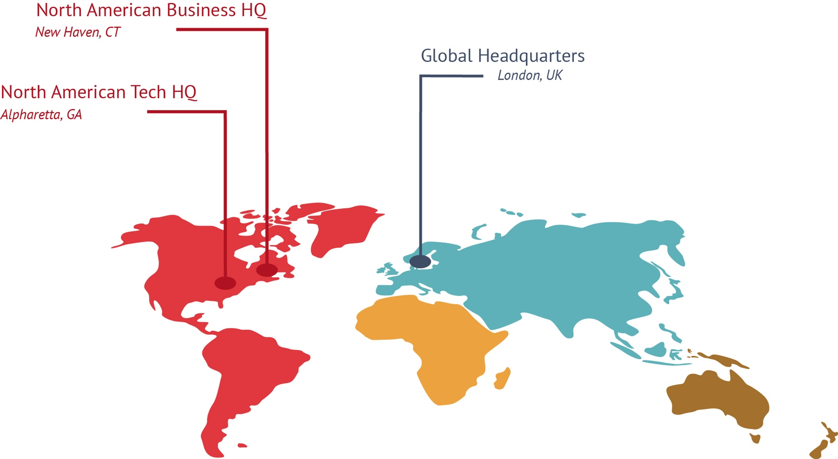
Sportech has 10 business, technical, and operational offices in 6 countries, with 3 of those being our key HQ locations
© 2015 Sportech, Inc. All Rights Reserved

Slide 6
Sportech in Georgia
Corporate citizen since 2003
Site of our global technology headquarters
  46 technology and professional jobs with a combined annual salary of $4.3 million
    CTO, Software Architects, Software Developers, Quality Assurance, Project Management
    Financial Director and Division Accounting Group
    VP Engineering and Terminal design and Engineering group
    National Parts Depot and Warehouse
18,000 square foot office
$160,000 in annual lease and facility-related spending
$215,000 in annual overhead costs for the Georgia facility
© 2015 Sportech, Inc. All Rights Reserved

Slide 7
OTB’s Role in Racing’s Ecosystem
More fans = more handle for live racing product at tracks
More handle = larger purses for horsemen
Larger Purses support agricultural programs and the people they employ
OTB Venues offer convenience to players and help bring new fans to the sport
© 2015 Sportech, Inc. All Rights Reserved

Slide 8
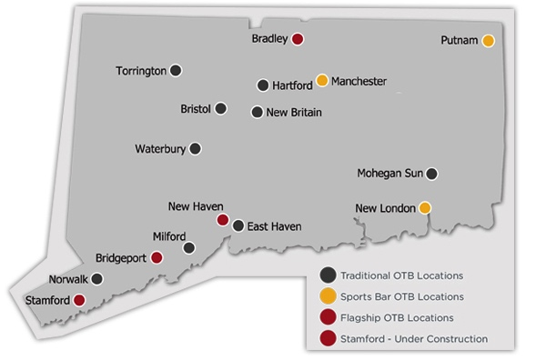
Sportech in Connecticut
Exclusive provider of pari-mutuel wagering services in CT since 1993
18 licenses to operate venues
  15 deployed
  New venue under construction
Exclusive license for Advance Deposit Wagering (Phone & Internet)
Regulated by CT Department of Consumer Protection and approved by local municipalities
Provider of wagering services at the Mohegan Sun Casino since 1998
© 2015 Sportech, Inc. All Rights Reserved

Slide 9
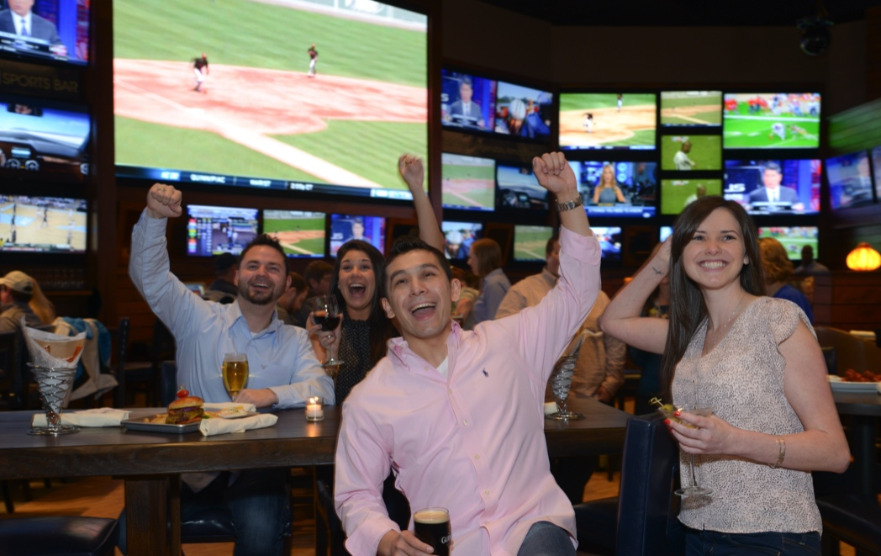
Economic Impact in Connecticut
350 employees with a combined annual payroll of over $10 million
Operations spending $2.8 million per annum
Property costs of $3.2 million per annum
Advertising and Promotion spending over $1 million per annum
Payments into Responsible Gaming funds $227K per annum
State and Municipal taxes paid $6.3 million per annum
TOTAL ANNUAL SPENDING >$24 MILLION
© 2015 Sportech, Inc. All Rights Reserved

Slide 10
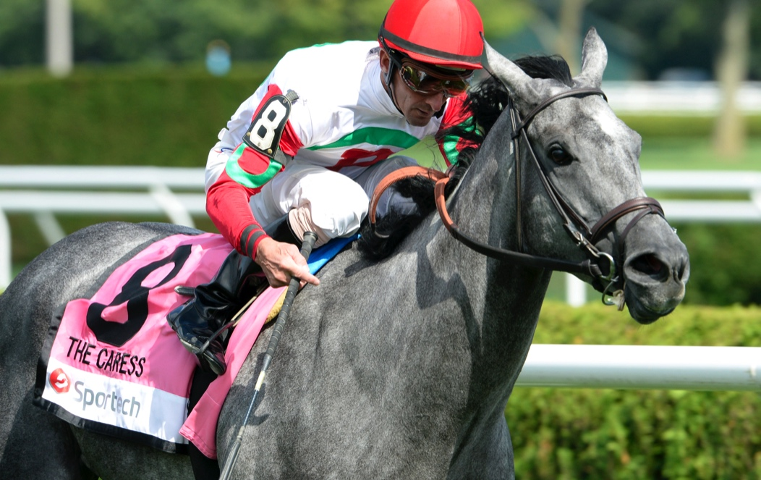
Sportech’s Philosophy for Venues
Promote live racing by increasing exposure to current and new fans
Provide a comfortable, enjoyable spaces in which to enjoy racing
  Modern facilities
  Partnerships with existing restaurants and entertainment centers
Provide convenient access to betting
  Internet & Mobile
  Phone
Provide easy-to-use technology
Emphasize the fun and excitement of racing as an entertainment option
© 2015 Sportech, Inc. All Rights Reserved

Slide 11
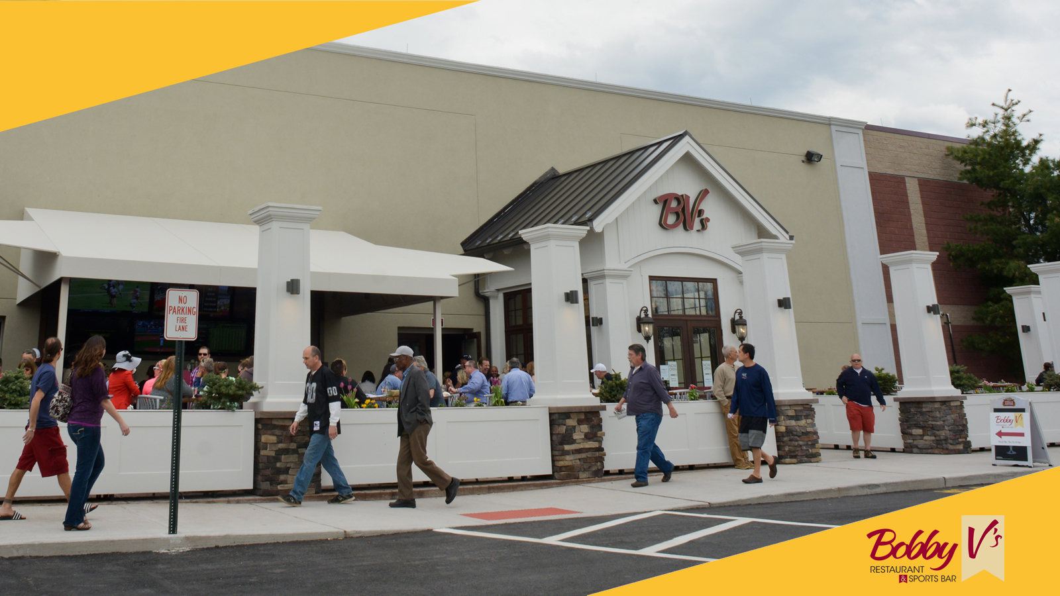
Inviting Exteriors
© 2015 Sportech, Inc. All Rights Reserved

Slide 12
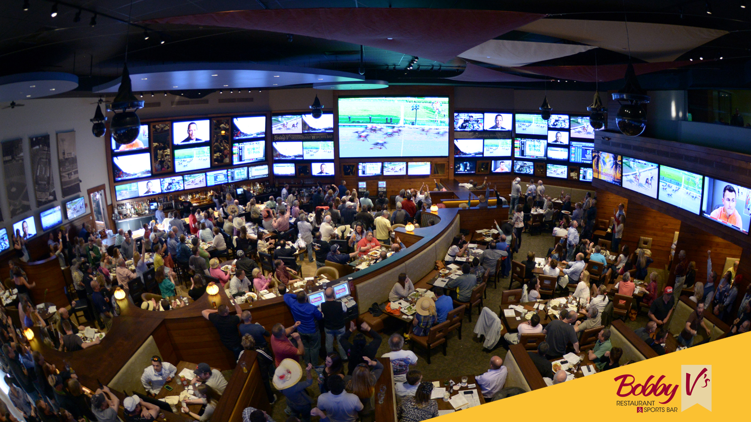
Dynamic Interiors Engage Guests in the Fun and Excitement of Racing
© 2015 Sportech, Inc. All Rights Reserved

Slide 13

© 2015 Sportech, Inc. All Rights Reserved

Slide 14
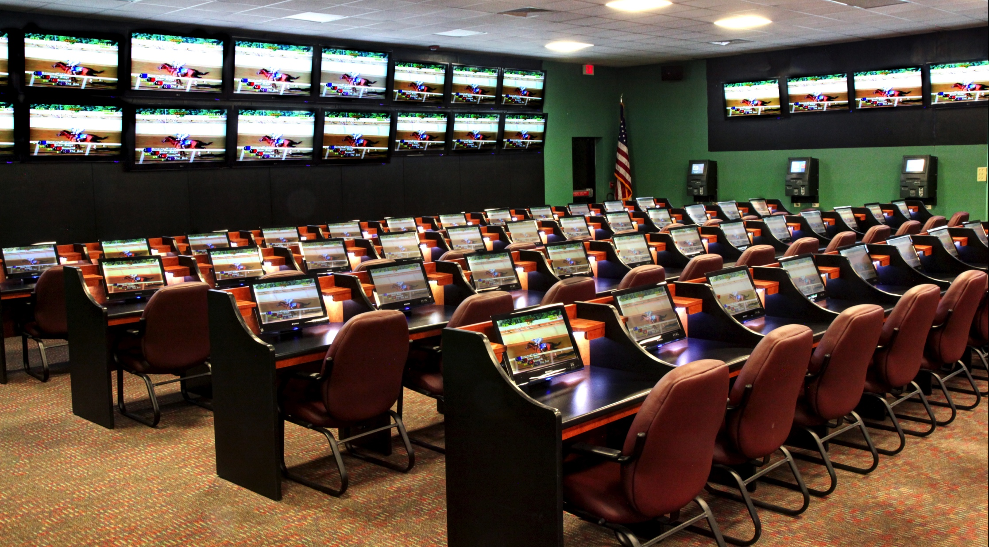

Dedicated Spaces Cater to the Seasoned Handicapper
© 2015 Sportech, Inc. All Rights Reserved

Slide 15
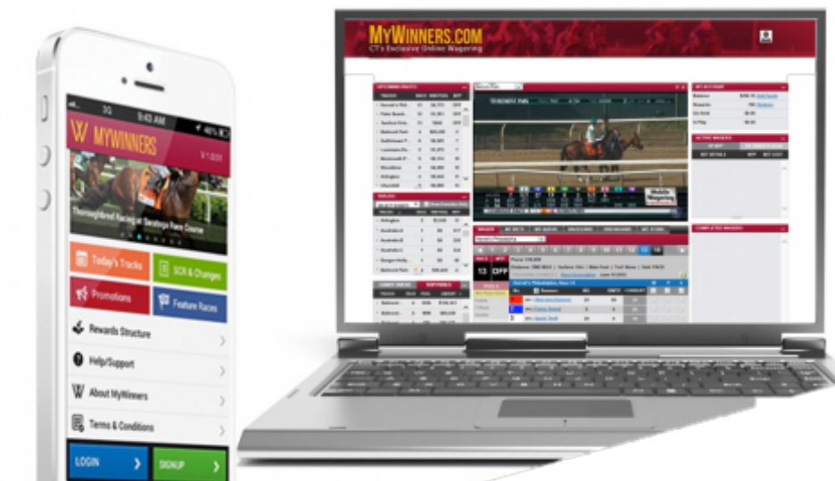
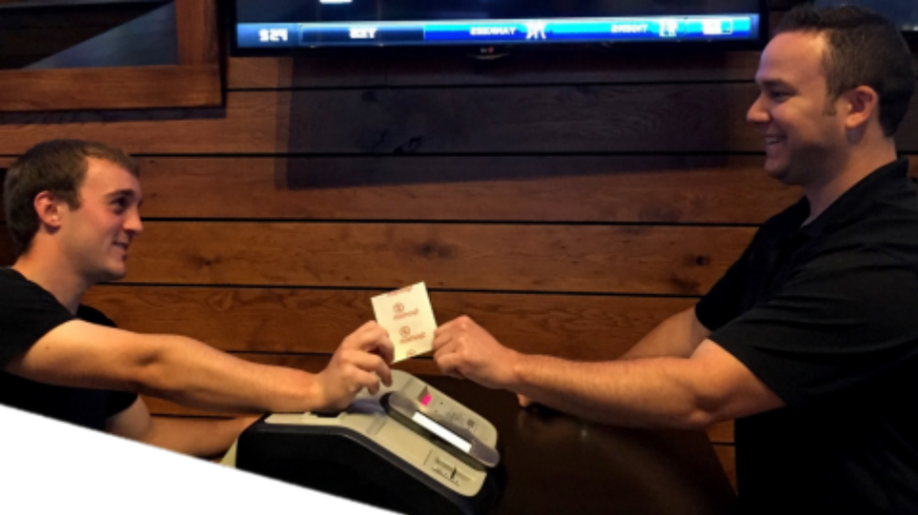

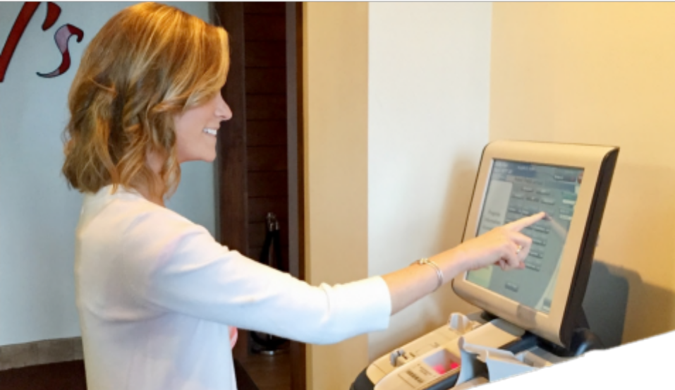

Technology that Enhances the User Experience
© 2015 Sportech, Inc. All Rights Reserved

Slide 16
Venues in the Community
Excellent corporate citizens
Highly regulated and monitored
Contributions to state, local and municipal funds
Steady employment base
Testimonials from leaders in government, Chambers of Commerce, Visitors Bureaus, and law enforcement

Slide 17
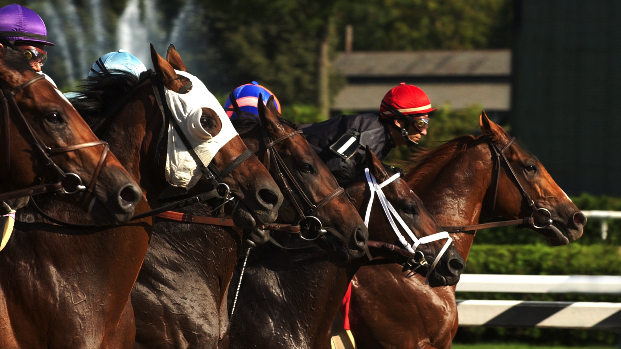

© 2015 Sportech, Inc. All Rights Reserved

