Slide 1

GEORGIA LEGISLATIVE STUDY COMMITTEE ON EVALUATING AND SIMPLIFYING PHYSICIAN OVERSIGHT OF PAs AND APRNs
Tom Bauer,
Georgia Association of Physician Assistants
August 28, 2019
Notes:
Good morning! Thank you for inviting me here today.

Slide 2



WHAT IS A PA?
AT A GLANCE
PA profession
established in
PAs have more than
400
1967
MILLION
131,000+
PAs in the U.S.
patient interactions
per year
2018 AAPA Salary Survey,
All data based on clinically practicing PAs in the U.S.
NCCPA, 2018
Notes:
PAs are medical professionals who diagnose illness, develop and manage treatment plans, prescribe medications, and often serve as a patient’s principal healthcare provider.
The first PA class graduated from Duke University in 1967
Today, there are more than 123,000 PAs and over 250 PA programs located across the country.
PAs see over 400 million patients a year.

Slide 3











WHAT CAN PAs DO?
Manage
patients
Prescribe
medication
Perform
medical
procedures
Order and
interpret tests
Assist in
surgery
Counsel on
preventive care
Notes:
PAs’ specific duties depend on the setting in which they work, their level of experience, their specialty, and state laws.
Generally, PAs can:
Take medical histories
Diagnose and treat illness
Conduct physical exams
Prescribe medication
Develop treatment plans
Perform procedures
Counsel on preventive care
Do clinical research
Order and interpret tests
Make rounds in hospitals and nursing homes
And assist in surgery

Slide 4




HOW ARE PAs EDUCATED?
Educated at
MASTER’S
DEGREE level
Programs are
27 MONTHS or 3 ACADEMIC YEARS
(Bachelor’s degree is required for acceptance)
2,000
PA Programs
in the U.S.
ARC-PA, 2019
hours
of clinical rotation
238

Slide 5
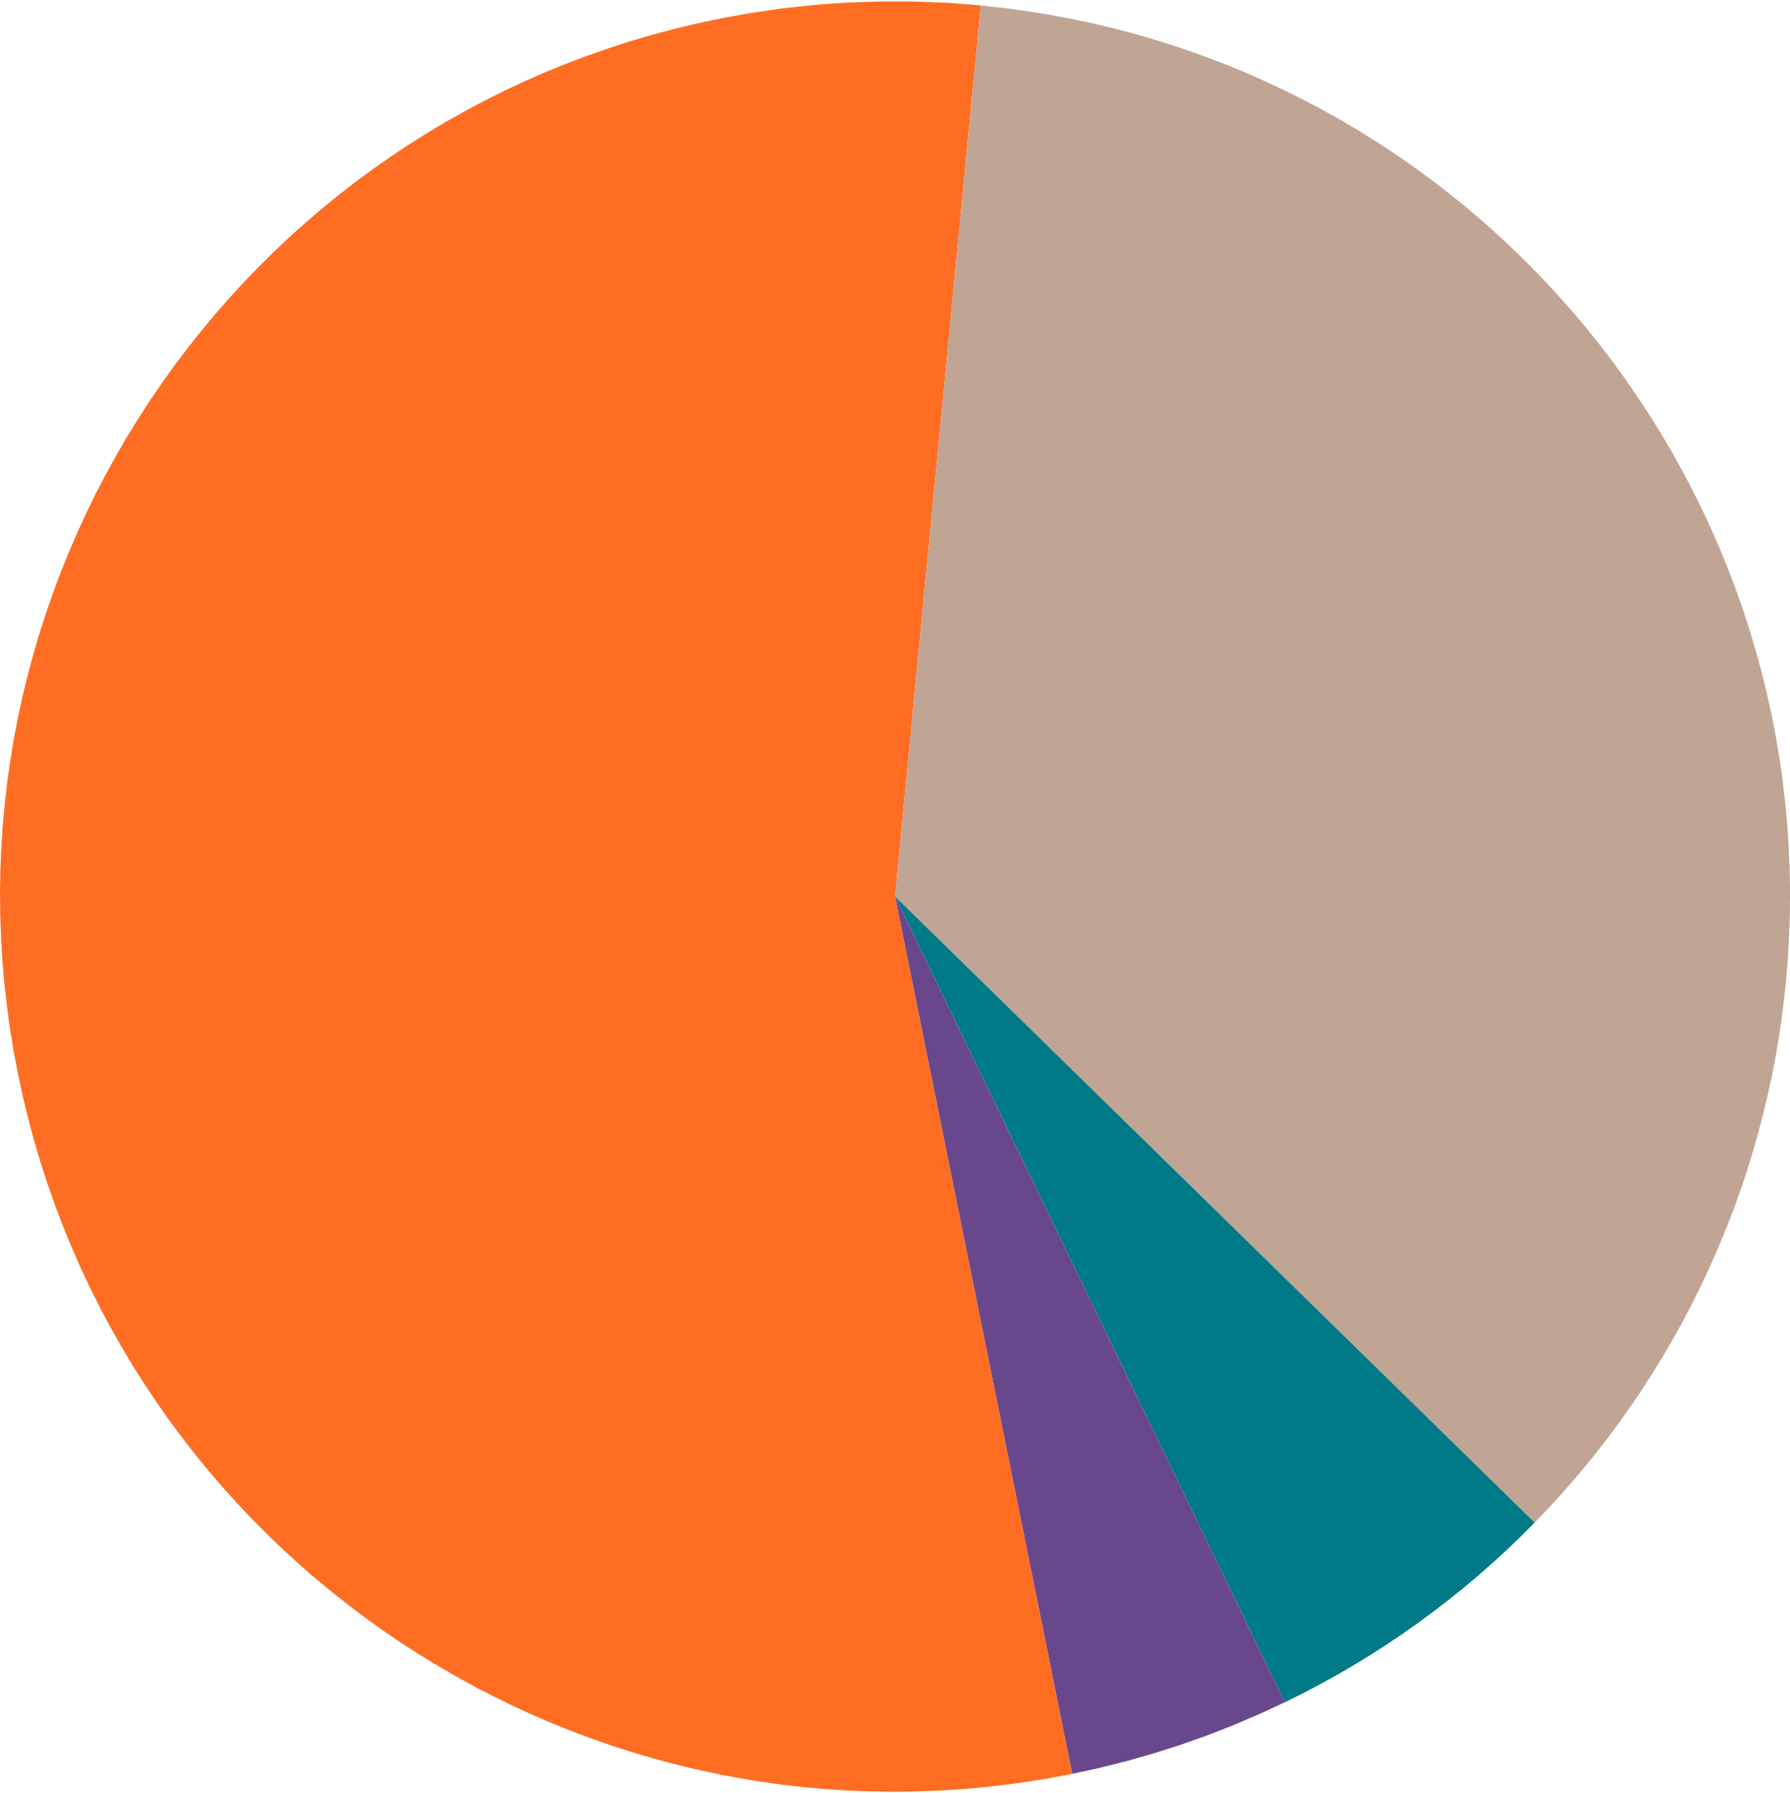
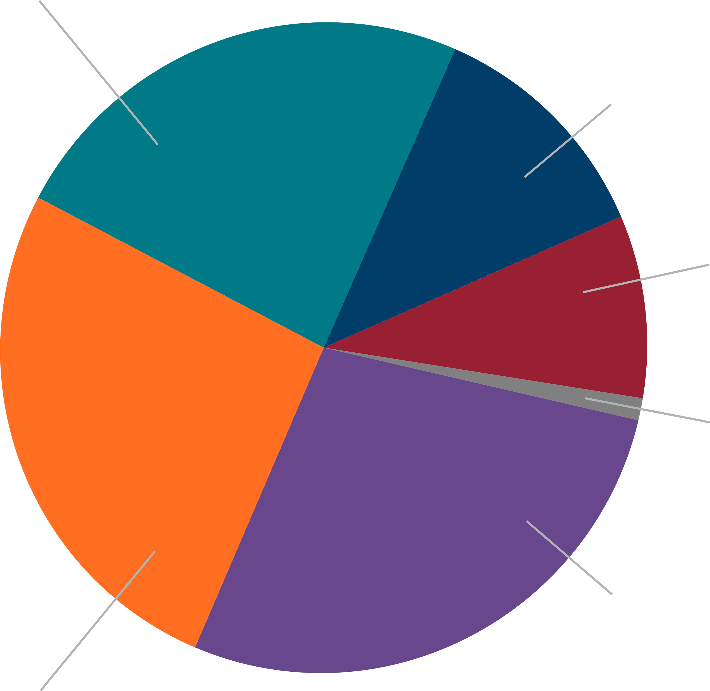
WHERE DO PAs WORK?
PAs practice in every work setting
PAs practice medicines in all specialties
54.7% Outpatient Office Or Clinic
^{23.9% Primary Care}
^{11.9% Internal Medicine}
^{Subspecialties}
^{35.8% Hospital}
^{9.1% Emergency Medicine}
^{1.1% Pediatric Subspecialties}
^{5.5% Urgent Care/Retail}
^{27.8% Other*}
(Examples include hospice and palliative care, addiction medicine, pain management)
^{4.0%} ^{Other*}
^{26.3% Surgical Subspecialties}
^{2018 AAPA Salary Survey}
All data based on clinically practicing PAs in the U.S.
*Other refers to a variety of work settings including but not limited to schools/universities, rehabilitation facilities, nursing homes and correctional facilities.
^{2018 AAPA Salary Survey}
All data based on clinically practicing PAs in the U.S.
*Other refers to a variety of healthcare settings including but not limited to psychiatry, hospice and palliative care, obstetrics and gynecology, addiction medicine, pain management, public health and dermatology.

Slide 6
IS THERE A HIGH DEMAND FOR PAs?
Demand for PAs
has increased
300%
from
2011 to 2014.
PA Employment will increase by 30%
between
2014 and 2024.
Multiple job offers are received by
76%
of PAs upon graduation.
*Merrit Hawkins
*U.S. Bureau of Labor Statistics
*NCCPA 2015 Profile of PAs

Slide 7


HOW MUCH DO PAs MAKE?
MEDIAN BASE SALARY FROM PRIMARY EMPLOYER
*Data provided by the AAPA 2018 Salary Survey

Slide 8
HISTORY OF GEORGIA PA ACT
Original Georgia PA Act (1972)
While containing the elements of a licensure bill, PAs were considered “certified”
Envisioned extensive supervision with basic and detailed (long) job descriptions
Anticipated the regulation of about 200 PAs
First attempted major legislative change (allow remote site practice) was circa 1988
Was not comprehensively updated until 2009

Slide 9
PIECEMEAL AMENDMENTS (Before 2009)
Delegation of Prescriptive Authority: 1995
“Licensing” of PAs (was “Certified”): 1997
Authorization for DEA Numbers: 1999
Increase in PA to Physician Ratio: 2001-2002
Authorization of the “Alternative Supervising Physician”: 2002
Redefining the Nature of PA Job Description (Making it More General): 2004
Request, Sign for Pharmaceutical Samples: 2004
PA Assistance for Disaster Relief: 2006

Slide 10
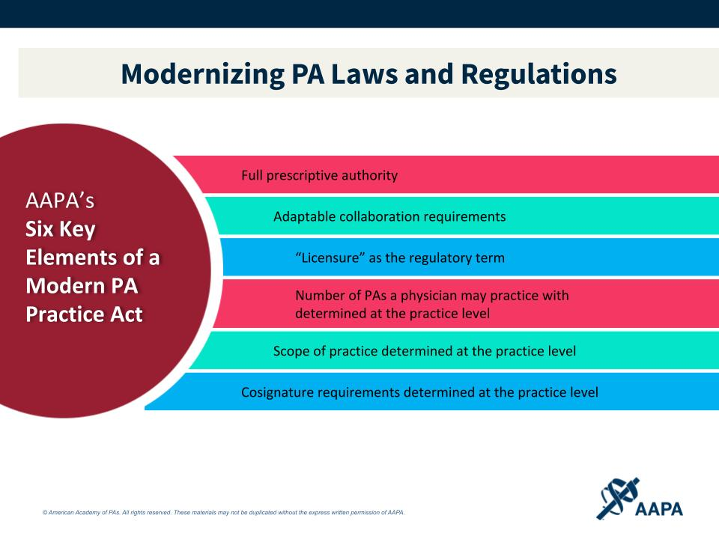

Slide 11
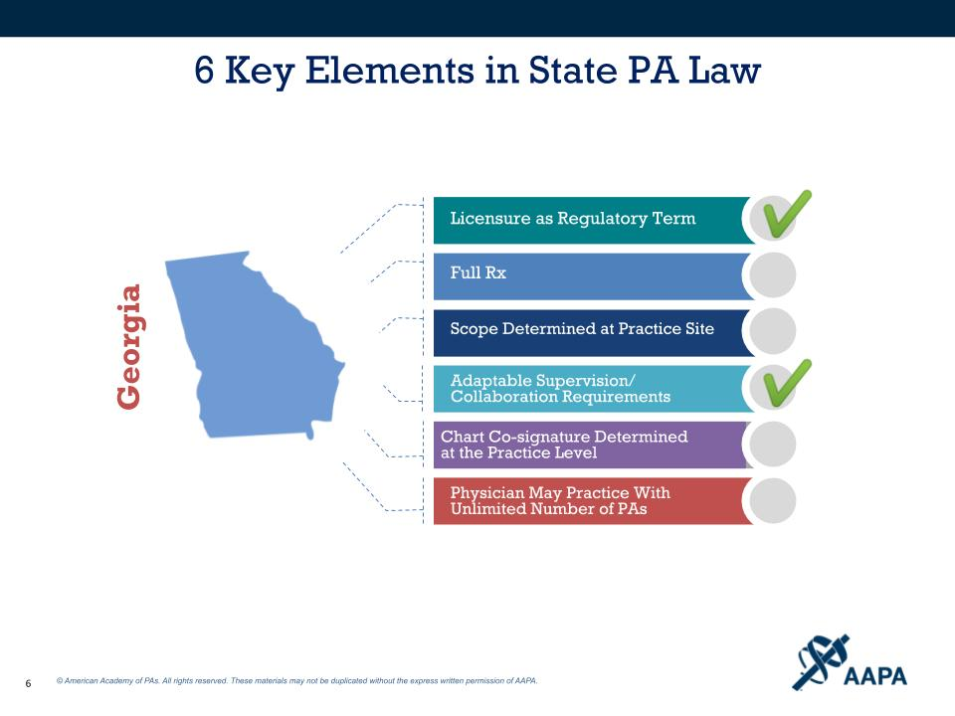

Slide 12
SIX ELEMENTS OF A MODERN PA ACT:
Georgia/National Comparison
Element | Georgia | Total States
Licensure as a Regulatory Term | Yes | 50
Full Prescriptive Authority (including Schedule II Drugs) | No | 43 (Note: including every neighbor state) and D.C.
PA Scope of Practice at Practice Site | No | 37 and D.C.
Adaptable Supervision Requirements (Distance, Physician Location) | Yes | 30
Chart Co-Signature Requirements at Practice Level | No | 33 and D.C.
No Ratio Restriction | No | 14 (Note: 26 other states have ratios less restrictive than Georgia)

Slide 13
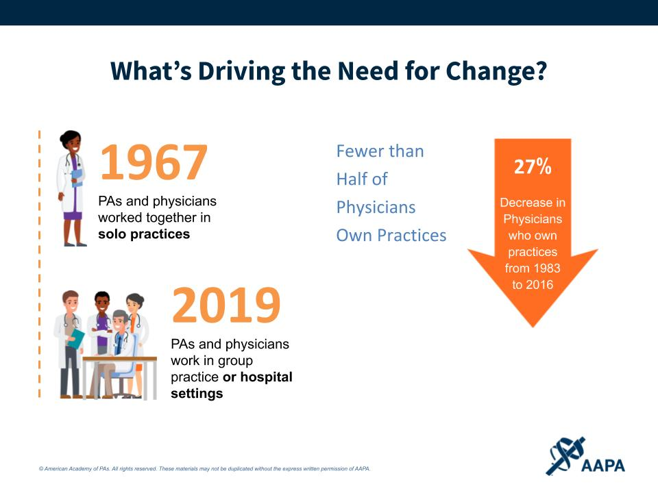

Slide 14
AREAS IN GEORGIA PA LAW TO EXAMINE
Physician chart review of patients receiving a prescription from a PA
Supervisory ratios
    Number of PAs a physician can supervise at one time
    Number of PAs with job description
    Elimination of ratios
Prescriptive authority
    All Schedule II drugs
    Hydrocodones

Slide 15
AREAS IN GEORGIA PA LAW TO EXAMINE (Continued)
Sites where PAs can practice (language on places where physician “regularly sees patient” needs to be eliminated)
Arcane language in PA Act
PA “licensed to” supervising physician
Notification to patient of the right to see a physician prior to issuance of an prescription
Inclusion of PAs in state statutes predating PA profession or where it was assumed that by including physicians, PAs were necessarily included

Slide 16
AREAS IN GEORGIA PA LAW TO EXAMINE (Continued)
Reimbursement issues
    PAs are not eligible for direct payment from Medicare and nearly all commercial insurance payers
    Can create problems:
        PA marketability
        Federal reimbursement of PA services in rural health clinics
Designation of PAs as “Primary Health Care Providers” in all state programs

Slide 17
FINAL NOTE
Both Governor Deal’s Rural Hospital Stabilization Committee and the House Rural Development Council have recommended the expansion of the scope of practice of physician assistants, among other health care professions.
QUESTIONS?

