Slide 1

Preservation of HOPE Scholarship Program
Joint House & Senate Study Committee
Debbie Alford
CEO/President
September 14, 2015
1

Slide 2
Georgia Lottery Corporation (GLC)
Nov. 1992 - Georgia voters approve a constitutional amendment to create the Georgia Lottery; first ticket sales began on June 29, 1993
36th lottery in the United States; now 44 + DC
GLC is established as a body corporate and politic which shall be deemed to be an instrumentality of the state and a public corporation OCGA 50-27-4
Net proceeds of lottery games shall be used to support improvements and enhancements for educational purposes and programs and that such net proceeds shall be used to supplement, not supplant, existing resources for educational purposes and programs
The GLC is governed by a Board of Directors composed of seven members appointed by the Governor and approved by the State Senate
Legislative Oversight Committees: House Regulated Industries/Senate Economic Development
Receives no state appropriations; operating dollars come from revenues; currently operate at 10.5% of net revenues
GLC transfers profit to the state treasury quarterly; does not administer the Lottery for Education Account or reserve funds
In 2013, HB 487 transferred regulatory oversight of COAM’s (coin operated amusement machines) in Georgia to the GLC
2

Slide 3
Students Benefit
On average, the GLC raises approximately $2.7 Million every day for Georgia’s HOPE & Pre-K Programs
To date, the GLC has raised more than $16.5 Billion for education
More than 1.7 Million students have attended college on a HOPE Scholarship or Grant
More than 1.4 Million four-year-olds have attended a lottery-funded Pre-K Program
3

Slide 4
Over $16.5 Billion Returned to Education
$ in millions
$ Change YOY
$138 $43 $38 -$26 $91 $37 $8 $35 $25 $31 $20 $20 $31 $14 $5 $11 -$37 $ 55 $26 $18 $35
4

Slide 5
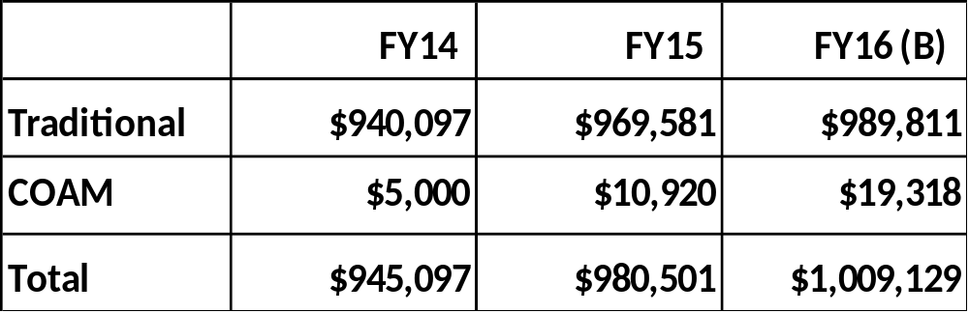
GLC Transfer to Lottery For Education
($ in Thousands)
5

Slide 6
Worldwide and National Lottery Rankings
National Rankings
#2 total per cap sales
#2 instant per cap sales
#4 per cap returns to beneficiaries
Source- LaFleur’s Magazine (September/October 2014)
Worldwide Rankings
#17 total sales
#5 total per cap sales
#10 instant sales
#2 instant per cap sales
Source - LaFleur’s 2015 World Lottery Almanac
6

Slide 7
FY 2015 Top Profit per Capita (PPC) Lotteries
($ in Thousands)
Lottery | Began | Years | Population | Net Sales | Profit | Profit Per Cap
Massachusetts | 1972 | 43 | 6,750 | $5,011,000 | $983,500 | $145.70
New York | 1967 | 48 | 19,750 | $7,251,000 | $2,203,000 | $111.54
Georgia | 1993 | 22 | 10,100 | $3,908,000 | $969,600 | $96.00
Connecticut | 1972 | 43 | 3,600 | $1,144,000 | $319,700 | $88.81
Maryland | 1973 | 42 | 5,980 | $1,762,000 | $525,000 | $87.79
Pennsylvania | 1972 | 43 | 12,790 | $3,820,000 | $1,061,000 | $82.96
Michigan | 1972 | 43 | 9,910 | $2,728,000 | $762,800 | $76.97
Florida | 1988 | 27 | 19,890 | $5,580,000 | $1,500,000 | $75.41
South Carolina | 2002 | 13 | 4,830 | $1,405,000 | $349,000 | $72.26
Virginia | 1988 | 27 | 8,330 | $1,844,000 | $533,800 | $64.08
New Jersey* | 1970 | 45 | 8,940 | $3,001,000 | N/A | N/A
NOTE: Population data obtained from 2014 U.S Census (rounded). FY15 sales and profit data obtained directly from specific lotteries.
* FY15 actual profit unavailable at this time. FY14 profit per cap was $107.94.

Slide 8
Top PPC Lotteries YOY $ Change
($ in Thousands)
 |  |  | YOY
Lottery | FY14* | FY15** | $ Change | % Change
South Carolina | $330,700 | $349,000 | $18,300 | 5.5%
Georgia | $940,097 | $969,600 | $29,503 | 3.1%
Michigan | $746,820 | $762,800 | $15,980 | 2.1%
Massachusetts | $974,560 | $983,500 | $8,940 | 0.9%
Maryland | $521,100 | $525,000 | $3,900 | 0.7%
Florida | $1,495,000 | $1,500,000 | $5,000 | 0.3%
Connecticut | $319,500 | $319,700 | $200 | 0.1%
Virginia | $538,600 | $533,800 | ($4,800) | (0.9%)
Pennsylvania | $1,079,600 | $1,061,000 | ($18,600) | (1.7%)
New York | $2,302,760 | $2,200,000 | ($102,760) | (4.5%)
New Jersey | $965,010 | N/A | N/A | N/A
*Based on data obtained from La Fleur's 2015 World Lottery Almanac except for Connecticut, Maryland, and New York which came from their financial statements.
** Unaudited FY15 data received directly from the specific lottery.

Slide 9
FY 2015 Top Lotteries Based on $ Profit
($ in Thousands)
Lottery | Began | Years | Population | Net Sales | Profit | Profit Per Cap
New York | 1967 | 48 | 19,750 | $7,251,000 | $2,203,000 | $111.54
Florida | 1988 | 27 | 19,890 | $5,580,000 | $1,500,000 | $75.41
California | 1985 | 30 | 38,800 | $5,500,000 | $1,350,000 | $34.79
Texas | 1992 | 23 | 26,960 | $4,529,700 | $1,242,702 | $46.09
Pennsylvania | 1972 | 43 | 12,790 | $3,820,000 | $1,061,000 | $82.96
Massachusetts | 1972 | 43 | 6,750 | $5,011,000 | $983,500 | $145.70
Georgia | 1993 | 22 | 10,100 | $3,908,000 | $969,600 | $96.00
Michigan | 1972 | 43 | 9,910 | $2,728,000 | $762,800 | $76.97
Ohio | 1974 | 41 | 11,600 | $2,743,100 | $739,900 | $63.78
Virginia | 1988 | 27 | 8,330 | $1,844,000 | $533,800 | $64.08
Maryland | 1973 | 42 | 5,980 | $1,762,000 | $525,000 | $87.79
Illinois* | 1974 | 41 | 12,880 | N/A | N/A | N/A
New Jersey* | 1970 | 45 | 8,940 | $3,001,000 | N/A | N/A
NOTE: Population data obtained from 2014 U.S Census (rounded).
* FY15 actual profit unavailable at this time. Illinois FY14 profit was $742M. New Jersey FY14
profit was $965M.

Slide 10
Top Lotteries Based on $ Profit
Comparison of Change in Profit
($ in Thousands)
 |  |  | YOY
Lottery | FY14* | FY15** | $ Change | % Change
Georgia | $940,097 | $969,600 | $29,503 | 3.1%
Michigan | $746,820 | $762,800 | $15,980 | 2.1%
Texas | $1,220,720 | $1,242,702 | $21,982 | 1.8%
California | $1,328,000 | $1,350,000 | $22,000 | 1.7%
Massachusetts | $974,560 | $983,500 | $8,940 | 0.9%
Maryland | $521,100 | $525,000 | $3,900 | 0.7%
Florida | $1,495,000 | $1,500,000 | $5,000 | 0.3%
Virginia | $538,600 | $533,800 | ($4,800) | (0.9%)
Pennsylvania | $1,079,600 | $1,061,000 | ($18,600) | (1.7%)
Ohio | $764,900 | $739,900 | ($25,000) | (3.3%)
New York | $2,302,760 | $2,200,000 | ($102,760) | (4.5%)
Illinois | $741,900 | N/A | N/A | N/A
New Jersey | $965,010 | N/A | N/A | N/A
*Based on data obtained from La Fleur's 2015 World Lottery Almanac, except for Maryland and New York which came from their financial statements.
**Based on unaudited data obtained from specific lotteries.

Slide 11
FY 2015 Southeast Region PPC & $ Profit
(All figures in Thousands except for PPC)
Lottery | Began | Years | Population | Net Revenue | Profit | Profit Per Cap | SE Rank in Total $ Profit
Georgia | 1993 | 22 | 10,100 | $3,908,000 | $969,600 | $96.00 | 2
Florida | 1988 | 27 | 19,890 | $5,580,000 | $1,500,000 | $75.41 | 1
South Carolina | 2002 | 13 | 4,830 | $1,405,000 | $349,000 | $72.26 | 5
Virginia | 1988 | 27 | 8,330 | $1,844,000 | $533,800 | $64.08 | 3
Kentucky | 1989 | 26 | 4,410 | $886,930 | $236,101 | $53.54 | 7
Tennessee | 2004 | 11 | 6,550 | $1,373,000 | $347,785 | $53.10 | 6
North Carolina | 2006 | 9 | 9,940 | $1,970,000 | $522,000 | $52.52 | 4
Louisiana | 1991 | 24 | 4,650 | $453,800 | $167,000 | $35.91 | 8
NOTE: Population data obtained from 2014 U.S Census data.

Slide 12
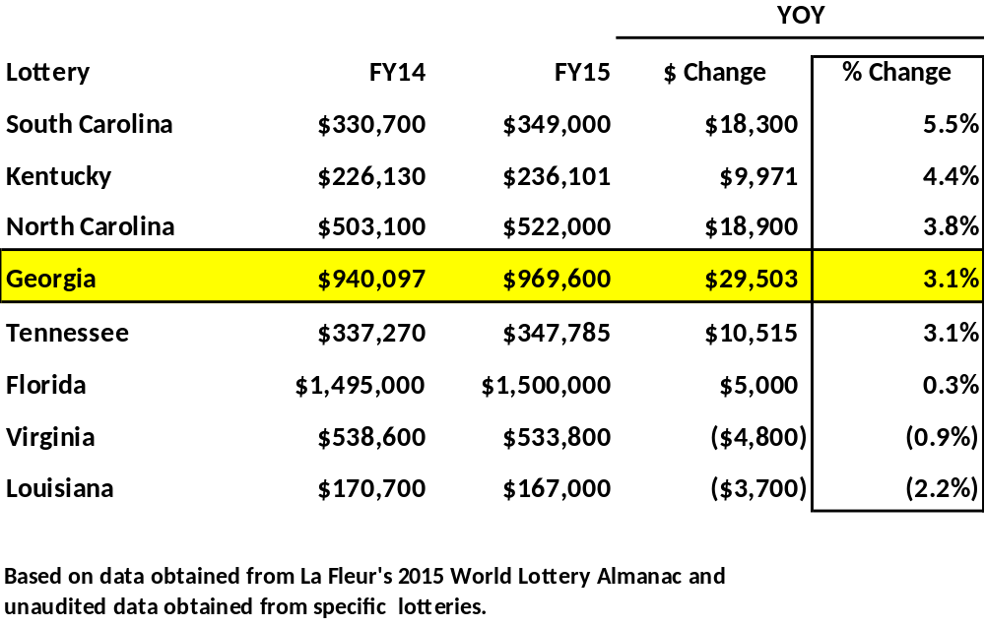
Southeast Region
Comparison of Change in Profit
($ in Thousands)

Slide 13
Who Plays the Lottery
The demographic profile of who has ever played the Georgia Lottery reflects the U.S. Census Bureau’s data of Georgia’s population regarding gender, ethnicity and income. Of those Georgians who have ever played the Georgia Lottery:
Approximately half are male and half are female
Approximately half are under the age of 45
Approximately half are married
Approximately half are Caucasian
Approximately half have an annual household income of $50,000 or more
(source: 2012 Bantam Group)

Slide 14
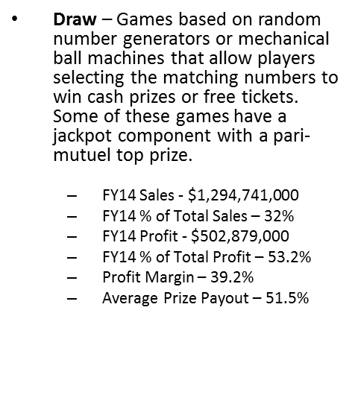
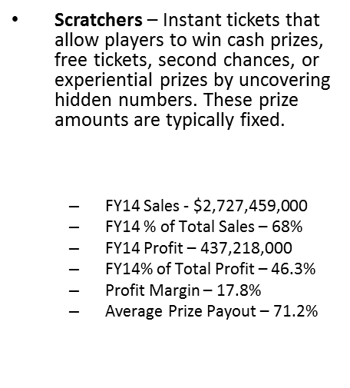
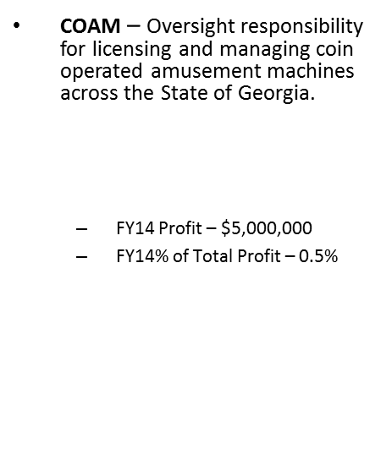
Our Products
Jackpot Games: Mega Millions
Powerball
Jumbo Bucks Lotto
Daily Games: Fantasy 5
Cash 3
Cash 4
Georgia FIVE
All or Nothing
KENO!
Games: $1, $2, $3, $5, $10, $20, $30. Diggi Games
Class A: kiddie rides, arcade games, juke boxes, pool tables, claw machines
      Class B: line-up, match-up video games with some skill (points carry over)

Slide 15
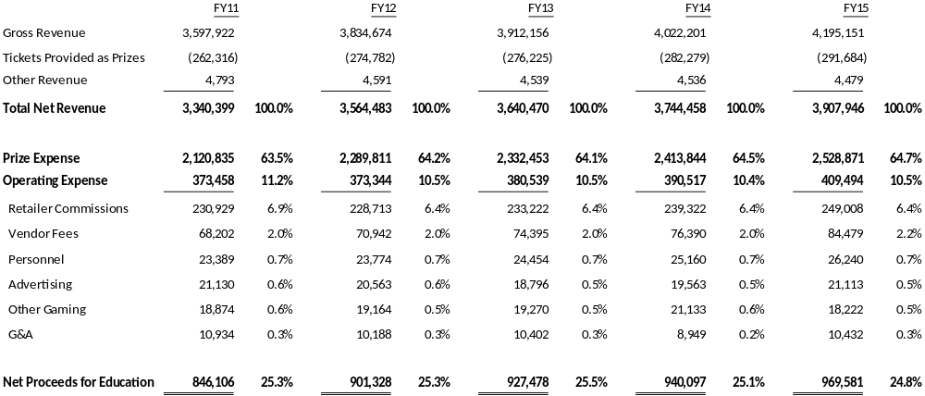
Georgia Lottery Corporation
P&L Statements FY2011 – FY2015 (Traditional Lottery)
($ in Thousands)

Slide 16
GLC Net Revenue & Product Mix
($ in Thousands)
$3.9B
$3.6B
$3.6B
$3.7B
32.2%
31.6%
$3.3B
32.8%
32.6%
32.6%
67.4%
67.2%
67.8%
68.4%
67.4%

Slide 17
GLC Product Mix
Profit Margin = 36.1%
Profit Return = $500,428,000
Prize Payout % = 50.5%
Profit Margin = 24.8%
Profit Return = $969,581,000
Prize Payout % = 64.7%

Slide 18
GLC Product Mix vs. New York Lottery
Profit Margin = 24.8%
Profit Per Cap = $96.00
Payout = 64.7%
Profit Margin 30.4%
Profit Per Cap = $111.54
Payout = 60.6%

Slide 19
GLC – Recalculated Based on
New York’s FY 2015 Product Mix
 | Existing Georgia
 | Mix |  | Net Revenue | Profit
Scratcher | 68.4% |  | $2,594,399 | $461,301
Draw | 31.6% |  | $1,313,547 | $508,280
Total Net Revenue |  |  | $3,907,946 | $969,581
 | Recalculated Georgia based on NY Product Mix
 | NY Mix |  | Net Revenue | Profit
Scratcher | 50.3% |  | $1,965,697 | $349,514
Draw | 49.7% |  | $1,942,249 | $751,558
Total Net Revenue |  |  | $3,907,946 | $1,101,071
 |  | Incremental Profit |  | $131,490
 |  | Revised Profit Margin |  | 28.2%
($ in Thousands)

Slide 20
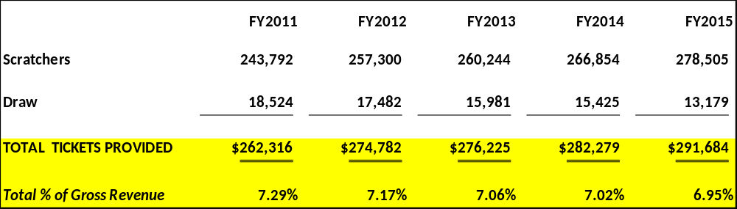
GLC Tickets Provided as Prizes
($ in Thousands)

Slide 21
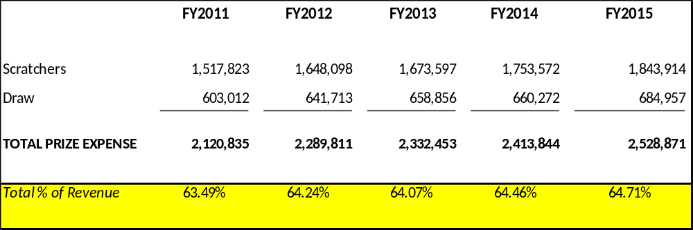
GLC Prize Expense
($ in Thousands)

Slide 22
Where We Sell
Approximately 8,700 Retailers
GLC Direct Sales (Airport Baggage Claim, 8 District Offices, Headquarters)
Internet Sales ($25m FY2015)
Top performing retail outlets located along state borders and Hartsfield-Jackson International Airport

Slide 23
Retailer Trade Styles
Independent vs Corporate Retailers
76% of GLC Retailers
are small businesses
Sales by Trade Style

Slide 24
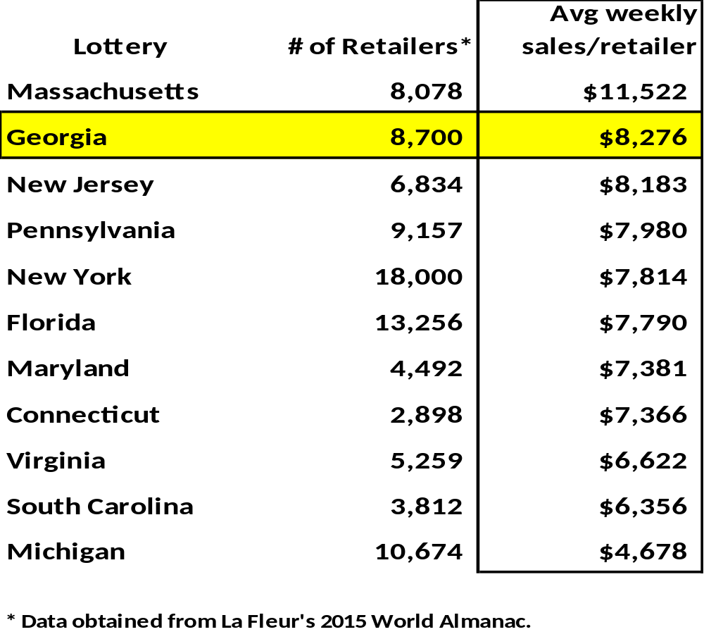
Top PPC Lotteries –
FY 2014 Retailer Productivity

Slide 25
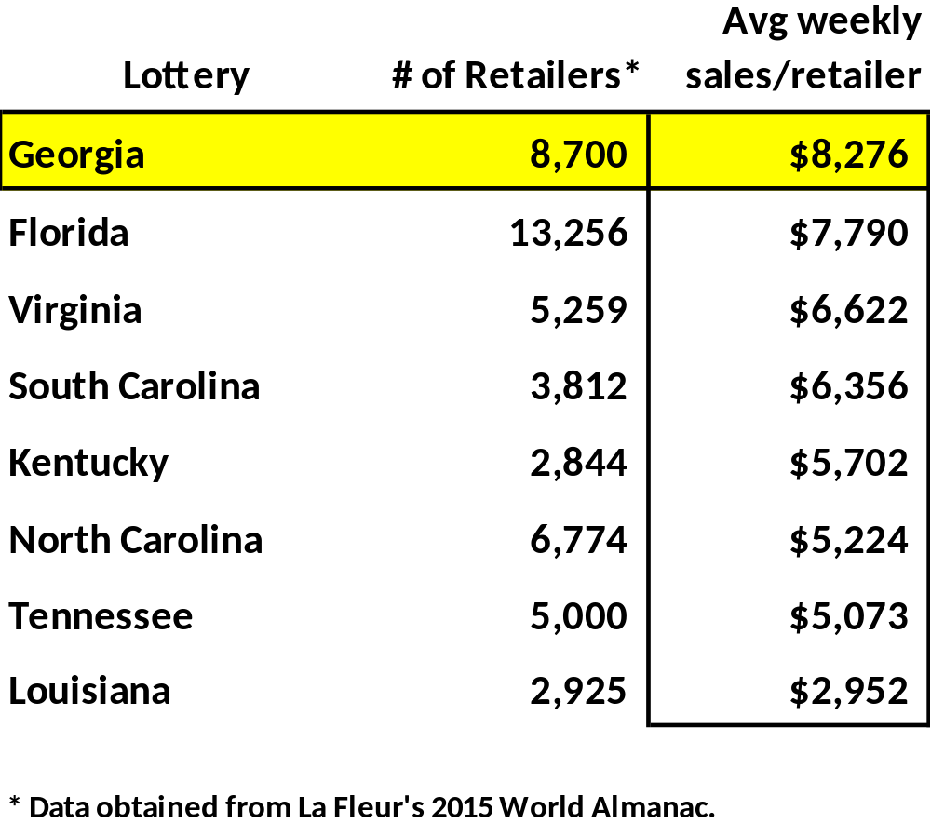
Southeast Region
FY 2014 Retailer Productivity

Slide 26
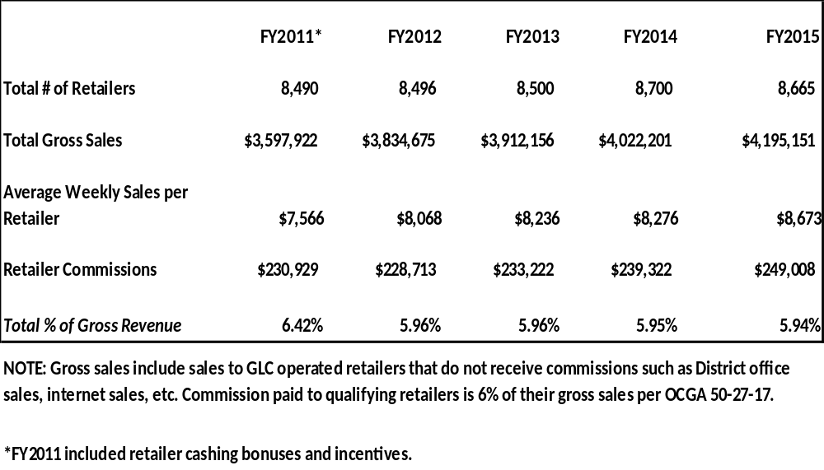
GLC Operating Expenses –
Retailer Commissions
($ in Thousands)

Slide 27
Lottery Retailer Commissions
*Source La Fleur’s 2015 World Almanac

Slide 28
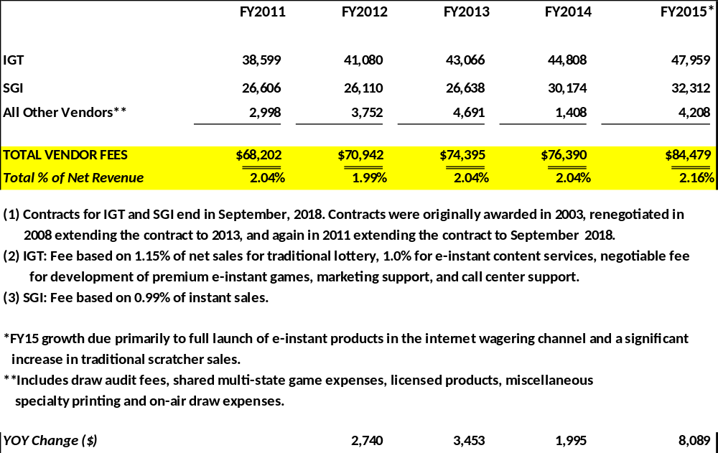
GLC Operating Expenses – Vendor Fees
($ in Thousands)

Slide 29
Our Employees
  Employee tenure
65% over 6 years of service
Almost 50% over 10 years of service
Approximately 17% over 20 years of service
  Employee turnover rate
FY11 – 4.5%
FY12 – 5.6%
FY13 – 4.5%
FY14 – 6.0%
FY15 – 7.3%

Slide 30
Our Employees
Georgia Lottery Employees - Ethnic Diversity
Georgia Lottery Employees - Gender Breakdown
Of the 13 individuals that comprise the GLC’s senior management team, six are minorities and four are women.
*source: Georgia Lottery Minority Business Participation Report (Dec. 1, 2014)

Slide 31
GLC Operating Expenses – Salaries
Total Salary and Headcount
($ in Thousands)
# of GLC Employees |  | 286 | 287 | 284 | 288 | 291 | 298
# of COAM Employees |  | - | - | - |  | 11 | 29
Total Employees |  | 286 | 287 | 284 | 288 | 302 | 327

Slide 32
Bonuses FY 2010 – FY 2015

Slide 33
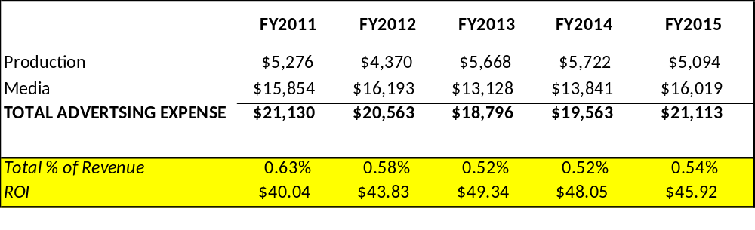
GLC Operating Expenses – Advertising
($ in Thousands)

Slide 34
Advertising costs as % of net sales
Source: 2015 Lafleur’s World Almanac

Slide 35
GLC Operating Expenses - Marketing
($ in Thousands)
 | FY2011 | FY2012 | FY2013 | FY2014 | FY2015
Advertising | $21,130 | $20,563 | $18,796 | $19,563 | $21,113
Other Gaming | 18,874 | 19,164 | 19,270 | 21,133 | 18,222
TOTAL MARKETING EXPENSE | $40,004 | $39,727 | $38,066 | $40,696 | $39,335
Total % of Revenue | 1.20% | 1.11% | 1.05% | 1.09% | 1.01%
ROI | $21.15 | $22.69 | $24.36 | $23.10 | $24.65

Slide 36
GLC Distribution of Net Revenues
- Traditional Lottery

Slide 37
How We Forecast Annually
By game
By price point
Based on historical trends
Incorporating strategic initiatives
New game launches and matrix changes

Slide 38
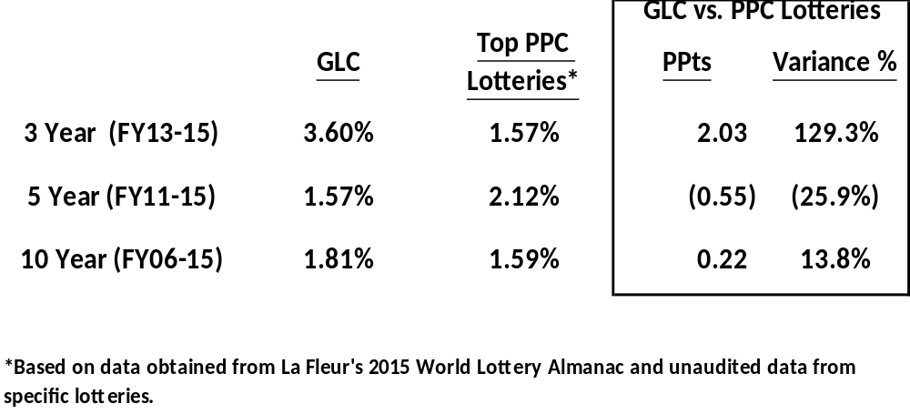
Historical Profit Growth

Slide 39
Our Strategic Focus
Stabilize and grow draw games
Focus on quality distribution and inventory optimization
Expand corporate business development, especially non-traditional locations
Deploy mobile sales channel
Achieve operational efficiencies

Slide 40
GLC Traditional Lottery Projected Profits
($ in Millions)

Slide 41
Coin Operated Amusement Machine (COAM) Origination
HB 487
  Signed by Governor Deal on April 10, 2013.
  Transferred COAM responsibilities to the Lottery
  Responsibilities include:
    Licensure of owners and operators of Class A and B COAMs
      Class A- kiddie rides, arcade games, juke boxes, pool tables, claw machines
      Class B- line-up, match-up video games with some skill (points carry over)
    Issuance of decals for COAMs
    Collection of license and decal fees for COAMs
    Implementation of a central accounting system
    Collection of net proceeds from Class B COAMs
    Compliance and Enforcement

Slide 42
Recent COAM Legislation
SB 190 - July 1, 2015
  Provides for licensing of manufacturers and distributors
  Mandates arbitration for licensee disputes
  Creates the ability to implement staggered licensing periods
  Places a cap on Master License Holders at 220 with an auction provision
  No more than 9 Class B COAMs in a location
  Increases late fee for licensing

Slide 43
COAM Update – FY 2014
Established intergovernmental agreements with GBI, DOAA and DOR
Developed and deployed a revenue reporting system
Developed licensing criteria with integrity checks
Created online license applications
Instituted enforceable rules and regulations
Met monthly with the COAM advisory board
Wrote and awarded an RFP for the centralized gaming system
Staffed the COAM Division
Implemented responsible gaming initiatives and doubled the transfer to DBHDD for treatment of problem gambling from $200,000 to $400,000
Created an anonymous “tip line” for consumers to report COAM fraud and abuse

Slide 44
COAM Update – FY 2015
Brought licensing and enforcement activities in-house
Processed 8,100 Class A and B licensees with integrity checks
Tested, certified, and deployed the centralized COAM gaming system
On-boarded over 20,000 Class B COAMs in approximately 5,000 locations throughout Georgia
Began conducting financial sweeps of retailers
Set up a hearing/arbitration system
Increased compliance, enforcement, and education efforts through partnerships with GBI, local law enforcement, DOAA, DOR, industry associations, and banking regulators

Slide 45
FY 2015 COAM Enforcement
Almost 4,400 compliance inspections were conducted
Over 1,300 citations and warnings were issued by GLC Compliance Inspectors- almost $1 million in fines levied
More than 340 audits of licensees were conducted
GBI served 58 search warrants, made 36 arrests, and seized currency, bank accounts, businesses, and property
48 retailers were suspended due to illegal activities and/or non-compliance

Slide 46
Georgia Lottery Corporation
P&L Statements FY2014-2015 (COAM)
($ in Thousands)
 | FY14 |  |  | FY15
COAM REVENUE
COAM Centralized System | - | 0.00% |  | 5,910 | 38.68%
COAM Licensing Renewals | 10,190 | 99.83% |  | 8,834 | 57.82%
COAM Fines/Pen/Assmt Fees | - | 0.00% |  | 470 | 3.08%
COAM NSF Fees | - | 0.00% |  | 26 | 0.17%
COAM Other Revenue | - | 0.00% |  | 0 | 0.00%
COAM CC Renewal Processing Fee | - | 0.00% |  | 9 | 0.06%
COAM ACH Renewal Processing Fee | - | 0.00% |  | 21 | 0.14%
Interest Income | 17 | 0.17% |  | 8 | 0.05%
COAM Revenue | 10,207 | 100.00% |  | 15,278 | 100.00%
COAM EXPENSES
Personnel Costs | 1,301 | 12.75% |  | 1,809 | 11.84%
Operating Expenses | 666 | 6.52% |  | 1,258 | 8.23%
COAM Operating Expenses | 1,967 | 19.27% |  | 3,067 | 21.45%
DOR MOU Expenses | 480 | 4.70% |  | 27 | 0.18%
DOAA MOU Expenses | 380 | 3.72% |  | 407 | 2.67%
Investigations and Enforcement | 472 | 4.62% |  | 1,295 | 8.48%
Other COAM Operating Expenses | 1,333 | 13.06% |  | 1,729 | 11.32%
Total Operating Expenses | 3,299 | 32.32% |  | 4,797 | 32.77%
Gaming Expenses
Intralot Vendor Fees | - | 0.00% |  | 1,469 | 9.62%
Total COAM Expenses | 3,299 | 32.32% |  | 6,266 | 42.38%
Gross Proceeds for Education | 6,908 | 67.68% |  | 9,012 | 57.62%
Distribution of Retained Earnings | - | 0.00% |  | 1,908 | 1.37%
Net Proceeds For Education | 6,908 | 67.68% |  | 10,920 | 58.99%
Proceeds Held as Retained Earnings | 1,908 |  |  | -
Net Transfer for Education | 5,000 |  |  | 10,920

Slide 47
COAM Projected Profits
($ in Thousands)

Slide 48
Consolidated Projected Profits
($ in Thousands)

Slide 49
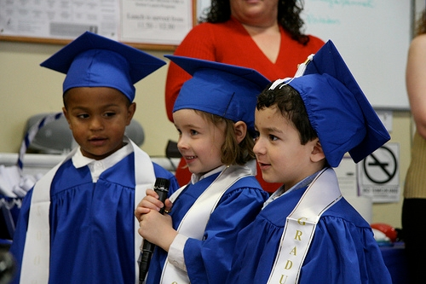


Our Mission
To maximize revenues for HOPE and Pre-K.
Our Vision
To be recognized globally as a top performer and innovative leader in the lottery industry and a trusted and valued partner for the state.
Our Motto
We do it for Georgia’s kids!
49

