Slide 1
WOMEN’S HEALTHCARE IN GEORGIA
PRESENTED TO:
SENATE WOMEN'S ADEQUATE HEALTHCARE STUDY COMMITTEE
BY: DR CATHERINE BONK
PRESIDENT
GEORGIA OBGYN SOCIETY
SEPTEMBER 14, 2015
Notes:
I am Dr Cathy Bonk a practicing OBGyn in Decatur Ga and current president of the Georgia OBGyn Society Thank for your interest in the issue of quality healthcare for the women in Georgia and for holding these hearings to look at the issues and discuss potential changes that can improve care for women and newborns

Slide 2



DAILY DILEMMAS IN HEALTHCARE FOR A WOMAN
Grandmother Mother Teen
Notes:
Lets start with the women of Georgia and what they need
We are the childcare providers, we are the eldercare providers, we are the neighbor care providers and the care for ourselves is what is left until last.

Slide 3
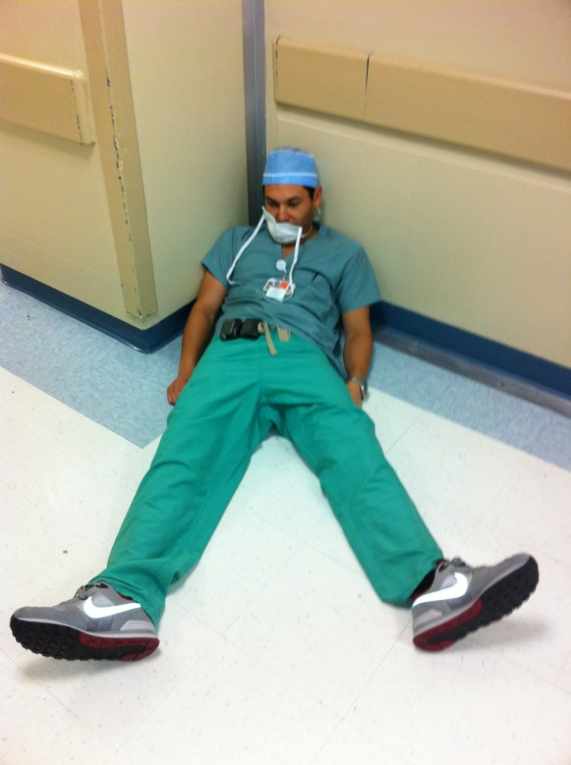

A DAY IN THE LIFE OF A PRACTICING OBGYN
Notes:
It may start with a day on call delivering babies as I did just yesterday. Or it may start with a hysterectomy. Or it may be an average office day seeing upwards of 30 women for annual check ups, same day infections and problems or OB checks.
Women save up their problems for the gyn. It may be the recent ungrieved death of their husband or mother, the school problems of their children who the doctor delivered or good news about a promotion at work or educational goal achieved . All in the fifteen minutes or less allotted for each exam. And then the nights, on call, checking labs and messages, signing charts. Or entering data into a new Electronic Medical Re
cord or converting that data into the new ICD 10 Coding system which goes into effect next month.

Slide 4
HOW DO YOU BECOME AN OBGYN?
4 years college
4 years medical school
4 years residency training as an OBGyn
Average Debt for an OB: $250,000

Slide 5
OBGYN RESIDENCY EDUCATION PROGRAMS IN GA
Program | Graduates Per Year
Emory School of Medicine, Atlanta | 9
Morehouse School of Medicine, Atlanta | 3
Georgia Regents University School of Medicine, Augusta | 3
Mercer University School of Medicine, Macon | 4
Mercer University School of Medicine, Savannah | 4
Approximately 23 graduates per year
Only 50% stay in Georgia
Notes:
Many residents in OB Gyn go on to subspeciaty fellowships of which there are few in GA. We need to keep those who graduate both in general OB Gyn and its subspecialties such as maternal fetal medicine and gynecology oncology. And we need more training slots

Slide 6

WHAT DOES THE OBGYN DO?
Primary care physician for:
  Female teens
  Women in their adult years.
Responsible for bringing the next generation of citizens into the state healthy
Notes:
Generally speaking the OBGyn is the primary care physician for female teens and for women in their adult years. And of course we are delivering your next constituents. The future of the state.

Slide 7
CHRONIC PROBLEMS
  Obesity
  Cardiovascular Disease
  Diabetes
  Mental health issues
  Unplanned pregnancies
Notes:
Toys are Us --Women are Us
We are the first stop and sometimes only physician a woman sees. We have helped them have their families and formed a very deep bond. We see their chronic problems which include obesity and it’s associated risks down the road arthritis and joint problems and their costly solutions like joint replacements. And of course detected or undetected diabetes, heart disease and mental issues. The American Heart association has a very active Go RED
for Women program which has been great at creating awareness for the problem but has just scratched the surface in terms of prevention and treatment. And of course menopause ( which my teenage son thought was a chronic disease)- don’t worry I cleared up for him that is a natural occurance fraught with troublesome symptoms and lastly unplanned pregnancies in women of all ages.

Slide 8
WHO HAS ACCESS TO AN OBGYN?
40+ Counties have no obstetrical care of any kind
    No OBGyn
    No Family physician doing OB
    No Midwife
    70+ counties have no OB physician

Slide 9
IMPORTANT FACTS
Research shows:
Inter conceptual health between pregnancies is critical to good pregnancy outcomes for mother and baby
Women need access to healthcare throughout their lives to remain healthy and well
51.2% of the population of Georgia is female

Slide 10
MEDICAID FOR WOMEN IN GEORGIA
Medicaid covers 50-60 percent of deliveries in GA (depending on the year)
Cover the woman for:
  pregnancy
  60 days after delivery
  then uninsured
  P4HB (if enrolled)
  Visit for birth control
  Limited services

Slide 11
CONSEQUENCES OF THE SYSTEM
Lack of health care and health insurance between pregnancies
Unhealthy women
Chronic diseases not under control
At risk pregnancy
Poor pregnancy spacing
Unplanned pregnancies
Results:
Poor pregnancy outcomes
Sick newborns with long term problems
Poor maternal health long term
Notes:
We are not ensuring the best new citizens for our state with our current system of care
Remember this is the system of care for 50 to 60 percent of our women and their pregnancies in Georgia

Slide 12
CONSEQUENCES OF THE SYSTEM
Private Insurance
Insurance does not equal coverage
High deductibles
High co-pays
Non-covered services
Results:
Substandard products
Narrow networks
Inadequate care
Lack of specialty care

Slide 13

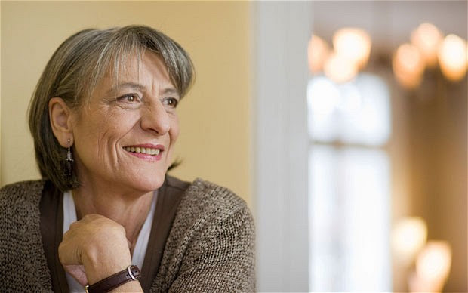



WHY FIX THE PROBLEM?
Effects half the population of Georgia
Notes:
Problem affects half the population in GA: Adult females and teen now and the females in the newborn and pediatric population who will be growing into the system in the next 10 to 15 years
There is no silver bullet. Various changes and activities are necessary to address the issue.

Slide 14
HOW CAN WE FIX THIS?
EXPAND EDUCATION
More OB residency programs
Loan repayment
Another midwifery program in rural GA
Re-entry programs for Gyns in good standing to return to OB
GBPW funding for OBGyn slots similar to FP slots

Slide 15
HOW CAN WE FIX THIS?
HELP RURAL GEORGIA
Telemedicine
Keep more Providers in State: 50% new grads leave
Increase use of CNMs
Incentives to practice in rural areas
Adequate funding for Public Health programs
Keep hospital OB units open
Understand rural problems
Strengthen support systems
Notes:
CNMs particularly in areas with no MD OB provider. I think this is going on now in Greene County. Some loan repayment moneys are now available however not enough uptake of this opportunity has been seen and once the incentive is over can we haelp the physician stay in that community and assure that the hospital in that community will keep its OB unit open.

Slide 16
HOW CAN WE FIX THIS?
STRENGTHEN AND SUPPORT OUR CURRENT WORKFORCE
  Adequate reimbursement (rural practice is a small business)
  More focus on education/communication to practicing OBGyns (Large diverse state)
  Stabilized malpractice climate
  Nonthreatening political climate
Notes:
OB practices are often small businesses as are hospitals. THey are making decisions on the ground about buying an electronic medical record or whether to provide USs in the office involving salaries , benefits and more and more expensive equipment.
We as a society are working on keeping our members updated both urban and rural. We send out a newsletter six times per year to every OB Gyn member or not of our society, as well as hold annual clinical meeting and twice yearly meeting for office staff. Every OB Gyn in GA knows Pat Cota , our executive director’s name and phone number. Truly, other states do not have nearly as active and available state OB Gyn society infrastructure.

Slide 17
HOW CAN WE FIX THIS?
STATE LEVEL EFFORTS
  State level advisory committee
  Organized planning to assure that obstetric and women’s healthcare remains accessible, particularly in rural GA
  Reorganized and strengthened Regional Perinatal Center System for high risk care
  Public Health campaigns to improve public education
Notes:
this committee is a wonderful first step. We need planning so that each doctor and hospital are not making practice strategies alone. the collective impact of these decisions has to be assessed and decisions influenced from a higher level. We are fortunate to have the bones of a coordination effort . Over time the regional Perinatal Center System established in the 70’s has become less well used and other practice referral patterns have arrisen but it’s structure is goos and it can be rerganized and stregthened to direct OB patterns refecting modern geogrphy and practice.
Dr Fitzgerald and her staff are to be commended for their educational campaigns such as safe sleep for infants , childhood obesity prevention and vaccinations but here is always more that can be done.
the key is to keep the link between women and their doctors viable. To provide enough providers who can provide enough quality care so that the caregivers of GA and their offspring can thrive.

Slide 18
THANK YOU
Discussion and Questions

