Slide 1

GDEcD TRADE SERVICES
Business Partner Identification
Export Counseling
Due
Diligence
International
Representatives
Global Events
Research Tools

Slide 2
SMALL BUSINESS ASSISTANCE
Engagement by Company Size
Successes by Company Size
International Rep Assistance
18%
20%
22%
56%
46%
26%
32%
80%
82% of export assistance provided to SMEs with fewer than 100 employees
78% of export successes achieved by SMEs with fewer than 100 employees
80% of key clients work with GDEcD’s International Representatives

Slide 3
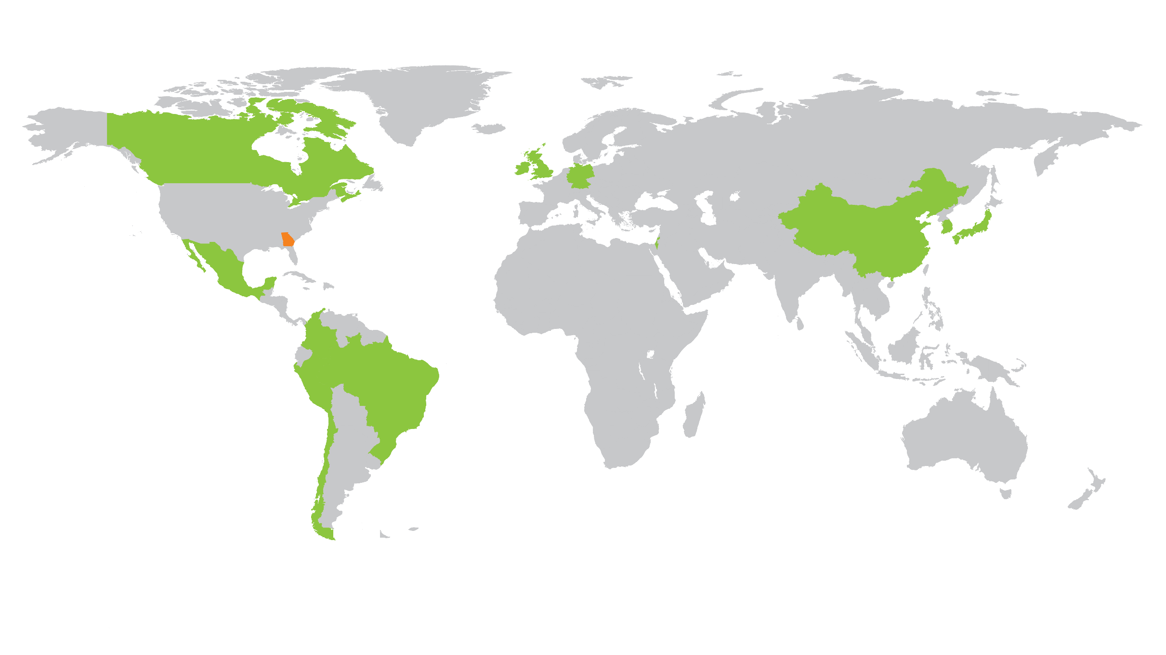
INTERNATIONAL REPRESENTATIVES
^{Brazil}
^{Canada}
^{Chile}
^{China}
^{Colombia}
^{Europe}
^{Israel}
^{Japan}
^{Korea}
^{Mexico}
^{Peru}
^{UK & Ireland}

Slide 4
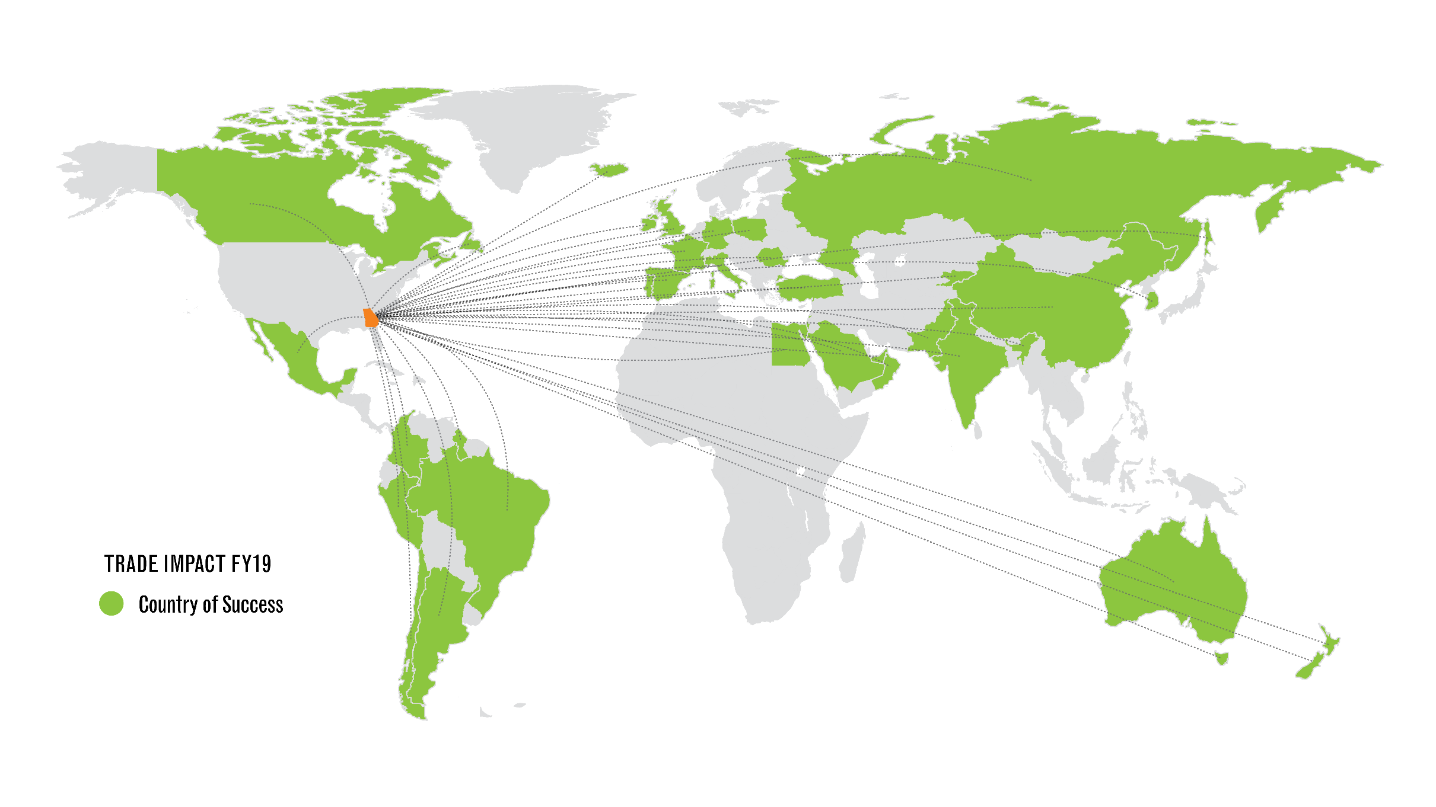
GLOBAL REACH

