Slide 1

GEORGIA HORSE RACING COALITION
The Senate Preservation of the
HOPE Scholarship Program
Study Committee
Senator Brandon Beach, 21st, Chairman
September 14, 2015

Slide 2

Executive Summary

Slide 3
GEORGIA HORSE RACING COALITION
About the Coalition
The GHRC is a group of leading business executives who love horse racing and understand the exponential economic impact that pari-mutuel wagering and the horse racing industry could bring to Georgia through statewide jobs, tax revenue and tourism.
Our Mission
Our mission is to work with our state leaders to
pass enabling legislation that will allow Georgians to vote on a constitutional amendment on the 2016 general election ballot to legalize pari-mutuel wagering on horse racing in our great State.

Slide 4
Winning Team: GHRC Board of Directors
Winning Team: Board of Directors
Chairman: Carl Bouckaert, Founder and Owner of Beaulieu Group LLC; Two-Time Olympic Equestrian; Owner Chattahoochee Hills Bouckaert Farm
President: Dean Reeves, Owner of Reeves Thoroughbred Racing and Breeders’ Cup World Champion, Mucho Macho Man; CEO of Reeves Contracting
VP / Treasurer: Jack Damico, Partner, Matson Driscoll & Damico Forensic CPAs; General Manager/Owner of The Posse Racing Stable
VP / Secretary: Tom Schulte, Senior Vice President, Dominion Benefits; Southern
Oak Farm; The Posse Racing Stable
Director: Tyler Alexander, VP / Partner GCI Graphics; Owner Calloway Stables
Director: Fred Fletcher, Executive VP Capital Group at Jones Lang LaSalle; Partner, The Posse Racing Stable
Executive Director: Steven Crayne, Founder & Owner of StartingGate Marketing LLC
❖ Chairman: Carl Bouckaert, Founder and Owner of Beaulieu Group LLC; Two-Time
Olympic Equestrian; Owner Chattahoochee Hills Bouckaert Farm
❖ President: Dean Reeves, Owner of Reeves Thoroughbred Racing and Breeders' Cup World
Champion, Mucho Macho Man; CEO of Reeves Contracting
❖
VP / Treasurer: Jack Damico, Partner, Matson Driscoll & Damico Forensic CPAs; The Posse Racing
Stable - General Manager/Owner
❖
VP / Secretary: Tom Schulte, Senior Vice President, Dominion Benefits, Southern Oak Farm. and
The Posse Racing Stable
❖
Director: Tyler Alexander, VP/ Partner GCI Graphics, Owner Calloway Stables.
❖
Director: Fred Fletcher, Executive Vice President Capital Group at Jones Lang LaSalle,
Partner The Posse Racing Stable .
❖
Executive Director: Steven Crayne, Founder & Owner of StartingGate Marketing LLC
❖
Directors of Equine Welfare Policies:
❖
Dr. Northrup is an UGA alumna and Vice Chairman of the Racing Committee
for the American Association of Equine Practitioners.
❖
Dr. Mueller is Professor, Director of Equine Programs and Chief of Staff, Large
Animal Veterinary Medical Teaching Hospital at the UGA College of Veterinary
Medicine.

Slide 5

Directors of Equine Welfare Policies
❖ Foster Northrop, DVM, and Eric Mueller, DVM, will help guide the
GHRC on animal welfare policies.
❖ Dr. Northrop is an UGA alumna and Vice Chairman of the Racing
Committee for the American Association of Equine Practitioners.
❖ Dr. Mueller is Professor, Director of Equine Programs and Chief of
Staff, Large Animal Veterinary Medical Teaching Hospital at the UGA
College of Veterinary Medicine.

Slide 6

The Time is Now:
‘Win-Win’ Factors for Pari-mutuel Wagering
❖
Privately Financed: No Taxpayer Dollars Required to Build
Year Round World Class Racing Entertainment Complex
❖ New Jobs: Thousands of Racing, Breeding, Farming,
Hospitality, Tourism, et al.
❖ Pari-Mutuel Wagering Proceeds: +/- $25 million for
need-based scholarships, grants, or loans to enable citizens to
attend units of the University or Technical College System of
Georgia, or eligible private colleges and universities; and
voluntary pre-kindergarten

Slide 7

Did You Know?
1. 72% Voter Support: Per 2012 Landmark
Communication Survey of Georgia Voters
2. Pari-Mutuel Wagering (Similar to Bingo):
Self-sufficient Without Casino or Alternate Gaming
3. Today’s Racing Model: Out-of-state Internet
wagering accounts for 87% of Monies Wagered,
with 6% on Track and 7% in State

Slide 8

Did You Know? (continued)
5. Regional Advantage: Georgia Offers the Ideal
Location for the Sport of Horse Racing
6. Established Equine Industry: Existing
180,000 Horse Population and Demographics
Provide Solid Foundation for Success
7. Partnerships: Racetrack Chaplaincy of America
& Old Friends Thoroughbred Aftercare

Slide 9

Building Strategic Partnerships
❖ GHRC has partnered with Race Track Chaplaincy of America and
Old Friends Thoroughbred Retirement Center to help bring
racing to Georgia
❖ The mission of RTCA is to minister to the spiritual, emotional, physical,
social and educational needs of people involved in all aspects of the
horse racing industry
❖ “Our partnership with the Georgia Horse Race Coalition will help us in
our mission to spread the word about the necessity for dignified
retirement and second careers for these great horses,” says Old
Friends founder Michael Blowen

Slide 10

Jobs For Georgia:
2012 Georgia State University Economic Impact Study (The Andrew Young School of Policy Studies)
The Possible Economic Benefits from instituting Pari-mutuel Wagering
on Horse Racing in Georgia Key Findings:
  Georgia has an established equine industry with nearly 180,000 horses in the state…thus by allowing pari-mutuel wagering, Georgia would be growing an industry that is already well established.
  The regional and metro advantage being located within the largest cluster of non-pari-mutuel states in the nation and in a position to grab market share from neighboring states that do have pari-mutuel wagering such as Florida, Kentucky, Maryland and New York.
  Overall, we find compelling evidence supporting arguments that legalizing pari-mutuel wagering would produce a broad range of economic benefits. Growing the state equine industry and increasing state revenues would be the two most likely possibilities. Broader impacts are also possible that would contribute to enhancing Georgia as a destination state and possibly creating a more positive synergy between urban and rural areas of the state.
Notes:
House Bill 4
By: Representatives Geisinger of the 48th, Lindsey of the 54th, Stephens of the 164th, McCall
of the 33rd, Riley of the 50th, and others
884 (4) One-half of 1 percent of the retainage to the University of Georgia College of Veterinary Medicine to be used solely for the promotion and growth of the equine racing
and breeding industries in the State of Georgia; One-half of 1 percent of the retainage to the University of Georgia College of Agricultural and Environmental Sciences to be used solely for the promotion and growth
of the equine racing and breeding industries in the State of Georgia.

Slide 11
Jobs For Georgia:
2014 Florida Economic Impact
of the Horse Racing Industry
In Feb. 2014 Senate Gaming Committee hearing in Tallahassee, members of the Florida horse industry presented new economic impact figures from a just released statewide, compressive and independent study of the economic impacts of the horse racing industry in Florida by Cummings Associates.
Major findings of the Cummings Associate study were that:
  The horse racing industry supports more than 12,000 jobs.
  The industry annually pays those workers more than $400M in wages and benefits.
  The industry generates an annual impact of more that $900M each year – a larger impact than spring training baseball in the state.
Notes:
House Bill 4
By: Representatives Geisinger of the 48th, Lindsey of the 54th, Stephens of the 164th, McCall
of the 33rd, Riley of the 50th, and others
884 (4) One-half of 1 percent of the retainage to the University of Georgia College of Veterinary Medicine to be used solely for the promotion and growth of the equine racing
and breeding industries in the State of Georgia; One-half of 1 percent of the retainage to the University of Georgia College of Agricultural and Environmental Sciences to be used solely for the promotion and growth
of the equine racing and breeding industries in the State of Georgia.

Slide 12
Jobs For Georgia:
2012 Univ. of Kentucky Ag Equine Study
Equine industry has total economic impact of almost $3B
Generated 40,665 jobs in 2012.
The tax contribution to Kentucky was approximately $134M.
Breeding had the highest employment figure of 16,198 with an output of $710M.
Racing had the highest output impact of $1.28B with an employment figure of 6,251.
The total number of racing and breeding jobs was 22,449.
Notes:
House Bill 4
By: Representatives Geisinger of the 48th, Lindsey of the 54th, Stephens of the 164th, McCall
of the 33rd, Riley of the 50th, and others
884 (4) One-half of 1 percent of the retainage to the University of Georgia College of Veterinary Medicine to be used solely for the promotion and growth of the equine racing
and breeding industries in the State of Georgia; One-half of 1 percent of the retainage to the University of Georgia College of Agricultural and Environmental Sciences to be used solely for the promotion and growth
of the equine racing and breeding industries in the State of Georgia.

Slide 13
The Georgia Horse Racing Business Model
• The new business model is vastly different than it was about 30 years ago, with wagering over the internet making large, expensive facilities and the need for on-track patrons almost a thing of the past. Our business model is based on considerable industry research which indicates that approximately 87% of the pari-mutuel handle (wagering) will come from out of state, 7% within the state and 6% at the track.
• A boutique 10-day live racing meet for Thoroughbreds, one in the spring and one in fall.
• On “dark days” when there is no live racing, simulcast operations would be open at the racetrack plus online wagering and additional OTB facilities around the state, except on certain holidays.
• In addition to Thoroughbreds, other horse racing breeds, such as Harness, Arabians, et al., could use the track at other times and other domestic and international equine / entertainment events.

Slide 14
Preliminary and Subject to Change Based on New or Additional Information.
Note: (1) Percentages are predicated on the 2014 actual results for Florida and presented for illustrative purposes only.
(2) Percentages for Georgia will change based on the number of live racing days and simulcast facilities.
Notes:
House Bill 4
By: Representatives Geisinger of the 48th, Lindsey of the 54th, Stephens of the 164th, McCall
of the 33rd, Riley of the 50th, and others
884 (4) One-half of 1 percent of the retainage to the University of Georgia College of Veterinary Medicine to be used solely for the promotion and growth of the equine racing
and breeding industries in the State of Georgia; One-half of 1 percent of the retainage to the University of Georgia College of Agricultural and Environmental Sciences to be used solely for the promotion and growth
of the equine racing and breeding industries in the State of Georgia.

Slide 15
Preliminary and Subject to Change Based on New or Additional Information.
Notes:
House Bill 4
By: Representatives Geisinger of the 48th, Lindsey of the 54th, Stephens of the 164th, McCall
of the 33rd, Riley of the 50th, and others
884 (4) One-half of 1 percent of the retainage to the University of Georgia College of Veterinary Medicine to be used solely for the promotion and growth of the equine racing
and breeding industries in the State of Georgia; One-half of 1 percent of the retainage to the University of Georgia College of Agricultural and Environmental Sciences to be used solely for the promotion and growth
of the equine racing and breeding industries in the State of Georgia.

Slide 16
Preliminary and Subject to Change Based on New or Additional Information.
Note: (A) Pro-forma racing operations based on estimated total revenue of $112M.
(B) Need-based scholarships, grants, or loans to citizens of this state to enable such citizens to attend units of the University System of Georgia, branches of the technical College System of Georgia, or eligible private colleges and universities; and voluntary pre-Kindergarten.
(C) According to the Georgia Student Finance Commission, these funds would benefit approximately 10,500 students.
Notes:
House Bill 4
By: Representatives Geisinger of the 48th, Lindsey of the 54th, Stephens of the 164th, McCall
of the 33rd, Riley of the 50th, and others
884 (4) One-half of 1 percent of the retainage to the University of Georgia College of Veterinary Medicine to be used solely for the promotion and growth of the equine racing
and breeding industries in the State of Georgia; One-half of 1 percent of the retainage to the University of Georgia College of Agricultural and Environmental Sciences to be used solely for the promotion and growth
of the equine racing and breeding industries in the State of Georgia.

Slide 17
Why Birmingham Race Course Failed
A. LOCATION-LOCATION-LOCATION
The demographics of the greater Birmingham Metro Area could not
support a racetrack of this size and considerable capital investment.
Their “build it and they will come” approach relied heavily on the
Atlanta Metro Area, in particular, which did not materialize.
B. OVER-BUILT
1. The BRC was constructed for $85M in 1987, which translates into $185M
in today’s dollars and was further saddled with significant debt it could not
service. Our privately funded complex will cost approximately $50M.
2. Their upscale, glitzy, Taj Mahal kind of Turf Club was a turn-off to its
regular blue collar patrons.
C. OVER PROMISED
The financial assumptions for attendance and pari-mutuel handle were seriously flawed and considered by some to be naïve.
D. DECLINE IN PURSES
As the actual v projected pari-mutuel handle dropped, it created a free-fall of significant proportion followed by owners, horses and jockeys moving to more favorable racing venues.

Slide 18
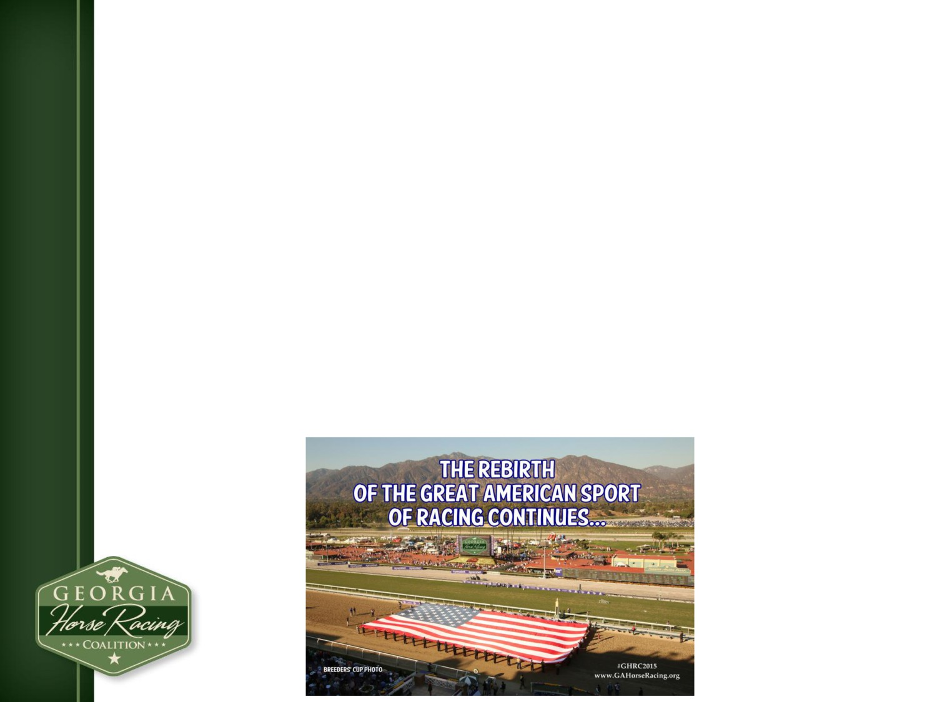
The Rebirth of the Sport of Horse Racing
❖ National TV Exposure: NBC Sports Signs 10 Year Deal
to Broadcast the Breeders’ Cup
❖ TV Ratings Rise: National Breeders’ Cup Ratings
Increase by 24% in 2014 with Atlanta Up 135%
❖ Fans Are Coming Back: Daily Average Attendance in
2015 Increases at Saratoga, Keeneland (Spring Meet),
Delmar. Major Racing Events See Steady Growth
❖ Keeneland Yearling Sales Up 3 Straight Years: Over
$200 Million in Yearlings Sold in November 2014 Sale

Slide 19
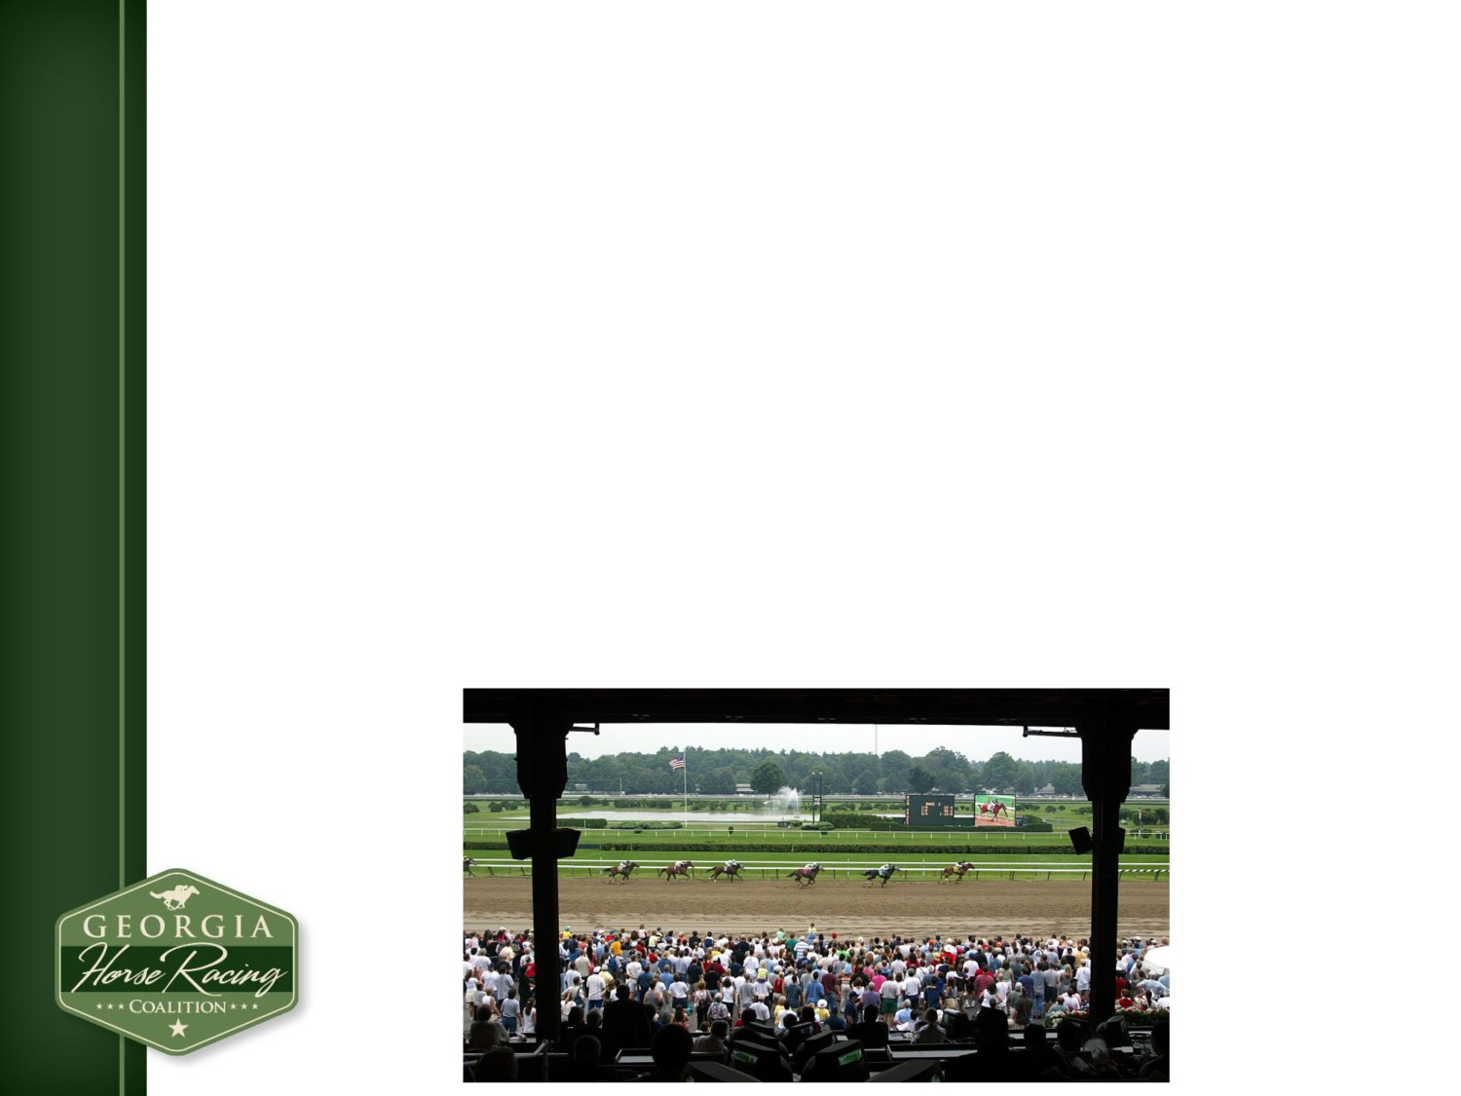
State of the Industry: Overview
U.S. Thoroughbred Horse Racing Industry
❖ Pari-mutuel Horse Race Wagering in 43 States
❖ Live Horse Racing in 33 States
❖ Over $10 Billion Wagered Annually
❖ Over 125 Racetracks in North America
❖ Over $1 Billion in Purses to Owners

Slide 20

Grassroots/ Social Media Campaign
❖ GHRC plan garners praise across the state from
political, business & civic leaders.
❖ Statewide and National following by reporters,
politicians, business leaders.
❖ Unanimous industry from the Breeders’ Cup, The
Jockey Club, National Racing Association and
Keeneland Association.
❖ Over 5,000 Fans, Followers and Connections that
reach over 50,000 people monthly

