Slide 1

The Georgia Lottery Corporation
Coin Operated Amusement Machine (COAM) Division

Slide 2
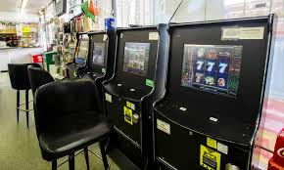
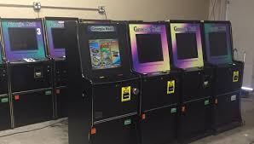
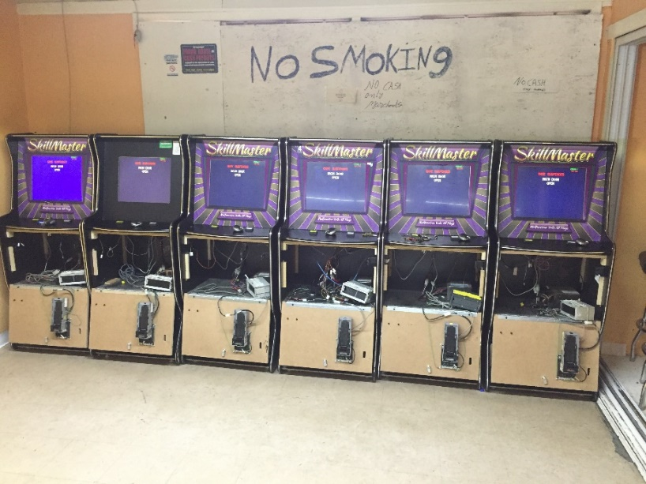
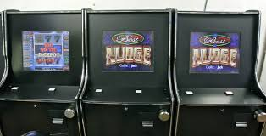

Slide 3
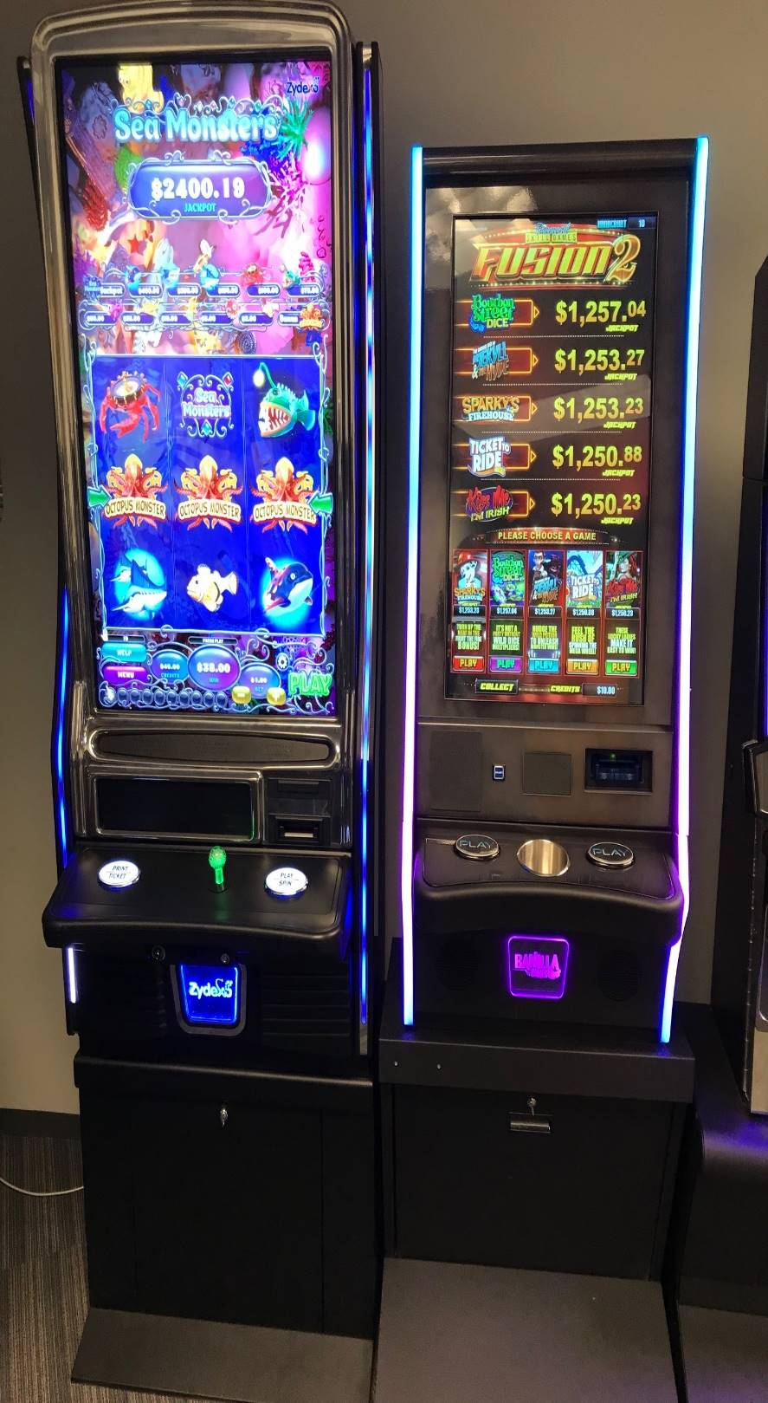
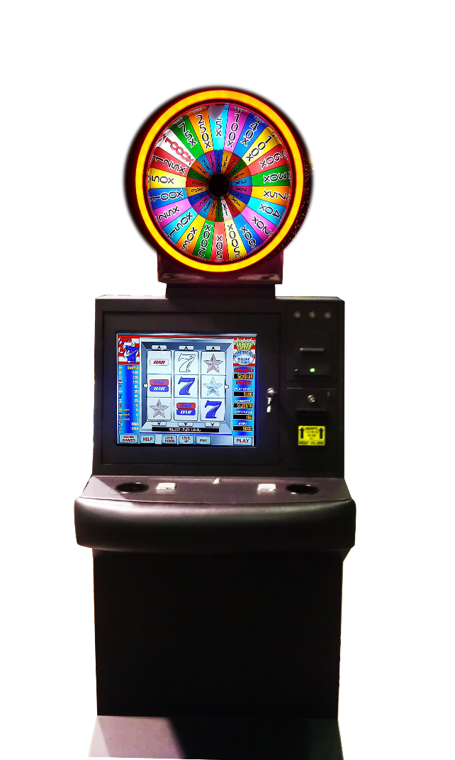
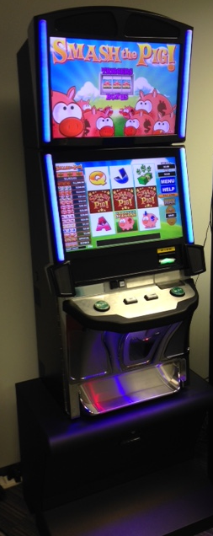

Slide 4

Types of Machines
Coin Operated Amusement Machine - A machine used by the public to provide amusement or entertainment whose operation requires the payment or insertion of a coin, bill, other money, token, ticket, card or similar object and the result of whose operation depends in whole or in part upon the skill of a player
Class A machine – A COAM that does not allow a successful player to carry over points won on one play to a subsequent play or plays
  Examples: Jukeboxes, crane machines, skee ball machines
Class B machine – A COAM that allows a successful player to accrue points on the machine or carry over points won on one play to a subsequent play or plays
  Example: Video line-up, match-up “slot type” machines with some skill
COAMs do not include the following types of machines:
  Examples: Coin operated washers or dryers, gumball machines, pay phones, parking meters

Slide 5
COAM Licensing data
(as of May 2019)
  MASTERS
  Master A: 283
  Master B: 185
  LOCATIONS
  Location A: 2,314
  Location B: 4,582
  MACHINE COUNT
  Class A COAMs: 19,002
  Class B COAMs: 22,354
Manufacturers- 22
Distributors- 2

Slide 6
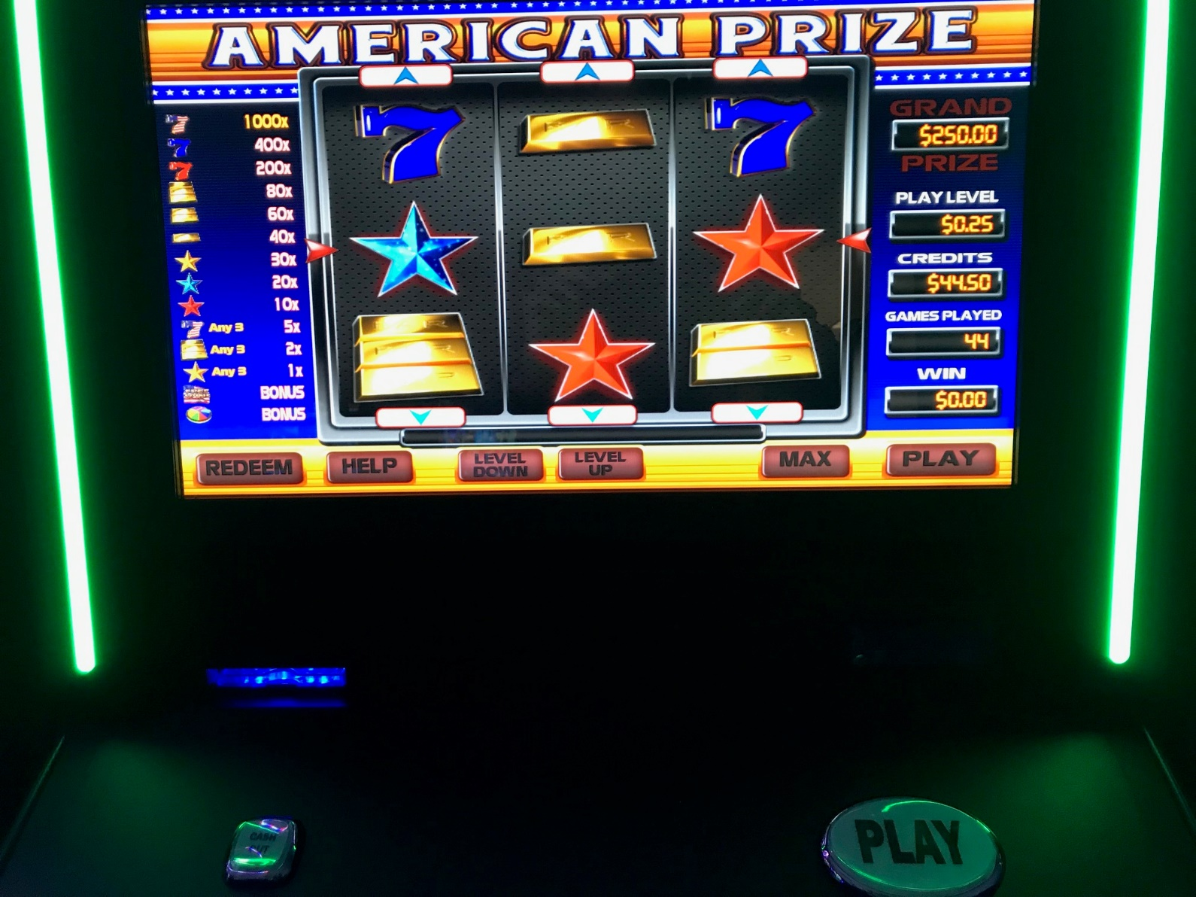
Legal Class B Machines

Slide 7
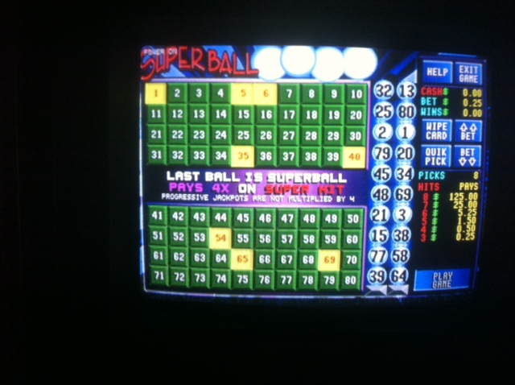
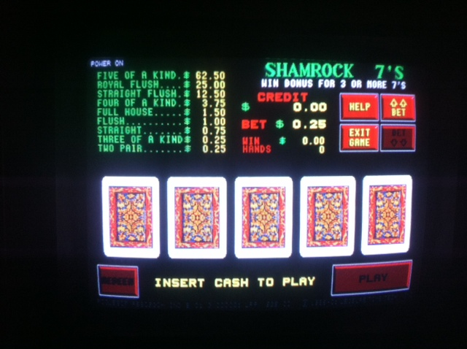
Illegal Class B Machines

Slide 8
Redemption
Restriction: Points/vouchers may only be redeemed at the premises on which the game or device is located
Items Allowed as Prizes
Lottery Tickets (any Price Point)
  Lottery Retailer
  Non-lottery Retailer
  Master License Holders as Lottery Retailers
Food and Beverages (non-alcoholic)
Store merchandise
Fuel
In-store gift cards
Items Not Allowed as Prizes
Cash
Alcohol
Tobacco
Firearms
Gift cards (to other stores)
Payment of utilities
“Teddy Bear” transaction

Slide 9
House Bill 487
(2013)
House Bill 487 was signed into law on April 10, 2013
Transferred responsibility for administration and enforcement relating to COAMs from the Department of Revenue (DOR) to the Georgia Lottery Corporation (GLC)
GLC responsibilities include:
  Issuance of licenses to owners and operators (Class A and B)
  Issuance of licenses to manufacturers and distributors
  Issuance of decals for COAMs (Class A and B)
  Revenue collection of license and decal fees
  Collection of net proceeds from Class B machines
  Enforcement of laws, rules, and regulations

Slide 10
TYPES OF COAM LICENSES
(VALID FROM JULY 1 – JUNE 30)
Master Licenses – The certificate (copy) which every owner of a COAM must purchase and display in the owner’s or operator’s place of business where the machine is located for commercial use by the public or play in order to legally operate the machine in the state.
Class A Master License
1 to 5 machines $ 500.00
6 to 60 machines $ 2,000.00
61 or more machines $ 3,500.00
Decals
Cost Per Decal $ 25.00
Class B Master License
Unlimited number of machines $ 5,000.00
Decals
Cost Per Decal $ 125.00

Slide 11
TYPES OF COAM LICENSES
(VALID FROM JULY 1 – JUNE 30)
Location Licenses – The initial and annually renewed license which every business location owner or business location operator must purchase and display in the location where one or more bona fide coin operated amusement machines are available for commercial use by the public for play in order to operate legally any such machine in this state.
Class A License Cost Per Machine $ 25.00
Class B License Cost Per Machine $ 125.00
Manufacturer and Distributor Licenses – A “Manufacturer" means a person, individual, partnership, corporation, limited liability company, or any other business entity that supplies and sells major components or parts, including software, hardware, or both, to Class B machine distributors or operators. A “Distributor" means a person, individual, partnership, corporation, limited liability company, or any other business entity that buys, sells, or distributes Class B machines to or from operators.
Manufacturer/Distributor License Cost $ 5,000.00

Slide 12
License expenditure sample
Master License Holder (Class B) Expenditure
Fee for Master License Class B $ 5,000.00
Fee for 1,425 Class B Decals $ 178,125.00
Subtotal $ 183,125.00
Processing Fees (.03% for ACH or 2% for credit card) $ 549.38
Total $ 183,674.38
Location License Holder (Class B) Expenditure
Fee for Location License Class B for 9 machines $ 1,125.00
Subtotal $ 1,125.00
Processing Fees (.03% for ACH or 2% for credit card) $ 22.50
Total $ 1,147.50

Slide 13
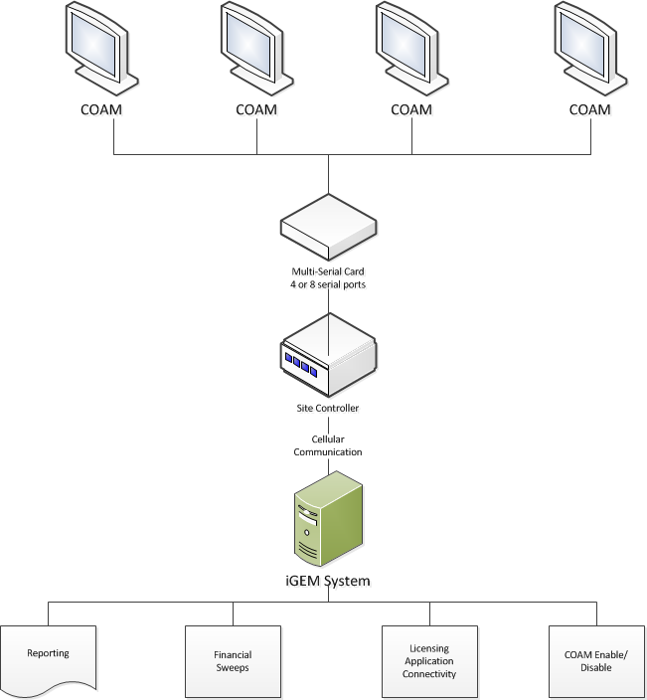
Central Accounting System Blueprint

Slide 14
Central Accounting System
Central Accounting System for Class B machines was procured July 1, 2014
Vendor for the Central Accounting System is Intralot USA
  1.2489% of Net Revenue
Connectivity to COAMs began on January 8, 2015
Ten (10) months after connectivity began, we connected to 20,410 Class B machines at 4,555 locations
Notes:
Difference in number of machines connected and the number of machines on location licenses is 442 (20,852) which are those pending to be installed.

Slide 15
Central Accounting System
(continued)
The GLC shall:
  Retain 5% of net receipts the first year and add 1% each year up to a max of 10% (Currently at max)
  Remainder of net receipts is split evenly between Location Licensees and Master Licensees (Currently 45% each)
  Location Licensee accounts are swept on Wednesdays
  Master License accounts are pushed on following Tuesday
  We can Disable and Enable individual machines and en masse

Slide 16
COAM Financial Reporting
On the 20th of each month Location Owners/Operators are required to access https://www.gacoam.com and report their Gross Retail Receipts
Inspectors use this data as well as DOR ST-3 forms and compare to Central Accounting System numbers
Audits
  Began with Georgia Department of Audits and Accounts
  Now use KPMG
Notes:
QUESTIONS AFTER THIS SLIDE

Slide 17
COAM revenues & Returns to Education
2016
Over $2B In/ $1.4B Out
$81.00/Class B COAM/Day
GLC Revenues
  $9.5M Licensing/Decals
  $1.4M Fines/Fees
  $35.9M Central Acct System @ 6%
$33.5M to Education
2017
Over $2.2B In/ $1.5B Out
$85.70/Class B COAM/Day
GLC Revenues
  $9.5M Licensing/Decals
  $1.2M Fines/Fees
  $47.2M Central Acct System @ 7%
  $4.5M Auction and Admin
$47.5M to Education
2018
Over $2.4B In/ $1.7B Out
$90.16/Class B COAM/Day
GLC Revenues
  $10.9M Licensing/Decals
  $3.9M Fines/Fees
  $58.8M Central Acct System @ 8%
  $900K Auction and Admin
$58.1M to Education
2019
Over $2.6B In/ $1.8B Out
$95.98/Class B COAM/Day
GLC Revenues
  $9.3M Licensing/Decals
  $3.5M Fines/Fees
  $70.6M Central Acct System @ 9%
  $73K Reprints and Admin
$66M to Education

Slide 18
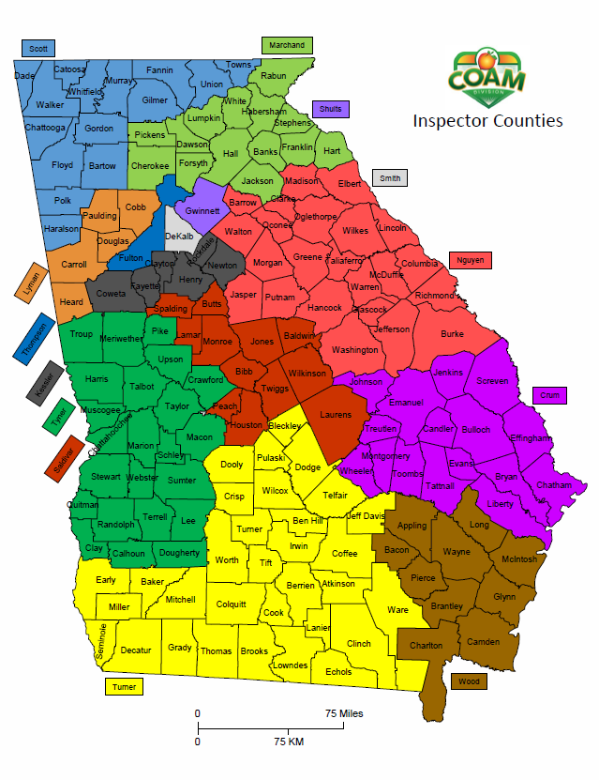
Compliance Inspector districts

Slide 19
Frequent Violations
  Cash Payouts
  Inducements
  50% Rule
  Violation of the 50-50 Split
  “Straw” Owners
  Illegal prize redemption
  Not keeping business records
  Hand Counts
  Not Reporting Sales
  Manipulating meters or game
  Failure to notify of owner/master change
  No written agreement
  Unlicensed location
  Machines without decals
  Illegal games
  No play responsibly and tip-line signage

Slide 20
Infractions and Penalties
Infraction Fine Other Penalties
No License Up to $25,000 Loss of all licenses
False Entry on Report/Application Up to $25,000 Felony
Cash Payout Up to $25,000 Felony
Inducements/Enticements Up to $50,000 Loss of all licenses
No Written Contract Up to $50,000 Loss of all licenses
50 Percent Rule Up to $50,000 Loss of all licenses
No Immediate Family Interest No Less $50,000 Loss of all licenses
Failure to Report Monthly $500 to $1,000 Loss of license
In-house hearing officer has levied over $2-3 million fines a year

Slide 21
How can you get more information about COAMs?
Go to https://www.gacoam.com
  Laws, Rules, and Regulations
  COAM Forms
  COAM Communications
  COAM Video
    English: https://www.youtube.com/watch?v=HNU9y_VyqB8
    Hindi: https://www.youtube.com/watch?v=LQTTJ1DcUFM
    Spanish: https://www.youtube.com/watch?v=E_cOo1RAagU

