Slide 1
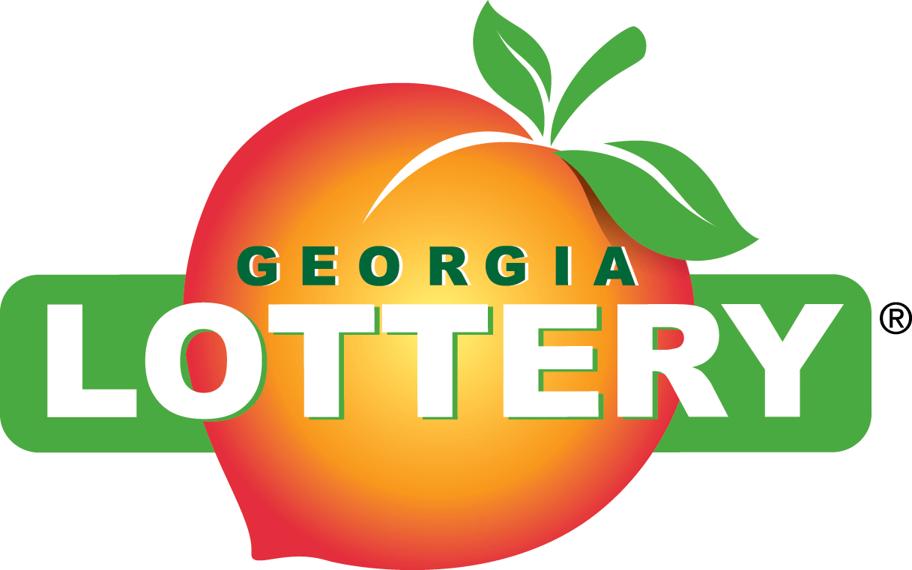
Gretchen Corbin
President & CEO

Slide 2


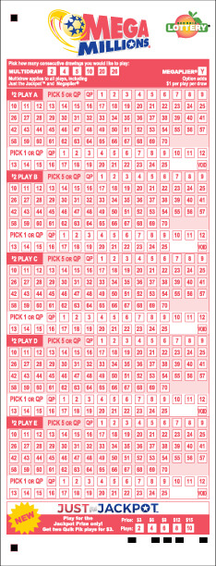
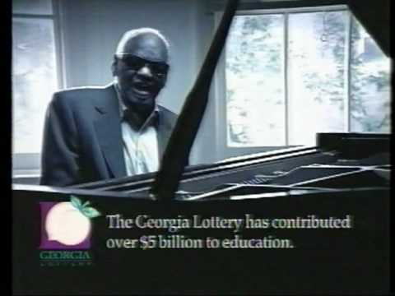
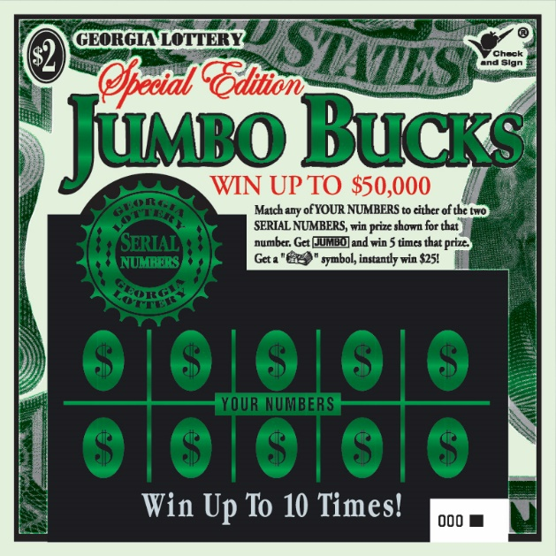
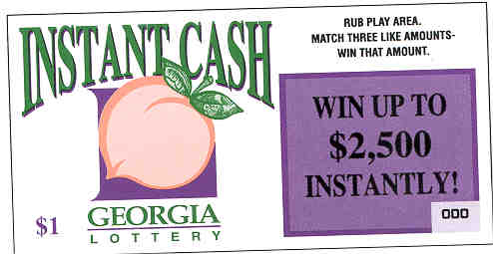
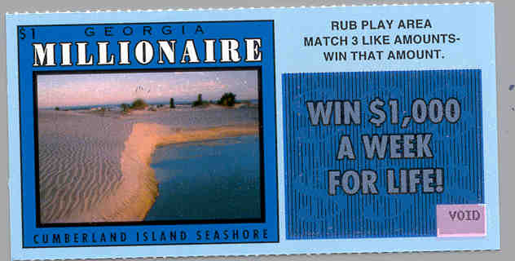
History of the Georgia Lottery

Slide 3
Georgia Lottery History and Oversight
Nov. 1992 - Georgia voters narrowly approve a constitutional amendment to create the Georgia Lottery to enhance educational funding (52-48)
Lottery for Education Act created the Georgia Lottery Corporation (GLC) to oversee and operate the lottery
Mission: Maximize revenues for HOPE and Pre-K
Governed by a 7 member Board appointed by the Governor and confirmed by the Senate
Board members serve staggered 5 year terms
Legislative oversight is provided by the General Assembly’s Lottery Corporation Legislative Oversight Committee, comprised of the House Committee of Regulated Industries and the Senate Economic Development Committee
Accountable through a series of reports including: quarterly and annual reports to the Governor, state auditor, state accounting officer, and the legislative oversight committee chairpersons
External Audits conducted annually by Mauldin & Jenkins and copy submitted to the Governor, Lieutenant Governor, Speaker of the House of Representatives, and oversight committee chairpersons
Annual operating budgets submitted to the Office of Planning and Budget, the state auditor, and the state accounting officer by June 30 for the following fiscal year

Slide 4
Georgia Lottery History and Oversight
By law, GLC is required to transfer proceeds on a quarterly basis to Lottery for Education Account in State Treasury
On an annual basis, Governor & General Assembly separately appropriate lottery proceeds to specific lottery-funded education programs, as defined by law
Lottery funds are to be used to supplement, not supplant state funding of existing education programs
HOPE Program is administered by Georgia Student Finance Commission
Pre-K Program is administered by Georgia Department of Early Care & Learning
$3.2 million (on average) raised for HOPE and Pre-K every day

Slide 5

Georgia Lottery’s Record
Over $21 billion for education
FY19 = record $1.207 billion for education
Over 1.8 million HOPE Scholarship & Grant recipients
Over 1.6 million Pre-K students
8 consecutive record years
4 consecutive years over $1 billion in returns

Slide 6
Georgia Lottery Rankings
National Rankings
#2 total per cap sales
#2 instant per cap sales
#3 per cap returns to beneficiaries (excluding states that have VLTs)
* Source- La Fleur's 2019 World Lottery Almanac
Worldwide Rankings
#15 total sales
#5 total per cap sales
#9 instant sales
#2 instant per cap sales
* Source – La Fleur’s 2019 World Lottery Almanac

Slide 7
Over $21 Billion Returned to Education

Slide 8
Returns Per Capita Trend
Population data obtained from 2018 U. S. Census (rounded).

Slide 9
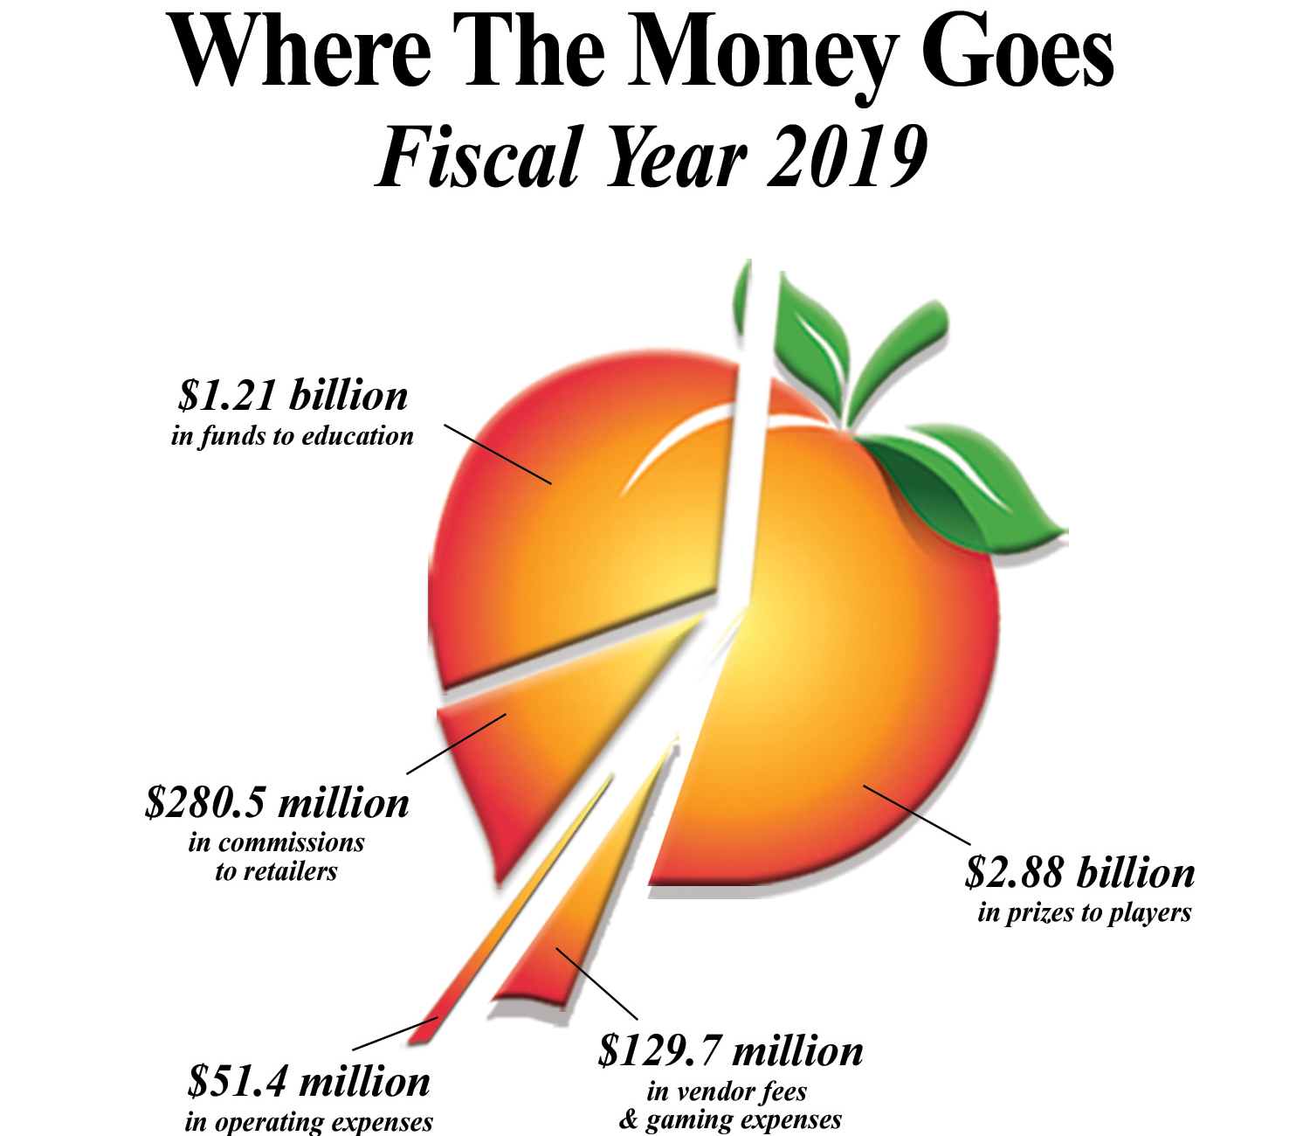
Where the Money Goes

Slide 10


Sales & Business Development
FY19 Annual Highlights
Draw
Sales Results
Increase of 6%
Cash 4 up 7% or $19.9M
Scratcher Sales Results
Increase of 2.5%
$30 Billionaire Club Series $219M
Keno up 6% or $11.2M
Mega Millions up 59% or $10M
Conducted 29,849 field promotions
$30 $75,000,000 Blowout $135M
$10 50X The Money $120M
$30 The New Super Max $113M
$10 $100 Million Cash Extreme $78.5M
$1.5B jackpot
Georgia Five up 9% or $.7M
Monopoly X Family ($1,$2,$5 and $10) $136M

Slide 11
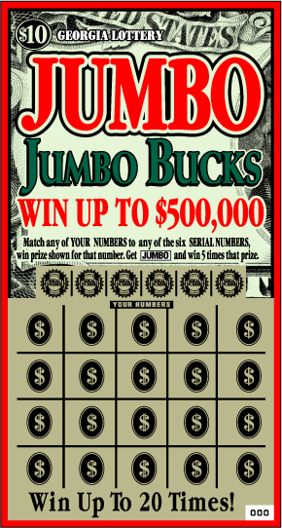


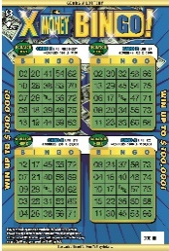

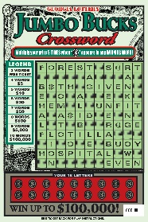







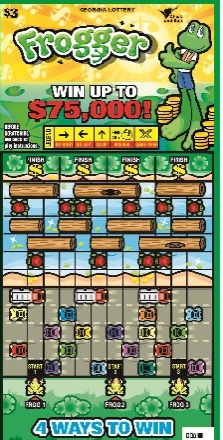

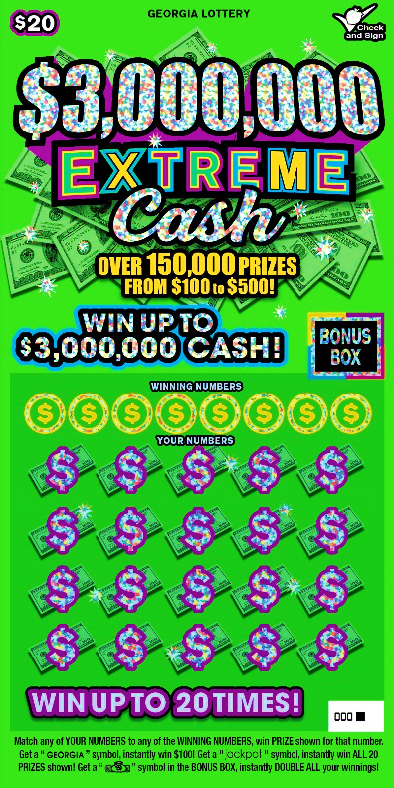

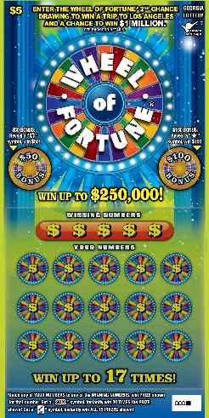

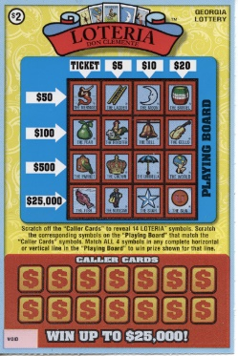
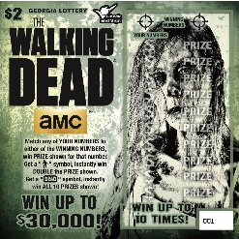

Product Development
Scratchers/Instant Tickets
Monthly launches of 4 to 6 games. Approx. 52 - 65 unique games launched each year
Wide range of price points: $1, $2, $3, $5, $10, $20, $25, $30
Design considerations: prize structure, top prizes, game themes, play types, licensed games, shelf appeal
Scratcher game portfolio must appeal to a wide-ranging audience of players

Slide 12















Product Development
DRAW (terminal generated games) – twelve (12) games in the current portfolio
Daily Draw Games
Multi-state Games
Regional Games
Unique Games
44 PARTICIPATING
STATES IN US
PARTICIPATING STATES:
FL, IN, MD, NJ, NY, PA,
TN, VA
WIN UP TO $500! Three times a day!
WIN UP TO $100,000 OVER 300 TIMES A DAY!
WIN UP TO $10,000!
Drawings twice a day!
JACKPOTS START AT $40 MILLION!
Drawings on Tuesdays and Fridays at 11:00 PM!
WIN $1,000 EVERYDAY FOR LIFE!
OR
WIN $1,000 EVERY WEEK FOR LIFE!
Drawings every day
JACKPOT STARTS AT
$1 MILLION!
Drawings on Mondays and Thursdays
WIN UP TO $5,000! Three times a day!
WIN UP TO $150,000! Drawings every day
JACKPOTS START AT $40 MILLION!
Drawings on Wednesdays and Saturdays at 11:00 PM!
WIN UP TO $250,000! Match ALL or NONE of the numbers to win!
Drawings 4 times a day!
JACKPOT STARTS AT $150,000!
Ask the clerk,
WIN INSTANTLY!

Slide 13
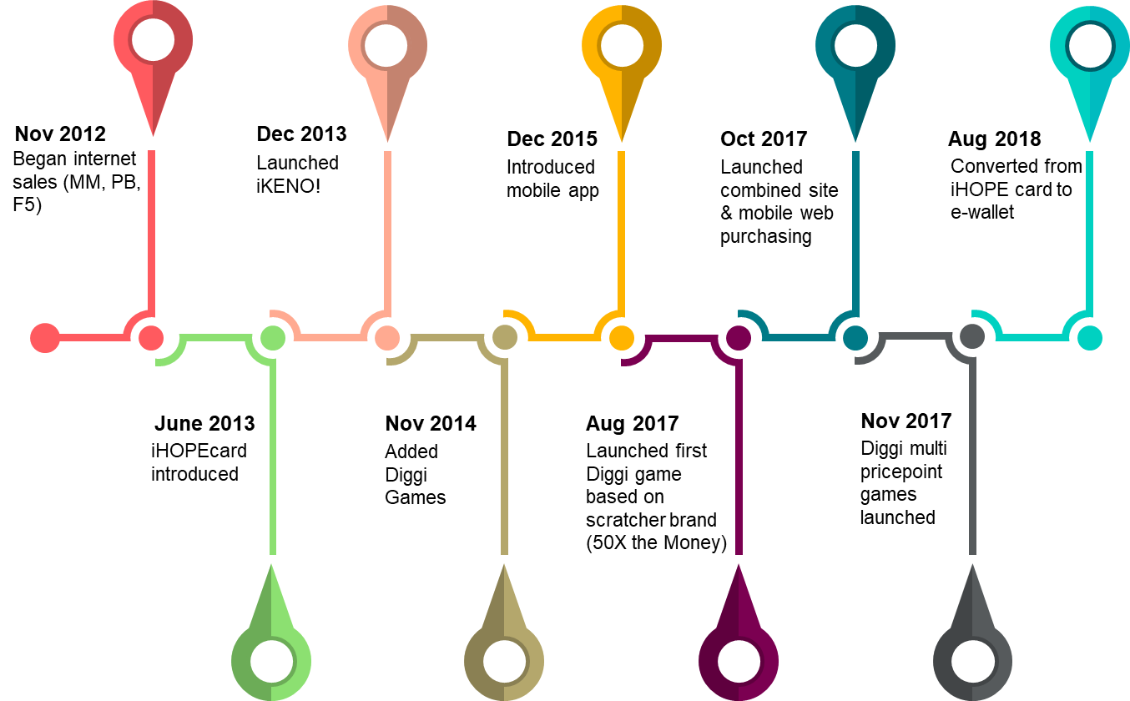
iLottery Timeline

Slide 14
iLottery Sales
Current product portfolio: KENO!, Diggi Games, Mega Millions, Powerball, Fantasy 5
  Channels: Internet (PC/Mac), mobile app (iOS/Android), mobile web
FY19 sales totaled $81,659,243 – 63% increase over FY18
More than 1.2 million app downloads
Players must have an iHOPE® account to purchase online
Over 1.4 million players in Players Club loyalty program
Players have won over $144 million in prizes.
Over $67 million returned to HOPE & Pre-K.
Sales at brick and mortar lottery retailers have increased every year since the introduction of the GLC’s iLottery channel.
FY2019 sales are July-June

Slide 15
Wire Act
Background
In 2011 the Department of Justice issued an opinion on the 1961 Wire Act that it did no apply to lotteries
The Georgia Lottery began selling products via the internet in 2012
Recent Activity
In January of 2019 the Department of Justice issued a new opinion on the 1961 Wire Act
The New Hampshire Lottery filed suit against the DOJ based on the new decision
The judge in New Hampshire ruled in favor of the lottery
The DOJ has filed notice to appeal the decision
Enforcement has been delayed until December 31st or when legal proceedings have concluded
Governor Kemp and Attorney General Carr raised the concerns of the Georgia Lottery in a letter sent to DOJ
Federal delegation continues to be engaged on the issue

Slide 16
COAM System/Licensing
HB 487 signed into law on April 10, 2013
Transferred responsibility for administration and enforcement relating to COAMs from the Department of Revenue to the Georgia Lottery Corporation
Responsibilities include:
  Licensure of owners and operators of COAMs
  Issuance of permits for COAMs
  Collection of license fees for COAMs
  Collection of net receipts from Class B machines
  Compliance
Licensing Numbers: 22,354 Class B COAMs in 4,582 locations
Almost $66 million generated from transfer through FY 19

Slide 17
GLC Recent Returns
($ in Thousands)
 | FY 14 | FY 15 | FY 16 | FY 17 | FY 18 | FY 19
Traditional | $940,097 | $969,581 | $1,064,100 | $1,053,529 | $1,085,328 | $1,141,423
COAM | $5,000 | $10,920 | $33,457 | $47,533 | $58,186 | $65,946
Total | $945,097 | $980,051 | $1,097,567 | $1,101,062 | $1,143,513 | $1,207,369
COAM revenue percentage to GLC will cap out at 10% in FY 2020

Slide 18
Georgia Lottery FY19 Highlights
The Georgia Lottery has now raised over $21 Billion for educational programs in Georgia
FY2019 profit was $63.8 Million or 5.6% higher than 2018
Largest quarterly transfer (Q2 2019) in Georgia Lottery history of $323.6 million
Followed by second largest Q3 transfer in Georgia lottery history
Q4 quarterly return was the largest Q4 return in history

Slide 19
Growth Projections
($ in Thousands)
Fiscal Year | Returns to Lottery for Education Account
FY19 (Actual Returns) | $1,207,369
FY20 (Projected Returns) | $1,212,000

Slide 20


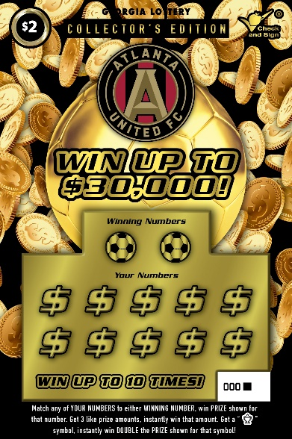
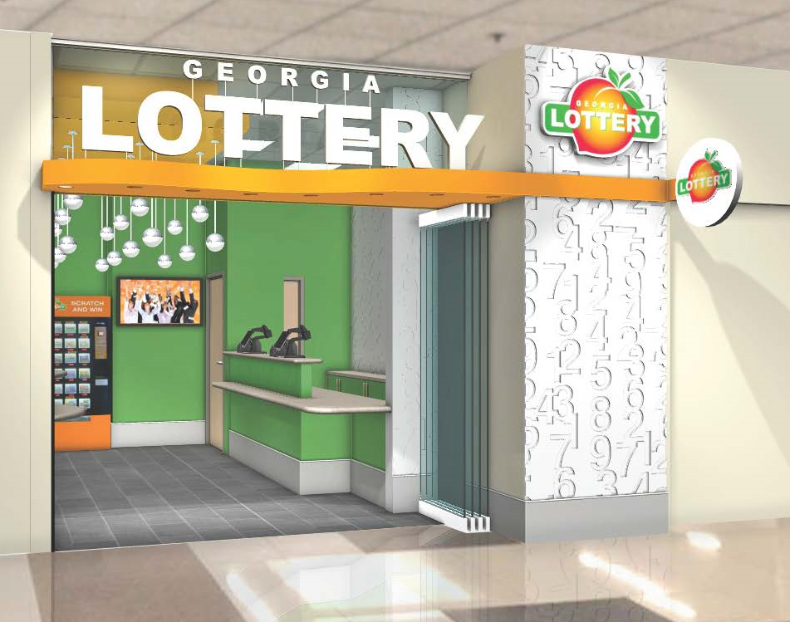
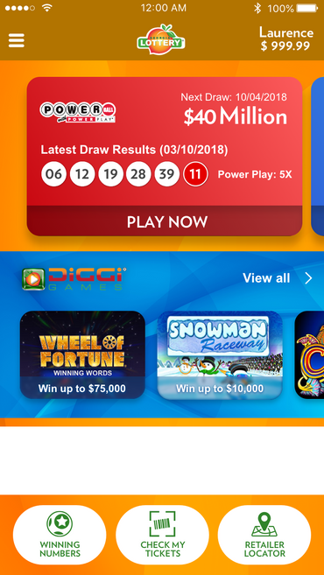

Partners and New Initiatives

Slide 21
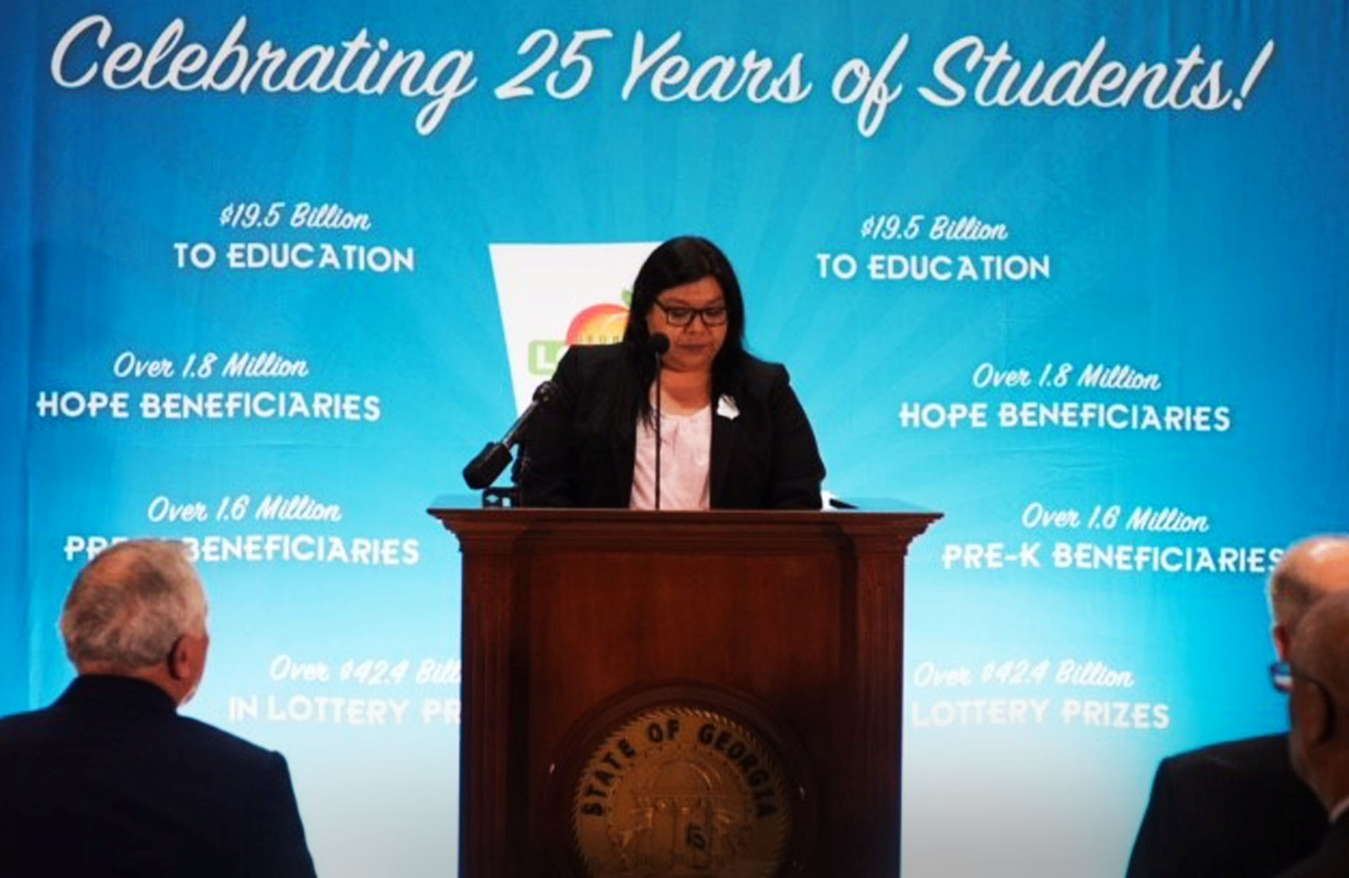
We Do It For The Students

