Slide 1
Georgia Technology Authority
Presentation to the Joint Study Committee on Transparency and Open Access in Government
September 8, 2017

Slide 2

What is the Georgia Technology Authority?
State authority
Promote an enterprise approach to state IT
Manage the state’s central IT infrastructure
  Data center, servers, desktops, laptops, network and telecomm services, cybersecurity
Support executive branch agencies
  Project review, consumption management, data sharing
  No authority over Legislative, Judicial, Constitutional, Regents
GTA Board
  11 members appointed by Governor, Speaker, Lt. Governor; plus ex officio member of judiciary
Notes:
No directly appropriated state funds
Funds for IT are loaded directly into agency budgets
Data sales, contract administration fees
Just exec branch
“We often get questions…” – don’t support GGA laptops
Remind that Calvin is on the study committee

Slide 3
Enterprise Approach to State IT
Enterprise IT services contracts
Managing state technology resources
Enterprise governance and planning
Cybersecurity
State web portal (Georgia.gov)
1-800-Georgia contact center
Radio frequency management
IT Infrastructure Services
  - Desktop computing
  - Laptops
  - Software & security included
  - Maintenance & refresh
  - Data center
Managed Network Services
  - Telecom/voice services
  - Network connectivity
  - Cabling
  Statewide policies, standards, guidelines
  Oversight of large IT projects
Notes:
Georgia is a federated model
Centralized at network
Partially centralized at server/desktop layer
Decentralized at the application layer
Agencies own the data

Slide 4
State’s IT Delivery Model
DBHDD
DCH
DDS
DHS
DJJ
DNR
DOAS
TCSG / DOT
Constitutional / Judicial Agencies
Small Agencies
Local Gov.
General Assembly
USG
Local Gov.
Responsible Entity
DOR
DPH
GBI
GDC
GOV
GTA
OPB
SAO
Agency
Applications (Software)
Agency & GTA
Middleware
GTA Manages
Database
GTA
Infrastructure Services
GTA
Managed Network Services
Voice
Notes:
Agencies are responsible for acquiring and managing the applications that meet their business needs.
GTA provides full services (EUC, NADC, Phone & MNS) to 15 largest (GETS) agencies, which represent about 80% of IT spend in state government.
Some agencies use our Managed Network Services
Local governments and the university system use our voice services
We bill approx. 1,400 at-will customers who are local and federal government offices.
GTA provides no services to the General Assembly.

Slide 5
What is the Enterprise Service Bus?
  The ESB allows different data systems with different types of data to communicate with each other
Health
Vital Records
Justice
ESB
Tax
Welfare
Education
Notes:
GTA also runs a data sharing service
Sometimes called “hub and spoke” model
GTA doesn’t own the data – we simply pass it through from the sender to the delivery point, providing translation as needed so that the information can be used by different systems.

Slide 6
Why Centralize Data Sharing?
  Simple: Complex:
Health
A
B
Vital Records
Justice
A
B
Welfare
Tax
C
Education
Notes:
- Simple data sharing is the exchange of homogenous data between a small number of points
Large organizations need to share large amounts of diverse data among multiple interfaces
Saves the labor of writing and maintaining multiple interfaces on each system, just connect once to the ESB
Analogy: postal service. You could deliver your own mail, or you could centralize delivery

Slide 7
Details on the Enterprise Service Bus
  GTA has operated the ESB as an enterprise application since 2003
  Uses Software AG’s webMethods product
  Over 150 different interfaces
  35 different trading partners (state agencies, local government, private companies, federal government)
  ESB allows quick and accurate data transfer in real time
    Guaranteed delivery; retries if a trading partner is down
    Once-and-only-once delivery; non-repudiation
    Scales to millions of transactions per day
  Simplifies data interfaces for partners (SSA, local governments, etc.)
Notes:
Over the past decade or so, the GTA team has constructed more than 48 touchpoints connecting GETS agencies, smaller agencies and the federal government.
Process more than 1M transactions each day to satisfy more than 350 separate business processes.
Software AG’s webMethods middleware technology rated as a best-of-breed product.

Slide 8
Entities using GTA’s ESB
Agencies Dept. of Behavioral Health and Developmental Disabilities
Dept. of Community Health
Dept. of Early Child Care and Learning
Dept. of Driver Services
Dept. of Human Services
Dept. of Natural Resources
Dept. of Education
Dept. of Revenue
Dept. of Public Health
Georgia Bureau of Investigation
Dept. of Corrections
Dept. of Labor
Georgia Superior Court Clerks' Cooperative Authority
Georgia Technology Authority
USG Board of Regents
Prosecuting Attorneys' Council
Board of Pardons and Parole
State Accounting Office
State Health Benefit Plan
Federal
HHS CMS - Federally Facilitated Marketplace (aka healthcare.gov)
HHS ACF - Public Assistance Reporting Information System (PARIS)
USDA FNS - Electronic Disqualified Recipient System (eDRS)
USDA FNS - Women, Infants, and Children (WIC)
USDA FNS - Electronic Benefit Transfer (EBT)
USDA FNS - Treasury Offset Program (TOP)
Social Security Administration US Citizenship and Immigration Services - Systematic Alien Verification for Entitlements Program (SAVE)
Third parties
Accuity |  | Morpho Trust
Contact Solutions |  | Platform 28
Experian |  | SilverPop
HP (now DXC) |  | SMI
Maximus PCS |  | Stellarware
MDRC |  | SureBill

Slide 9
Examples of State Data Sharing
  Does this SSN belong to this person?
  Does this driver’s license belong to this person? Is it valid?
  Is this person currently in prison?
  Does this person owe child support?
  Is this person already receiving a benefit in another state?
  Who owns this vehicle? Boat? RV?
  Is this person wanted for a crime? Outstanding warrant?
  Criminal justice information: release information / inmate details / rap sheets to P&P, DoC, DJJ, locals
  Birth/death records
Notes:
Why do we share?

Slide 10
Regulatory Restrictions on Data Sharing
Federal tax information, subject to IRS Pub. 1075
Criminal justice information, subject to Criminal Justice Information Services (CJIS) Security Policy
Personal health information (HIPAA data), subject to HHS MARS-E 2.0
Social Security Administration data, subject to SSA rules
Personally Identifiable Information (PII), subject to OCGA §§10-1-910, -911, -912; § 46-5-214
Notes:
Agency presentations will probably talk more about specific restrictions, but here are some of the main ones

Slide 11
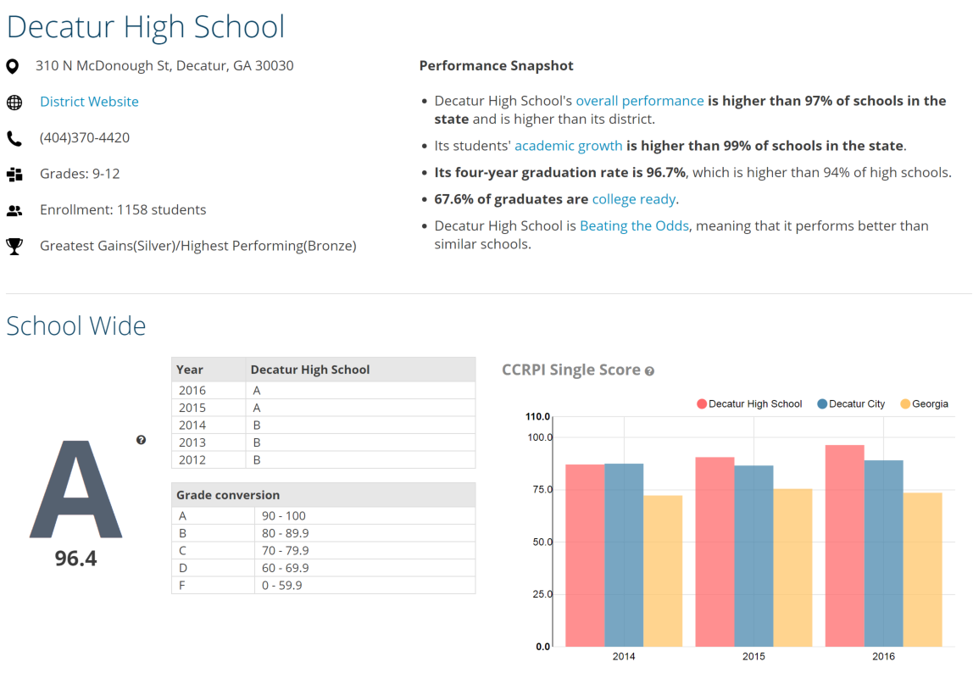
Data Visualization
Notes:
GOSA
Other than GOSA,
Georgia Board of Physician Workforce (GBPW)
State Charter School Commission (SCSC) host their data sets with us.
We are getting ready to publish their dashboards in a week or so.
We have DHS and DPH in the pipeline.

Slide 12
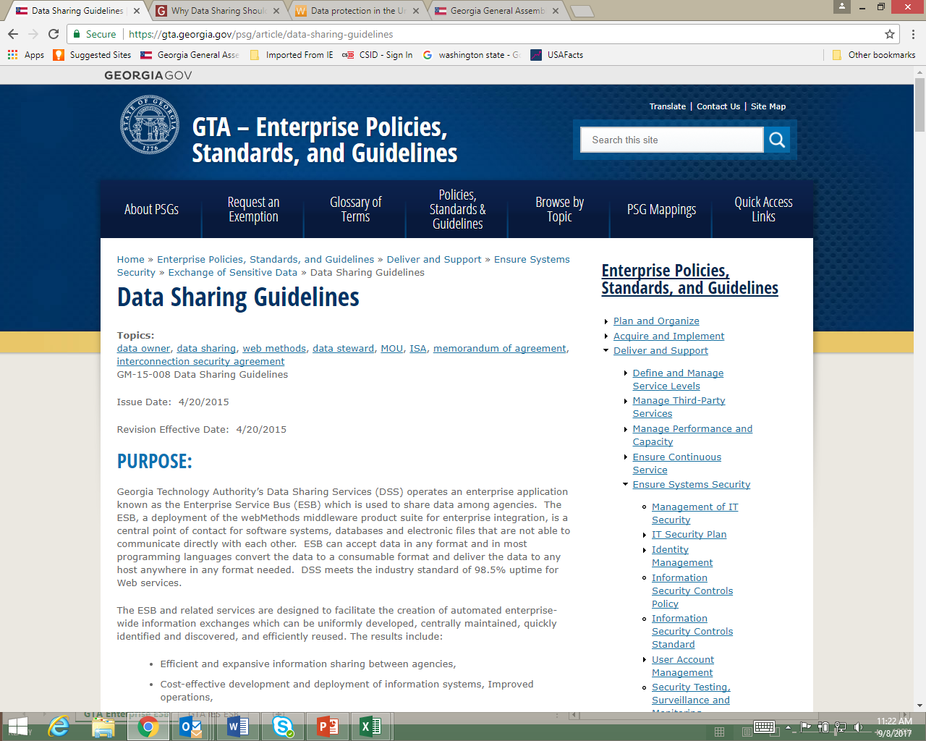

Questions?
Steve Nichols, PhD
Georgia Technology Authority
404-463-4760
Steve.Nichols@gta.ga.gov
Jeff McCord
Georgia Technology Authority
404-463-2905
Jeff.McCord@gta.ga.gov
Technology enabling the business of government

