Slide 1




Dyslexia Identification and Services in Georgia
Caitlin McMunn Dooley, Ph.D.

Slide 2
“Dyslexia …”
Can be diagnosed prior to conventional reading
Does not go away
Is a continuum
Affects phonological processing (e.g., matching sounds to letters)
Can affect comprehension (e.g., meaning making)
Can be detected early via a neurobiological exam
  Auditory attention shifting
  Auditory processing
  Auditory meaning making
  Language development delays

Slide 3
Dyslexia

Slide 4
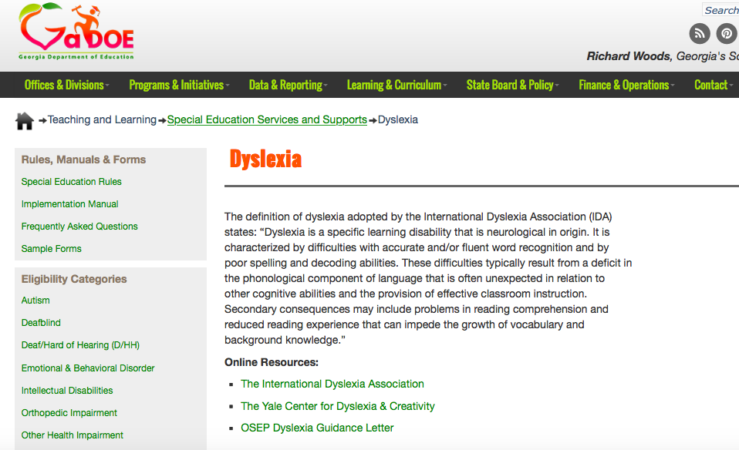
Dyslexia Defined

Slide 5
Georgia Law
“Learning Disabilities”
160-5-1-.34 GEORGIA SPECIAL NEEDS SCHOLARSHIP PROGRAM
delineates which students are qualified to participate in the program
160-4-7-.14 PERSONNEL, FACILITIES AND CASELOADS
Special Education rule: Occurs as it regards class sizes and caseloads when serving students with specific learning disabilities
160-5-1-.08 CLASS SIZE
Regards class sizes when serving students with specific learning disabilities
160-4-7-.21 DEFINITI0NS
Special education rule: The term occurs in the definition of a “child with a disability”

Slide 6
Georgia Law
Rule 160-4-7-.05 ELIGIBILITY DETERMINATION AND CATEGORIES OF ELIGIBILITY
“Definition
(1) Specific learning disability is defined as a disorder in one or more of the basic psychological processes involved in understanding or in using language, spoken or written, that may manifest itself in an imperfect ability to listen, think, speak, read, write, spell or do mathematical calculations. The term includes such conditions as perceptual disabilities, brain injury, minimal brain dysfunction, dyslexia and developmental aphasia. The term does not apply to children who have learning problems that are primarily the result of visual, hearing or motor disabilities, intellectual disabilities, emotional or behavioral disorders, environmental, cultural or economic disadvantage. [34 C.F.R. §300.8(c)(10)]”

Slide 7
“Dyslexia can look like and co-present with…”
Dyslexia
Dialectal Difference
Hearing Impairment
Garden-variety learning difficulties
Dysgraphia
Dyscalculia
Attention and sensory processing issues
Social and emotional developmental delays
Speech and language delays
Autism

Slide 8
Prevention First
Georgia Tiered System of Supports
Tier I: Instruction/Core Curriculum
Language Nutrition training
Standards-based instruction
Differentiated instruction for students by general education teacher
Tier II: Intervention
Student Support Team (SST) recommended interventions
Early Intervention Program (EIP) for Reading
Tier III: Intensive Intervention
Special Education services for Learning Disabilities per Individual Education Plan (IEP)

Slide 9
Tier 1
Standards and Instruction
Speech and Language | Literacy
Aural and oral development Temporal processing Articulation Voice issues Dialect Explicit code-switching Syntax and Morphology Prefix/suffixes/roots Sentence structures Semantics Meanings as they relate to context Pragmatics What’s “appropriate” | Phonology Rhyming Segmenting sounds (e.g., syllables, onset-rime) Blending sounds Deletion of sounds Phonics Letter-sound relationships Concept and background knowledge development Semantic instruction (e.g., agent-object; cause-effect, sequence) Vocabulary Concepts of print; familiarity Communication Social and emotional development

Slide 10
Tier 1 to Tier 2
“Look Fors”
Early Literacy Challenges:
difficulty with rhyming
difficulty identifying the beginning, middle, and ending sounds in words
difficulty identifying upper and lower case letters
difficulty reading and writing own name
Writing Challenges:
poor spelling
difficulty copying with accuracy
difficulty with correct use of capitalization and punctuation
difficulty with legible handwriting and spacing
Reading Challenges:
difficulty learning the sounds that correspond with letters
difficulty sounding out (decoding) words
difficulty differentiating between letters or words that look similar
difficulty reading accurately (may leave out parts of words or add sounds)
difficulty with reading fluency
difficulty maintaining place while reading
difficulty with comprehension of text

Slide 11
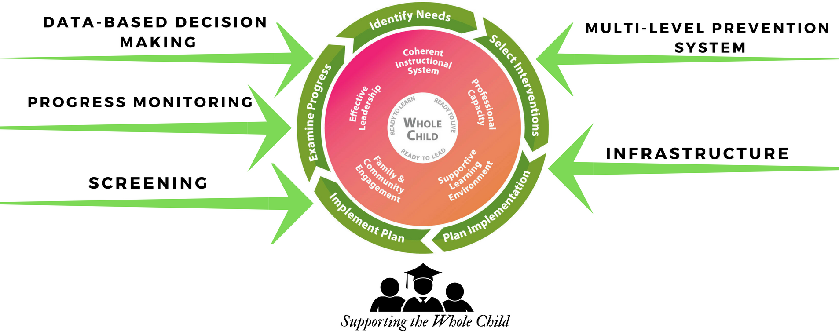
How do the components of Georgia Tiered System of Supports for Students advance the work of the Systems of Continuous Improvement?
Georgia Tiered System of Supports for Students
Essential Components

Slide 12
“Catching” Dyslexia
Birth
Prior to K-12
K-12
Assumption:
5-10% of General Population have Dyslexia
(Annual Population Estimation = about 13,000)
(National Institutes of Health)
~130,000 Births Annually in Georgia
(Centers for Disease Control)
18,833 children served annually in Preschool SpEd (ages 3-5)
(~ 6,278 per age)
~ Students served:
  186,099 in EIP (‘18)
  (~ 31,000 per grade K-5)
  Special Education SLD and SLI = 98,114 (‘18)
  (~7500 per grade 1-12+)

Slide 13
System for Serving Students with Dyslexia
Birth
Prior to K-12
K-12
Universal Screening
Trigger Identification
Assess/Diagnose
General/Universal Services and Prevention
Trigger Identification
Assess/Diagnose
Provide and Monitor Early Intervention
Consider Eligibility for Special Services
General/Universal Services and Prevention
Trigger Identification
Assess/Diagnose
Provide and Monitor Early Intervention
Consider Eligibility for Special Services

Slide 14
WHO would trigger identification?
Birth
Prior to K-12
K-12
Maternal/pediatric nurse or doctor
Pediatrician referral
Department of Community Health referral
Early Education Program referral
Family referral to Preschool Special Education program for diagnostic assessment
Classroom teacher identifies via formative assessments and refers to Student Support Team (SST)
Student Support Team (SST) refers using the Response to Intervention (RTI) process
SST identifies SWD category(ies) and annually reviews appropriateness and effectiveness of modifications

Slide 15
HOW? Formative and Diagnostic Assessments
Birth
Prior to K-12
K-12
Universal Newborn Hearing Screening
Early Hearing Detection and Intervention (EHDI)
Dept. Public Health Maternal Child Health Assessment
Ages and Stages Parent Questionnaire
Georgia PreK Work Sampling System (PreK)
School districts provide formative assessments for entrance/exit for Preschool Special Ed services (Child Outcome Summary submitted to GaDOE)
G-Kids and Kindergarten Readiness Check (K)
Keenville (COMING SOON) (K-3)
Georgia Milestones (3-12)

Slide 16
HOW? Formative and Diagnostic Assessments
Birth
Prior to K-12
K-12
Screening
and Follow-up GAP
Universal Newborn Hearing Screening
Early Hearing Detection Inventory (EHDI)
Dept. Public Health Maternal Child Health Assessment
Ages and Stages Parent Questionnaire
Georgia PreK Work Sampling System (PreK)
School districts provide formative assessments for entrance/exit for SpEd services (Child Outcome Summary Form provided by GaDOE)
G-Kids and Kindergarten Readiness Check (K)
Keenville (COMING SOON) (K-3)
Georgia Milestones (3-12)

Slide 17
State-wide Intervention Programs
Birth
Prior to K-12
K-12
Children First (Dept. Public Health; Ages 0-5)
Georgia PINES (3-5 years)
Preschool Special Education programs
Early Headstart and Headstart programs
“Tier 1” instruction via Georgia Early Learning and Development Standards (GELDS) for emergent literacy skill development (PreK)
“Tier 1” instruction via Georgia Standards of Excellence for foundational literacy skill development (K-3)
Early Intervention Program (EIP) (K-5); Remedial Education Program (REP) (6-12)
Special Education services (K-12) for Specific Learning Disability (including Dyslexia)
Language nutrition coaching training (e.g., Talk with Me Baby)
Babies Can’t Wait (birth – 3 years)

Slide 18
State-wide Intervention Programs
Birth
Prior to K-12
K-12
Children First (Dept. Public Health; Ages 0-5)
Georgia PINES (3-5 years)
Preschool Special Education programs
Headstart programs
“Tier 1” instruction via Georgia Early Learning and Development Standards (GELDS) for emergent literacy skill development (PreK)
“Tier 1” instruction via Georgia Standards of Excellence for foundational literacy skill development (K-3)
Early Intervention Program (EIP) (K-5); Remedial Education Program (REP) (6-12)
Special Education services (K-12) for Specific Learning Disability (including Dyslexia)
Talk with Me Baby in hospital maternal ward
Babies Can’t Wait (birth – 3 years)
Retention GAP
Awareness and Training Gap
Workforce GAP
Workforce GAP

Slide 19
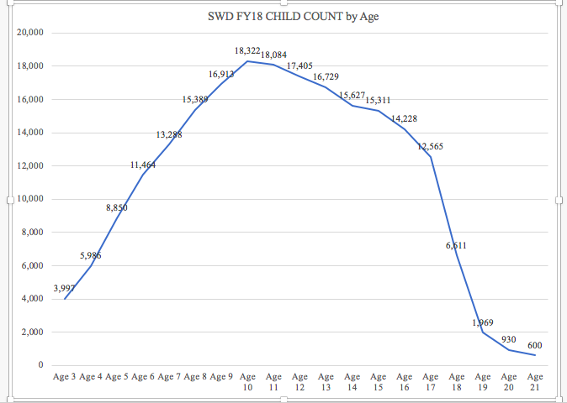
Identification Patterns for Special Education

Slide 20
So What is GaDOE Doing About It?
Get Georgia Reading Campaign assists with cross-agency coordination, collaboration, and incubating innovations
Cross-agency Child Data System (CACDS) provides a secure cross-agency data sharing for population-level perspective on supports
Georgia Tiered System of Supports for Students across K12
Competitive grant awarded for 12 additional GaDOE Staff to support professional learning and implementation of tiered student services (prevention, intervention, intensive)
P-20 Partnerships to support coordinated teacher recruitment and retention efforts
L4GA
Offering competitive sub-grants focused on using data to determine Tiered Supports
Convening Literacy Think Tank network w/ SpEd, Speech Language, and Dyslexia experts
Supporting Professional Learning for current teachers and leaders re: Foundational Reading Skill development as part of Coherent Instruction
Integrating literacy in Georgia Standards of Excellence across social studies, science
Ingesting proven K-5 early literacy curriculum into online resource collection

Slide 21
Recommendations
Consider the SWYC for Universal Screening at Birth and throughout early childhood in sequence with hearing screening (pilot in process)
Ensure that there is a system for follow-up using screening data (e.g., training; workforce for follow-up) via Children 1st
Provide parents with information on “look fors”
Expand access to professional learning for Georgia Teachers and Leaders
Provide recruitment and retention incentives for Special Education teachers and Speech Language service providers
Expand access to early Speech Language services

Slide 22


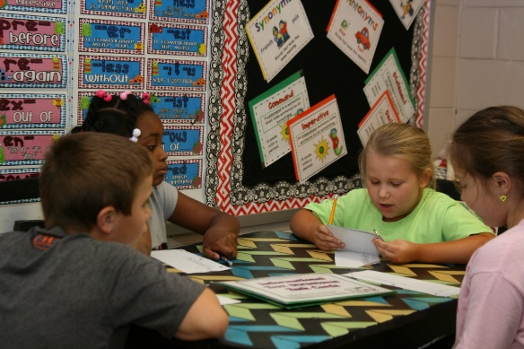

cdooley@doe.k12.ga.us

Slide 23
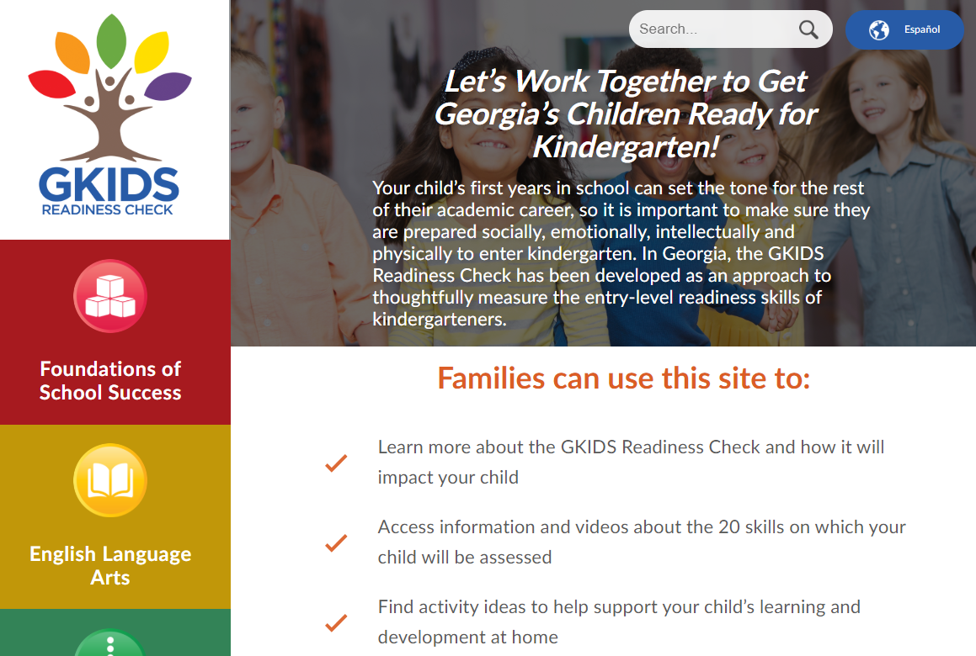
GKIDS Readiness Check
K-5 Focus: Literacy and Numeracy
Administered during the first six weeks of kindergarten
Provides information about the knowledge and skills of students entering kindergarten – solely to guide instruction
Domains of learning assessed through activities and classroom observations include
  Foundations of School Success: approaches to learning, social and emotional development, and physical development and development of motor skills
  English Language Arts: early language and literacy development
  Mathematics: understanding of shapes and spatial relationships, identifying similarities and differences, and basic numeracy concepts
Parent Resources Website – GKIDSReadinessCheck.GaDOE.org

Slide 24

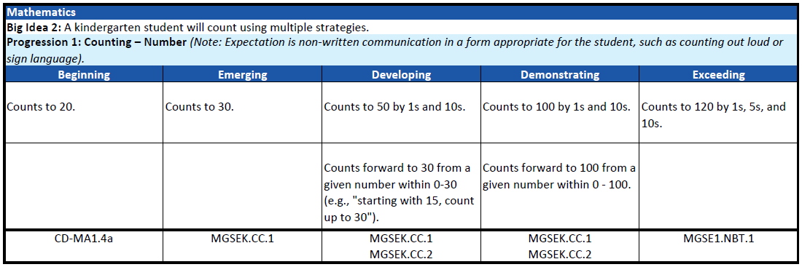

GKIDS 2.0
K-5 Focus: Literacy and Numeracy
A progression-based formative assessment, integrated into classroom work, that is aligned to the state content standards.
  A big idea describes the integration of concepts and skills from the kindergarten standards that are most important for success in first grade.
  A learning progression shows where the student is in the learning continuum of content and reasoning development regarding the big idea from the GSE.
  Provides teachers with one source of real-time information to adjust instruction
    Identifies what a student already knows, what the student needs next, and allows teachers to monitor growth

Slide 25
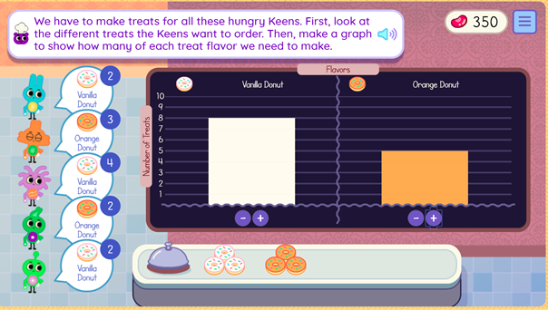
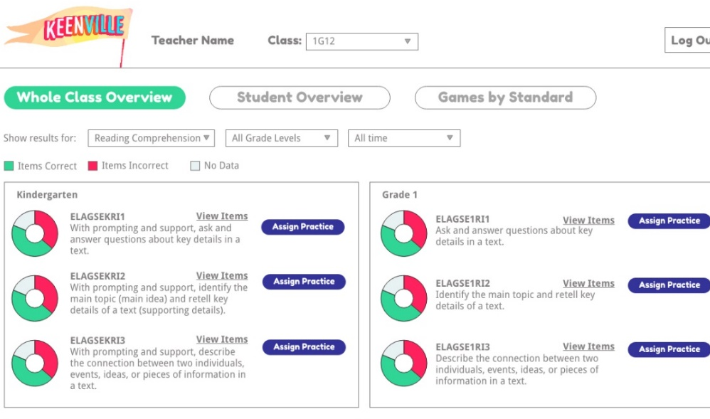
Keenville
K-5 Focus: Literacy and Numeracy
Keenville is a game-based, formative assessment in literacy and mathematics for grades 1 and 2.
Students will explore Keenville and help the Keens by engaging in challenges.
Keenville is designed to be integrated alongside instruction, supporting teachers with real-time feedback to differentiate instruction and improve learning.
Interactive dashboards will give teachers the ability to drill down to individual students, standards, and games to analyze progress.
keenville.gadoe.org

Slide 26
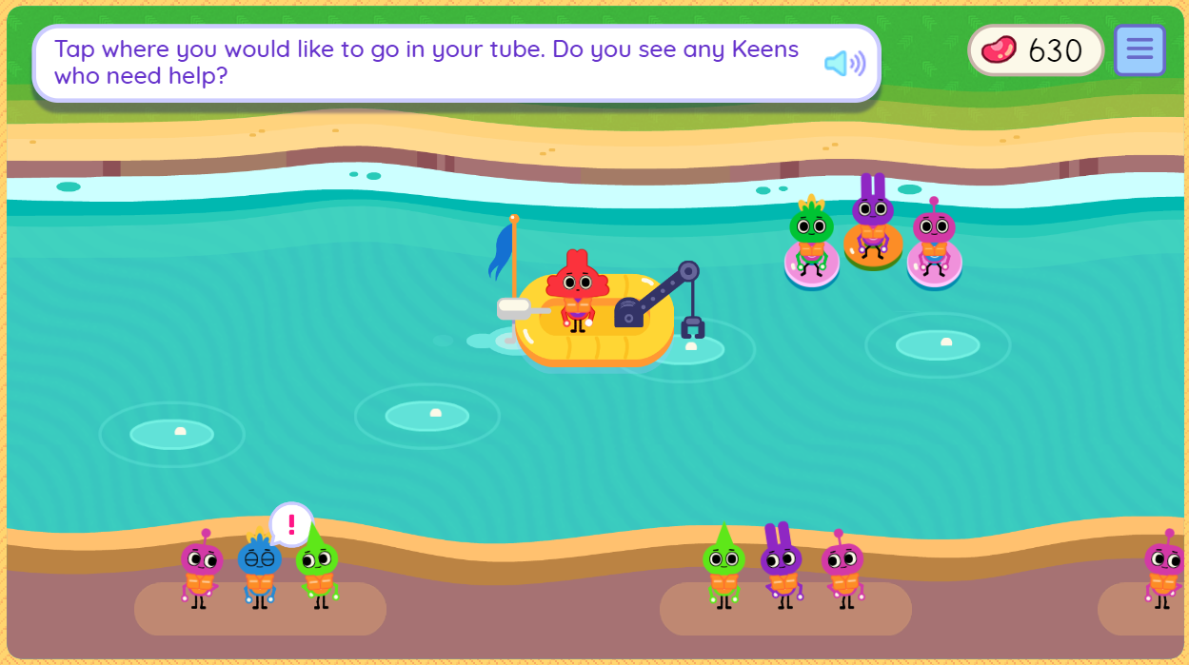
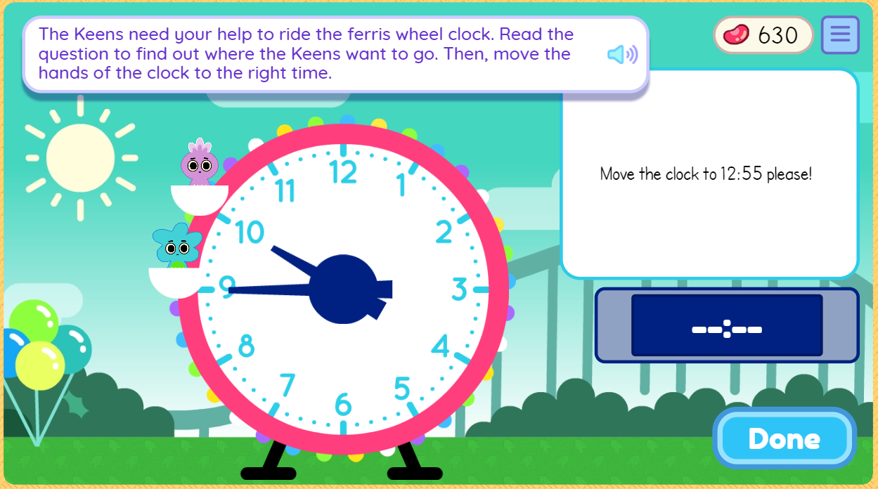

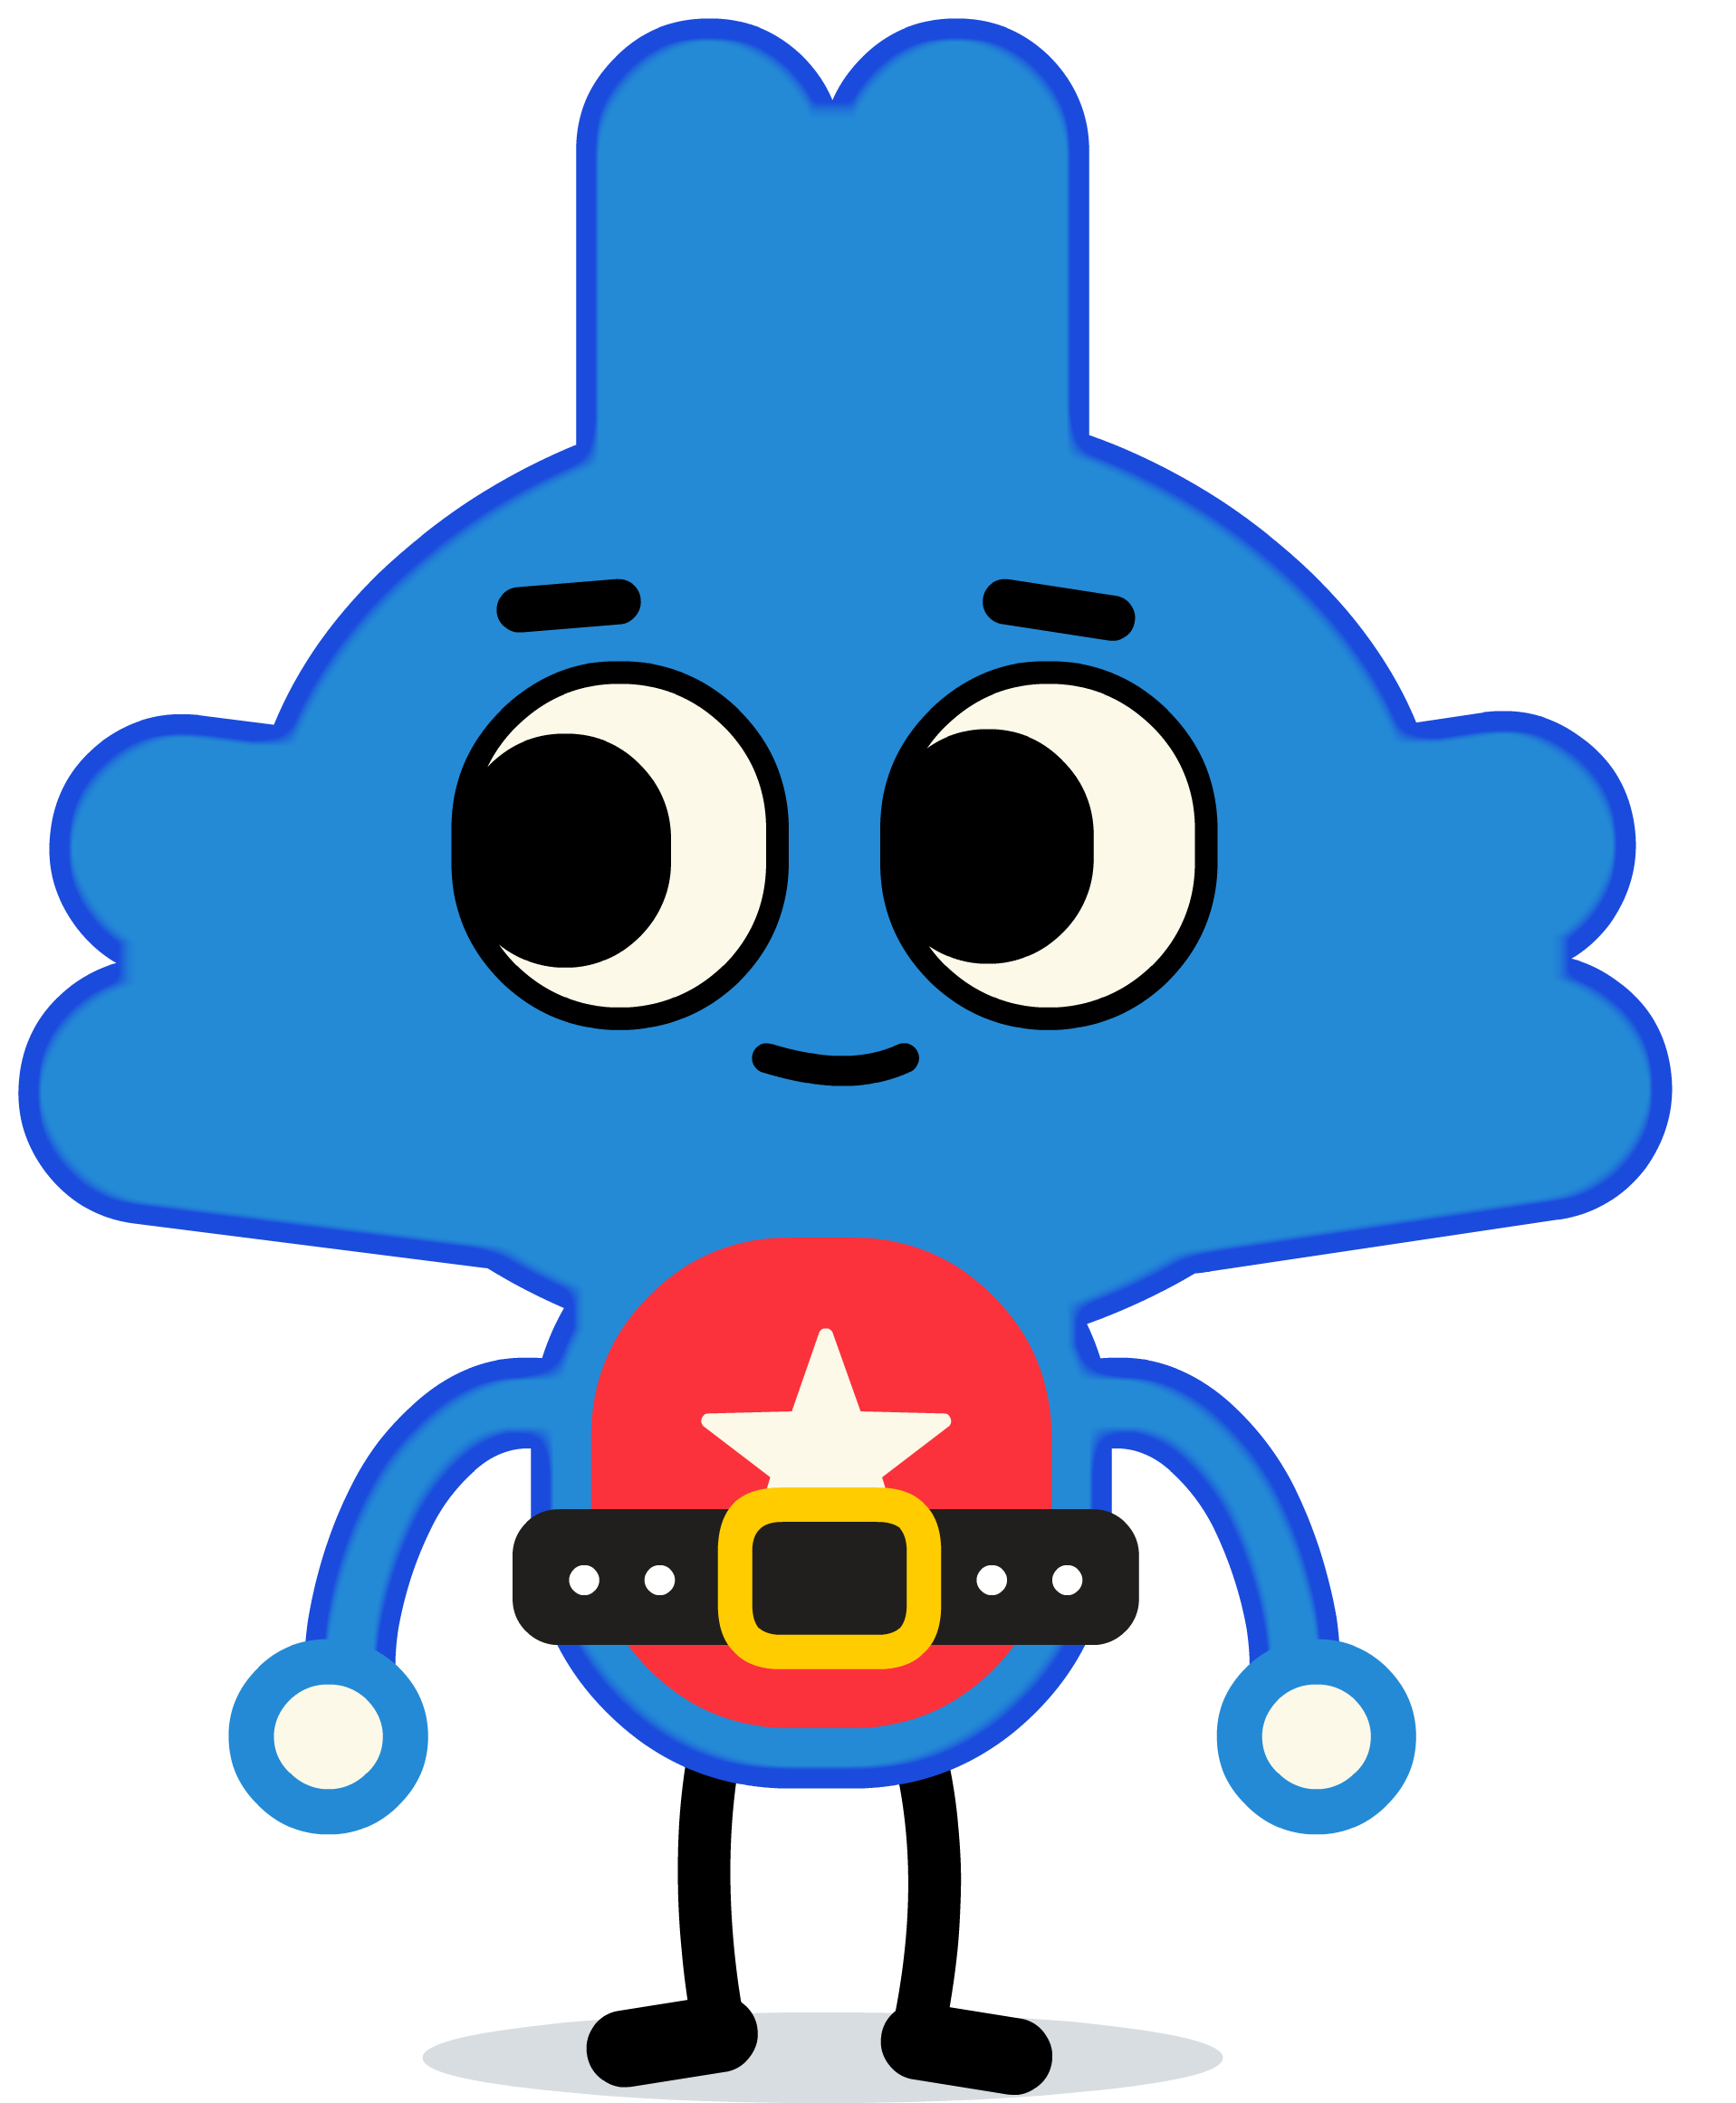
Keenville
K-5 Focus: Literacy and Numeracy
First Challenges
River Tubing ELA
River Tubing Math
Guess My Rule ELA
Guess My Rules Math
Treat Factory
Farmer’s Market
Carnival Time
Dining Hall
Cave Explorer
ELA Skills Assessed
Reading comprehension (literary and informational)
Phonics and word recognition
Math Skills Assessed
Operations and algebraic thinking
Numbers and operations
Counting and cardinality
Fractions
Measurement and data
Challenges 10-30 will become available throughout 2019 and will reinforce some of these ELA and math skills as well as assess additional skills.

Slide 27

Georgia Milestones
K-5 Focus: Literacy and Numeracy
Georgia Milestones scores and resources can be used to understand student performance, inform instructional practice, and continuously improve the instructional program.
  Scale scores, achievement level descriptors (ALDs), domain scores, reading indicator (Lexiles)
  Assessment guides and blueprints, range ALDs, released items and student samples
Lexiles describe students’ reading ability and can describe books’ reading demand or difficulty.
  Together, Lexiles can help match a reader with reading material at the appropriate level of difficulty and suggest how well a reader will comprehend a text.

Slide 28
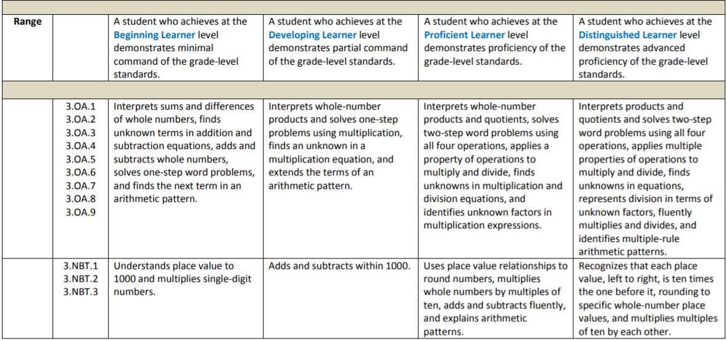
Georgia Milestones
K-5 Focus: Literacy and Numeracy
Range Achievement Level Descriptors (ALDs) describe the progression of knowledge and skills, as related to the content standards, across achievement levels.
Example: Grade 3 Mathematics

Slide 29
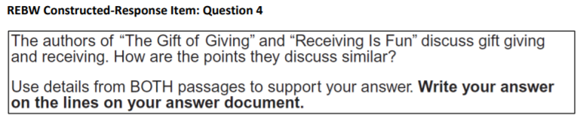
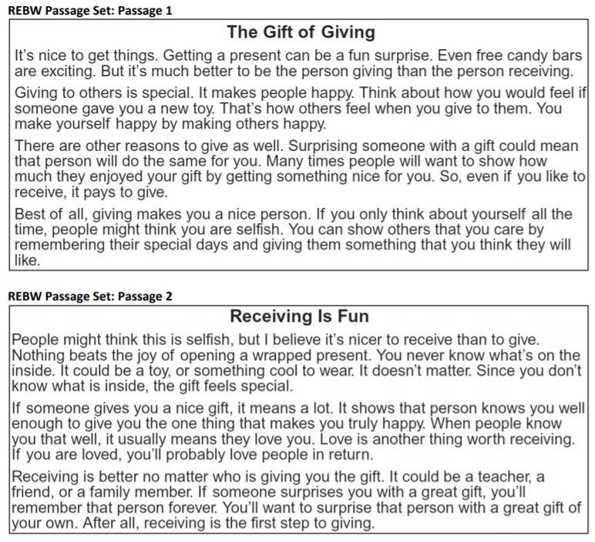
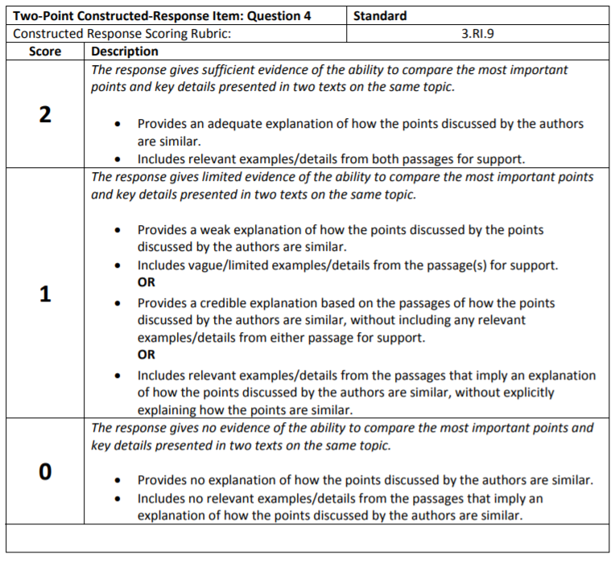
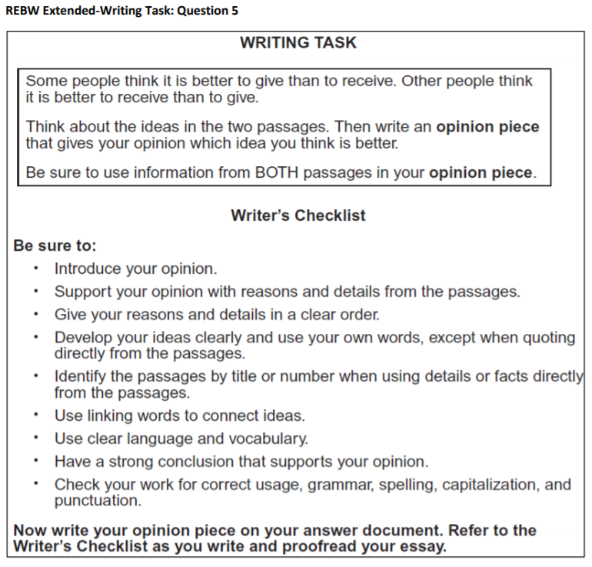
Georgia Milestones
K-5 Focus: Literacy and Numeracy
Item and Scoring Samplers provide detailed information on test items and include examples of different item types (including rubrics and student responses).
Reading and Evidence-Based Writing Passage and Item Sets include passage sets, selected response items, constructed response item, extended writing task, and rubrics.
Example: Grade 3 ELA

Slide 30
Redesigning the CCRPI
ACCOUNTABILITY TO SUPPORT LEARNING
What we heard…
Simplify
Focus on key opportunities and outcomes
Avoid gaming and chasing points
Minimize annual changes
Focus on school improvement
Update the online reporting system
Provide more comparative information
Release results earlier
What we did…
Reduced the number of indicators
Focused the indicators on key opportunities and outcomes, including opportunities to show growth and improvement
Simplified scoring by reporting all indicators, components, and overall scores on a 0-100 point scale
Developed a new online reporting system that is easier to comprehend and navigate
Streamlined GaDOE processes to release results earlier
Educating Georgia’s Future: Georgia’s State ESSA Plan

Slide 31
CCRPI Highlights
ACCOUNTABILITY TO SUPPORT LEARNING
Focuses on the opportunities and outcomes expected of all students
  Maximizes local flexibility to determine the programs and policies that best meet the needs of students
  Removes pressure to “chase points” by adopting a particular program or policy because it earns extra points on CCRPI
Includes multiple measures and values educating the whole child
  Different ways of looking at student performance (Content Mastery, Progress, Closing Gaps)
  Exposure to a well rounded curriculum (Beyond the Core)
  Engagement/climate and skills for success (Student Attendance)
  Relevance (Pathway Completion)
  Accelerated enrollment opportunities (AP, IB, Dual Enrollment)
  Postsecondary readiness (College and Career Readiness – multiple opportunities to demonstrate readiness)
Individualized targets and rewards progress
  Improvement targets are calculated individually for every school and district
  Partial points for making progress and extra points for exceeding targets
Educating Georgia’s Future: Georgia’s State ESSA Plan

Slide 32
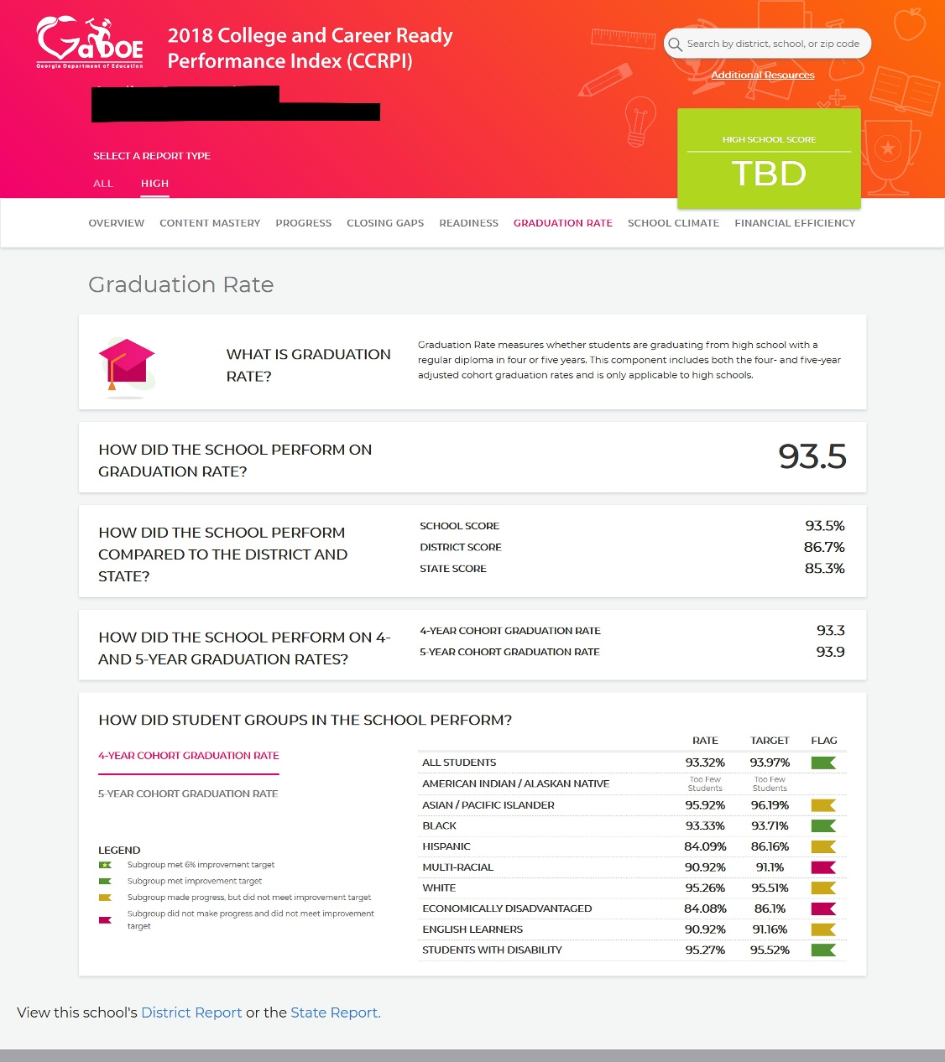
New CCRPI Reports
ACCOUNTABILITY TO SUPPORT LEARNING
Simple and streamlined
Easy to navigate
Includes guiding questions and explanations to understand the calculations and help interpret the data
Will include comparison to previous year’s performance
Can disaggregate all indicators by subgroup
Engages users with the data – encouraging them to drill past the overall score

Slide 33
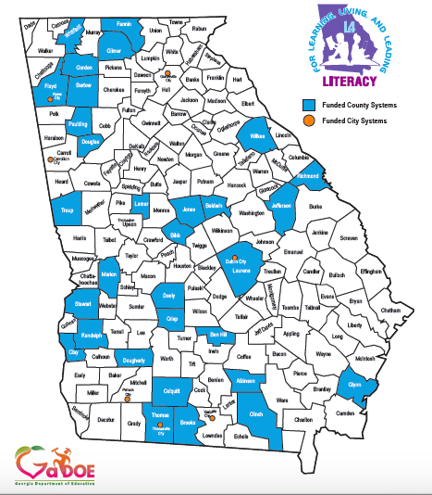
K-5: L4GA Grant
Educating Georgia’s Future: Georgia’s State ESSA Plan

Slide 34


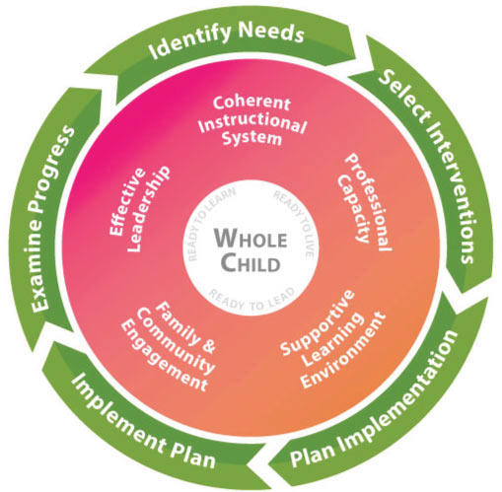
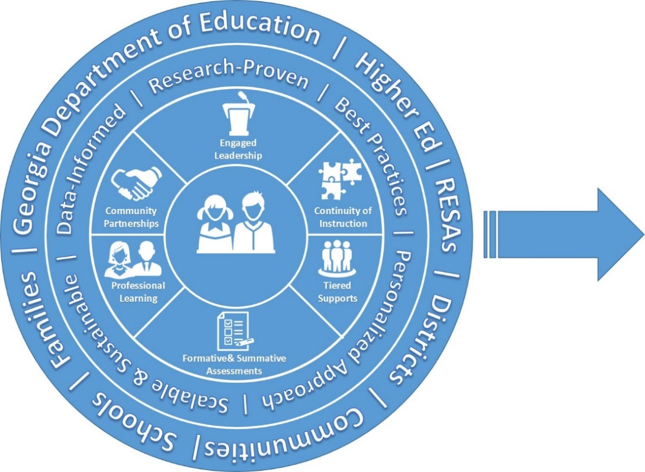
Educating Georgia’s Future: Georgia’s State ESSA Plan

Slide 35







Georgia’s
P-20 Literacy Think Tank
Research Practitioner Partnerships

