Slide 1
Georgia’s
Community School Certification
Ashley Harris, MS
Director of Whole Child Supports and Strategic Partnerships
Georgia Department of Education

Slide 2
What Works in Georgia
Driving performance through recognition and roadmaps rather than requirements
Setting state-level expectations but giving local districts and schools flexibility on how to meet them

Slide 3
Our Approach
State recognized, school-level “Community Schools” certification
  Past success: STEM/STEAM certification
  Clearly defines and sets expectations for the common elements of a Community School (i.e. rubrics, evaluators, etc.)
  Multiple pathways to earn Community School certification
    Ex: Communities in Schools; Wraparound Centers

Slide 4
Our Approach
Characteristics of a Community School
Working with partners and districts, the Georgia Department of Education is developing a roadmap for schools that:
  Engages the community (business and industry, parents, faith based/civic organizations, nonprofits) in a meaningful way
  Aligns the goals of both the community and the school with a community-school needs assessment and asset map
  Brings together the voices of students, parents, and educators to drive the direction of the school
  Coordinates academic and non-academic supports around the individual needs of students
  Expands access to academic opportunities (AP, IB, STEM/STEAM, fine arts, computer science, etc.) and non-academic supports (nutritional, physical, mental/behavioral health)
  Transforms schools into community hubs where facilities, resources, and services are harnessed throughout and outside of a traditional school day

Slide 5
Our Commitment to the Whole Child
Created position at GaDOE focused on Whole Child efforts:
  Engaging state-level agencies, organizations, and non-profits
  Coordinating efforts, supports, and services across our agency

Slide 6
Our Commitment to the Whole Child
Adopted an agency-wide school improvement framework:
  Centering on meeting the needs of the Whole Child
  Organizing tools, resources, best practices, plans, etc. across our agency around one framework
  Aligning to the Whole School Whole Community, Whole Child (WSCC) model so schools have access to supports and services from national organizations
    Healthy
    Safe
    Supported
    Challenged
    Engaged

Slide 7
Our Commitment to the Whole Child
Developed an online toolkit for school leaders and partners
  Guiding districts on how to leverage different federal funds to support the Whole Child
  Organizes professional learning, best practices, data, program/initiatives, and partners all in the same place

Slide 8
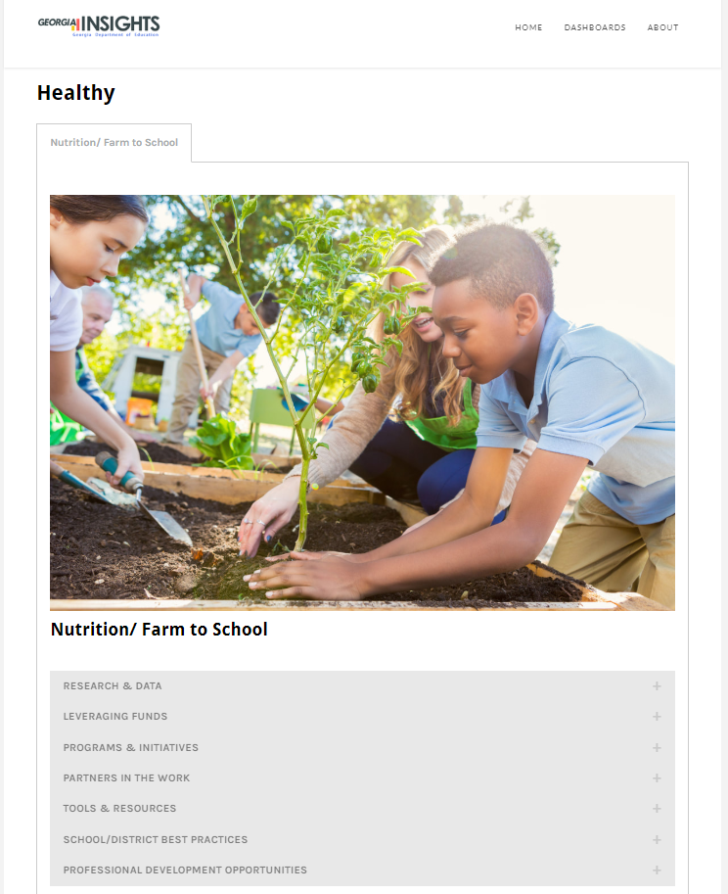
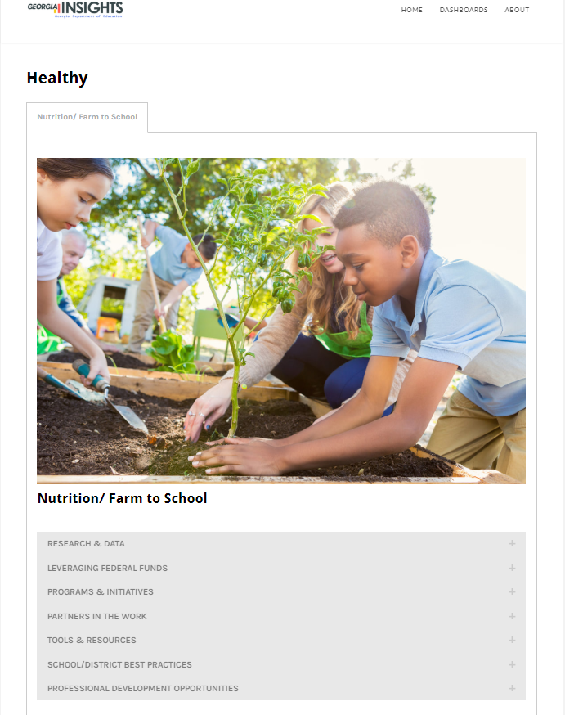

Slide 9
Progress
Defined Community School
Developed a roadmap, evaluation rubrics, community asset mapping, and manual
Meetings with state agencies and organizations
Alignment to national work but ensuring a Georgia grown concept
Toolkit that organizes resources, partners, best practices, and guides

Slide 10
Next Steps
Convene focus groups (districts, community organizations, state agencies, etc.) to review and approve materials/guidance
Launch pilot
Identify model schools
Continue integration of state initiatives/priorities (school-based health centers, PBIS, mental health counseling, advisory councils, school governance teams, etc.) into the Community Schools roadmap

Slide 11
Next Steps
  Needs:
    Increase the capacity at GaDOE (currently, army of one)
    Grants for schools to support the certification process or fill gaps that are identified through the improvement process
    State funds needed to support schools not federally identified (250 federal identified schools out of 2200 schools; can’t use federal funds to support the work if not federally identified)

Slide 12
Ashley Harris, M.S.
Email: asharris@doe.k12.ga.us
Office: 404.463.1646

