Slide 1

Georgia Education Budget Primer
Stephen J. Owens, Ph.D.
Georgia Budget & Policy Institute

Slide 2
Georgia Budget and policy institute
Mission: To advance lasting solutions that expand economic opportunity and well-being for all Georgians
Vision: A fair and inclusive Georgia where all people prosper

Slide 3
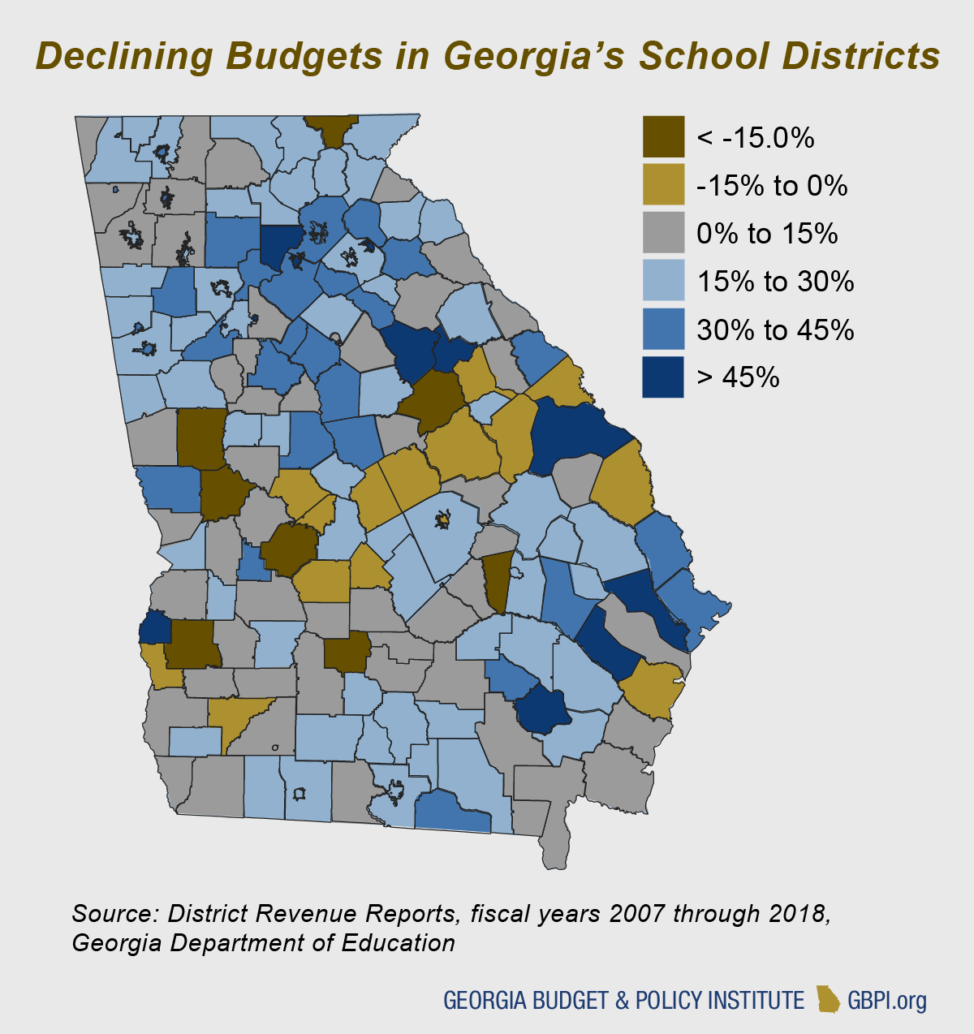
Education in Georgia’s Black Belt: Policy Solutions to Help Overcome a History of Exclusion

Slide 4
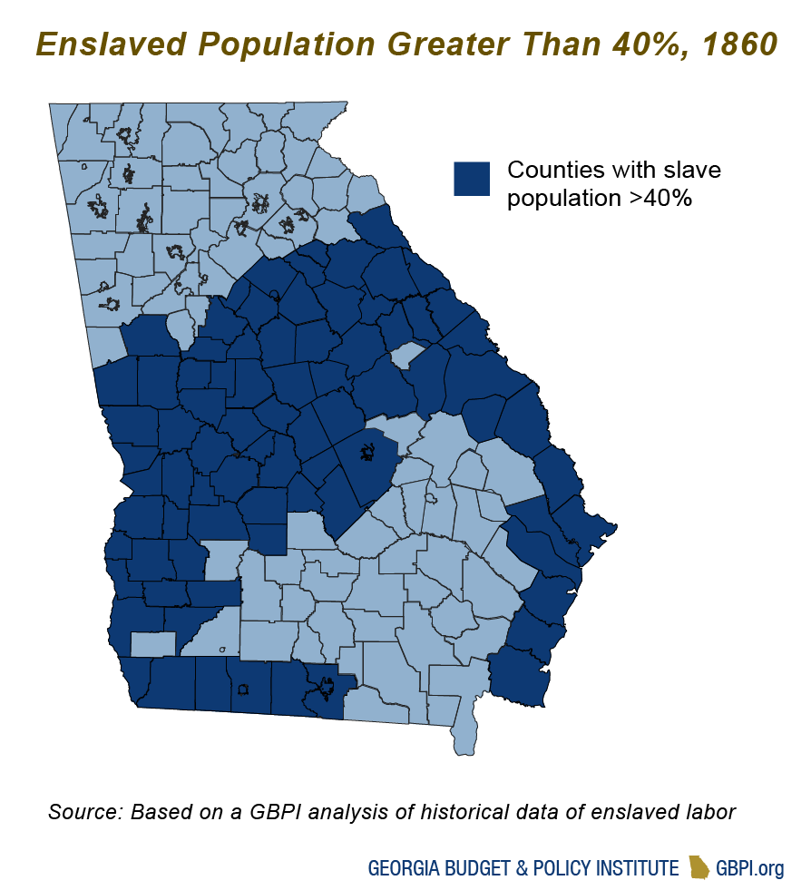
Education in Georgia’s Black Belt: Policy Solutions to Help Overcome a History of Exclusion

Slide 5
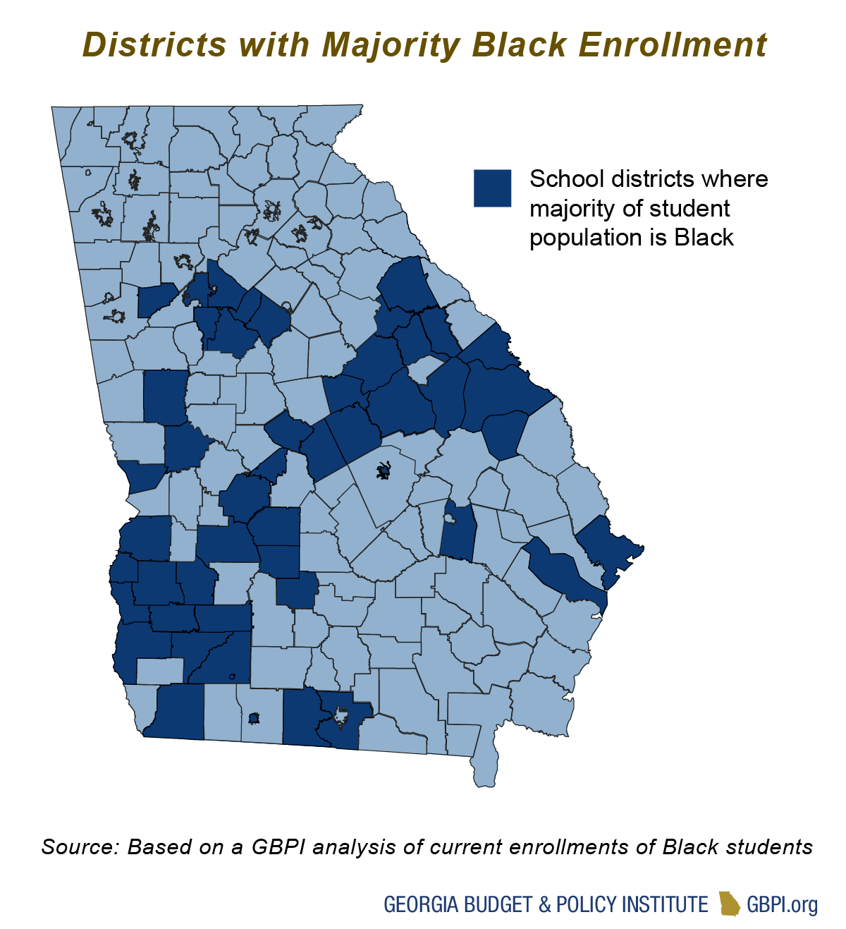
Education in Georgia’s Black Belt: Policy Solutions to Help Overcome a History of Exclusion

Slide 6
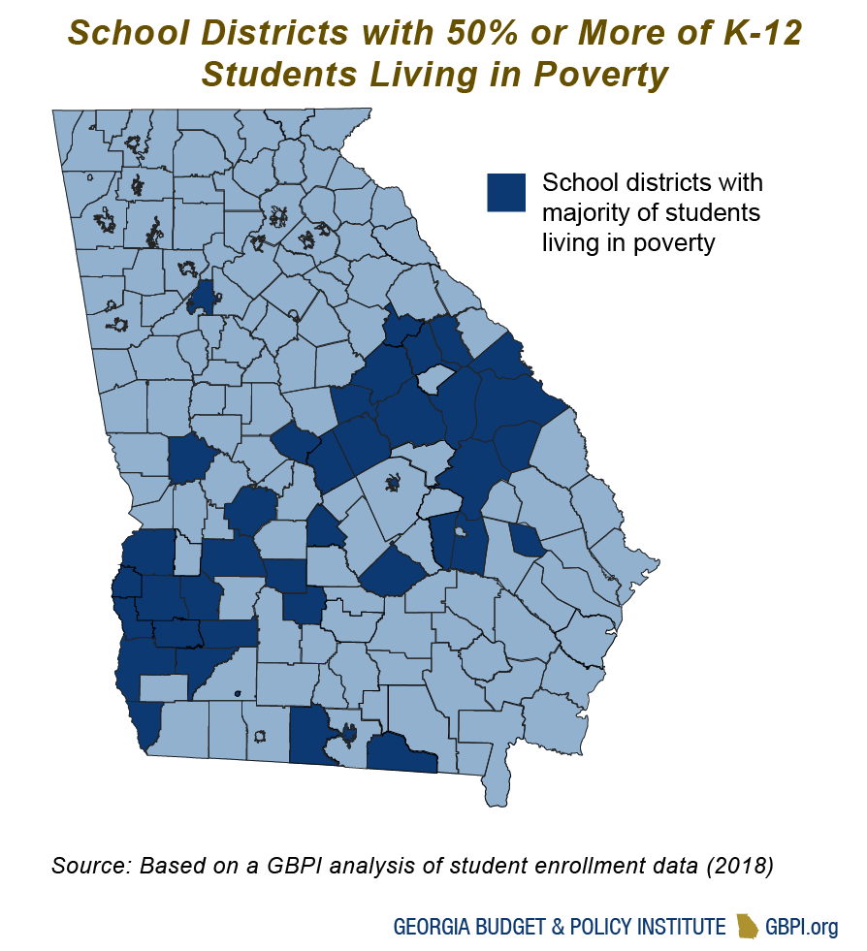
Education in Georgia’s Black Belt: Policy Solutions to Help Overcome a History of Exclusion

Slide 7
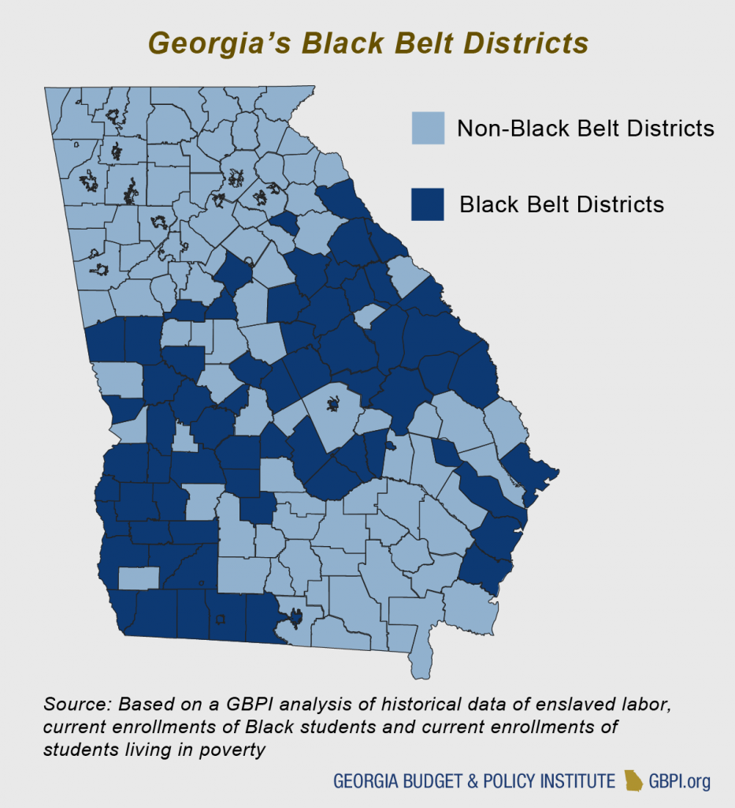
Education in Georgia’s Black Belt: Policy Solutions to Help Overcome a History of Exclusion

Slide 8
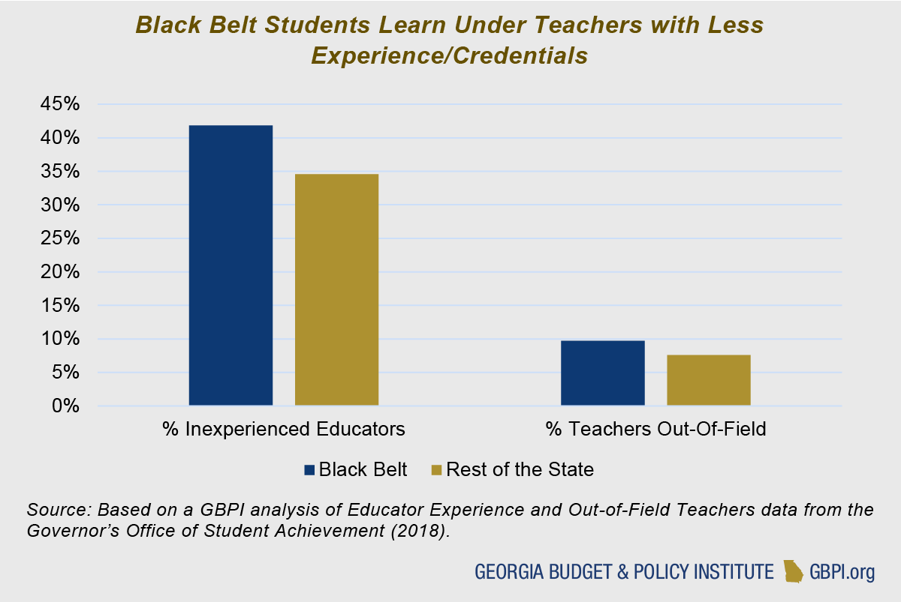
Education in Georgia’s Black Belt: Investments
Notes:
Black Belt students are 21 percent more likely to be taught by teachers with fewer than four years of experience. These same children are 28 percent more likely to have teachers that are teaching “out-of-field,” meaning they are not teaching the subject in which they are licensed or certified.

Slide 9
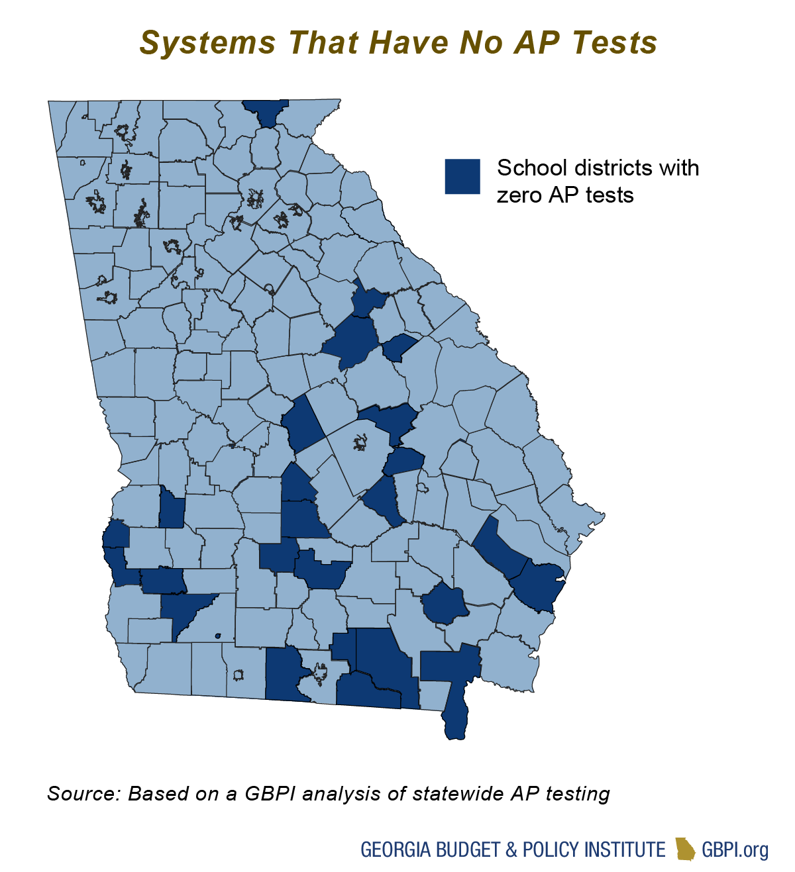
Education in Georgia’s Black Belt: Investments
Notes:
Average 12 AP subjects per district outside the Black Belt
-7 within

Slide 10
Education in Georgia’s Black Belt: Consequences of Disadvantage
Notes:
3rd Grade ELA – 14.8% difference
8th Grade Math – 13.9%
AP Passage – 61% outside, 40% in Black Belt
Hope Eligible – 16 districts in BB have less than 30%, only 2 in the rest of the state

Slide 11
Education in Georgia’s Black Belt: Consequences of Disadvantage

Slide 12
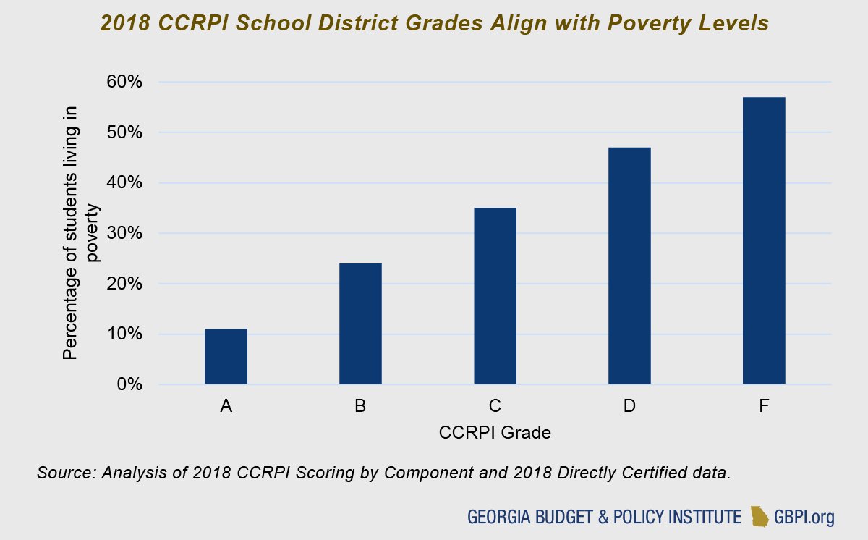
Education in Georgia’s Black Belt: Consequences of Disadvantage

Slide 13
Education in Georgia’s Black Belt: Targeted Policy Solutions to Better Serve Students
Create an Opportunity Weight to Serve Students Living in Poverty
Revise Equalization and Sparsity Grants to Better Address District-Specific Needs
Reinvest in Pre-Kindergarten to Improve Educational Outcomes

Slide 14
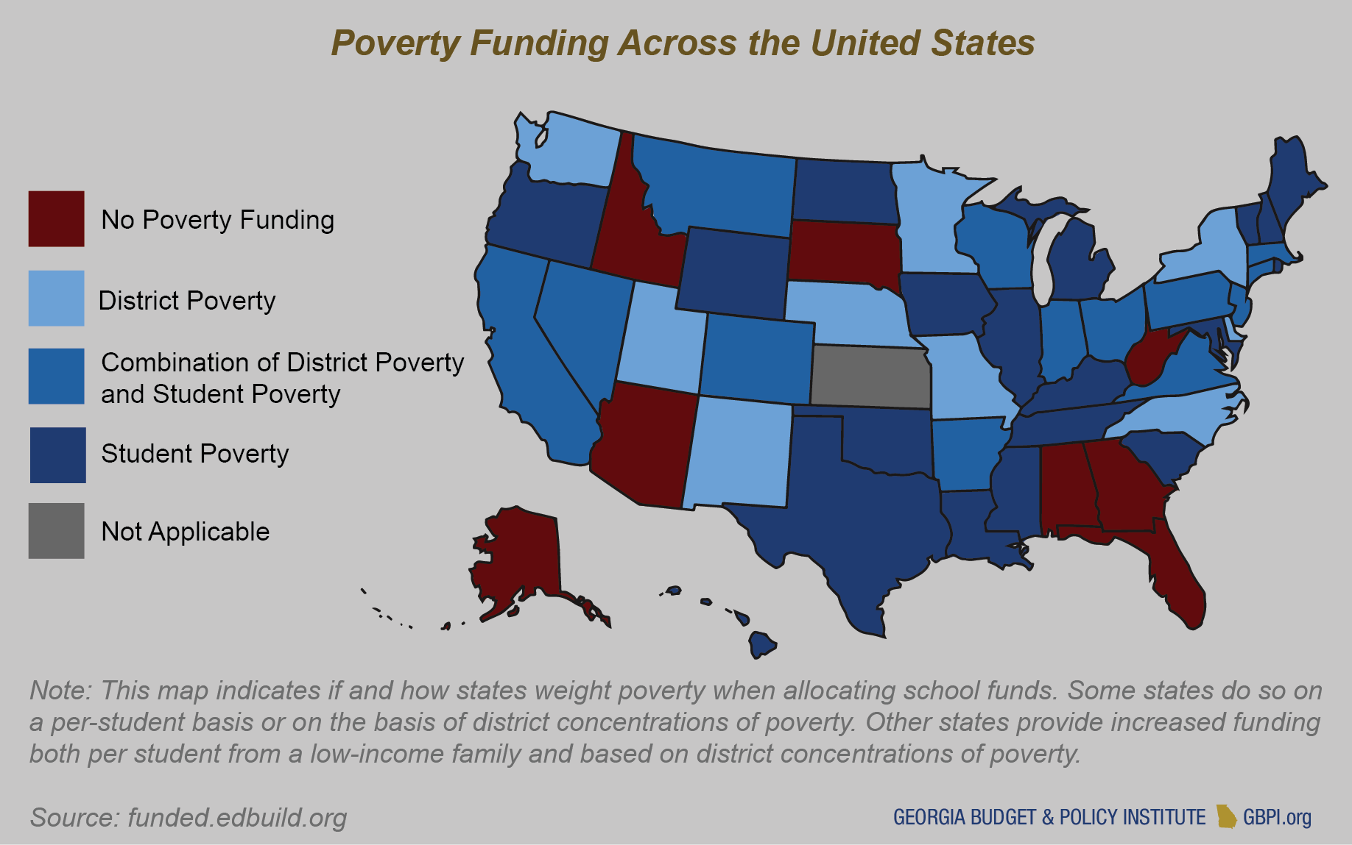
Education in Georgia’s Black Belt: Targeted Policy Solutions to Better Serve Students

Slide 15
Education in Georgia’s Black Belt: Targeted Policy Solutions to Better Serve Students
Equalization
  FY2000 – Lowered to 75th percentile
  FY2013 – Lowered to state average
    Result is $3.4 billion less given to low-wealth school districts annually
Sparsity
  Funded at 27% of formula requirement
    FY2020 Calculated Funding - $24.8 million
    FY2020 Allotment – $6.7 million

Slide 16
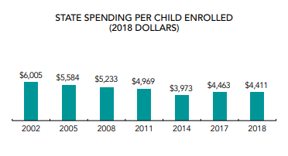
Education in Georgia’s Black Belt: Targeted Policy Solutions to Better Serve Students

Slide 17
Stephen J. Owens, Ph.D.
sowens@gbpi.org
404-420-1324 x105
@StephenGBPI
Georgia Budget & Policy Institute

