Slide 1
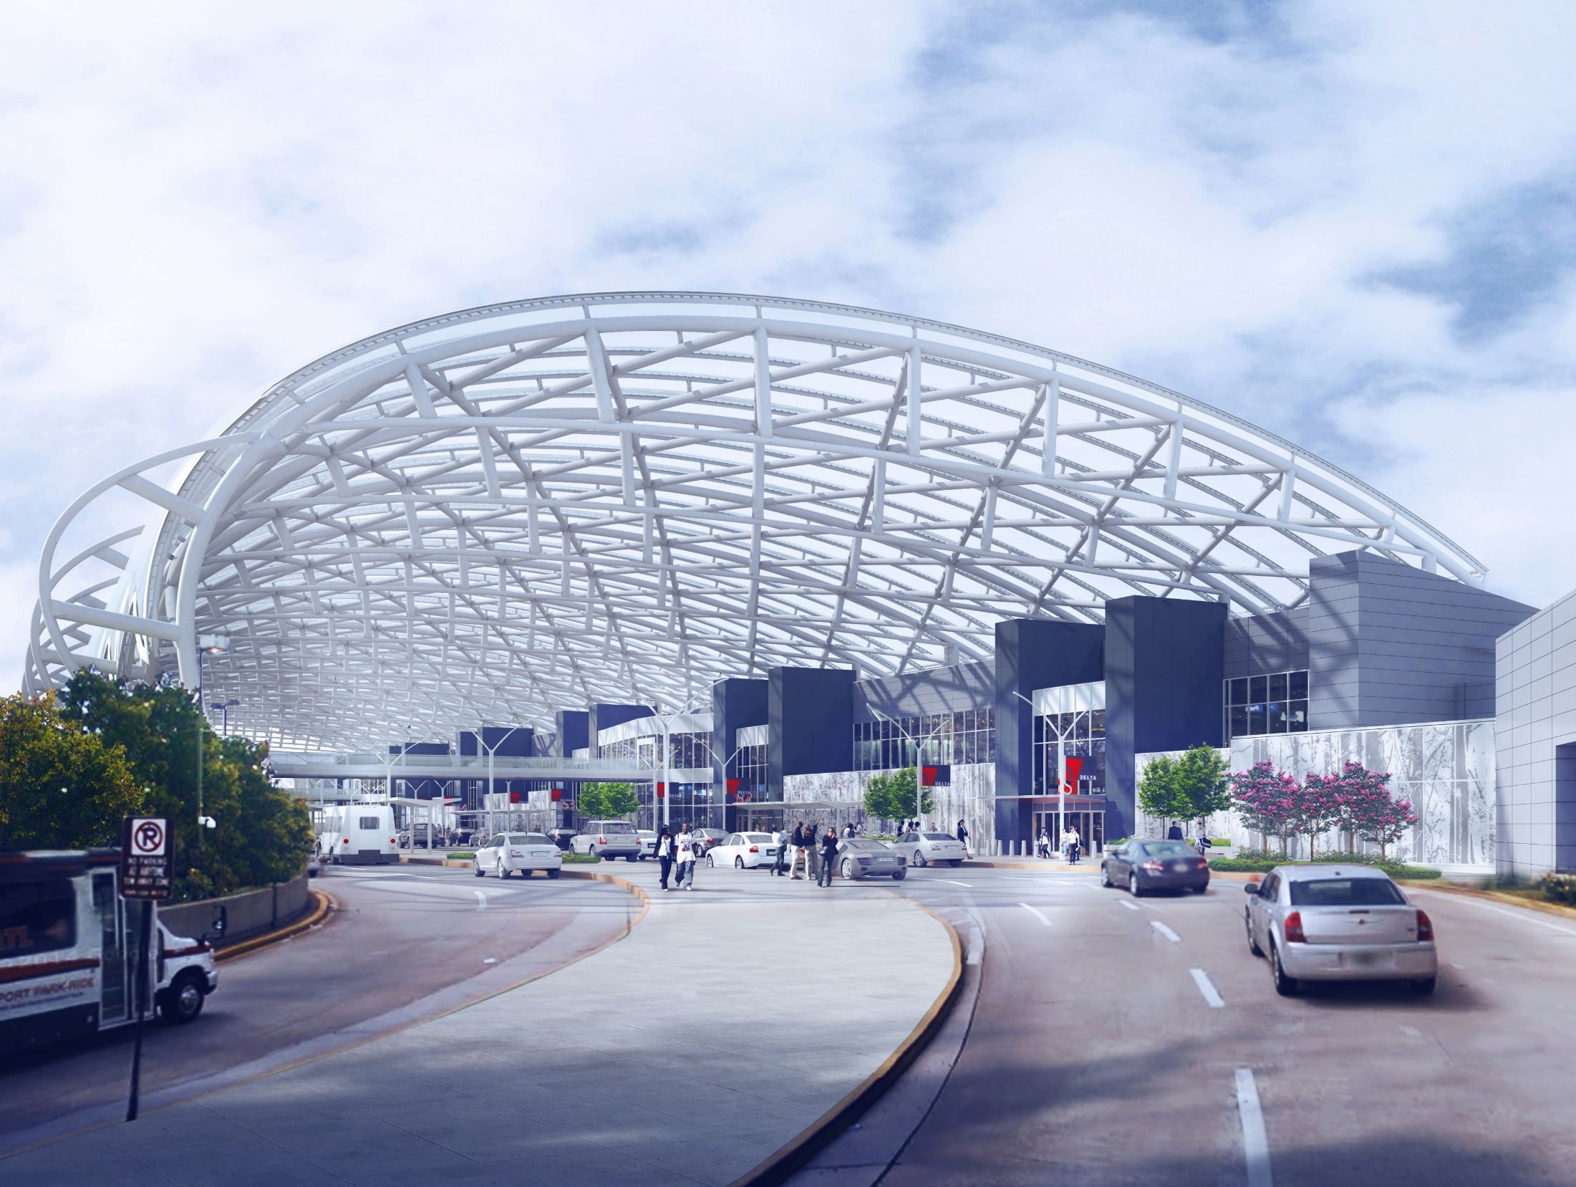

Airport Overview
Senate Study Committee
September 2018

Slide 2
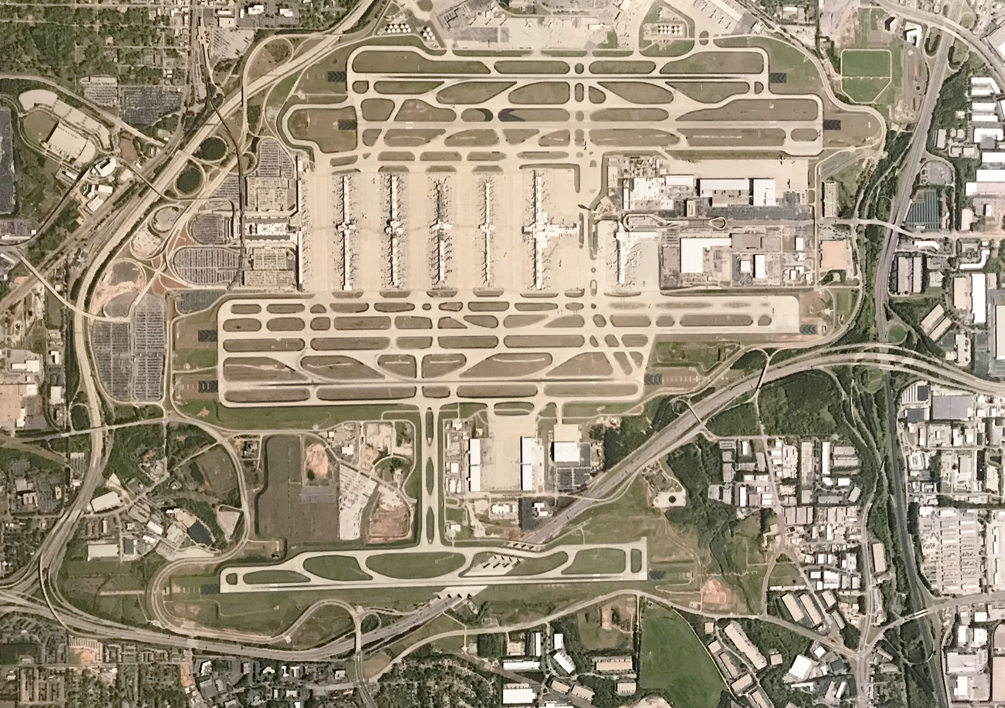

Introduction to ATL
Five parallel runways
193 gates on 7 concourses
World’s busiest airport for 20 years, consecutively
103.9 million passengers in 2017
880,342 operations in 2017 (over 2,400/day)
Most efficient airport in the world

Slide 3
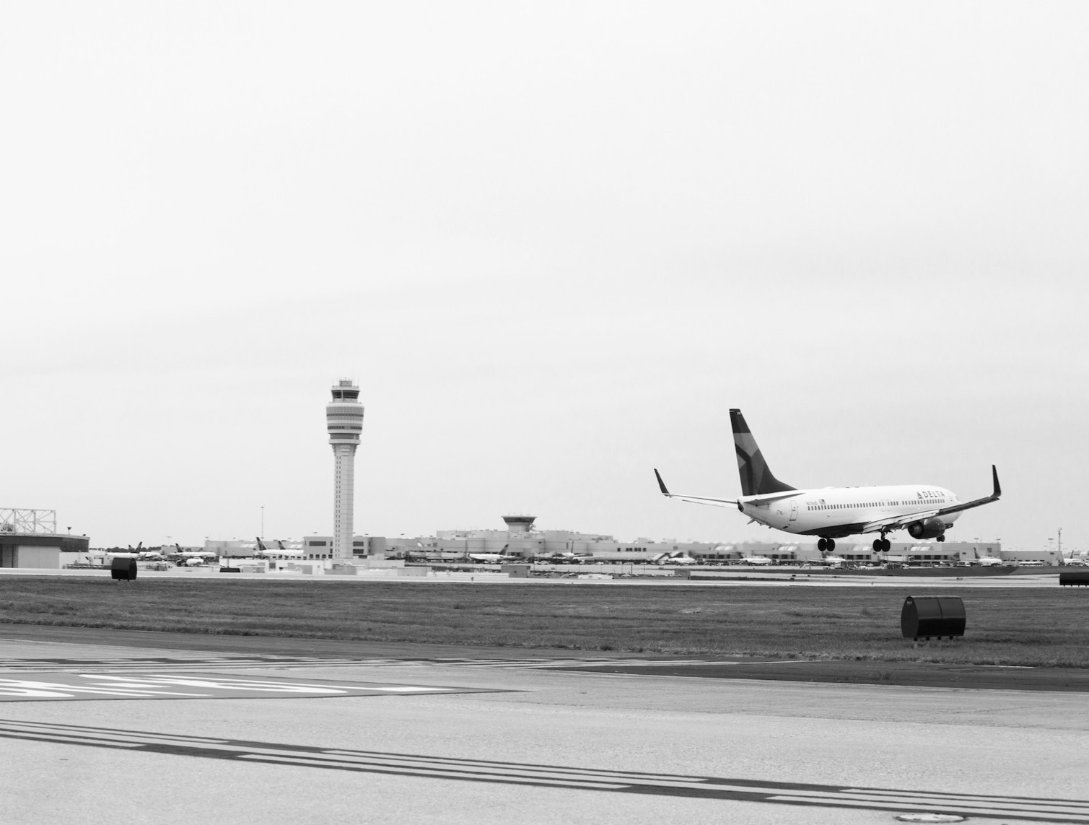
Regional Economic Impact
CATEGORY | REVENUE | JOBS
Direct | $35 billion | 245,536
Indirect | $15 billion | 99,011
Induced | $14 billion | 104,149
Total | $64 billion | 448,696

Slide 4
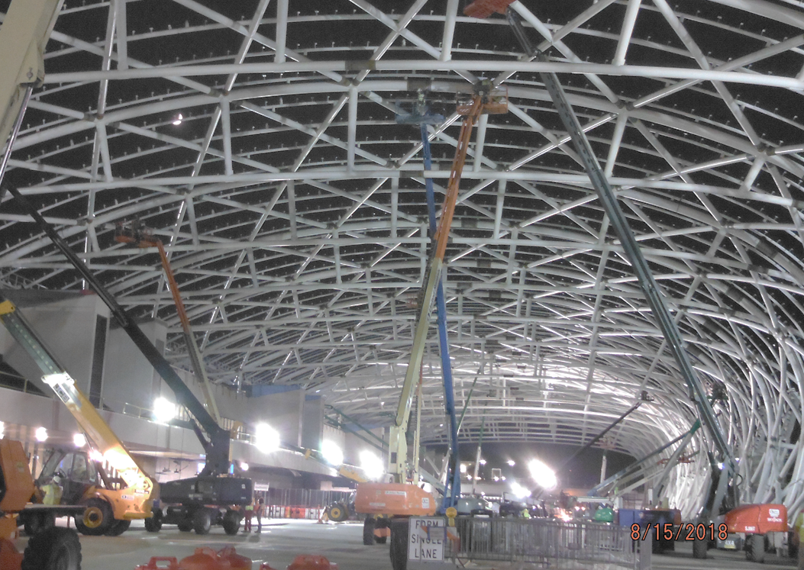
ATLNext – Capital Improvement Plan
ATLNext is the Airport’s multi-billion dollar capital plan.
ATLNext consists of a series of projects to boost capacity and enhance the passenger experience. They include projects to …
  Modernize facilities
  Expand cargo operations
  Expand concourses
  Replace 2 parking decks

Slide 5
ATLNext: 2015 - 2035 CIP
Projects | Cost (2015 $’s M) | Share
Airfield Sixth runway R/W 9L end-around taxiway Other Subtotal | $ 977.0 60.4 247.0 $1,284.4 | 20.8%
Terminal Terminal modernization program Existing terminal complex Concourse G Subtotal | $ 361.1 1,624.7 1,018.6 $3,004.3 | 48.7%
Total Airline Cost Centers | $4,288.7 | 69.6%
Landside Parking & commercial GT Air cargo Infrastructure & other Subtotal | $1,069.9 237.3 567.0 $1,874.2 | 30.4%
Total Landside | $1,874.2 | 30.4%
TOTAL CIP | $6,162.9
40% of CIP will be funded with non-debt sources

Slide 6
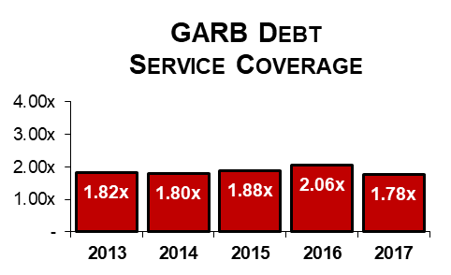
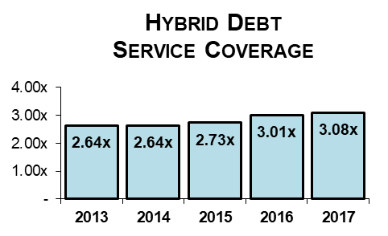
ATL’s Superior Financial Performance
Exceptional Liquidity
923 days cash on hand
as of June 30, 2017
Efficient and Low-Cost Airport
FY 2017 Airline CPE: $2.50
Superior Credit Ratings (M/S/F)
GARB: Aa3 / AA- / AA-
Hybrid: Aa3 / AA- / A+

Slide 7
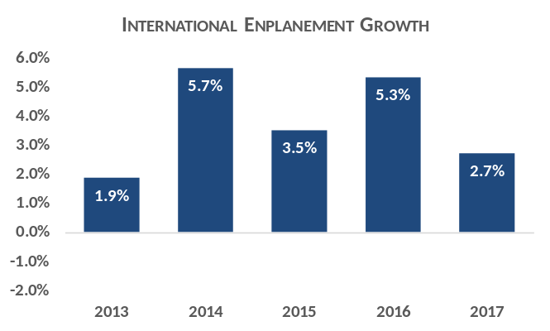
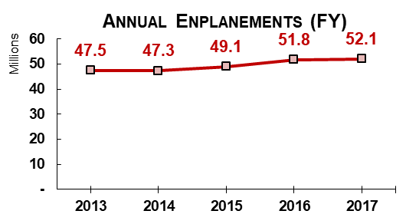
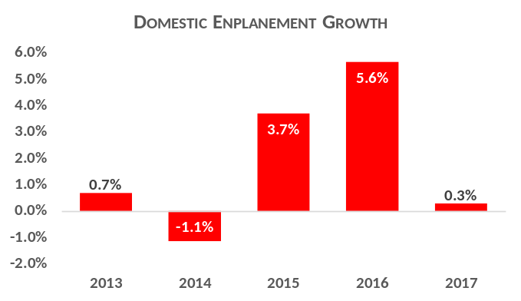
ATL: The World’s Busiest Airport
ATL served 103.9 million passengers in CY 2017
Source: Airport records

Slide 8
Overview: Airport Bonds
The City of Atlanta has funded certain capital projects for Hartsfield-Jackson Atlanta International Airport under the Master Bond Ordinance (the “Ordinance”) adopted by the Council of the City on March 20, 2000, as amended and supplemented
Under the Ordinance, the City has issued long-term debt:
  Airport General Revenue Bonds (“GARBs”)
  Airport Passenger Facility Charge and Subordinate Lien General Revenue Bonds (“Hybrid Bonds”)
In addition, the City has secured interim funding under the Ordinance for certain ongoing capital projects with Bond Anticipation Notes and Commercial Paper Notes (collectively, “Notes”)

Slide 9
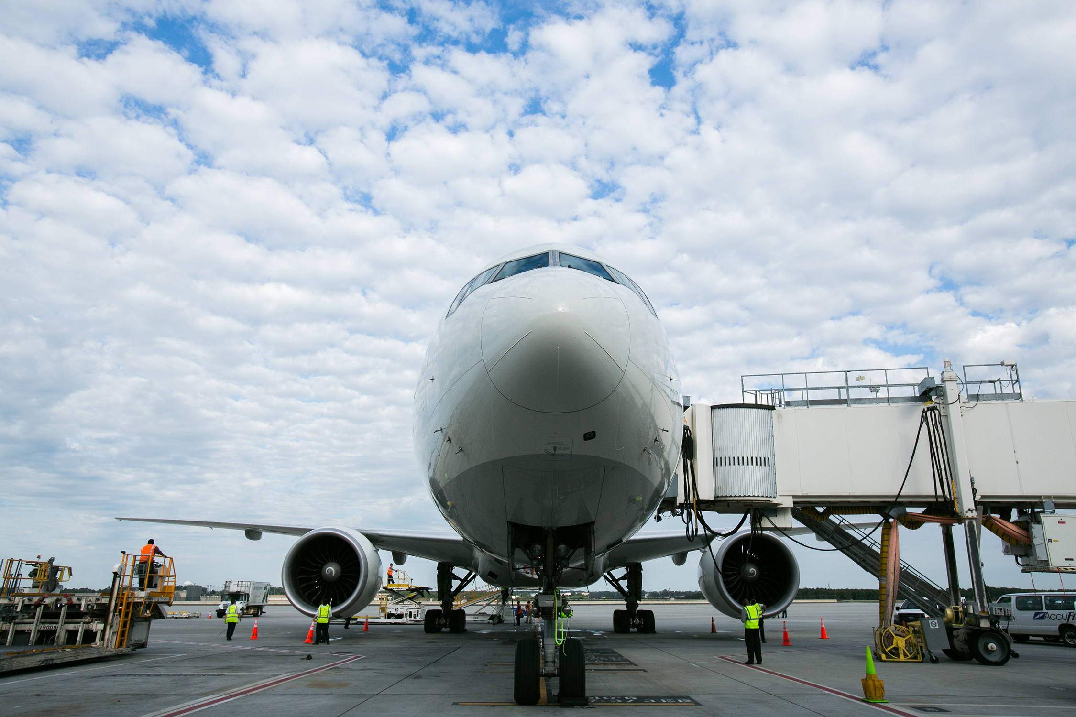
Amount of Outstanding Airport Bonds
As of Sept. 1, 2018, the following amount of bonds are outstanding:
GARBs | Hybrid Bonds | Notes
$1,523,635,000 | $767,680,000 | $605,114,000 *
* Total current Note capacity is $1,175,000,000

Slide 10
Types of Debt Outstanding
GARBs:
  100% fixed rate
  Certain bonds are insured by Assured Guaranty Municipal
Hybrid Bonds:
  100% fixed rate
  No credit support or bond insurance
Notes:
  100% variable rate
  Commercial Paper Notes are supported by Letters of Credit

Slide 11
Description of Hedge Agreements
There are no hedge agreements associated with currently outstanding debt under the Ordinance.

Slide 12
GARBs
 |  | Original Issue Aggregate Principal Amount |  | Outstanding Principal Amount as of September 1, 2018 | Tax Status | Current Scheduled Final Maturity - January 1
Series 2010A |  | $177,990,000 |  | 159,875,000 | Non-AMT PAB | 2040
Series 2010C |  | 524,045,000 |  | 387,095,000 | Non-AMT | 2030
Series 2011A |  | 224,195,000 |  | 118,730,000 | Non-AMT | 2021
Series 2011B |  | 216,195,000 |  | 171,335,000 | AMT | 2030
Series 2012A |  | 63,695,000 |  | 58,970,000 | Non-AMT | 2042
Series 2012B |  | 184,660,000 |  | 172,305,000 | Non-AMT PAB | 2042
Series 2012C |  | 225,740,000 |  | 210,170,000 | AMT | 2042
Series 2014B |  | 141,005,000 |  | 135,645,000 | Non-AMT | 2033
Series 2014C |  | 181,875,000 |  | 109,510,000 | AMT | 2030
Total |  |  |  | $1,523,635,000

Slide 13
Annual GARB Debt Service

Slide 14
Hybrid Bonds
 |  | Original Issue Aggregate Principal Amount |  | Outstanding Principal Amount as of September 1, 2018 | Tax Status | Current Scheduled Final Maturity - January 1
Series 2010B |  | $409,810,000 |  | $244,075,000 | Non-AMT PAB | 2026
Series 2014A |  | $523,605,000 |  | $523,605,000 | Non-AMT | 2034
Total |  |  |  | $767,680,000

Slide 15
Annual Hybrid Debt Service

Slide 16
Credit Ratings
GARBs:
Hybrid Bonds:
 | Moody’s | Standard & Poor’s | Fitch Ratings
Rating | Aa3 | AA- | AA-
Outlook | Stable | Stable | Stable
 | Moody’s | Standard & Poor’s | Fitch Ratings
Rating | Aa3 | AA- | A+
Outlook | Stable | Stable | Stable

Slide 17
Comparison – U.S. Large Hub Airports
Airport | Moody’s (Aaa to Aa3) | S&P (AAA to A-) | Fitch (AAA to A-)
Boston Logan | Aa2 | AA | AA
Los Angeles | Aa3 | AA | AA
Las Vegas | Aa2 | AA-
Hartsfield-Jackson | Aa3 | AA- | AA-
Minneapolis | - | AA- | AA-
Orlando | Aa3 | AA- | AA-
Phoenix Sky Harbor | Aa3 | AA-
Tampa | Aa3 | AA- | AA-
Charlotte | Aa3 | AA- | AA-
Wash. DC Authority | Aa3 | AA- | AA-
PANYNJ (Consolidated) | Aa3 | AA- | AA-
Houston System | Aa3 | AA-

Slide 18
Restated and Amended Master Bond Ordinance (Ordinance No. 99-O-1986)
City of Atlanta (the “City”) adopted its Restated and Amended Master Bond Ordinance (Ordinance No. 99-O-1986) on March 20, 2000 (the “MBO”).
MBO authorizes and secures Airport Revenue Bonds
Pledged Revenues: (i) all revenues, income, receipts and money derived from ownership and operation of Airport, (ii) all gifts, grants, reimbursements or payments. Pledged Revenues includes PFC Revenues.
  Note: No City of Atlanta General Funds are pledged to secure Airport Revenue Bonds
General Revenues: all Revenues other than PFC Revenue
PFC Revenues: all income required to be remitted to City from passenger facility charges imposed pursuant to Federal PFC Act.
CFC Revenues: Customer Facility Charge Revenues, collected by City and pledged in connection with Consolidated Rental Car Facility.
Airport Revenue Bonds:
  General Revenue Bonds (Secured by Senior Lien on General Revenues) (“GARBs”)
  Hybrid PFC Bonds (Secured by Subordinate Lien on General Revenues and a Senior Lien on PFC Revenues) (“Hybrid Bonds”)
  Modified Hybrid PFC Notes (Secured by Second Lien on PFC Revenues and Third Lien on General Revenues)

Slide 19
Revenues Under MBO
Deposit of Revenues
  Revenue Fund and PFC Revenue Fund - for deposit of all Revenues.
  Operating Expenses (all expenses reasonably incurred in connection with the operation, maintenance and repair of Airport (does not include Bond payments)
  Sinking Fund Deposits (to pay debt service on Bonds)
  Rebate Account (to pay any required rebate payments)
  Hedge Payments
  Other Airport Obligations (e.g., certain Short Term Notes and Commercial Paper)
  Renewal and Extension Fund
Closed Bond Ordinance
  No transfers permitted to General Fund

Slide 20
MBO Rate Covenant
City required to at all times prescribe, fix, maintain and collect rates, fees and other charges for facilities sufficient to provide:
  100% of Operating Expenses;
  General Revenues = to 120% of Debt Service Requirement on related Bonds
  PFC Revenues = 100% of Debt Service Requirement on related Bonds
Failure to meet Rate Covenant in any Fiscal Year requires Airport Consultant report and revision of rates, fees and other charges.

Slide 21
MBO Change of Control Provisions
Due on Sale Provision - City covenants to “not to sell, transfer, lease, encumber or dispose of Airport, in whole or in part, until all bonds and interest thereon have been paid or provision for payment has been made
  “Provision for Payment” described as deposit of sufficient non-callable “government obligations” with Paying Agent/Depository to pay maturing interest, principal and redemption premiums when due on the Bonds
Reserved Transfer Rights - Reserve right to transfer, sell, lease or otherwise dispose in limited conditions:
  Experience: Evidence that successor entity has comparable airport operations and management experience (both size and scope) as the Airport
  Local Government Reorganization Act: Successor entity formed under duly adopted and ratified local government reorganization act per Art. IX, Section III, Par II of State Constitution
  No Adverse Effect Opinion: No Adverse Effect Opinion re: Tax Covenants
  Airport Consultant Report: Must demonstrate that transfer will not result in diminution of Net Revenues such that 120% average annual Debt Serve Requirement on Senior Lien Bonds met.

Slide 22
AULA Change of Control Provisions
Airport Use and Lease Agreements (AULAs) with Delta and Southwest prohibit a “change of control” of the Airport:
  Prior AULAs expired September, 2010 (extended to September, 2017)
  Current AULAs were effective on October 1, 2017, and expire June 30, 2036 (unless extended)
  City ownership and control, and unique partnership between the City and the Air Carriers, was a “material inducement” for Airlines to enter into AULAs
  Prohibit the City from, directly or indirectly, transferring the ownership, management, operation or control of the Airport except in connection with the adoption and ratification of a local government reorganization act

Slide 23
General Revenue Fund – FY2017 – Revenues and Expenses
Revenue: Landing Fees Central Passenger Terminal Complex (CPTC) Rentals CPTC Cost Recoveries Commercial Revenues Other Revenues Non-Airline Cost Recoveries Revenues | $17,220 87,379 37,890 293,199 46,866 15,401 $497,955
Expenses (including debt service) Administration Operations & Safety AGTS Maintenance Building Maintenance Rental Car Center Operations SkyTrain Parking Operations Airfield Maintenance Fire Services Police Services Other City Departments Nondepartmental Debt Service Expenses | $62,536 33,751 20,864 7,763 5,567 6,455 33,345 19,596 25,554 18,479 14,982 19,516 139,633 $408,041
FY 2017 ending June 30, 2017; $’s in ‘000s
Source: FY 2017 Disclosure Filing – Tables 9 & 10

Slide 24

DEPARTMENT OF AVIATION
Q&A

