Slide 1
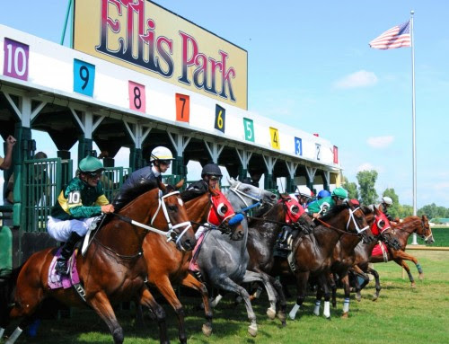
The Impact of the Horse Industry on the Commonwealth
Elisabeth Jensen
Executive Vice President
Kentucky Equine Education Project

Slide 2
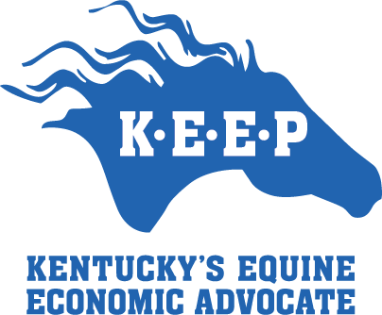
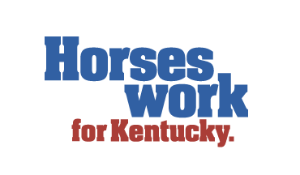
Kentucky’s Horse Industry by the Numbers
$23.4 billion: Value of equines and assets across Kentucky
Annual Impact
  The horse industry contributes nearly $1.6 billion to the Commonwealth’s GDP
  From those direct effects, the horse industry’s contribution ripples out into other sectors of the economy. Adding these ripple effects, feed, hay, supplies, etc., results in an estimate of $ 2.7 billion GDP
  Including the horse industry hospitality and tourism, the total economic impact reaches as high as $5.2 billion and is growing every year.

Slide 3
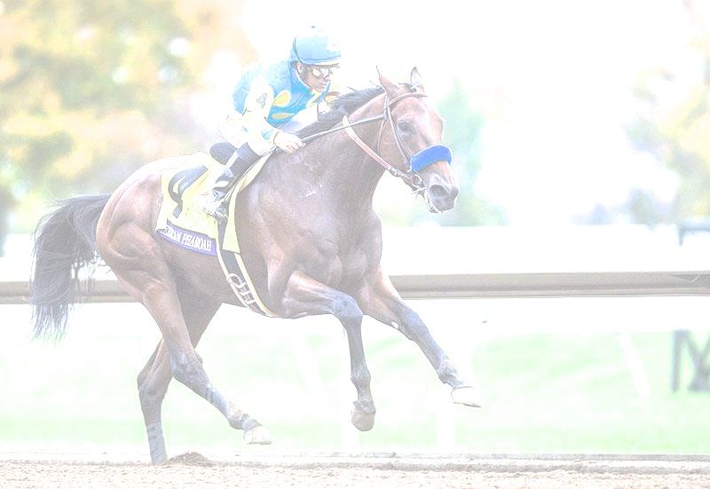
Example: American Pharoah’s Impact on Kentucky (over the past three years)
$45.5 million: Estimated amount of revenue in stud fees based on publicly available numbers and industry calculations
$2.7 million: Paid in to Kentucky in state taxes on breeding alone
Not included in this example are other way American Pharaoh has impacted Kentucky’s tax revenue through equine tourism, increased interest in horse racing and more.
226: Other thoroughbred stallions in Kentucky
4,532: Active stallions among non-race breeds

Slide 4
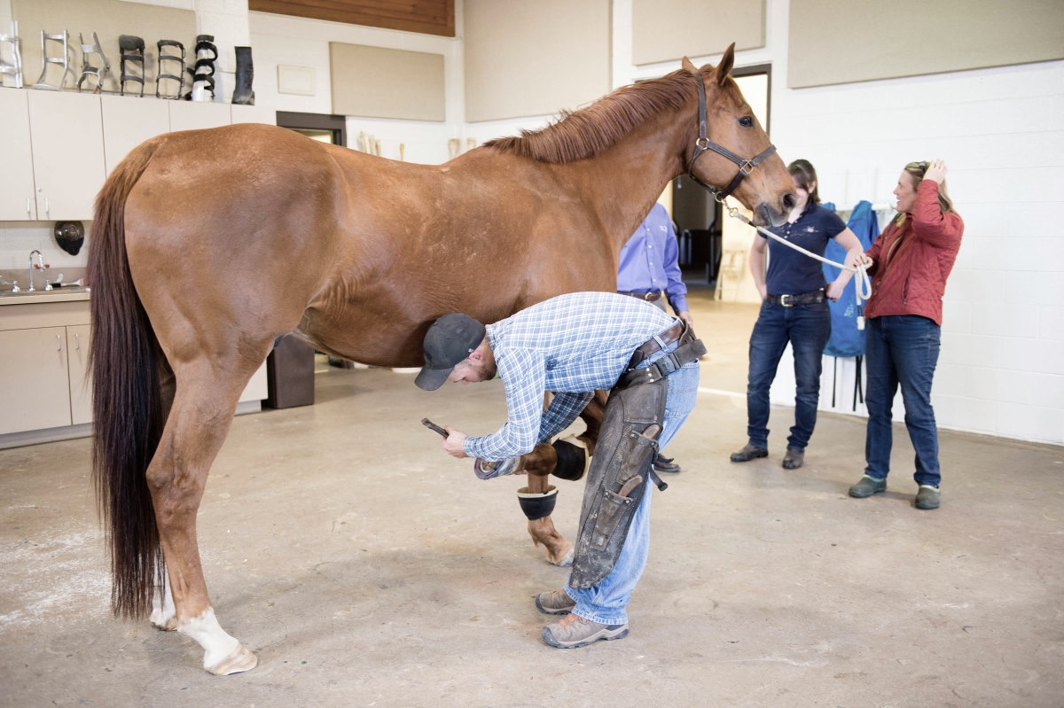
Example: Equine Veterinarians
335: Doctors of Veterinary Medicine in Kentucky registered with the American Association of Equine Practitioners (AAEP). There are many others not registered with AAEP
319: employees at Rood and Riddle, one of the nation’s largest equine vet facilities
  65 of which are veterinarians, caring for 25,000 horses
These veterinarians are responsible for an incredible impact on local economies through their businesses, salaries, taxes and more.

Slide 5
Example: Pari - Mutuel Wagering
Pari-Mutuel wagering has generated $23,528.277 in total excise tax for YTD 2018

Slide 6
Example: Working at the Racetracks in Kentucky
In 2017 KHRC issued over 19,000 licenses to workers at Thoroughbred and Standardbred facilities.
This includes trainers and assistant trainers, jockeys, exercise riders, mutuel clerks, racing officials, farriers, dental technicians, veterinarians, event staff and numerous other functions.

Slide 7
Kentucky’s Horse Industry by the Numbers
242,400: Equines in Kentucky including, but not limited to:
  54,000 Thoroughbreds
  42,000 Quarter Horses
  36,000 Tennessee Walkers
  14,000 American Saddlebreds
  14,000 Donkeys and Mules
  12,500 Mountain Horse Breeds
  9,500 Standardbreds
  7,000 Miniatures
  7,000 Ponies
  6,500 Paints
  5,500 Arabian and Half-Arabians

Slide 8
Kentucky’s Horse Industry by the Numbers
44,000 – 60,000: Direct and indirect jobs in Kentucky
35,000: Operations with at least one horse
17,275: Thoroughbred mares bred to 227 Kentucky stallions in 2017
7,620: Foals born in Kentucky in 2016 (34.6% of North America)
55%: Share of Thoroughbreds in North America sired by Kentucky stallions

Slide 9
Kentucky’s Horse Industry by the Numbers
49%: Share of Kentucky trail rides by out of state visitors
30.5%: Households in Kentucky that contain horse enthusiasts
10%: Share of Kentucky households that participate in trail riding, with the vast majority using public lands

Slide 10
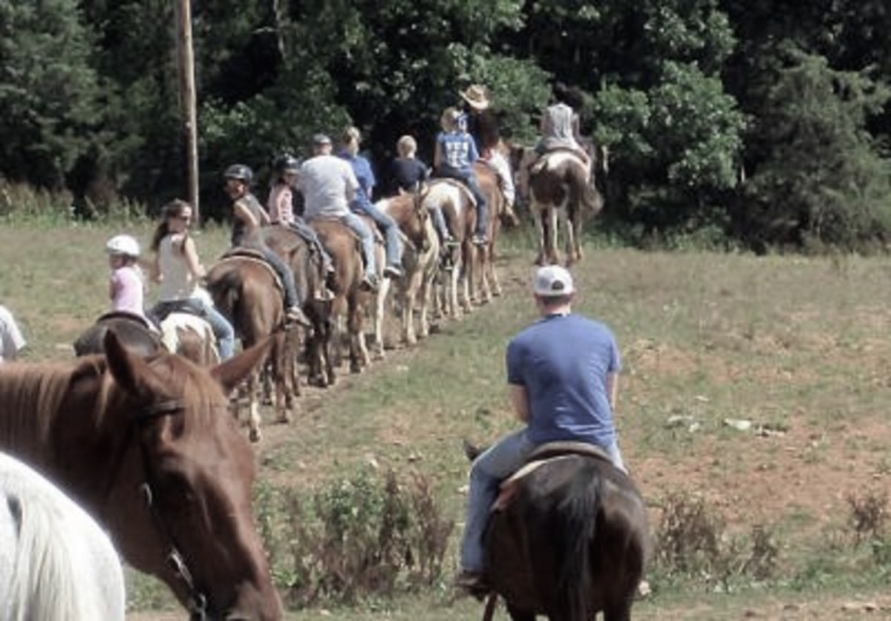
Kentucky’s Horse Industry by the Numbers
Primary use of Kentucky’s equines:
  79,500 Trail riding/pleasure
  38,000 Broodmares
  33,000 Idle/not working
  24,500 Competition/show
  23,000 Yearlings, weanlings and foals
  15,000 Racing
  13,000 Other activities
  12,500 Work/transportation
  3,900 Stallions at stud

Slide 11
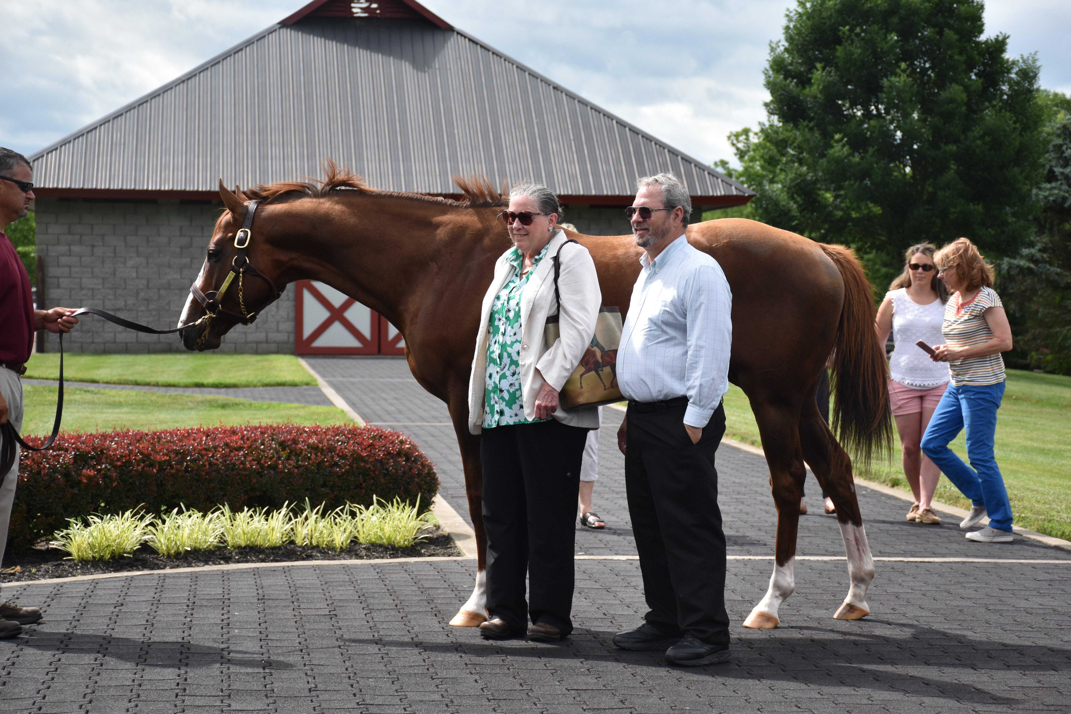
Kentucky’s Horse Industry by the Numbers
#1
Ranking in impact on Kentucky’s economy

