Slide 1
Current Barriers To the Care of Older Georgians
Carolyn Clevenger, RN, DNP, AGPCNP-BC, GNP-BC, FAANP
Clinical Director, Emory Integrated Memory Care Clinic
Associate Dean for Clinical and Community Partnerships
Associate Professor
Nell Hodgson Woodruff School of Nursing
Emory University

Slide 2
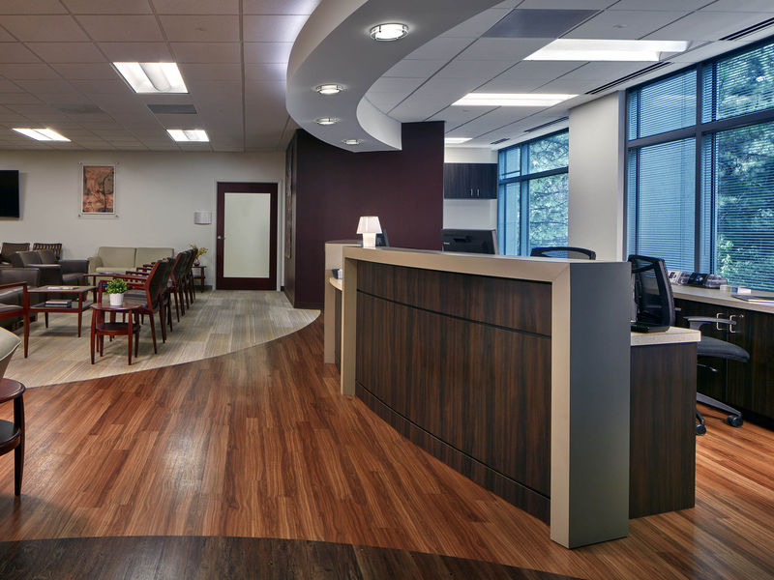
“Primary Care for People Living with Dementia”
Advanced Practice Nurse-led clinic embedded in the Cognitive Neurology Clinic located in the Emory Brain Health Center
Clinically Supported by Cognitive Neurology, Geriatric Medicine and Palliative Care Center
Notes:
Carolyn

Slide 3


Integrated Memory Care Clinic
The Integrated Memory Care Clinic (IMCC) is a nationally-recognized patient-centered medical home that provides primary care individualized for someone living with dementia.
This Integrated Memory Care Clinic is designed to replace the current primary care provider.
The clinic is a one-stop shop. Whether the patient living with dementia has a cold, needs a vaccine, or has a change in behavior, the clinic can help.

Slide 4
Integrated Memory Care Clinic
Design Principles
One stop shopping
Thoughtful utilization of services
Candid discussions about difficult topics
Connecting healthcare and community services
Aggressive symptom management
Access
High-functioning team
Patient/family-driven
Notes:
Likely barriers outside of a big system like Emory are much greater that Experienced at this practice too. Unable to find supervising MD.

Slide 5
Integrated Memory Care Clinic
Dementia and other chronic conditions are managed exclusively by nurse practitioners who collaborate with geriatricians and neurologists on the team. The nurse practitioners have advanced training and specializations in dementia, geriatrics, and palliative care.
A clinical social worker is also a vital member of the team.

Slide 6
Integrated Memory Care Clinic
Barriers Experienced in this APRN Directed Practice:
1. Requirements for Collaborative Practice Agreement
2. Inability to order radiologic testing
3. Inability to prescribe full scope
4. Lack of recognition as primary care provider
Notes:
Likely barriers outside of a big system like Emory are much greater that Experienced at this practice too. Unable to find supervising MD.

Slide 7
Integrated Memory Care Clinic
Collaborative Practice Agreements:
Artificially require “collaboration”– something healthcare professionals do as part of their daily performance
Create challenges in growing and expanding practices and practice sites
Notes:
Likely barriers outside of a big system like Emory are much greater that Experienced at this practice too. Unable to find supervising MD.

Slide 8
Integrated Memory Care Clinic
Radiologic Testing:
Some patients arrive without the “gold standard” diagnostic work-up to determine whether they have
Alzheimer’s disease
Frontotemporal degeneration
Lewy body dementia
NP’s cannot order the appropriate tests to complete their evaluation
(I co-authored the Clinical Practice Guideline instructing providers on when to order these tests!)
Notes:
Likely barriers outside of a big system like Emory are much greater that Experienced at this practice too. Unable to find supervising MD.

Slide 9
Integrated Memory Care Clinic
Full Scope Prescribing:
Dementia is a progressive and terminal illness
Occasionally, our patients require pain medications—following surgery or before hospice can begin
Notes:
Likely barriers outside of a big system like Emory are much greater that Experienced at this practice too. Unable to find supervising MD.

Slide 10
Integrated Memory Care Clinic
Recognition as PCP:
“Restricted Practice Environment” creates a permissive environment to ignore NP’s as primary care provider
Tests ordered do not send results to the NP (radiologic tests in particular)
Hospital discharge documents are not sent to the NP by insurers so that post-hospital follow-up can occur (preventing hospital readmissions)
Notes:
Likely barriers outside of a big system like Emory are much greater that Experienced at this practice too. Unable to find supervising MD.

Slide 11
And Yet…
Outcomes of the IMCC Speak for Themselves

Slide 12
Types of Dementia IMCC Serves
96% satisfied
Notes:
Carolyn
For our first 140 patients--
53% Alzheimer’s
14% Mixed -- Orange
11% MCI – Light Blue
9% NOS – Other or NOS
5% FTD -- Green
5% Lewy Body --Aqua
3% Vascular -- Purple

Slide 13
Stages of Dementia IMCC Serves
98% satisfied

Slide 14
Overall Measure of Success:

Slide 15
Hospital Admissions, Another View

Slide 16
Appointment Feedback
Debbie Gunter is the Best!!
Alison is Awesome!!! I am so very Happy "Alison S." is my Mother's N.P.
This clinic has become my favorite place! They are so caring, helpful, and educational. Thank you.
Keep up the good work
This is the best clinic Emory ever created!! Alison is Fabulous
Very Excellent!
The nurse Practitioner Debbie is among the best we've had. Her knowledge and skills are what we need.
Great Team
3.9/4

Slide 17


Slide 18
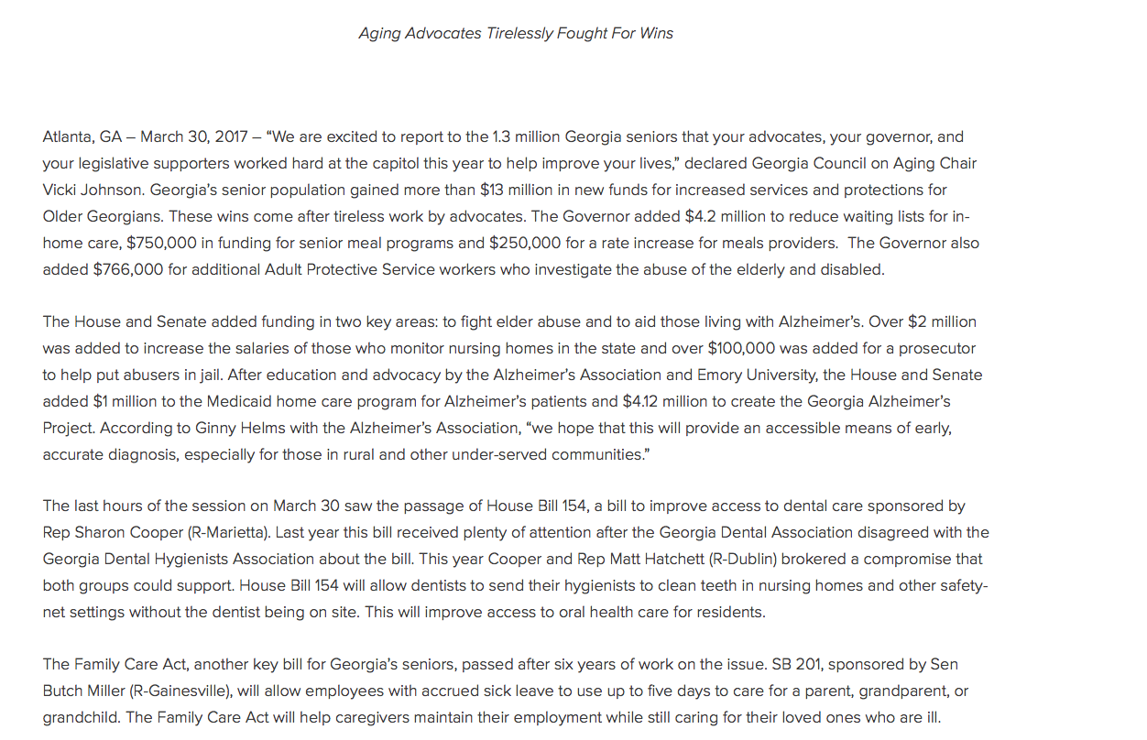

Slide 19
Barriers to Expanding IMCC-alike Clinics
Georgia Alzheimer’s Project = EXCELLENT First Step
  Diagnostic work-up for people concerned about memory loss and thinking problems
IMCC sites would be appropriate NEXT Step
  For care of those living with the disease
What will stop Georgia from creating this comprehensive approach?
  Requirements of collaborative practice agreements
  Inability to order radiologic testing
  Inability to prescribe full-scope
  Lack of recognition of APRNs as Primary Care Providers

Slide 20
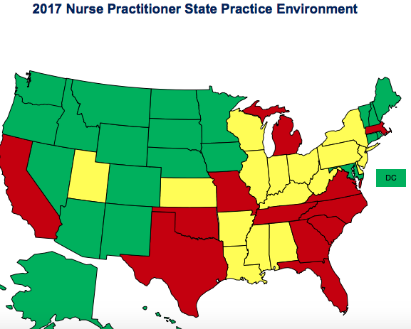
Overview:
States with Most APRN Barriers at a Glance
Red States are Restricted Practice Environment States….
Illinois #24 state with FPA Sept 19,2017
Source: https://www.aanp.org/images
/documents/state-leg-reg/stateregulatorymap.pdf

Slide 21
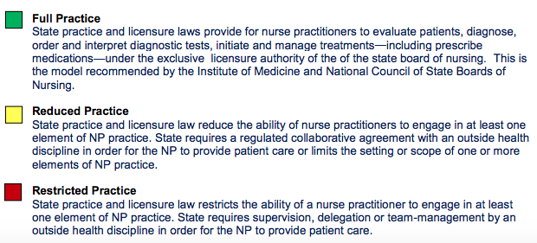
APRN State Practice Environment Legend

Slide 22
Georgia APRNs can help improve both Access to Care and Health Outcomes in GA ...if barriers to practice are removed

Slide 23
So what Barriers are preventing APRNs from opening new innovative practices to provide needed Healthcare to Georgians?

Slide 24

Barrier # 1: Georgia’s
Nurse Practice Act is Outdated
BON does not not grant APRN
License, but instead
“authorized practice as APRN”
BON does not not have sole Oversight over APRN practice
Nursing Practice is currently being Regulated by an outside Health Discipline (Through Supervising MD, NPA must be filed with Georgia Composite Board of Medicine)

Slide 25
Barrier # 2: The State of Georgia
Mandates Physician Supervision of APRNs for APRNs to provide care
Utilizing voluntary physician/APRN collaboration for physician/APRN Coordinated Care is the national trend that is increasing APRNs ability to practice in areas with significant physician shortages

Slide 26
Barrier # 3: Illegal for an APRN to Hire a Physician to enter into Nurse Protocol Agreement In Georgia
When APRN Rx Authority was gained in 2006 (Schedule II—V) the legislation included language that made it illegal for an APRN to hire a Physician to enter a Nurse Protocol Agreement.
SB 480: Sec 9, lines 21-25
"unlawful for APRN to hire a MD“
Link to Rx Authority Legislation: http://www.legis.ga.gov/Legislation/20052006/64077.pdf
Note: If legalized, in underserved areas, with severe shortages of Healthcare Providers finding a physician to hire to satisfy NPA requirement for Rx Authority, would still be problematic

Slide 27
What is keeping APRNs from functioning fully in their current practice settings?

Slide 28
Barrier # 4: Georgia APRNs
Lack Legal Authority to order Schedule II Drugs

Slide 29
Schedule II Drug
APRN Barrier Stories
“I prescribe minimal amounts of schedule II drugs; however, for the patients that require these agents it is very challenging. Our team tries to plan ahead and a have signed Rx for patients to receive at their appointment but unexpected changes can occur. I practice autonomously and many times there is not a physician around to sign the Rx. This increases the time the patient must wait at the clinic until I can track down someone to sign the Rx. The current law wastes a lot of the APRN’s and patient’s time.”

Slide 30
Schedule II Drug APRN Barrier Stories
“As a Neonatal Nurse Practitioner, not being able to prescribe schedule II Drugs can be an issue- I have to alert my attending that I am ordering a Schedule II and they have to cosign the order before it is released to Pharmacy for filling. They hate having to be woken up at 2am when I’m placing a chest tube or starting a baby on Morphine or Methadone for NAS (Neonatal Abstinence Syndrome)… and it does delay care."

Slide 31
Barrier # 5: Georgia APRNs
Radiology Ordering Restrictions
The Problem: Georgia is the only state in the United States that has a statutory restriction specific to radiographic imaging tests.
The Remedy: Amend O.C.G.A. 43-26-3 by removing the words “or in life threatening situations” from the statute related to radiologic imaging exams.

Slide 32
More on APRN
Radiology Ordering Restrictions
No safety, quality or cost data was found to support the “in life threatening emergencies” restriction of APRN ordering this singular medical act.
There have been unintended negative consequences due to this restriction.
There is no evidence from other states to support the contention that removing Georgia’s statutory restriction would result in increased costs, inappropriate utilization of resources or increased liability to either the physician or radiologist.

Slide 33
Radiology
APRN Barrier Stories
“I can avoid a visit to the emergency department for an older person who experienced a fall and now has symptoms that indicate a head CT is needed. I could send patients directly to radiology for the scan and get a fast response by radiologist except that I first have to find a physician to sign the order. When I can find a physician for this (interrupting their own patients’ visits), I can keep someone with dementia out of the overwhelming and confusing environment of the ED.”

Slide 34
Radiology
APRN Barrier Stories
“the regulation on imaging is my biggest barrier to practice. Many of my patients will have some type of imaging. When imaging results are complete they are sent to the ordering physician instead of the provider of record. This creates delays in diagnosis and is frustrating to patients. PAMA was passed by Congress in 2014 and is planned to go into effect in 2018. This mandates that all advanced imaging studies include clinical decision support. With this going into effect I am not sure the imaging regulations are relevant. “

Slide 35
Protecting Access to Medicare Act of 2014 PAMA)
Mandate requiring a qualified clinical decision support mechanism (qCDSM)
PAMA mandates that starting January 1, 2017, physicians ordering advanced diagnostic imaging exams (CT, MRI, nuclear medicine and PET) must consult government- approved, evidence-based appropriate-use criteria, namely through a CDS system. Physicians furnishing advanced imaging services will only be paid if claims for reimbursement confirm that the appropriate-use criteria was consulted, which CDS mechanism was used, and whether the exam ordered adhered or did not adhere to an acceptable CDS rating. It’s important to note that physicians ordering advanced diagnostic imaging services do not have to adhere to the appropriate-use criteria; however, they must confirm that the guidelines have been consulted.
Source: http://www.radiologybusiness.com/topics/policy/clinical-decision-support-mandate-now-what

Slide 36
Barrier # 6: Reimbursement Issues/Institutional Barriers
Private Insurers in Georgia are not directly credentialling APRNs (not including APRNs on provider panels within the networks)This makes opening an APRN owned or directed practice very difficult.
While Medicaid and Medicare do recognize APRNs as providers of record, their reimbursement rate for the same service is 80% of the physician rate.
Healthcare facilities not granting privileges to APRNs is very problematic for APRNs that practice in hospital settings

Slide 37
Barrier # 6: Reimbursement Issues/Institutional Barriers
Remedy: Support the enactment and enforcement of insurance laws for direct credentialing and reimbursement of nurse practitioners, ensuring that reimbursement rates promote sustainable practice, and including APRNs in network directories.
As states experiment and deploy new models of care delivery and reimbursement, policy decisions must include NPs as primary care providers and leaders of Accountable Care Organizations, Patient-Centered Medical Homes, and other coordinated care initiatives.
Additionally, full and open participation for NPs in value-based payment models and telehealth will be critical as the health care system shifts to promoting quality outcomes of care over volume and enhanced accessibility to health care services.
State policies that ensure fair, competitive and level playing fields that support patient choice in providers, network adequacy, meaningful reporting measures and sustainability.
Source: https://www.aanp.org/images/documents/state-leg-reg/State%20Policy%20Priorities.pdf

Slide 38
Barrier # 7: Lack of APRN Signature Recognition & use of Provider-Inclusive Language in Legislation
Inefficiencies occur when NPs are unable to “treat the paperwork”
This was addressed in one instance in the last 2017 legislative session where APRNs were given recognition to pronounce patient’s dead in Nursing Home facilities (SB 96). Specifically codifies that an NP may sign death certificates in select settings when deceased is an organ donor.
Remedy: Georgia Legislators recognize the signature of APRNs on forms for care that is within the NP’s scope of practice, and commit to using provider-inclusive/provider-neutral language in future policies whenever appropriate to prevent further barrier issues in the realm of signature recognition.

Slide 39
The Future is full of Possibilities and Innovations for Healthcare in GA when All Providers can Practice to the fullest extend of their Education, Training, and Certification

Slide 40
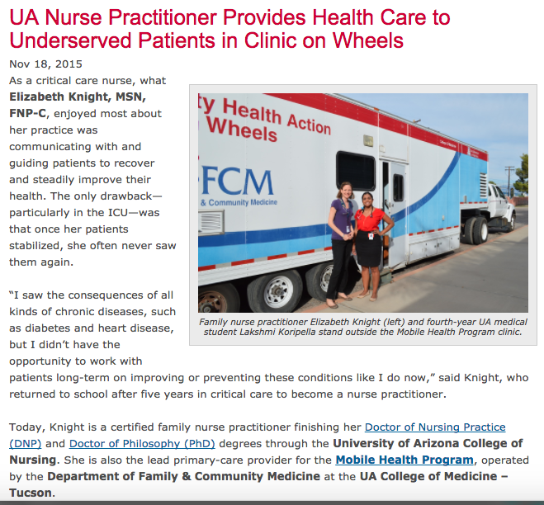
Notes:
Source: https://www.google.com/search?rlz=1C5CHFA_enUS709US709&biw=1186&bih=635&tbm=isch&sa=1&q=Nurse+Practitioner+clinics&oq=Nurse+Practitioner+clinics&gs_l=psy-ab.3..0i24k1l5.39936.45989.0.47012.22.20.2.0.0.0.71.1057.20.20.0....0...1.1.64.psy-ab..0.19.922...0j0i8i30k1j0i67k1j0i30k1j0i5i30k1j0i13k1.0.x6E-d8k0hg8#imgrc=a8EzgbvP2tY4WM:

Slide 41
Third Street Family Health Services’ new OB/GYN physician, Dr. Nativa Modi, will be accompanied
by a nurse practitioner to provide care within the mobile unit. In addition, OhioHealth will provide lab services.

Slide 42
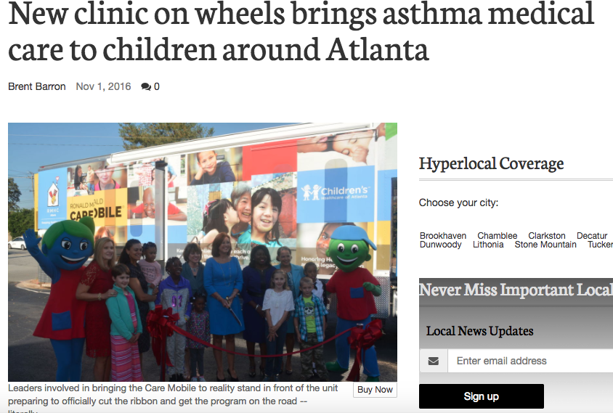
“The Care Mobile will break many of the barriers to effective asthma care [...] to deliver critically-needed care.”
The Atlanta mobile is part of the Ronald McDonald House Charities’ core programming in collaboration with Children’s Healthcare of Atlanta at Hughes Spalding.
The staff will include a nurse practitioner, registered nurse, licensed practical nurse and mobile outreach technician,
Source: http://www.mdjonline.com/neighbor_newspapers/dekalb/new-clinic-on-wheels-brings
-asthma-medical-care-to-children/article_9356c982-a03c-11e6-95d6-9f3c2b18684c.html

Slide 43
Thank you!
Slides prepared in conjunction with Georgia Coalition of Advanced Practiced Registered Nurses
*

