Slide 1
Jimmy Lewis
CEO - HomeTown Health, LLC

Slide 2
Who is Jimmy Lewis?
A native to Cordele, Georgia, Jimmy Lewis has roots in rural south Georgia and a passion for rural issues that has only continued to grow over the years. After high school, he attended Middle Georgia College and then Auburn University where he received a Bachelor’s Degree in Industrial Engineering. Jimmy has held senior management positions in six fortune five hundred companies, received many professional and civic awards, and is often quoted in trade journals, state and national newspapers, as well as magazines. He currently serves as a governor’s appointee to Governor Deal’s Rural Hospital Stabilization Committee. Jimmy and his wife, June, currently live in Cumming, Georgia.

Slide 3
Major Question #1
What is the number one reason for rural hospital failure?
Notes:
Short list of what is to be covered. Tailor this slide content to each presentation. Tailor speaker notes to each presentation.

Slide 4
Major Question #2
What, if anything, can the State do to help rural hospitals?
Notes:
Short list of what is to be covered. Tailor this slide content to each presentation. Tailor speaker notes to each presentation.

Slide 5
Major Question #3
What do successful rural hospitals do that can be used elsewhere?
Notes:
Short list of what is to be covered. Tailor this slide content to each presentation. Tailor speaker notes to each presentation.

Slide 6
Rural Hospitals Overwhelmed by the numbers
40,000 Population
Notes:
Short list of what is to be covered. Tailor this slide content to each presentation. Tailor speaker notes to each presentation.

Slide 7
Rural Hospitals Overwhelmed by the numbers
$103,000
Annual Net Revenue per FTE
Notes:
Short list of what is to be covered. Tailor this slide content to each presentation. Tailor speaker notes to each presentation.

Slide 8
Rural Hospitals Overwhelmed by the numbers
SB180
Tax Credit Bill
Notes:
Short list of what is to be covered. Tailor this slide content to each presentation. Tailor speaker notes to each presentation.

Slide 9
Rural Hospitals Overwhelmed by the numbers
49 Most Needy
DCH list for SB 180 Tax Credit eligible hospitals
Notes:
Short list of what is to be covered. Tailor this slide content to each presentation. Tailor speaker notes to each presentation.

Slide 10
Rural Hospitals Overwhelmed by the numbers
85.6% of cost
Notes:
Short list of what is to be covered. Tailor this slide content to each presentation. Tailor speaker notes to each presentation.

Slide 11
Rural Hospitals Overwhelmed by the numbers
15-20% self-pay
Notes:
Short list of what is to be covered. Tailor this slide content to each presentation. Tailor speaker notes to each presentation.

Slide 12
Rural Hospitals Overwhelmed by the numbers
2%-5% Denials
Notes:
Short list of what is to be covered. Tailor this slide content to each presentation. Tailor speaker notes to each presentation.

Slide 13
Rural Hospitals Overwhelmed by the numbers
42
Payor Platforms
Notes:
Short list of what is to be covered. Tailor this slide content to each presentation. Tailor speaker notes to each presentation.

Slide 14
Rural Hospitals Overwhelmed by the numbers
95% NonEmergent
5%
Emergency
Notes:
Short list of what is to be covered. Tailor this slide content to each presentation. Tailor speaker notes to each presentation.

Slide 15
Rural Hospitals Overwhelmed by the numbers
1100 Ambulances with Wi-Fi
Notes:
Short list of what is to be covered. Tailor this slide content to each presentation. Tailor speaker notes to each presentation.

Slide 16
Rural Hospitals Overwhelmed by the numbers
108
Schools with Telemedicine, and growing!
Notes:
Short list of what is to be covered. Tailor this slide content to each presentation. Tailor speaker notes to each presentation.

Slide 17
Rural Hospitals Overwhelmed by the numbers
8
Rural hospitals closed in last five years
Notes:
Short list of what is to be covered. Tailor this slide content to each presentation. Tailor speaker notes to each presentation.

Slide 18
Rural Hospitals Overwhelmed by the numbers
25%
Rural hospitals projected to close or downsize in 10 years
Notes:
Short list of what is to be covered. Tailor this slide content to each presentation. Tailor speaker notes to each presentation.

Slide 19
Rural Hospitals Overwhelmed by the numbers
30 or so rural hospitals closed OB in last five years/Pat Coda
Notes:
Short list of what is to be covered. Tailor this slide content to each presentation. Tailor speaker notes to each presentation.

Slide 20
Rural Hospitals Overwhelmed by the numbers
$2.5 - $4.0 Million Annual Loss
Payor mix driven loss
Notes:
Short list of what is to be covered. Tailor this slide content to each presentation. Tailor speaker notes to each presentation.

Slide 21
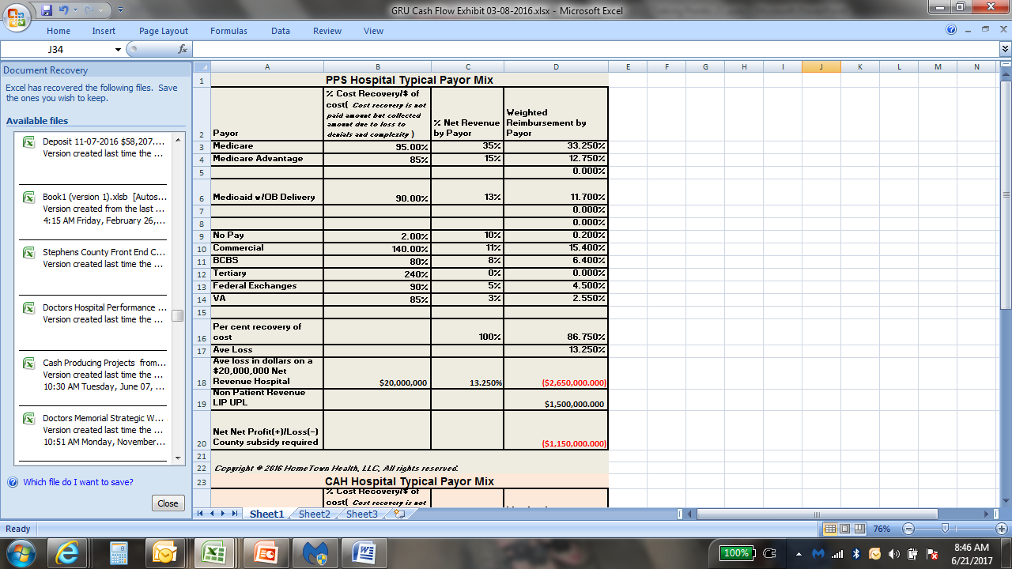
Major Rural Hospital Financial PPS Payor Mix
Notes:
Short list of what is to be covered. Tailor this slide content to each presentation. Tailor speaker notes to each presentation.

Slide 22
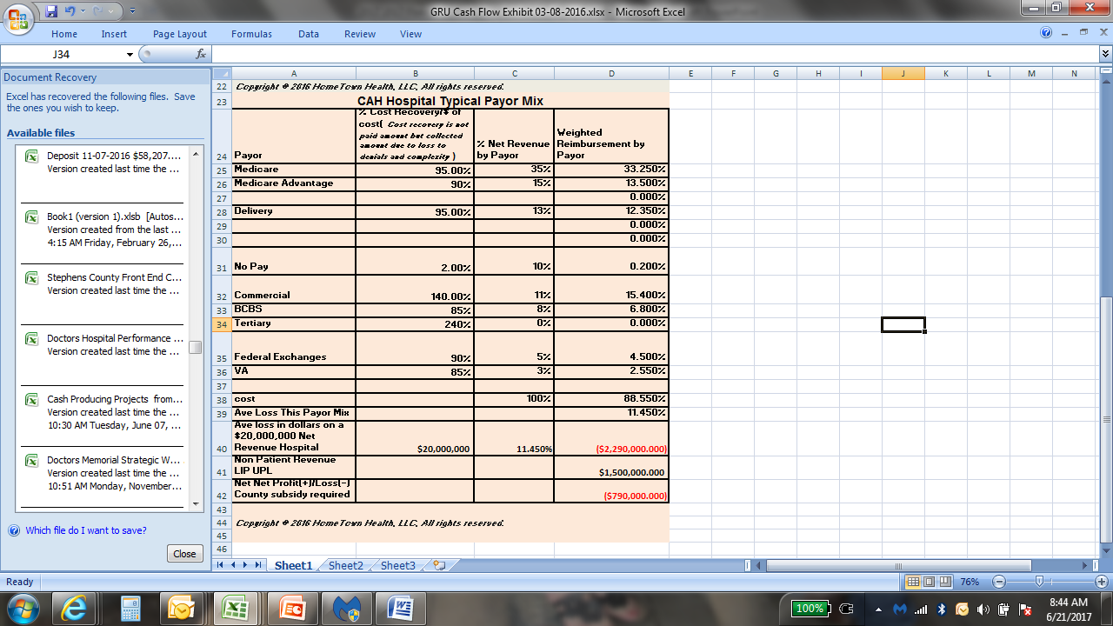
Major Rural Hospital Financial CAH Payor Mix
Notes:
Short list of what is to be covered. Tailor this slide content to each presentation. Tailor speaker notes to each presentation.

Slide 23
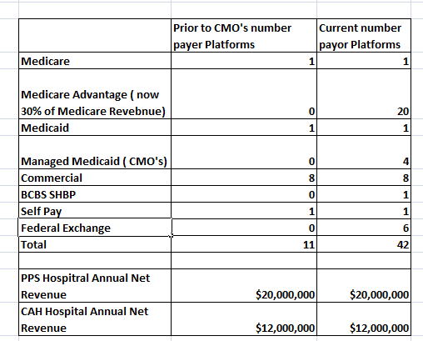
Major Rural Hospital Financial Payor Mix Erosion Due to Payor Platforms
Notes:
Short list of what is to be covered. Tailor this slide content to each presentation. Tailor speaker notes to each presentation.

Slide 24
Rural Hospitals Overwhelmed by the numbers
Cost to charge ratio – the Federal efficiency penalty
  What?
  Why?
  When?
  Where?
  How it can kill a rural hospital
  Interim Cost Report a must
  Oops
    Chargemaster
    Major expense control
    Major Revenue increase
Notes:
Short list of what is to be covered. Tailor this slide content to each presentation. Tailor speaker notes to each presentation.

Slide 25
Future of Georgia Healthcare
    Urbanization
      60% annualized Hospital net revenues in five Atlanta systems – policy control
      75% Atlanta plus HCA
    Federalization
      cut $880 billion when Georgia at bottom of payment ladder nationally
    HCA - Expansion Southeast Ga. Corridor – CON control
      Doctors Augusta Burn Unit
      Northside Macon
      Coliseum Macon
      Fairview Park
      Memorial Savannah
      Waycross
      Jacksonville Tertiary

Slide 26
Future of Georgia Healthcare
    No stand alone ED’s except HCA types in urban areas
    Maximize use of technology
      Telemedicine
      Tele-monitoring
    Consolidation – Piedmont/Columbus/Athens, HCA
    Additional hospital closures
    Simple loss of access
    Better ambulances as rolling hospitals with EMS
    Better placement and use of helicopters
    Acuity index for providers
    Loss of DSH?????
    Urgent Care centers
    Expanded use of PA’s and mid levels
    Maximize use of current access points that do not talk to each other

Slide 27
Future of Georgia’s Healthcare
    Competition
    Insurer Narrow Networks
    HCA Expansion
    Talent Shortage
    Must Expand Diversification
    Pick Right Tertiary to Partner
    Implement Stabilization Committee Findings
    Manage Payor Mix

Slide 28
Major Question #1
What is the number one reason for rural hospital failure?
There are three!
  Medicaid underpayment at 85.6% of cost since 1999
  Self Pay uninsured 17%-20%
  EMTALA
Notes:
Short list of what is to be covered. Tailor this slide content to each presentation. Tailor speaker notes to each presentation.

Slide 29
Major Question #2
What, if anything, can the State do to help rural hospitals?
  Pay Medicaid at cost
  Pay Telemedicine at Market rates to cover telemedicine as a coverage for physician shortage
  Expand scope of PA’s, Nurse Practitioners., and other mid-levels and pharmacists to offset physician shortage
  Standardize CMO Input Portal
Notes:
Short list of what is to be covered. Tailor this slide content to each presentation. Tailor speaker notes to each presentation.

Slide 30
Major Question #3
What do successful rural hospitals do that can be used elsewhere?
  Diversify
  Have a service area of 40,000 population
  Embrace change with educated staff and boards
  Have C-Suite continuity beyond the 40% turnover over last five years
  Enforce industry benchmarks, e.g., $103,000 annual net revenue/FTE
  Implement Telemedicine
Notes:
Short list of what is to be covered. Tailor this slide content to each presentation. Tailor speaker notes to each presentation.

Slide 31

Reading that Defines Obamacare

Slide 32

Reading that Defines Obamacare

Slide 33
Copyright Notice
All rights reserved. No part of this publication-presentation, except book covers which may have their own restrictions, may be reproduced or transmitted in any form or by any means, electronic or mechanical including photocopy, recording, or any information storage and retrieval system, without permission in writing from the author.

Slide 34
Thank you!
    Questions?
    Jimmy Lewis
    770-363-7453
    theleadershipgrp@mindspring.com

