Slide 1

Tourism &
Rural Georgia
Senate Rural Georgia Study Committee
Wednesday, August 9

Slide 2



Slide 3
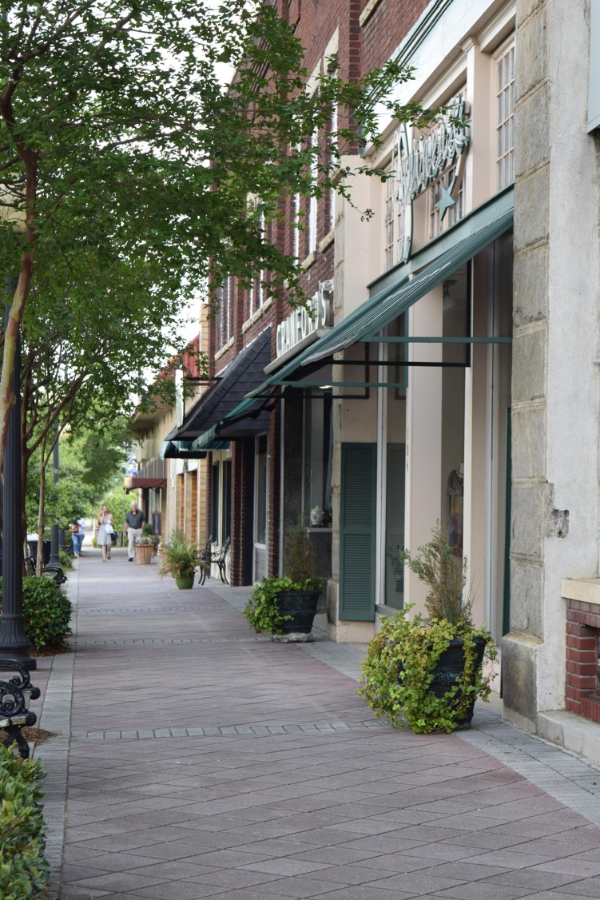


Slide 4


Slide 5



Slide 6
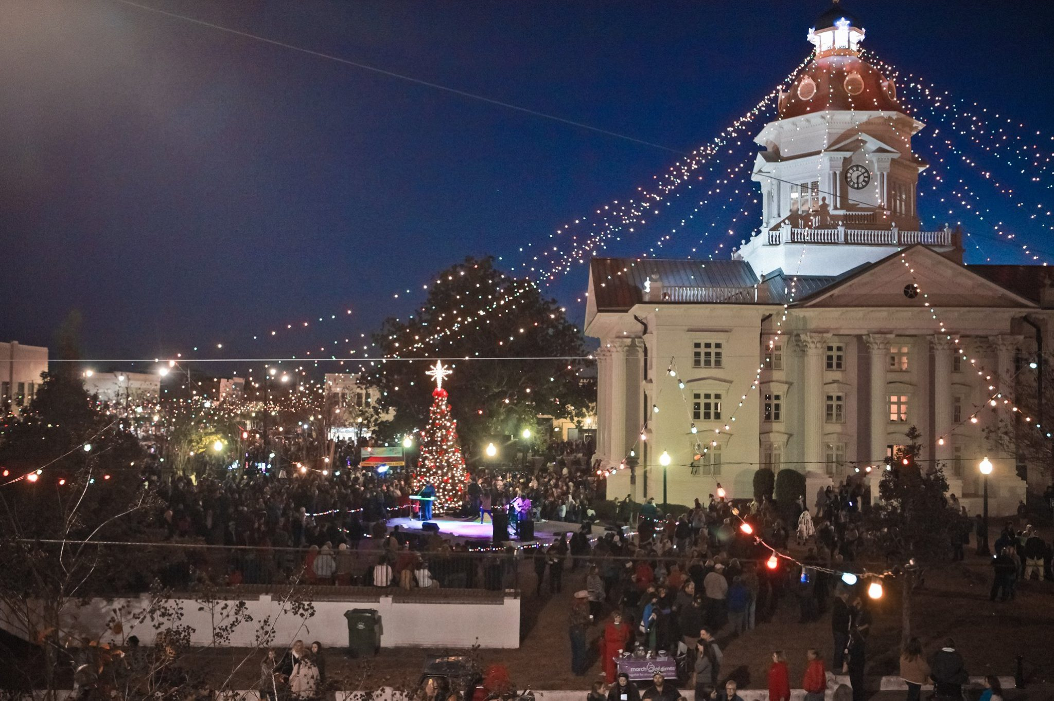

Slide 7


Slide 8
Georgia Tourism 2016
$61.1 billion economic impact
105 million visitors
$3.2 billion in state and local taxes
Estimated 450,000 jobs

Slide 9


GEORGIA TOURISM
Research, Marketing &
Advertising

Slide 10

Visitor Information Centers

Slide 11



Publications

Slide 12
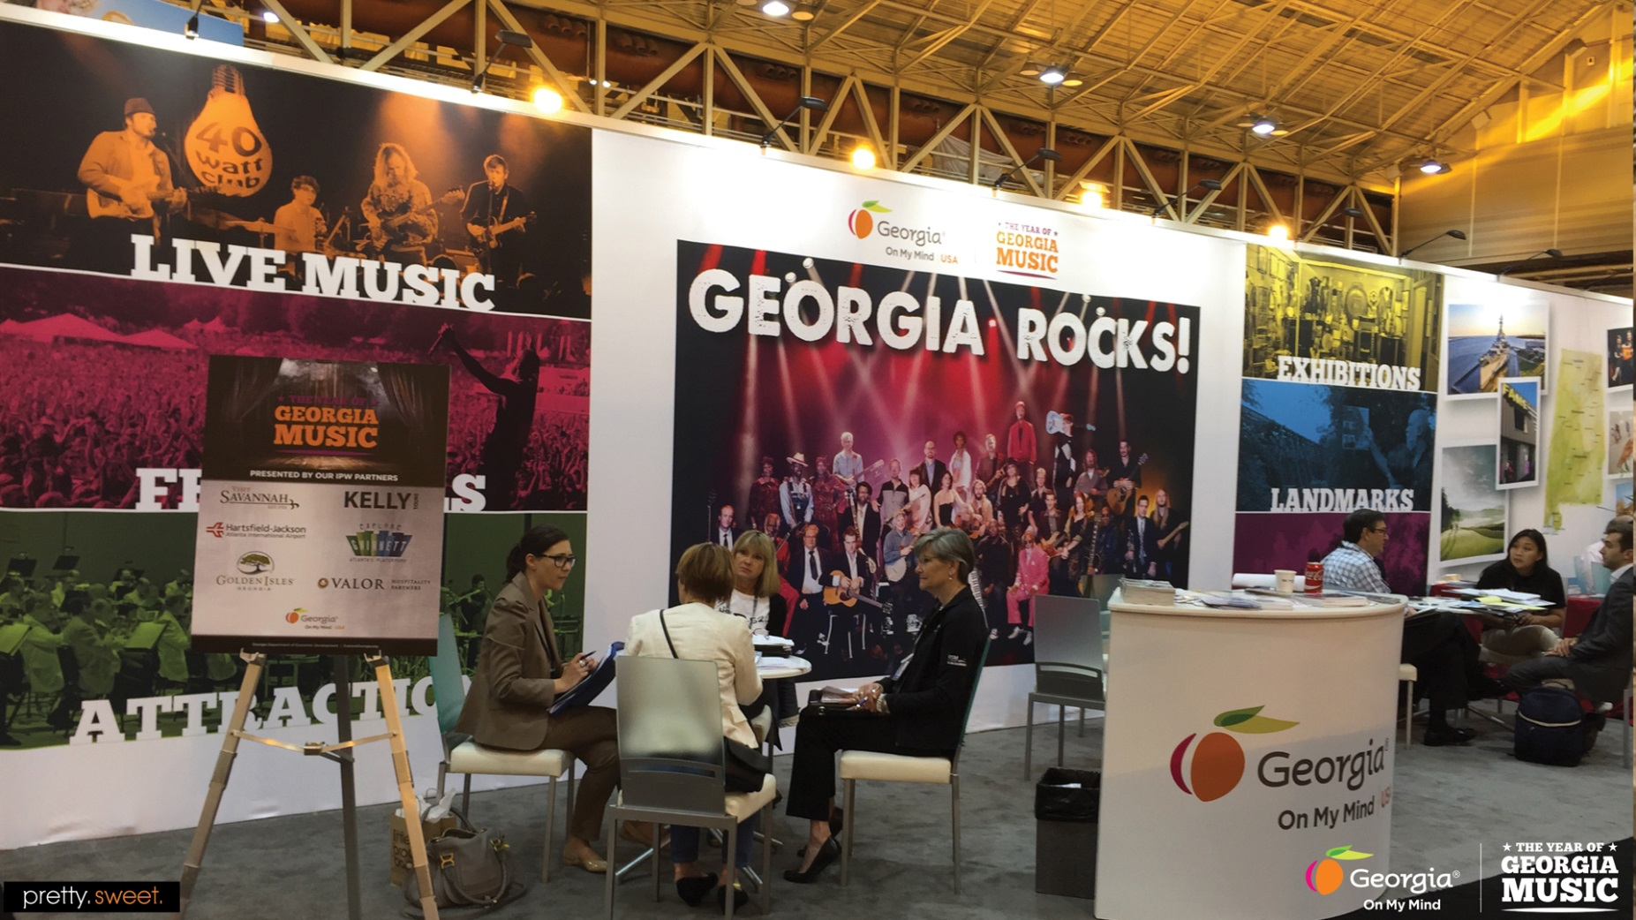
Domestic & International Sales

Slide 13
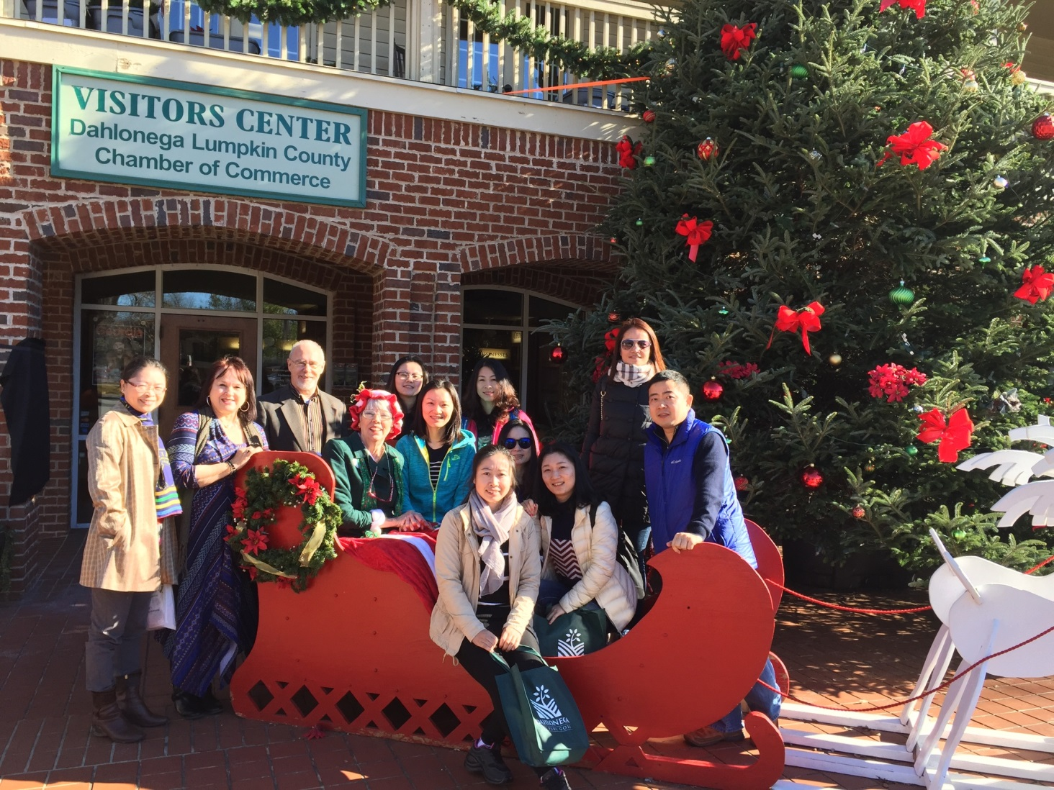
FAM Tours for Media & Tour Operators

Slide 14
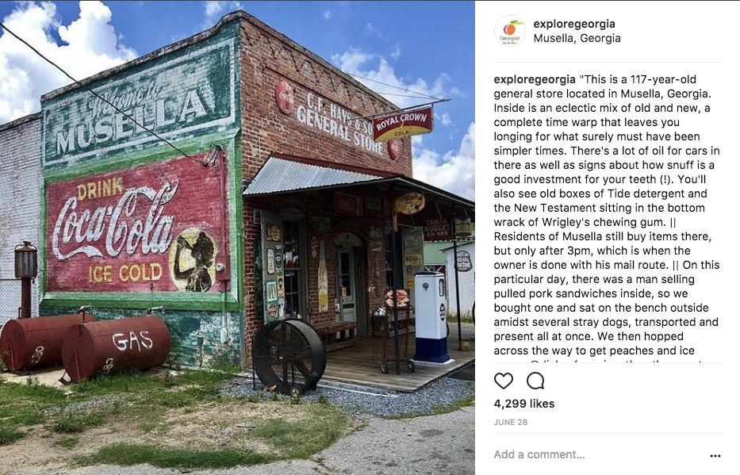
Digital and Social Media

Slide 15
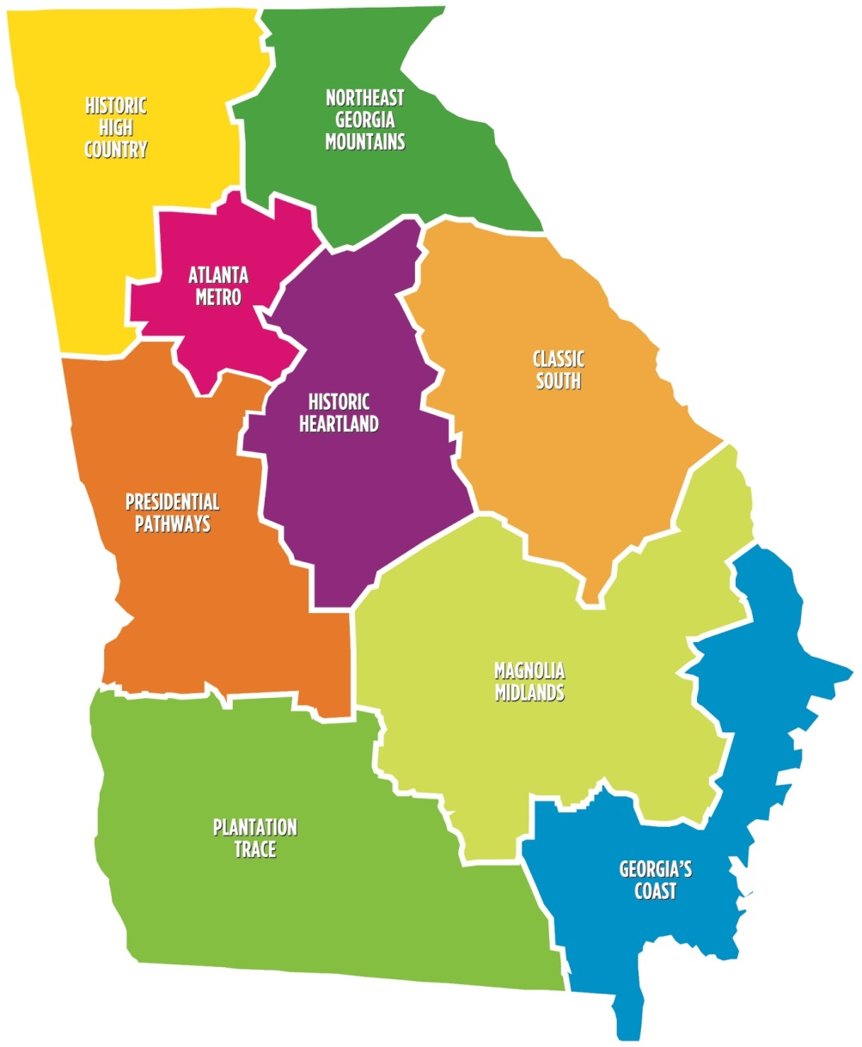

Slide 16
Tourism Project Managers
Serve as liaison between regions and GDEcD
Manage FAM tours & assist with media
Assist with tourism product development
Support Regional Travel Associations

Slide 17
Tourism Product Development
Technical assistance via Resource Teams
Financial assistance via Grants
Ongoing Product Development support

Slide 18
Tourism Product Development Resource Teams
Areas of Focus:
Heritage & Cultural
Historic Preservation
Downtown Development
The Arts
Agritourism
Lodging
Recreation & Eco Tourism
Media & Interpretation
Marketing
Team Partners:
The GA Council for the Arts
GDEcD: Global & Tourism
DCA
Georgia Power
GEMC
Private Sector
Regional Commissions
UGA Carl Vinson Institute
GA Department of Agriculture
GA Department of Natural Resources
Historic Preservation Division
Governor’s Office

Slide 19
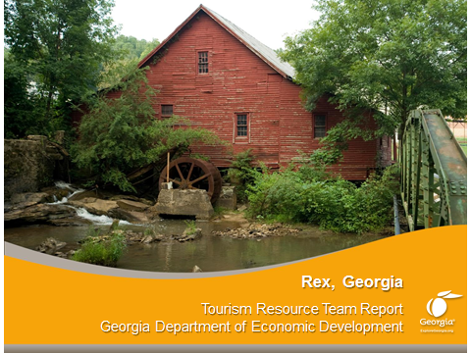
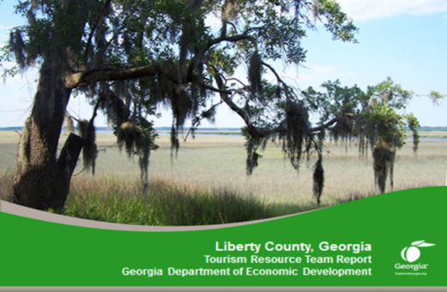
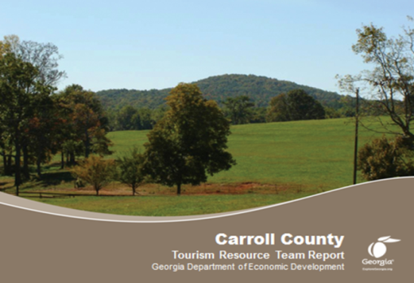

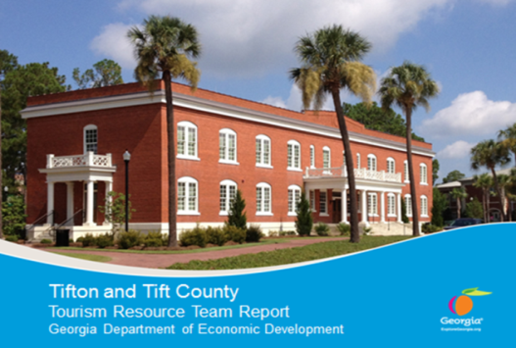
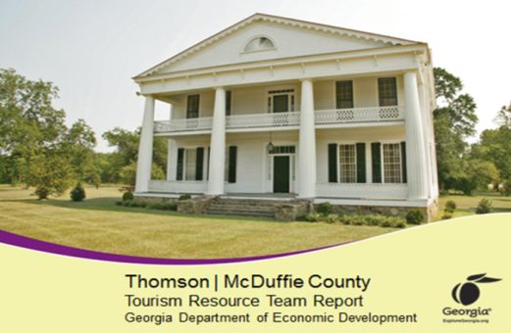
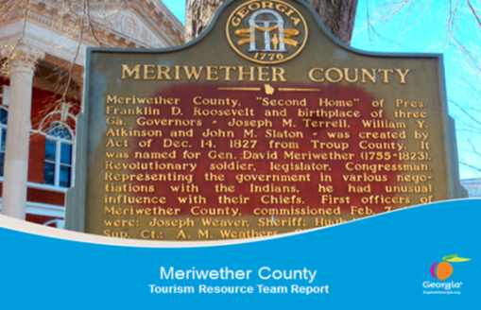

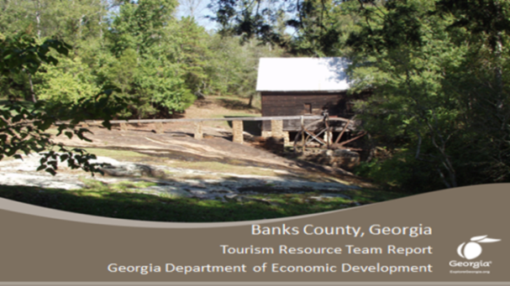
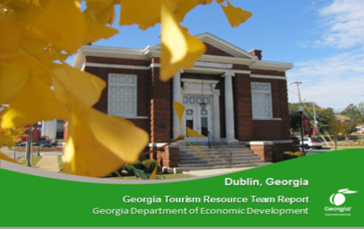

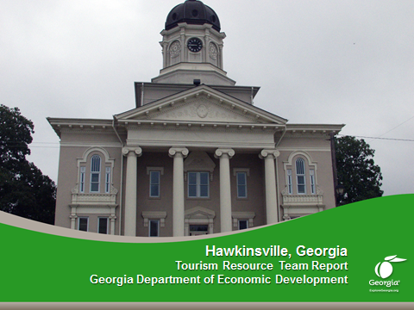
Completed TPD Resource Teams Include:

Slide 20

TPD Resource Team Grant Recipient:
App to hear stories about the Agricultural History of Pike County.

Slide 21
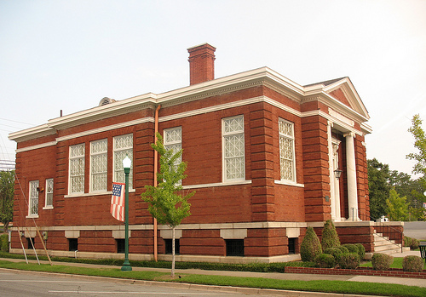
TPD Resource Team Grant Recipient:
Restoration of Historic Carnegie Library for Event Space

Slide 22


Slide 23
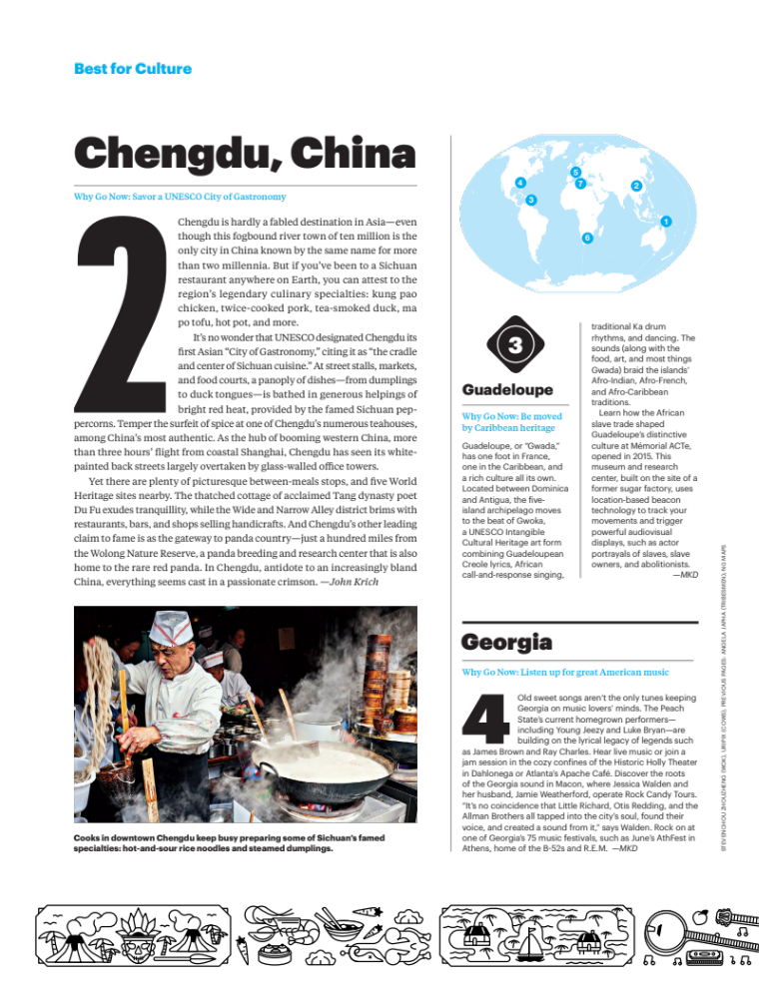
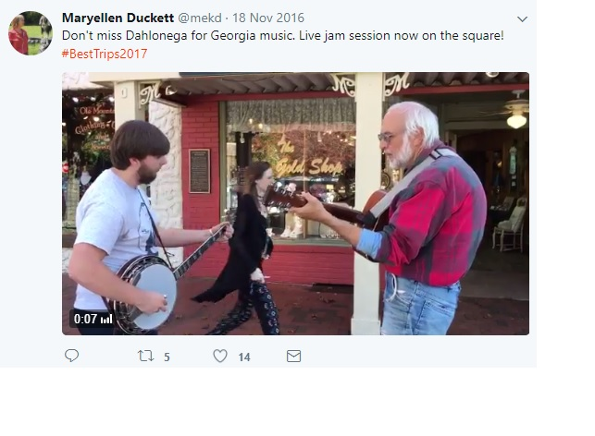

Slide 24

THANK YOU.

