Slide 1

How Expanding Legislation Regarding
Cannabis for Medical Use
Puts Georgia’s Toddlers, Children and Adults
At Risk
Gregg Raduka, Ph.D., LPC, ICPS
  Executive Director/CEO
  August 29, 2018

Slide 2


Slide 3
What is Let’s Get Clear Georgia?
What We Do
Our advocacy efforts focus on protecting all of Georgia’s children, teens, adults, communities and workplaces, and empowering them to protect themselves from the destructive effects of any form of marijuana lacking the approval of reputable medical associations.
Our Mission
To promote advocacy and other collaborative efforts using best practices and policies to prevent the expansion of “medical” marijuana legalization lacking the approval of established medical associations as well as to prevent recreational legalization in Georgia.

Slide 4

Numerous people are saying their or their child’s medical condition has been helped greatly by taking cannabis oil.
Let’s Be Clear Georgia applauds the sincere, heartfelt efforts of all those who are trying to find solutions to suffering due to serious medical conditions.

Slide 5

But there is an untold side of the story that involves great tragedy and suffering
for many more thousands of Georgians . . .
Pre-Teens, Teenagers, Young Adults, and Adults who are addicted to THC . . .

Slide 6
How Does This Relate to Access?
The costs of increasing access via in-state cultivation and manufacturing, as well as their regulation
will have to be financed by increased demand and use, putting more Georgian’s in harm’s way
from the harmful effects of THC.

Slide 7
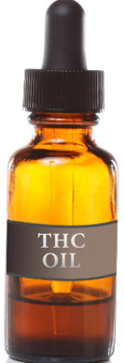
5% THC Oil is Much Stronger than Most People Realize
5% THC Oil contains about 5 grams of THC in 100 milliliters of oil.
4 drops (from a standard medicine dropper) of 5% THC oil contain approximately 10 mg of THC.

Slide 8

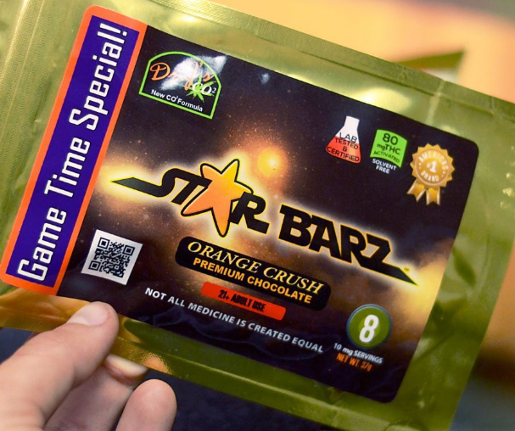
4 Drops of 5% Oil =
10 milligrams of THC
=1 standardized serving of
an edible in Colorado

Slide 9
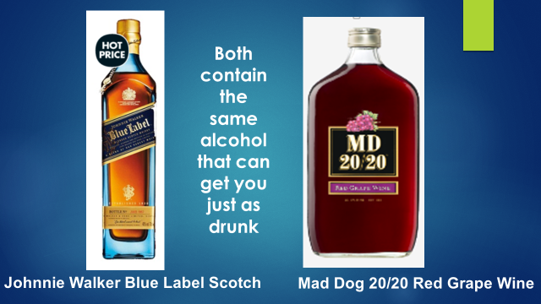
Just like alcohol is alcohol no matter what form it’s in,

Slide 10
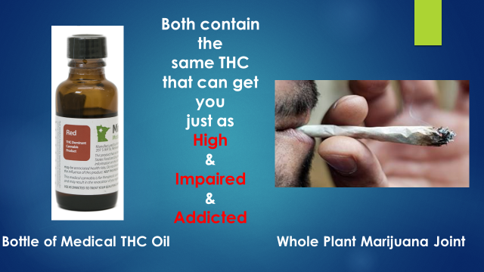
So THC is THC no matter whether you swallow it or smoke it:

Slide 11

4 drops of 5% THC oil contains 10 mg of THC
Especially someone who is a new user and has not built up a tolerance to THC can easily get intoxicated on 10 mg or 4 drops of 5% THC oil.

Slide 12
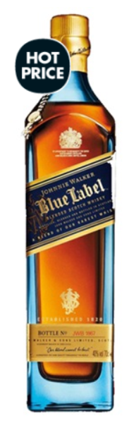
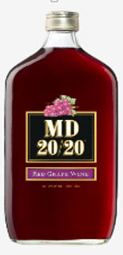
Both contain the
same alcohol
that can get you
just as drunk
Johnnie Walker Blue Label Scotch
Mad Dog 20/20 Red Grape Wine

Slide 13
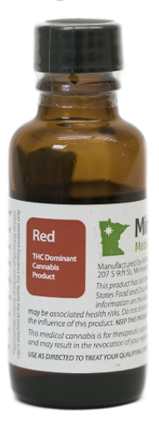
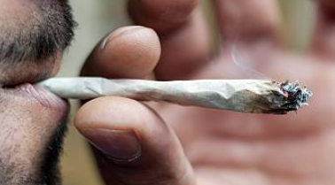
Both contain the
same THC
that can get you
just as
High
&
Impaired
&
Addicted
Bottle of Medical THC Oil
Whole Plant Marijuana Joint

Slide 14
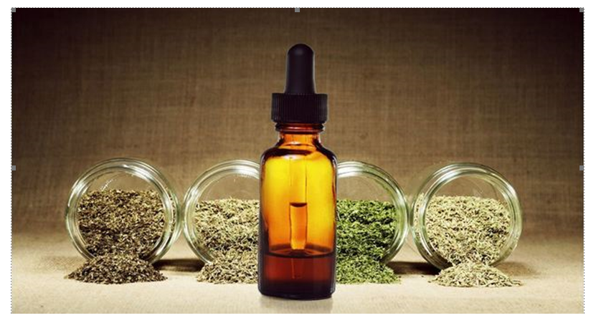
The major difference between medical THC Oil and recreational THC Oil is that medical marijuana oil has “medical marijuana” written on the label.

Slide 15
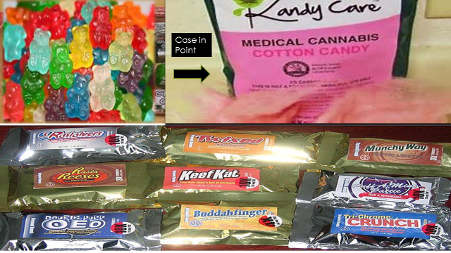
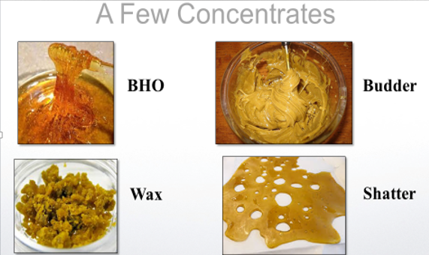
“Medical Cannabis” per HB 65, can mean just about anything

Slide 16
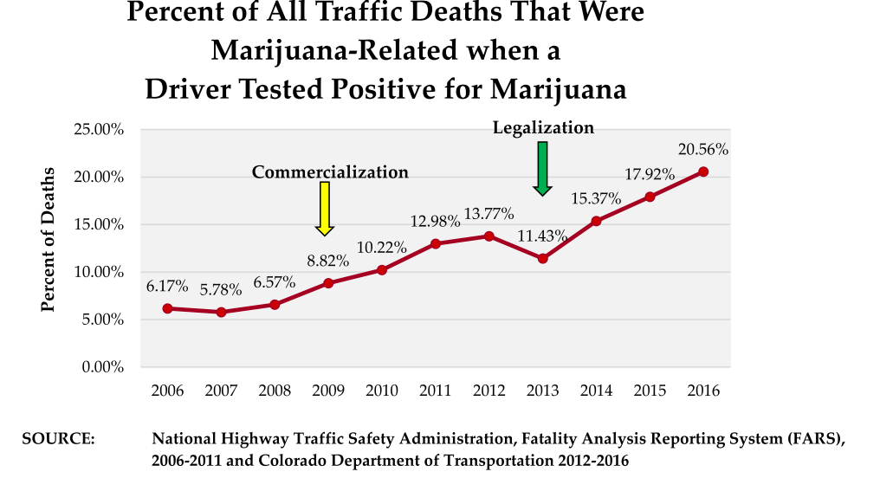

Slide 17
Broad Medical Legalization
Has Meant
De Facto Recreational Legalization
in other states
(just like they had legalized
Recreational Marijuana)

