Slide 1


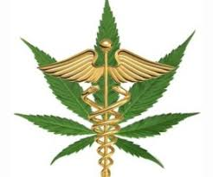
Retail Outlook

Slide 2
About us…
Muna Mashini – Founder/CEO
  Nutritionist
  Former Micro-Biologist
  20+ Years Experience
  EXPERTISE:
    Overall Health
    Preventative Nutrition
    Pain / Inflammation
    GI / Digestion
    Sleep / Stress
    Weight Loss
    Everything else you can imagine…
Anthony La Borde – Operations
  Engineering / Business
  NOT a Micro-Biologist
  5+ Years Experience
  EXPERTISE:
    Exercise Science
    Sports Nutrition
    Pain / Inflammation
    Weight Loss

Slide 3
Mission
To provide education, guidance and science-backed supplementation to health-conscious individuals in order to NOURISH the body so that it might be able to HEAL itself.
“A healer is not someone that you go to for healing. A healer is someone that triggers within you, your own ability to heal itself.”
~ Unknown

Slide 4
Introduction to CBD
Introduced in 2015 by CV Sciences – started with just a few SKUs
Averaged 8-10 units sold per month
Mid-late 2017, word of mouth continued to grow demand
Realizing this wasn’t just another fad, we begin educating ourselves via vendor training and research

Slide 5
What we discovered…
The ultimate, pure, all-natural, whole-body medicine capable of nourishing and healing with ZERO negative side effects.
The only medicine who’s main goal is to identify problems and fix them
  Constantly bringing the body into homeostasis – balance
Long-term science-backed data supporting the claims

Slide 6
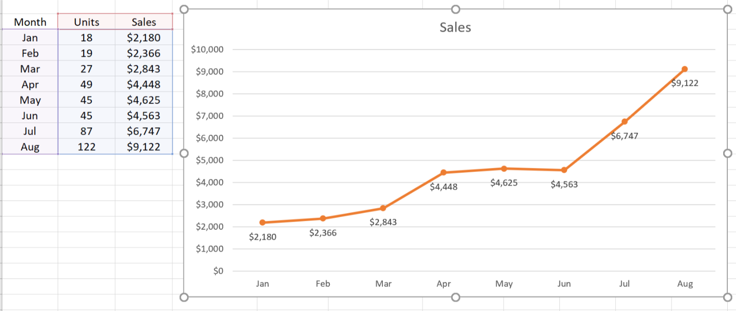
Hemp CBD Monthly Sales YTD

Slide 7
Criteria
Quality starts at sourcing
  Hemp is a “hyper-accumulator” – absorbs EVERYTHING
  Quality of soil / rich soil yields in a high quality plant and CBD oil
  Pesticide free / Herbicide free / Residual Solvent free
Vertical Integration – Full traceability from “Seed-to-Shelf”
  Traceable batches
Produced & packaged in FDA registered facility
  Strict regulations
CO2 Extracted – NO CHEMICALS!
  Chemical extraction leaves toxins – butane, propane and ethanol

Slide 8
Criteria
“Whole-Plant” or “Full Spectrum”
  Isolates are cheaper than whole plant extracts
  Ensures the oil contains CBD plus terpenes, flavonoids, and other cannabinoids
Members of essential trade organizations
  American Botanical Council
  National Hemp Association
  Organic and Natural Health Association
  American Herbal Products Association
  Hemp Round Table.
Effectiveness – testimonials
Customer Support
  webinars, on-going education, available EXPERTS
3rd Party Unbiased LAB TESTS!!!

Slide 9
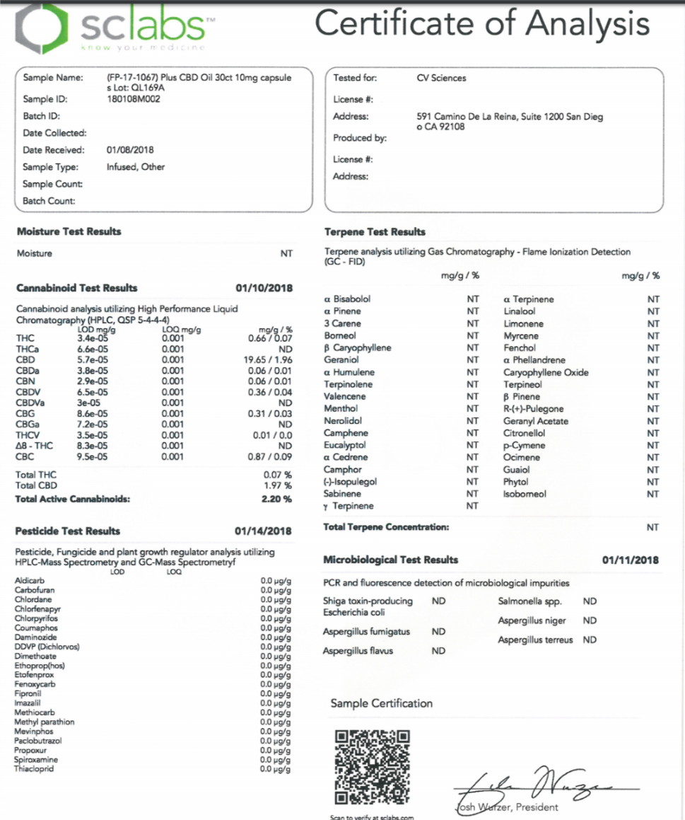
Terpene Analysis
Allows for the ability to provide an optimized hemp oil to maximize the desired therapeutic effect
Cannabinoid Profiling
Reveals the concentration of active cannabinoids for accurate dosage and to ensure quality
Pesticide Testing
Detects even trace amounts of chemical pesticides in hemp concentrates using advanced testing procedures
Microbiological Screening
Identifies if there are any microorganisms and harmful pathogens such as bacteria and fungi present in hemp
Residual Solvent Testing
Identifies the presence of harmful solvents, impurities and other added odorants and chemicals present

Slide 10
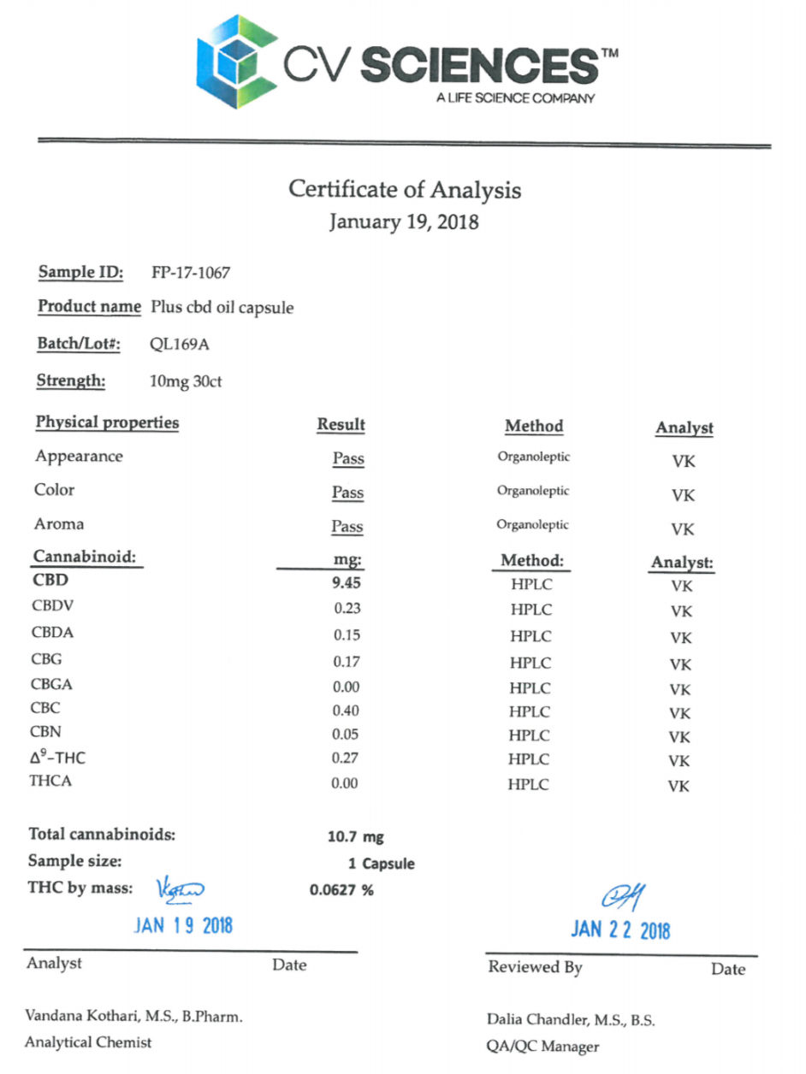
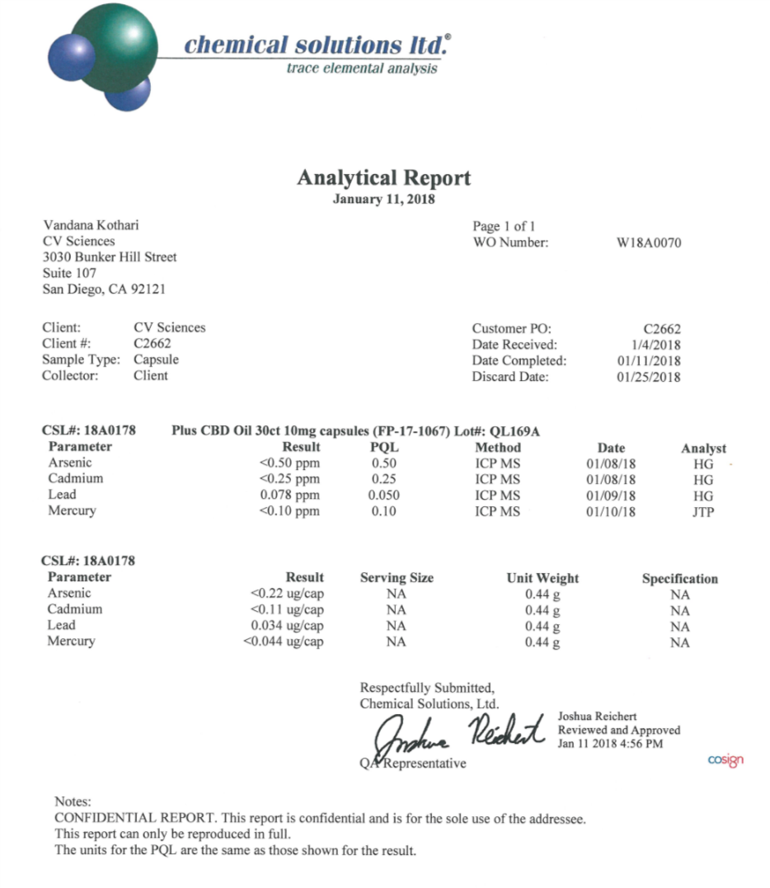
CV Sciences Lab Tests

Slide 11
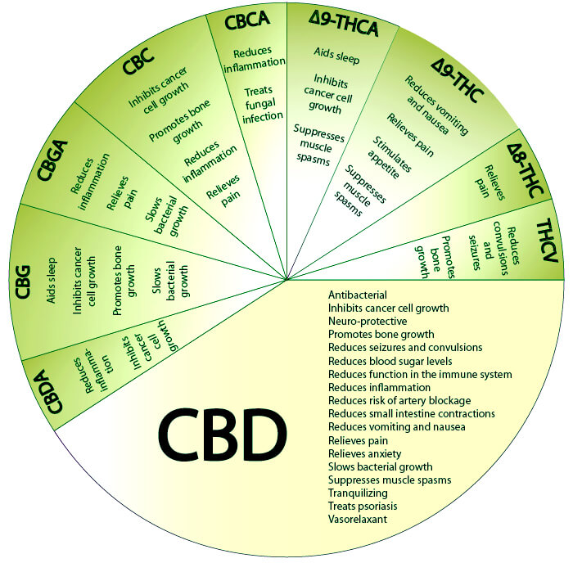
Benefits of
“Whole-Plant” or “Full-Spectrum”
Labeling

Slide 12
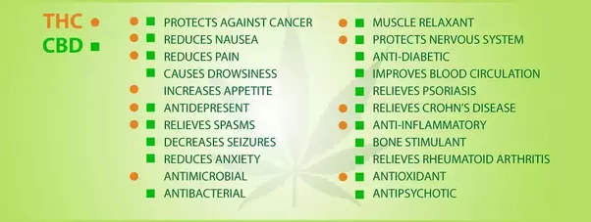
The Unity of CBD and THC

Slide 13



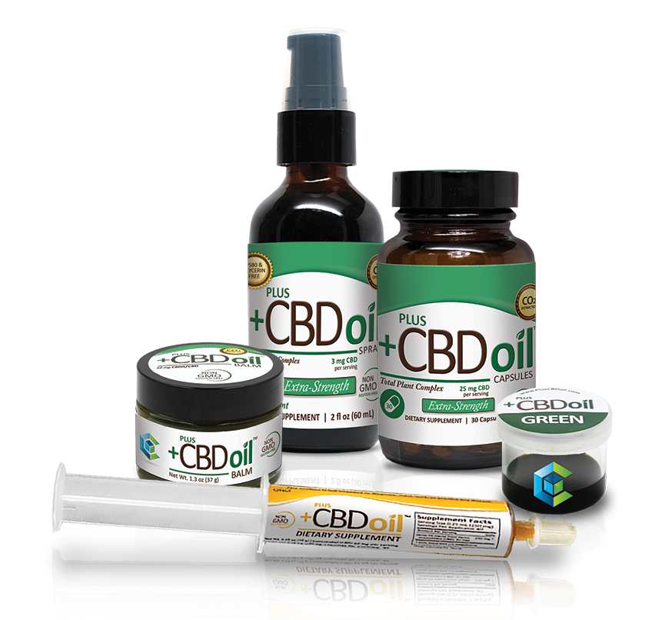
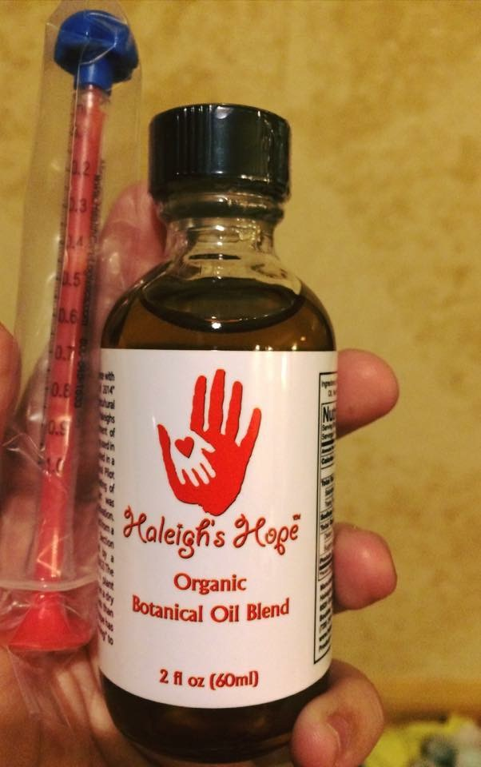
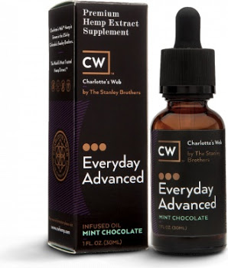
Brands we use
IN APPROVAL PROCESS

Slide 14
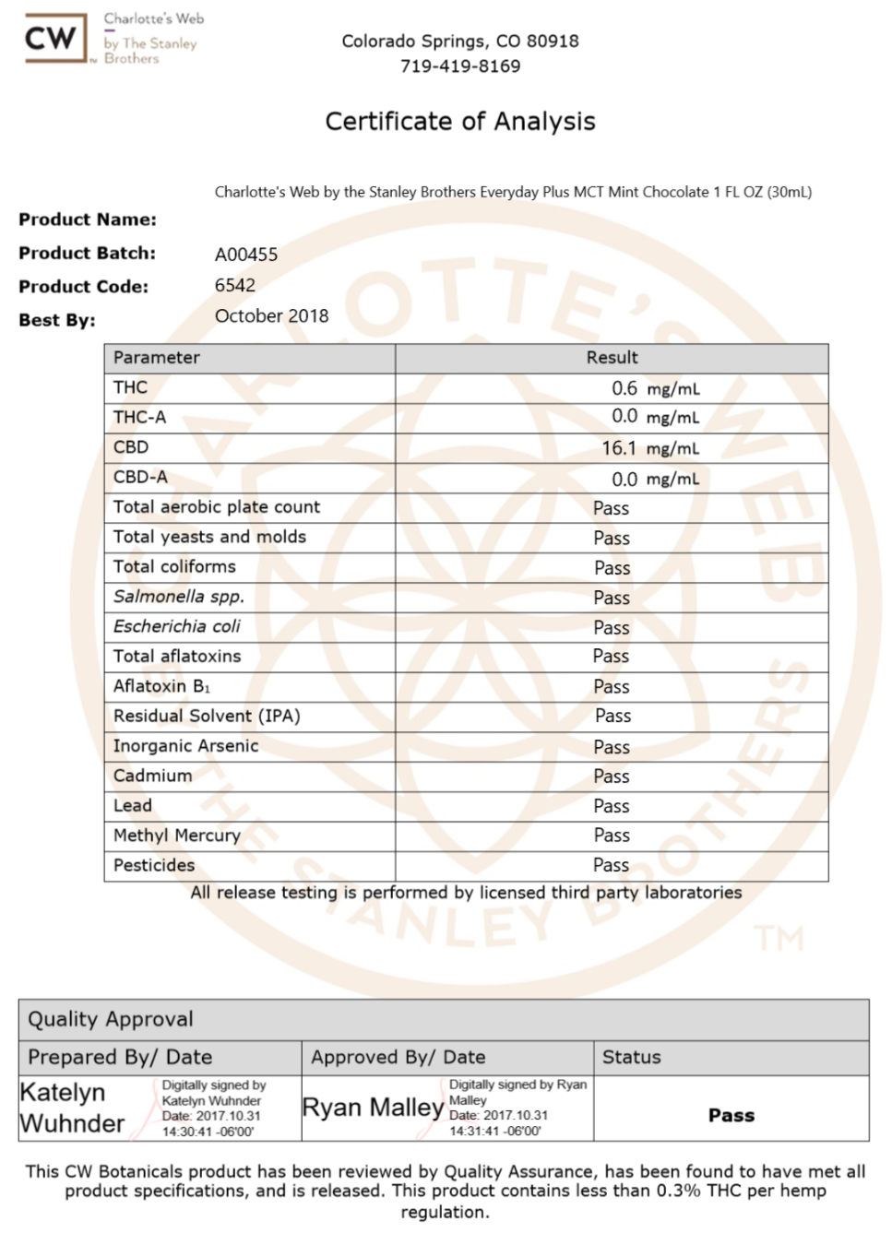
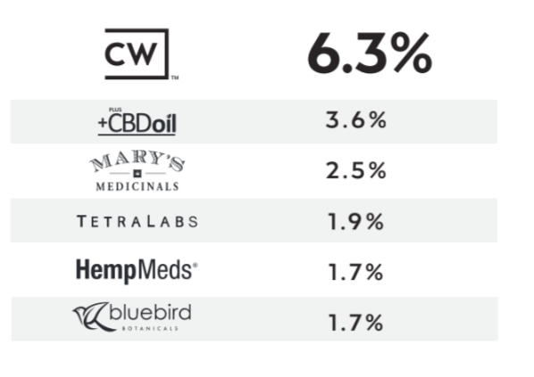
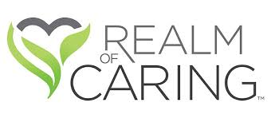

“Among patients who use Hemp products, by far, the favorite brand is Charlottes Web”
Understanding Cannabidiol / CBD: study by the Brightfield Group in partnership with HelloMD, the nation’s largest online community of medical cannabis patients, expert, brands and retailers.
MARKET SHARE

Slide 15
Full traceability – From Seed to Shelf
Environmentally friendly CO2 extraction process
State of the art laboratory facilities
Certified Organic, Non-GMO
3rd Party COA
World class customer service and on-going training / education

Slide 16

Currently going through approval process
Customer feedback
USDA Organic Certification
No COA on website, but access is available
Obviously it works, but we need to ensure the quality and purity is there first

Slide 17
Customer Testimonials
Sonia – mother of 6 yr old daughter
  Severe epilepsy
  30-40 seizures a day from 6 mos old
  $5000 / month on meds, diets, physical therapy, speech, etc..
  $600/ month
Sherry – mother of 17 yr old boy
  Severe epilepsy since birth
  20 - 30 seizures a day from 6 mos old
  Anxiety from the seizures
Terrell – 33 yr old female
  3 years ago, suffered spinal injury in car crash forcing her to use a walker
  multiple surgeries, plates, and pins led to severe levels of pain and anxiety
  As a trial med, Lithium was provided for pain which led to severe Vertigo
  Severe depression
  Within 3 months of taking CBD
    Vertigo almost completely gone
    Pain drastically reduced
    Meds nearly eliminated
    She has hope!

Slide 18
Customer Testimonials
Blake – Asperger’s, crippling social anxiety, panic attacks, insomnia, joint pain
Shawn – Meniere's Disease (inner ear), vertigo, severe migraines, anxiety
Debra – Crohns Disease, gut inflammation (combined with Black Seed Oil)
Janet – young daughter with severe epilepsy, 20-30 seizures / day
Jon – Neuropathy, nerve pain, arthritis, muscle spasms
Kerry – Crippling migraines, sever anxiety
Ashley – Joint pain, inflammation, anxiety, insomnia
Jerry – Rheumatoid Arthritis, joint inflammation
Nan – Arthritis, insomnia
Tom – Effects of Cancer treatment – radiation and chemo
Brandon – Opioid addiction

Slide 19
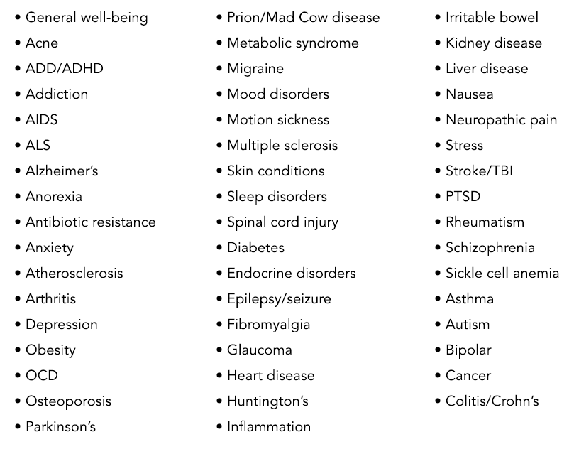

Slide 20


