Slide 1
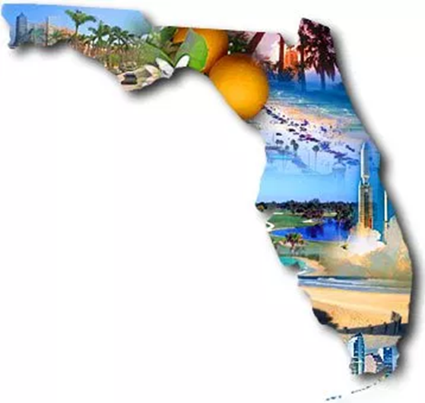
Physicians, Dispensaries, and Products: What’s Happening with Medical Marijuana in Florida
Presentation to the Georgia Study Commission on
Low THC Medical Oil Access
October 5, 2018
Jessica Spencer Ed.D., CAP, CPP
Spencer Solutions Group LLC.

Slide 2
Physicians
Florida law requires:
  physicians have no direct \indirect interest dispensary or lab.
  Complete a 2 hour annual course
  Conduct patient exam while physically in same room
  (Age) < 18 requires 2 physicians approval
  Only low THC for pregnant patients
  Review PDMP for patients’ Rx History

Slide 3
Physicians- Who is making the recommendations?
A Tampa Bay Times examination of the 1,432 doctors in the program reveals Florida has turned into a magnet for physicians with troubled pasts.
  2.8 times as likely as other doctors to have been disciplined by the Board of Medicine
  2.4 times as likely to have been charged with a crime
  108 of them were responsible for $69.4 million in malpractice judgments and settlements, some for maiming or killing patients.

Slide 4
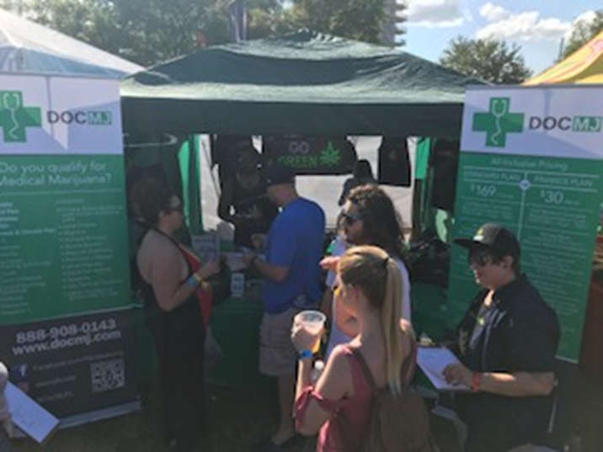
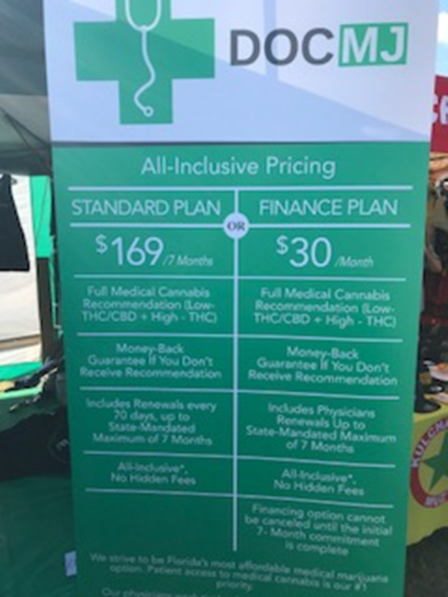
Physicians – Marketing
Physician group marketing set up at Reggae Rise Up, a recurring music festival held in St. Petersburg, Florida.
Offering all inclusive pricing and finance plans for medical marijuana and money back guarantees. Would we allow this for Xanax or Oxycontin? Is this how your family physician operates?

Slide 5
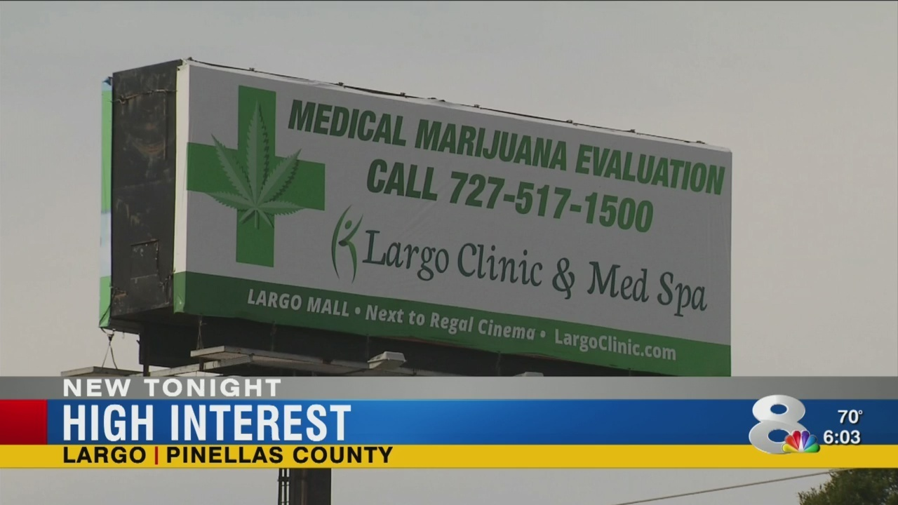
Medical Marijuana Clinic Billboard Largo

Slide 6
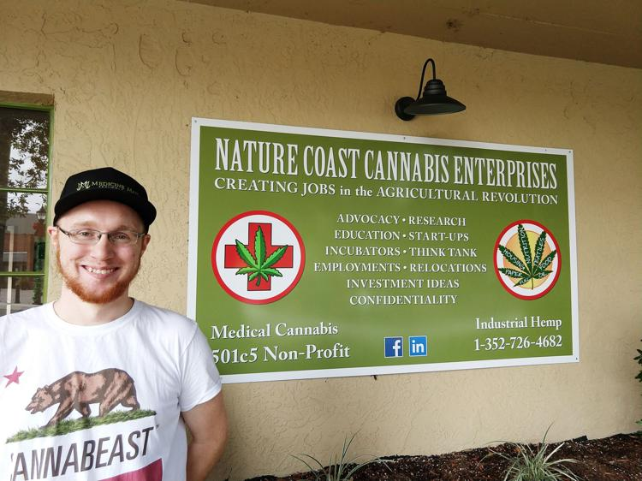
Nature Coast Cannabis- Inverness
Assisting companies locating or expanding in the Emerald Nature Coast during the "Green Rush“.
We plan to be at the cutting edge of what is possible in the fields of Industrial Hemp and Medical Cannabis.

Slide 7

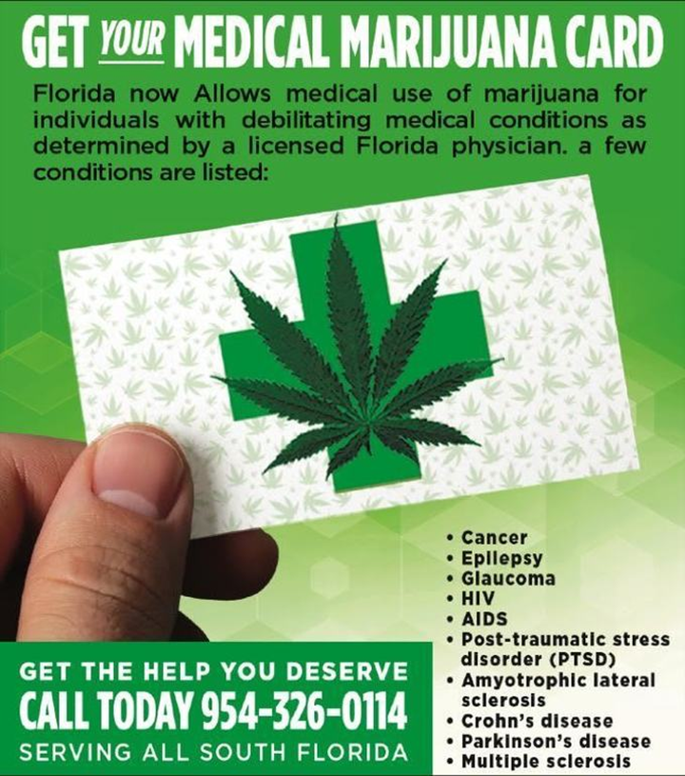
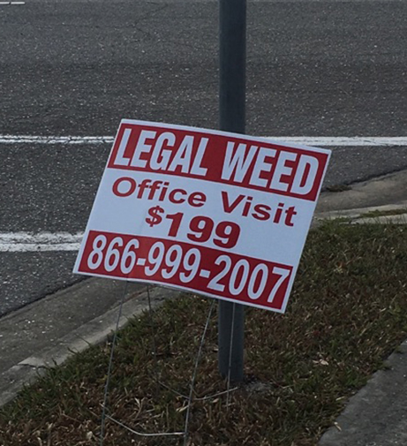
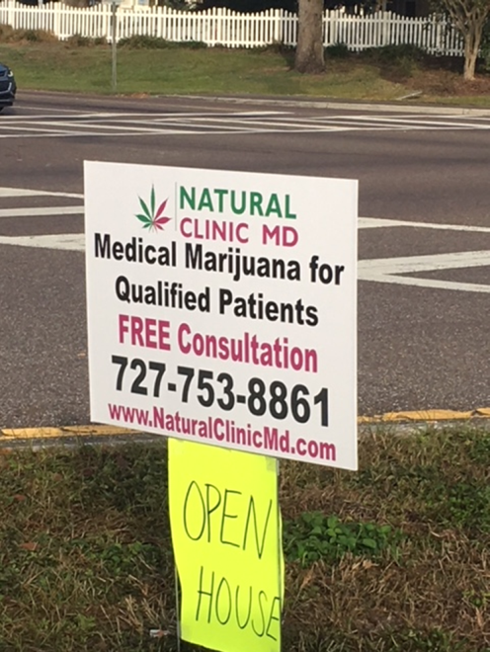
Physician Marketing

Slide 8


Physician Marketing
When did we start determining medicine by if we “like” to take it or if it is “made easy?”
Unsolicited internet pop up ads appearing on Facebook, Twitter and Instagram.
Blimps appearing over Tampa Bay and our beautiful shorelines that are often packed with youth.
Both of these types of advertising are prohibited for dispensaries under Florida law, but not for physician groups.

Slide 9
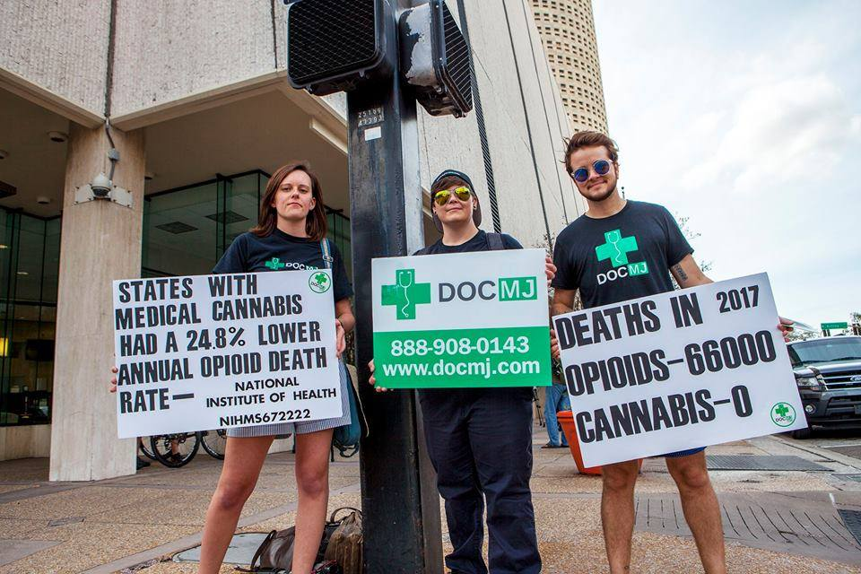
Physician Marketing
Marketing medicine on street corners and making false claims on the impact on the opioid crisis.

Slide 10

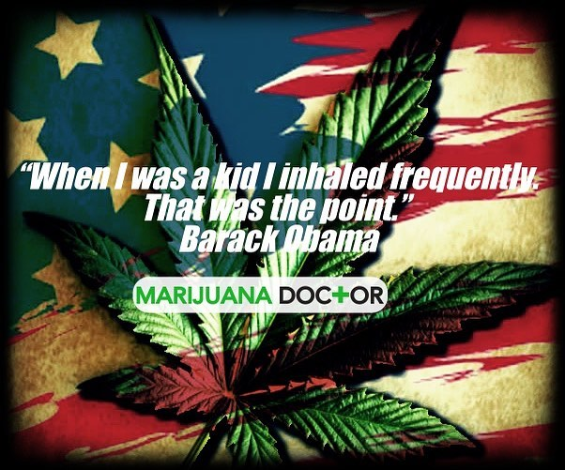
Physician Marketing
Florida’s law does not allow smoking. How is this about medicine?

Slide 11
Physician Recommendations
Florida law requires:
  Cannot be smoked
  Include the amounts and forms of marijuana authorized and the types of delivery devices needed
  Record in the MMJ registry within 7 days
  Obtain consent form

Slide 12
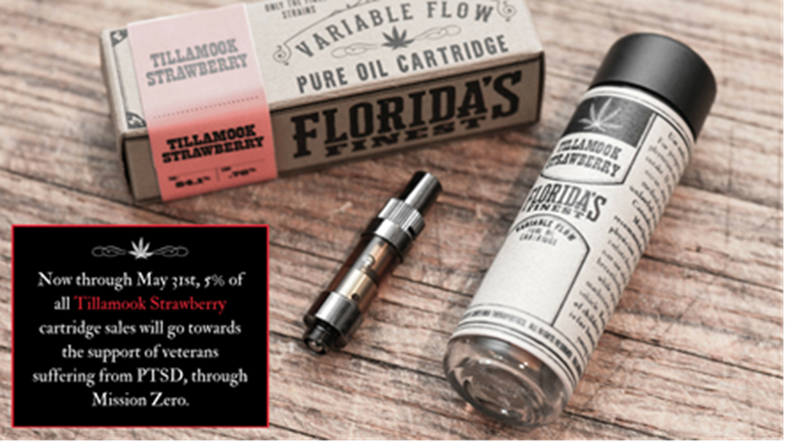
Florida Medical Marijuana Products
From their website: “The strain is a slightly sativa dominant hybrid made up of 84% THC and 0.76% CBD, which may be helpful for MMJ patients that have chronic anxiety or stress, loss of appetite, or inflammation.”

Slide 13
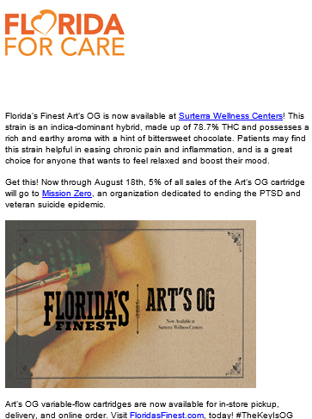
Florida Medical Marijuana Products

Slide 14
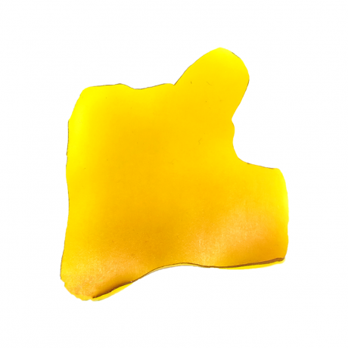
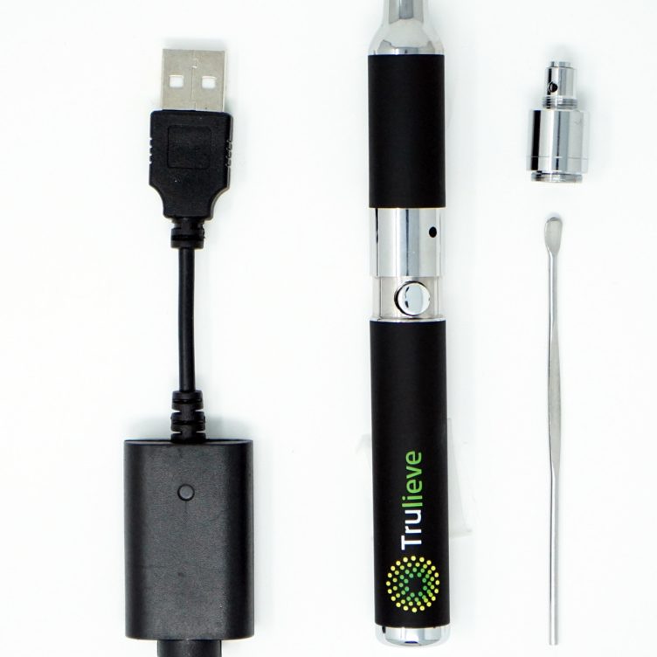
Florida Medical Marijuana Products
From their Website:
“TruShatter is full spectrum cannabis oil preserving the plants cannabinoids and terpenes making it a part of our entourage line providing patients with whole plant benefits. TruShatter is packaged in 1 gram amounts and is for use with the Trulieve Concentrate Pen. Each package is individually labeled to show the amount of active ingredient which ranges based on potency.”
https://www.trulieve.com/shop/trushatter-1-gram-indica

Slide 15

AltMed Medical Marijuana- Shatter

Slide 16
Why we care about MMJ Products
National Poison Data System from 2005 to 2011
  Decriminalization was associated with
    increased reports of unintentional exposures in young children.
    30% increase per year of MJ-related calls to poison control.
    transitioning to decriminalization associated with an average increase of 11.5% in MJ-related calls to poison control per year.
    MJ-related calls to poison control centers in non-legal states showed an average increase of only 1.5% per year from 2005 to 2011

Slide 17
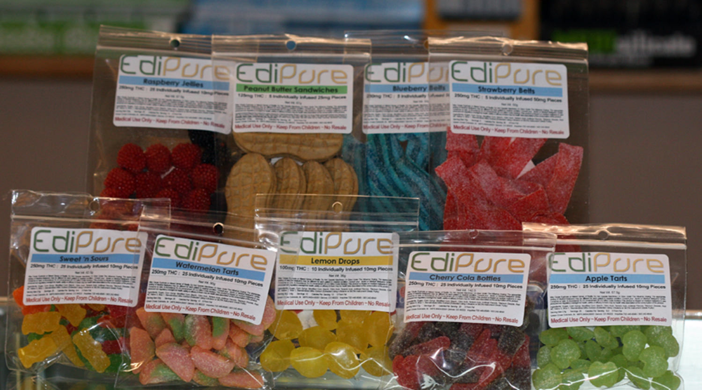
MMJ Products

Slide 18
Why we care about MMJ Products
A more recent review of National Poison Data System data showed similar increases in edibles-related calls to poison control centers from 2013 to 2015.
Suggests that accidental exposures may become more common as more states legalize recreational or medical cannabis use.
The need for additional regulation of edibles is evident given the frequency of cannabis overdoses and accidental pediatric exposures.

Slide 19
Why we care about marketing and storefront sales
Past month use is higher in states that allow distribution of medical marijuana through store front dispensaries.
The density of local dispensaries is associated with a greater number of hospitalizations with a primary or secondary marijuana abuse/dependence DSM-5 mental disorder code.
  An additional 1 dispensary per sq. mile in a zip code was associated with a 6.8% increase in the number of hospitalizations with a mj abuse/dependence code.
Sources: Pacula, RL.; Powell, D.; Heaton, P.; Sevigny, EL. Assessing The Effects Of Medical Marijuana Laws On Marijuana And Alcohol Use: The Devil Is In The Details. Cambridge, MA: National Bureau of Economics Working Paper Series; 2013. Christina Maira, Bridget Freisthler, William R. Ponicki, and Andrew Gaidus. The impacts of marijuana dispensary density and neighborhood ecology on marijuana abuse and dependence. Drug Alcohol Depend. 2015 September 1; 154: 111–116. doi:10.1016/j.drugalcdep.2015.06.019

Slide 20
Why we care
Availability of medical marijuana (through dispensaries and delivery services) at the city-level is positively related to current marijuana use and higher frequency of use
Regulations on the number and densities of marijuana outlets may be a sufficient means to restrain overall levels of marijuana use within cities

Slide 21
Cultivation and Dispensaries
14 Medical Marijuana Treatment Centers (MMTC) approved by the state (licensed to cultivate, process, transport, dispense) in Florida. After 100,000 registered patients another 4 licenses are issued, and 4 more each time another 100,000 is reached. FL now allows 18 MMTCs. Number of Qualified Patients: 131,258 (DOH September 2018)
Each MMTC can operate up to 25 dispensaries. Upon reaching the 100,000 MMJ patients threshold another 5 can become operational. Currently 30 dispensaries per MMTC are allowed. Cap expires in 2020.
Current limit: 540 Dispensaries in Florida

Slide 22
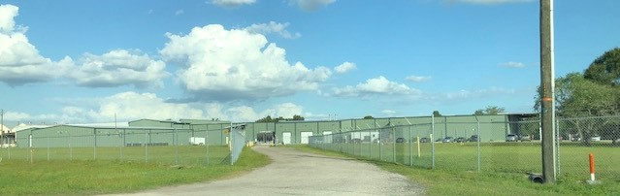
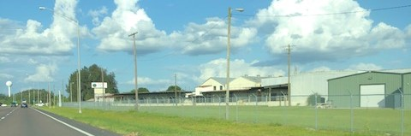
Cultivation (AltMed)

Slide 23
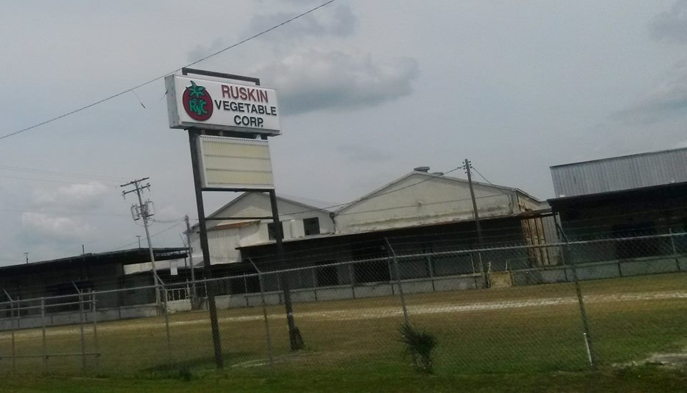
Cultivation (AltMed)

Slide 24
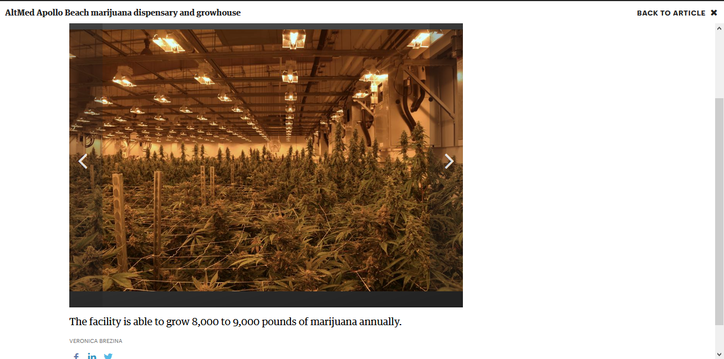
AltMed MMJ Growhouse
Source: Tampa Bay Business Journal, 2018

Slide 25
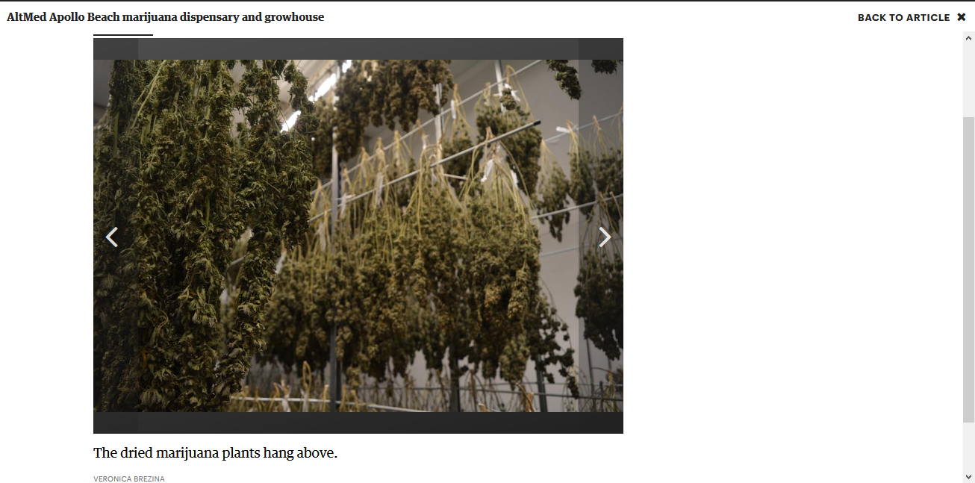
AltMed Marijuana Growhouse- Drying
Source: Tampa Bay Business Journal, 2018

Slide 26
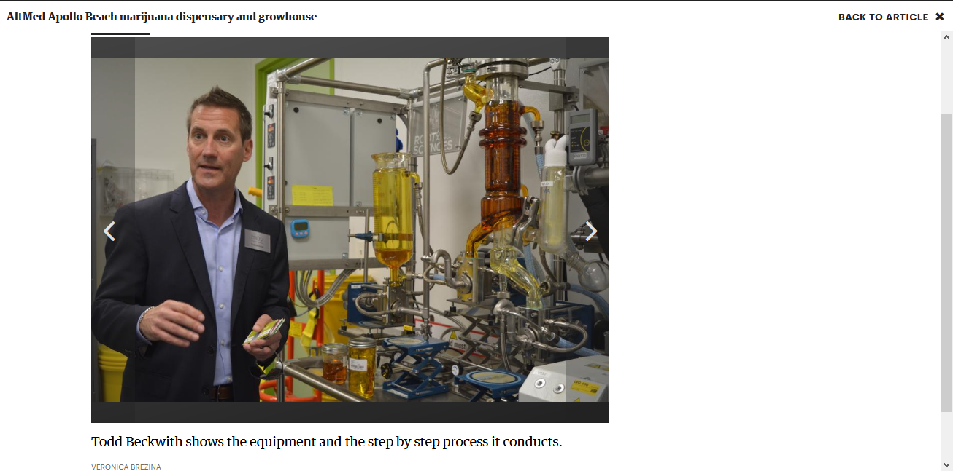
AltMed Processing Hash Oil
Source: Tampa Bay Business Journal, 2018

Slide 27
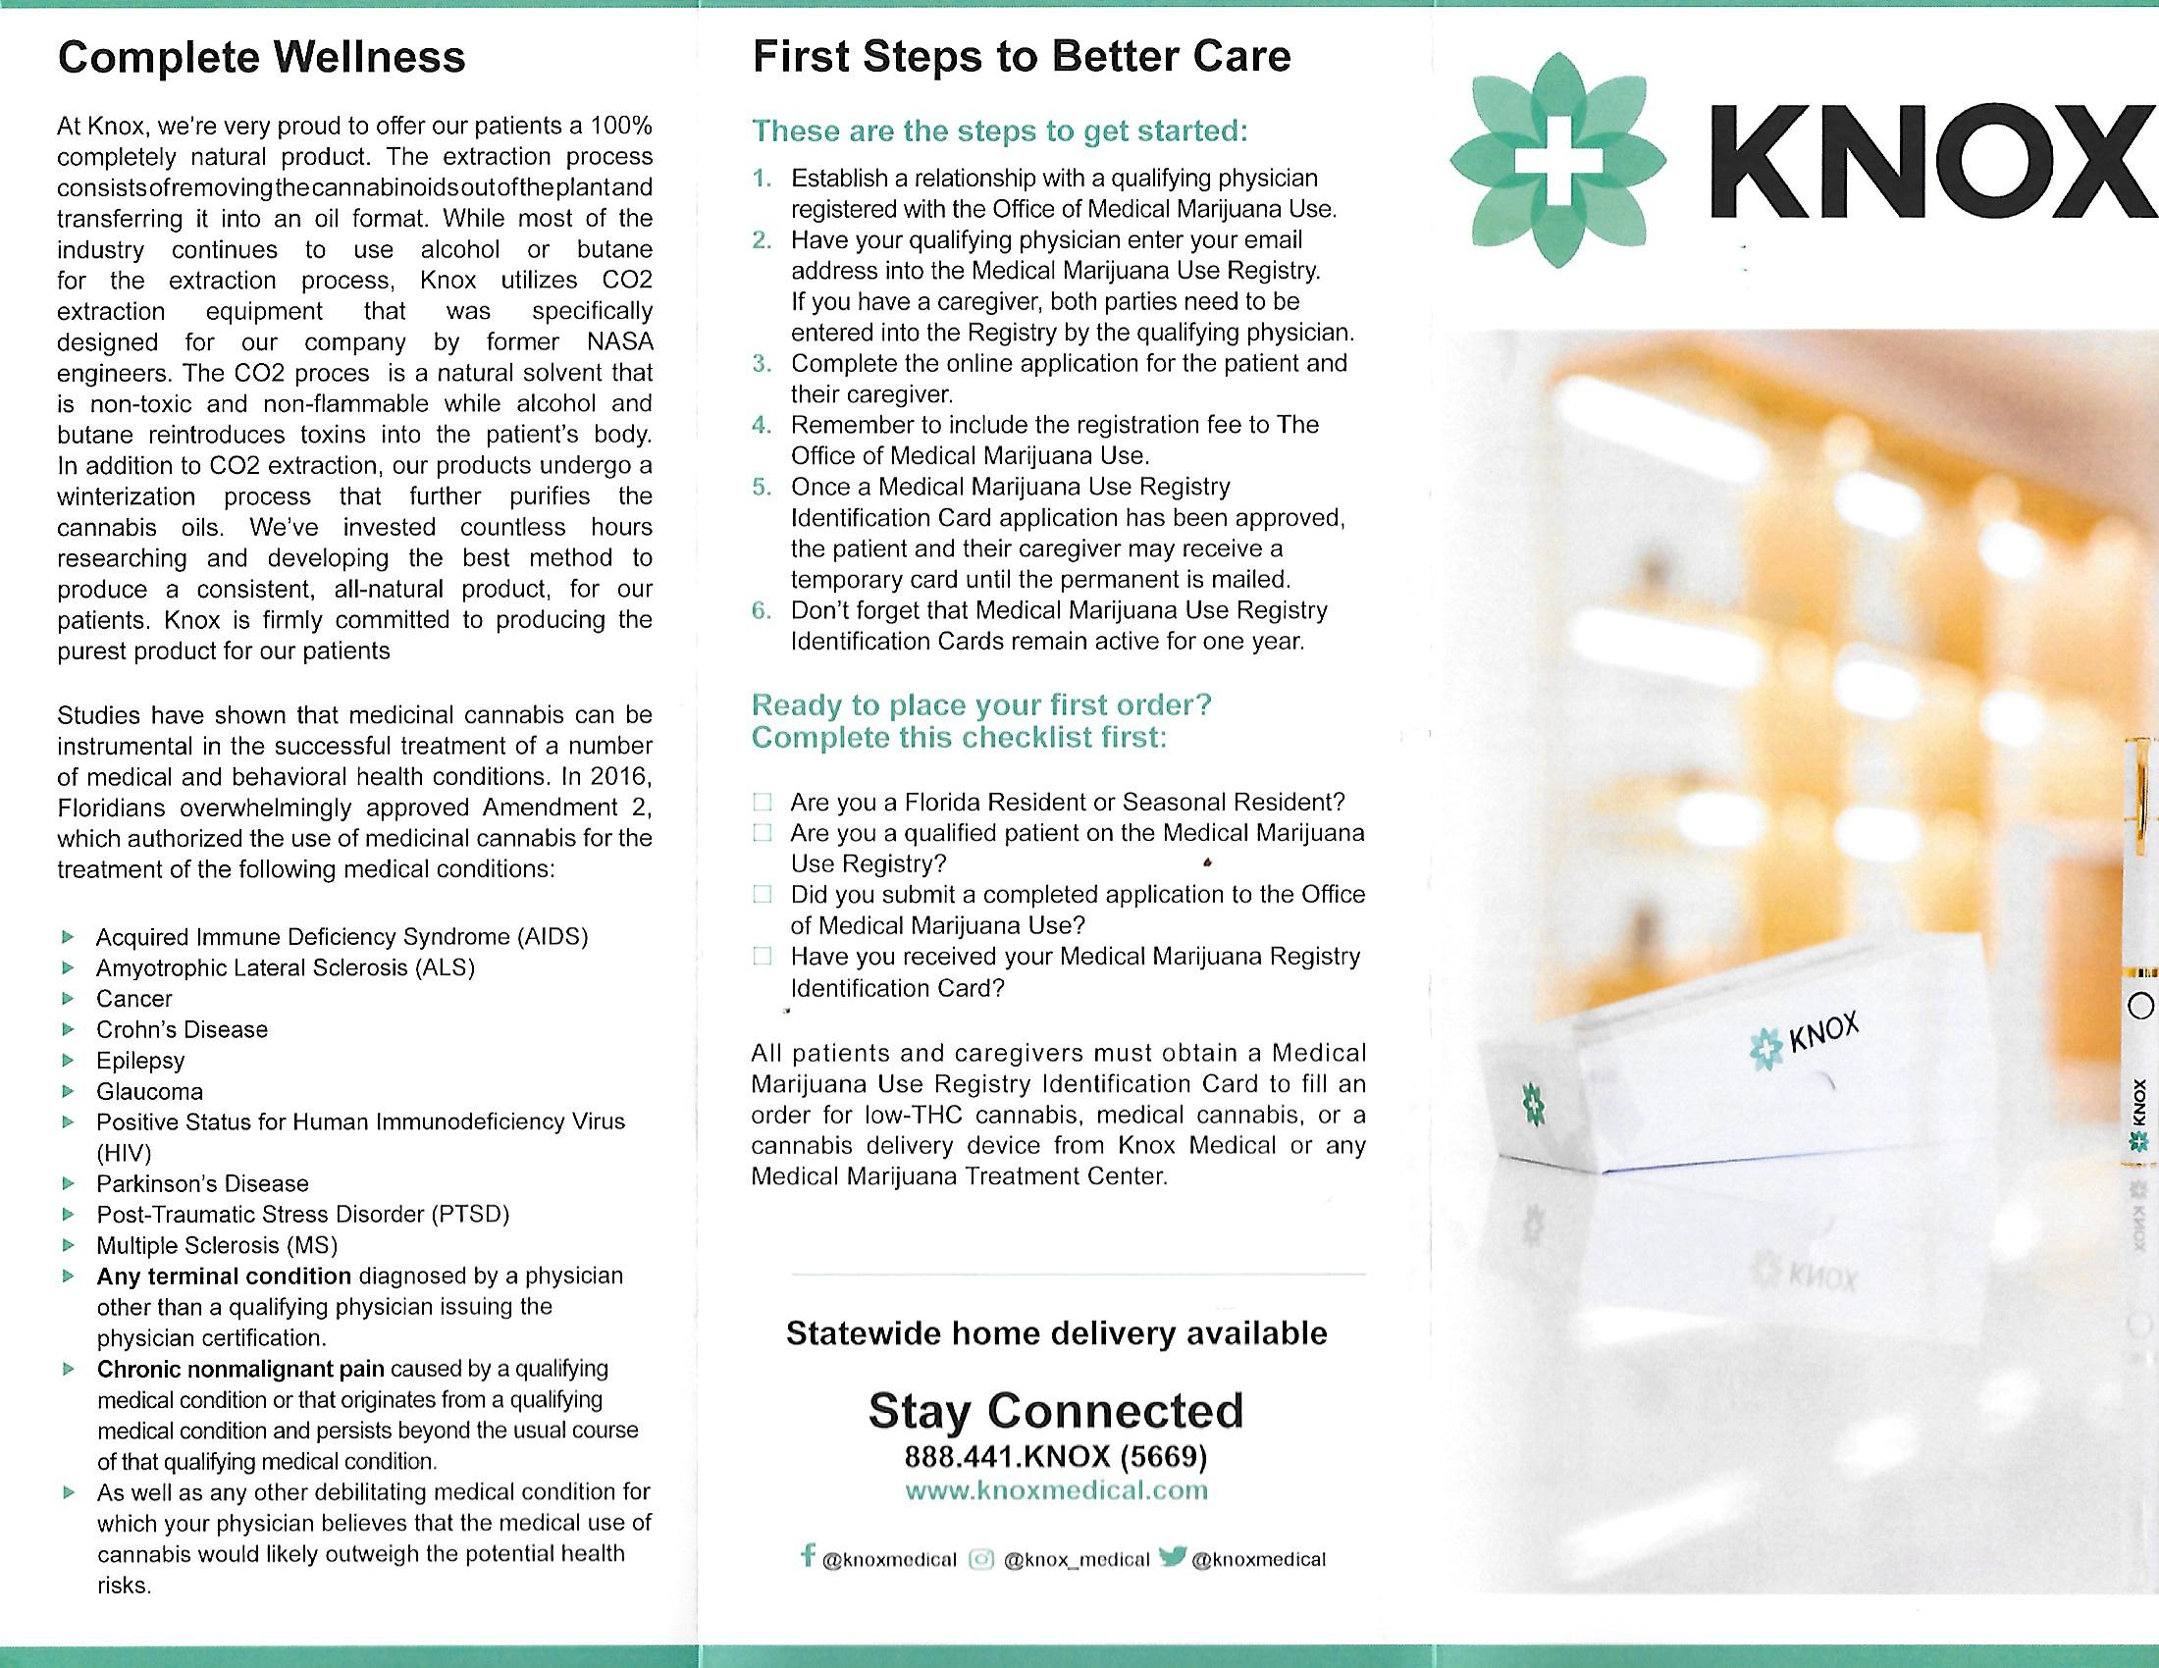

Slide 28
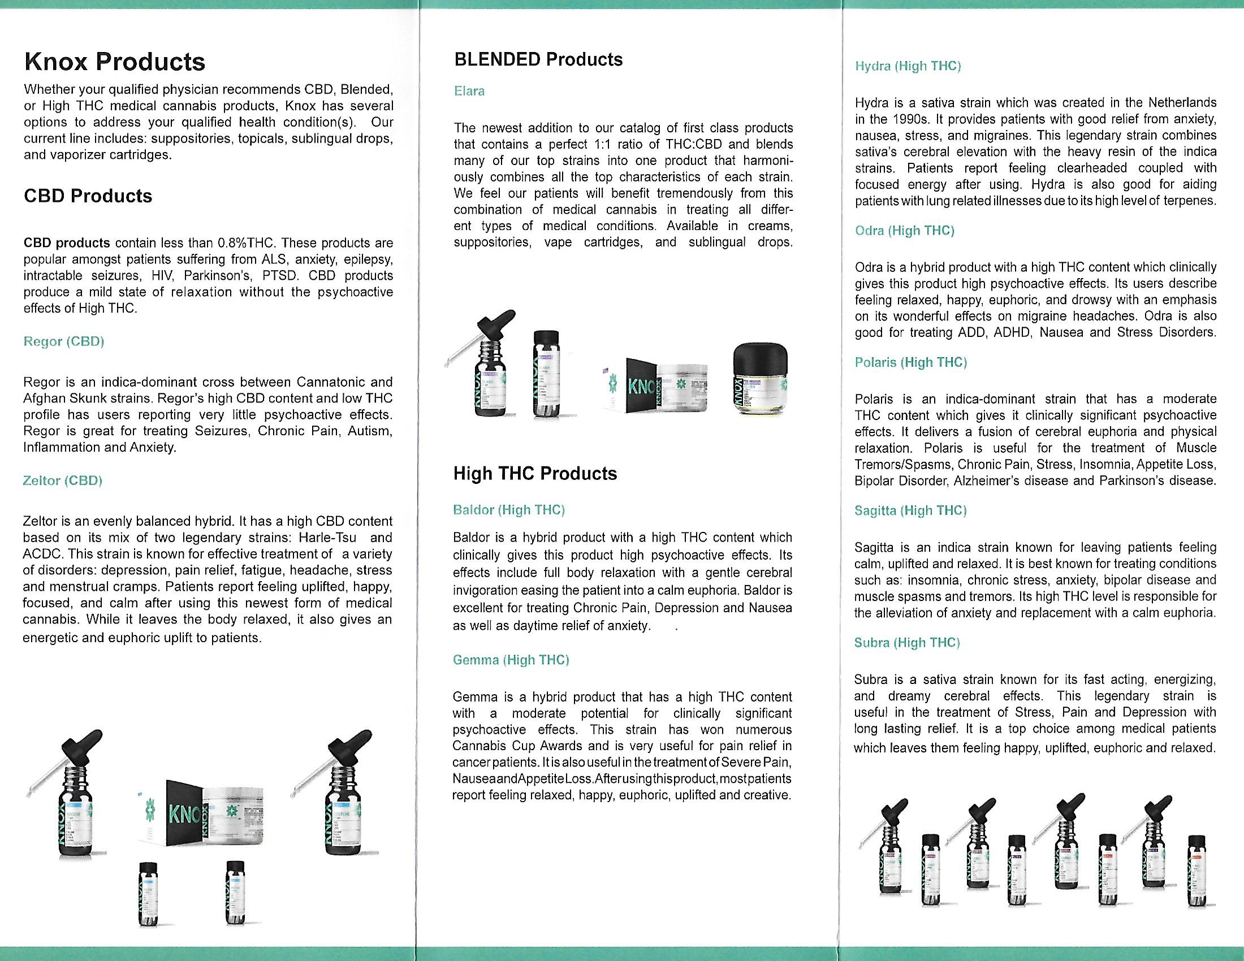

Slide 29
Dispensaries
Dispensaries numbers
Also determined by regional population.
Central Region- Brevard, Citrus, Hardee, Hernando, Indian River, Lake, Orange, Pasco, Pinellas, Polk, Seminole, St. Lucie, Sumter and Volusia.
Total population is 6,468,118 which is 31% of the state’s population. The Central Region can have no more than 132 dispensaries.
Utilize seed to sale tracking system (real time and 24 hr. access by FL DOH)

Slide 30
Dispensary Rules
Florida law requires:
  Employees 21 or older and pass background check
  Trained on legal dispensing requirements
  Implement a drug free workplace
  May not display products in waiting area
  24 hour delivery – cannot dispense from MMTC between 9pm and 7am

