Slide 1



G e o rg i a L e g i s l at i ve C o m m i tte e o n C a n n a b i s ; O c t o b e r 5 , 2 0 1 8
N e i l B r i g h a m – C h i e f O p e r a t i n g O f f i c e r
0 l CONFIDENTIAL PROPERTY OF SURTERRA HOLDINGS, INC. DO NOT COPY, FORWARD OR FAX TO UNINTENDED PARTIES.
n b r i g h a m @ s u r t e r r a . c o m

Slide 2



U N D E R S TA N D I N G Y O U R O B J E C T I V E S
Thank you for inviting Surterra to share our perspectives.
We understand your objective is to develop a better understanding regarding how to professionally deliver wellness
solutions to the citizens of Georgia….
Our Mission
TO EMPOWER YOUR HEALTH AND ENABLE
YOUR LOVED ONES TO LIVE WELL
We fulfill this mission through our vertically integrated business structure, best-in-class leadership team, and “professionally-enabled compassion.”
We know cannabis is a safe, natural alternative to pharmaceuticals and emerging research agrees.
We’re not your typical cannabis company. We’re disrupting the status quo and
building the medical cannabis industry so that all people can live life well.
0
…which fully aligns with our Mission.
1

Slide 3
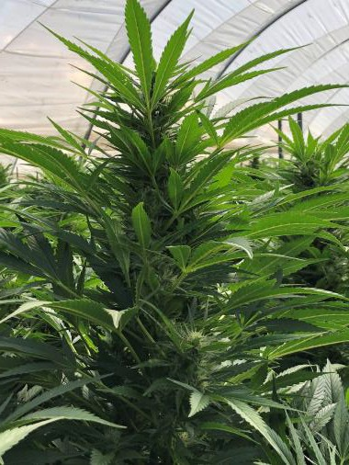
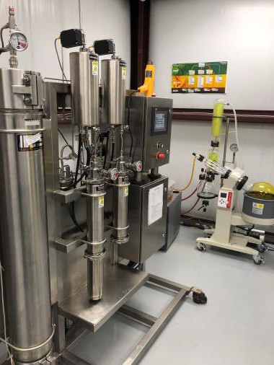
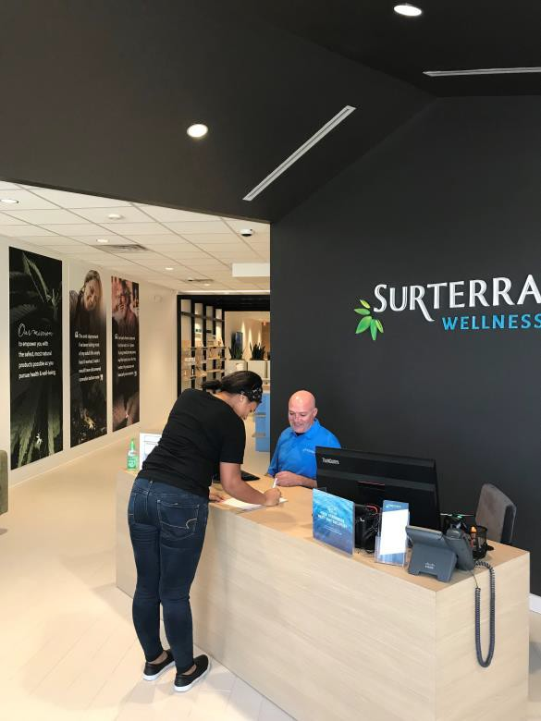
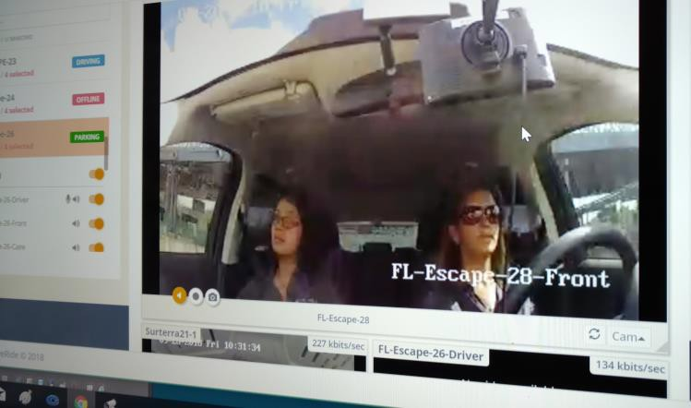
C A N N A B I S O P E R AT I O N S
At the core, there are five key processes to deliver on our mission of “empower your health and enable your loved ones to live well”.
… all of which need to be done with absolute integrity and professionalism, complying with the Federal and State
regulations, and aligning with local municipalities requirements.
1.
Grow
2.
Process
5.
Champion
3.
Enable
Our Mission
TO EMPOWER YOUR HEALTH AND ENABLE YOUR LOVED ONES
TO LIVE WELL
4.
Deliver
2 © Copyright 2018 and Confidential Property of Surterra Holdings, Inc. and Surterra Wellness. All rights reserved.

Slide 4
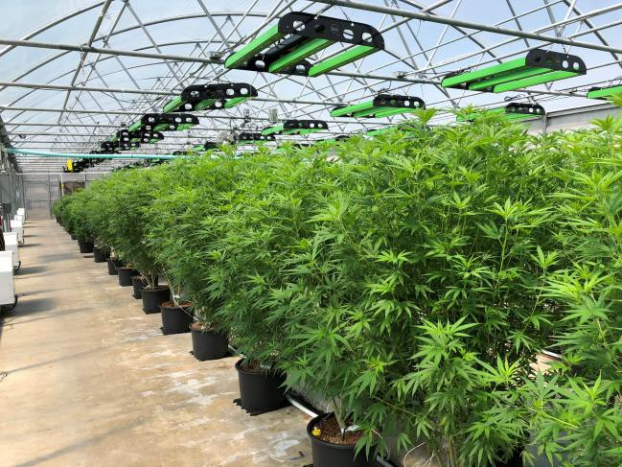
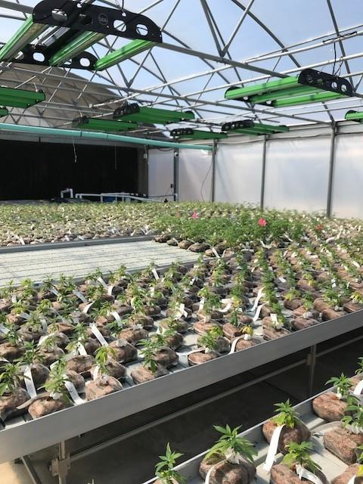
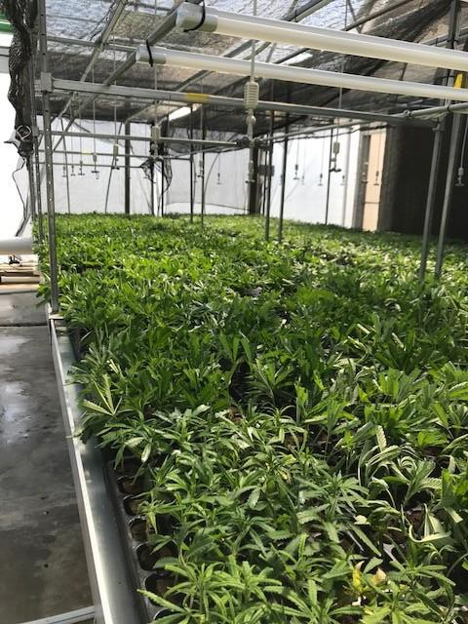
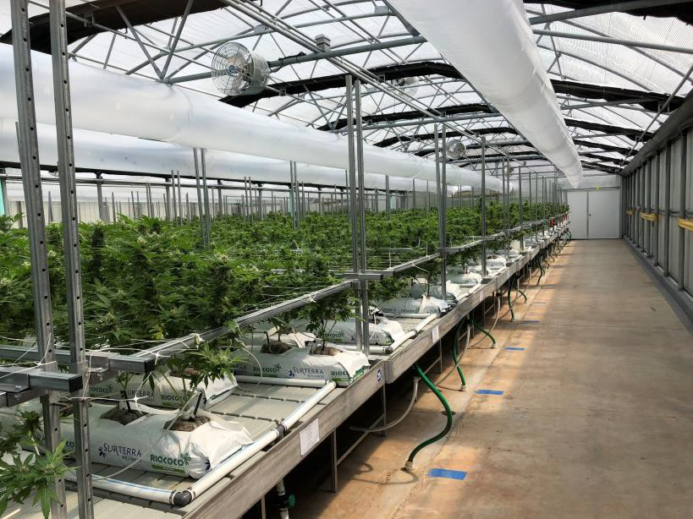
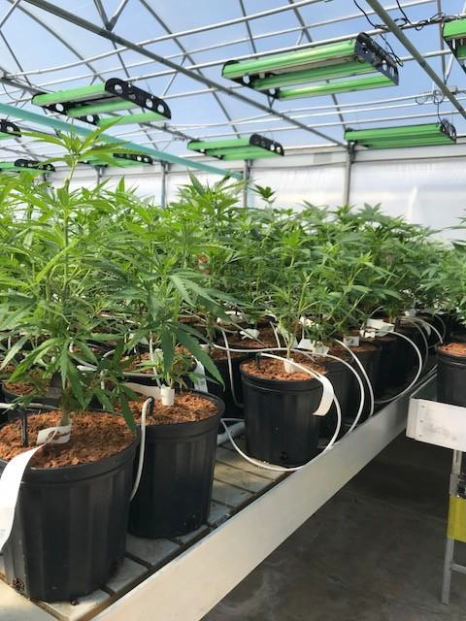
C A N N A B I S O P E R AT I O N S - G R O W
It takes 127 days to go from clipping to harvest.
Grow
Process
Champion
Enable
Deliver
Mother
Mature “mother plants” are the start of the
process …
“Veg”
Grow the
clippings.
….Take clippings from the mother to create new mothers plants and flower plants.
Grow plants to full lower.
Grow
Grow new “mothers”.
3 © Copyright 2018 and Confidential Property of Surterra Holdings, Inc. and Surterra Wellness. All rights reserved.

Slide 5
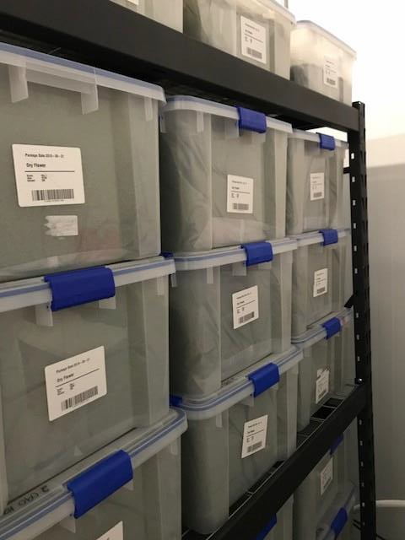
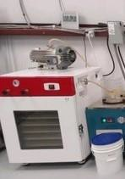
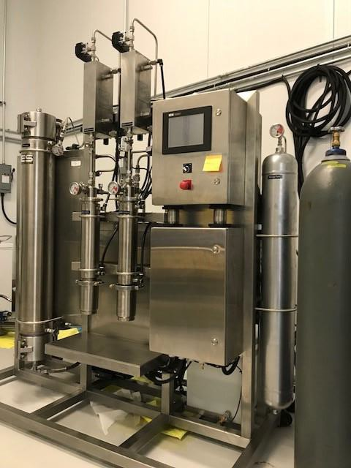
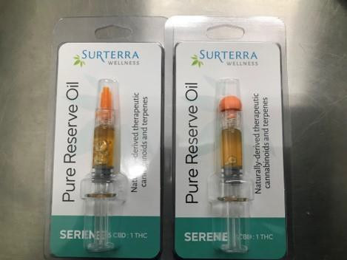
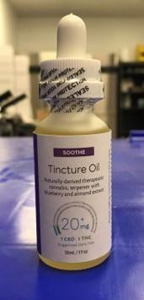
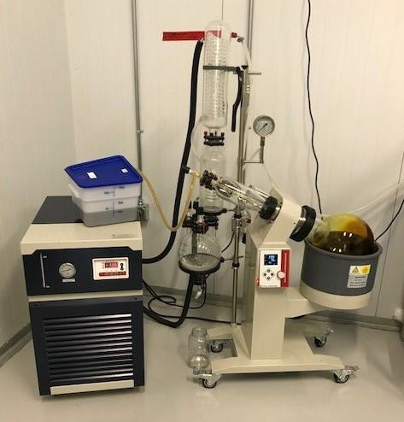
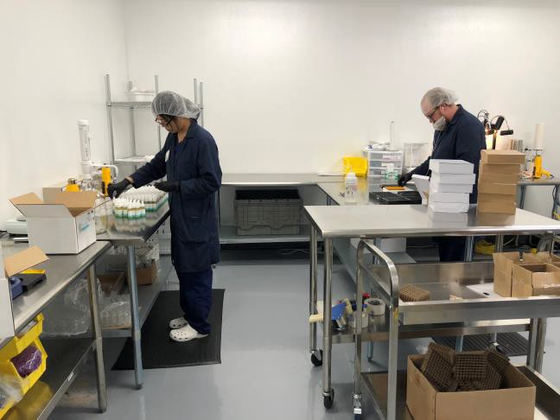
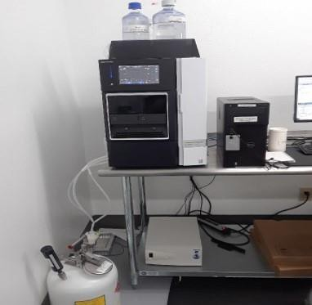
C A N N A B I S O P E R AT I O N S - P R O C E S S
Transforming the dry flower to beneficial product requires a careful execution of multiple controlled tasks.
Grow
Process
Champion
Enable
Deliver
Decarboxylate
Extract
Package
Refine
Test
4 © Copyright 2018 and Confidential Property of Surterra Holdings, Inc. and Surterra Wellness. All rights reserved.

Slide 6
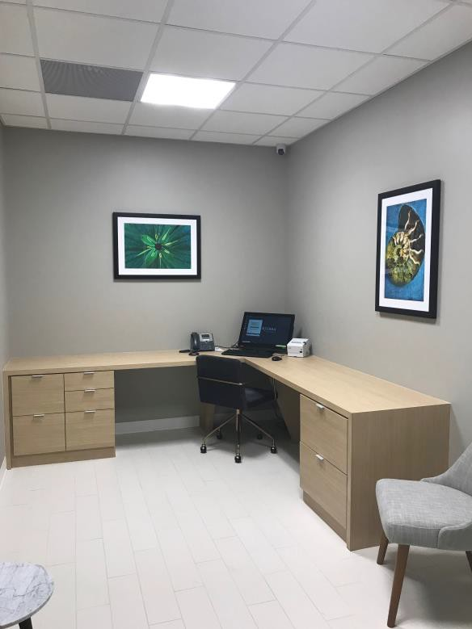
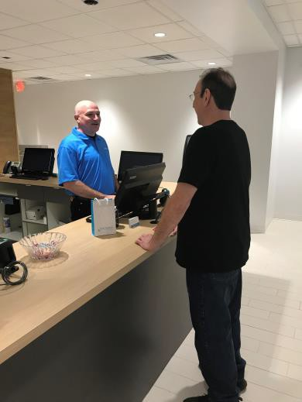

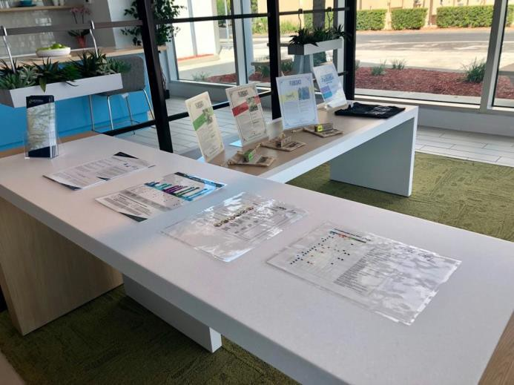

C A N N A B I S O P E R AT I O N S - E N A B L E
Our professionalism is setting the standard of excellence in this industry.
Grow
Process
Champion
Enable
Deliver
Check-In
Private
Consultation
Check-Out
Product Education
Discuss
5 © Copyright 2018 and Confidential Property of Surterra Holdings, Inc. and Surterra Wellness. All rights reserved.

Slide 7
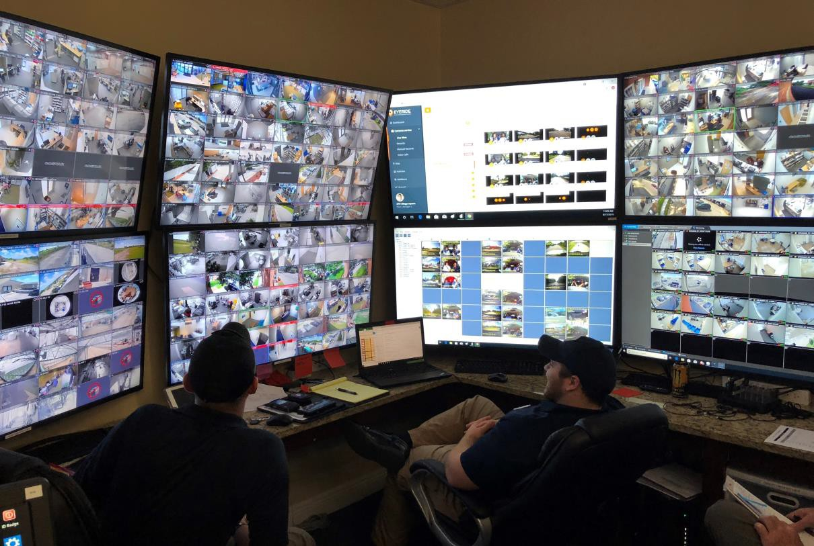
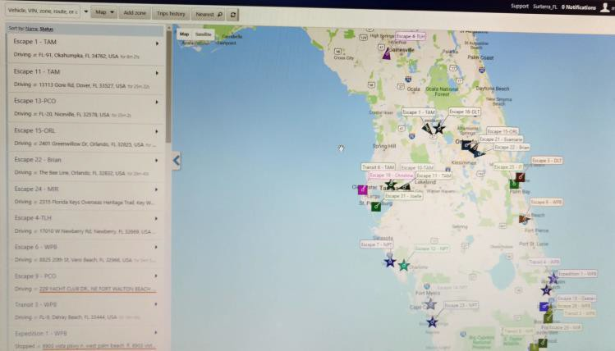
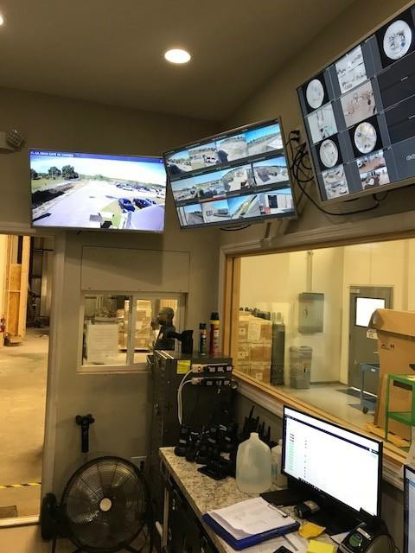

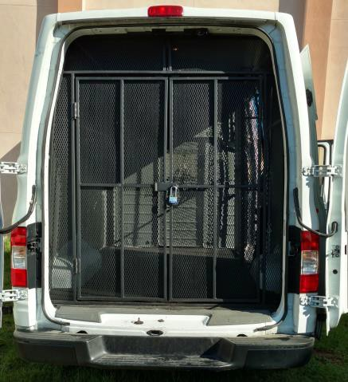
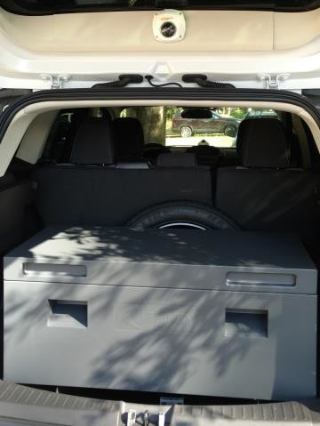
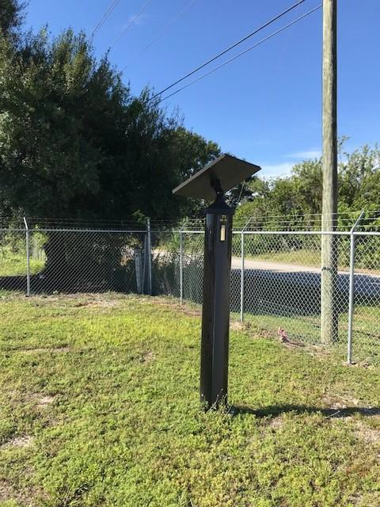
O P E R AT I O N S – D E L I V E R & P R O T E C T
We provide next-day delivery, balancing serving our wellness customers with keeping our people and products safe.
Grow
Process
Champion
Enable
Deliver
6
© Copyright 2018 and Confidential Property of Surterra Holdings, Inc. and Surterra Wellness. All rights reserved.

Slide 8


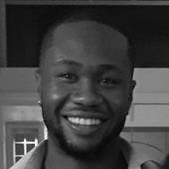
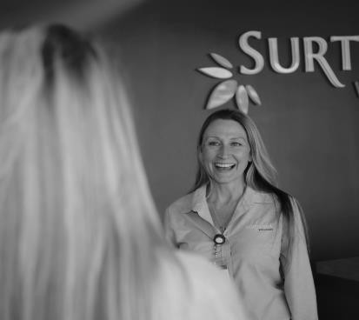






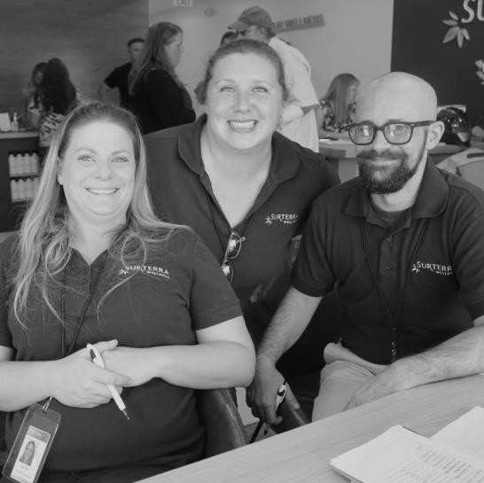

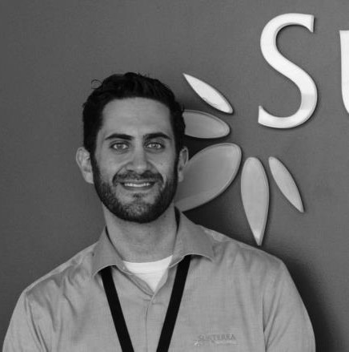








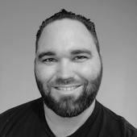






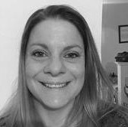



C A N N A B I S O P E R AT I O N S – C H A M P I O N
Grow
Process
We’ve built a best-in-class team of wellness coordinators, professionals, and call center Champion
representatives to help our customers understand how best to meet their wellness needs.
Enable
Deliver
7 © Copyright 2018 and Conf
idential Property of Surterra Holdings, Inc
. and Surterra Wellness. All rights reserved.

Slide 9
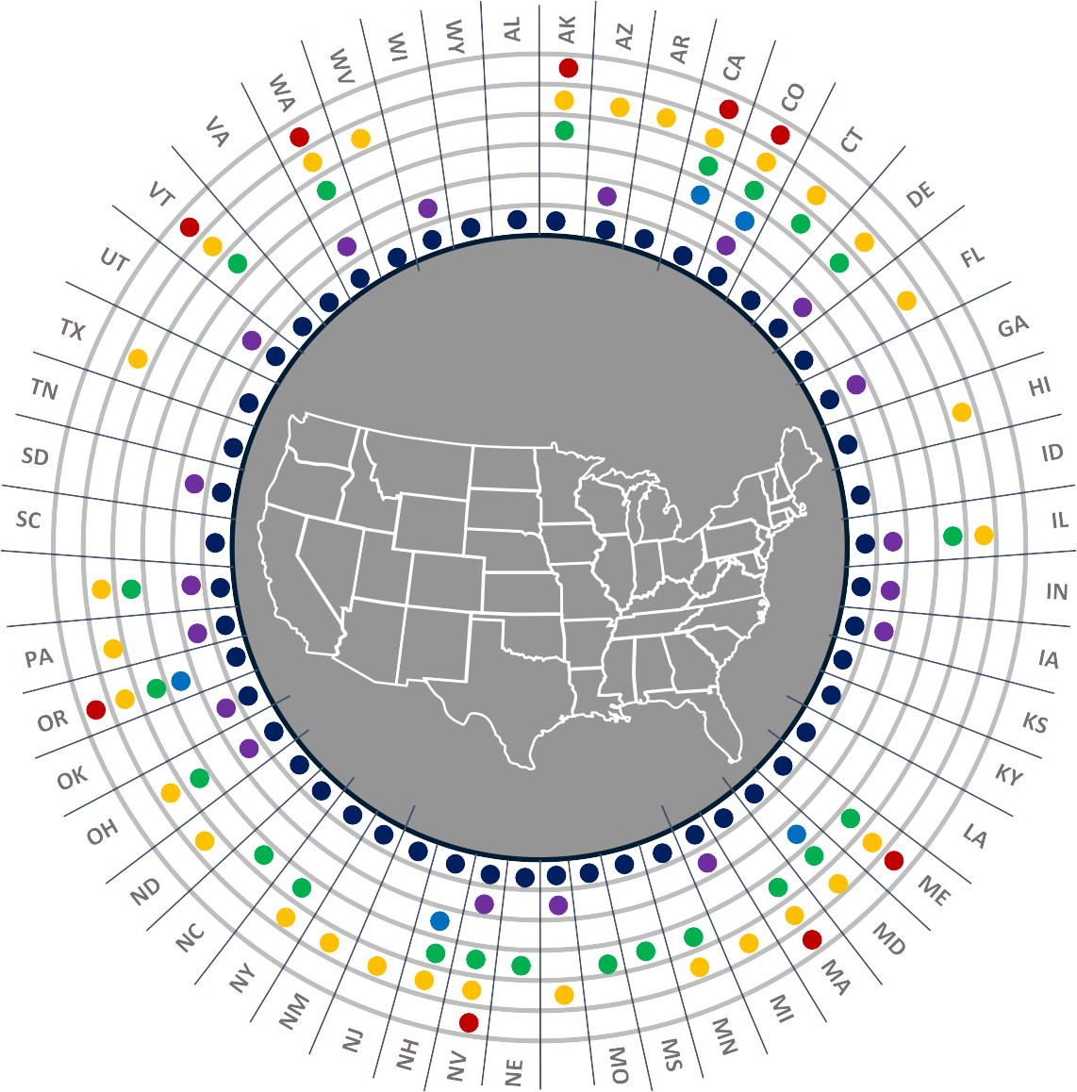






W H AT ’ S T H E L E G A L L A N D S C A P E ?
While still illegal federally, the legal landscape varies dramatically state by state with increasing momentum towards full legalization for adult use.
Key
Legalized for adult use
Legalized for medicinal use
Decriminalized
Enables prior convictions to be reduced, sealed or expunged
Illegal to drive if motorist is impaired by marijuana or tests positive for THC or metabolites
Illegal to drive if motorist is impaired by marijuana
Key areas of focus in 2018 and beyond
FinCEN Guidance
CARERS Bill
Rohrabacher- Blumenauer Amendment
Small Business Tax Act / 280e reform (Rep. Curbelo)
DEA Rescheduling for Research (Rep. Gaetz)
STATES Act (Sens. Gardner / Warren)
RI
MT
8 © Copyright 2018 and Confidential Property of Surterra Holdings, Inc. and Surterra Wellness. All rights reserved.

Slide 10
W H AT ’ S T H E L E G A L L A N D S C A P E ?
TO achieve your goals, we ask you consider supporting the bipartisan piece of legislation in the
U.S. House and Senate, H.R.6043 and S.3032 called the STATES Act.
FinCEN Guidance provided safe harbor to financial institutions who follow strict compliance guidelines for businesses that operate legally under the Cole Memo.
The Rohrabacher–Farr amendment (also known as the Rohrabacher–Blumenauer amendment), prohibits the DOJ from spending funds to interfere with the implementation of state medical
cannabis laws (does not protect recreational operators).
It passed the House in May 2014, after six previously failed attempts, becoming law in December 2014 as part of an omnibus spending bill. It must be renewed each fiscal year to remain in effect.
In January 2018, U.S. Attorney General Jeff Sessions rescinded the 2013 Cole Memo.
In 1851, cannabis is admitted as a recognized medicine in the 3rd edition of the U.S. Pharmacopoeia under the name of Extractum Cannabis or Extract of Hemp and listed until 1942.
The Marihuana Tax Act of 1937, drafted by Harry Anslinger in coordination with newspaper publishing giant William Randolph Hearst, placed a tax on the sale of cannabis.
Cannabis was officially outlawed for any use (medical included) with the passage of the Controlled Substances Act (CSA) of 1970.
The Cole Memo, issued by the U.S. Department of Justice in 2013 in response to States’ implementation of regulated medical cannabis programs, provided a safe harbor for cannabis operators that followed a list of eight law enforcement criteria.
9 © Copyright 2018 and Confidential Property of Surterra Holdings, Inc. and Surterra Wellness. All rights reserved.

Slide 11
W H AT ’ S T H E L E G A L L A N D S C A P E ?
Florida passed the Compassionate Medical Cannabis Act of 2014 and has been evolving since how to best serve the citizens of Florida.
The Florida Legislature passed the Compassionate Medical Cannabis Act of 2014, establishing a framework for low-THC cannabis to be recommended to, and accessed by, patients suffering from cancer, or any disorder which produces seizures or severe and persistent muscle spasms.
This law has been subsequently amended:
In March 2016, by way of HB 307, Florida Legislature allows terminally ill patients to access full strength medical marijuana.
In November 2016, 71.3% of Florida voted in favor of a constitutional amendment to significantly expand access to medical cannabis to patients suffering from 11 debilitating conditions, or those like them.
F.S. Sec. 381.986 defines
Possession, use and administration
Qualifying medical conditions
Qualifications and requirements of recommending physicians
Requirements of caregivers
Responsibilities of the Florida Department of Health
Requirements of licensed Medical Marijuana Treatment Centers
Penalties for unlicensed activity
₁₀ © Copyright 2018 and Confidenti al Property of Surterra Holdings, Inc. and Surterra Wellness. All rights reserved.
Requirements for FL licensed MMTCs:
$5 million performance bond
Registered to do business in FL for past 5 years
Employ medical director
Cultivating, processing, dispensing & delivery
Testing, packaging & safety
Security provisions for product, employees & facilities

Slide 12
C O N S I D E R AT I O N S F O R G E O R G I A
We fully agree on the beneficial impact of cannabis to empower your health and enable wellness.
We offer our input and learnings to help the people and the State of Georgia.
Develop a solid understanding of “cannabis”.
There are many misunderstandings about cannabis and marijuana.
  Cannabis, hemp or marijuana is our oldest crop, sown for over 12,000 years and may have been domesticated over 30,000 years ago.
  More than 750 compounds have been identified in cannabis to date; 105 cannabinoids, and over 200 terpenes.
    Of these, CBD and THC have been studied most extensively.
There is a lot of confusion.
  Hemp, cannabis or marijuana all are scientifically denoted by the Latin term, Cannabis Sativa.
    Hemp, cannabis or marijuana are all the same plant species, Cannabis Sativa.
    Varieties known as Cannabis Indica are just different varieties of the same
species.
    Today, almost all varieties of cannabis used for medicine and social use are cross-breeds of both indica and sativa varieties.
  Marijuana is a nickname of Mexican origin for cannabis, coming from the word marihuana.
  “Medical” cannabis and “recreational” cannabis are in essence the same thing, it
is a question of the concentration of CBD, THC, and terpines.
Deregulation of cannabis is rapidly occurring.
Define how you want it done for Georgia, don’t
have it dictated to you.
Structure the regulations to bring to Georgia cannabis companies that have the same focus on wellness as you.
No surprise, some companies are in it just to make money.
Guiding principles should be focused on ensuring the health and wellness of communities in the safest, most impactful manner.
Seek innovators in the medical cannabis industry, working to elevate the natural benefits already found in cannabis by intentionally formulating its therapeutic components.
Seek companies who will “partner” with the regulators to evolve the application of cannabis to benefit the people in Georgia, not fight the regulators.
Seek companies of the highest integrity and professionalism, to deliver only the highest quality products.
Seek companies with the financial strength and proven processes to build a successful operation within Georgia.
Have relentless focus on the wellness of Georgia’s citizens.
Be open to the many positive benefits from cannabis.
  Compounds in marijuana, including THC and CBD, are known to produce therapeutic effects by interacting with the endocannabinoid system.
  Daily we hear from Florida residents how the availability of medical marijuana has positively impacted their lives and the lives of their family.
11 © Copyright 2018 and Confidential Property of Surterra Holdings, Inc. and Surterra Wellness. All rights reserved.

Slide 13

12
© Copyright 2018 and Confidential Property of Surterra Holdings, Inc. and Surterra Wellness. All rights reserved.

