Slide 1
Georgia
medical cannabis
update
August 29,2018

Slide 2
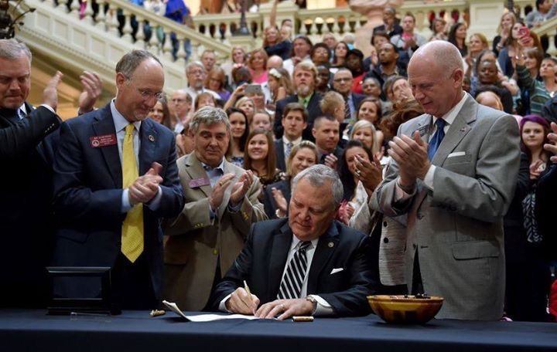
HB 1 Haleigh’s Hope Act
Signed into law by Governor Nathan Deal on April 16, 2015

Slide 3
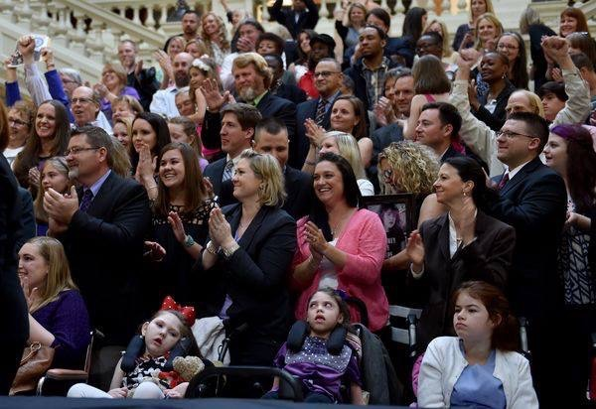
HB 1 Final Passage

Slide 4
What did HB 1 do?
Provides immunity from prosecution for possession of medical cannabis oil for 8 qualifying conditions
Cannot possess more than 20 ounces
Patient must register with the state for registration card in order to have immunity
Oil cannot exceed more than 5% THC

Slide 5
HB 1
Qualifying conditions for immunity are:
  Seizures
  Cancer
  ALS, Lou Gehrig’s Disease
  MS
  Crohn’s Disease
  Parkinson’s Disease
  Mitochondrial Disease
  Sickle Cell Disease

Slide 6
SB 16 signed into law May 19,2017
Adds 6 conditions to existing law
  Alzheimer’s
  AIDS
  Autism
  Tourette’s Syndrome
  Peripheral Neuropathy
  EB (rare skin disease)
  Also adds eligibility if in hospice care

Slide 7
SB 16 signed into law May 19,2017
Provides reciprocity with other states
Reduced reporting requirements for physicians

Slide 8
Legislative Addition 2018
HB 65
Adds PTSD & Intractable Pain to Low THC oil registry
Creates Commission to study and recommend a solution for the access issue in Georgia
Signed by Governor Deal May, 2018

Slide 9
Current Low THC Oil Registry status
as of July 31, 2018
Physicians Registered – 646
Patients Registered – 5,425

Slide 10
Current Low THC Oil Registry conditions
as of July 31, 2018
  Seizures 1,356 24%
  Cancer 1,225 21%
  Peripheral Neuropathy 1,169 20%
  MS 638 11%
  Autism 323 5%
  Crohn’s 289 5%
  Parkinson’s 242 4%
  Intractable Pain 177 3%
  Mitochondrial 100 2%
  Sickle Cell 91 2%
  PTSD 67 1%
  Tourette’s 26
  Other 91

Slide 11
Monthly additions to
Low THC oil registry
For 2018
March 284
April 280
May 334
June 332
July* 472
    *PTSD and Intractable Pain added July 1

Slide 12
Challenges remaining for patients
Typical daily message:
“I’ve signed up for the registry,
what do I do now????”
or
“How do I now get the oil???”

Slide 13
Challenges remaining for patients
Still can’t access medicine in Georgia, with limited exceptions – very low THC oil (less than .3%), considered hemp, can be purchased online (don’t know content)
Must travel to another state to obtain it, and risk violating federal law by bringing it back to Georgia (impractical for most)
Many are buying plant off the street, and making the oil themselves (illegal, don’t know content)
Underground network………..(not sustainable)

Slide 14
NATIONAL UPDATE
46 states now have some form of medical cannabis law on the books
31 allow some form of cultivation inside their state, including Florida and Arkansas
15 have possession only laws similar to Georgia, including Tennessee, Alabama and South Carolina

Slide 15
Federal Solution?
CARERS Act:
  Protect state medical programs
  Remove CBD from controlled substance act
  Eliminate federal research barriers
  Ensure equality for military veterans

Slide 16
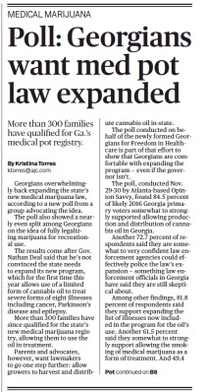
Public Opinion? AJC poll

Slide 17
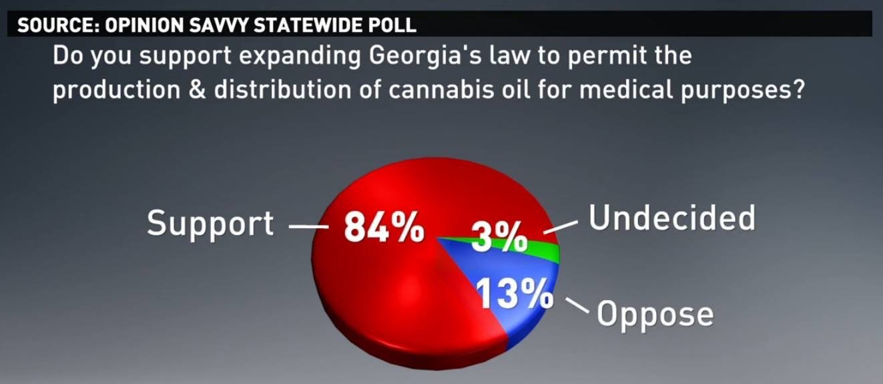
Survey says…….(11Alive poll)

Slide 18
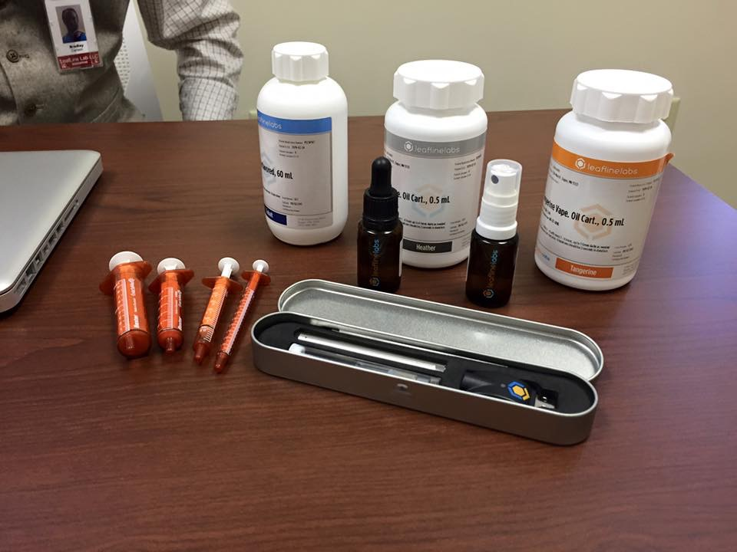
Potential Recommendation
-Limited licensees (5-10)
-No smoking
-Strictly regulated by DPH with proper restrictions

Slide 19
